Slide 1
Microservices-Eureka Server

Slide 2
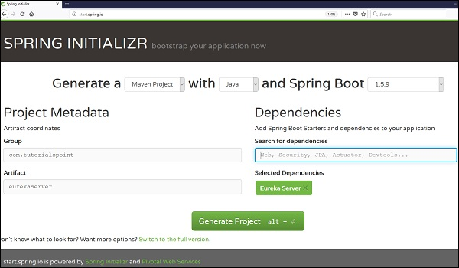
Spring – Eureka Server
Eureka Server is an application that holds the information about all client-service applications.
Every Micro service will register into the Eureka server and Eureka server knows all the client applications running on each port and IP address.
Eureka Server is also known as Discovery Server.
Building a Eureka Server
Eureka Server comes with the bundle of Spring Cloud. For this, we need to develop the Eureka server and run it on the default port 8761.

Slide 3
we need to add @EnableEurekaServer annotation.
The @EnableEurekaServer annotation is used to make your Spring Boot application acts as a Eureka Server.
@SpringBootApplication
@EnableEurekaServer
public class EurekaserverApplication {
public static void main(String[] args) {
SpringApplication.run(EurekaserverApplication.class, args);
}
}

Slide 4
Service Registry and Discovery Overview
In the microservices projects, Service Registry and Discovery play an important role because we most likely run multiple instances of services.
we need a mechanism to call other services without hardcoding their hostnames or port numbers.
In addition to that, in Cloud environments service instances may come up and go down anytime.
So we need some automatic service registration and discovery mechanism.
Spring Cloud addresses this problem by providing Spring Cloud Netflix Eureka project to create Service Registry and Discovery.
Spring Cloud makes it very easy to create a Service Registry and discover other services using Load Balanced
@Bean
@LoadBalanced
public RestTemplate restTemplate(){
return new RestTemplate();
}

Slide 5
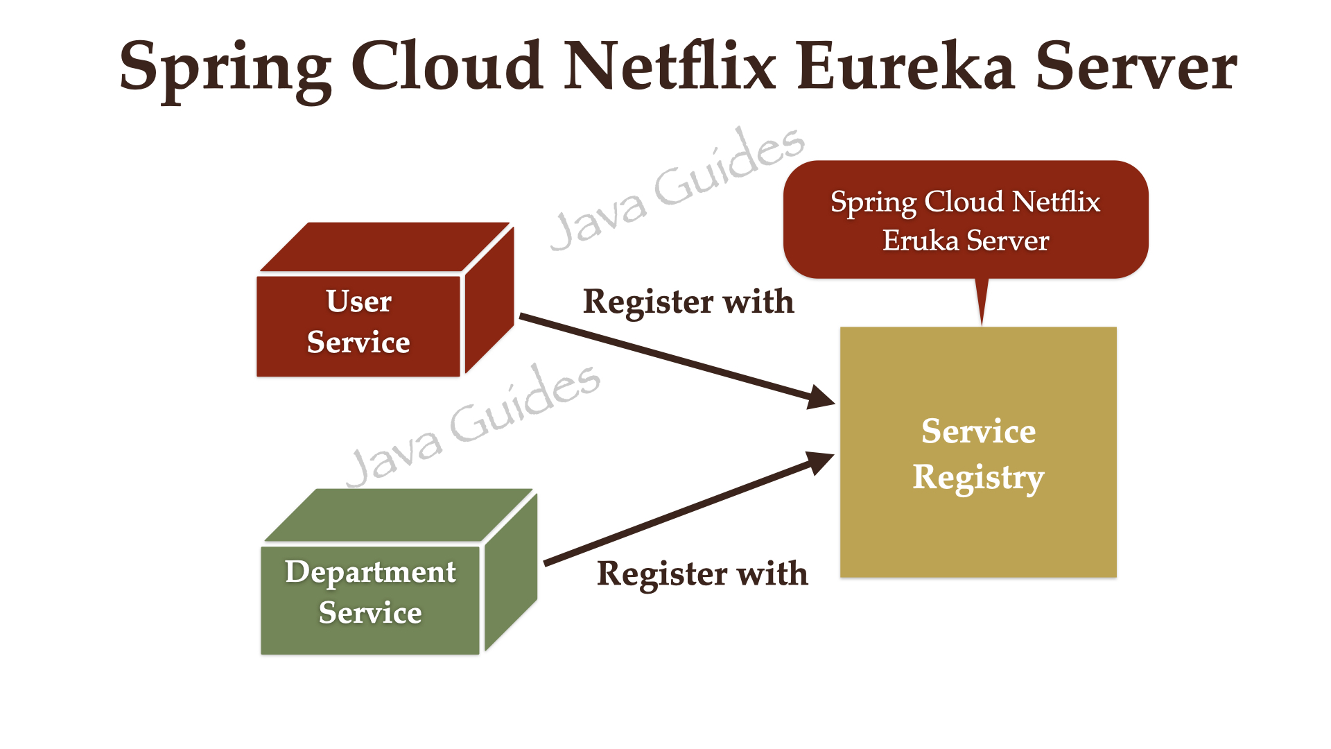

Slide 6
Spring Cloud Gateway:
Spring Cloud Gateway provides a library for building an API Gateway on top of Spring WebFlux.
Spring Cloud Gateway aims to provide a simple, yet effective way to route to APIs and provide cross-cutting concerns to them such as security, monitoring/metrics, and resiliency.
Solution:
We can define an API Gateway which will acts as single entry point for all type of clients. Following are the other benefits of API Gateway −
Simple Proxy − API Gateway can acts as simple proxy to some requests to redirects them to relevant service.
Multiple Services − API Gateway can redirects call to multiple services.
Client Specific API − API Gateway can provide client specific API as well, like a different API for Desktop version than a Mobile Application.
Protocol Handling − API Gateway handles the communication protocols to each service call internally and clients are concerned only with request/response.
Security and Authentication − API Gateway can implement a security that each request goes to service only after authentication and authorization.

Slide 7
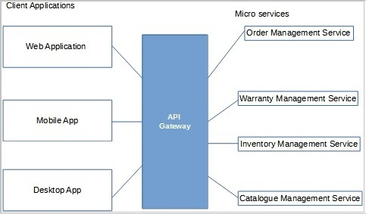
Consider an example of an Online Book Store. API Gateway allows to use the online Book store APIs on multiple devices seemlessly.

Slide 8
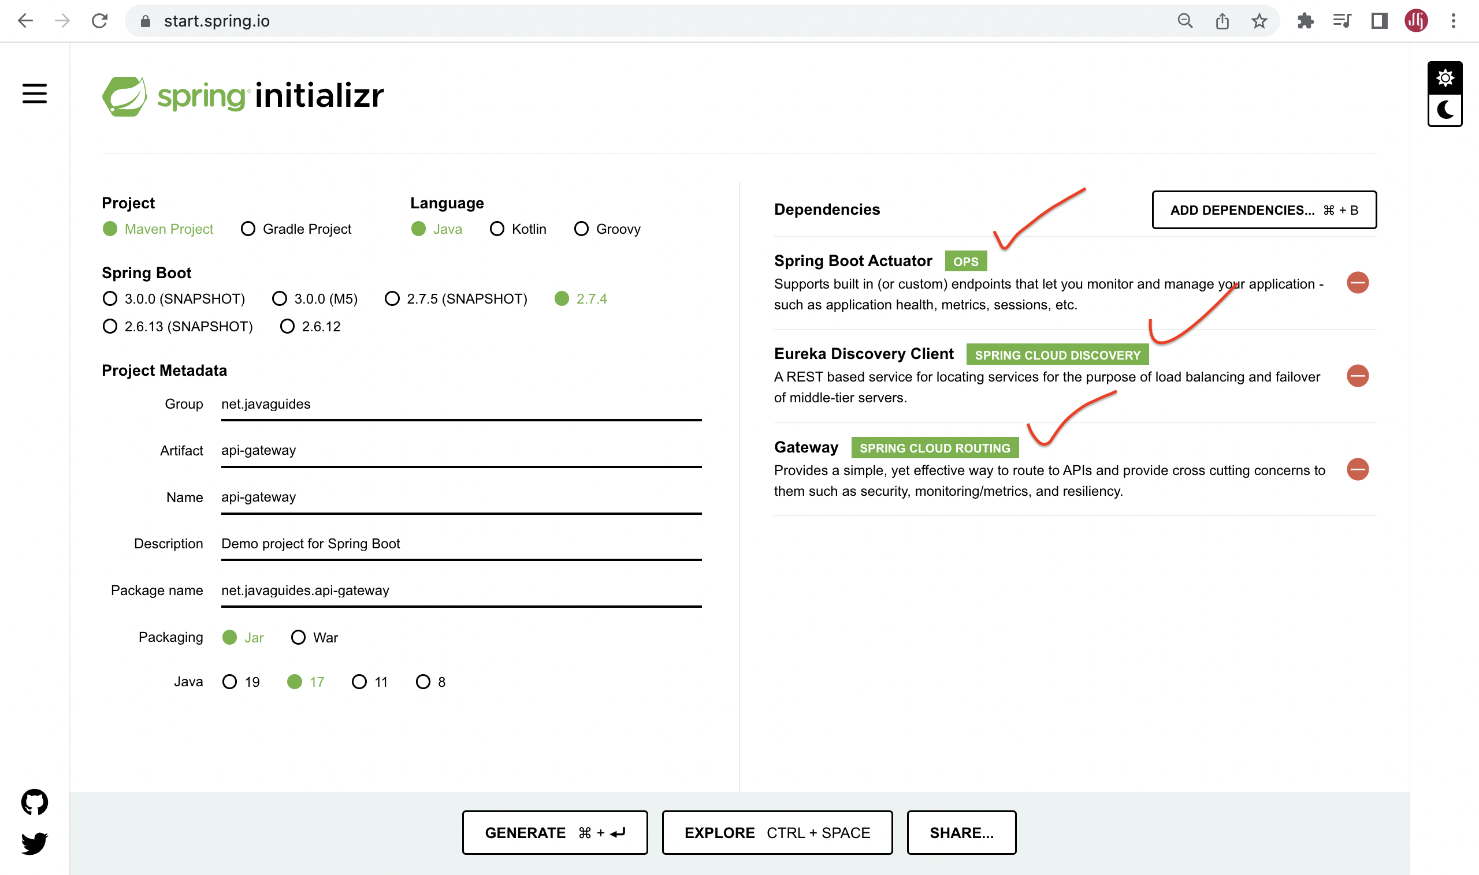

Slide 9
The Spring Cloud Gateway has three important parts to it:
Route − These are the building blocks of the gateway which contain the URL to which the request is to be forwarded to and the predicates and filters that are applied to the incoming requests.
Predicate − These are the set of criteria that should match for the incoming requests to be forwarded to internal microservices. For example, a path predicate will forward the request only if the incoming URL contains that path. Filters − These act as the place where you can modify the incoming requests before sending the requests to the internal microservices or before responding back to the client.
server.port=9005
spring.application.name=API-GATEWAY
spring.cloud.gateway.routes[0].id=PRODUCT-SERVICE
spring.cloud.gateway.routes[0].uri=lb://PRODUCT-SERVICE
spring.cloud.gateway.routes[0].predicates[0]=Path=/products/**
What are the properties that we set for API gateway routes?
id – This is just an identification of the routes.
URI – Here we can use either URL http://localhost:8080 or lb://DEPARTMENT-SERVICE. But if we need to use the inbuilt load balancer on the Netflix Eureka server, we should use lb://DEPARTMENT-SERVICE, then the API registry will take over the request and show a load-balanced request destination to the API gateway.
predicates – In here we can set multiple paths to identify a correct routing destination. Eg:- If the API gateway gets and request like http://localhost:9191/api/users/1 then it will be routed into http://localhost:8081/api/users/1.

Slide 10
Next Topic?
Mock Interviews ……??

