Slide 1
Dodge Asteroid
Rebuilding a broken hobby game into something worth shipping
TypeScript · Canvas 2D · zero runtime dependencies
mattathiasa.github.io/Dodge-Asteroid
Notes:
The project started as a jQuery prototype that did not work. This deck covers what was wrong, what I rebuilt, and what the result measures.

Slide 2
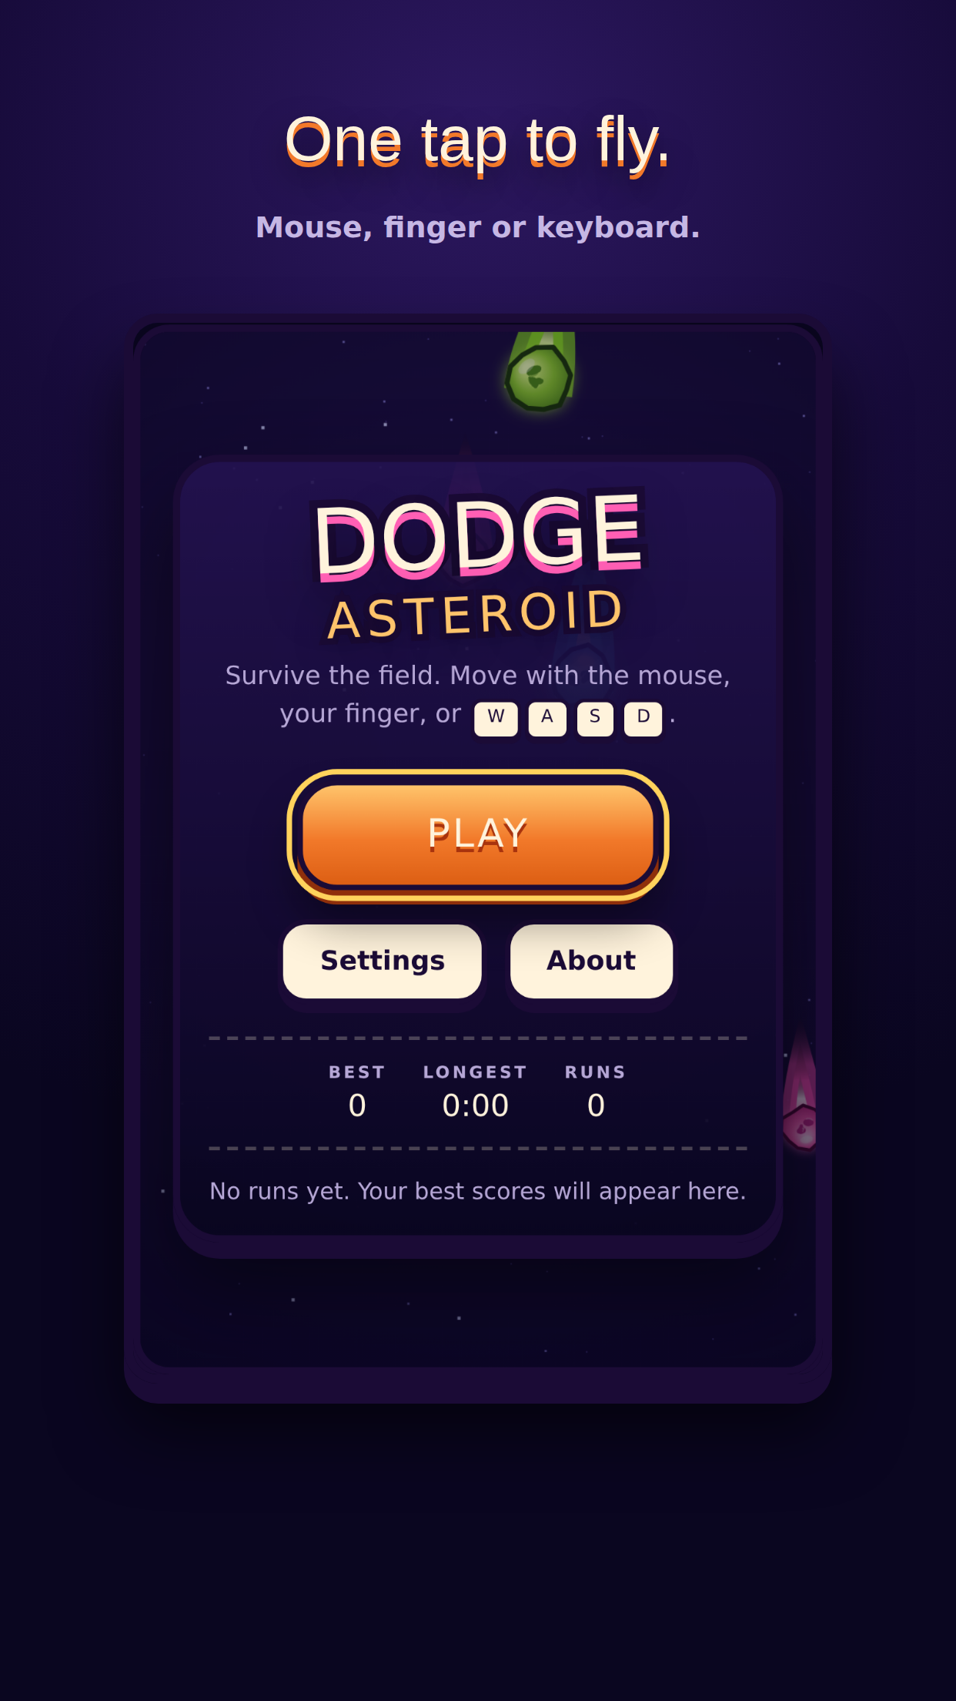
The starting point
431 lines of jQuery, uploaded through the GitHub web UI in three commits all named "Add files via upload". It looked finished. It was not.
2
0
functions called but never defined
tests, CI, README or licence
86 KB
~30 s
of vendored jQuery, three CVEs
until the game became unplayable
Notes:
Three commits, no history worth reading, and several code paths that threw at runtime.

Slide 3
What was actually broken
pauseGame · animateAsteroids
Called but never defined. The first threw during ready() and aborted the bindings after it; the second left Resume permanently broken.
isColliding()
Ended in a bare return, so it always read false and gameOver() was unreachable. Game over was a blocking alert() fired from inside the collision test.
setInterval per asteroid
A new timer created on every spawn, never cleared, assigning to the wrong this. A leak that did nothing.
speed /= 1.09 per spawn
Compounding with no upper bound. Mathematically unplayable about thirty seconds in.
Notes:
Every one of these is quoted from the original source, not inferred.

Slide 4
One rule holds the design up
core/ and game/ never import from render/, input/, audio/ or the DOM.
core/
Three things follow
seeded RNG · math · viewport geometry
Runs are reproducible — a run is a pure function of its seed
Side effects are reported, not performed — the sim emits events
The loop is testable — fixed timestep, injectable clock
game/
phases · loop · collision · difficulty · spawning · scoring
render/ input/ audio/ ui/ storage/
the browser lives only out here
Notes:
That single rule is what makes the whole simulation headless-testable.

Slide 5
The curve that broke the game
The original multiplied fall speed by a constant on every spawn, with no cap. The rewrite is a bounded smoothstep ramp: gentle, then steep, then flat.
Notes:
The original line leaves the chart. The rewrite plateaus by design and is hard-capped so nothing can outrun continuous collision detection.

Slide 6
What is tested — and what isn't
The simulation is a pure function of its seed, its input and its timestep. That is what the tests cover.
153
12
60 s
unit tests
end-to-end specs
simulated per run test
difficulty · collision · scoring · spawning · phases · loop · pools · storage
the real built game in Chromium and on an emulated phone
played twice, asserted identical — that is how frame-rate independence is proved
Canvas draw calls and WebAudio graphs are not unit-tested. Asserting that ctx.arc ran 22 times is a test that only breaks when the visuals improve.
Notes:
Deliberate, stated scope reads as judgement. Chasing 100% coverage on a renderer does not.

Slide 7
Before and after
Runtime dependencies
jQuery 3.3.1, 86 KB, 3 CVEs
None
Bundle
n/a
37 KB · 13 KB gzipped
Tests
None
153 unit · 12 end-to-end
CI
None
Typecheck, lint, format, test, build, deploy
Input
Mouse only
Mouse, touch and keyboard
Game over
Blocking alert(), stacked
In-page screen with a local leaderboard
Notes:
Every number here is measured from the repository, not estimated.

Slide 8
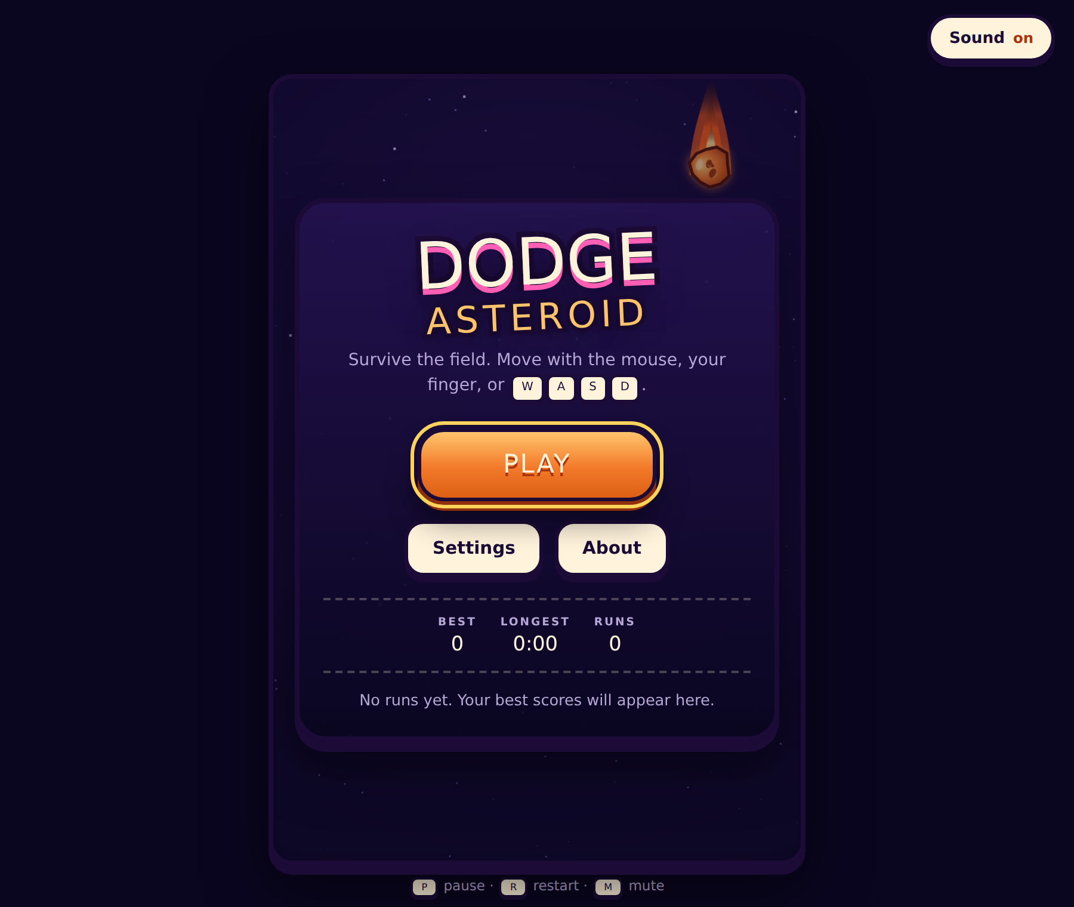
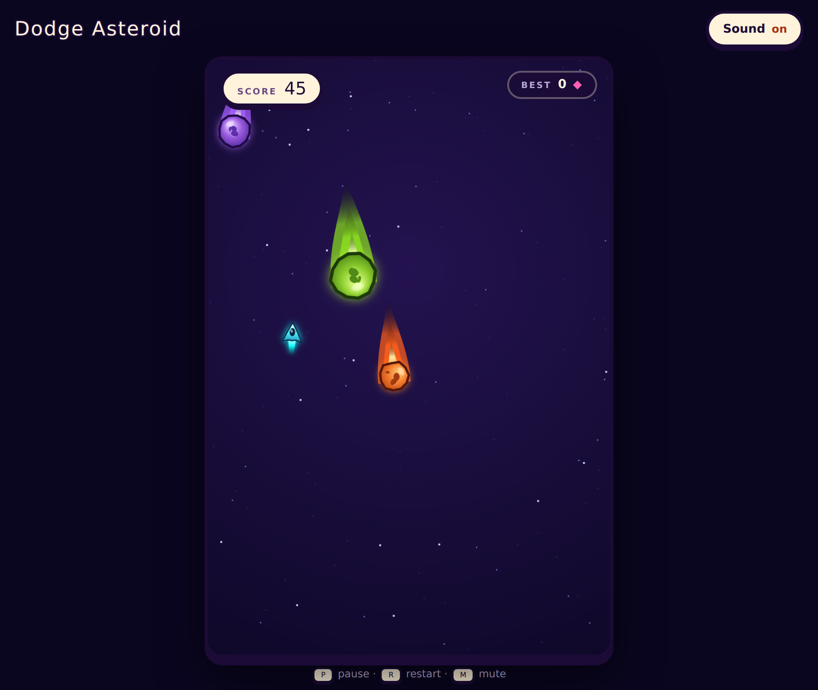
The result
Survival scoring with near-miss combos
Shield, slow-motion and extra-life pickups
Three difficulties and a local leaderboard
Reduced motion, ARIA announcements, focusable controls
Sound synthesised at runtime — no binary assets
Notes:
The screenshots are generated by a script that plays the game, so they cannot drift from the code.

Slide 9
Play it
mattathiasa.github.io/Dodge-Asteroid
Source: github.com/Mattathiasa/Dodge-Asteroid
Notes:
Built by Mattathias Abraham.

