Slide 1
Choosing a look
Three directions for the Dodge Asteroid interface
Notes:
The first pass was competent and completely generic. These are three ways out of that, on genuinely different axes.

Slide 2
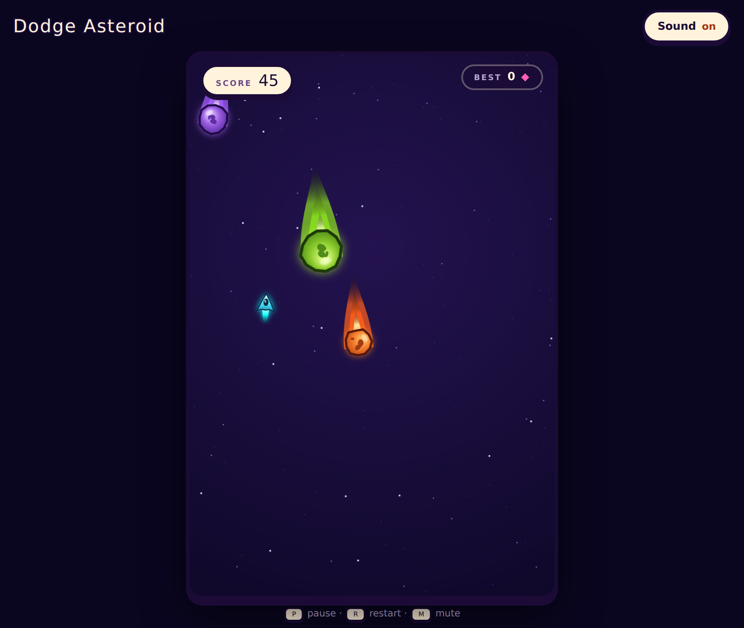
The first pass was the problem
Neon cyan on near-black. It is the default setting for every space game, which is exactly why it reads as nothing in particular.
The art had already solved it
The meteors are drawn as glossy rocks with thick dark outlines. The chrome was ignoring that language entirely, so the interface and the art looked like two different products.
Brief: make it read as a polished arcade game, not a code demo.
Notes:
The meteors were already right. The chrome had to join them.

Slide 3
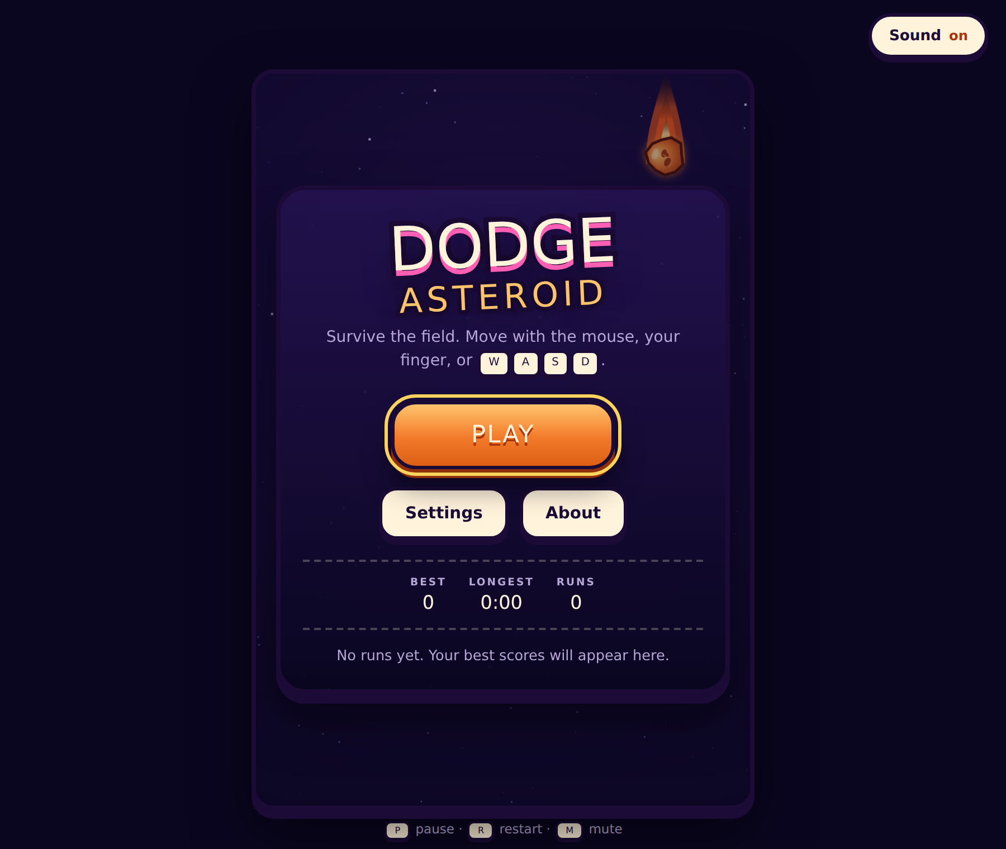
A — Sticker Arcade
CHOSEN
Ink outlines, warm cream panels, hard offset shadows so controls have visible thickness and a real press. Cream on deep purple, rather than more neon on black.
Why it wins
It speaks the meteors’ own language, so the chrome and the art become one piece instead of two competing ones.
The tradeoff
Warm and playful sets a tone. It would be the wrong choice for something that wanted to read as serious or technical.
Notes:
Chosen and shipped. The logo is stroked with paint-order rather than stacked shadows, which ghost into a doubled word.

Slide 4
The two it beat
B — Arcade cabinet
C — Instrument
Phosphor green, scanlines, a bezel, pixel type, "insert coin".
Thin rules, orbital telemetry, one hot accent, technical type.
For
For
Strong identity, and it leans into the 1979 heritage.
Sleek and grown-up; the most restrained of the three.
Against
Against
The nostalgia does most of the work, and it dates the piece on purpose.
Closest to the original problem — quiet reads as generic.
Both were kept deliberately low-fidelity. They existed to make the choice real, not to be finished work.
Notes:
Offering only one polished option and two throwaways would have been a rigged vote, so each got an honest case and an honest cost.

Slide 5
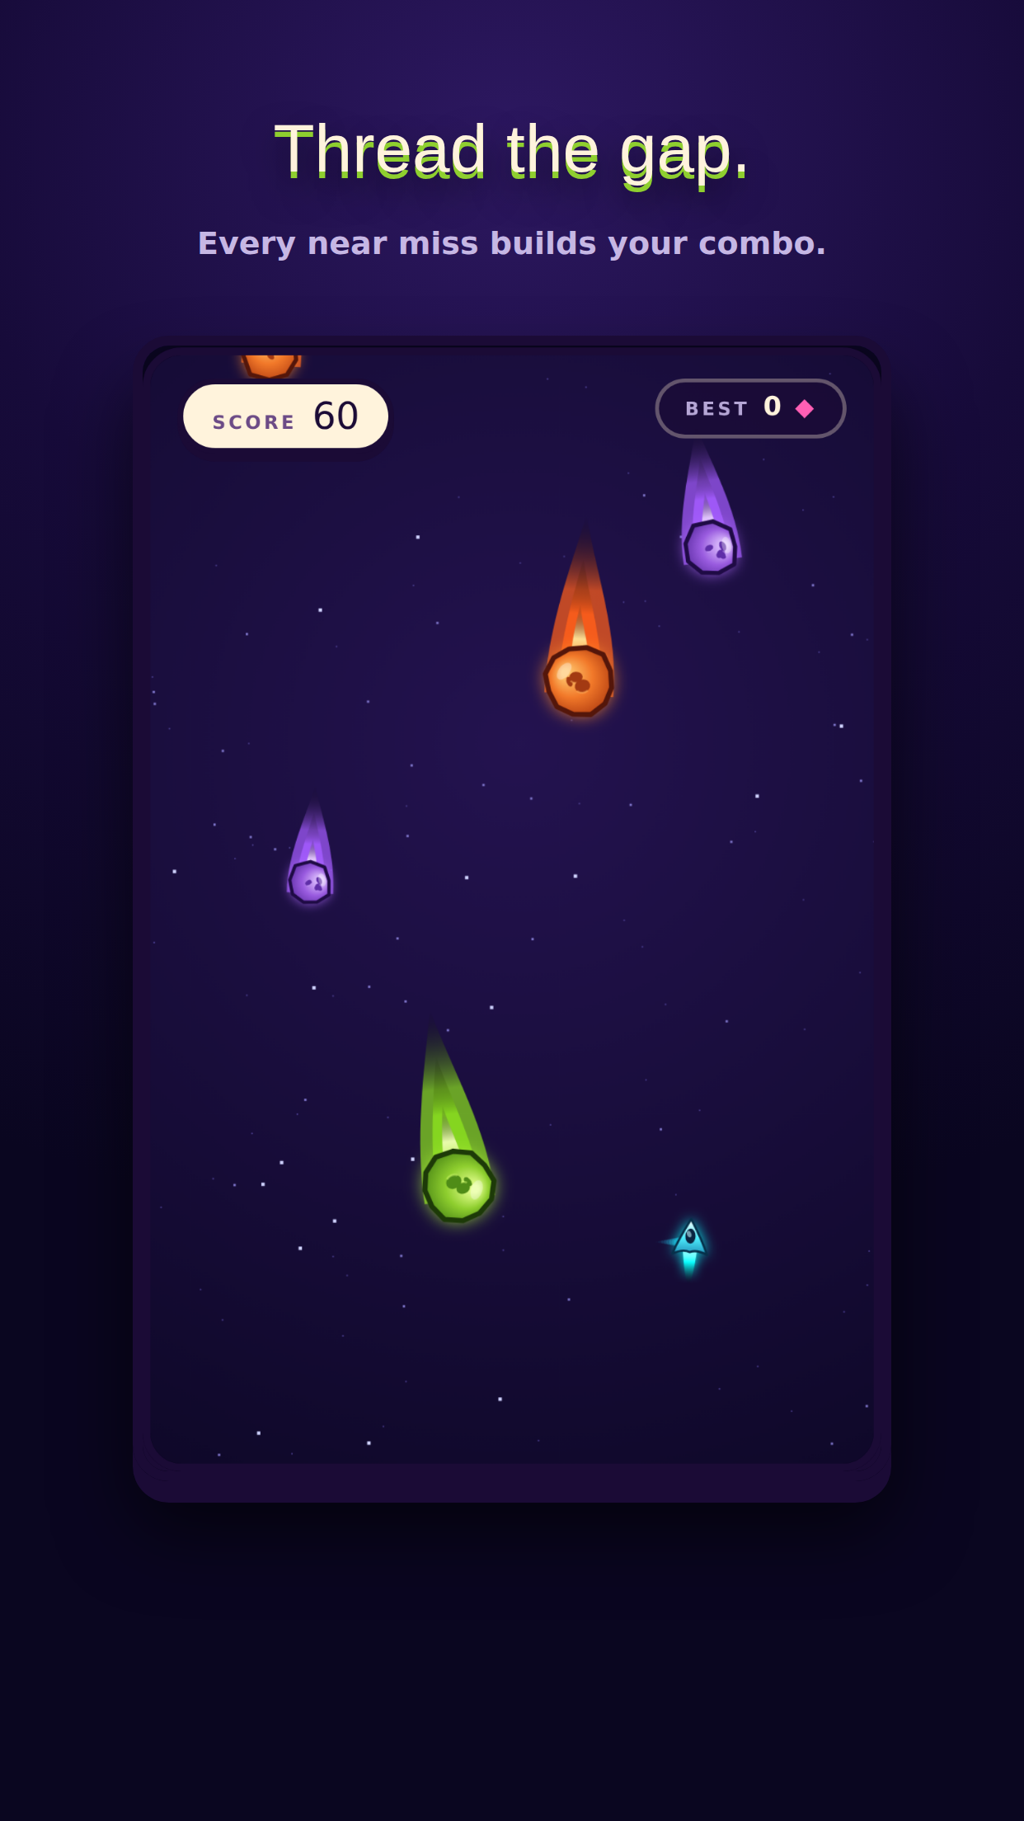
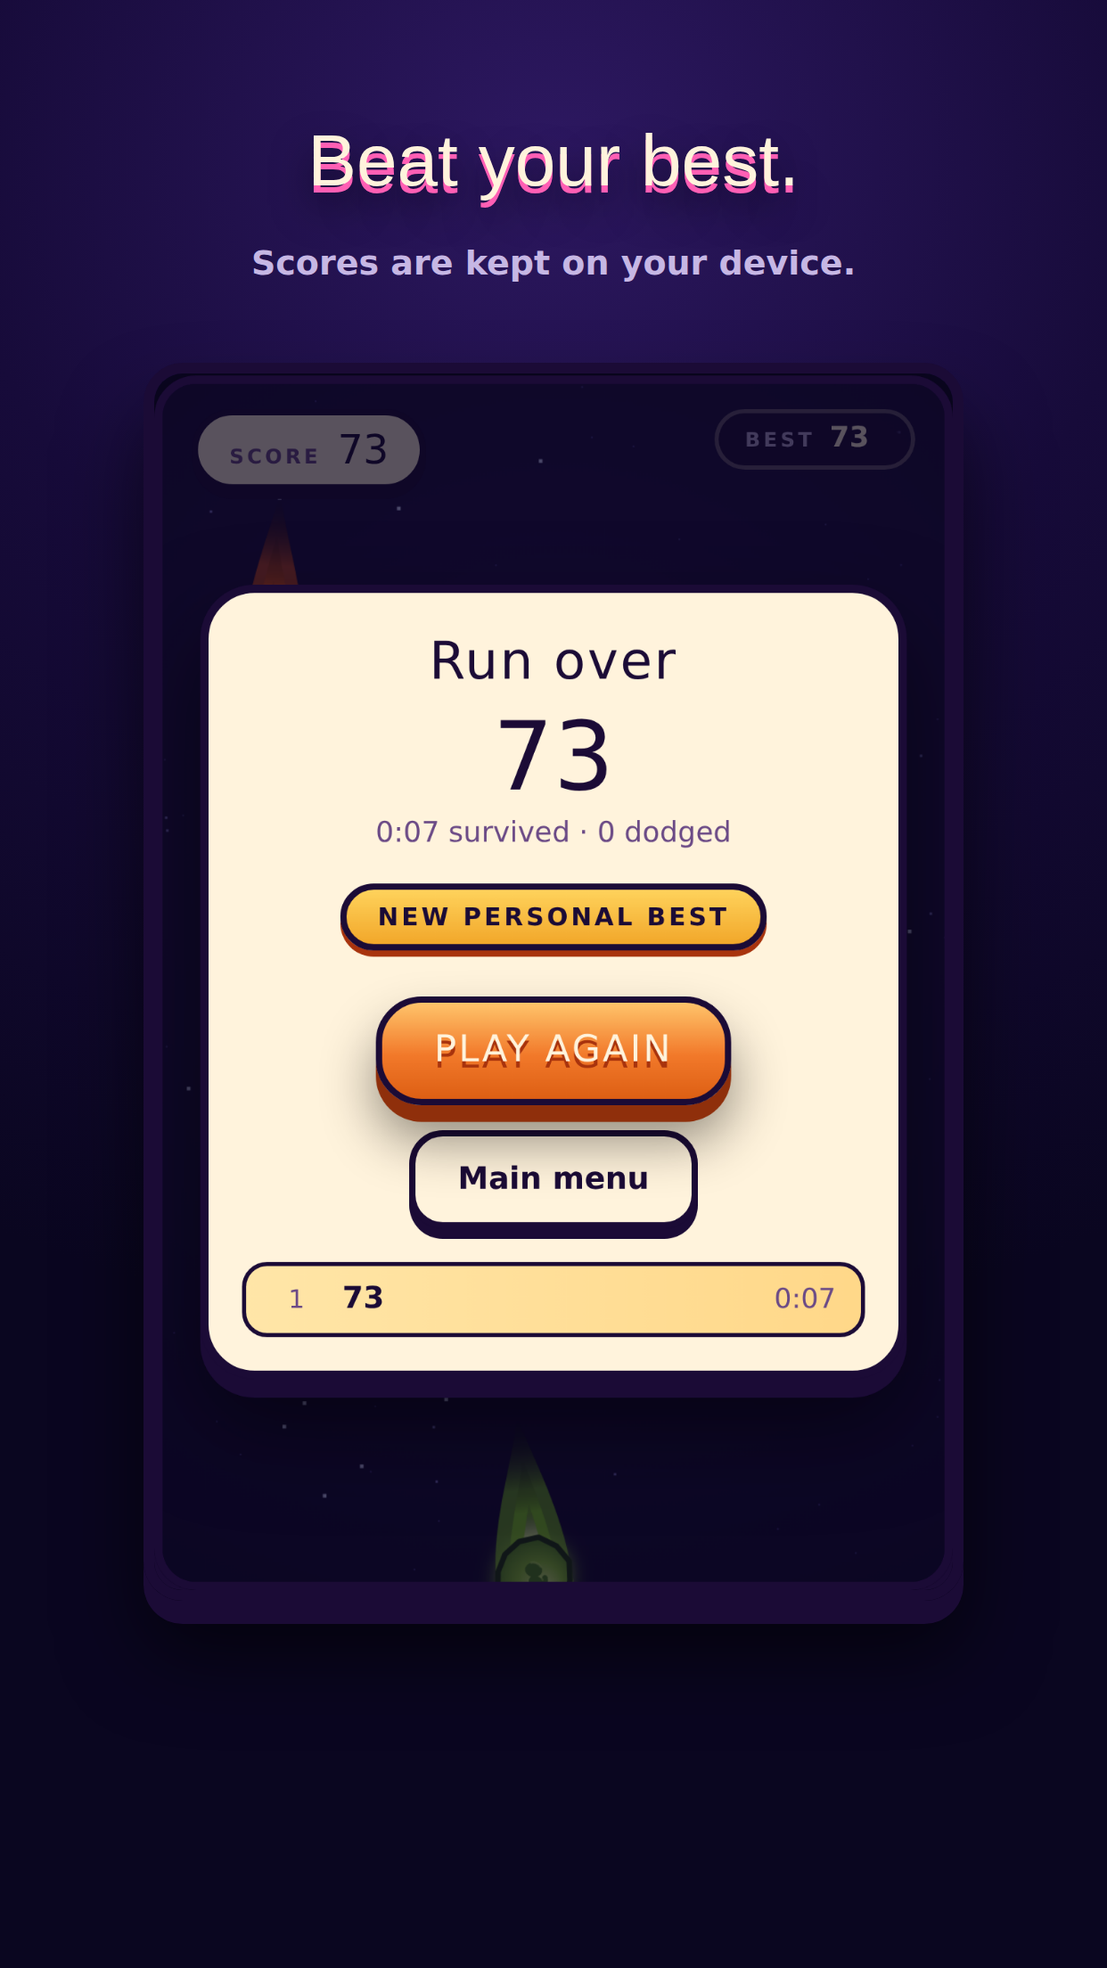
What shipped
Chrome matches the art
Ink outlines and cream panels, the same language as the meteors.
Buttons have thickness
An offset lower layer the press sinks into, not a flat rectangle.
The frame is the play field
Fitted in JS, because a percentage max-height leaves dead bands on tall phones.
The title screen plays itself
Meteors drift behind the menu using the real spawner.
Notes:
The store cards are generated by a script that plays the game, so they cannot drift from the build.

