Slide 1
STALL RADAR
$12.1B of pandemic relief is on track to go unspent. We found which projects.
An out-of-time validated model that scores every open ARPA project before the Dec 31, 2026 spending deadline, and a free closeout worklist for every government.
Live demo: stall-radar-bice.vercel.app
Code (MIT): github.com/Mattbusel/stall-radar
Matthew Busel | Track: Operations Research and Decision Intelligence | Problem: DN-OP-01 Open Innovation
Stall Radar | DataNova 2026 Global Data-thon | Open Innovation (DN-OP-01)

Slide 2
PROBLEM STATEMENT
A hard deadline, $26 billion still open, and no way to see what is stuck
$26.3B
Dec 31, 2026
9 months
obligated but not spent on Mar 31, 2026
last day to spend ARPA SLFRF money
left at the latest data point
23,295 projects, 4,726 governments
unspent funds return to Treasury
the reports lag the spending by a quarter
Who has the problem: city and county finance directors, state ARPA offices, auditors and the Treasury itself.
Why it matters: money left unspent is lost to the communities it was granted to (water systems, broadband, housing, health).
Why it is hard: thousands of projects per state, each at a different stage; the public reports are 190,000-row spreadsheets released quarterly.
What they need: a ranked list of the projects most likely to miss, with a reason, early enough to act (reallocate, accelerate, or close out).
Stall Radar | DataNova 2026 Global Data-thon | Open Innovation (DN-OP-01)

Slide 3
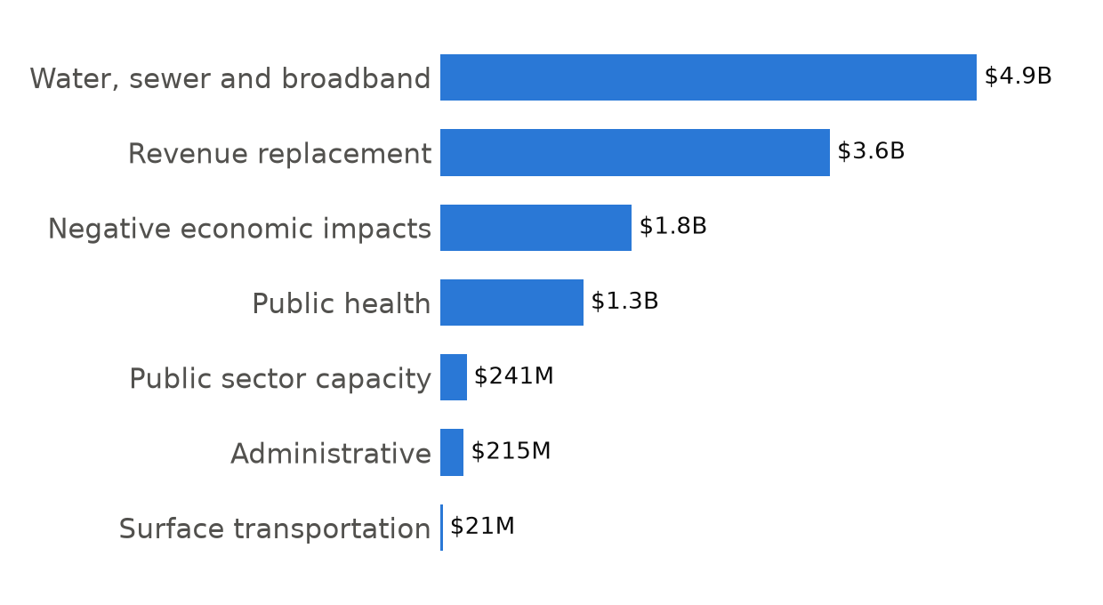
DATA AND METHODOLOGY
Data: seven Treasury releases, followed project by project
Source: U.S. Treasury SLFRF Project and Expenditure public data, releases with data through Mar 2023, Dec 2023, Mar 2024, Dec 2024, Mar 2025, Dec 2025, Mar 2026.
Scale: about 900,000 project-snapshot rows; ~190,000 projects at ~31,000 governments in the latest release.
Linking: Treasury project IDs are stable, so every project is tracked across snapshots (99.99% overlap between consecutive March releases).
Unit of prediction: a project with more than $1,000 obligated but unspent at a snapshot.
Label: share of that unspent balance actually spent over the next 12 months. Projects with no fresh follow-up report are excluded, not counted as stalls.
Privacy: all inputs are public, government-level records. No personal data.
Projected unspent at deadline by Treasury category
Stall Radar | DataNova 2026 Global Data-thon | Open Innovation (DN-OP-01)

Slide 4
SOLUTION AND METHODOLOGY
Method: pace, position, context and text, in one gradient-boosted model
1 Ingest
2 Panels
3 Text model
7 xlsx releases to parquet; header and schema drift handled
features at T0, outcome at T1: train 2024>2025, test 2025>2026, score 2026
TF-IDF (1-2 grams) ridge on name + description, stacked out-of-fold
4 LightGBM
5 Explain
6 Forecast
cross-entropy on spent share, dollar-weighted; 29 features
exact TreeSHAP per project, mapped to plain-language reasons
12-month share to 9 months via constant hazard; drift correction from holdout
Features: prior-year and prior-quarter spending pace, unspent balance, share spent, status and its change, late budget revisions, the government's overall pace, open-project count, category, capital flags, tier, type, state, text score.
Stack: Python, pandas, pyarrow, LightGBM, scikit-learn; static web app (vanilla JS, hand-built SVG charts) on Vercel.
Stall Radar | DataNova 2026 Global Data-thon | Open Innovation (DN-OP-01)

Slide 5
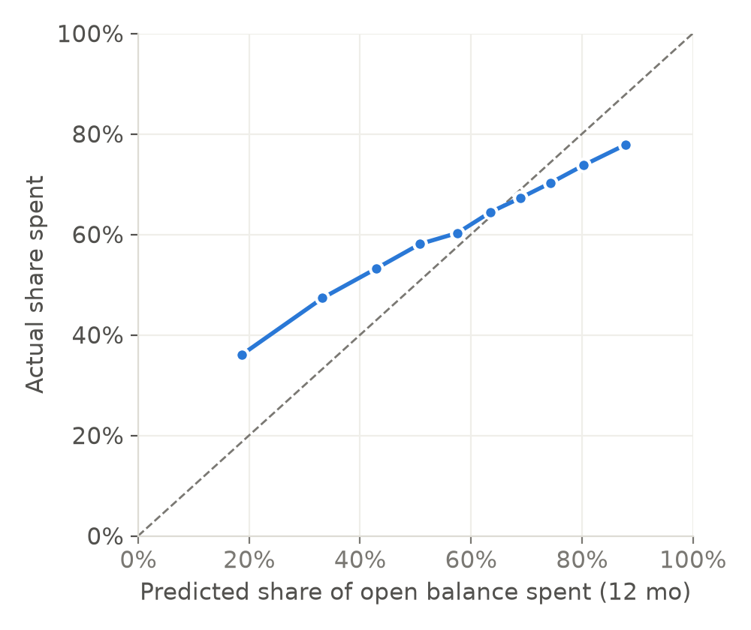
RESULTS AND VALIDATION
Validation: graded on a year the model never saw
Model | AUC | AUC ($-weighted) | Avg precision | Brier
base rate | 0.500 | 0.500 | 0.377 | 0.238
persistence (last-year pace) | 0.584 | 0.687 | 0.433 | 0.400
text only (TF-IDF ridge) | 0.594 | 0.619 | 0.466 | 0.235
GBM, no text | 0.665 | 0.759 | 0.549 | 0.222
GBM + text (Stall Radar) | 0.665 | 0.754 | 0.545 | 0.223
Fit on 37,222 projects (2024 to 2025 outcomes); graded on 37,842 projects (2025 to 2026), after the obligation deadline.
Beats last-year-pace persistence and the base rate on every ranking metric.
Text adds little on top of the tree model; we report the ablation and keep it for explanations.
Calibration by decile on the held-out year
Stall Radar | DataNova 2026 Global Data-thon | Open Innovation (DN-OP-01)

Slide 6
DATA AND ANALYTICAL RIGOR
What we learned: the ranking held, the level drifted
$31.8B
$26.9B
x0.847
model's predicted unspent on holdout
actual unspent, Mar 2026
measured drift factor
bootstrap, 500 resamples
Spending accelerates as a deadline nears. The slowest-rated projects spent faster than history predicted (see calibration).
We carry the measured drift into the forecast: $12.1B projected unspent at Dec 31, 2026, 90% band $11.7B to $12.5B.
If the last quarter accelerates harder than 2025 did, the true figure will be lower. The ranking is the product; the national total is a planning estimate.
Slice checks: AUC holds from 0.63 (annual reporters) to 0.72 (administrative spending); weakest where data is sparsest.
Stall Radar | DataNova 2026 Global Data-thon | Open Innovation (DN-OP-01)

Slide 7
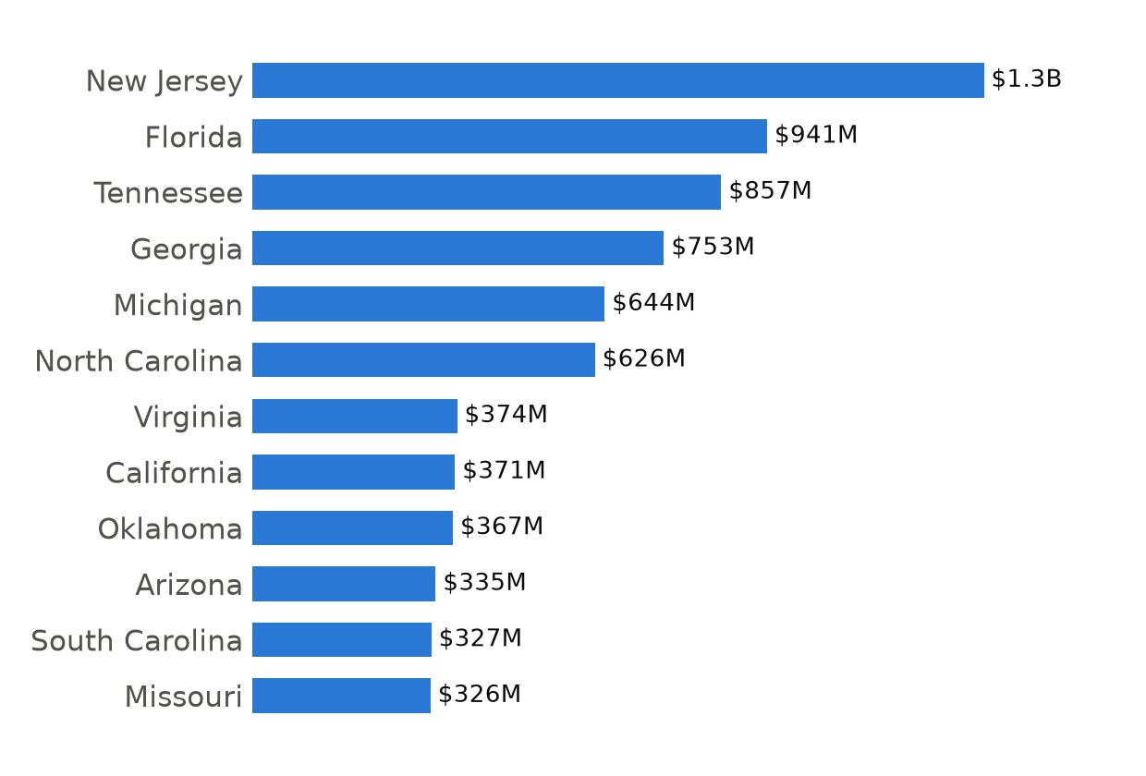
IMPACT
Findings: where the stuck money is
Largest rescue targets
Water/Sewer Infrastructure: $258M projected unspent of $464M open (stall risk 66%)
HMFA Affordable Housing Production Fund: $195M projected unspent of $341M open (stall risk 67%)
DEP Water Infrastructure Sewer Overflow: $186M projected unspent of $248M open (stall risk 88%)
NC DIT GREAT Grant Program: $135M projected unspent of $164M open (stall risk 97%)
Resilient Florida Trust Fund (Resilient Florida Gran: $122M projected unspent of $218M open (stall risk 66%)
State Highway System Projects: $102M projected unspent of $278M open (stall risk 43%)
Stall Radar | DataNova 2026 Global Data-thon | Open Innovation (DN-OP-01)

Slide 8
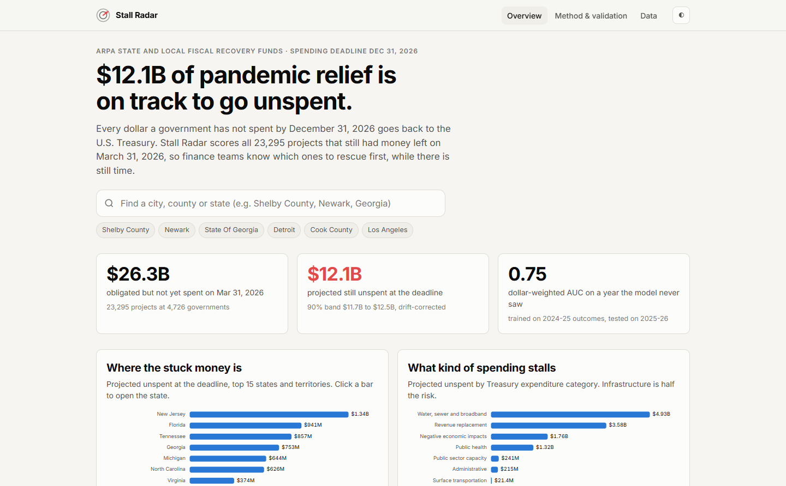
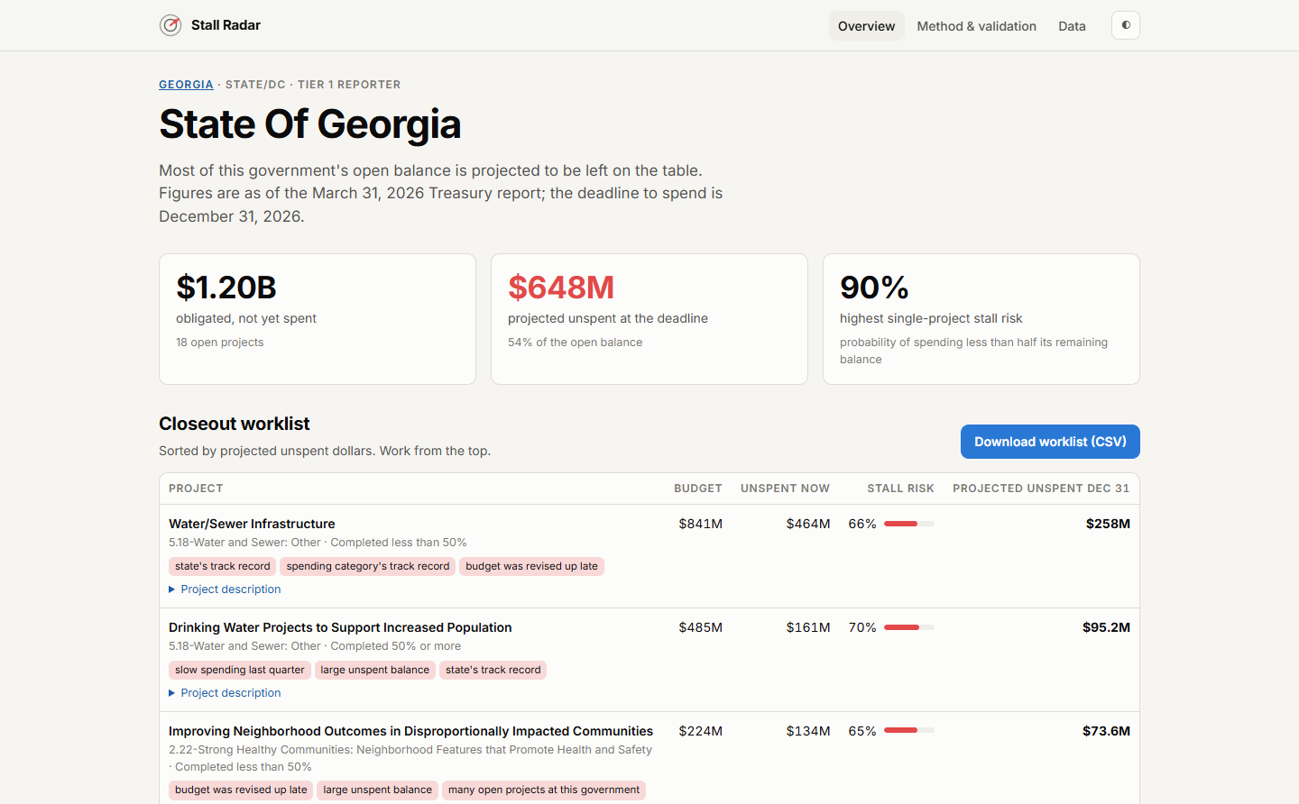
DEMONSTRATION
Working demo: a closeout worklist for every government
Overview: national forecast, search, top targets
Government view: ranked worklist with reasons, CSV export
stall-radar-bice.vercel.app | search any of 4,726 governments | 23,295 scored projects | method page with every metric
Stall Radar | DataNova 2026 Global Data-thon | Open Innovation (DN-OP-01)

Slide 9
IMPACT AND FEASIBILITY
Impact and feasibility
Who uses it: finance directors get a worklist in one search; state ARPA offices see every subrecipient; auditors and Treasury get a risk-ranked sample.
What it changes: staff time goes to the few projects that hold most of the at-risk money. In the holdout, the top 10% of projects by predicted stuck dollars held 81% of the stuck dollars.
Cost to run: zero. Public data, a laptop-sized pipeline (under 2 minutes end to end after download), a static site.
Scales and repeats: re-run when Treasury posts the next release; the same panel design works for any grant program with a spending deadline (IIJA, CHIPS, E-Rate, BEAD).
Next: monthly state-portal data for faster pace signals, and survival models that use the deadline explicitly.
Stall Radar | DataNova 2026 Global Data-thon | Open Innovation (DN-OP-01)

Slide 10
RESPONSIBLE AI
Responsible use
A flag is a reason to check, never a finding of waste or non-compliance. Some balances are spent but not yet reported.
Every prediction ships with its top reasons (exact TreeSHAP), so a person can disagree with it.
State is a strong feature: a government is partly judged by its neighbors' track record. The reason tags make that visible when it drives a score.
Annual (Tier 5) reporters are measured less precisely; their slice AUC is shown, not averaged away.
Only public, government-level data. No people are scored. Open code and data so anyone can audit the model.
Stall Radar | DataNova 2026 Global Data-thon | Open Innovation (DN-OP-01)

Slide 11
TEAM CONTRIBUTIONS
Team and links
Matthew Busel (solo): problem framing, data pipeline, feature design, modeling and validation, web app, deck and video.
Tools used while building: Claude Code as a coding assistant.
Demo: stall-radar-bice.vercel.app
Code and full reproduction steps (MIT): github.com/Mattbusel/stall-radar
Data: U.S. Department of the Treasury, SLFRF Project and Expenditure public data.
Stall Radar | DataNova 2026 Global Data-thon | Open Innovation (DN-OP-01)

