Slide 1
Restaurant Database
By:
Caleb iamkui Seiji Suenaga Matt sunderland

Slide 2
Intro
We were hungry and thought why not make a database for a restaurant to enable people to view a menu, its items, and employees
We have all been to restaurants who seem very disorganized with their menus or with their staff
A database could help small restaurants around the KC area who are disorganized like this

Slide 3
Intro
We developed our application using ASP.NET MVC to implement our tables into a very nice web page for users to navigate through application
The application should allow the user to view the breakfast, lunch, and dinner menus
Our main priority is the database, so setting up security clearance depending on user will only be implemented if time permits

Slide 4
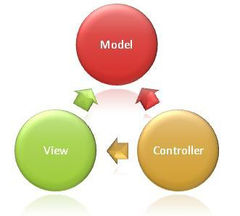
architecture
3-Tier architectural design

Slide 5
External schema
The Restaurant database is a database that stores all the different products from the menu, ingredient, address, and employee information. The database may be used to store newly created menu options along with the needed ingredients that make the product from the store. Employees can use this database to look up recipes for all their products, and help in their decision of what types of ingredients are in a higher demand. We need to keep track of menu items. Along with the stuff needed to make them, and should also keep track of the cost, nutritional info, and number of calories. Each menu item is identified by product ID, name, calories, nutritional value, and price. Each ingredient is identified by name, and amount.

Slide 6
Relationships
1:1 – 1 store has 1 address
1:N –1 store has multiple employees, 1 store has multiple menus, 1 store has multiple ingredients, and 1 menu item has multiple ingredients
N:M – multiple menu types have multiple ingredients

Slide 7
Schema Diagram

Slide 8
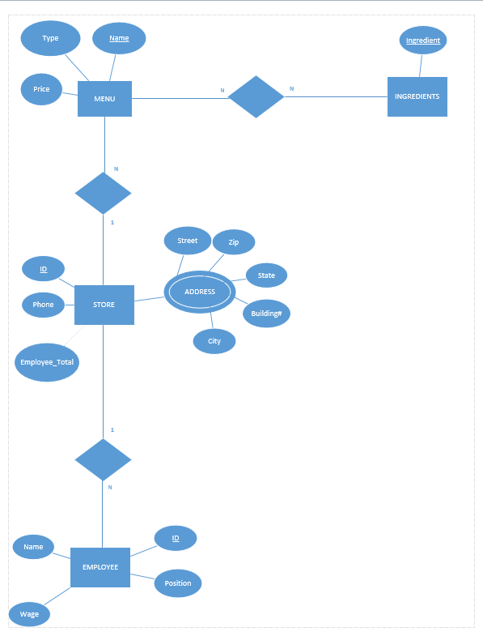
Non-normalized diagram

Slide 9
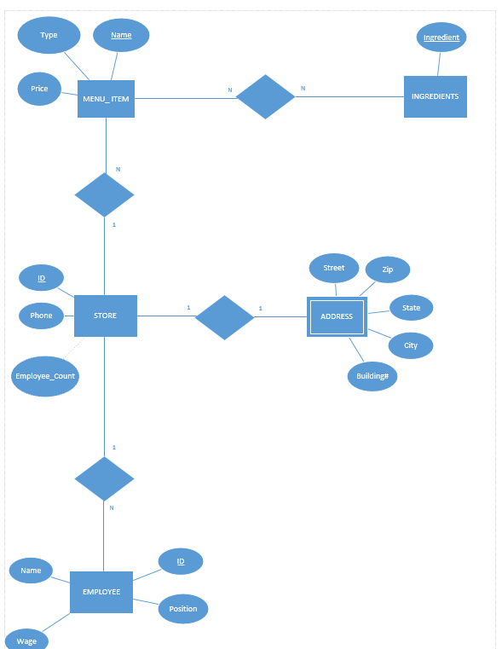
Normalized diagram

Slide 10
Relational algebra
Π _{MENU_ITEM.Menu_Name=”Dinner”}
Π MENU_ITEM.Menu_Name=”Breakfest”
Π _{MENU_ITEM.Menu_Name=”Lunch”}
Π INGREDIENT.Name(σ INGREDIENT.Amount = INGREDIENT.Amount_Low OR INGREDIENT.Amount < INGREDIENT.Amount_Low)
Π MENU_ITEM.Name (σ MENU_ITEM.Is_Vegetarian = True)
Π MENU_ITEM.Name (σ MENU_ITEM.Is_Vegen = True)

Slide 11
Challenges and deficiencies
Calories We had trouble deciding how we wanted to implement the calories into the tables. If we have a calorie count for each ingredient then we would have to list the amount and weight. Then the total calorie for each menu item would have to be calculated by going through the ingredients and totaling, but also would need to find out how much of each ingredient was used. For simplicity, we finally decided to set a calorie count on just the menu item.
Framework
We had trouble at first deciding what sort of

Slide 12
Future scope
Potentially we’d like our application to grow not only to small restaurants in KC but also around the nation and even the world. We would first need to fix all of our current deficiencies in our application in order for us to fully have restaurants even want our application. We could then get feedback from our users and direct all that feedback towards future implementation for our application.
Log in page for managers or specific personal from the restaurant
Location finder in case a restaurant had multiple locations
Detailed nutritional information for every menu item and ingredient

