Slide 1
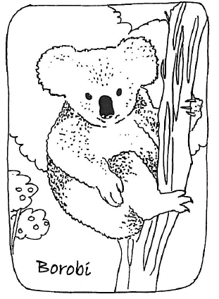
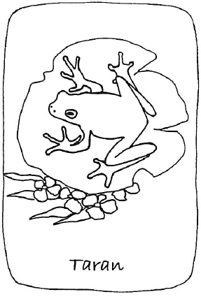
Aussie Animal Scavenger Hunt
Search for animals in their indigenous language

Slide 2
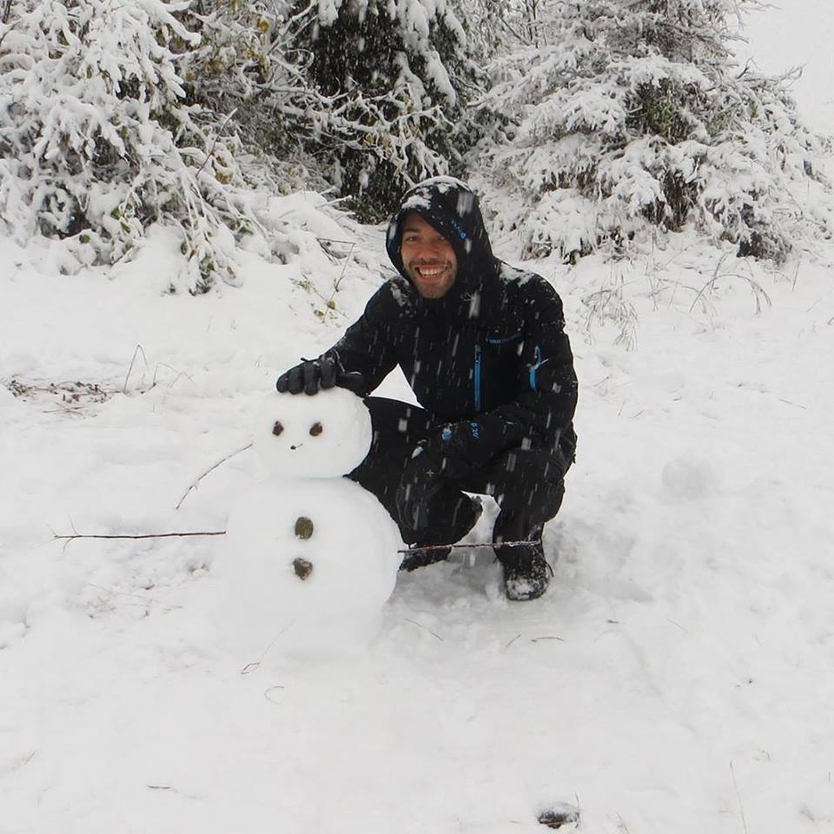
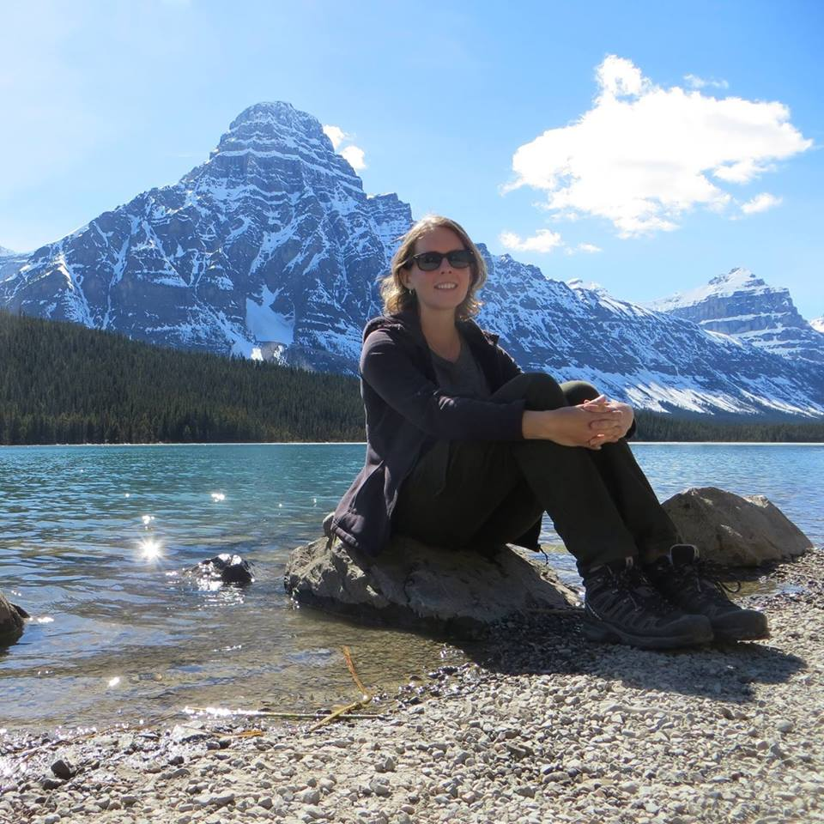
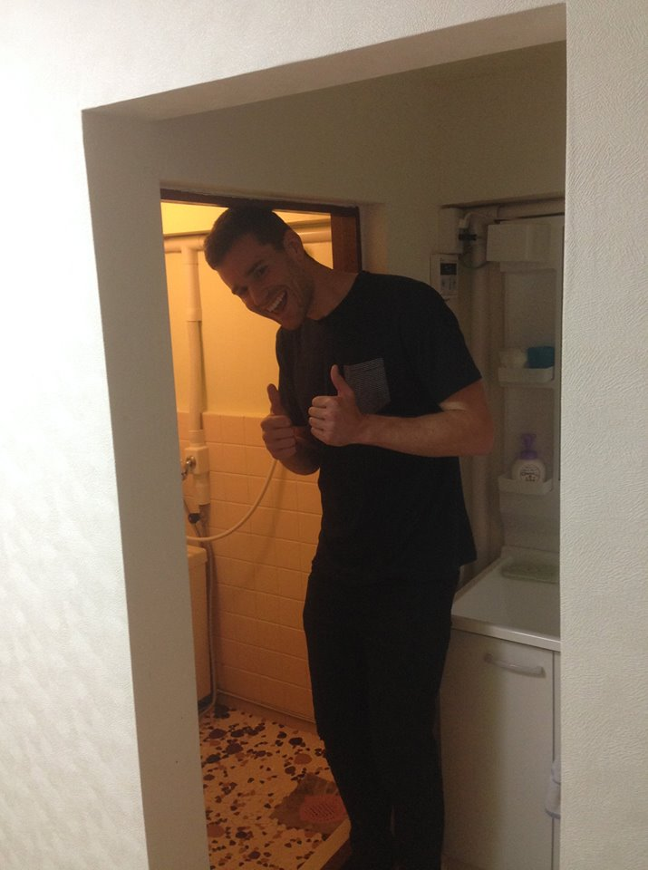

Title and Content Layout with List
Matt (Fellowship)
Katie (Rocketship)
Nick (Milksteak)
Glen (Convoke)

Slide 3
Title and Content Layout with Chart

Slide 4
Two Content Layout with Table

Slide 5
Two Content Layout with SmartArt
First bullet point here
Second bullet point here
Third bullet point here

Slide 6
Add a Slide Title - 1

Slide 7
Add a Slide Title - 2

Slide 8
Add a Slide Title - 3

Slide 10
Add a Slide Title - 4

Slide 11
Add a Slide Title - 5

