Slide 1
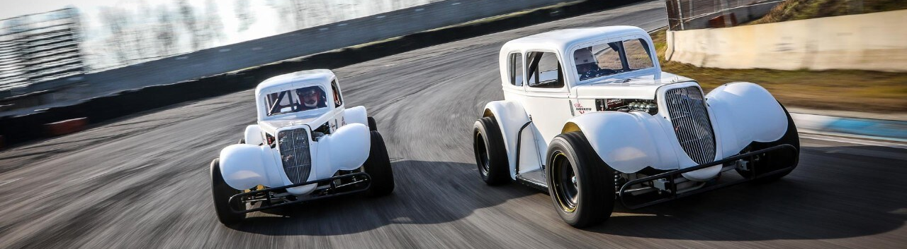
IMPACT of DIFFERENT CHASSIS CONFIGURATION on LEGENDS CAR RACING CAR
Matteo Baio
Gaia Lapucci
Laura Livoti
Thomas Magni
Aerodynamic of Transport Vehicle
Academic year 2024-2025
Prof. Alex Zanotti
Prof. Paolo Schito

Slide 2
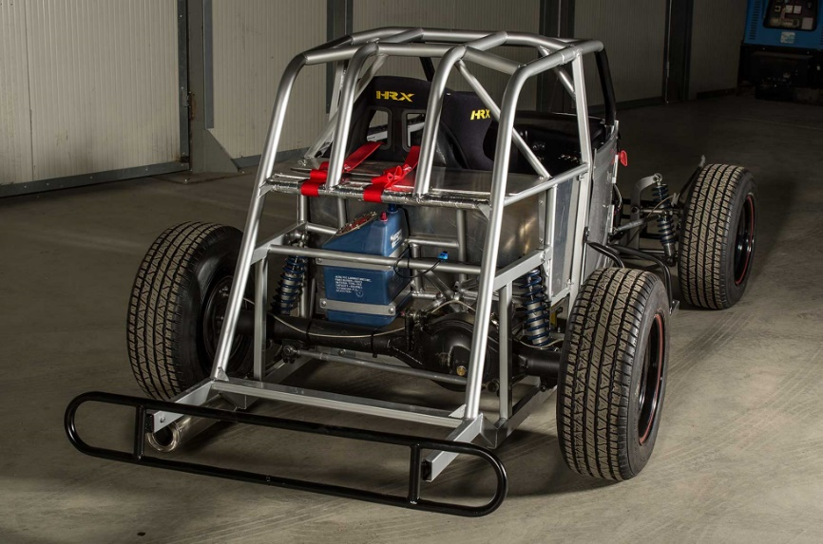
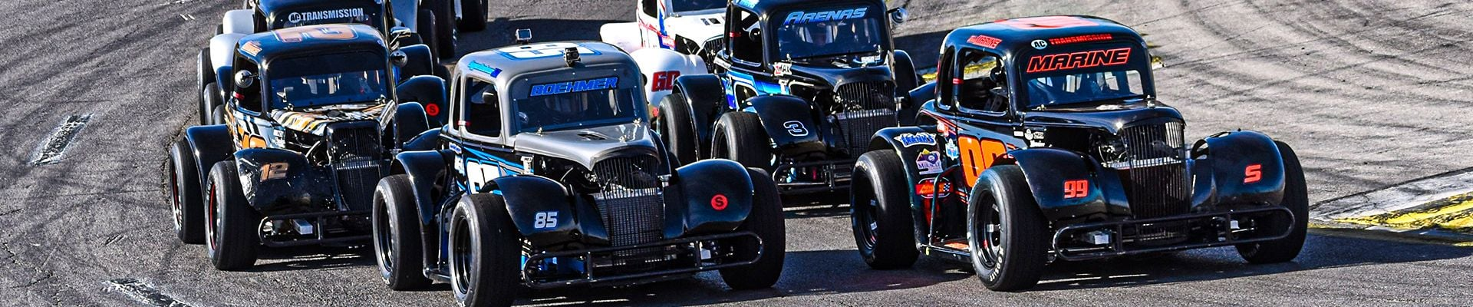
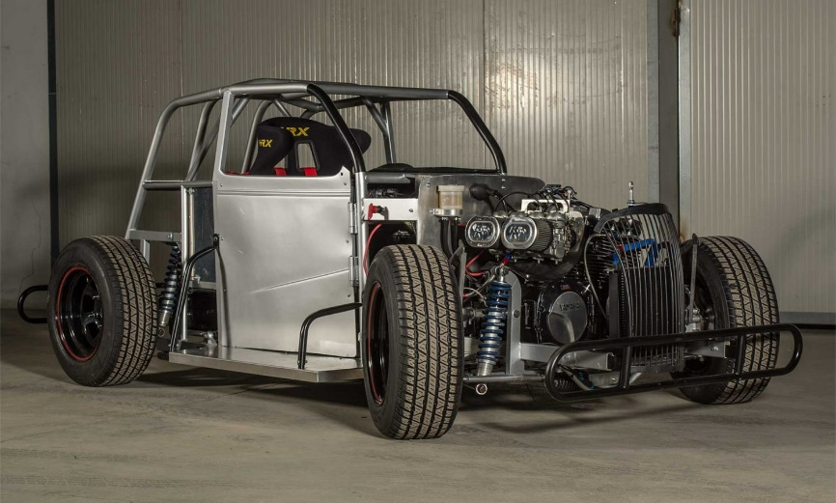

Work overview
Legends Car Championship is a motorsport series featuring cars inspired by 1930s American hot rods.
Known for…
Tight wheel-to-wheel racing
Affordability
Accessibility
Amateur and experienced drivers

Slide 3
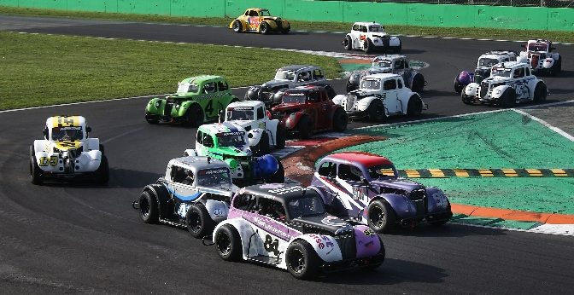




Work overview
In the last years, due to raising popularity, races took place in some of the most famous Italian racing track. Some mid to high-speed track has been added to the calendar
Different chassis generate difference aerodynamic loads…
Some cars may have advantages over others
OBJECTIVE
Evaluate chassis differences impact on performance

Slide 4
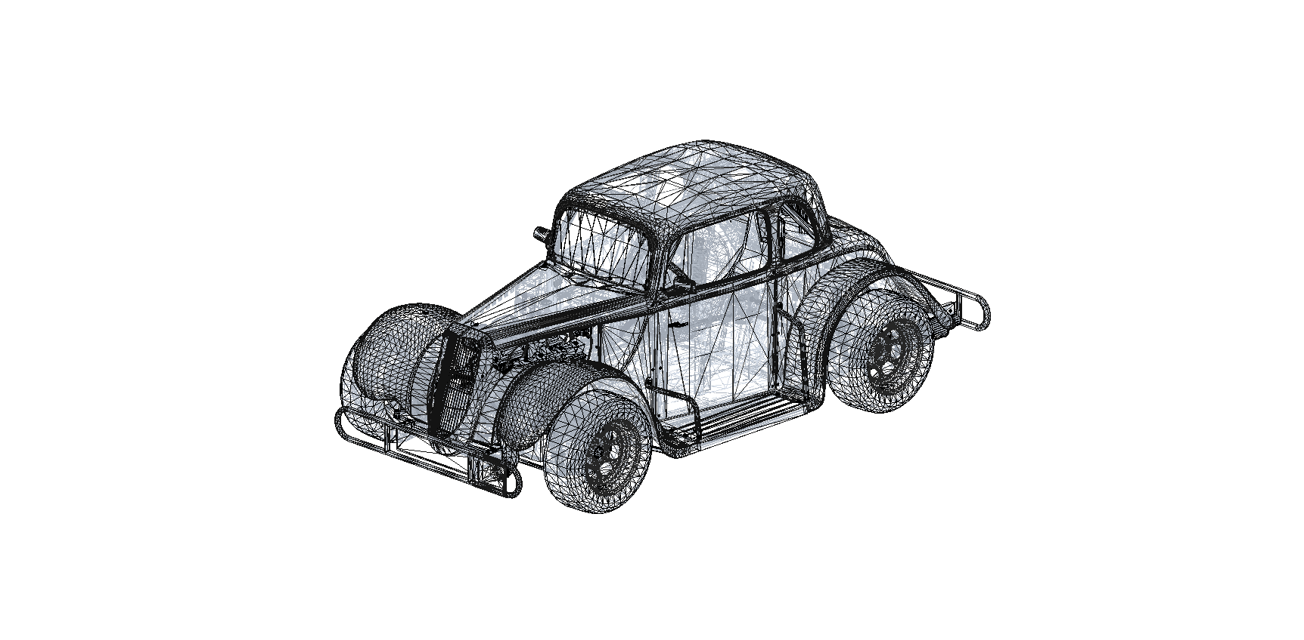
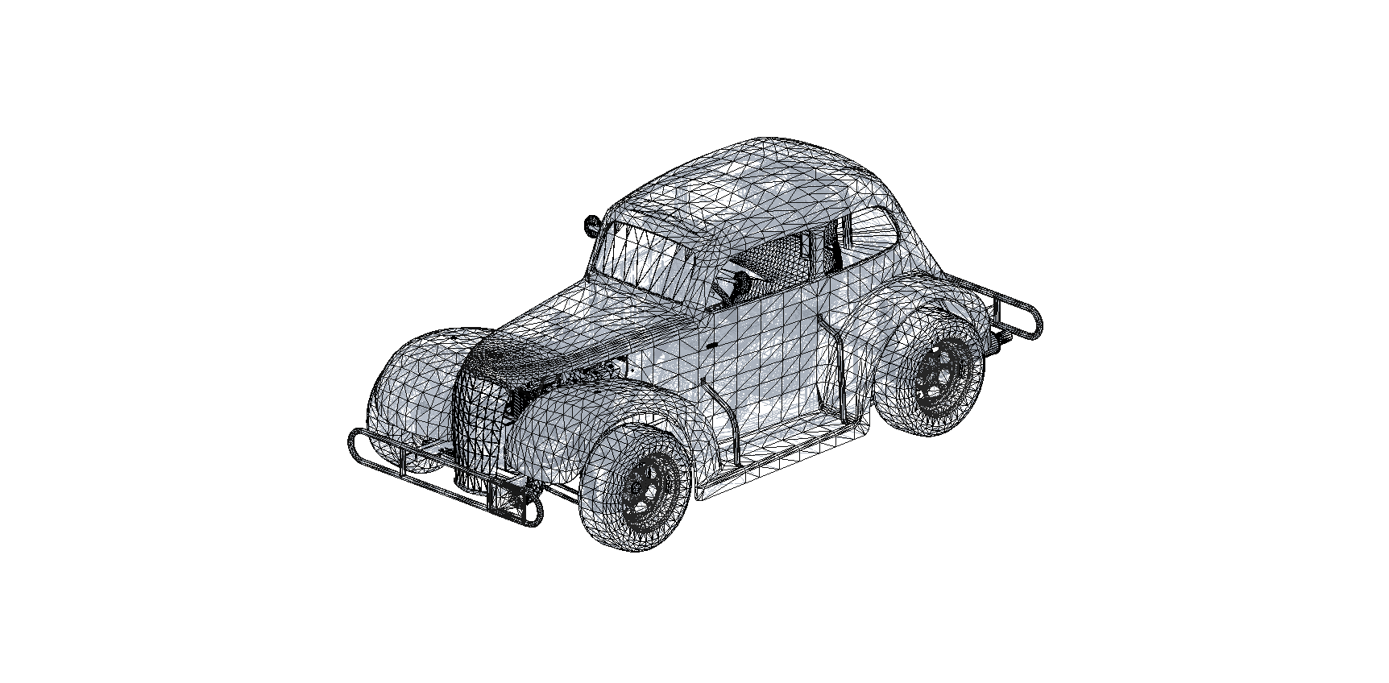
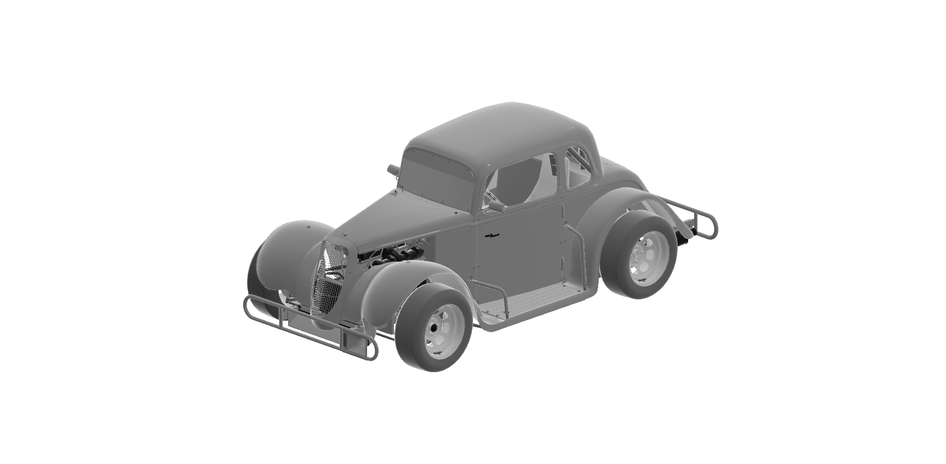
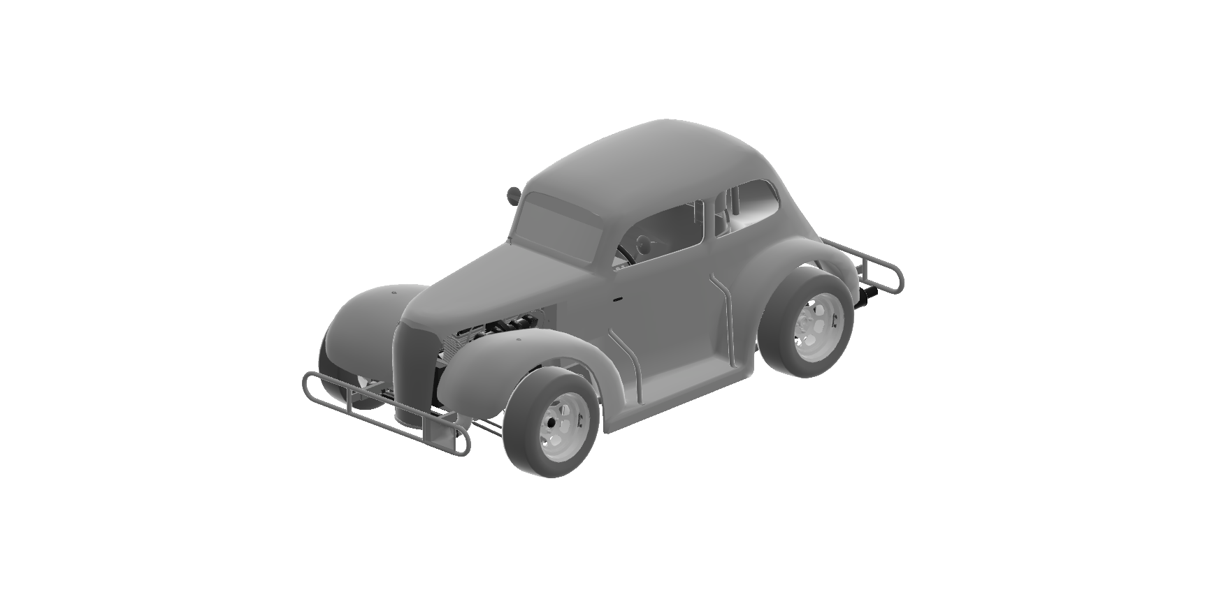


Numerical Methodology
CAD
Inventor or Catia
Mesh
Snappy or Pointwise
CFD
OpenFOAM 3D RANS
Post Processing
Paraview
Extracted from 3D model in Assetto Corsa simulator
Measures verified with real cars in Castelletto circuit
Legends Chevrolet 37 Sedan
Legends Ford 34 Coupe

Slide 5
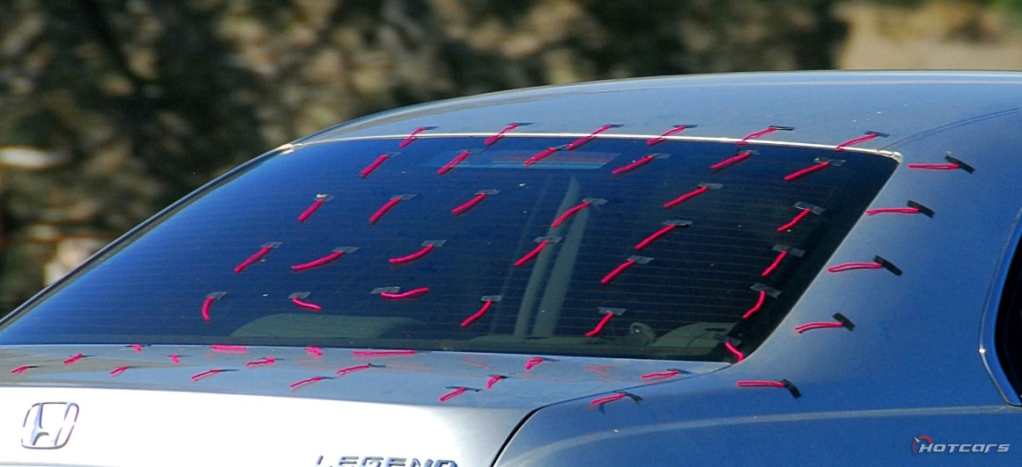
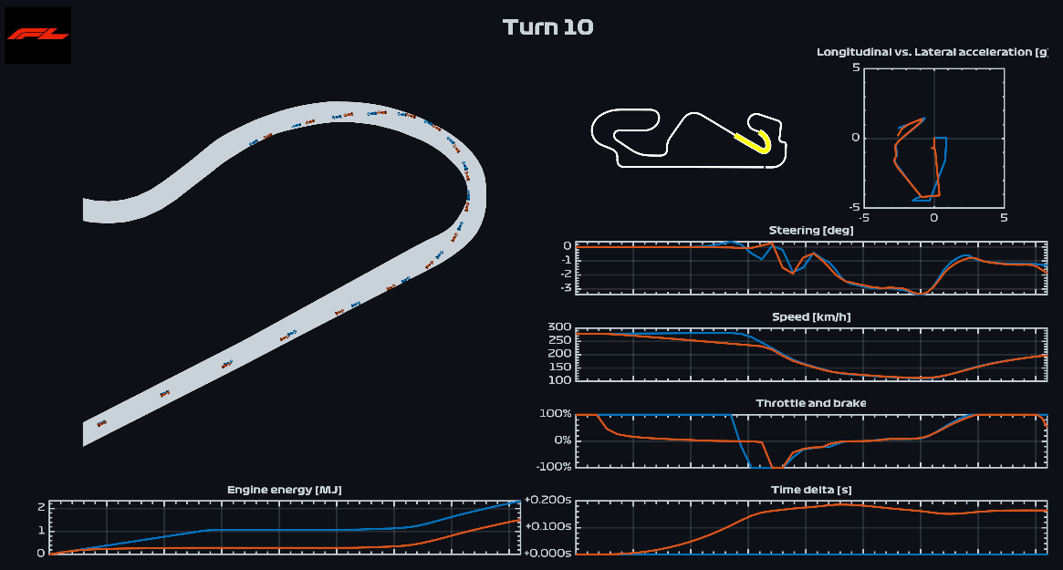
Experimental Methodology
Tuft test on real car
Track simulation
Wind tunnel test
Validate separation point predicted using CFD
Using open source software Fastest-Lap
Force measurements

