Slide 1
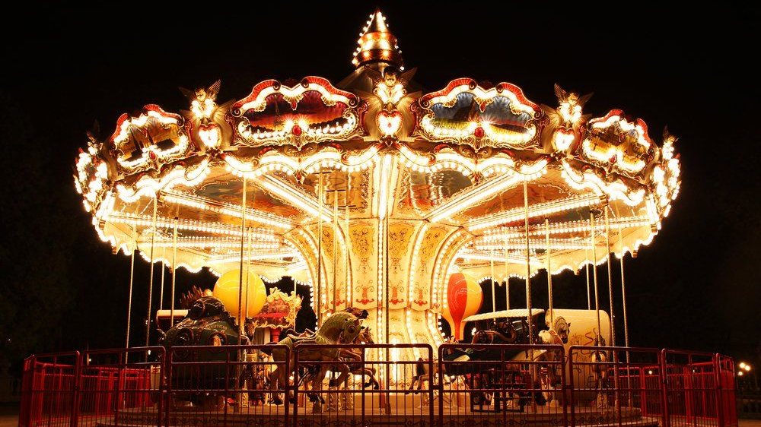
Merry Go Round Project
Performance Evaluation of Computer Systems and Networks
Biondi Matteo
Cristofani Federico
Guidotti Matteo

Slide 2

Introduction and Modeling
The aim of our work is to evaluate the earnings per unit of time of the MGR owner and optimize it, in addition to evaluate the utilization time of the MGR, in order to detect the costs involved.
KPIs:
$Coins per Unit of Time→C_{t}= \frac{N_{c}}{T_{s}}$ [coin/second]
$Utilization→U= \frac{T_{r}}{T_{s}}$
Assumptions:
All the activities that regards a ride are included in time duration T
The threshold to start a ride depends only on a fraction of the total number of seats
Enjoying a ride has a grater priority than leaving the queue in case of simultaneous events
The earnings per unit of time, in our model, is gross of costs
The increasing probability of leaving the queue is modelled with a quantity that indicates the maximum amount of time that a child would accept to remain in the queue.

Slide 3
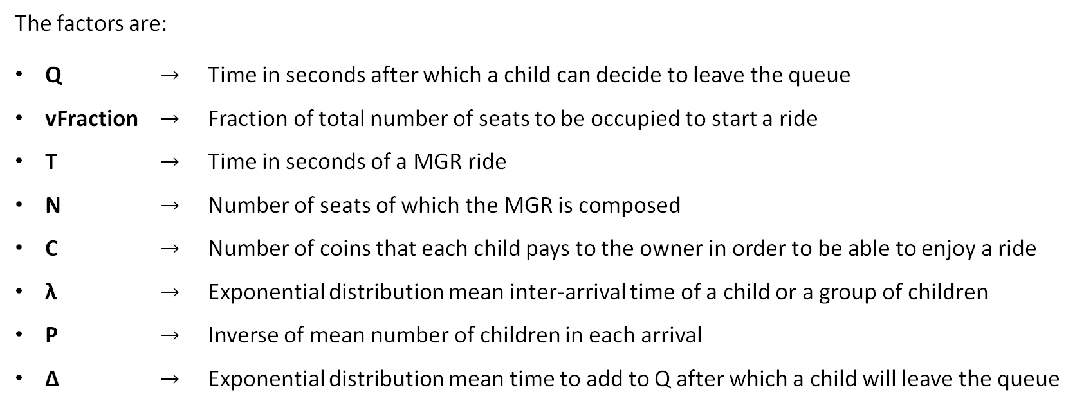
Introduction and Modeling
The factors are:
Q $→$ Time in seconds after which a child can decide to leave the queue
vFraction $→$ Fraction of total number of seats to be occupied to start a ride
T $→$ Time in seconds of a MGR ride
N $→$ Number of seats of which the MGR is composed
C $→$ Number of coins that each child pays to the owner in order to be able to enjoy a ride
λ $→$ Exponential distribution mean inter-arrival time of a child or a group of children
P $→$ Inverse of mean number of children in each arrival
Δ $→$ Exponential distribution mean time to add to Q after which a child will leave the queue

Slide 4
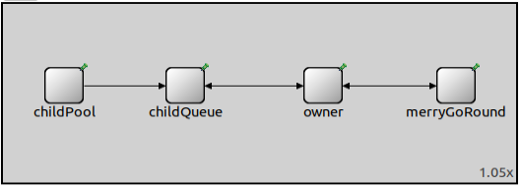
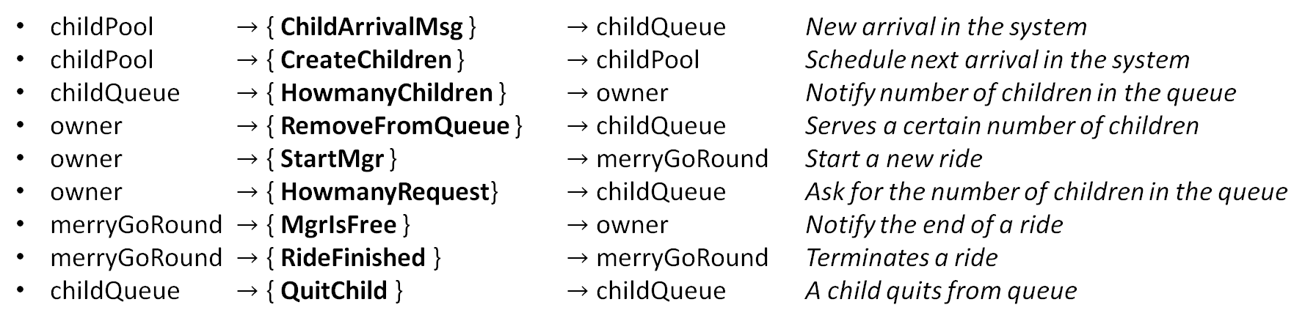
Implementation
The interconnections are 0 delay
New format of messages defined
Messages with different levels of priority
childPool $→$ { ChildArrivalMsg } $→$ childQueue New arrival in the system
childPool $→$ { CreateChildren } $→$ childPool Schedule next arrival in the system
childQueue $→$ { HowmanyChildren } $→$ owner Notify number of children in the queue
owner $→$ { RemoveFromQueue } $→$ childQueue Serves a certain number of children
owner $→$ { StartMgr } $→$ merryGoRound Start a new ride
owner $→$ { HowmanyRequest} $→$ childQueue Ask for the number of children in the queue
merryGoRound $→$ { MgrIsFree } $→$ owner Notify the end of a ride
merryGoRound $→$ { RideFinished } $→$ merryGoRound Terminates a ride
childQueue $→$ { QuitChild } $→$ childQueue A child quits from queue

Slide 5
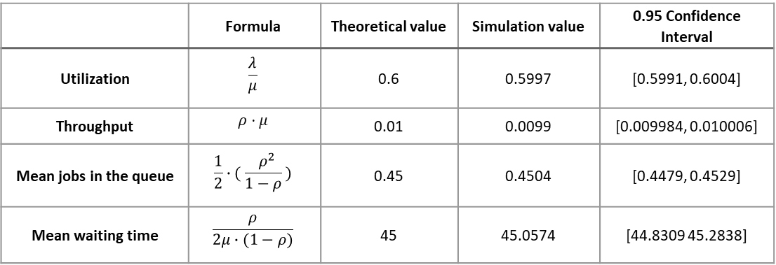
Verification
We performed different tests to assess correctness of simulator:
Deterministic test
Consistency test
Degeneracy test
Continuity test
M/D/1 model
N = 1, vFraction=1
Q = simulation duration
P = 1
λ = [80, 100, 120] s
Δ = 300 s
T = 60 s
C = 1
Simulation duration = 3000 hours
Warmup time = 150 hours
 | Formula | Theoretical value | Simulation value | 0.95 Confidence Interval
Utilization | $$\frac{λ}{μ}$$ | 0.6 | 0.5997 | [0.5991, 0.6004]
Throughput | $$ρ⋅μ$$ | 0.01 | 0.0099 | [0.009984, 0.010006]
Mean jobs in the queue | $$\frac{1}{2}∙( \frac{{ ρ}^{2}}{1−ρ} )$$ | 0.45 | 0.4504 | [0.4479, 0.4529]
Mean waiting time | $$\frac{ρ}{2μ∙(1−ρ)}$$ | 45 | 45.0574 | [44.8309 45.2838]

Slide 6
Calibration and 2^{k}r factorial analysis
Calibration phase:
Different load scenarios
Single arrivals
Bulk arrivals
Simulation warm-up
Simulation duration
Factorial analysis phase:
Coins per unit of time
Utilization
High
Medium
Low
 | T | Q | vFraction
Coins per Unit of Time | ✘ | ✔ | ✔
Utilization | ✔ | ✘ | ✔
Factors Δ, C, N are constant
Factors λ, P depend by the scenario and type of arrival

Slide 7
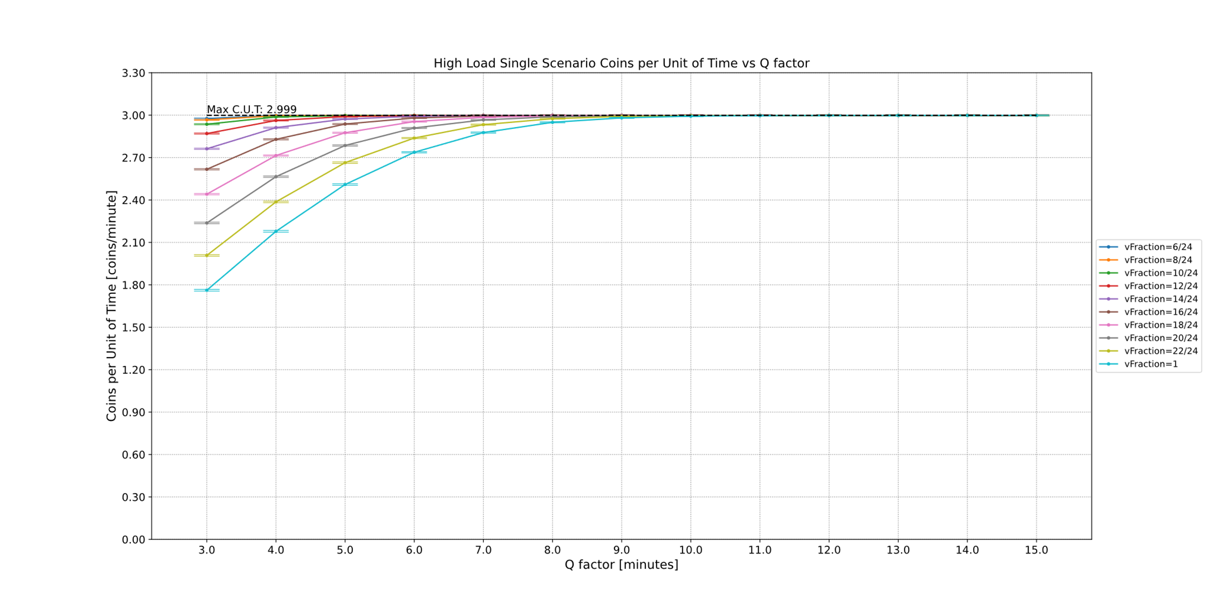
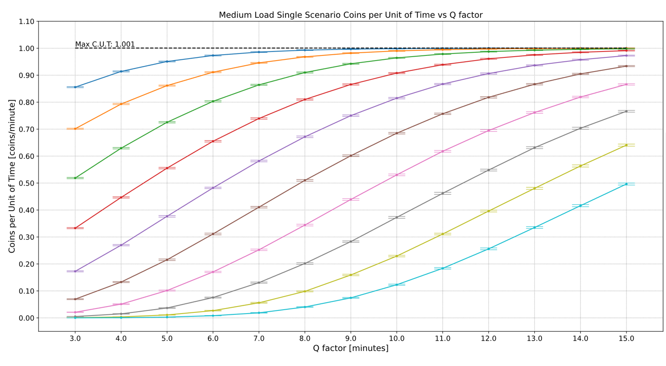
Earnings Optimization and Scenarios Comparison
Coins per unit of time (C.U.T.) varying Q and vFraction factors
Results:
C.U.T. grows with increasing values of Q and decreasing vFraction
As Q increases, different curves collapse towards the maximum
Varying mean inter-arrival time, same values of vFraction reach higher C.U.T.
λ = 60
λ = 20
Measurements with 95% CI

Slide 8
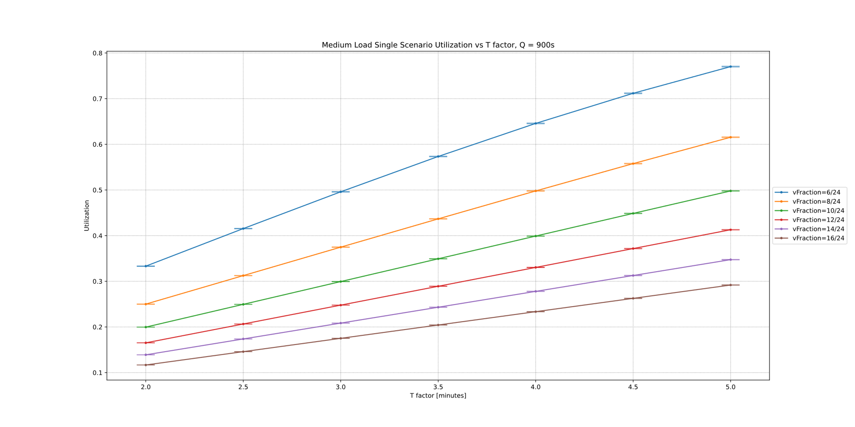
Maximum Earning and Minimum Utilization
T factor doesn’t impact heavily on earnings
Utilization considered as metric of cost for the owner
The curves are the ones with coins per unit of time over 90% of the maximum
The objective is to minimize the cost maintaining an acceptable C.U.T.
Results:
Utilization decreases with increasing vFraction and decreasing T
Different scenarios show the same trend but different values
Changing Q the number of acceptable curves decreases
Factor Q is fixed at 15 minutes (best case)
Measurements with 95% CI

Slide 9
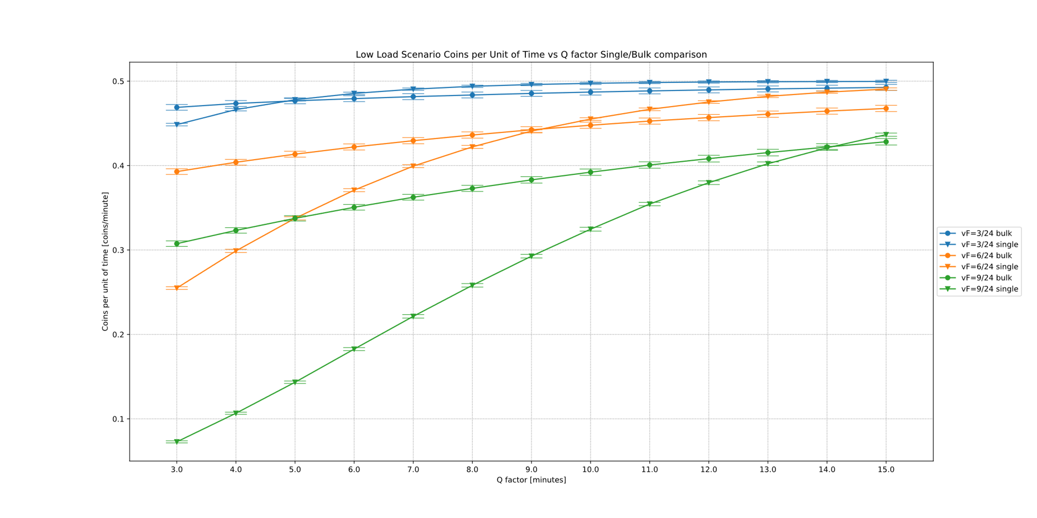
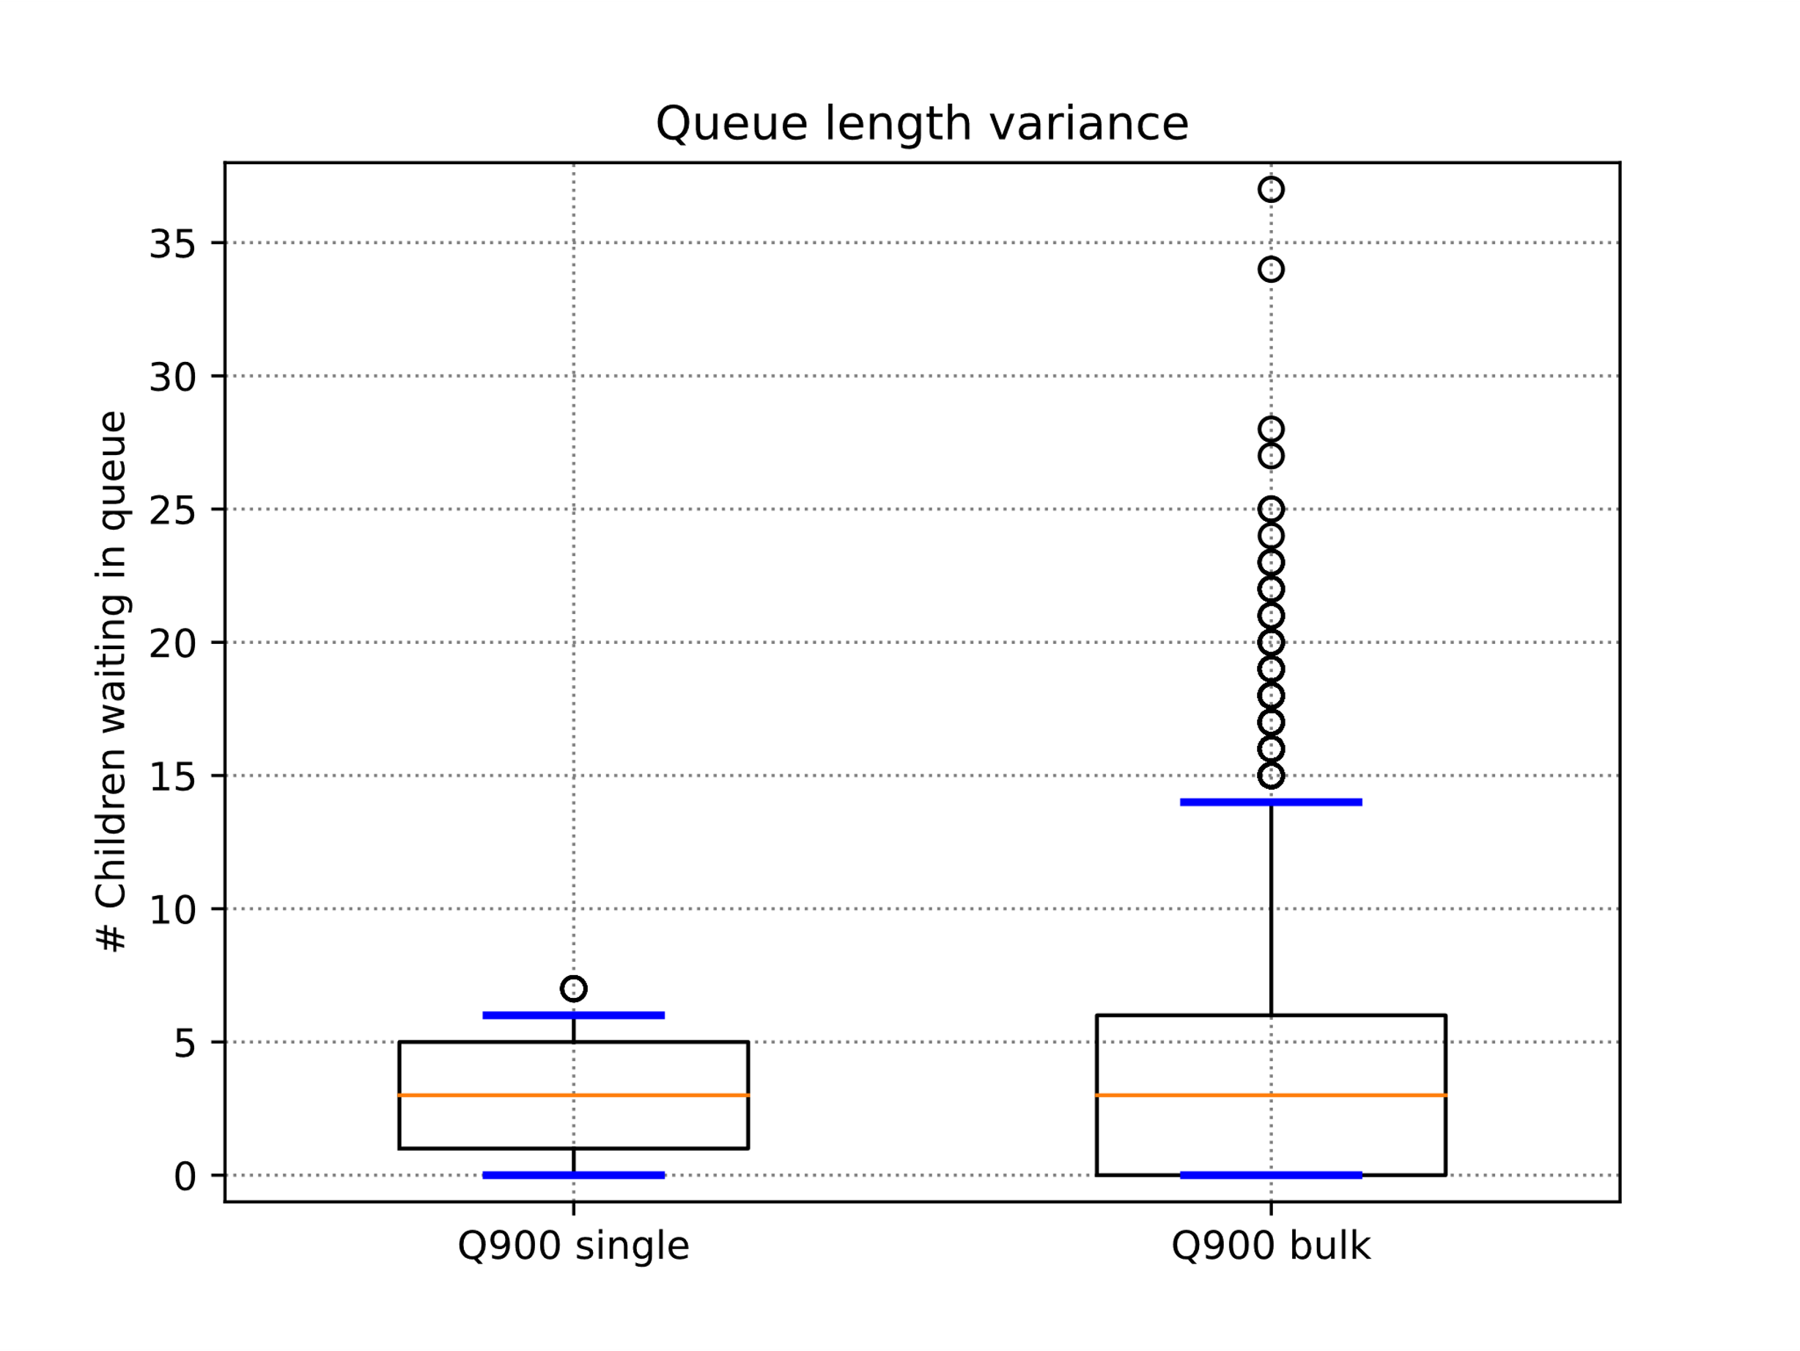
Single arrivals vs Bulk arrivals
Results:
For low values of Q, bulk reaches higher values of C.U.T.
For high values of Q, single reaches higher values of C.U.T.
The intersection point moves towards higher Q values with increasing values of vFraction
The intersection point moves towards lower Q values increasing the load, fixing vFraction
Due to irregular trend of bulk arrivals
Measurements with 95% CI
C.U.T. metrics for different vFractions and Q values for both types of arrivals

Slide 10

Conclusions
After the presented analysis we can conclude that:
Highest C.U.T. for smallest vFraction and highest Q values
To minimize utilization without reducing significantly C.U.T. select smallest T
Tune the vFraction value taking into account trade off between utilization and C.U.T.
Suggested insight:
If the market allows to increase the paid coin per ride by increasing T, this could lead to a significant increase of C.U.T without heavily affecting the cost

