Slide 1
HappyApp – group high5
We are HappyApp - Christopher, Hanna, Måns and Hanna

Slide 2
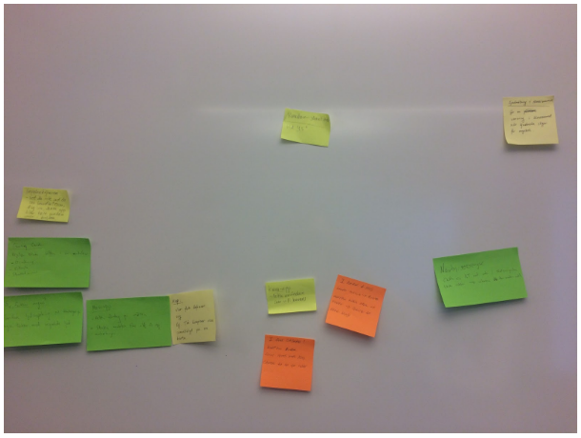
HappyApp – group high5
The Start-Up of the project - Brainstormning

Slide 3
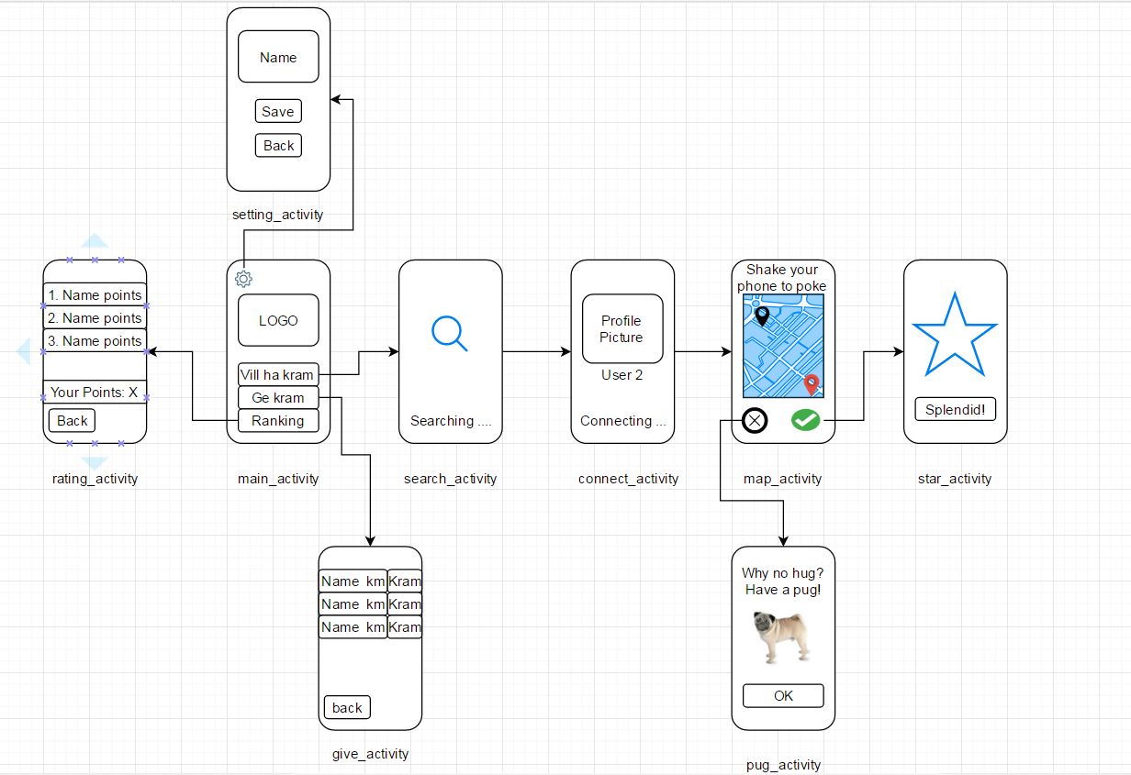
HappyApp – group high5
Design meeting - basic layout and interaction flow

Slide 4
HappyApp – group high5
Implementation and iteration 1. Functionality 2. GPS, vibrations, audio and visual interaction 3. Layout
Super visor meetings
- Feedback from the meeting -- > evaluation to improve or disregard

Slide 5


Slide 8
HappyApp – group high5
Improvements: NFC, ImLost Shake, direction guide

