Slide 1
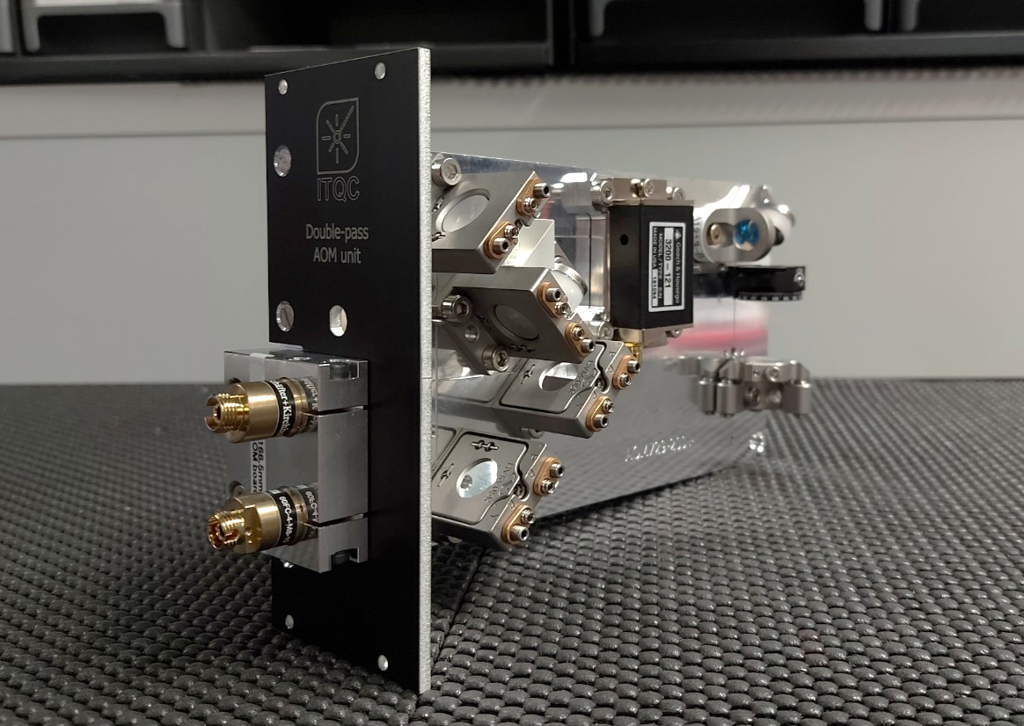


Slide 2
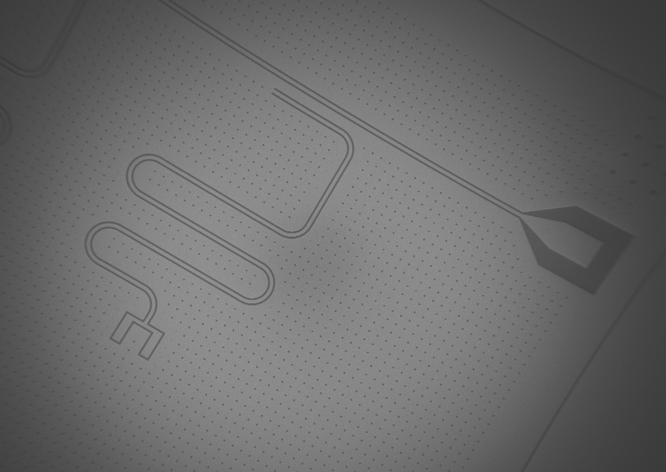



Slide 3
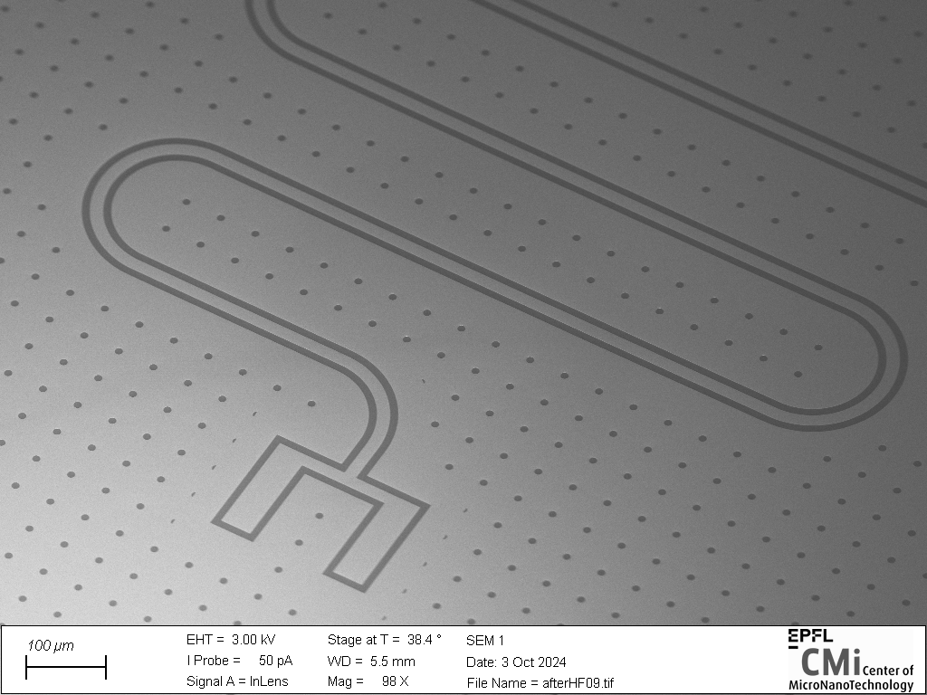

Slide 4
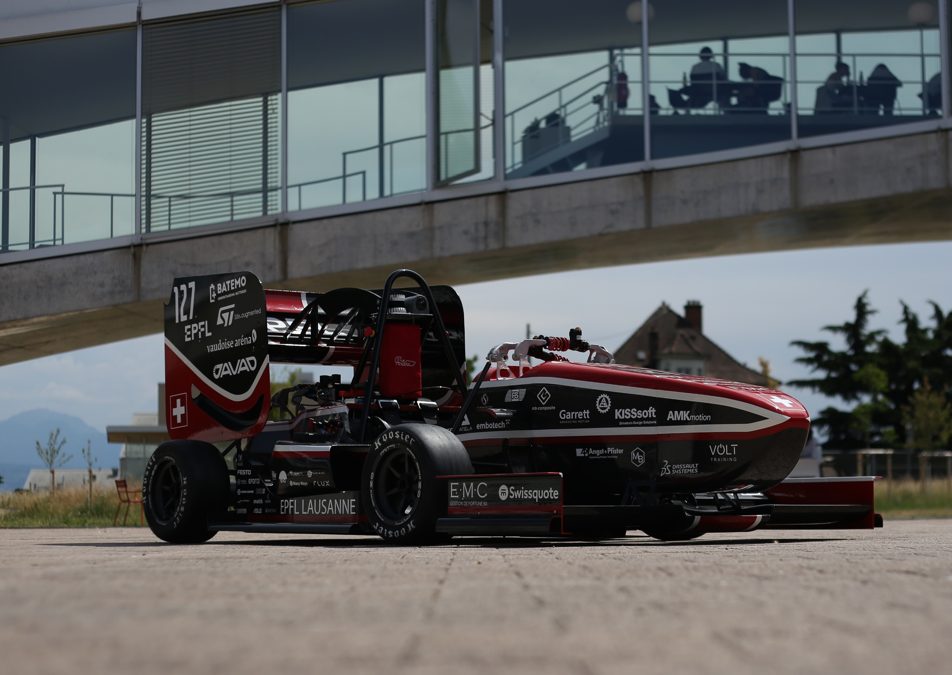


Slide 5
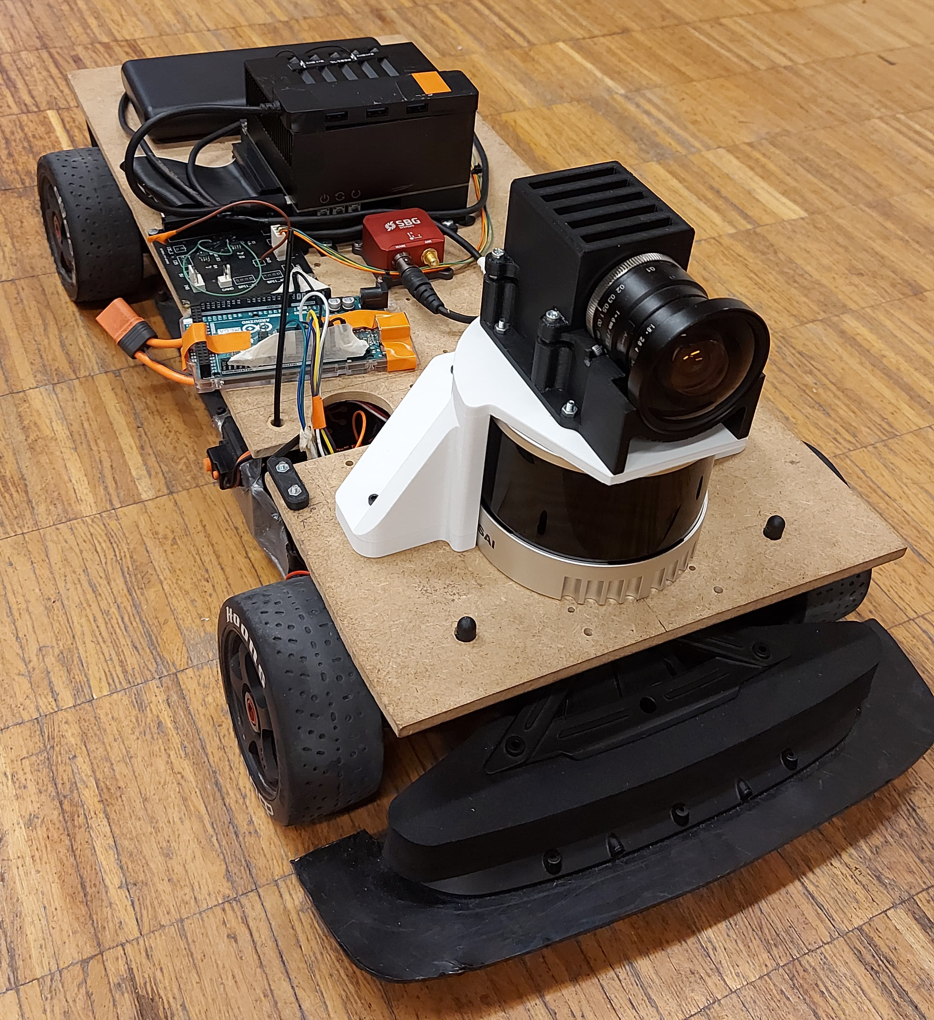
Nvidia Jetson computer
Power bank
CAN converter PCB
INS + RTK
Arduino Mega
Camera
LiDAR
RC car

