Slide 1
Statistical Learning
a.a. 2022/2023 (2nd edition)
Prof. Francesco Finazzi francesco.finazzi@unibg.it
Dott. Frank Massoda frank.massodatchoussi@unibg.it

Slide 2
Course structure
Statistical learning is the 2nd module of Optimization (3CFU) and Statistical Learning (6CFU)
Optimization is not mandatory but suggested
48 hours
32 hours of theoretical lessons
16 hours of lab (coding)

Slide 3
Textbook
Gareth, James, Witten Daniela, Hastie Trevor, and Tibshirani Robert. An introduction to statistical learning: with applications in R. Second Edition. Springer, 2021.
Book website: www.statlearning.com
R files and data sets: https://www.statlearning.com/resources-second-edition

Slide 4
Software
R 4.1.2 (https://cloud.r-project.org)
This is the engine
R-Studio (https://www.rstudio.com/products/rstudio/download/#download)
This is the user interface
R vs MATLAB
Free
Statisticians make new packages available every day
Requires better coding skills
Usually slower than MATLAB (not a problem for us)

Slide 5
Student evaluation
Teamwork (groups of 1, 2 or 3 students max)
You choose the data set to analyze
The analysis is based on the methods seen during the course
R or MATLAB
The tutor will be available for help during the course
The evaluation will be based on a report
Mid and final evaluation (only the final evaluation gives the grade)
Each group will present in front of the class (in English)

Slide 6
Why this course
To provide advanced statistical tools that enable the extraction of useful information from data sets…
In order to make decisions…
Following a statistical inference approach…
Thus, knowing the risk to make the wrong decision.

Slide 7
Why this course
In many contexts, collecting large amount of data is an easy task.
It is not uncommon to find data sets of few GB or TB.
Large data sets do not imply useful information.
We need tools to extract the useful information.

Slide 8
Prerequisites
Statistical inference
Distributions
Estimators
Confidence intervals
Hypothesis testing
Simple and multiple regression (Chapter 3)
Validation and cross-validation techniques(?) (Chapter 5)
Monte Carlo and Bootstrap(?) (Chapter 5)

Slide 9
What we won’t address
Generalized linear models
Stochastic processes
Time series techniques
State-space models (Kalman filter)
Space-time models (next year -> Statistics for high dimensional data)

Slide 10
What is statistical learning?
𝑌 = 𝑓 𝑋 + 𝜖
is the set of predictors
𝑌 is the output
𝑋 = 𝑋₁, … , 𝑋_{𝑝}
𝑓 is fixed but unknown function
The function 𝑓 can be:
A simple equation
A complex equation (e.g., neural network)
An algorithm (from few lines to a large number of lines)

Slide 11
Why estimate 𝑓?
Two main goals
Prediction: 𝑌෠ = 𝑓 𝑋෠
Inference
Which predictors are associated with the response?
What is the relationship between the response and each predictor?
Can the relationship between Y and each predictor be adequately summarized using a
linear equation, or is the relationship more complicated?

Slide 12
How to estimate 𝑓?
We need data!
For us a data set has this form:
𝑥₁, 𝑦₁ , … , 𝑥_{𝑛}, 𝑦_{𝑛}
′
𝑥_{𝑖} = 𝑥_{𝑖1}, … , 𝑥_{𝑖𝑝} , 𝑖 = 1, … , 𝑛
We will apply statistical learning methods to estimate the unknown function
𝑓 such that 𝑌 ≈ 𝑓^{መ} 𝑋 .

Slide 13
Which methods?
Parametrics
We made assumptions on the functional form of 𝑓 (e.g, linear, quadratic, etc.)
The function 𝑓 is usually simple and has some parameters to be estimated (e.g., using least squares)
Once estimated, the model is easy to interpret
Non-parametrics
No assumptions on 𝑓 are made
We look for a 𝑓 which is close to the data point (without overfitting)
Parameters are still there but usually they are in large number (e.g, splines)
Hard to interpret the model from its parameters

Slide 14
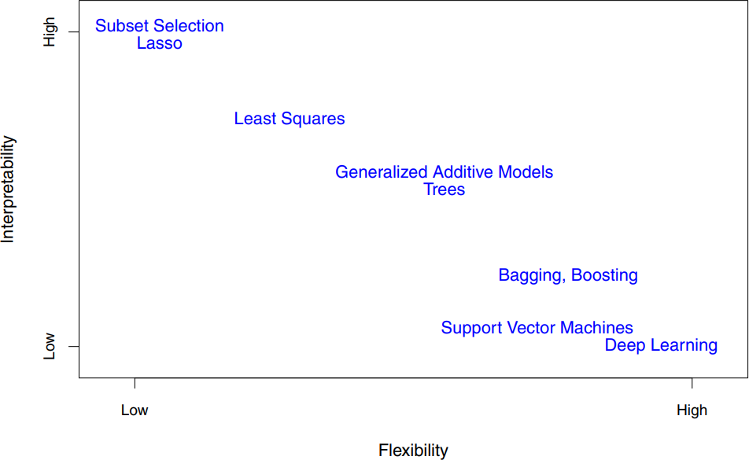
Flexibility vs interpretability
SMS1/SMS2

Slide 15
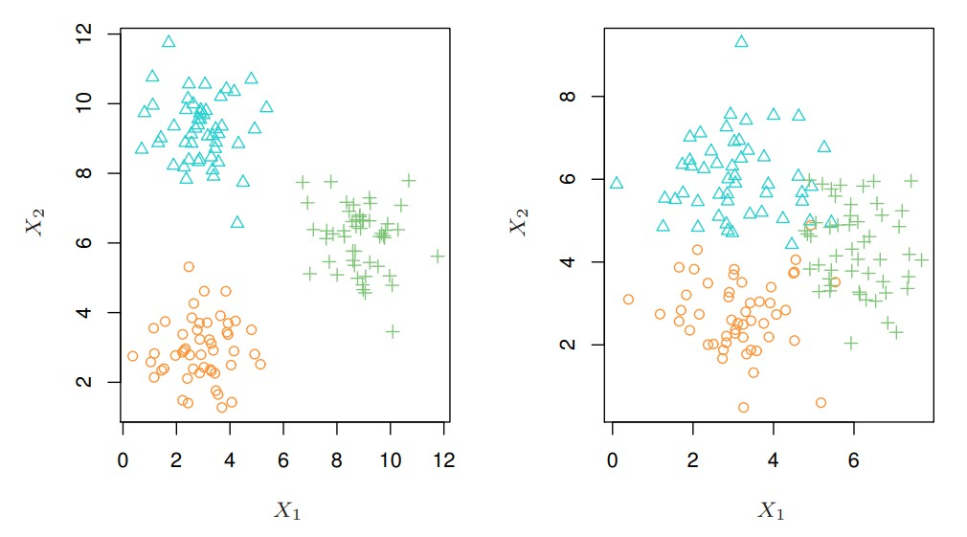
Which methods? (2)
Supervised
When we have both X and Y (e.g, linear regression)
Unsupervised
When we only have X (e.g, clustering)

Slide 16

Measuring the quality of fit
In order to evaluate the performance of a statistical learning method on a given data set, we need some way to measure how well its predictions actually match the observed data.
In the regression setting, the most commonly-used measure is the mean squared error (MSE):

Slide 17
Measuring the quality of fit
The MSE in (2.5) is computed using the training data that was used to fit the
model and is called “training MSE”.
But in general, we do not really care how well the method works on the training data.
We are interested in the accuracy of the predictions that we obtain when we apply our method to previously unseen test data.
We want to choose the method that gives the lowest test MSE, as opposed to the lowest training MSE.
If we had a large number of test observations, we could compute

Slide 18
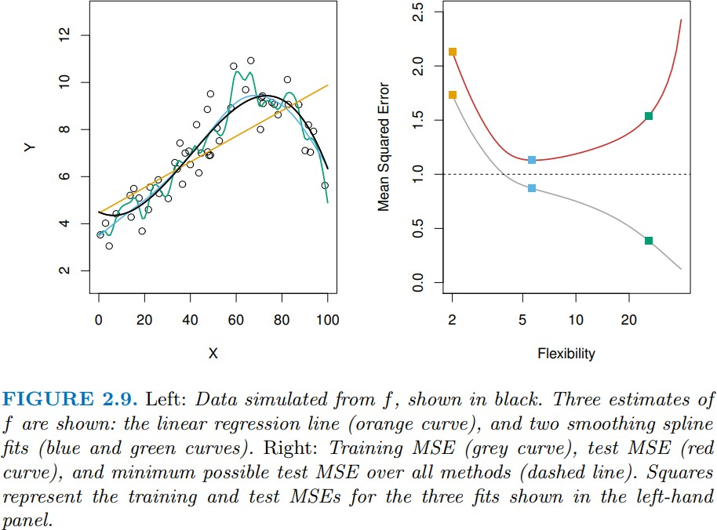
Overfitting problem

Slide 19
The Bias-Variance trade-off
The U-shape observed in the test MSE curve is the result of two competing
properties of statistical learning methods.
The expected test MSE, for a given value 𝑥₀, can always be decomposed into the sum of three fundamental quantities: the variance of 𝑓^{መ} 𝑥₀ , the squared bias of 𝑓^{መ} 𝑥₀ and the variance of the error term 𝜖.
To minimize the expected test error, we need to select a statistical learning method that simultaneously achieves low variance and low bias.

Slide 20
The Bias-Variance trade-off (2)
Variance refers to the amount by which 𝑓^{መ} would change if we estimated it using a different training data set. If a method has high variance, then small changes in the training data can result in large changes in 𝑓^{መ}.
In general, more flexible statistical methods have higher variance!
Bias refers to the error that is introduced by approximating a real-life problem by a much simpler model.
As a general rule, as we use more flexible methods, the variance will
increase and the bias will decrease (trade-off).

