Slide 1


Analyzing & Predicting NBA Rookie Success: A Statistical Learning Approach
Wasim Essbai - 1060652
Matteo Locatelli - 1059210

Slide 2
Outline
Introduction
Dataset Overview
Data Preprocessing
Regression Analysis: Predicting Points Per Game
Classification Analysis: Predicting Career Length
References

Slide 3
Outline
Introduction
Dataset Overview
Data Preprocessing
Regression Analysis: Predicting Points Per Game
Classification Analysis: Predicting Career Length
References

Slide 4
NBA Rookies
Every year, the NBA selects new rookies based on their talent to join the league.
From college or other championships, 30 teams carefully select the top 60 basketball players.
But…
How good will they play in the league?

Slide 5
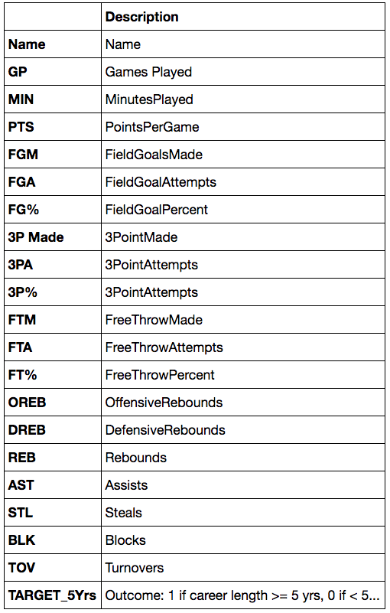
Dataset Description
Dataset provided by ‘data.world’ [1].
1340 samples and 21 columns.
The table presents the dataset’s columns.

Slide 6
Objectives
What are the key contributing factors that significantly influence a player’s ability to score points at a high level?
Is it true that a player’s career length increase based only on scoring more points?

Slide 7
Outline
Introduction
Dataset Overview
Data Preprocessing
Regression Analysis: Predicting Points Per Game
Classification Analysis: Predicting Career Length
References

Slide 8
Data Cleaning
Removal of inconsistent sample
Removal of duplicates
The clean dataset contains 1278 samples

Slide 9

Variable Selection
The following variables are omitted from all the analysis:
‘NAME’
‘REB’ →
$$REB=OREB+DREB$$
The final dataset contains 1278 samples and 19 columns.

Slide 10
Outline
Introduction
Dataset Overview
Data Preprocessing
Regression Analysis: Predicting Points Per Game
Classification Analysis: Predicting Career Length
References

Slide 11
Histograms: 1

Slide 12
Histograms: 2

Slide 13
Histograms: 3

Slide 14
Histograms: 4

Slide 15
Outline
Introduction
Dataset Overview
Data Preprocessing
Regression Analysis: Predicting Points Per Game
Classification Analysis: Predicting Career Length
References

Slide 16
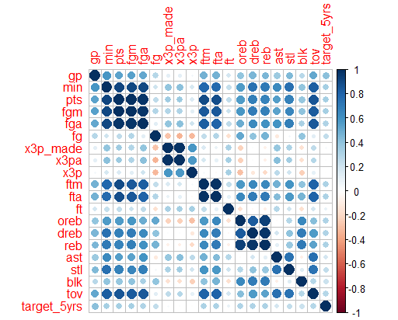
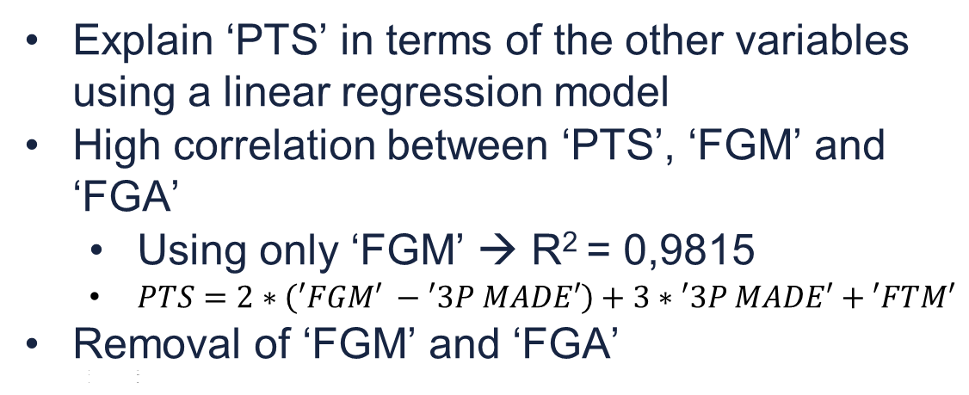
First analysis
Explain ‘PTS’ in terms of the other variables using a linear regression model
High correlation between ‘PTS’, ‘FGM’ and ‘FGA’
Using only ‘FGM’ → R² = 0,9815
$PTS=2∗\left(′FGM′ −′3P MADE′\right)+3∗′3P MADE′+′FTM′$
Removal of ‘FGM’ and ‘FGA’
In
xxv
kb

Slide 17
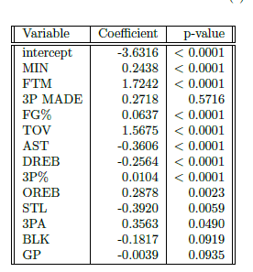
Forward stepwise 1
13 variables selected
‘3P MADE’ is definetly not significant
In
xxv
kb

Slide 18
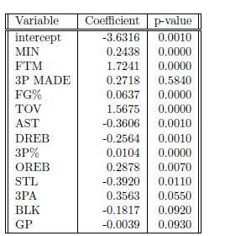
Forward stepwise 2
Usage of bootstrap resampling
Estimation coherent with the previous table

Slide 19
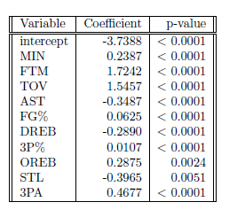
Forward stepwise 3
Removal of not significant variables
The final model contains 10 variables

Slide 20
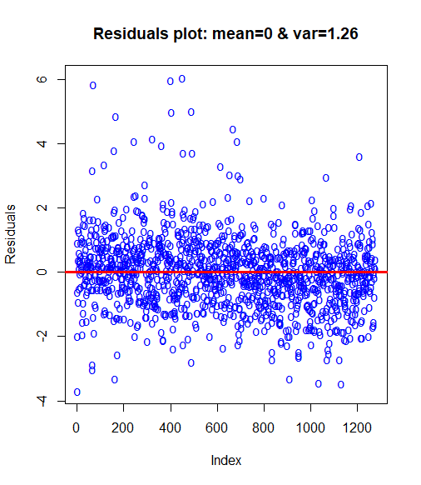
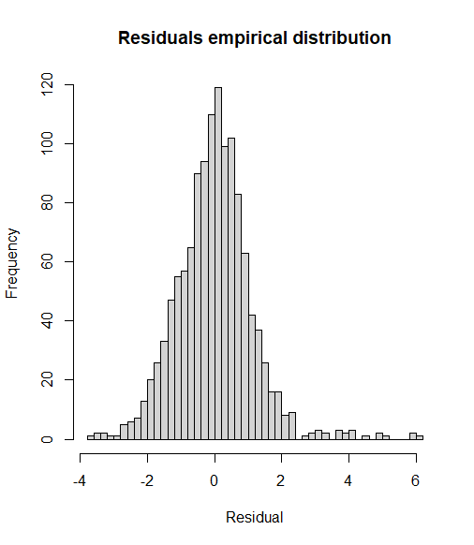
Forward stepwise 4

Slide 21
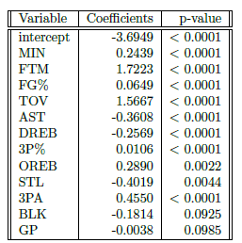
Backward stepwise
Backward
Forward

Slide 22

Ridge regression
$$λ_{opt}=0.0268$$
No selection performed

Slide 23

Lasso regression
$$λ_{opt}=0.0036$$
No selection performed

Slide 24
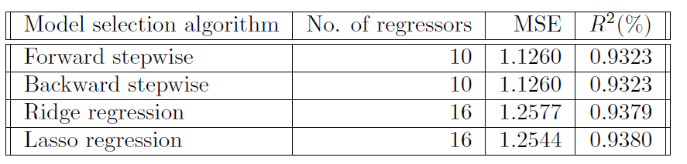
Conclusions
Key factors: ‘MIN’, ‘FTM’, ’TOV’, ’AST’, ’3P%’, ’3PA’, ’OREB’, ’DREB’, ‘FG%’, ’STL’
‘GP’ not significant

Slide 25
Outline
Introduction
Dataset Overview
Data Preprocessing
Regression Analysis: Predicting Points Per Game
Classification Analysis: Predicting Career Length
References

Slide 26
First analysis
The goal is to explain ‘TARGET_5Yrs’ in terms of the other variables
Removal of ‘PTS’ for the observation made in the previous section
Dataset with 1278 samples and 18 columns
Application of different techniques
Logistic regression
Classification trees with ensemble methods
K-nearest-neighbors
Support vector machines

Slide 27
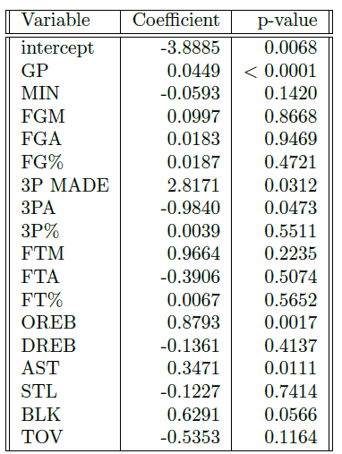
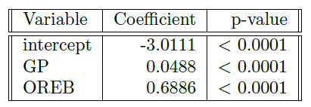
Logistic regression
Model A
Selection of significant features
Model B
Logistic regression with all the features

Slide 28
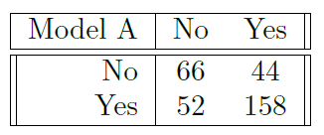
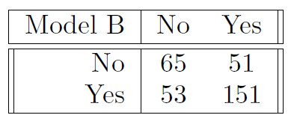


Logistic regression: Model A vs Model B
$$MER=30,0\%$$
$$MER=32,5\%$$

Slide 29
Logistic regression
Model A
Selection of significant features
Model B
Logistic regression with all the features
‘GP’ expected to be important

Slide 30
Classification trees
Using gini minimization function results in a tree with 109 terminal nodes
It’s possible to prune the tree at different sizes using cross-validation

Slide 31
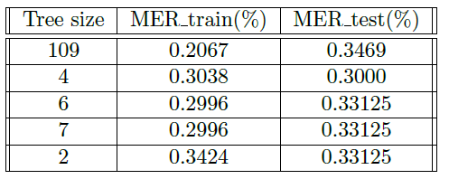
Classification trees: pruning
Best size is 4
‘GP’ most important

Slide 32
Ensemble methods: random forest
Random forest build with 500 trees
Cross-validation to find the best number of predictors m.

Slide 33
Ensemble methods: random forest vs bagging
Random forest performs better on test data

Slide 34
Ensemble methods: random forest vs bagging

Slide 35
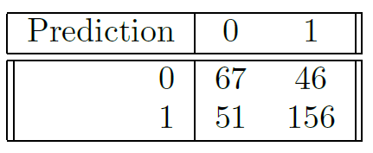
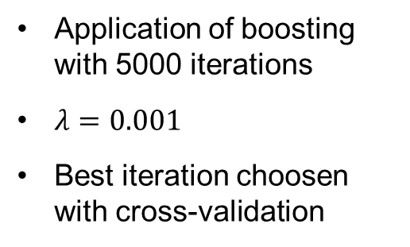
Ensemble methods: boosting
Application of boosting with 5000 iterations
$λ=0.001$
Best iteration choosen with cross-validation

Slide 36
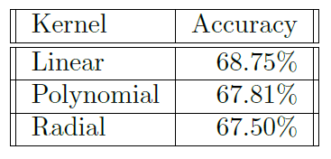
Further methods
K-nearest-neighbors
k=3
No improvements
Support vector machines
Different kernels applied
No improvements

Slide 37
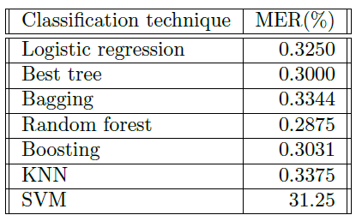
Conclusions
Limit on the achievable performances around 70%
‘GP’ is the most important feature
The scored points are not really important

Slide 38
References
“Nba rookie stats,” 2016. data retrieved from data.world, https://data.world/exercises/logistic-regression-exercise-1.
G. James, D. Witten, T. Hastie, and R. Tibshirani, An Introduction to Statistical Learning: with Applications in R. Springer, 2013.

Slide 39
Q & A
Wasim Essbai - 1060652
Matteo Locatelli - 1059210

