Slide 1
Milestone meeting
Sandra Friebolin, Matteo Malvestiti, Yusuf Berber

Slide 2

Index
Dataset download and pre-processing
Documents’ database
Embeddings
Vector database
Ongoing and upcoming steps
Dataset
Our choice:
Abstracts from 2013-2023
Metadata: PMID, title, authors, publication date, DOI
Sandra Friebolin, Matteo Malvestiti, Yusuf Berber
Notes:
Fin qua 4 minuti
Description of our problem environment
Emitter with small radius
Collector non in mesh
BCs
Initial refinement at emitter (not distorted mesh, emitter is our interest)

Slide 3
Download Data via Python script
Utilize the ‘Bio.Entrez. Module in Python for data downloading
Data Format: XML
Refine filtering criteria to download quarterly
Sandra Friebolin, Matteo Malvestiti, Yusuf Berber
Notes:
Fin qua 4 minuti
Description of our problem environment
Emitter with small radius
Collector non in mesh
BCs
Initial refinement at emitter (not distorted mesh, emitter is our interest)

Slide 4
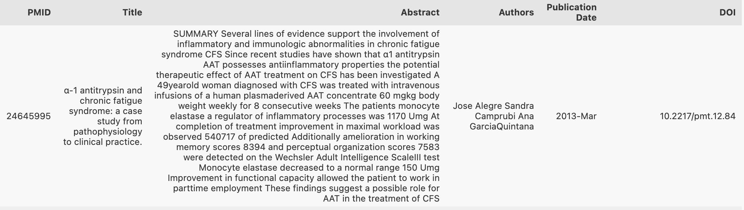
Preprocessing
Replace NaN with string “Unknown”
Remove special characters (for example with Scandinavian names)
Remove non-breaking spaces and trailing whitespaces
To-Do: experiment with stop-word removal, n-grams/phrases, lemmatization
Sandra Friebolin, Matteo Malvestiti, Yusuf Berber
Notes:
Fin qua 4 minuti
Description of our problem environment
Emitter with small radius
Collector non in mesh
BCs
Initial refinement at emitter (not distorted mesh, emitter is our interest)

Slide 5


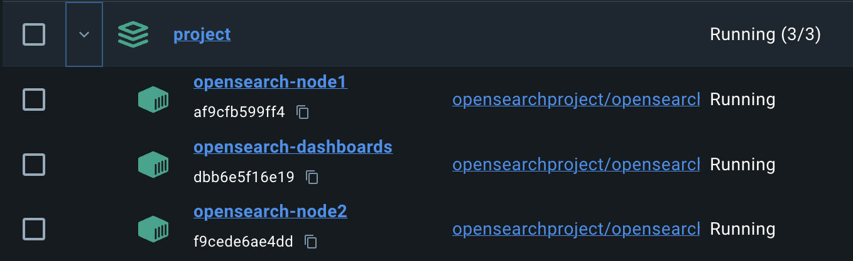
Index
Dataset download and pre-processing
Documents’ database
Embeddings
Vector database
Ongoing and upcoming steps
OpenSearch
Sandra Friebolin, Matteo Malvestiti, Yusuf Berber
Notes:
Poisson formula
Representation of f and why is negligible
BCs

Slide 6
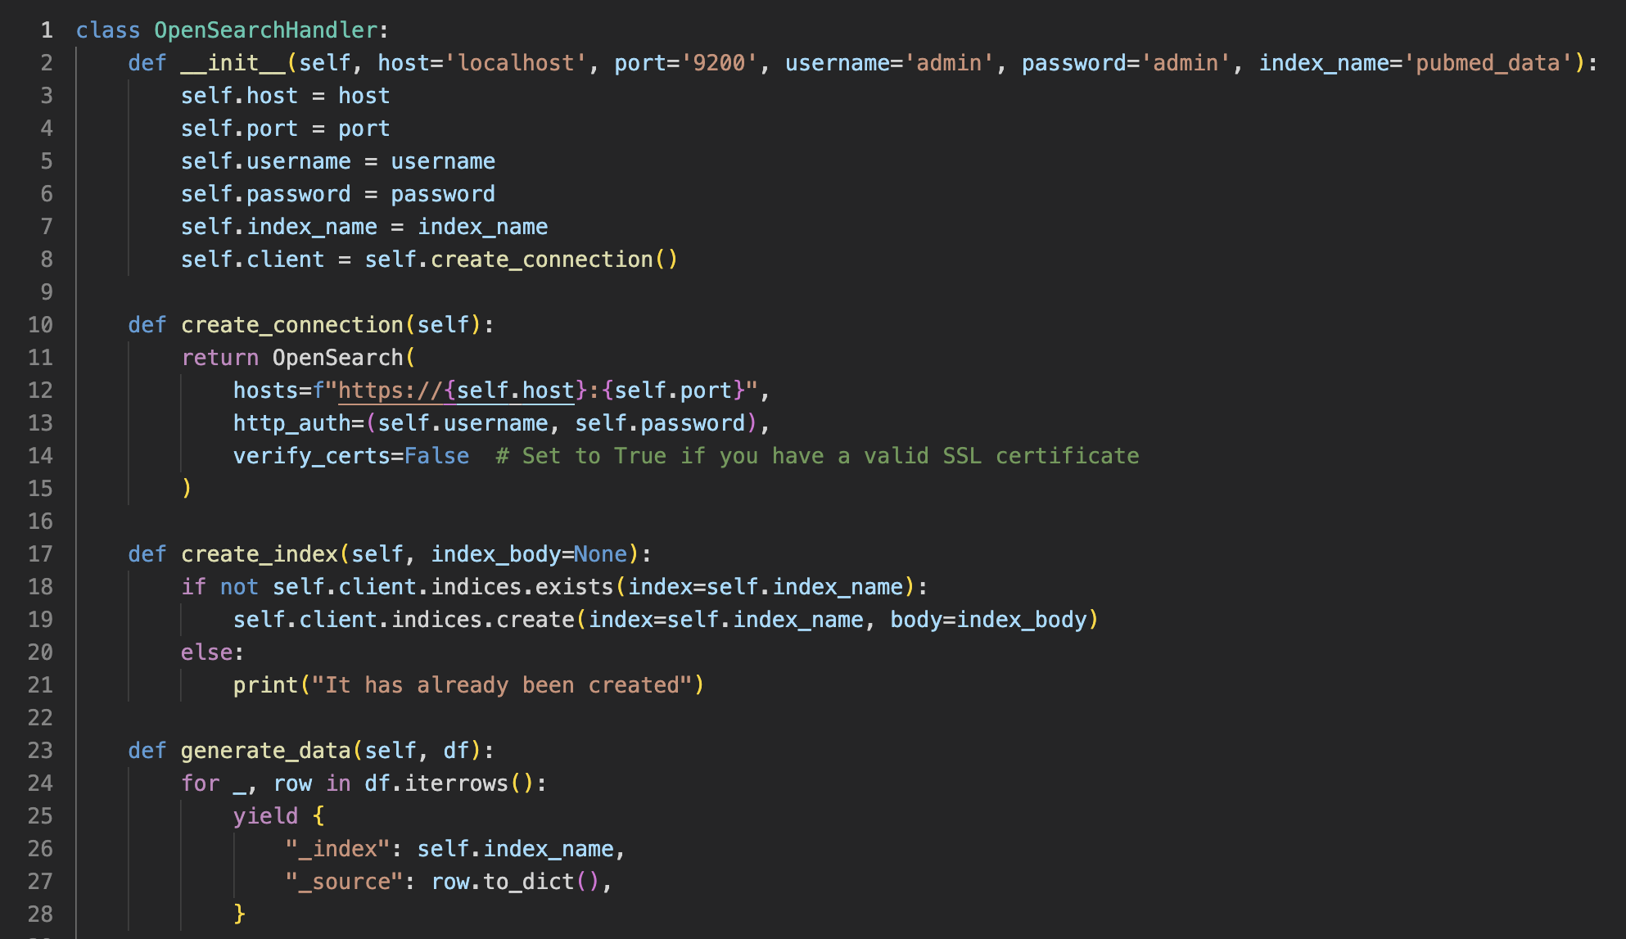
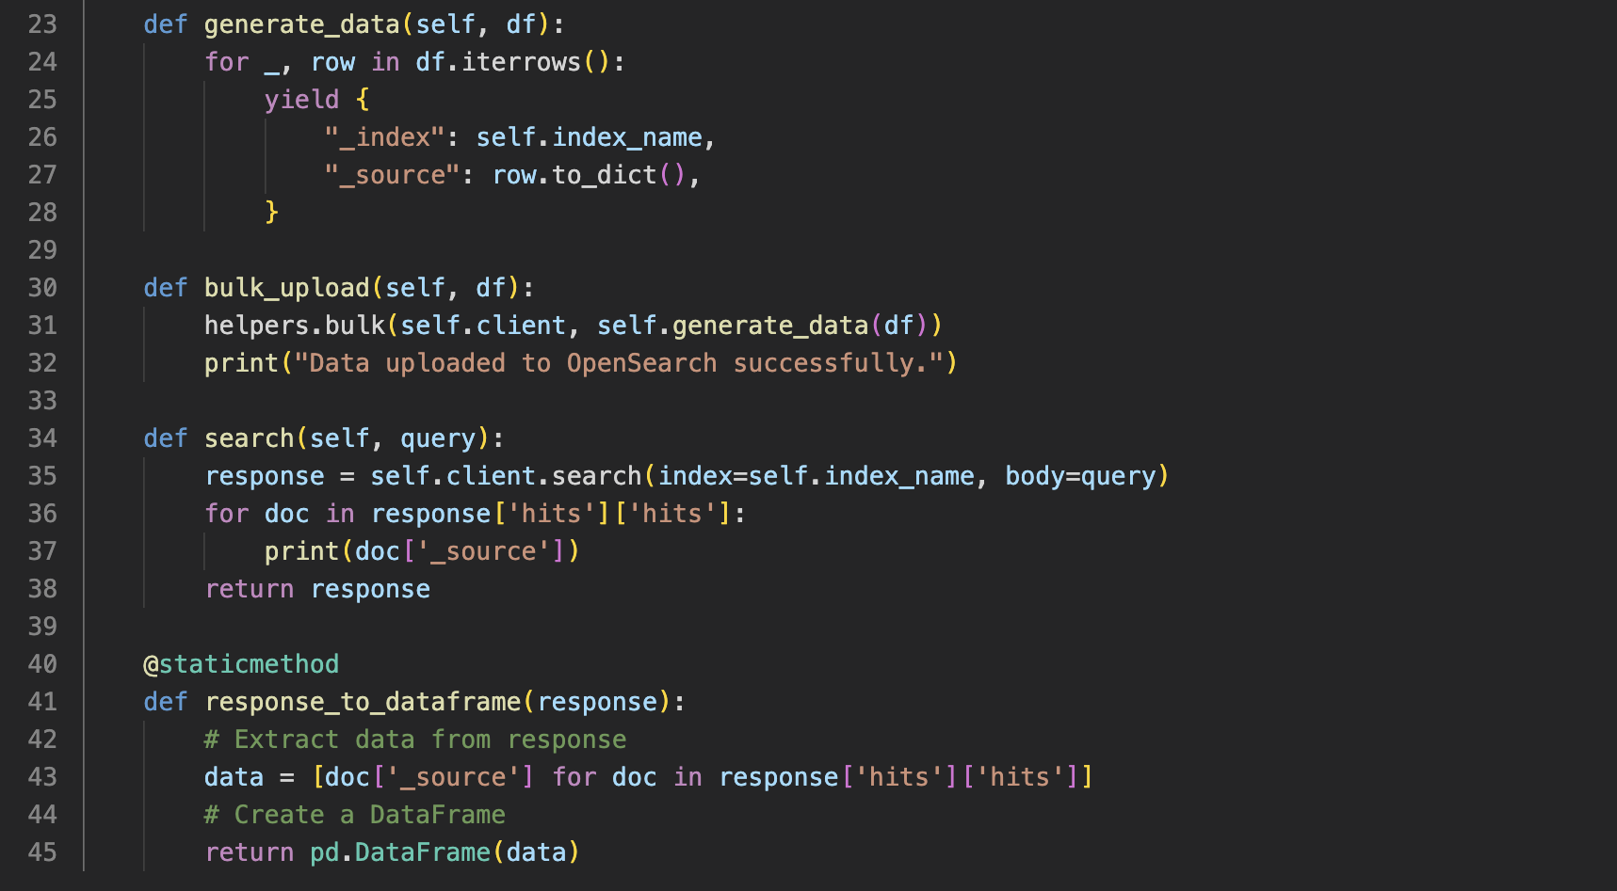
We handle the connection through a python notebook
Sandra Friebolin, Matteo Malvestiti, Yusuf Berber
Notes:
Fin qua 4 minuti
Description of our problem environment
Emitter with small radius
Collector non in mesh
BCs
Initial refinement at emitter (not distorted mesh, emitter is our interest)

Slide 7
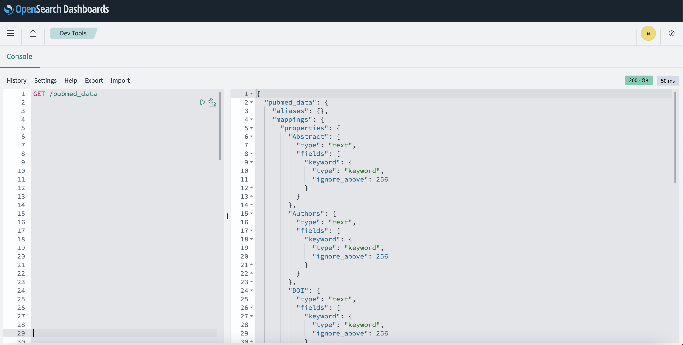
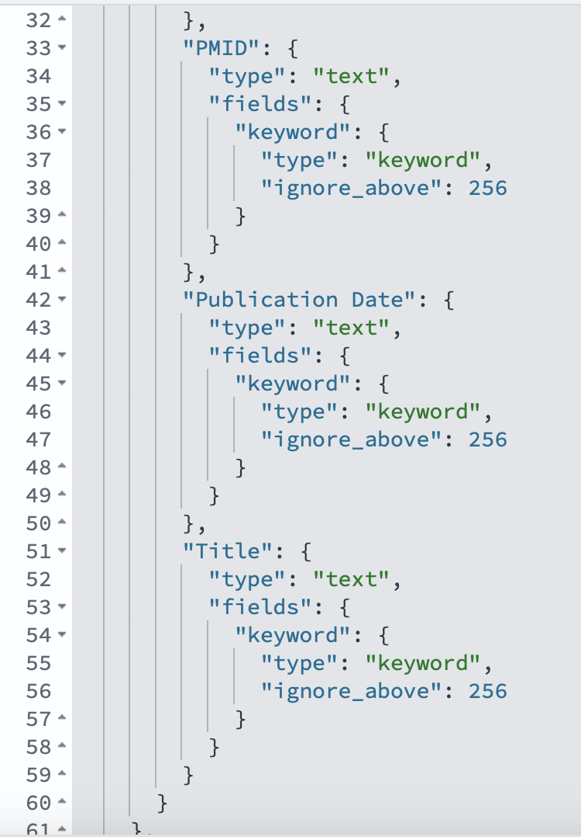
How the index looks like
a question for later
Sandra Friebolin, Matteo Malvestiti, Yusuf Berber
Notes:
Fin qua 4 minuti
Description of our problem environment
Emitter with small radius
Collector non in mesh
BCs
Initial refinement at emitter (not distorted mesh, emitter is our interest)

Slide 8
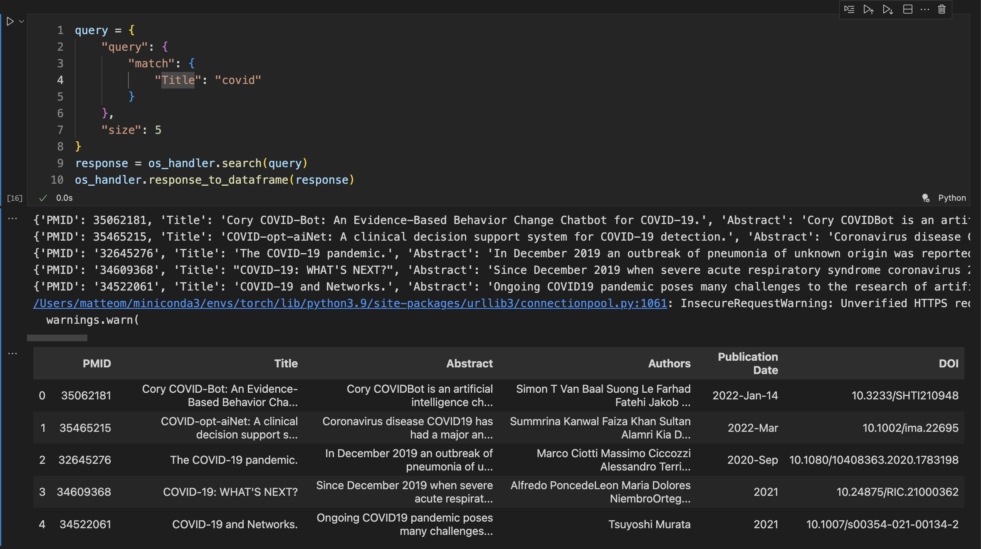
Some query example to prove it’s working properly
Many results for “covid”
Sandra Friebolin, Matteo Malvestiti, Yusuf Berber
Notes:
Fin qua 4 minuti
Description of our problem environment
Emitter with small radius
Collector non in mesh
BCs
Initial refinement at emitter (not distorted mesh, emitter is our interest)

Slide 9
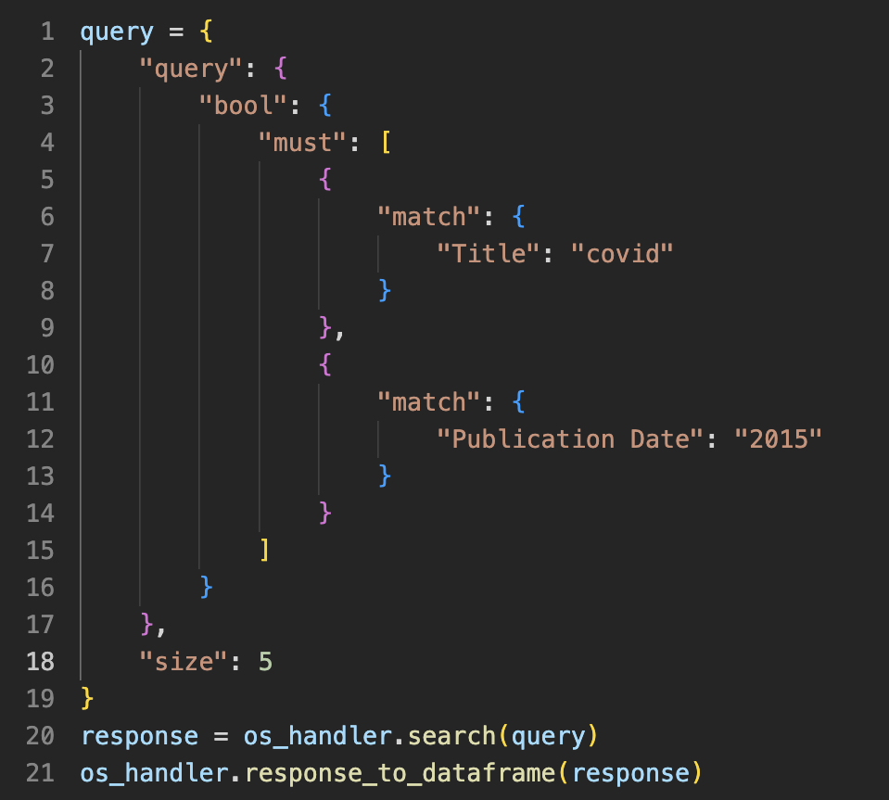
Some query example to prove it’s working properly
Something more elaborated:
a Boolean search
No mentions for covid in 2015! Didn’t anyone write about it before the pandemic??
Sandra Friebolin, Matteo Malvestiti, Yusuf Berber
Notes:
Fin qua 4 minuti
Description of our problem environment
Emitter with small radius
Collector non in mesh
BCs
Initial refinement at emitter (not distorted mesh, emitter is our interest)

Slide 10
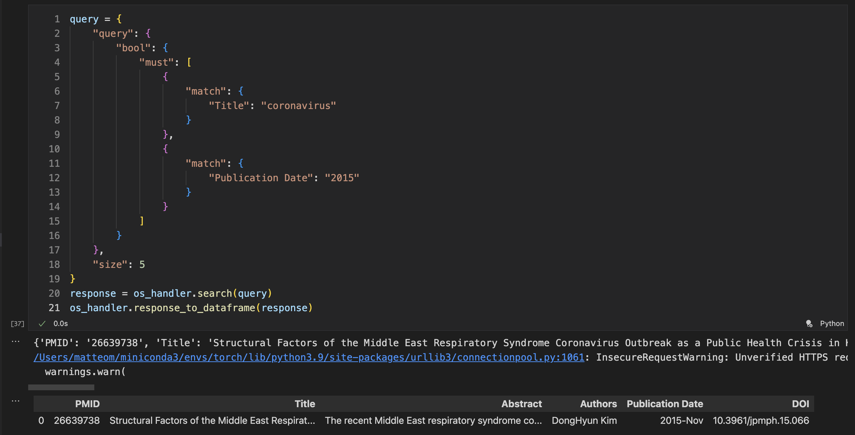
Some query example to prove it’s working properly
'Title': 'Structural Factors of the Middle East Respiratory Syndrome Coronavirus Outbreak as a Public Health Crisis in Korea and Future Response Strategies.'
Test: Successful
It’s working
Sandra Friebolin, Matteo Malvestiti, Yusuf Berber
Notes:
Fin qua 4 minuti
Description of our problem environment
Emitter with small radius
Collector non in mesh
BCs
Initial refinement at emitter (not distorted mesh, emitter is our interest)

Slide 11
Index
Dataset download and pre-processing
Documents’ database
Embeddings
Vector database
Ongoing and upcoming steps
Embeddings:
1) BioBERT
domain-specific adaptation of BERT model, pre- trained on large-scale PubMed corpus
capture the context and semantics of biomedical texts
used pre-trained version
To-Do: fine-tune on own data?
2) To-Do: Embedding-Pipeline
test different embedding models, e.g. SGPT-5.8B-msmarco (best results for semantic retrieval, see MTEB: Massive Text Embedding Benchmark)
Sandra Friebolin, Matteo Malvestiti, Yusuf Berber
Notes:
Poisson formula
Representation of f and why is negligible
BCs

Slide 12
Live-Demo: Retrieval of most similar abstracts based on test queries
Sandra Friebolin, Matteo Malvestiti, Yusuf Berber
Notes:
Fin qua 4 minuti
Description of our problem environment
Emitter with small radius
Collector non in mesh
BCs
Initial refinement at emitter (not distorted mesh, emitter is our interest)

Slide 13
Index
Dataset download and pre-processing
Documents’ database
Embeddings
Vector database
Ongoing and upcoming steps
Vector database: Pinecone
Create a free pinecone account
Write a ‘PineconeHandler’ class for various operations within Pinecone
Write an ‘upload_embeddings’ notebook to upsert embeddings into pinecone
Sandra Friebolin, Matteo Malvestiti, Yusuf Berber
Notes:
Poisson formula
Representation of f and why is negligible
BCs

Slide 14
Python script to upload embeddings
Sandra Friebolin, Matteo Malvestiti, Yusuf Berber
Notes:
Fin qua 4 minuti
Description of our problem environment
Emitter with small radius
Collector non in mesh
BCs
Initial refinement at emitter (not distorted mesh, emitter is our interest)

Slide 15
Index
Dataset download and pre-processing
Documents’ database
Embeddings
Vector database
Ongoing and upcoming steps
Ongoing steps
We are trying to finetune BioBert on our Dataset
Upcoming steps
Langchain script for RAG (and put all pieces together)
Embed Abstracts with different models
Introduce a unique identifier to link abstracts on OpenSource to embeddings on Pinecone
Sandra Friebolin, Matteo Malvestiti, Yusuf Berber
Notes:
Poisson formula
Representation of f and why is negligible
BCs

Slide 16
Questions for you
Manipulation of dates
…
Sandra Friebolin, Matteo Malvestiti, Yusuf Berber
Notes:
Schema interattivo

