Slide 1
Insurance costs predictION
Matteo Salvatore
Davide Varacalli
Notes:
Matteo

Slide 2
INTRODUCTION
Medical Cost Personal Datasets (from kaggle.com) contains the following informations, taken from 1338 different insurance contractors in USA:
age;
sex;
Body Mass Index;
Number of children;
Smoker;
Beneficiary’s residential area in the US;
Individual medical costs billed by health insurance.
Our goal is to predict the insurance costs using different algorithms.
For our tests we did not considered the columns about the number of childrens and residential area.
Notes:
Matteo

Slide 3
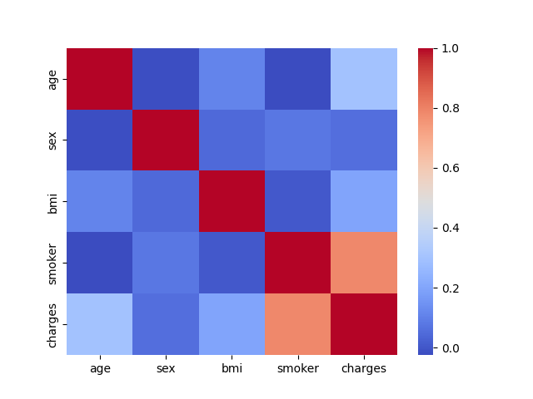
Some data analysis…
A strong correlation with smoking patients can be observed from the correlation matrix.
Starting from this result we decided to investigate this category in detail.
Notes:
Matteo
Correlazione = rapporto tra covarianza e prodotto tra le deviazioni standard. Varia tra [-1, 1]

Slide 4
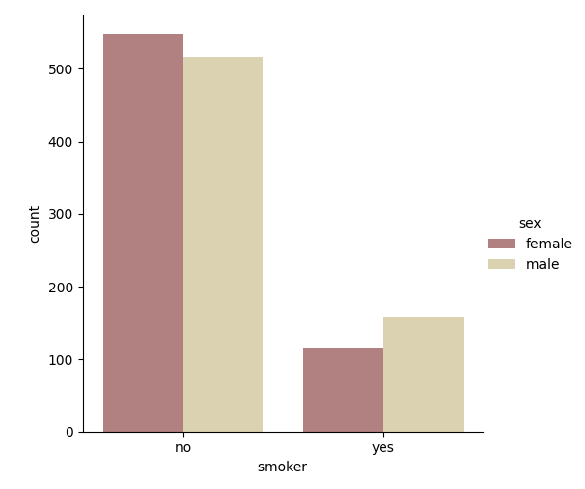
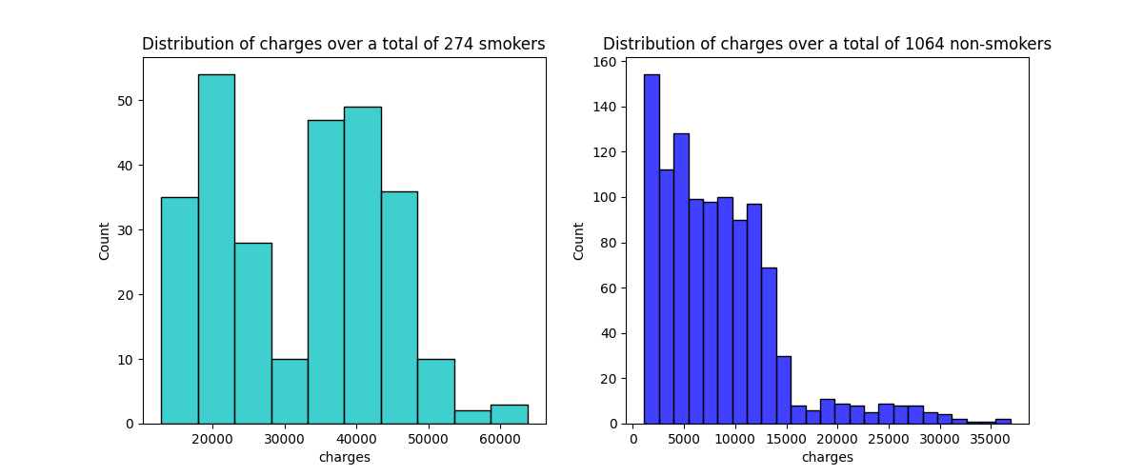
Smokers vs non smokers
On the right one, instead, we focus our analysis on the sex of the patients. We conclude that there are more male smokers.
the graph on the left shows that smokers spend more on treatment. In addition, the number of non-smoking people is greater.
Notes:
Matteo

Slide 5
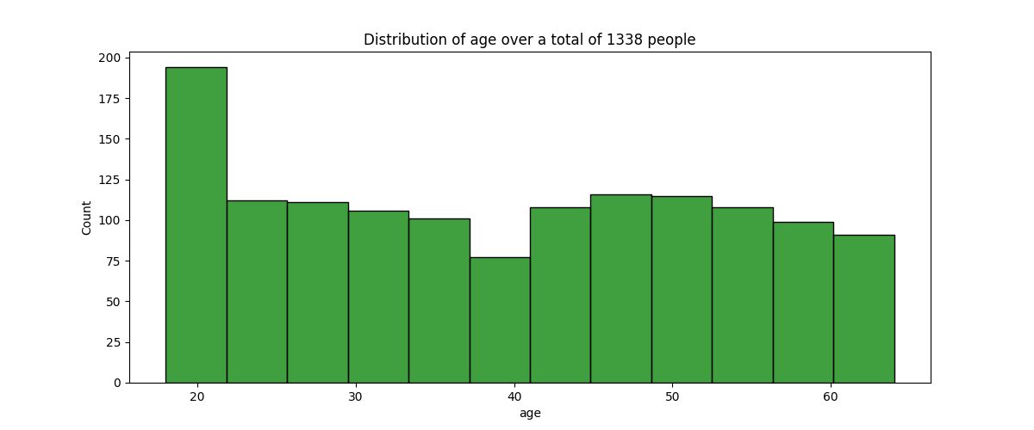
Distribution of age
Notes:
Matteo

Slide 6
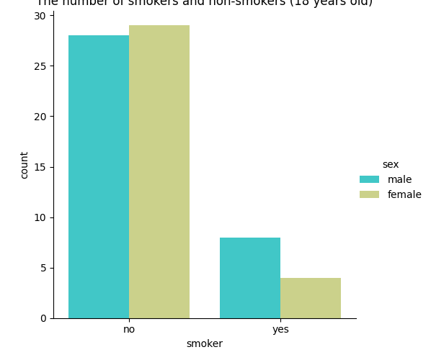
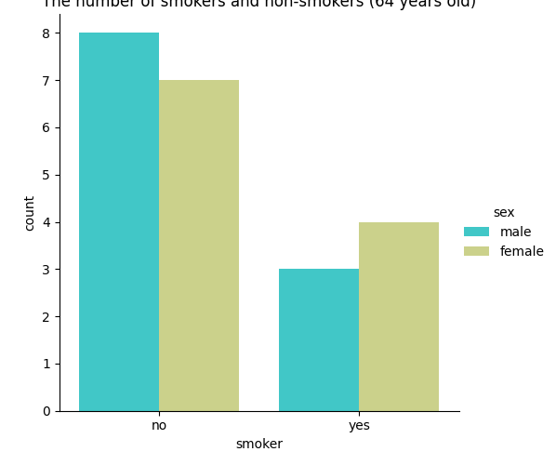
RELATION age-SMOKERS
The number of smokers and no-smokers (18 years-old)
The number of smokers and no-smokers (64 years-old)
Notes:
Matteo: Notare come fascia 18 anni + fumatori maschi mentre nel caso dei 64 anni + fumatrici femmine

Slide 7
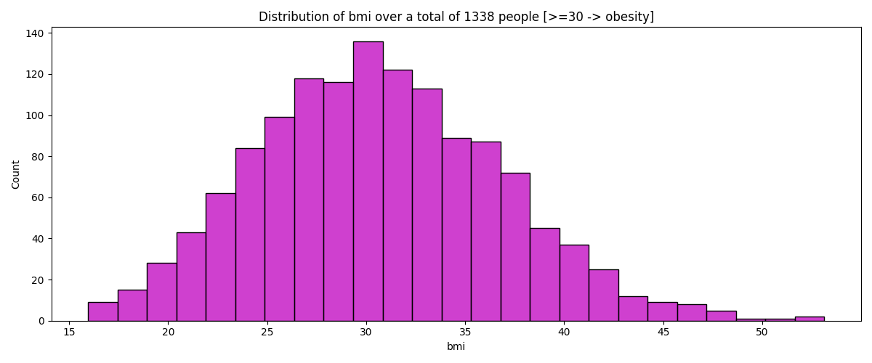
DISTRIBUTION OF BMI
Notes:
Davide: Notare come come ci sia il picco della distribuzione con il bmi =30

Slide 8
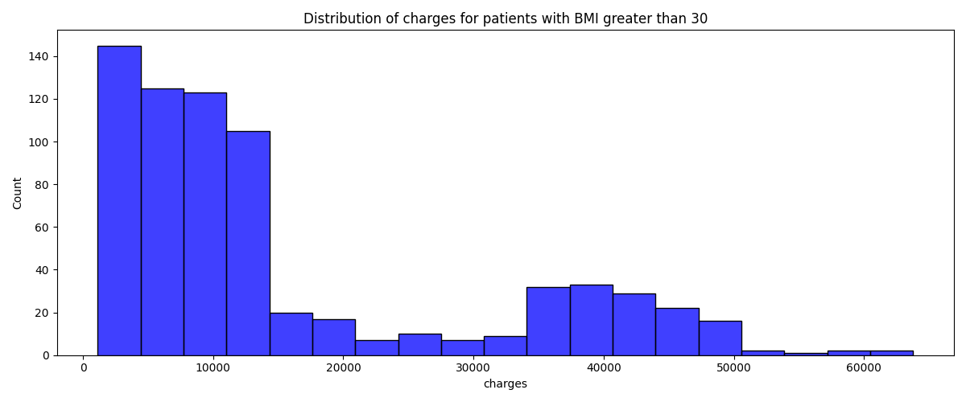
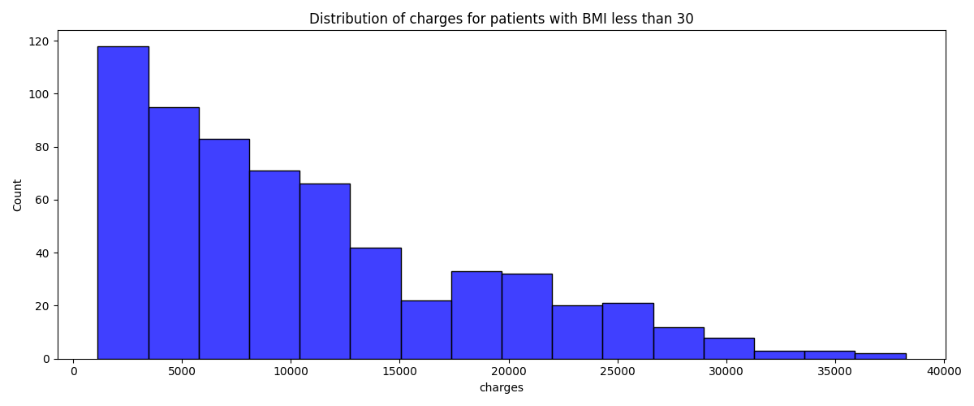
DISTRIBUTION OF BMI
Patients with BMI > 30 spends, on average, more on treatment with respect of non-obese
Notes:
Davide

Slide 9
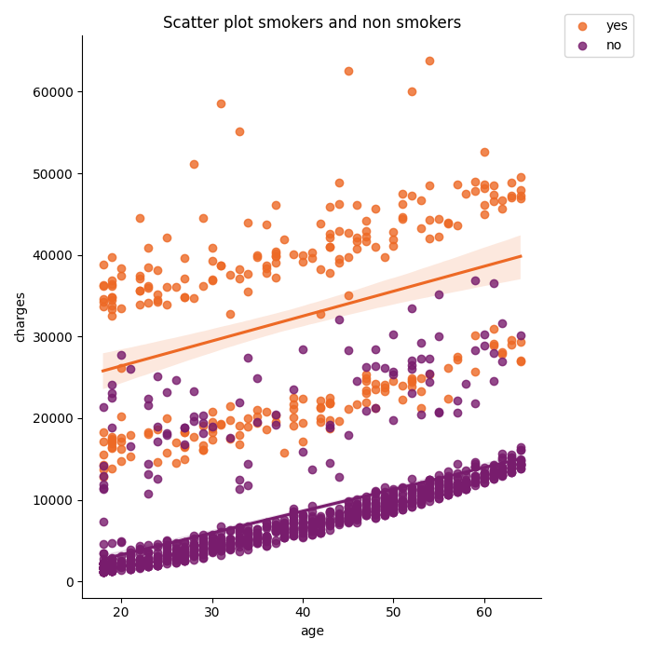
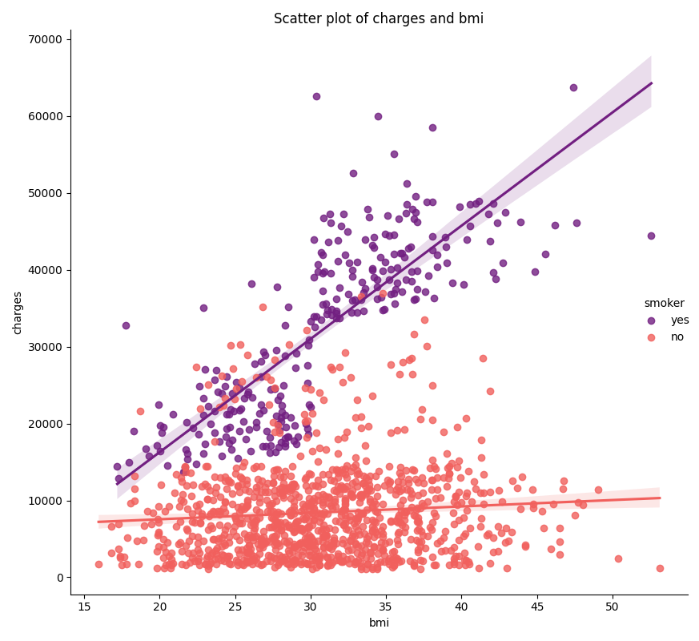
SCATTER PLOTS
As we saw earlier, non-smokers spend less on treatment
We can see that, from BMI > 30, the smokers spend much more on treatment
Notes:
Davide: In media i non fumatori, qualsiasi sia il loro BMI, spendono intorno ai 10000 (soprattutto fino ad un BMI intorno ai 35). Si vede invece che i fumatori, anche con un BMI basso, spendono di più. Questo dato si incrementa quando il BMI supera 30. Abbiamo deciso di inserire nello scatter plot tutto quello che abbiamo viso n precedenza

Slide 10
Algorithms used
We have decided to compare 4 different prediction algorithms, in particular:
Linear Regression;
Random Forest;
Support Vector Regression;
Kernel Ridge Regression.
For SVR and KRLS we used Cross Validation over the RBF kernel in order to select the best hyperparameters.
We compared the performance between the selected algorithms using three different metrics: the Mean Absolute Error, the Accuracy and the Execution time.
In our tests we also considered the column of smokers, but it’s possible to delete it.
The project is based on the Scikit Learn library.
Notes:
Davide: 10 fold-cross validation → 9 test e 1 validation

Slide 11
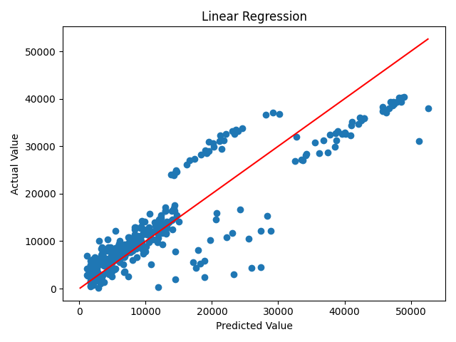
LINEAR REGRESSION
Accuracy (R²): 0.7923828990966664
MAE: 4003.4493625242053
Execution time: 0.0019 s
Notes:
Davide: R^2 (coefficiente di determinazione) parametro Accuracy → quanto è precisa la predizione effettuata R=1 → valori predetti = reali, R=0 valori predetti = media di tutti i valori di y, R < 0 =modello errato.

Slide 12
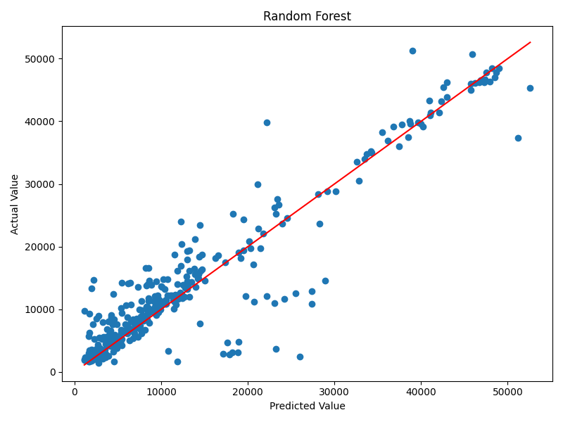
RANDOM FOREST
Accuracy (R²): : 0.8658287691470219
MAE: 2675.410844602352
Execution time: 0.2473 s
Number of trees in the forest = 100 (default value)
Notes:
Davide

Slide 13
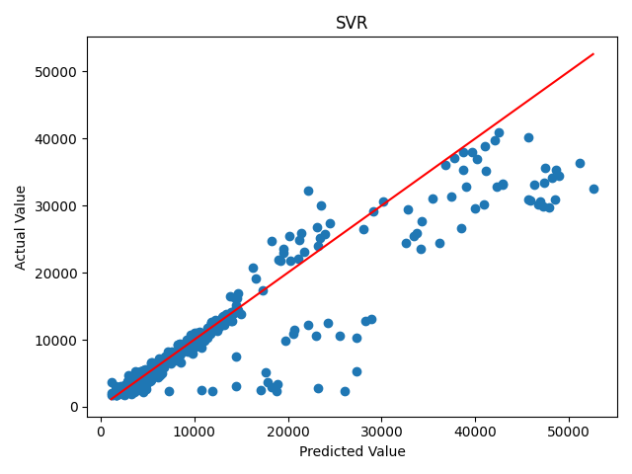
SUPPORT VECTOR REGRESSION
C = 1000.0, γ= 4.641588833612782, ε=0.1
Accuracy (R²): 0.8044116021616403
Model MAE: 2812.082926520215
Execution time: 90.4771 s
For the selection of C and γ we have choosen a logarithmic space between -4 and 3 (base 10), meanwhile for ε a value 0 or 0.1
Notes:
Matteo: Notare il tempo di esecuzione!!
gamma del kernel radial basis = exp(-gamma*||u-v||^2)
+alto -> soluz. + non lineare
- alto -> soluz. – non lineare
C: parametro regolarizzazione corrispondente ad alpha per KRLS
Epsilon: loss function |Yi – WiXi! <= epsilon

Slide 14
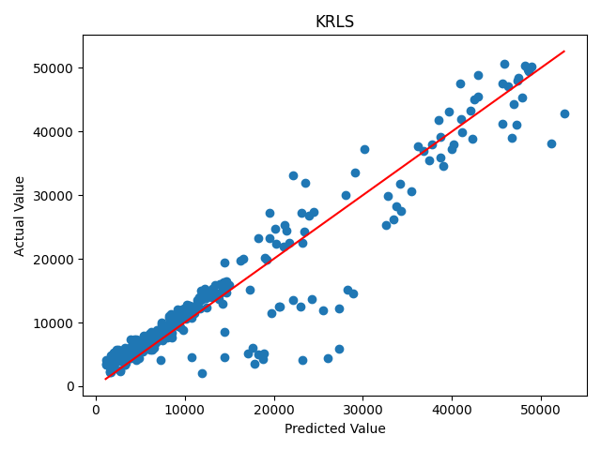
KERNEL RIDGE REGRESSION
α = 0.0005994842503189409, γ = 0.774263682681127
Accuracy (R²): 0.8875784071189448
Model MAE: 2642.995709687133
Execution time: 32.4135 s
For the selection of α and γ we have choosen a logarithmic space between -4 and 3 (base 10)
Notes:
Matteo
Alpha: parametro di regolarizzazione = (Q+lambda*I)^-1*Y
Gamma: sempre radial basis
Lambda: di alpha, regola complessità soluzione
grande -> + lineare
piccola -> - lineare
Loss: square loss (y-f(a))^2

Slide 15
CONCLUSION
By comparing the values of the different algorithms considered we can see that the KRLS has the best accuracy.
The accuracy value ~ 0.89 indicates that the distance between the predicted and real values is small.
For our analisys we have also considered MAE, execution time and scatter plot as parameters.
In conclusion, all this metrics confirms that KRLS is the best one, not only in a quantitative terms, but also qualitative.
Finally, we decided to predict medical cost values also for specific categories which are smokers, non smokers, bmi >= 30 and bmi < 30.
As expected, the considerations made during the data analisys are confirmed.
Notes:
Matteo: L’algoritmo più lento è svr (più di 1 minuto e mezzo!!), il più veloce (ovviamente) linear regression e il più preciso KRLS.
Ricordo R^2 (coefficiente di determinazione) parametro Accuracy

