Slide 1
CI-CD Practices with the TANGO-controls framework in the context of the Square Kilometre Array (SKA) Telescope Project
Matteo Di Carlo (INAF-OAAB)
Yilmaz U., Harding P., Bartolini M., Le Roux G., Dolci M.

Slide 2
SKA Project
International effort to build two radio interferometers in South Africa and Australia
One Observatory monitored and controlled from the global headquarters (GHQ) based in the United Kingdom at Jodrell Bank
Agile development process is Agile
Mainly incremental and iterative
Specialized team (known as system team) devoted to support the continuous Integration, test automation and continuous Deployment.

Slide 3
Why CI-CD?
When many parts of the project are developed independently for a long period of time (weeks or longer),
Code base and build environments diverges
When changes are integrated
Weeks in verifying that everything works
Developers spend time in solving bugs introduced months earlier

Slide 4
Continuous integration
Set of development practices that requires developers to integrate code into a shared repository several times a day.
Each check-in is then verified by an automated build, allowing teams to detect problems early.

Slide 5
The practices
Single source repository (for each component of the system)
minimize the use of branching
Automate the build (build all in one command)
Automate testing (together with the build)
Every commit should build on an integration machine
Commit often! (at least once per day)
the smaller is the change the easier is the fix
Build fast (so that a problem in integration can be found quickly)
Multi-stage deployment: every build software must be tested in different environments
Ref: martinfowler.com/articles/continuousIntegration.html

Slide 6
Delivery vs Deployment
Continuous delivery
Automate the delivery of new releases of software
Deployment has to be predictable and sustainable
The code must be in a deployable state
Testing needs to cover enough of your codebase.
Continuous deployment
One step further: every single commit to the software that passes all the stages of the build and test pipeline is deployed into the production environment

Slide 7
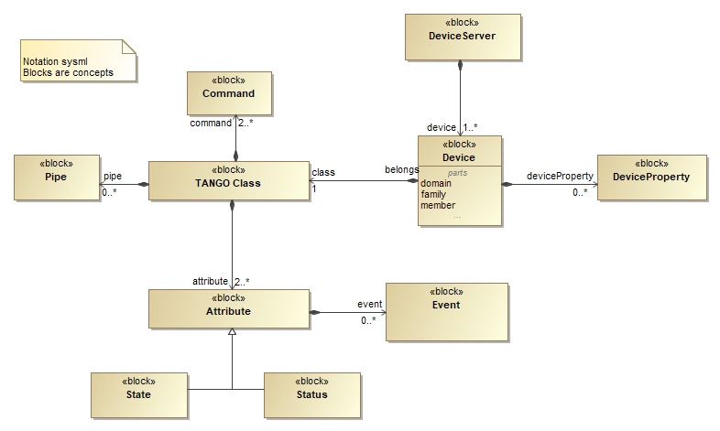
TANGO-controls framework
The TANGO –controls comes with a number of tools and services which can be deployed as a conteinerized application (SKA-docker project)
Ref: www.tango-controls.org

Slide 8
Containerization
SKA can be seen as a set of elements which can be seen as a set software modules (for each module, there is one repository)
For each module there is one docker image
standard unit of software that packages up code and all its dependencies so the component runs quickly and reliably across different computing environments
Containerized environment
Kubernetes (k8s) for container orchestration (kubernetes.io)
Helm for packaging k8s applications (helm.sh)

Slide 9
Kubernetes and Helm
Helm is a tool for managing Kubernetes charts
Chart is a package of pre-configured Kubernetes resources (set of information necessary to create an instance of a Kubernetes application)
Each component of the system can be deployed (run) with an helm chart

Slide 10
SKA MVP Product Integration (SKAMPI)
Main effort to integrate the components from the different SKA elements with each other
OET
Tango-base
KEY
TMC
Depends-on
Archiver
Helm Chart
CSP
Dish
SDP
Webjive

Slide 11
In Helm - Subcharts architecture
OET
Tango-base
Tango-base
UMBRELLA
For every repository, there is an umbrella chart for integration testing
TMC
UMBRELLA
Archiver
TMC
UMBRELLA
Archiver
Webjive
CSP
CSP
SDP
Dish
SDP

Slide 12
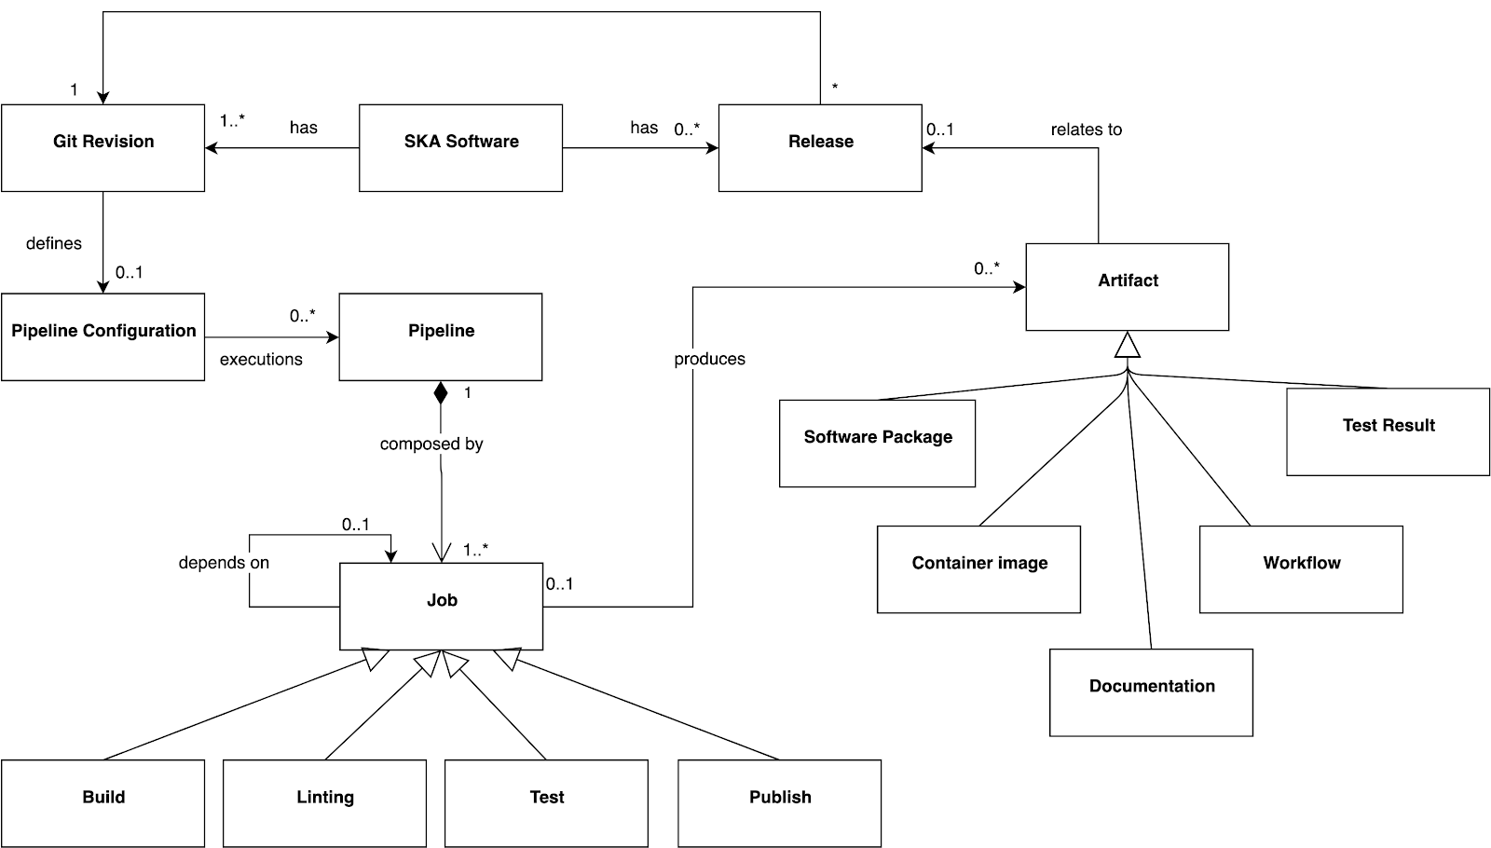
Gitlab pipeline model

Slide 13
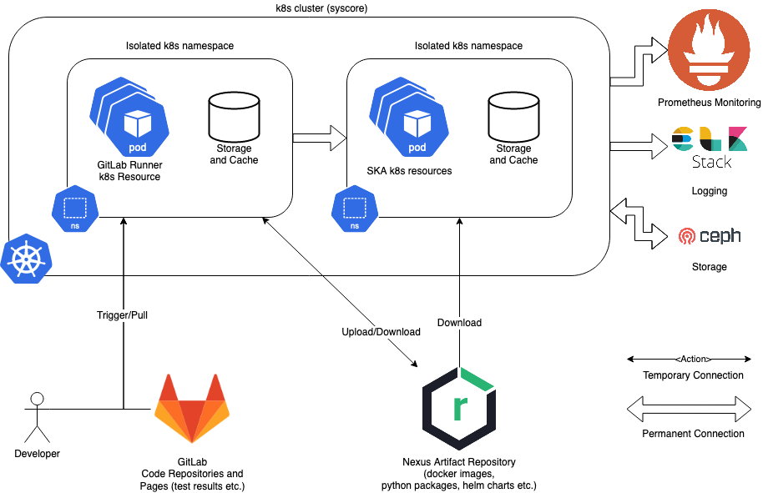
Gitlab pipeline – run-time

Slide 14
Deployment and Testing
For each repo and for each commit (!):
Pre-deployment tests: made without the real system to be online
Post-deployment tests
installs the chart (with the sub-charts needed) in an isolated namespace
wait for every container to be running
For the tests:
Create a k8s pod in the isolated namespace
Run pytests inside the above pod
Return the tests results

Slide 15
Conclusion
Every commit deploys in a isolated and dedicated environment
One component-one repository
short lived use of branching
Makefile: build and test of each component in one command
Every commit triggers a build, a deployment and run tests
Test Artifacts in gitlab for each pipeline run
Other artifacts available on nexus (docker images, helm charts, python modules, etc.)
Integration environment is accessible for every developer in every repository

Slide 16
Thanks

Slide 17
Gitlab pipeline – run-time
GitLab Source-Code repository
Gitlab page
(Tests artifacts)
Nexus
(docker images, python packages, other packages)
Testing happens in each namespace
every 30 seconds
Umbrella chart
Umbrella chart
Umbrella chart
SKA k8s resources
Umbrella chart
Umbrella chart
GitLab Runner k8s resources
SKA k8s resources
Umbrella chart
SKA k8s resources
Isolated namespace
Isolated namespace
Isolated namespace
Isolated namespace
Elasticsearch
Makefile for the automation of the deployment and testing
K8s-cluster

