Slide 1
Quantum Search algorithm
And Quantum Oracles

Slide 2
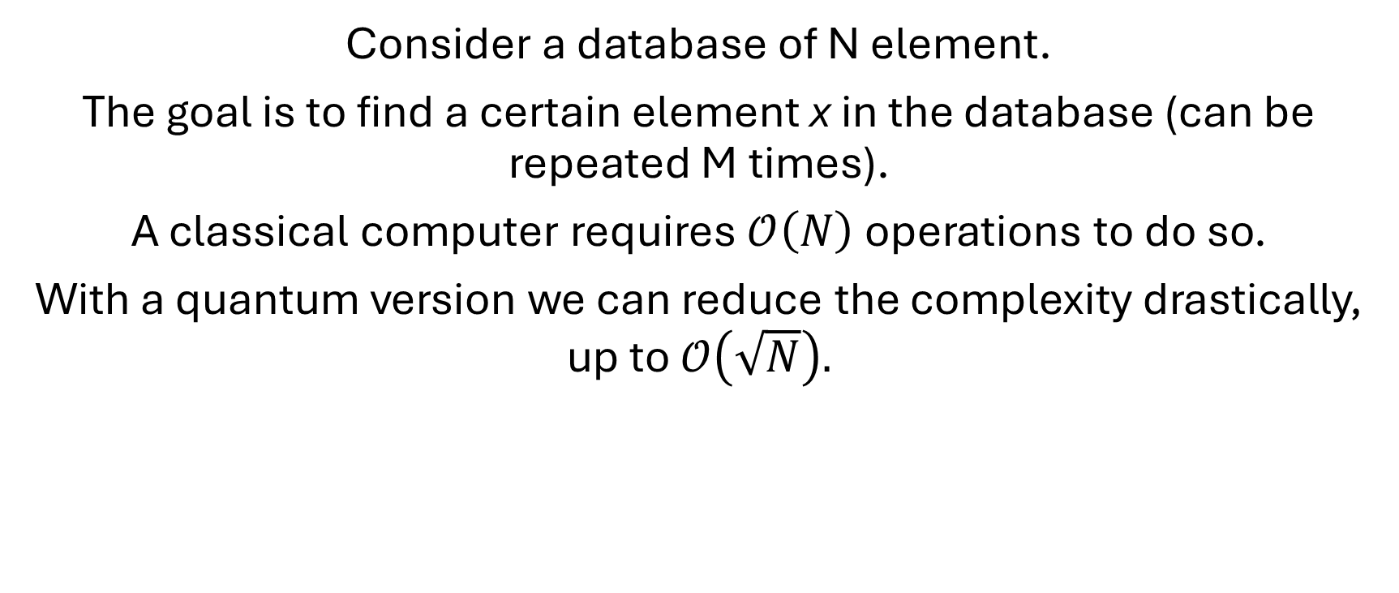
The problem
Consider a database of N element.
The goal is to find a certain element x in the database (can be repeated M times).
A classical computer requires $𝒪\left(N\right)$ operations to do so.
With a quantum version we can reduce the complexity drastically, up to $𝒪\left(\sqrt{N}\right).$

Slide 3

Follow me and try yourself!

Slide 4
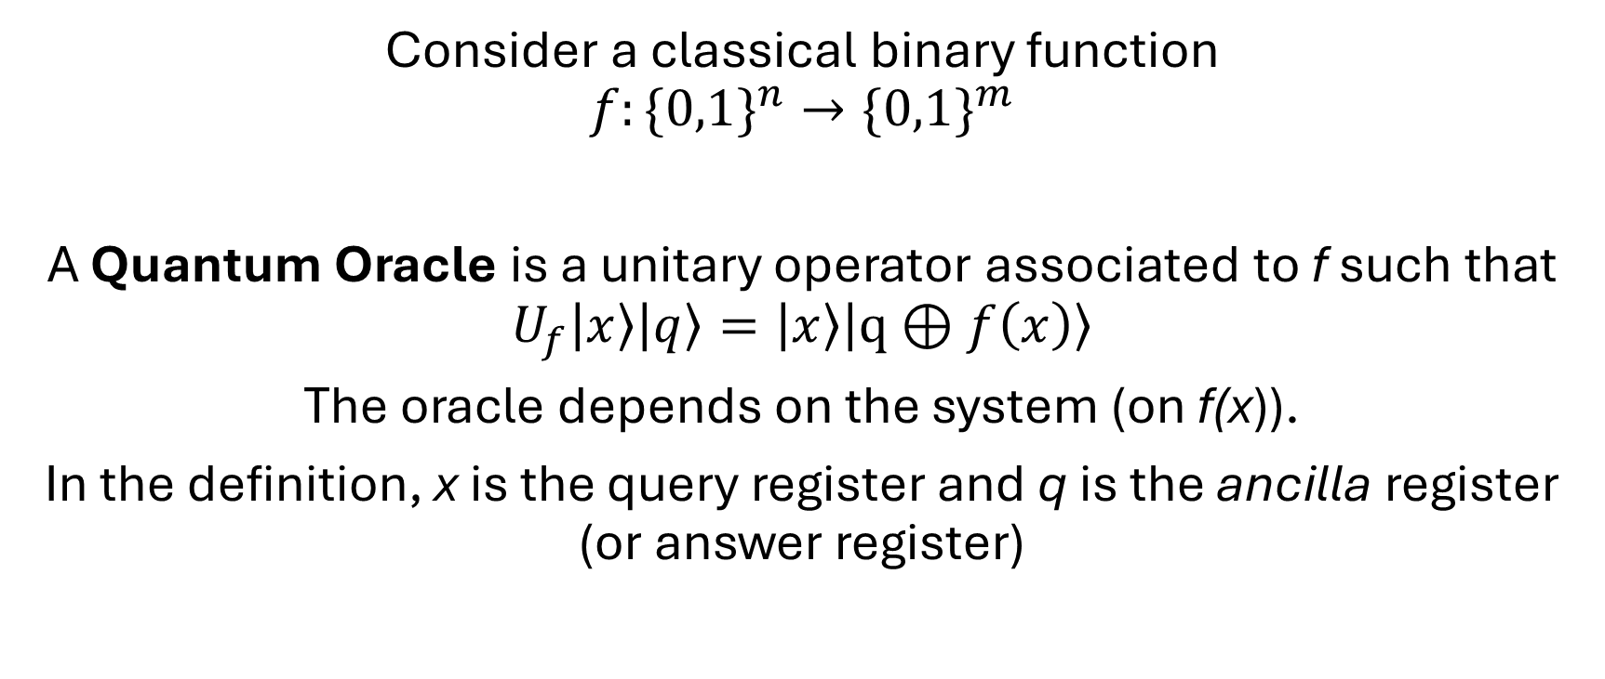
Quantum Oracles
Consider a classical binary function
$$f:\{0,1\}^{n}→\{0,1\}^{m}$$
A Quantum Oracle is a unitary operator associated to f such that
$$U_{f}\left|x\right\rangle \left|q\right\rangle =\left|x\right\rangle \left|q⊕f\left(x\right)\right\rangle$$
The oracle depends on the system (on f(x)).
In the definition, x is the query register and q is the ancilla register (or answer register)

Slide 5
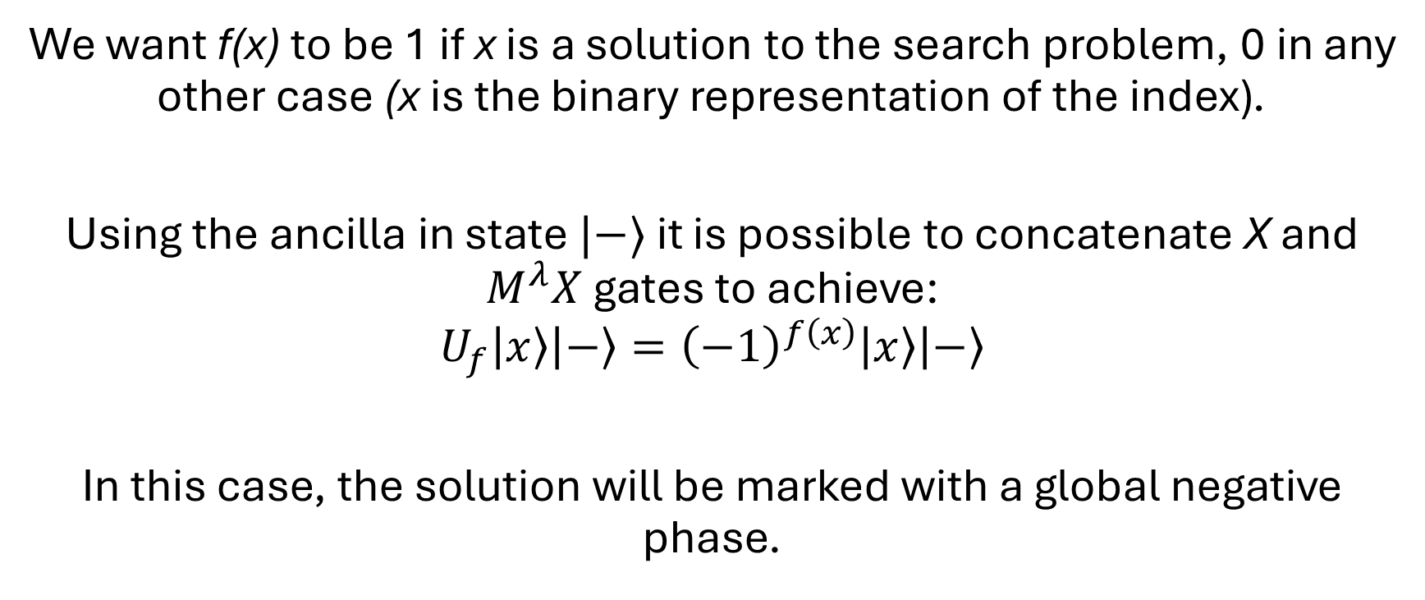
Grover Oracle
We want f(x) to be 1 if x is a solution to the search problem, 0 in any other case (x is the binary representation of the index).
Using the ancilla in state $|−〉$ it is possible to concatenate X and $M^{λ}X$ gates to achieve:
$$U_{f}\left|x\right\rangle \left|−\right\rangle ={\left(−1\right)}^{f\left(x\right)}\left|x\right\rangle \left|−\right\rangle$$
In this case, the solution will be marked with a global negative phase.

Slide 6
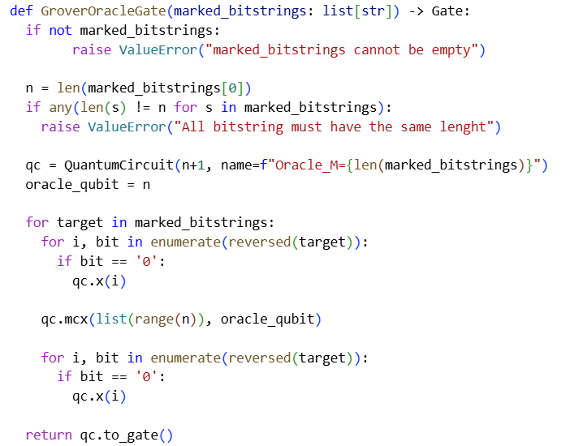
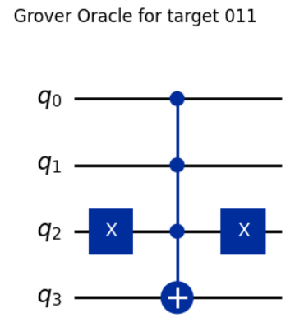
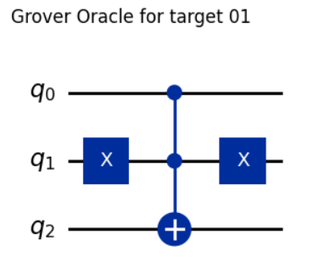
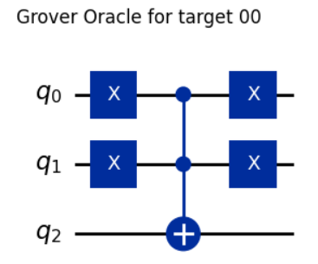
Grover Oracle - Implementation

Slide 7
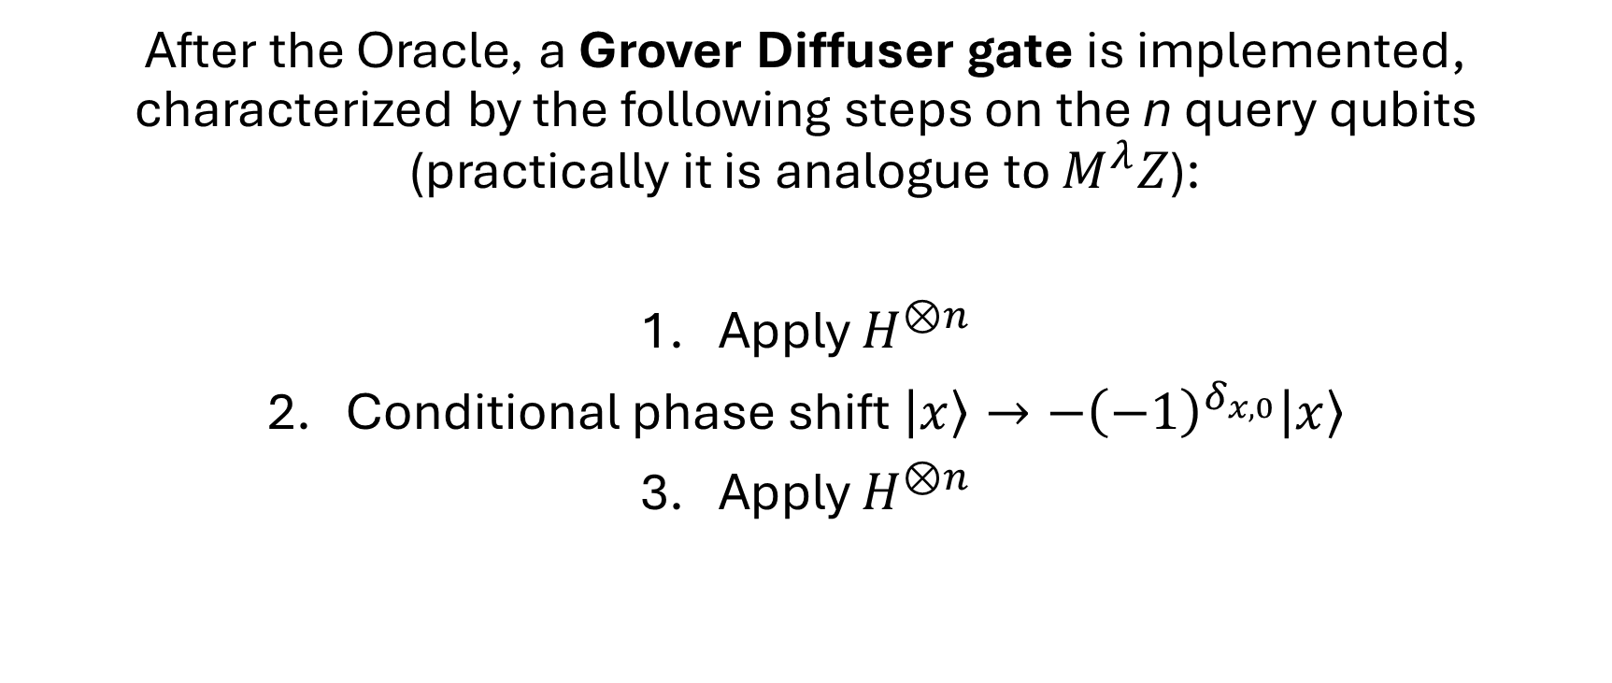
Grover Diffuser
After the Oracle, a Grover Diffuser gate is implemented, characterized by the following steps on the n query qubits (practically it is analogue to $M^{λ}Z$):
Apply $H^{⊗n}$
Conditional phase shift $\left|x\right\rangle →−{\left(−1\right)}^{δ_{x,0}}\left|x\right\rangle$
Apply $H^{⊗n}$

Slide 8
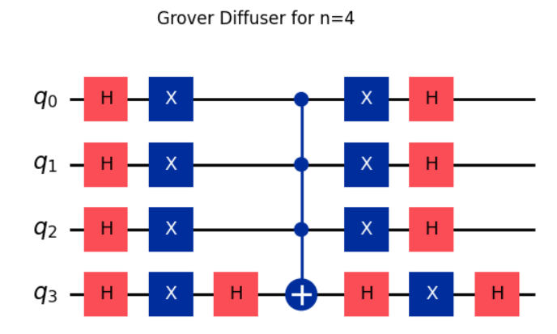
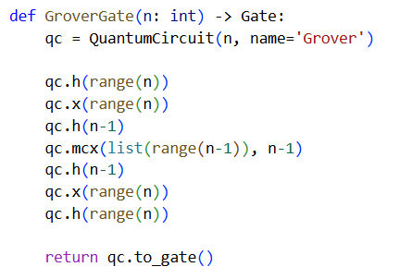
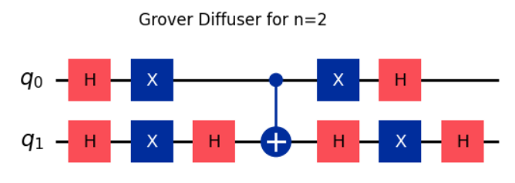
Grover Diffuser - Implementation

Slide 9
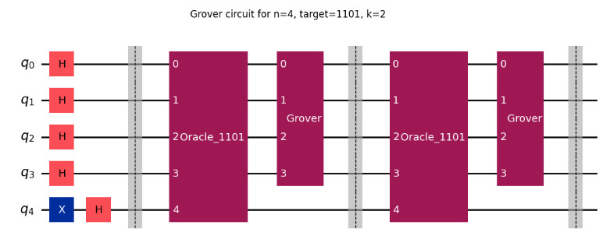

Grover Algorithm
Start with ${\left|0\right\rangle }^{⊗n+1}$, apply X to the ancilla, then $H^{⊗n+1}$
The whole algorithm then consists in the concatenation of the Oracle and the Diffuser, performed for k times.

Slide 10
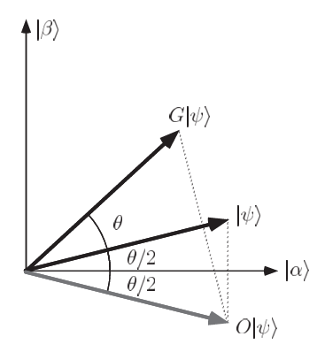
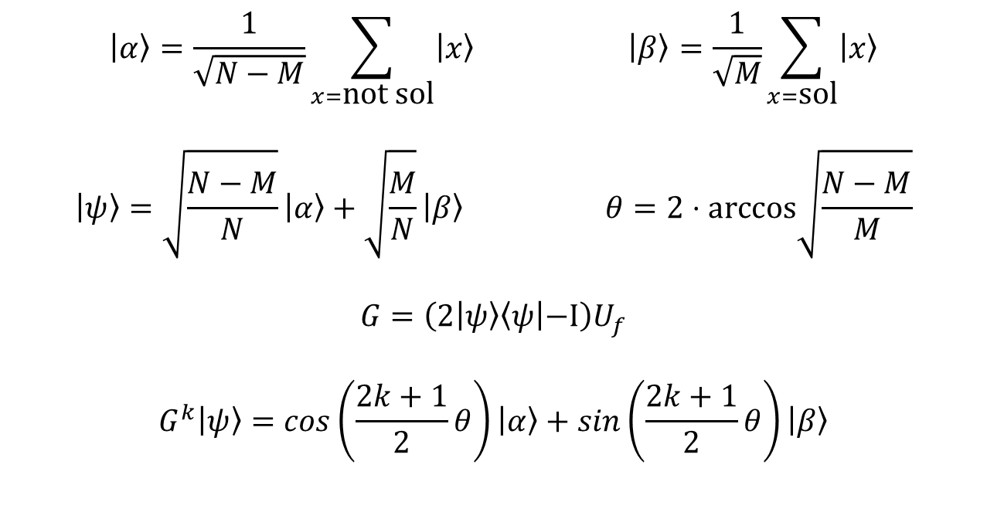

Grover Algorithm – Geometric interpretation
Apply the Grover gate can be seen as a 2D rotation of angle $θ$ in the solution/non-solution plane.
$$\left|α\right\rangle =\frac{1}{\sqrt{N−M}}\sum_{x=\text{not} \text{sol}}{\left|x\right\rangle } \left|β\right\rangle =\frac{1}{\sqrt{M}}\sum_{x=\text{sol}}{\left|x\right\rangle }$$
$$\left|ψ\right\rangle =\sqrt{\frac{N−M}{N}}\left|α\right\rangle +\sqrt{\frac{M}{N}}\left|β\right\rangle θ=2⋅\text{arccos}\sqrt{\frac{N−M}{M}}$$
$$G=\left(2 | ψ\right\rangle \left\langle ψ | −I\right)U_{f}$$
$$G^{k}\left|ψ\right\rangle =cos\left(\frac{2k+1}{2}θ\right)\left|α\right\rangle +sin\left(\frac{2k+1}{2}θ\right)\left|β\right\rangle$$

Slide 11
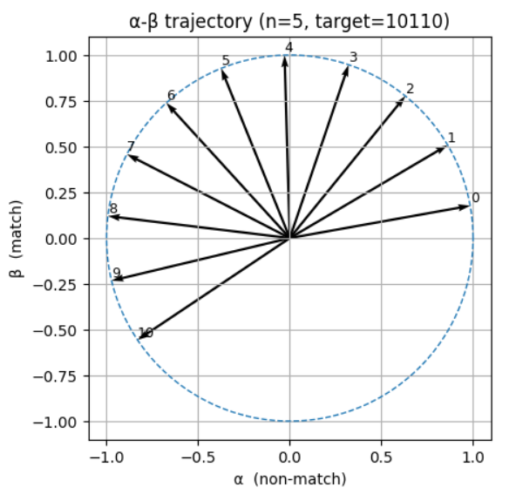
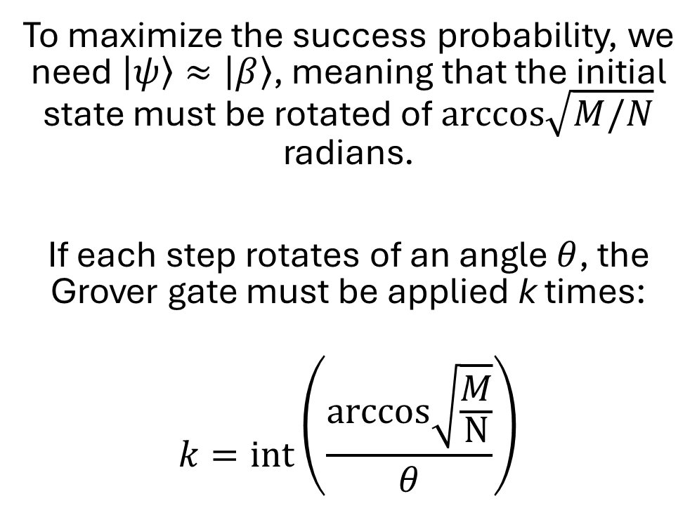
How many times?
To maximize the success probability, we need $\left|ψ\right\rangle ≈\left|β\right\rangle$, meaning that the initial state must be rotated of $\text{arccos}\sqrt{M/N}$ radians.
If each step rotates of an angle $θ$, the Grover gate must be applied k times:
$$k=\text{int}\left(\frac{\text{arccos}\sqrt{\frac{M}{N}}}{θ}\right)$$

Slide 12
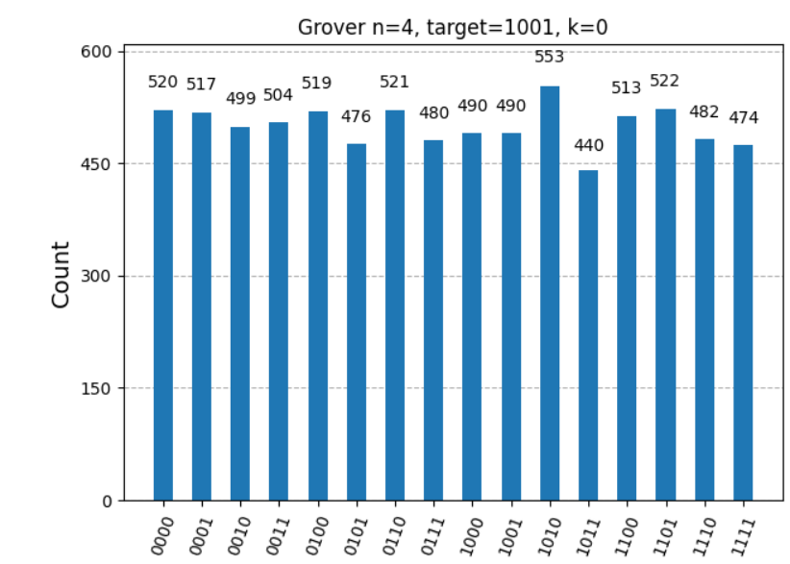
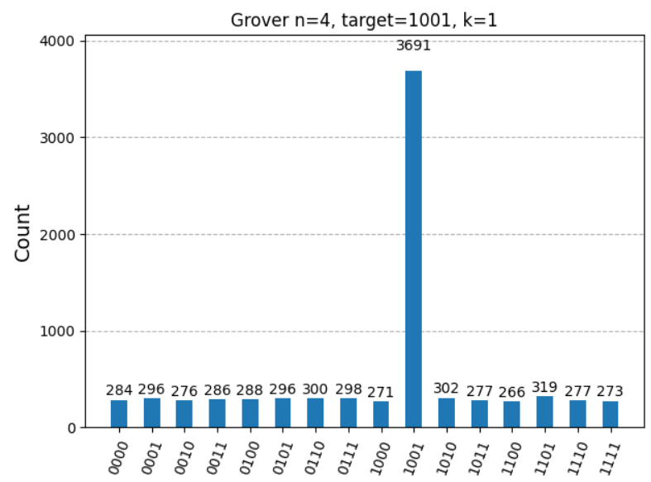
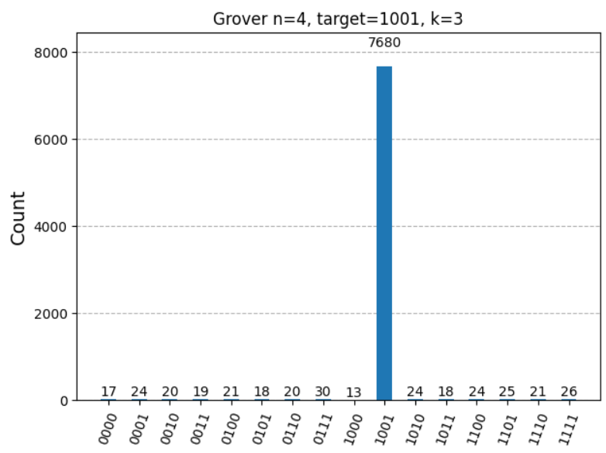
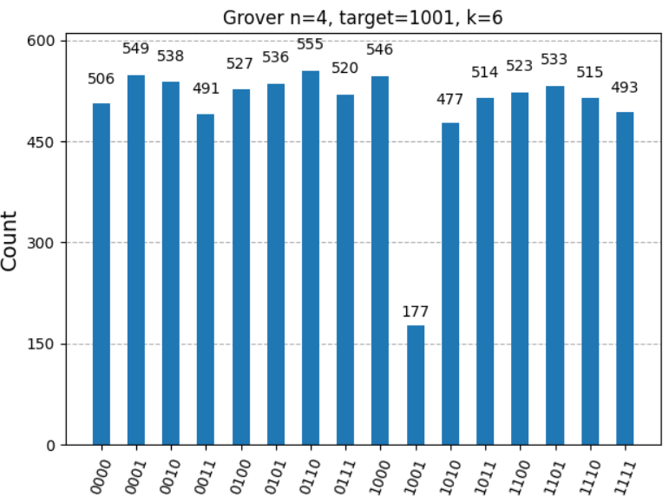
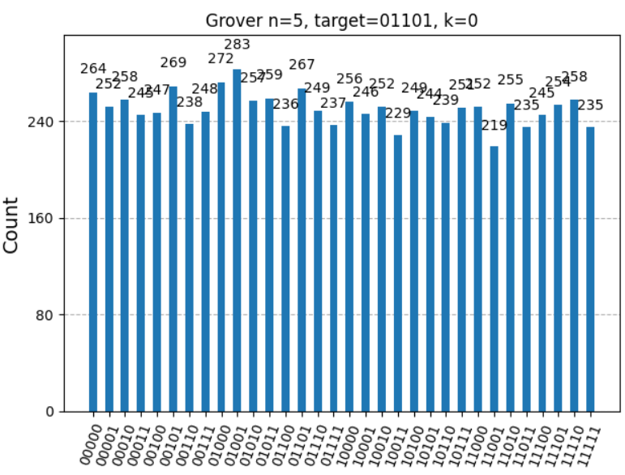
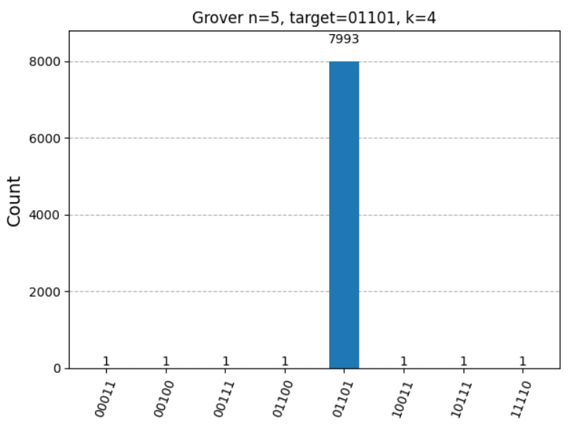
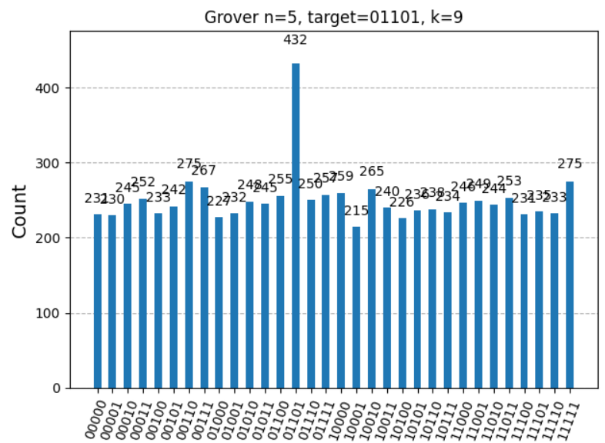
Results – correct picks VS k

Slide 13
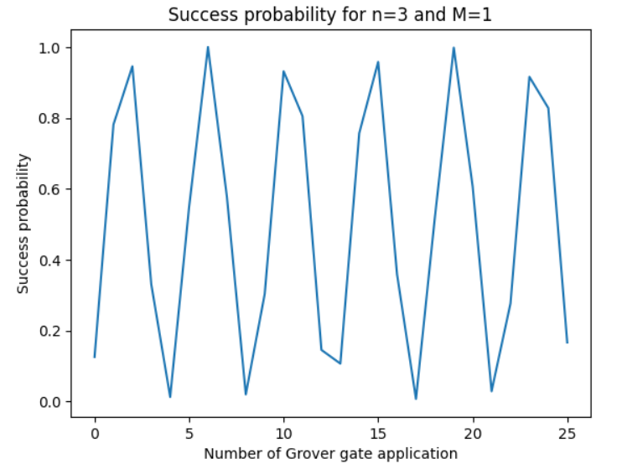
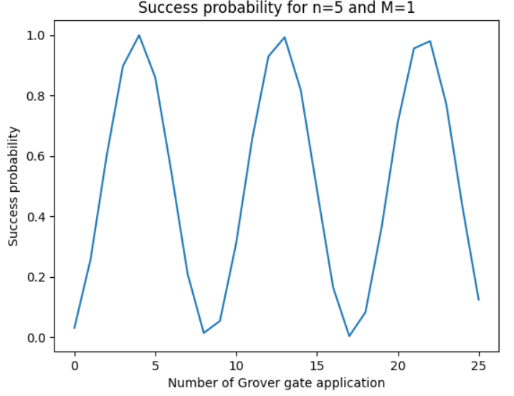
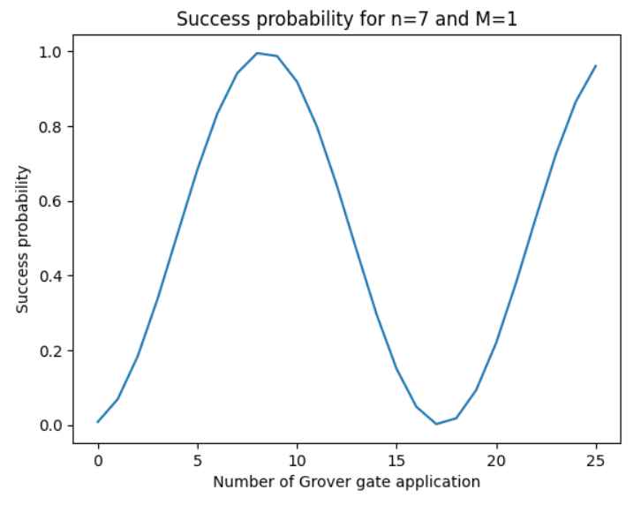
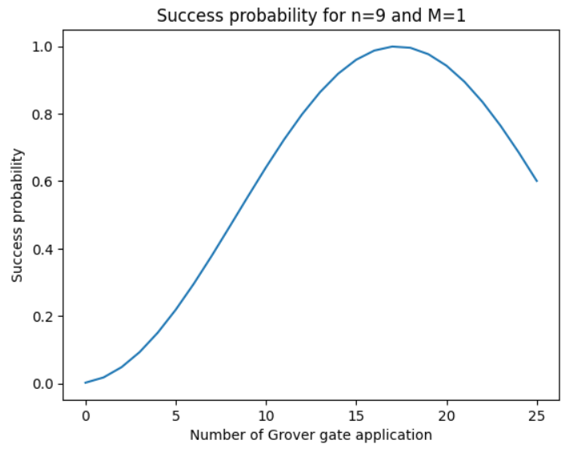
Results – success VS k

Slide 14
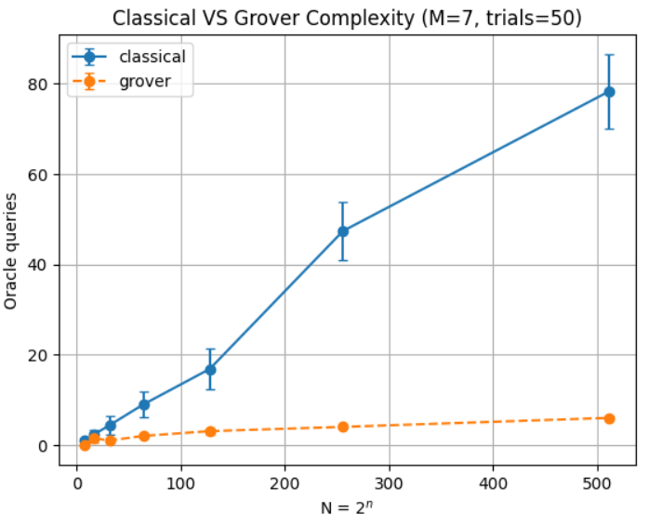
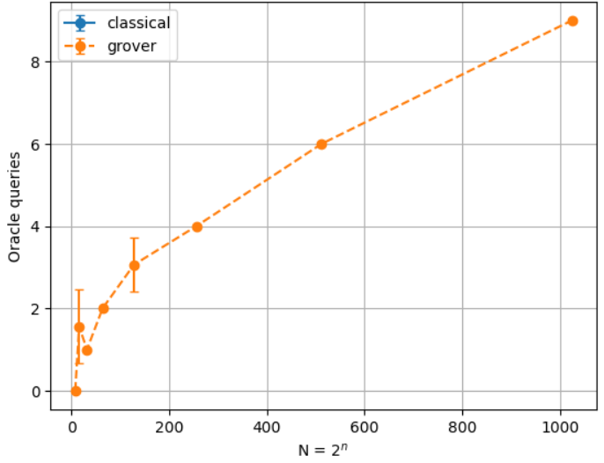
Results – complexity

Slide 15
Thanks for the attention!

Slide 16
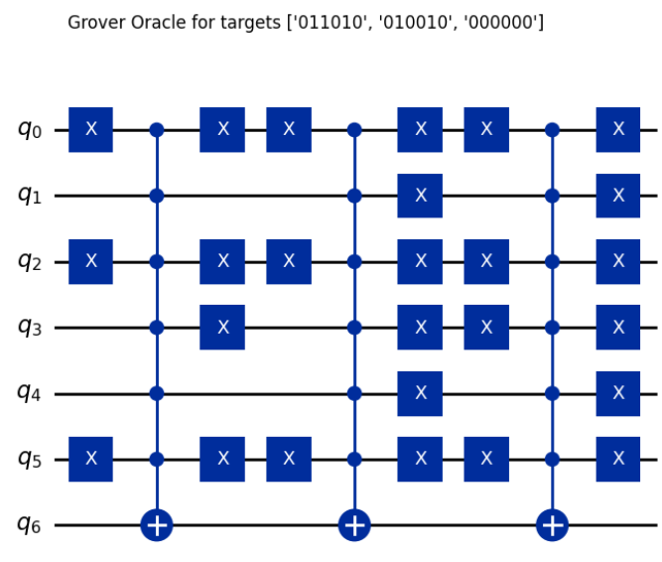
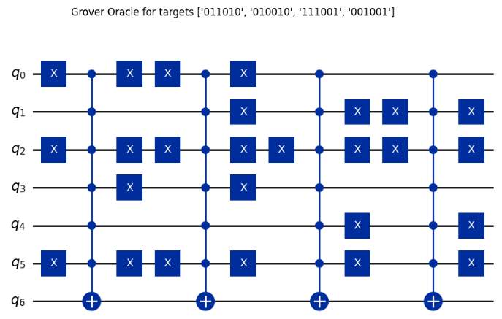
Backup

