Slide 1

SABD Project #1
Macroarea di Ingegneria
Dipartimento di Ingegneria Civile e Ingegneria Informatica
A comparative Analysis of Carbon Intensity and Carbon-Free Energy in Italy and Sweden (2021- 2024) Using Apache Spark
Corso di Sistemi e Architetture per Big Data
Laurea Magistrale in Ingegneria Informatica
A.A. 2024/25
Matteo Basili, Adriano Trani

Slide 2
Outline
Goals
Introduction & Background
Overview
Data Acquisition and Ingestion (NiFi)
Implementation of Queries (Spark)
Export of the Results (HDFS → Redis)
Charts Creation (Grafana)
Results, Performance Analysis and Discussion
Demo

Slide 3
Goals
Analyze carbon intensity and carbon-free energy share in Italy and Sweden (2021–2024) using ElectricityMaps data
Develop a distributed Big Data pipeline to:
Retrieve, process, and analyze data
Answer specific queries
Export results and generate charts
Measure execution time for each query in a controlled environment
Present and discuss the results of the analysis

Slide 4
Queries
Q1 – Yearly Aggregation by Country
Compute the average, minimum, and maximum values of:
Carbon intensity
Carbon-free energy share (CFE%)
Comparison between Italy and Sweden with visual plots
Q2 – Monthly Aggregation for Italy
Identify the top 5 and bottom 5 months for each metric (carbon intensity and CFE%)
Display monthly trends through visualizations
Q3 – 24-Hour Aggregation
For both countries, compute:
Minimum, 25th percentile, median (50th), 75th percentile, and maximum for carbon intensity and CFE%
Show hourly comparisons using charts

Slide 5
Introduction & Background
The term carbon intensity describes the amount of greenhouse gases emitted per unit of electricity load
It's expressed as grams of CO₂ equivalent per kilowatt hour (gCO₂eq/kWh)
The term carbon-free energy represents the percentage of electricity available on a grid from low or zero carbon emission sources
Wind
Hydro
Geothermal
Biomass
Nuclear energy

Slide 6
Overview - Technology Stack
Docker & Docker Compose: Containerization of the entire system
Apache Spark: Processing the data
HDFS: Distributed data storage
Apache NiFi: Data acquisition and ingestion
Redis: Exporting the results of the queries
Grafana: Charts maker
Python: Main programming language

Slide 7
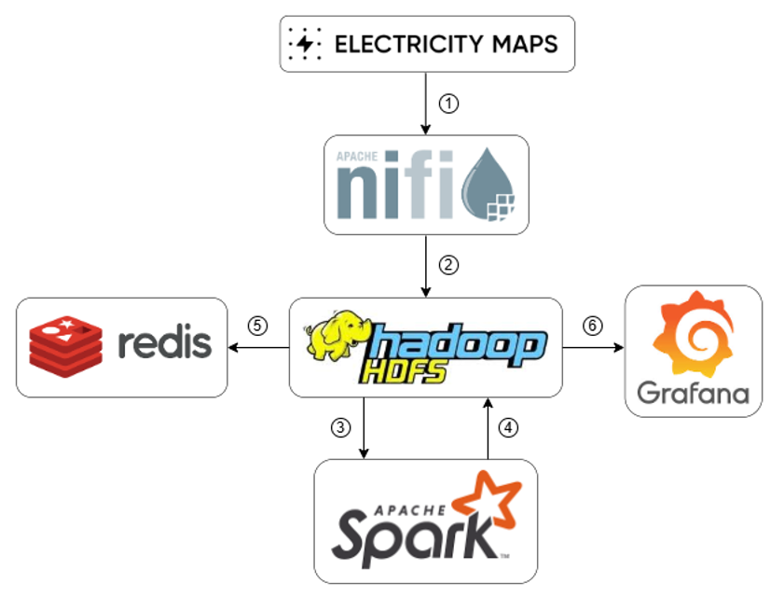
Overview - Architecture

Slide 8
Overview - DataFlow
Hourly CSV files are retrieved from Electricity Maps via API
NiFi preprocesses the data and loads both CSV and Parquet formats into HDFS
Spark reads the data from HDFS and executes processing
Query results are written back to HDFS in CSV format
Aggregated results are exported to Redis for fast access
Grafana reads the data (CSV format) and creates charts

Slide 9
Overview - Docker Containers
The system is fully containerized with Docker and orchestrated using Docker Compose
HDFS: namenode, datanode1, datanode2
NiFi: nifi
Spark: spark-master, spark-worker-1, spark-worker-2
Redis: redis, results_exporter
Grafana: grafana, grafana-image-render

Slide 10
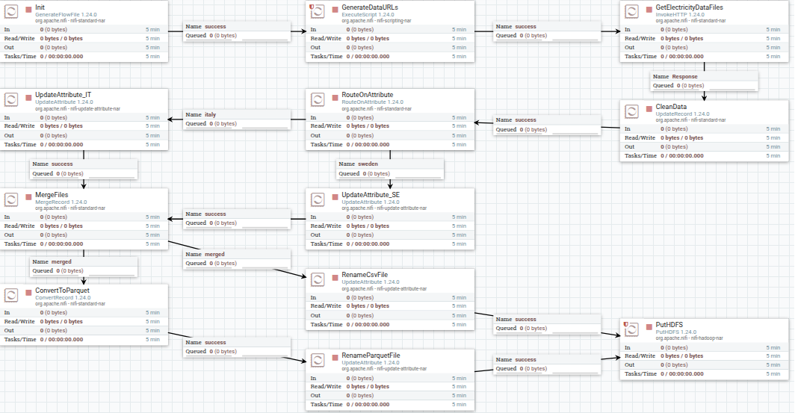
NiFi - Data Acquisition and Ingestion

Slide 11
Implementation
The analytical queries have been implemented using three different Spark programming interfaces
RDD API
CSV input format
DataFrame API
Parquet input format
SQL
Parquet input format

Slide 12
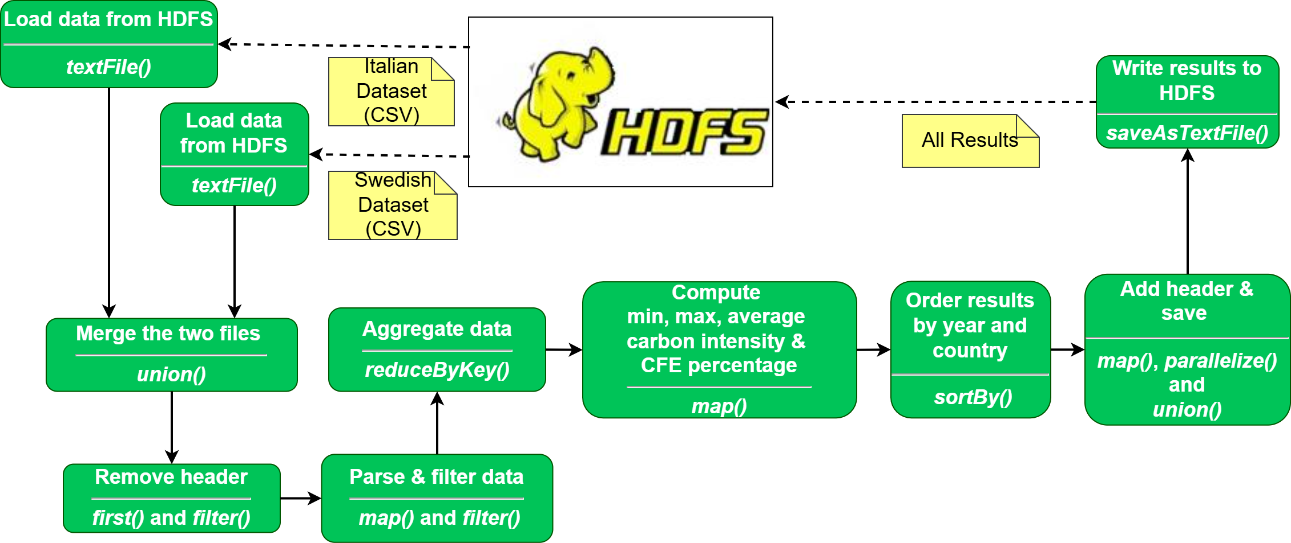
Implementation – Q1 (RDD Version)

Slide 13
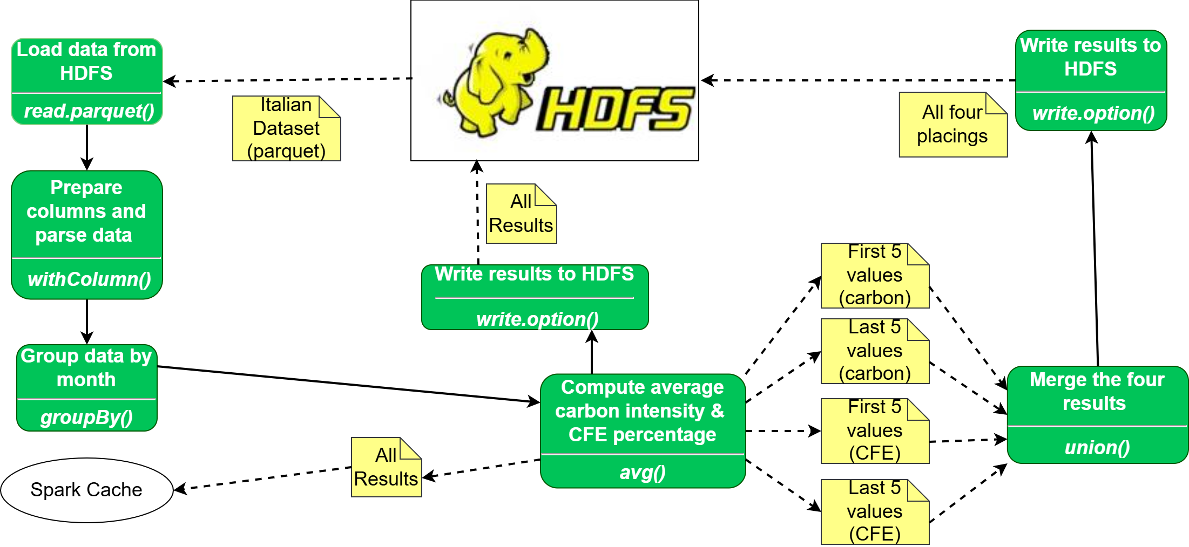
Implementation – Q2 (DataFrame version)

Slide 14
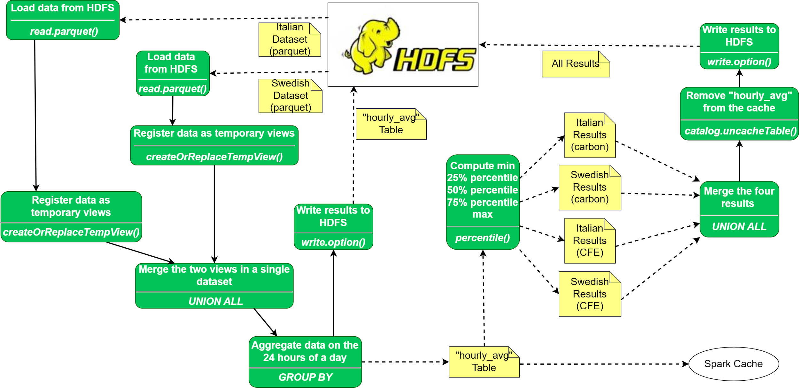
Implementation – Q3 (SQL version)

Slide 15
Export – HDFS & Redis
Results are written directly to HDFS
Each output is saved under the /output/ directory with a unique timestamp to distinguish different runs
The data is written as a CSV file that includes a header row
Spark automatically handles partitioning internally
Output files are filtered and read with streaming
Every line is parsed
Headers ignored, rows splitted, fields validated, keys builded
Q1 - key: Q1:<country>:<year>
Q2 - key: Q2:IT<order_type>:<rank>
Q3 - key: Q3:<country>:<metric>
Use a non-transactional pipeline for batch writing to Redis
export_q*_hdfs_to_redis.py scripts

Slide 16
Grafana
create_q*_plots.py scripts
Create the CSV Data Source
Grafana API and marcusolsson-csv-datasource plugin
Create the Dashboard and Panel using the API
Save the dashboard using Selenium
Use Grafana's render service to export panel images as PNGs
Save them in the Results/images directory

Slide 17
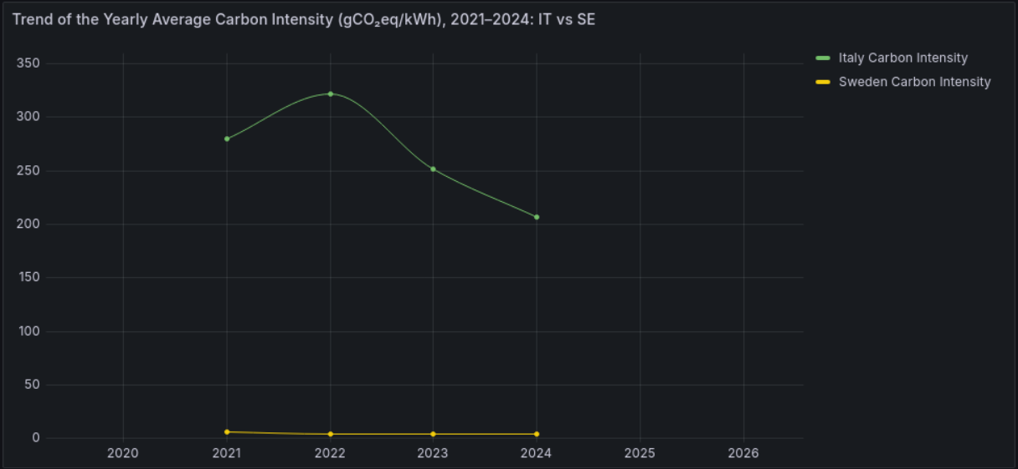
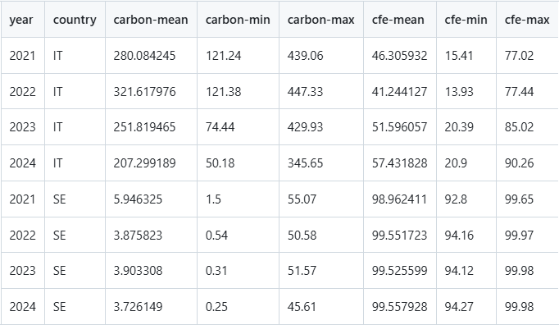
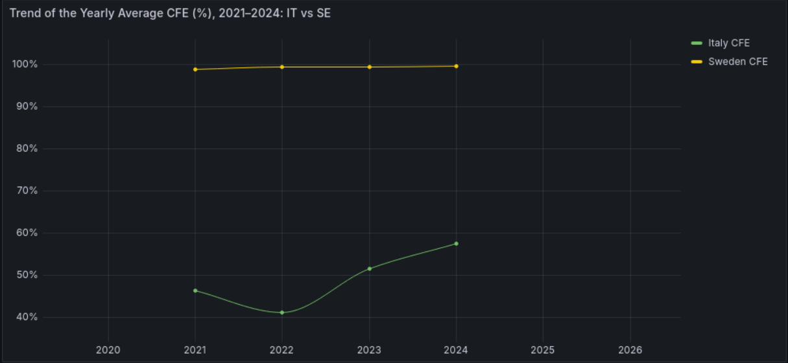
Results
For example

Slide 18
Performance Analysis – Setup
Spark Cluster (default) Configuration:
Executors: 2 (1 per worker node)
Cores per Executor: 2 (total 4 vCPUs)
Memory: ~1 GB per executor and driver
Partitioning: Based on HDFS block size (128 MB)
Deploy Mode: Client mode (driver on spark-master)

Slide 19
Performance Analysis – Execution Logic
run_query_isolated.py script
10 runs
Ensures cold-start conditions (no cache interference)
Execution time measured before and after job
Compute mean & standard deviation
Results saved to Results/analysis/ folder

Slide 20
Performance Analysis – Results
Q1 | Average | Standard Deviation
RDD | 42.12 seconds | 3.05 seconds
DataFrame | 52.45 seconds | 11.07 seconds
SQL | 49.04 seconds | 0.73 seconds
Q2 | Average | Standard Deviation
RDD | 44.04 seconds | 0.59 seconds
DataFrame | 71.80 seconds | 1.12 seconds
SQL | 52.90 seconds | 1.43 seconds
Q3 | Average | Standard Deviation
RDD | 47.93 seconds | 1.13 seconds
DataFrame | 93.35 seconds | 1.60 seconds
SQL | 79.46 seconds | 0.81 seconds

Slide 21
Discussion – Query Results
Annual Trend (Q1)
Italy: Between 2022 and 2024, –35% carbon intensity (~322 → 207 gCO₂eq/kWh);
CFE ↑ from 41% to 57%
Driven by renewables, hydropower recovery, low-carbon imports
Sweden: Stable near-zero emissions (3–6 gCO₂eq/kWh) and ~99% CFE
Consistent clean mix: hydro, nuclear, wind
Monthly Variability – Italy (Q2)
Peak: Dec 2022 (~360 gCO₂eq/kWh), Best: May 2024 (~158 gCO₂eq/kWh)
CFE % inversely correlated with emissions
2024 shows structural progress
Hourly Distribution (Q3)
Italy: Emissions ↓ at midday (~220 gCO₂eq/kWh), ↑ at night (~297 gCO₂eq/kWh);
CFE peaks at ~57% (day), drops to ~42% (night)
Sweden: Flat profile <6 gCO₂eq/kWh & ~99.5% CFE → steady supply

Slide 22
Discussion – Performance Analysis
RDDs with CSV perform better than Dataframe/SQL with Parquet
Initial Overhead: DataFrame + Parquet
DataFrames trigger Catalyst optimizer:
Logical plan → Physical plan → Extra planning time
Parquet needs:
Metadata parsing, schema resolution, deserialization
RDD + CSV is direct and low-level
RDDs skip Catalyst, schema parsing, and logical planning
CSV is simple to parse (line-by-line, no metadata)
Cold Start impacts DataFrame + Parquet more
Spark must initialize driver, executors, and plan queries
Parquet files need to be scanned and interpreted

Slide 23
References
https://github.com/MatteoBasili/sabd-progetto1-2024_25

Slide 24
Demo
Open terminal
Enter the root directory of the project
Launch containers
$ docker compose up -d
Execute the full pipeline for one of the queries
$ python3 ./scripts/run_full_pipeline.py [q1|q2|q3] [rdd|df|sql]
Check the results (tables and/or images) in the directory Results

