Slide 1

SABD Project #2
Macroarea di Ingegneria
Dipartimento di Ingegneria Civile e Ingegneria Informatica
Real-Time Defect Detection in L-PBF Manufacturing Using Stream Processing with Apache Flink
Corso di Sistemi e Architetture per Big Data
Laurea Magistrale in Ingegneria Informatica
A.A. 2024/25
Matteo Basili, Adriano Trani

Slide 2
Outline
Goals
Introduction & Background
Overview
Data Acquisition and (Kafka) Ingestion
Implementation of Queries (Flink)
Results
Performance Analysis and Discussion
Demo

Slide 3
Goals
Analyze real-time thermal images from L-PBF additive manufacturing using DEBS 2025 dataset
Develop a distributed stream processing pipeline to:
Retrieve, process and analyze data
Answer specific queries
Export results
Measure latency and throughput for each query
Present and discuss the results and system performance

Slide 4
Introduction & Background
Laser Powder Bed Fusion (L-PBF) is a 3D printing technology that builds metal parts layer by layer using a high-power laser
Enables complex geometries and reduces material waste compared to subtractive methods
Quality issues (e.g., porosity, thermal instabilities) can affect part integrity and are traditionally detected post-production
Real-time defect detection can reduce waste and improve reliability
Optical Tomography (OT) captures high-resolution thermal images during the printing process
These images represent temperature distribution across the powder bed for each layer

Slide 5
Dataset
Provided by ACM DEBS 2025 Grand Challenge as a continuous stream via a REST-based LOCAL-CHALLENGER
Organized by layers (z-axis)
Each layer divided into tiles (sub-images)
Each tile is a temperature map: pixels represent temperature values (0–65,535)
Each element of the data stream includes:
seq_id: Sequence number
print_id: Printed object ID
tile_id: Tile identifier
layer: Z-coordinate
tiff: Binary temperature image

Slide 6
Queries
Q1 – Saturation Analysis
Identify pixels in each tile with:
Tp < 5,000 → void areas (excluded from further analysis)
Tp > 65,000 → saturated pixels (potential defects)
Count the number of saturated points
Q2 – Outlier Detection
Sliding window over last 3 layers
For each pixel in the newest layer:
Compute local temperature deviation =
| avg(inner neighbors) - avg(outer neighbors) |
Mark as outlier if deviation > 6,000
Output top-5 points with highest local temperature deviation per tile
Q3 – Outlier Clustering
Apply DBSCAN clustering on Q2 outliers (Euclidean distance) to compute cluster centroids and sizes
Output sent to Local-Challenger for performance evaluation
Q1
Data flow
Q2
Output
Q3

Slide 7
Overview - Technology Stack
Docker & Docker Compose: Containerization of the entire system
Apache Flink: Processing the data
Apache Kafka: Message brokering between components
Python: Main programming language

Slide 8
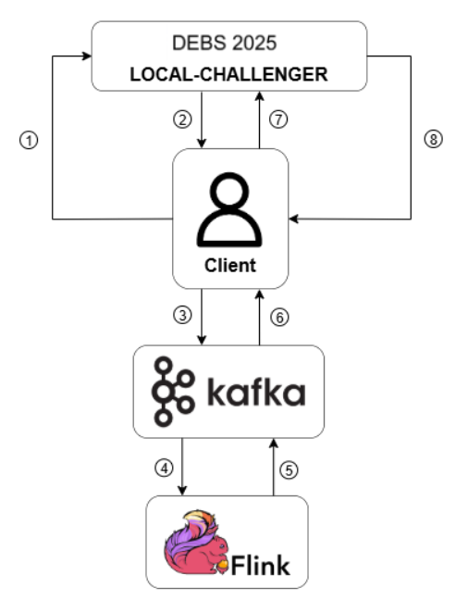
Overview - Architecture

Slide 9
Overview - DataFlow
Client establishes a session with the LOCAL-CHALLENGER and starts the benchmark
OT image tiles are fetched in real time from the LOCAL-CHALLENGER stream
Retrieved tiles are published to a Kafka topic for processing
Flink consumes the tiles and executes the multi-stage analysis pipeline
Query results are written to dedicated Kafka output topics
Client consumes Q3 outputs from Kafka
Q3 results are sent to the LOCAL-CHALLENGER to complete the benchmark
The LOCAL-CHALLENGER evaluates and returns performance metrics (latency, throughput)

Slide 10
Overview - Docker Containers
The system is fully containerized with Docker and orchestrated using Docker Compose
LOCAL-CHALLENGER: local-challenger
Flink: jobmanager, taskmanager1, taskmanager2
Kafka: zookeeper, kafka1, kafka2, topic-init
Client: l-pbf-client
Results exporter: csv-writer

Slide 11
Client – Data Acquisition and Ingestion
Client continuously requests image batches from the LOCAL-CHALLENGER platform via REST API
The data is published to the Kafka topic tiff-batches, which serves as the input stream for the Flink pipeline
A dedicated Kafka producer thread handles batch publishing

Slide 12
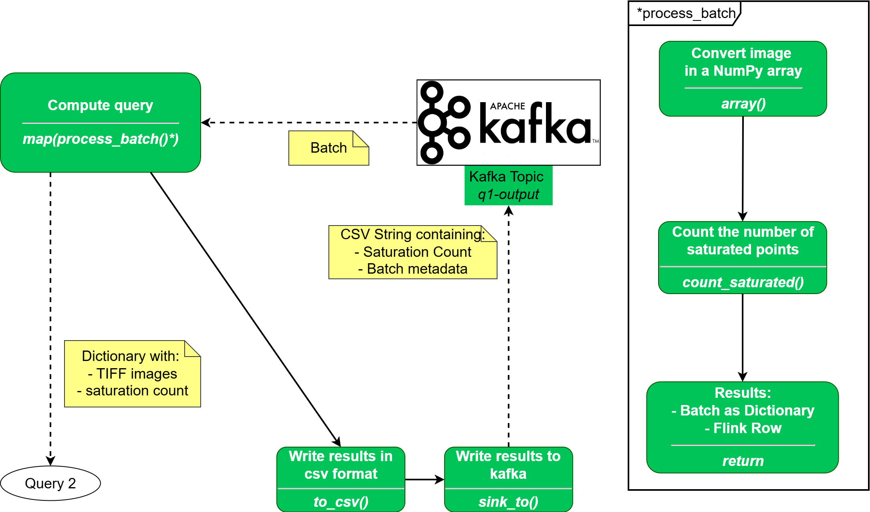
Implementation – Q1

Slide 13
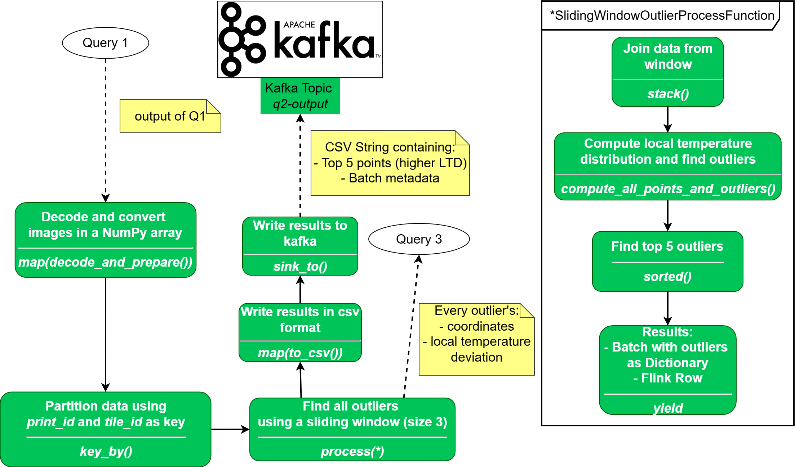
Implementation – Q2

Slide 14
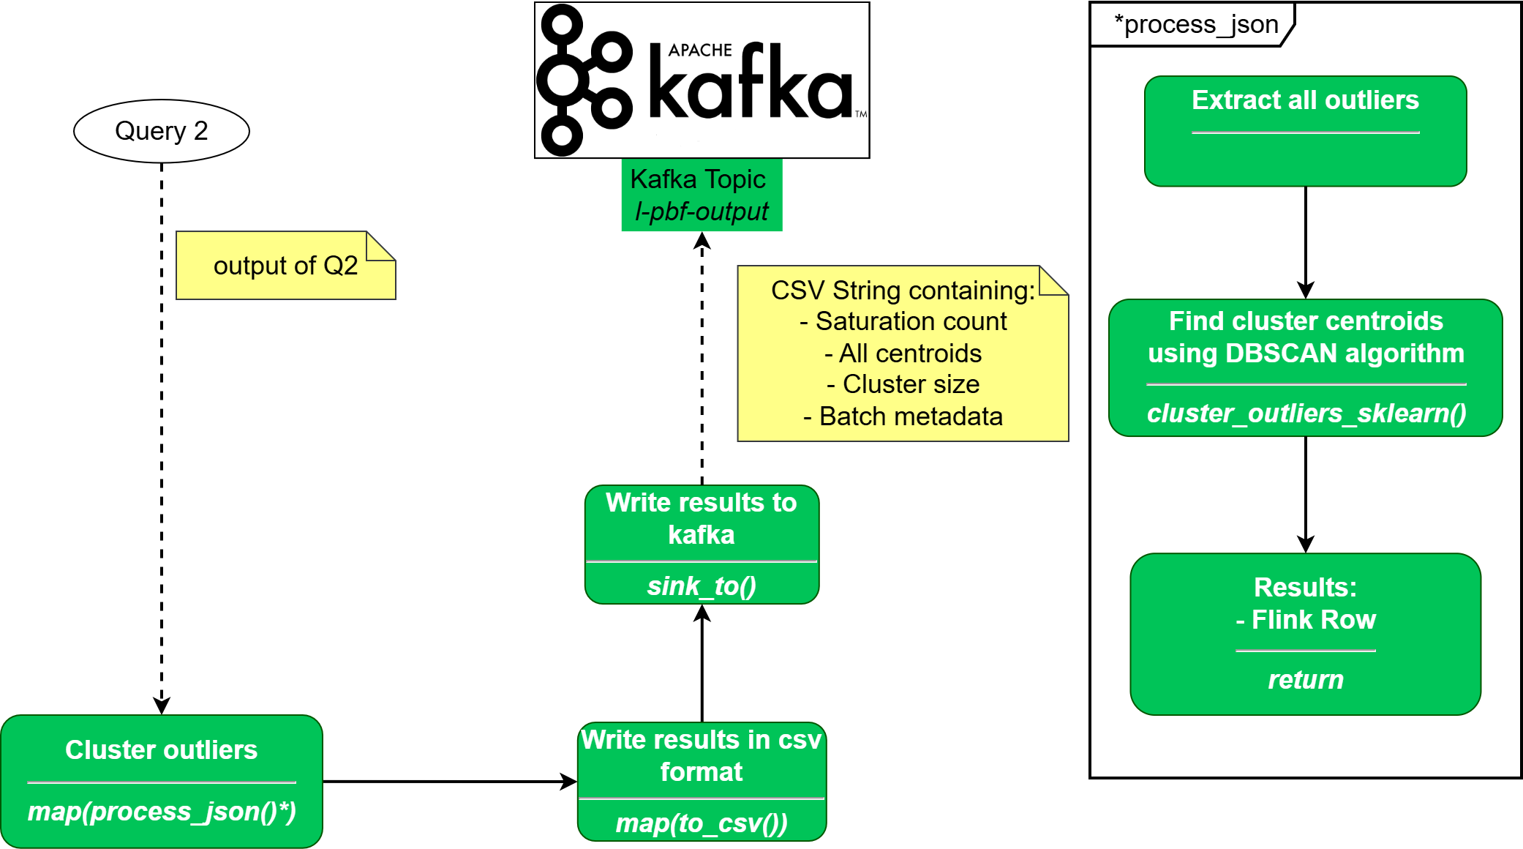
Implementation – Q3

Slide 15
Client – Results collection
A Kafka consumer runs in a separate thread, continuously listening to the Q3 output topic (l-pbf-output)
Each message is sent via REST to LOCAL-CHALLENGER for validation
When all batches are received, the client:
Finalizes the benchmark
Triggers LOCAL-CHALLENGER to return application performance metrics (latency, throughput, etc.)
l-pbf_client.py script

Slide 16
Results – Export
The CSV Writer ingests streaming data from multiple Kafka topics and writes them to corresponding CSV files in real time
Uses Kafka consumers, spawning one thread per topic for concurrent consumption
Each message is parsed as a CSV string and appended to a query-specific file
Output:
Q1: seq_id, print_id, tile_id, saturated
Q2: seq_id, print_id, tile_id, p_1, dp_1, p_2, dp_2, p_3, dp_3, p_4, dp_4, p_5, dp_5
Q3: seq_id, print_id, tile_id, saturated, centroids
kafka_to_csv_stream_writer.py script

Slide 17
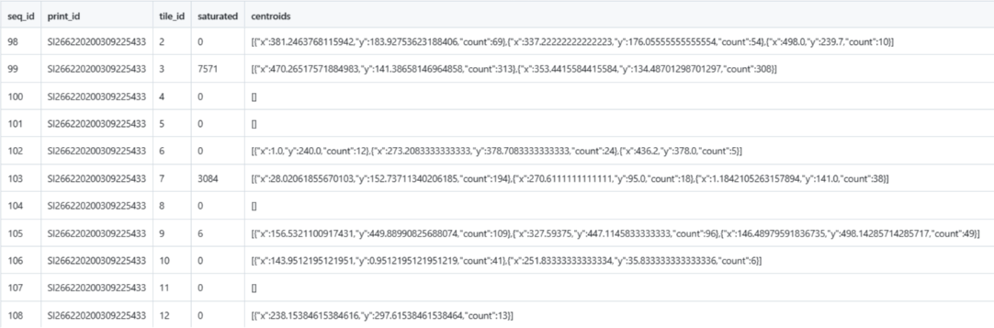
Results - Example
Q3 output

Slide 18
Performance Analysis – Setup
Apache Flink (default) configuration
Parallelism: set to 1
→ Each operator runs as a single task
Kafka Topics:
Single-partition
→ One Flink subtask per topic → no parallel reads
Replication factor = 2
→ Basic fault tolerance
Rationale:
Simplified setup for baseline performance evaluation
Avoids noise from parallelism and tuning overhead

Slide 19
Performance Analysis – Execution Logic
Custom log lines emitted by each query with batch ID and latency:
METRICS|Q1|batch=123|latency_ms=17.46
Implemented via manual timestamp logging in each query function
analyze_latency.py script
Log parsing
Latency stats
Mean, max, p50/p90/p99, batch counts
Throughput estimation
Batches processed / total run time
Excel export
3 runs
100, 200 and 300 batches

Slide 20
Performance Analysis – Results
Q1 | Mean Latency (ms) | Max Latency (ms) | Latency Perc 50 (ms) | Latency Perc 90 (ms) | Latency Perc 99 (ms) | Throughput (batch/s)
100 batch | 58.7562 | 942.16 | 22.14 | 80.521 | 711.49 | 0.352939
200 batch | 87.36195 | 2535.01 | 27.085 | 83.67 | 1506.5952 | 0.233359
300 batch | 100.7782 | 2081.97 | 31.23 | 128.08 | 1606.7608 | 0.244792
Q2 | Mean Latency (ms) | Max Latency (ms) | Latency Perc 50 (ms) | Latency Perc 90 (ms) | Latency Perc 99 (ms) | Throughput (batch/s)
100 batch | 3390.3514 | 10696.52 | 3212.92 | 8266.299 | 9991.9865 | 0.352274
200 batch | 4280.8253 | 11439.79 | 3743.695 | 8620.857 | 10433.9657 | 0.232865
300 batch | 4711.088267 | 12825.29 | 4095.37 | 8836.136 | 11893.4476 | 0.244775
Q3 | Mean Latency (ms) | Max Latency (ms) | Latency Perc 50 (ms) | Latency Perc 90 (ms) | Latency Perc 99 (ms) | Throughput (batch/s)
100 batch | 9.129 | 592.46 | 0.06 | 9.117 | 76.8383 | 0.269552
200 batch | 5.09805 | 440.77 | 1.3 | 7.424 | 17.7009 | 0.225976
300 batch | 5.2814 | 493.82 | 2.52 | 8.68 | 29.8744 | 0.207425

Slide 21
References
https://github.com/MatteoBasili/sabd-progetto2-2024_25

Slide 22
Demo
Open terminal
Enter the root directory of the project
Launch containers
$ docker compose up --build –d
Execute the full pipeline
$ python3 ./scripts/run_all.py [--limit N]
Check the results (CSV files) in the directory Results/csv

