Slide 1
Design Document Review
Matteo Biasielli, Emilio Capo, Mattia Di Fatta

Slide 2
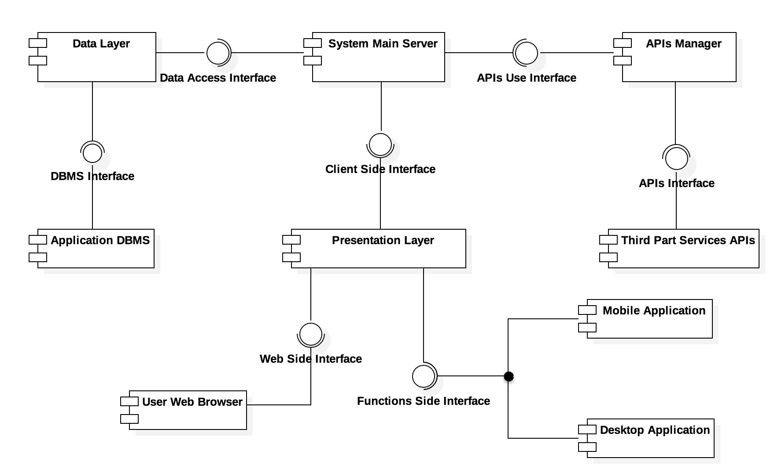
Main Architecture Components

Slide 3
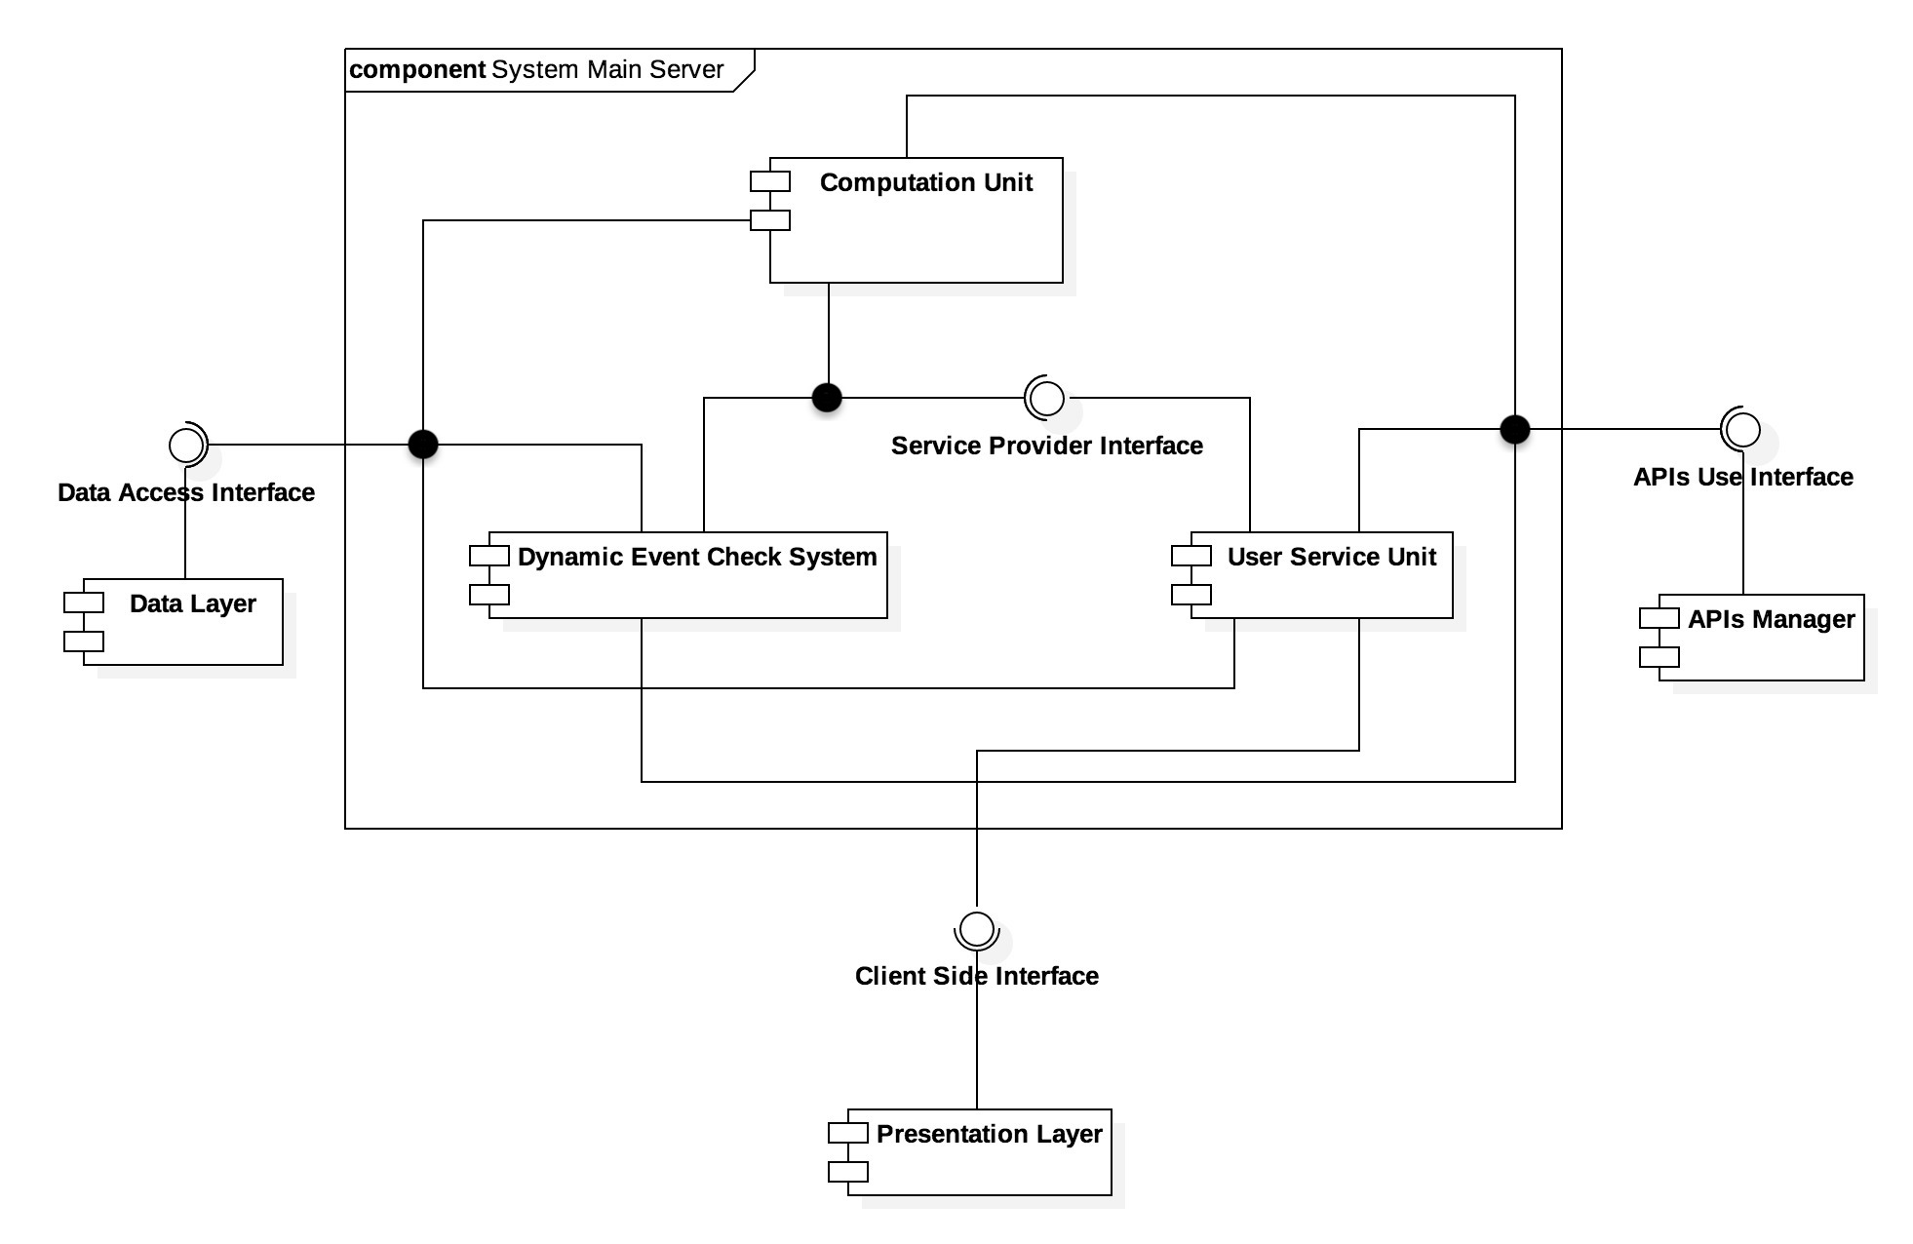
System Main Server: Detailed View

Slide 4
Three-Tiers/Layers Architecture
Presentation Layer: represented by the mobile application, the desktop application and the web server, they allow the user to display the information we provide them with and to organize them.
Application Layer: represented by the System Main Server, as it carries out all the computation required to provide the user with best travel plans, notifications and warnings.
Data Layer: represented by the omonimous component, it contains all the queries that the System Main Server may need to access the Database.
The aforementioned three layers structure perfectly overlaps with a three tiers architecture, which constitutes a good compromise between security and complexity.

Slide 5
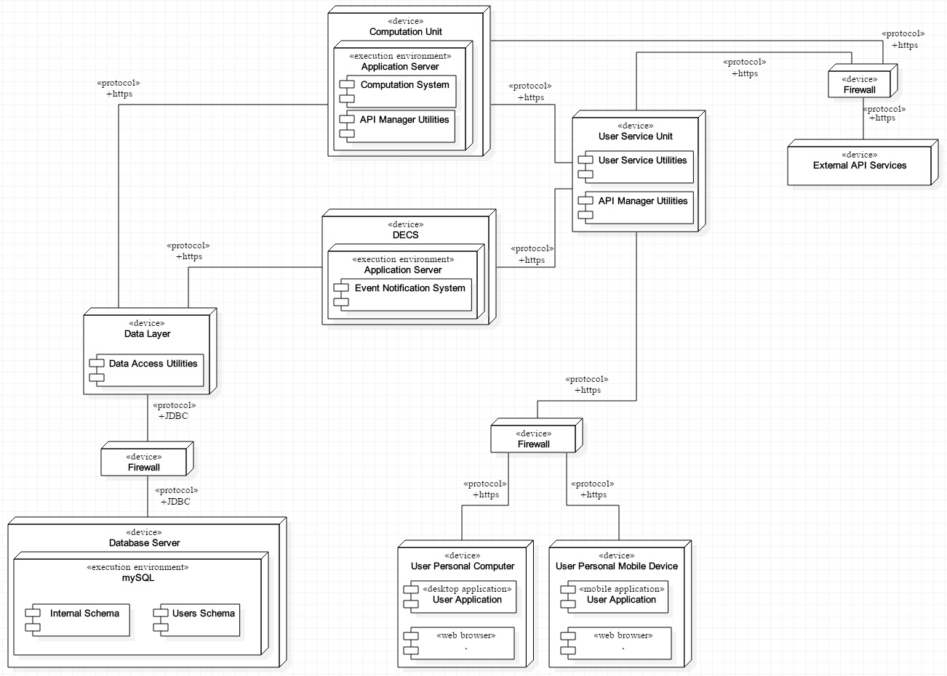
Deployment Diagram

Slide 6
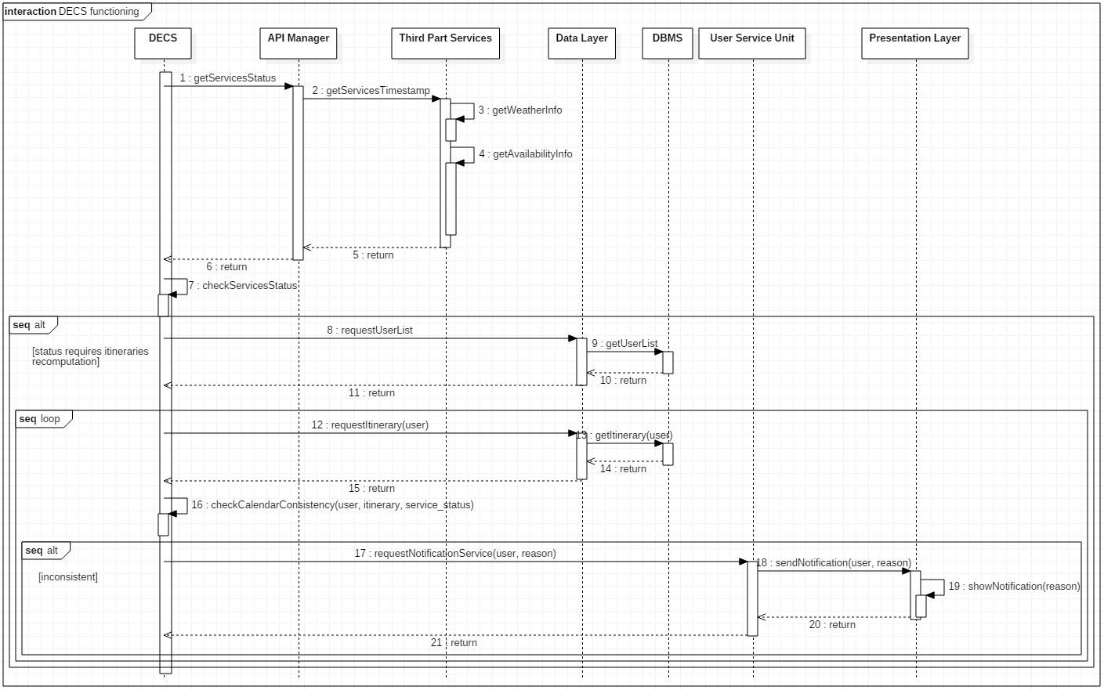
Runtime View: DECS Warnings

Slide 7
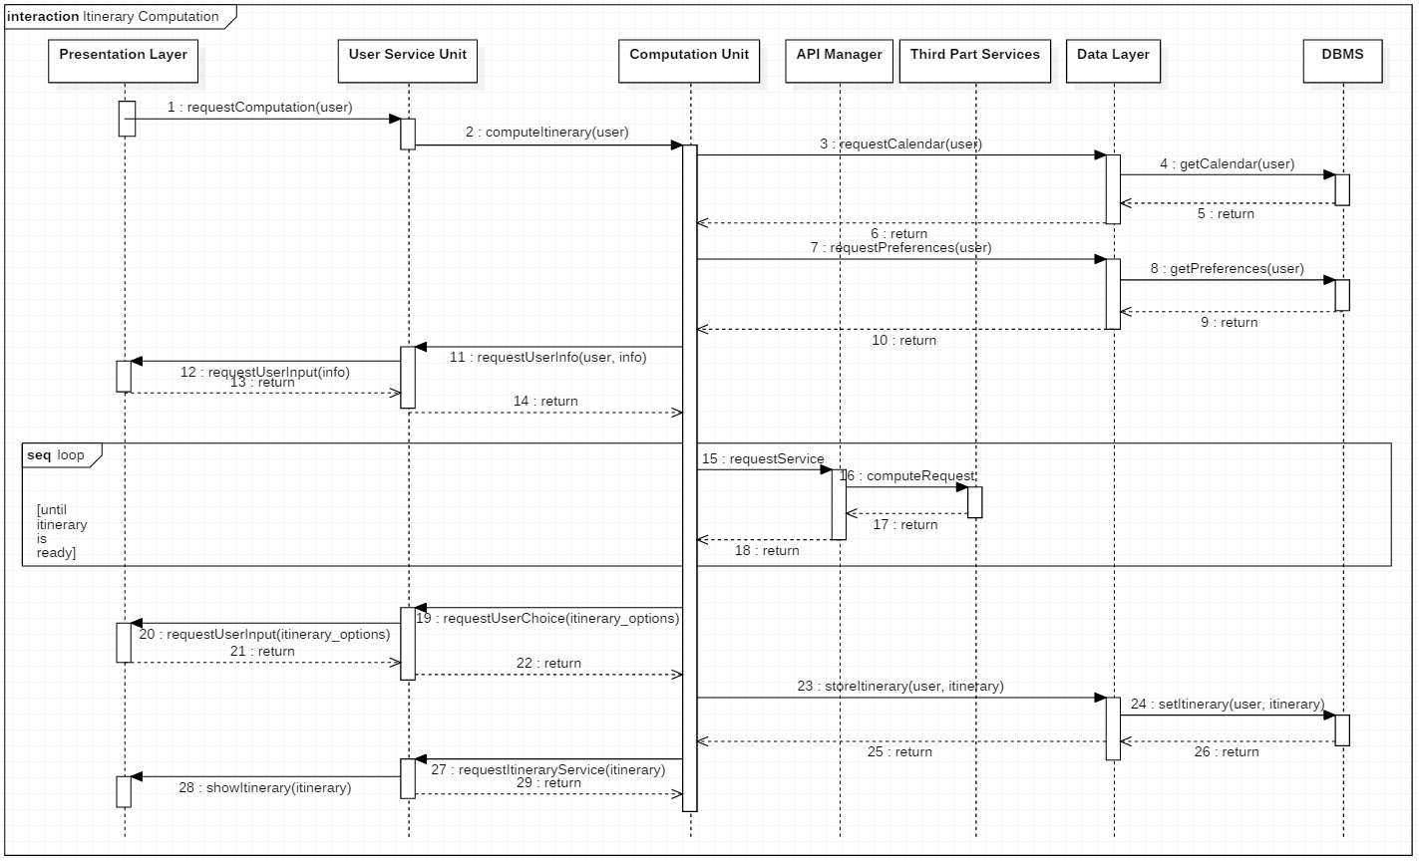
Runtime View: Itinerary Computation

Slide 8
Best Travel Plan Algorithm (1)
INPUT: A user, a starting point and an arrival point.
OUTPUT: Either the best travel option or a list of optimal options, computed taking into account the user preferences.
RELEVANT ASSUMPTIONS: third part services APIs correctly functioning.
ALGORITHM:
According to the user’s preferences and weather forecast, build a list of the available veichles.
For each vehicle available, compute the travel option from starting position to ending position using that vehicle.

Slide 9
Best Travel Plan Algorithm (2)
Eliminate all options that don’t satisfy modality constraints or take more than the available time to reach the location.
If there are travel options remaining, they are shown to the user ordered accordingly to his preferences.
If there isn’t any travel option remaining, then the user is warned of the situation and shown all the possible travel options computed before filtering them according to the constraint.

Slide 10
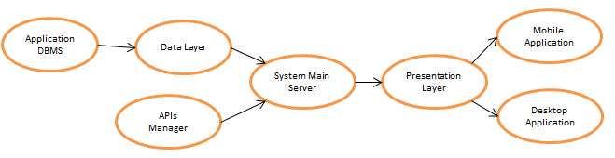
Implementation Plan
Due to their independancy from other components, the Application DBMS and the APIs Manager can be developed first.
Once the Application DBMS is ready, the Data Layer, with all the necessary queries, can be developed.
At this point, all the conditions for the development of the System Main Server are satisfied, so its various components can enter development phase.
When the Presentation Layer Unit is working, the mobile and desktop application can finally be developed.

Slide 11
Integration & Test Plan
Immediate testing of Data Layer and DBMS after completion, to make sure that all the queries on the Database are correctly implemented.
Concurrently, the testing of the APIs Manager can be carried out, provided that the Third Party Systems are correctly working, to ensure that the data is properly extracted.
At this point, relying on the correctness of the previous tested components, the System Main Server can be integrated with them from the beginning. At the end of the development phase, its functionalities must be tested completely.
Following the same principle, the Presentation Layer can be then integrated and tested.
Finally, after the development of the Mobile and Desktop Applications, the integration is immediate and testing can guarantee the complete and correct functioning of the system.

Slide 12
Thanks for the attention! ☺

