Slide 1
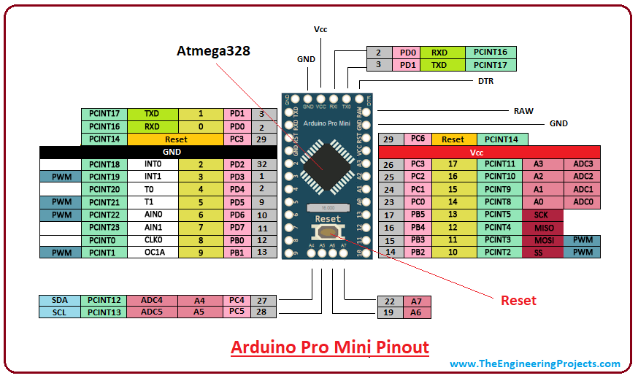
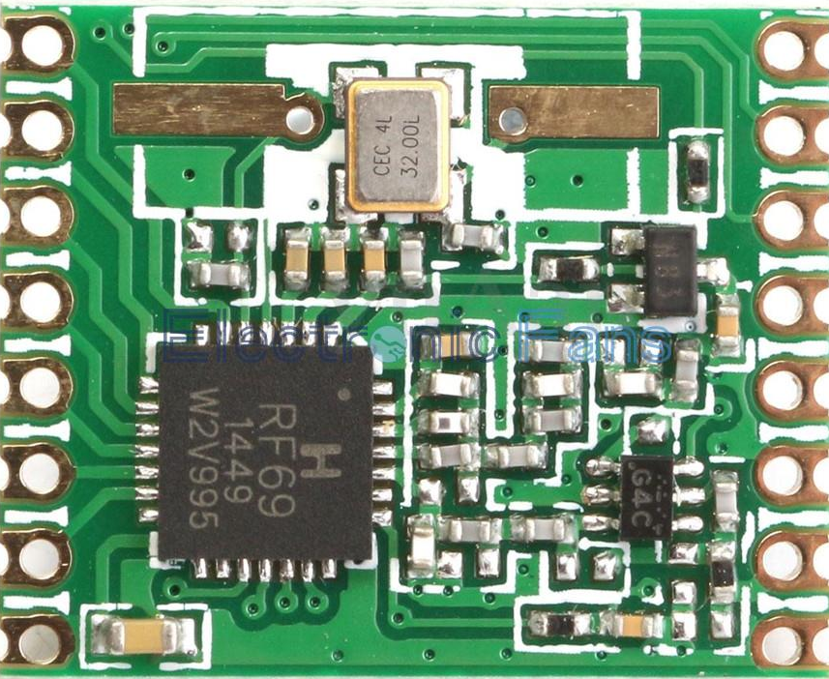
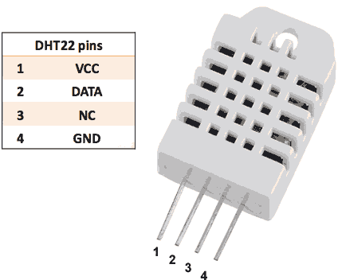
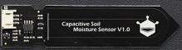
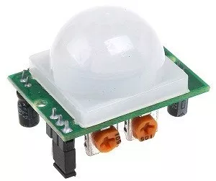
Basic nodes
Microcontroller: atmega320p 3.3V 8MHz (Arduino pro-mini)
Radio modules: RFM69HW (433MHz)
Temperature and Relative Humidity Sensor: DHT22
…meglio usare il BME280?
Capacitive soil moisture sensor: https://www.dfrobot.com/wiki/index.php/Capacitive_Soil_Moisture_Sensor_SKU:SEN0193
Motion sensor: HC-SR501 (to be modified for 3.3V operation)
Check openhardware for similar sensor → lowerst power consumption
Power management board (solar panel)

Slide 3
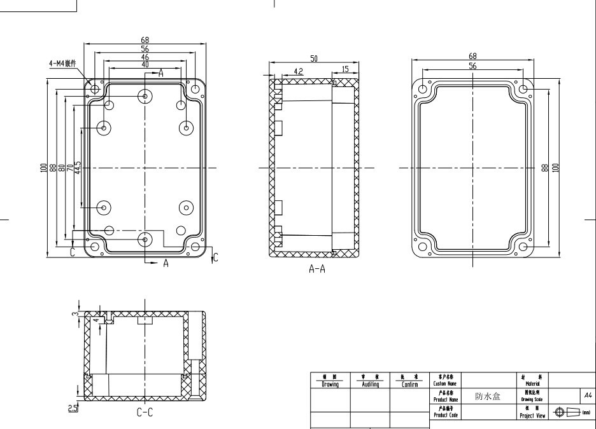
Box
Cheap Chinese 100x68x50mm
Waterproof enclosure

Slide 4
https://www.ebay.co.uk/itm/B9E6-Mini-1W-5V-Solar-Cell-Monocrystalline-Silicon-Solar-Panel-Module-Portable/302944260399?hash=item4688e2912f:g:t8EAAOSwJtJb3Tht:rk:18:pf:0

