Slide 1
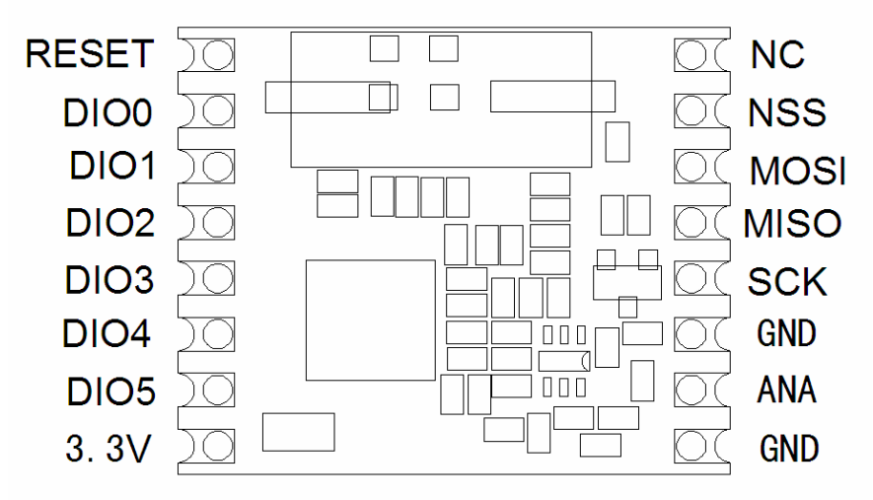
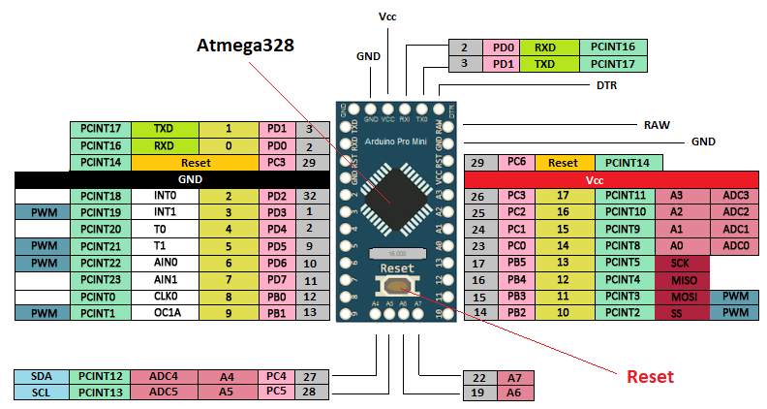
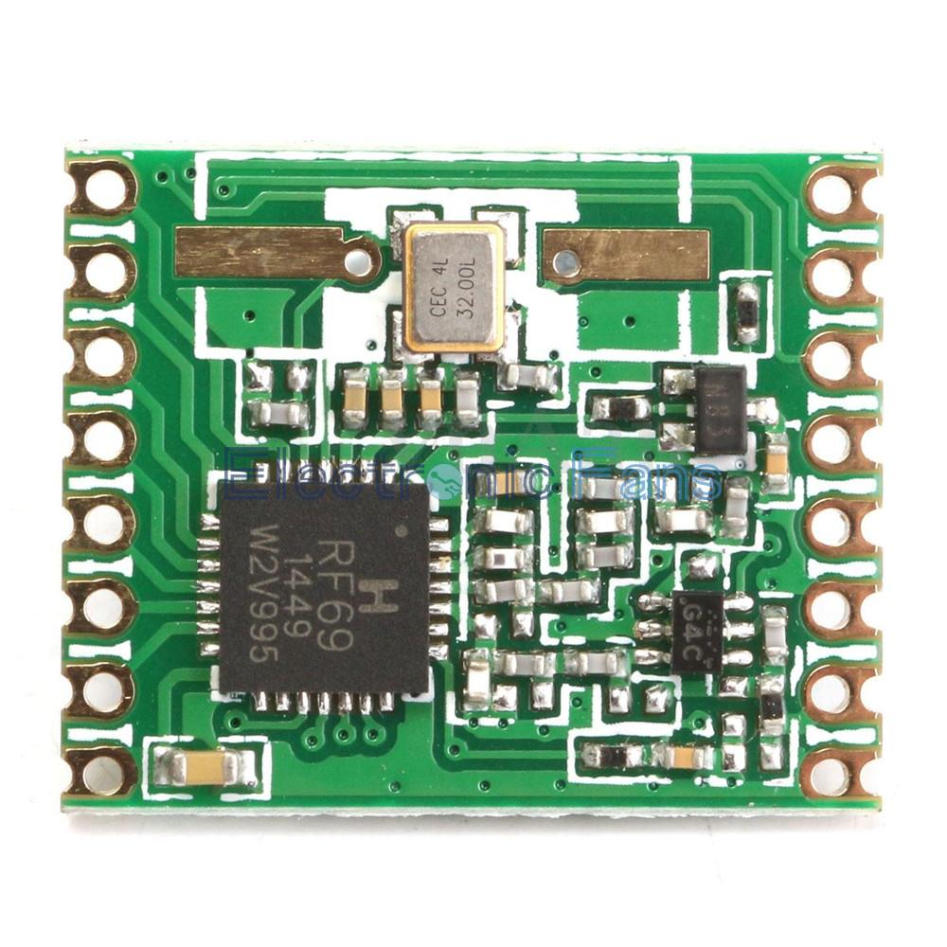
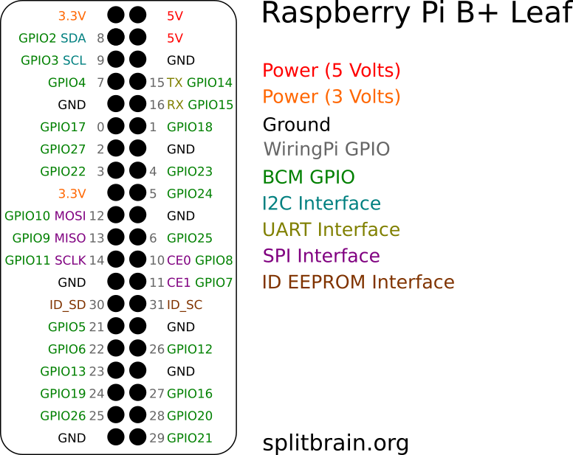

Slide 2
RFM69 HCW - RPi 3 VB+
RPi3 B+ | RFM69HCW
GPIO25 | DIO0
CE0 | NSS
GPIO10 | MOSI
GPIO9 | MISO
GPIO11 | SCK
GPIO24 | Reset
VCC | +3.3V
GND | GND
GND
ANA
GND
SCK
MISO
MOSI
NSS
NC
3.3V
DIO5
DIO4
DIO3
DIO2
DIO1
DIO0
RESET

Slide 3
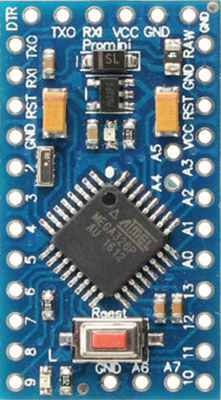
RFM69 HCW - Arduino Pro-Mini 3.3V 8MHz
Pro Mini | RFM69HCW
2 | DIO0
10 | NSS
11 | MOSI
12 | MISO
13 | SCK
VCC | +3.3V
GND | GND

