Slide 1
PRACTICA 1: A* LABORATORY PROJECT
Main Class:
matrix creation and case management
Node Class
aStar Class
Implementation of the algorithm

Slide 2
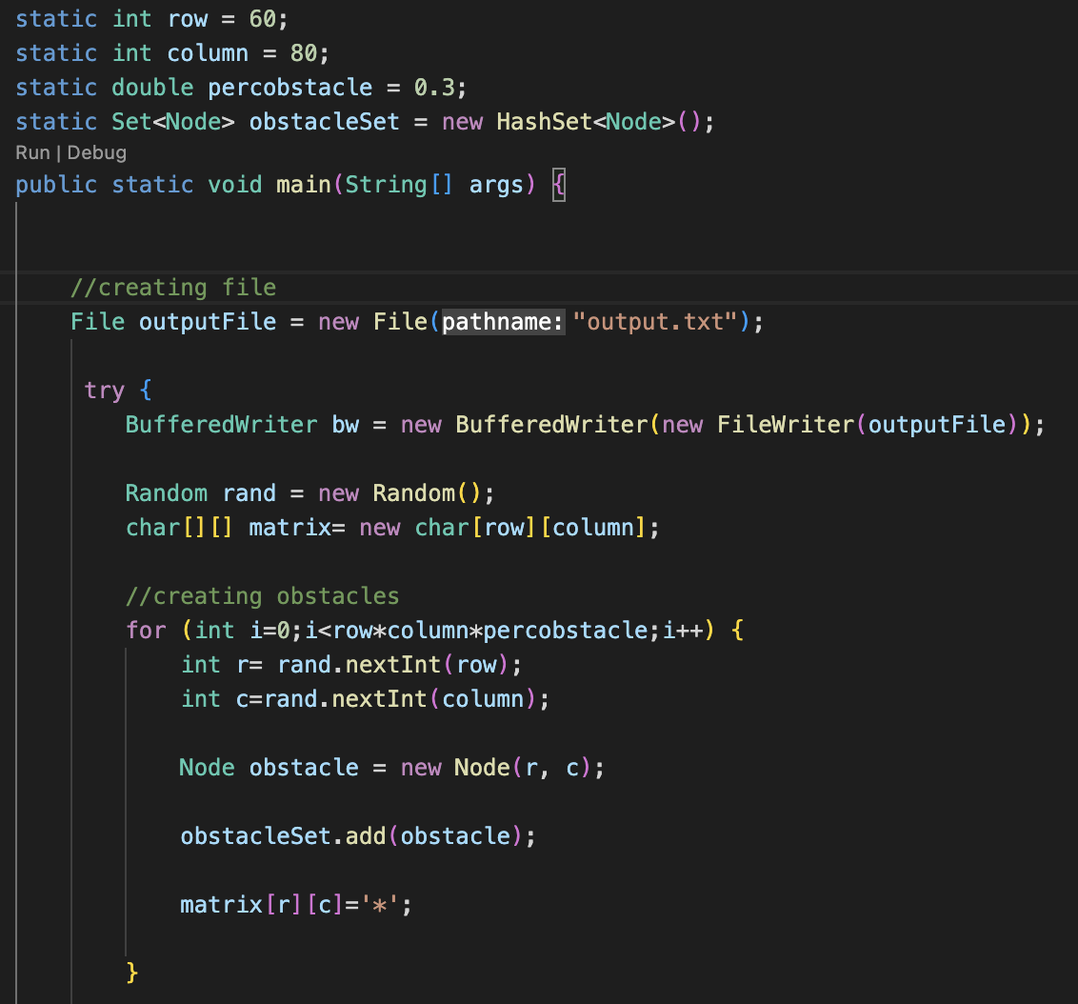
A* LABORATORY PROJECT: MAIN CLASS
Creation of matrix
Adding obstacles randomly

Slide 3
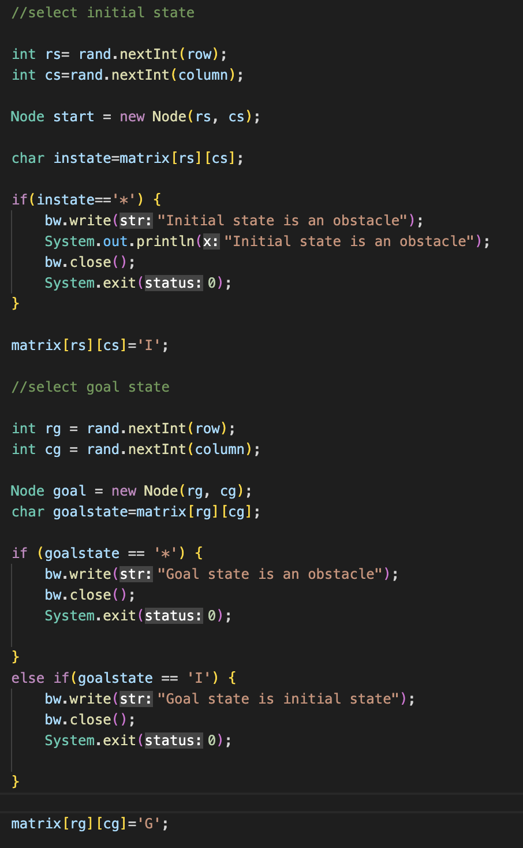
A* LABORATORY PROJECT: CASE MANAGEMENT
Initial state is an obstacle
Goal state is an obstacle
Initial state and goal state are the same

Slide 4
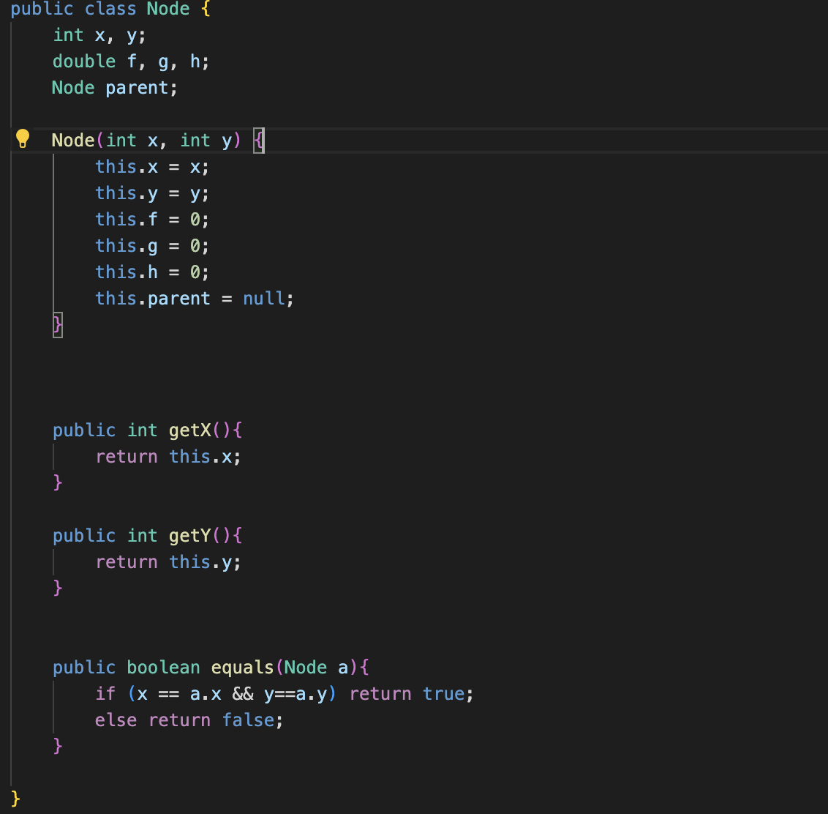
A* LABORATORY PROJECT: NODE CLASS
Creation of the constructor
Getter
«equals» function

Slide 5
A* LABORATORY PROJECT: A* CLASS
Findpath function
creation of the Set

Slide 6
A* LABORATORY PROJECT: A* CLASS
Findpath function
Path found!

Slide 7
A* LABORATORY PROJECT: A* CLASS
Findpath function
Visit of the neighbor

Slide 8
A* LABORATORY PROJECT: A* CLASS
Findpath function
Visit of the neighbor

Slide 9
A* LABORATORY PROJECT: A* CLASS
Findpath function
Calculate the g value of the adiacent node

Slide 10
A* LABORATORY PROJECT: A* CLASS
Findpath function
After checking if the node has a lower g-value we register the new path

Slide 11
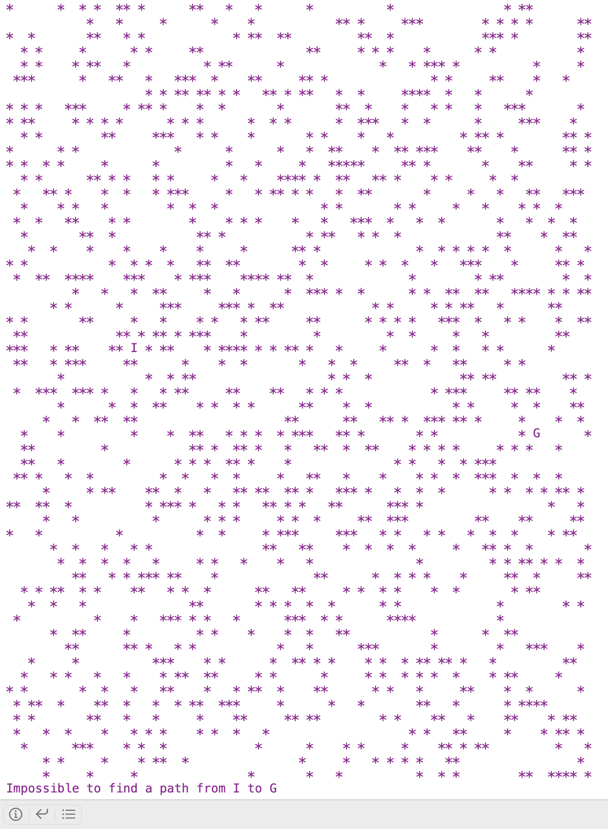
A* LABORATORY PROJECT: FAILURE EXAMPLE

Slide 12

A* LABORATORY PROJECT: SUCCESSFULL EXAMPLE

