Slide 1
Software Verification
Homework B: Software Project
Static analysis Homework
Matteo Cusin
18 February, 2026
A.Y. 2025/2026

Slide 2
Introduction - 1/2
Project scope
Implement an abstract interpreter for the abstract equational semantics of While, as described in Antoine Miné's "Abstract Interpretation with Control Flow Graphs" course notes.
Boundaries:
  Instantiate the interpreter to this parametric version of the interval domain:
  Let the user manage the analysis configuration
Notes:
Se m > n, fallback al constant propagation domain
Se m = -inf, n = +inf, standard interval domain

Slide 3
Introduction - 2/2
The big picture
Syntax
Lexer
Interpreter
REPL
Parser
CFG Builder
Notes:
Syntax: definire categorie sintattiche e costrutti da analizzare
Lexer: definire i token (keyword) del linguaggio
Parser: costruire AST dal programma tokenizzato
CFG builder: costruire CFG da AST
Interprete: analizzare staticamente il programma tramite il CFG che ne è rappresentazione
REPL: Read-eval-print-loop, modalità di interazione utente con il software

Slide 4
While language - 1/2
Adopted syntax
One datatype: integer numbers
Definition of ±∞
Syntactic categories
  Variables, finite set
  Arithmetic expressions (“c” is shorthand for [c,c])
  Boolean expressions

Slide 5
While language - 2/2
  Statements: used to construct AST
  Commands: used to construct CFG from AST
<numero> of 15

Slide 6
Lexer + Parser 1/2
Parsec library
Based on higher-order parser combinators
Let us define the tokens used by the lexing phase
Notes:
Parsec è basata su higher-order parsers combinators, consentendo quindi di poter combinare diversi parser per crearne di piu’ complessi.

Slide 7
Lexer + Parser 2/2
Can create helper parsers from the lexer
Parsing example (if statement)

Slide 8
CFG Builder
Inductively creates the Control-Flow Graph starting from the Abstract Syntax Tree of the loaded program file.

Slide 9
Interpreter 1/4
Abstract domain
Implemented the standard interval domain
The “parametrization” is induced by passing the runtime configuration of the analyzer to the arithmetic expression evaluation
Notes:
Parametrizzazione indotta da:
- Configurazione intervallo di analisi da parte dell’utente
- Valutazione delle espressioni aritmetiche basata su questa configurazione: la funzione di valutazione prende in ingresso i valori m, n

Slide 10
Interpreter 2/4
Abstract tests
Bottom-up evaluation of expressions
Test on the result, refining the evaluated value
Top-down refinement on the sub-expressions (using the old values) checking for incompatibilities
Notes:
Per migliorare la precisione di analisi, ho deciso di implementare gli abstract test tramite valutazione bottom-up, applicazione della condizione su questo valore e propagazione top-down del nuovo valore (singola passata).

Slide 11
Interpreter 3/4
Widening
Applied at loop heads (found by exploring the graph )
Not necessary in parametric interval domain with finite m, n.
Notes:
Controlla la stabilità dello 0

Slide 12
Interpreter 4/4
Narrowing
Applied at loop heads after convergence
First implemented as GLB, finite number of iterations
Later implemented (but not used) as infinite bounds refinement

Slide 13
REPL 1/2
What can be configured?
The parametric interval domain (constants m, n)
The loaded file to analyze (from a folder of examples)
The chance of using narrowing and widening at loop heads program points
The initial configuration for the analysis, used as input for the entry program point (by default, it would be ⊤)

Slide 14
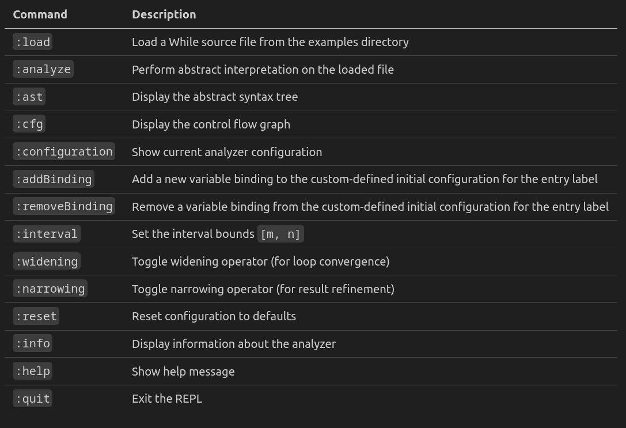
REPL 2/2
Available commands

Slide 15
References
Project source code:
https://github.com/MatteoCus/abstract-while-interpreter.git
Antoine Miné's "Abstract Interpretation with Control Flow Graphs" course notes
Parsec:
  https://en.wikipedia.org/wiki/Parsec_(parser)
  https://hackage.haskell.org/package/parsec

