Slide 1

LBG Split vector quantization applied to RGB images
Professor: Dr. Giancarlo Calvagno
Student: Matteo Drago
June, 29, 2018

Slide 2
Outline
Introduction on Data Compression
LBG
Initialization of centroids
LBG Split
Results
Conclusions
Notes:
Brief introduction on how I planned my presentation

Slide 3

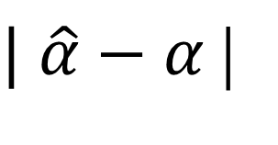



$$α$$
$$α′$$
$$\hat{α}$$
TX
Encoder
Decoder
RX
In the lossless scenario:
$$\hat{α}=α$$
And the only limit on the compression is the entropy of the input message
In the lossy scenario we want to minimize:
$| \hat{α}−α$ |
And in this case we have to find a suitable trade-off between
rate and distortion

Slide 4
Scenario:
(R,G,B) Image
Each channel takes values from
0 to 255
Codebook of (R,G,B) pixels

Slide 5
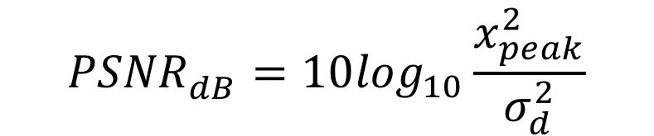
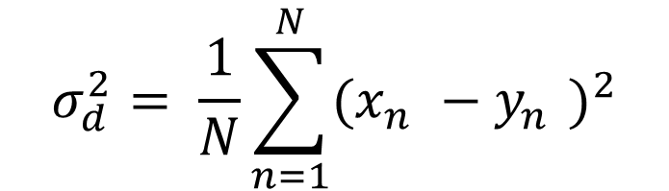
In the image domain, two measures are used for the comparison between original and reconstructed image:
$$σ_{d}^{2}= \frac{1}{N}\sum_{n=1}^{N}{{(x_{n}^{}−y_{n}^{})}^{2}}$$
$${PSNR}_{dB}^{}=10\log_{10}\frac{x_{peak}^{2}}{σ_{d}^{2}}$$

Slide 6
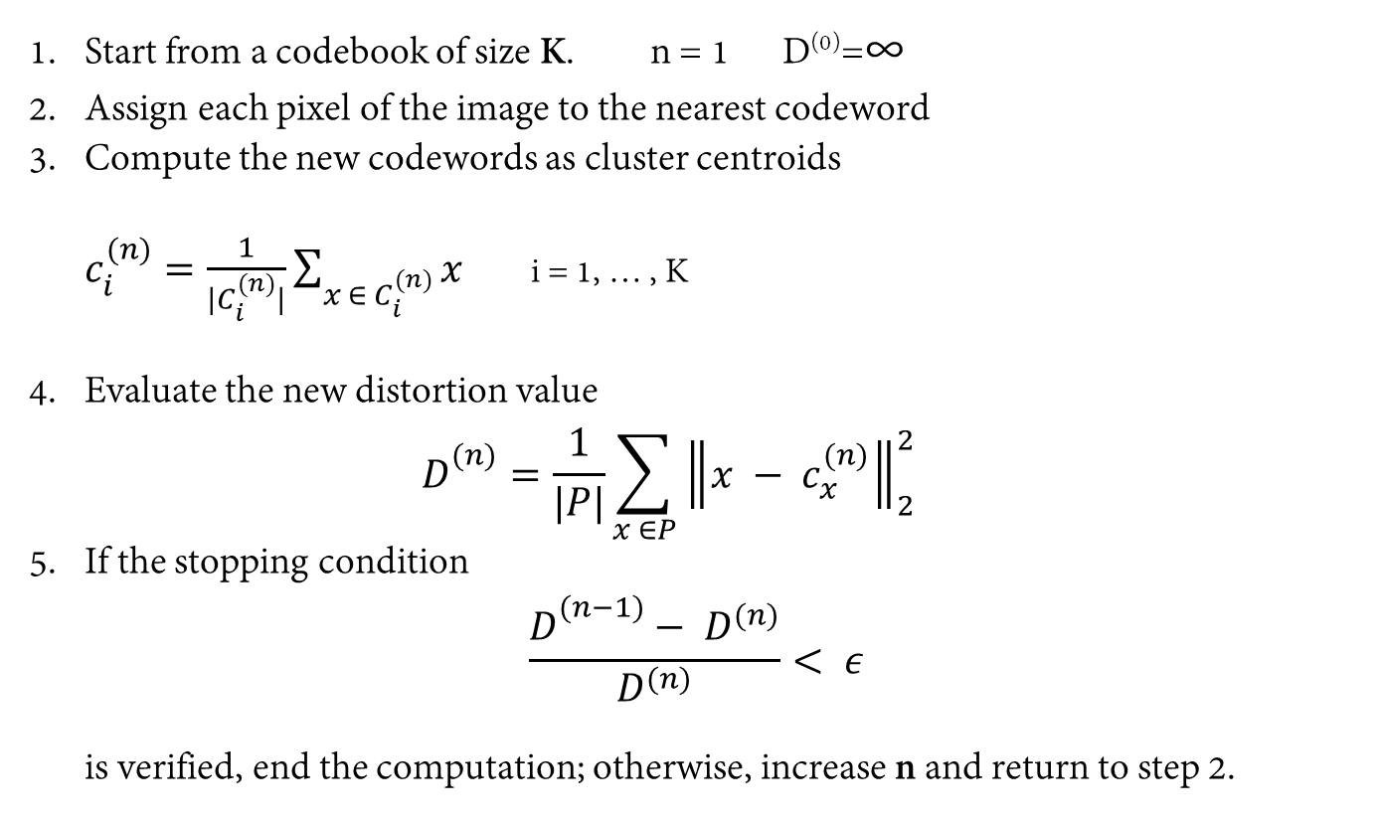
Linde Buzo Gray – Vector Quantization
Idea: Constitute a set of representative codewords
Start from a codebook of size K. n = 1 D⁽⁰⁾=∞
Assign each pixel of the image to the nearest codeword
Compute the new codewords as cluster centroids $c_{i}^{(n)}=\frac{1}{|C_{i}^{(n)}|}\sum_{x ∈ C_{i}^{(n)}}{x}$ i = 1, … , K
Evaluate the new distortion value $D_{}^{(n)}=\frac{1}{|P|}\sum_{x ∈P}{{\left\|x − c_{x}^{(n)}\right\|}_{2}^{2}}$
If the stopping condition $\frac{D_{}^{(n−1)}− D^{(n)}}{D^{(n)}}< ε$ is verified, end the computation; otherwise, increase n and return to step 2.

Slide 7

Problem 1: Codebook Initialization
LBG Split
Apply LBG algorithm starting from a codebook of size 1, doubling each time the codebook dimension. In this way we are sure that we start from the optimal version of the codebook
How are the new codewords are determined?
$$c_{2i}= c_{i}+ δ$$

Slide 8
Problem 2: Empty Cells
It may happen that no pixels are assigned to the one codeword, so we need to find a codeword that is more representative for the image
Solution: choose randomly one pixel from the most populated cluster, substitute it with the codeword that represent the empty cluster and proceed with the re-assignement of pixels. Iterate until no cluster is empty.

Slide 9
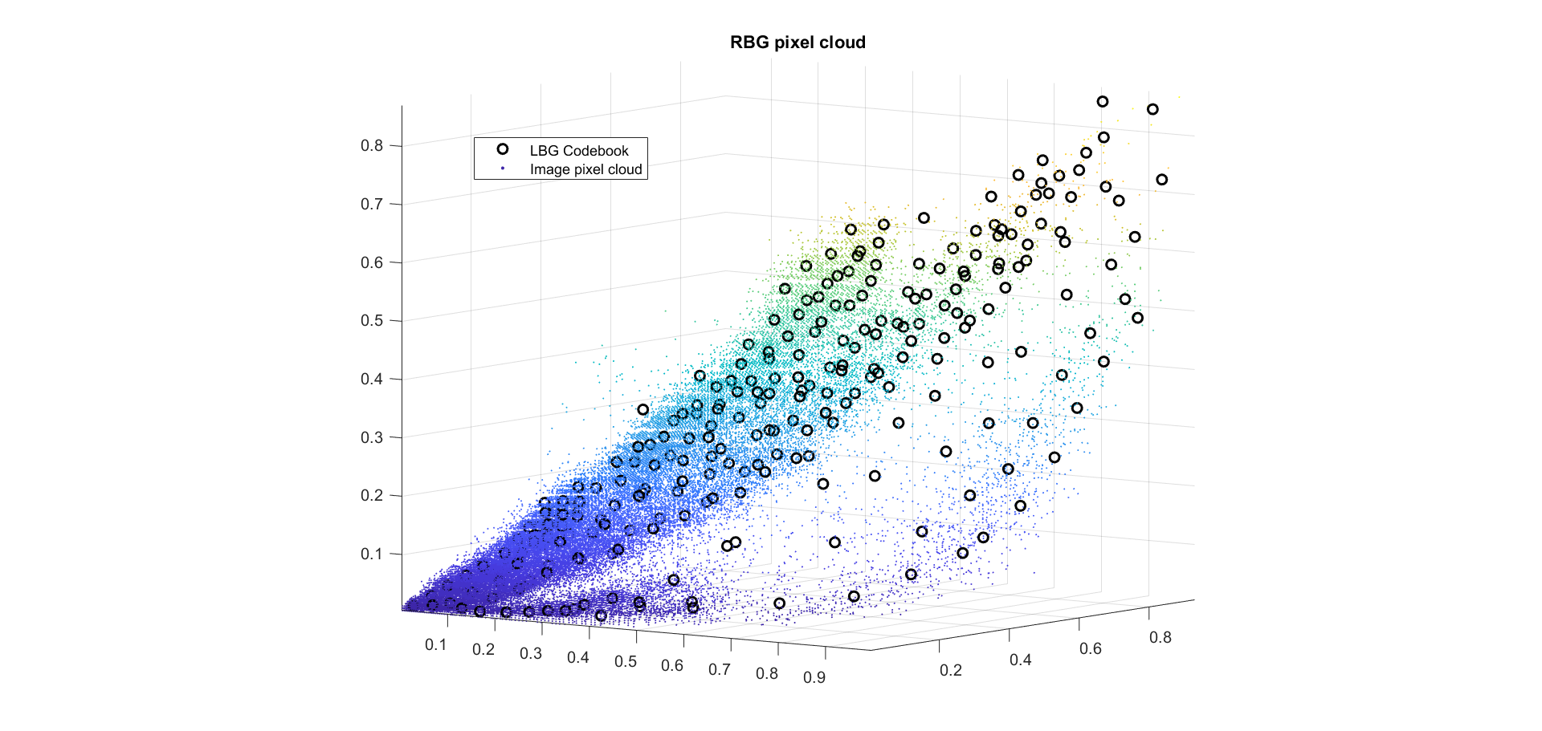

Slide 12
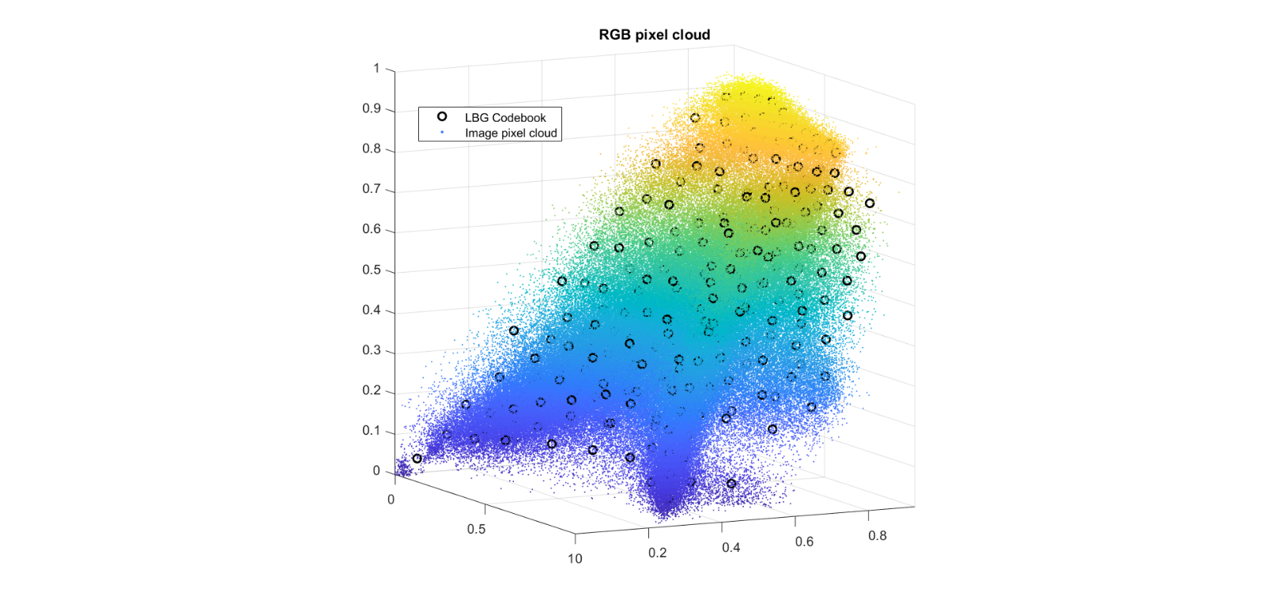

Slide 15
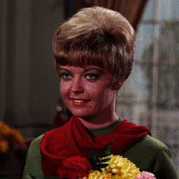



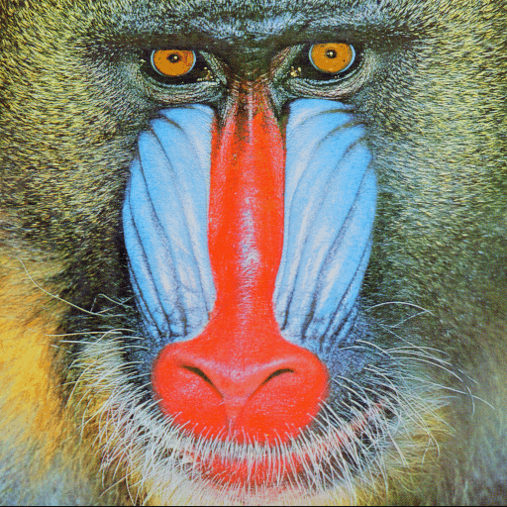


Slide 16
Conclusion:
In general, JPEG outperforms LBG. It provides a faster and better way of coding images
All problems encountered with the design of LBG have been solved and the procedure works as expected
It was interesting to see also how well the color palette represented the image
Future works could focus on finding methods to speed up the computation of LBG without losing in terms of quality of the output image

Slide 17
LBG Split vector quantization applied to RGB images
Professor: Dr. Giancarlo Calvagno
Student: Matteo Drago
June, 29, 2018

