Slide 1
Minimum Weight
Vertex Cover
Problem
Artificial Intelligence Project
a.y. 2024/25 - made by Matteo Galletta - assigned by professor M. Pavone

Slide 2
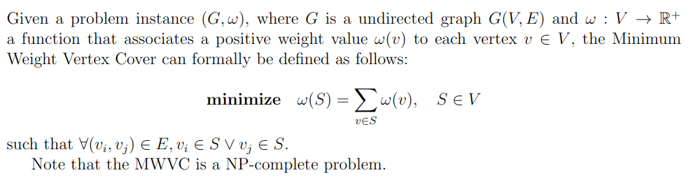
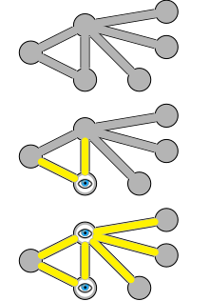
The problem

Slide 3

The solution
Tabu Search (TS);
Branch-and-Bound;
Genetic Algorithm (GA) with uniform crossover and roulette-wheel selection;
Genetic Algorithm (GA) with one-point crossover and k-tournament selection;

Slide 4
Genetic Algorithm
Evaluation
Selection
Crossover
Mutation
Replacement
Each individual in the population is evaluated based on a predefined fitness function

Slide 5
Genetic Algorithm
Evaluation
Selection
Crossover
Mutation
Replacement
A subset of individuals are selected from the populations, based on fitness.
In case of the k-tournament selection algorithm, it involves running several ”tournaments” among k individuals chosen at random from the population, until the desired amount of population is reached. Each tournament selects the best amongst the k selected individuals

Slide 6
Genetic Algorithm
Evaluation
Selection
Crossover
Mutation
Replacement
Genetic material of the individuals are combined to create offspring
In case of single-point crossover, a random crossover point is selected and the genetic material is exchanged between the parents at that point

Slide 7
Genetic Algorithm
Evaluation
Selection
Crossover
Mutation
Replacement
With a certain probability, random mutations are introduced into the offspring, helping to maintain diversity within the population

Slide 8
Genetic Algorithm
Evaluation
Selection
Crossover
Mutation
Replacement
This newly generated population replaces the old one.
The process repeats until a stopping criteria is satisfied.

Slide 9
Implementation
DEAP Framework
Gene Representation
Fitness Function
Performance Metrics
Parameters
Benchmarking Flow

Slide 10


DEAP Framework
Implementation
DEAP is a Python library that excels at rapid prototyping and testing of ideas

Slide 11

Gene Representation
Implementation
Each gene is a binary string where each bit represents the presence of a vertex in the solution

Slide 12
Fitness Function
Implementation
It calculates the weight of the solution by summing the weights of the vertices present in the solution.
Additionally, it imposes a penalty for each edge that is not covered by the vertices in the solution.

Slide 13
Performance Metrics
Implementation
Fitness Function
Objective Function
Number of Evaluations

Slide 14
Parameters
Implementation
Population Size
Crossover Probability
Mutation Probability
K–Tournament Selection Size
Number of Generations

Slide 15
Benchmarking Flow
Implementation
The best parameters are found using an iterative process.
Test instances are loaded
The algorithm is run
The results are saved
The results are analyzed using a Jupyter Notebook

Slide 16
Results

Slide 17
1st Iteration
The algorithm is run with defaults parameters, to see how it performs.
It turns out that the penalty mechanism isn’t effective - a repair function is implemented to transform individuals into valid solutions

Slide 18
2nd Iteration
The population size is tuned.
The size of 400 is found to be the best.

Slide 19
3rd Iteration
Crossover and Mutation parameters are analyzed.
These are studied together since they’re tightly coupled.
The best parameters found are 0.4 and 0.25 for crossover and mutation probability, respectively.

Slide 20
4th Iteration
Tournament size is modified.
Using k=3 gave the highest results in most the instances, so this was chosen.

Slide 21
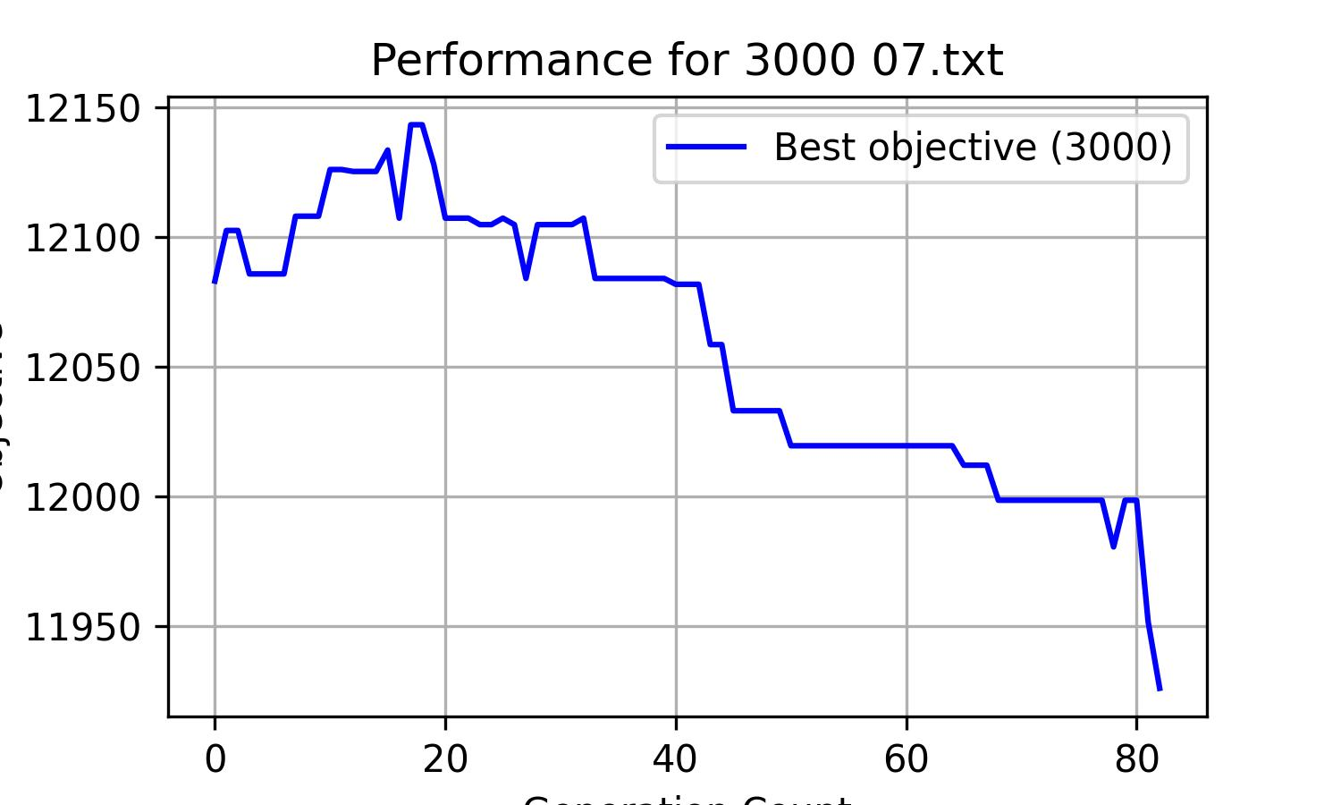
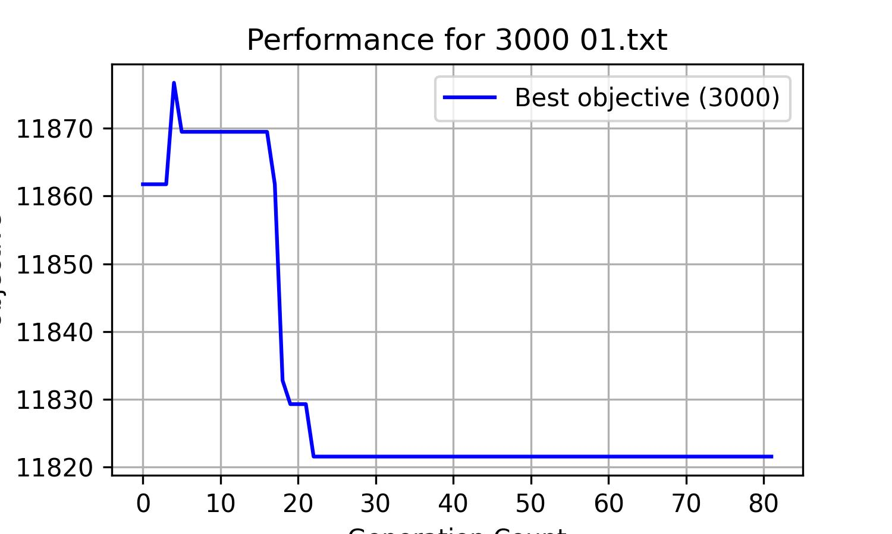
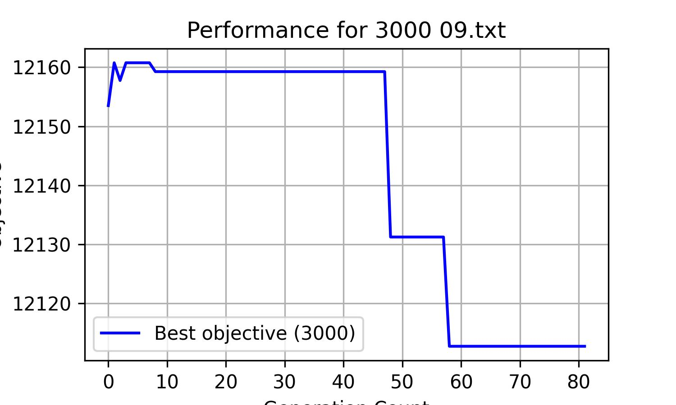
5th Iteration
To improve efficiency, the number of generations must be tuned.
Analyzing the plots, there’s no correlation between optimal number of generation and problem size.
The chosen stopping criteria is to stop the algorithm after a fixed 40 generations of no improvement.

Slide 22
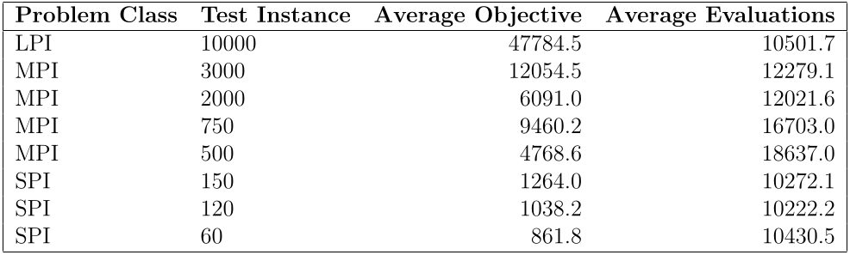
Final Results

Slide 23
Thanks

