Slide 1
Technologies for Advanced Programming
Project by Matteo Galletta – A.Y. 2024/2025
FastID Report
A real time pipeline with an online learning model allowing predictive scaling
Prof: Salvatore Nicotra

Slide 2
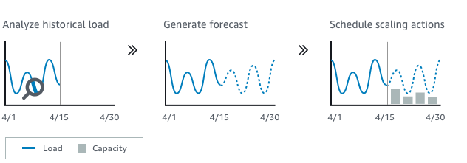
What’s predictive scaling?

Slide 3
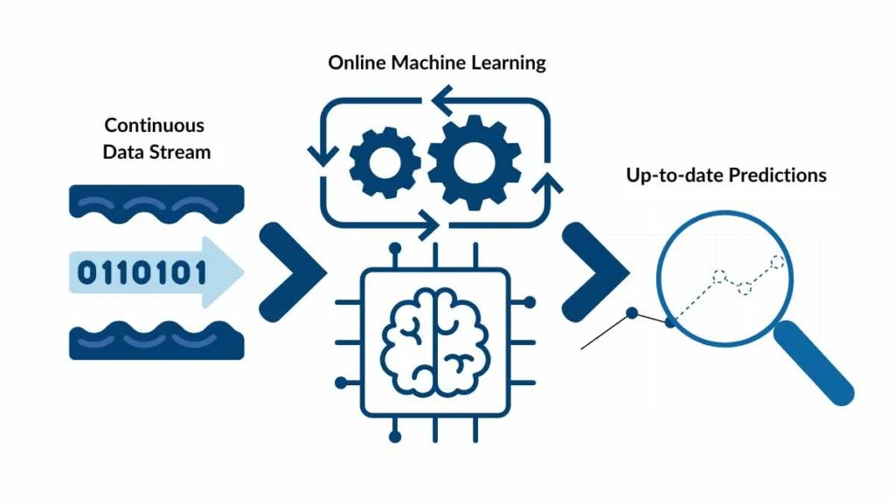
What’s an online learning model?

Slide 4



I swear it’s not
how it looks…
TAP PROJECT
FASTID ADV

Slide 5
What’s FastID?
FastID is a SaaS allowing to implement easily SPID and CIE integrations in your websites. It handles every user authentication and redirects them in the respective website.
As it handles the authentication, it logs them in a database.
FastID must guarantee access to all the customers’ websites without downtimes, even in high traffic situations.
Its infrastructure should be able to scale according to current traffic, allowing to scale in case of high load.

Slide 6
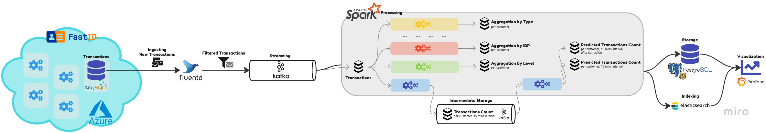


How does FastID look like?

Slide 7
Ingestion using Fluentd

Slide 8
Streaming using Kafka

Slide 9
Processing using Spark

Slide 10

Processing using Spark

Slide 11
Storing using Postgres and Indexing using Elasticsearch

Slide 12
Visualizing using Grafana

