Slide 1


Stitches
Simone Mungari Luigi Montaleone Matteo Notaro Giuseppe Benvenuto Matteo Loria Andrea De Seta

Slide 2
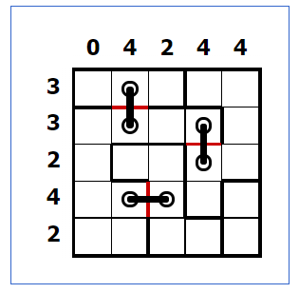
Introduction

Slide 3
REPOSITORY GITHUB
https://github.com/MatteoLoria/Stitches_MiniZinc

Slide 4
Minizinc Model & Input Validation

Slide 5
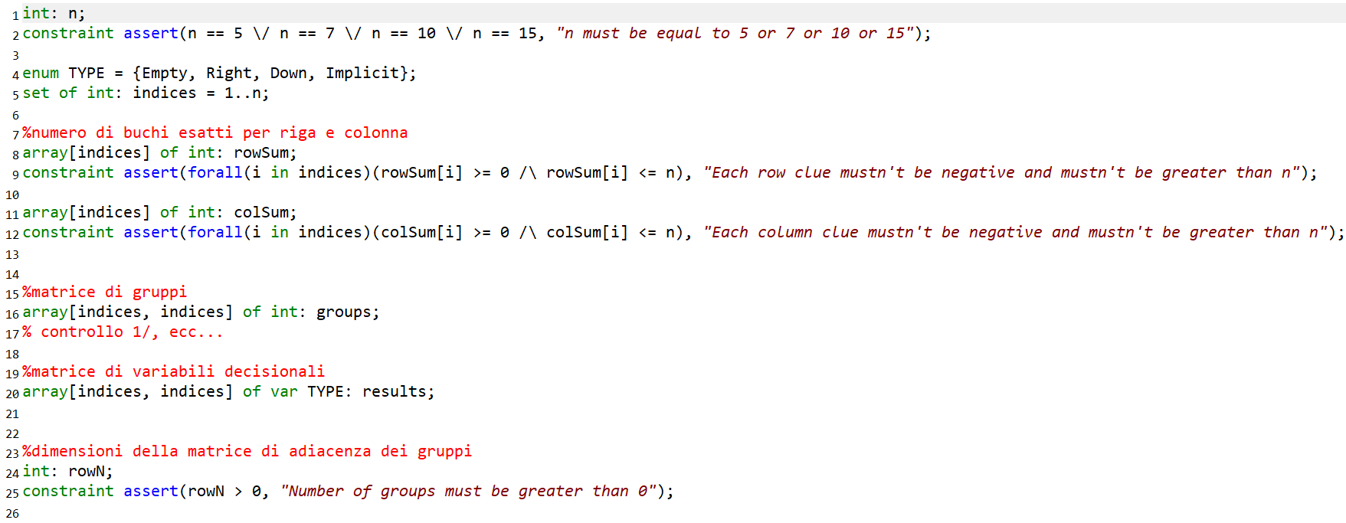
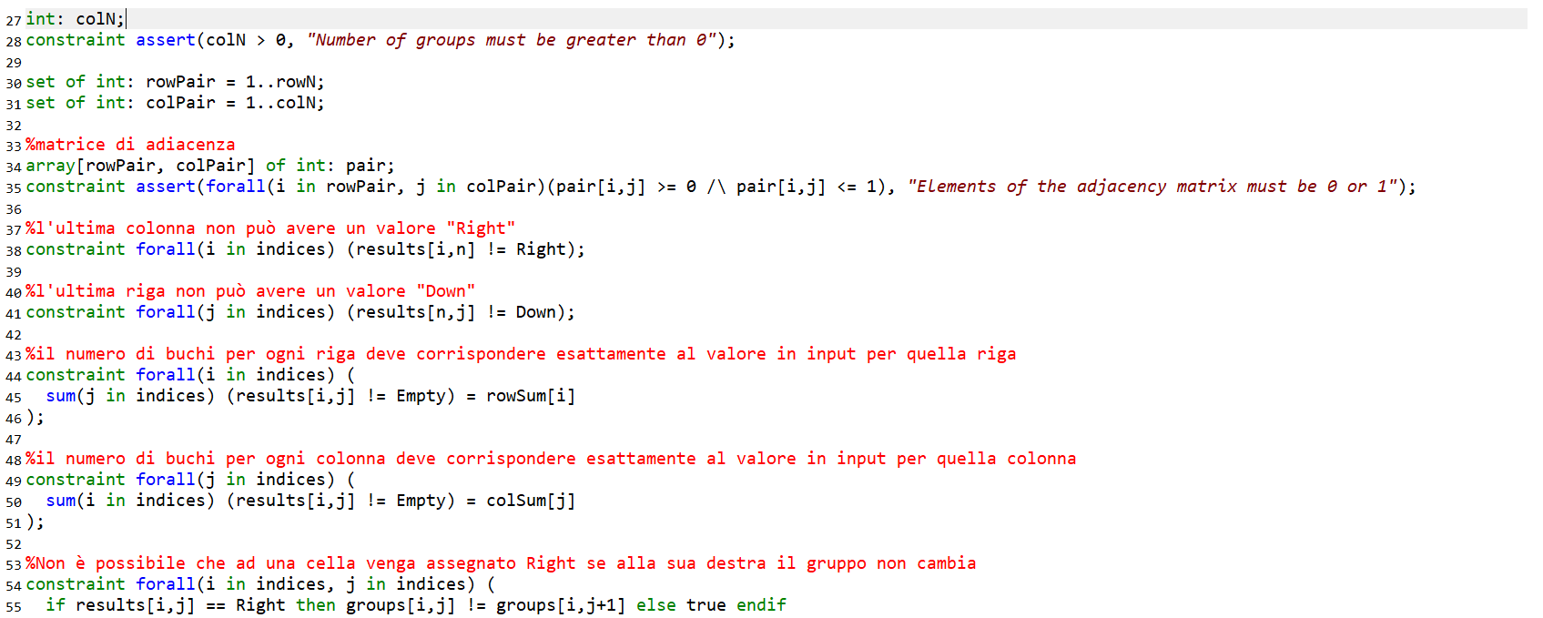

Slide 6
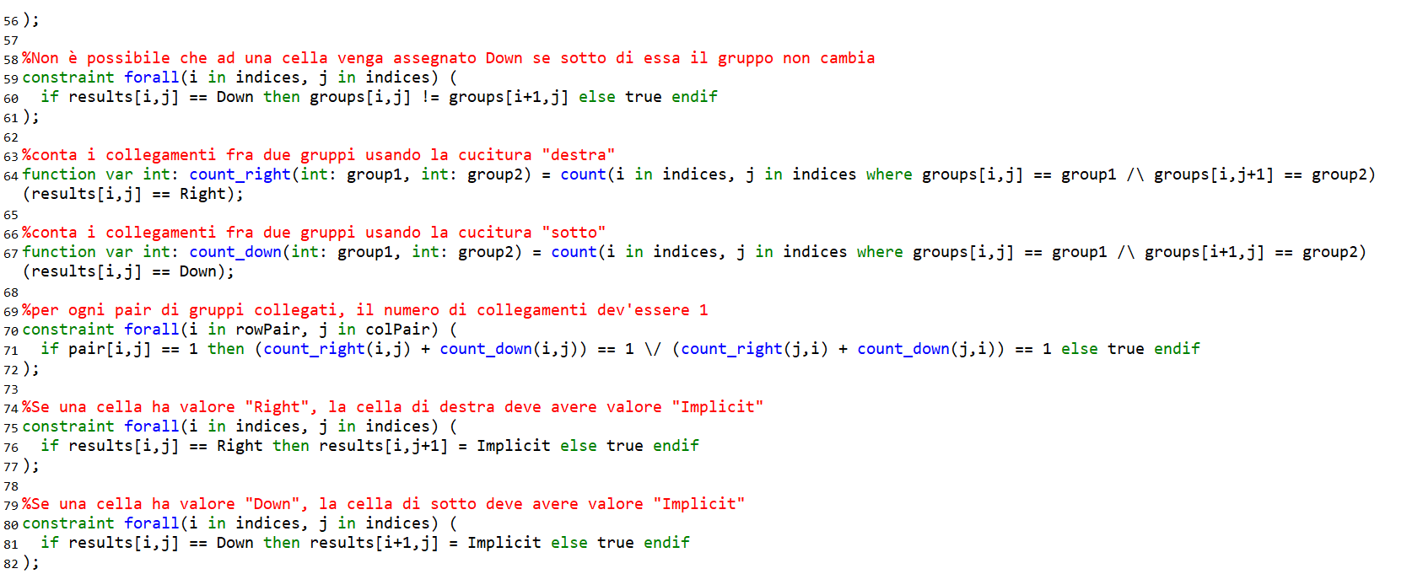
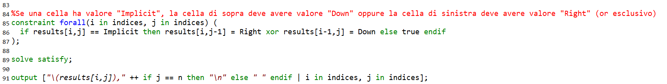

Slide 7

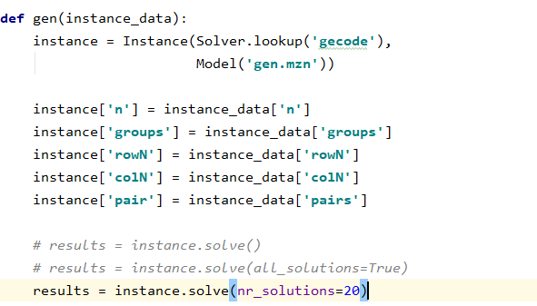
Generate Instances

Slide 8
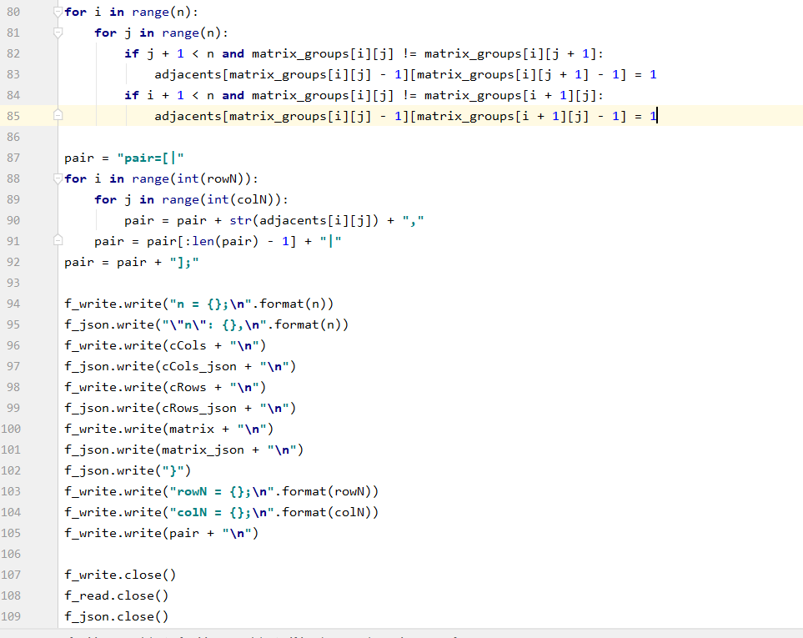
Extract instances

Slide 9
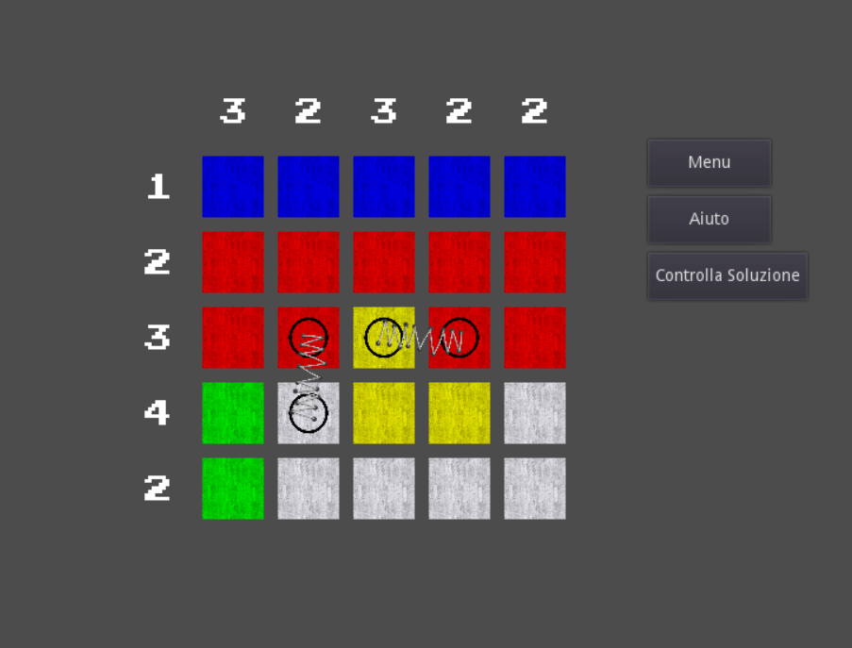
Implement GUI

Slide 10
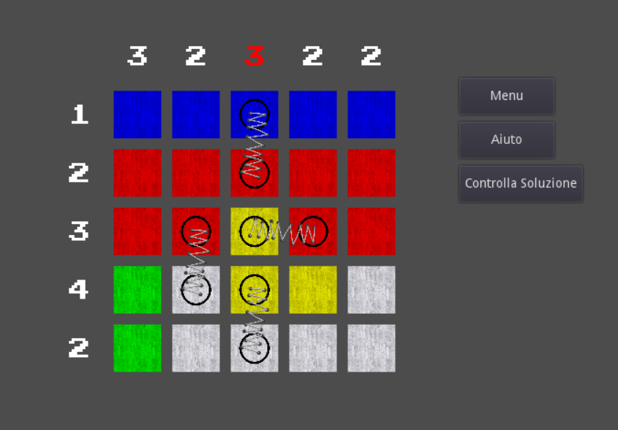
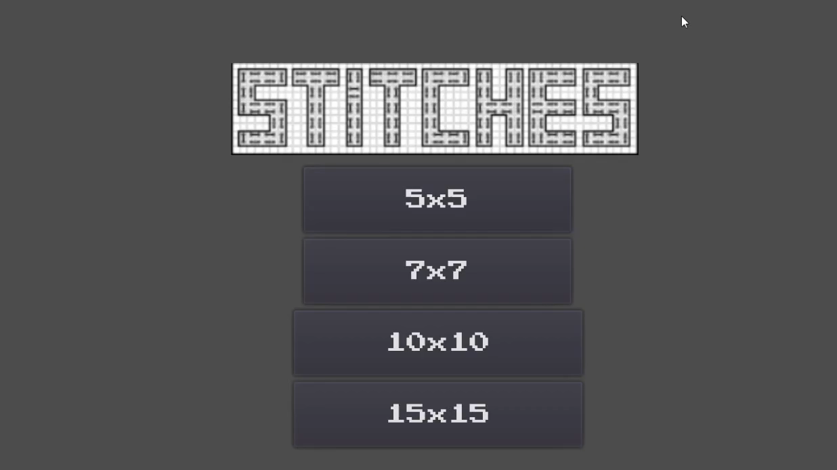
Suggestions

