Slide 1


Stitches
Simone Mungari Luigi Montaleone Matteo Notaro Giuseppe Benvenuto Matteo Loria Andrea De Seta

Slide 2
REPOSITORY GITHUB
https://github.com/MatteoLoria/Stitches_MiniZinc

Slide 3
Minizinc Model & Input Validation

Slide 4
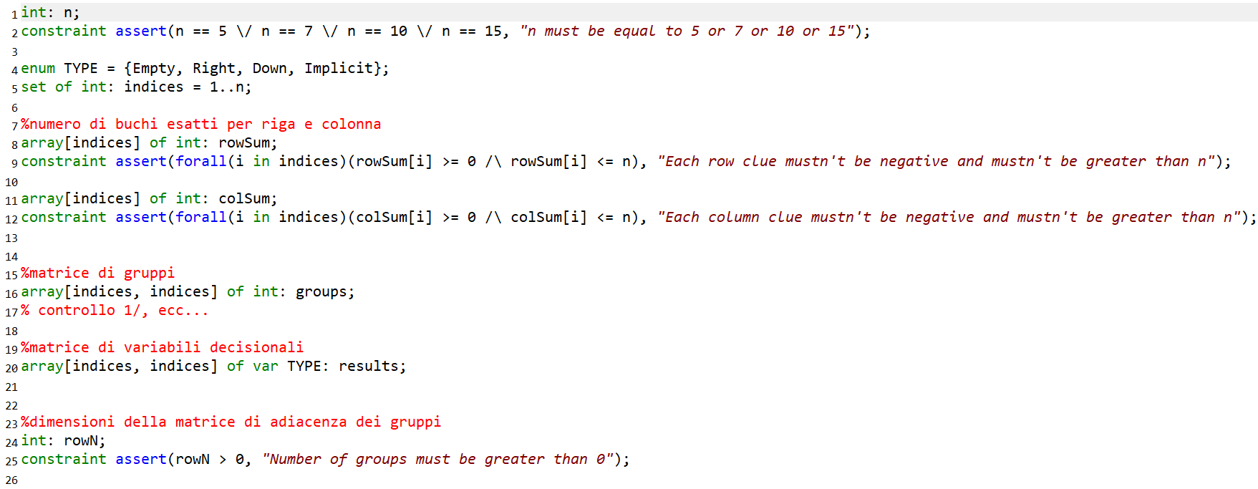
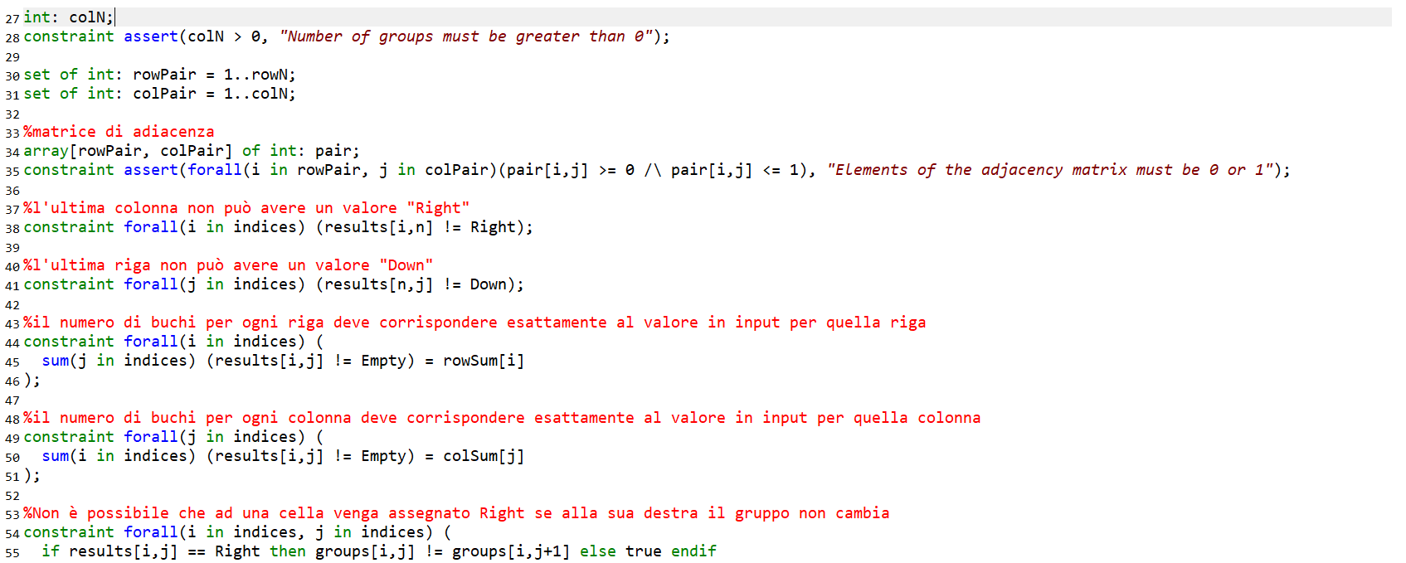

Slide 5
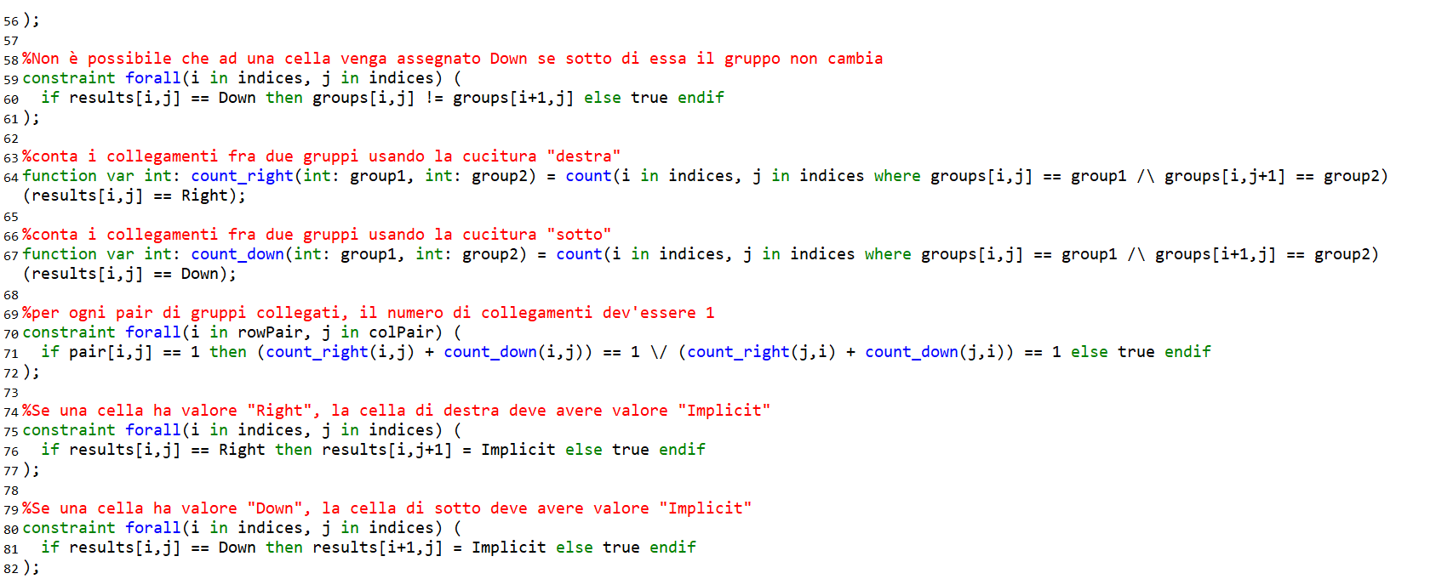
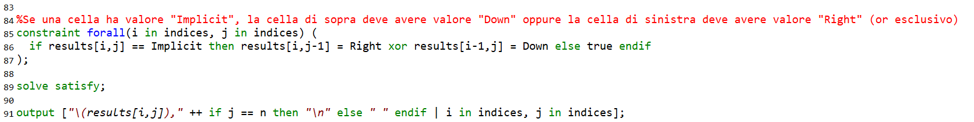

Slide 6

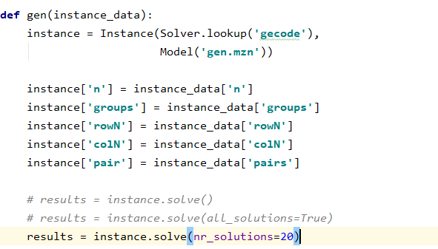
Generate Instances

Slide 7
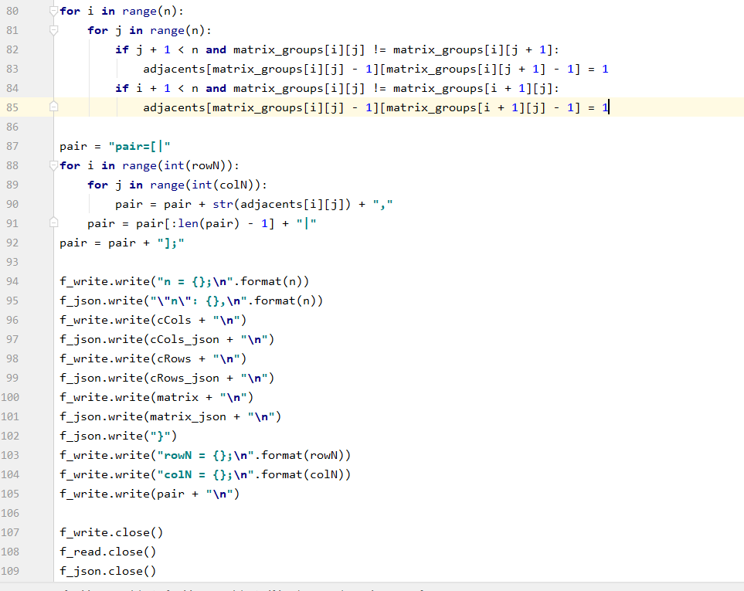
Extract instances

Slide 8
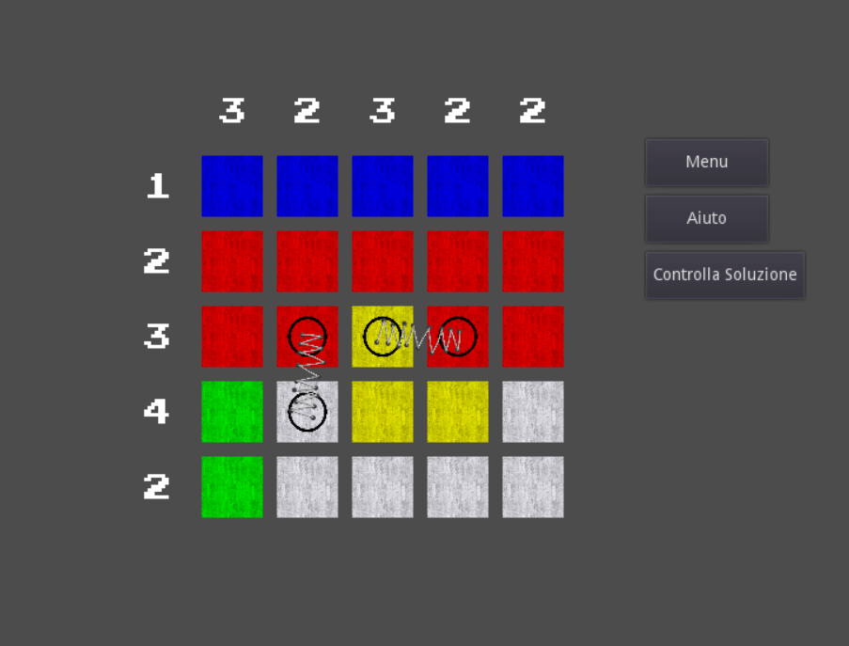
Implement GUI

Slide 9
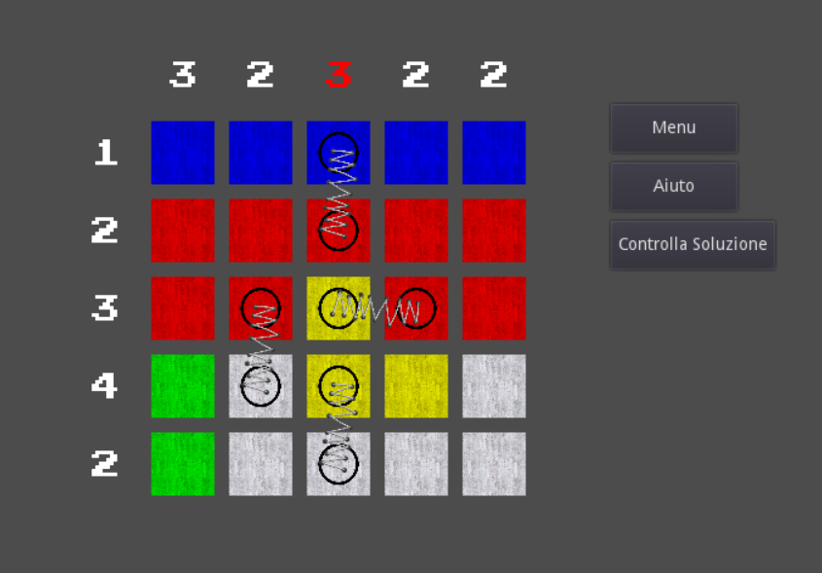
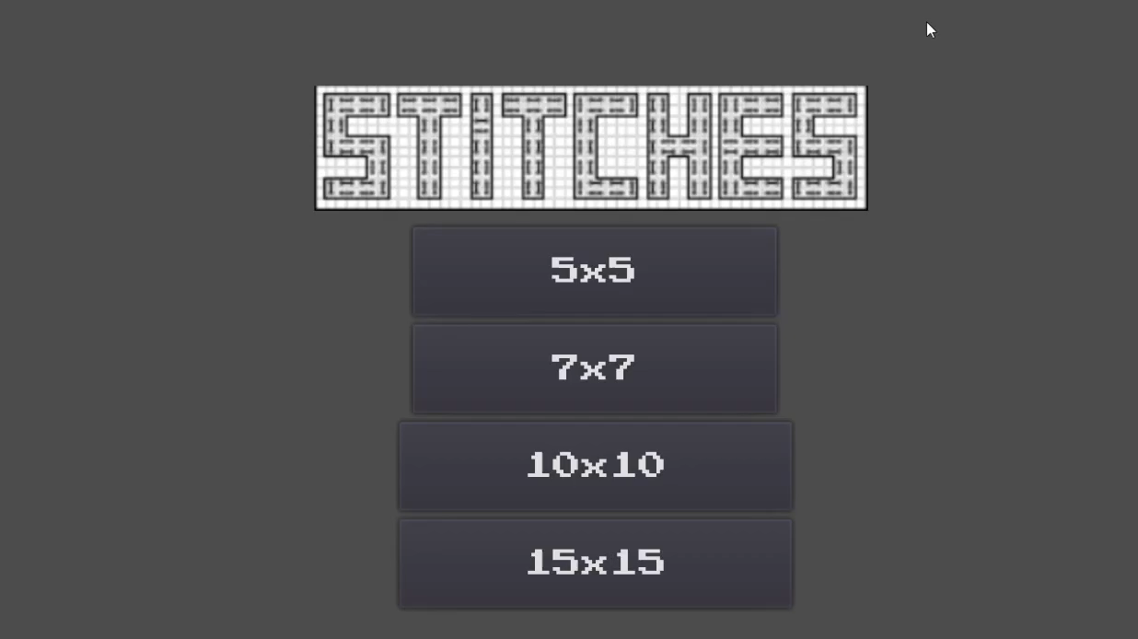
Suggestions

