Slide 1


Titolo presentazione sottotitolo
DETECTION AND RESTORATION OF IMPULSIVE DISTURBANCES
Milano, XX mese 20XX
Sound Analysis, Synthesis and Processing project
Matteo Manzolini (905054), Federico Simeon (914757)

Slide 2

PROJECT’S MAIN STRUCTURE
CLICK GENERATION
CLICK DETECTION (DAAP)
CLICK REMOVAL (SSSP)

Slide 3
CLICK DETECTION ALGORITHMS
AR click detection
[ S. J. Godsill and P. J. W. Rayner, Digital Audio Restoration — A Statistical Model Based Approach, Springer-Verlag, London, UK, 1998 ]
Double threshold detection
[ P. A. A. Esquef, L. W. P. Biscainho, P. S. R. Diniz and F. P. Freelanci, "A double-threshold-based approach to impulsive noise detection in audio signals," 2000 10th European Signal Processing Conference, Tampere, 2000, pp. 1-4. ]
Template matching detection
[ M. Nied´zwiecki, M. Ciołek, Localization of impulsive disturbances in audio signals using template matching, Digit. Signal Process. 46 (2015) 253–265. ]

Slide 4
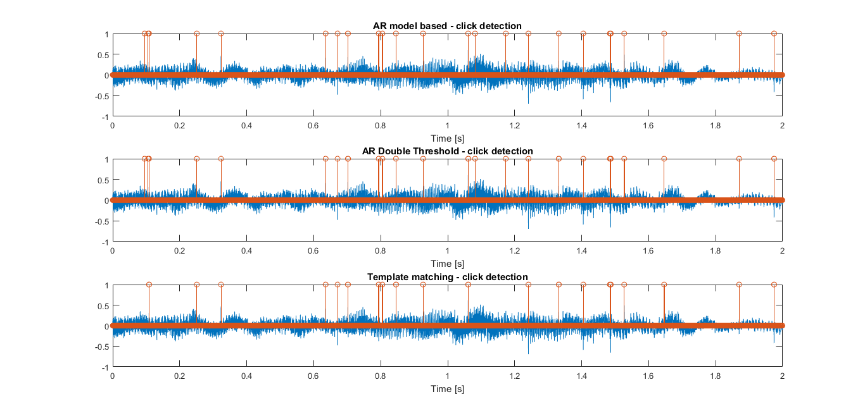
CLICK DETECTION – Mussorgski

Slide 5
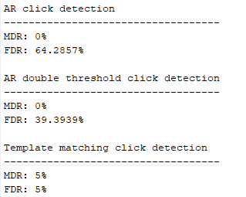
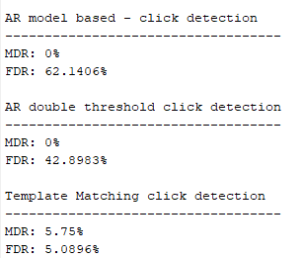
CLICK DETECTION – Mussorgski
Values on a single iteration
Mean values on 20 iterations

Slide 6
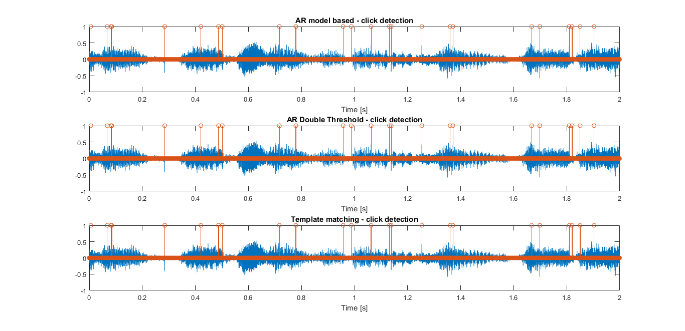
CLICK DETECTION – Hot Fives

Slide 7
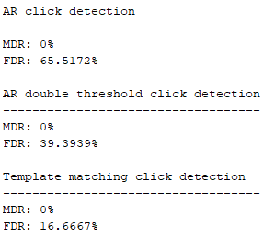
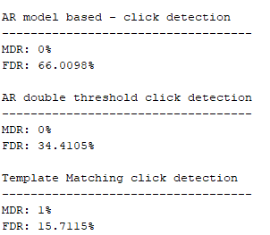
CLICK DETECTION – Hot Fives
Values on a single iteration
Mean values on 20 iterations

Slide 8
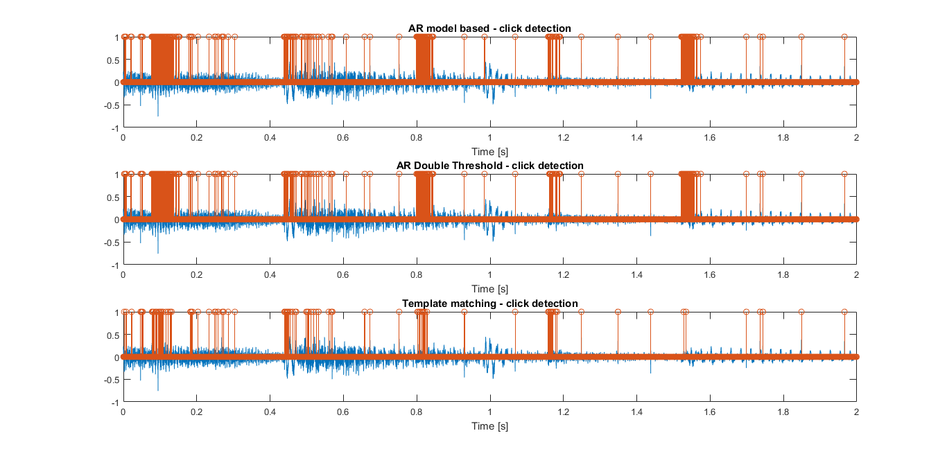
CLICK DETECTION – Morandi

Slide 9
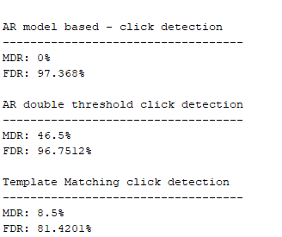
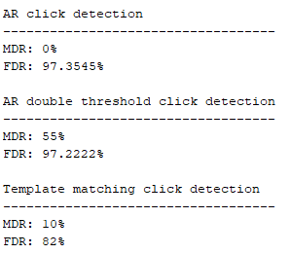
CLICK DETECTION – Morandi
Values on a single iteration
Mean values on 20 iterations

Slide 10
CLICK REMOVAL ALGORITHMS
Adaptive median filter
[ S. Manikandan and D. Ebenezer, "A New Prediction Based Adaptive Median Filter for Restoration of Degraded Audio Signals," 2008 International Conference on Signal Processing, Communications and Networking, Chennai, 2008, pp. 203-207. ]
Weighted Neighbour
[ L. Stanciu and C. Stanciu, "Complete computer program for audio restoration," 2010 8th International Conference on Communications, Bucharest, 2010, pp. 61-64. ]
Least Square AutoRegressive (LSAR)
[ S. J. Godsill and P. J. W. Rayner, Digital Audio Restoration — A Statistical Model Based Approach, Springer-Verlag, London, UK, 1998 ]

Slide 11
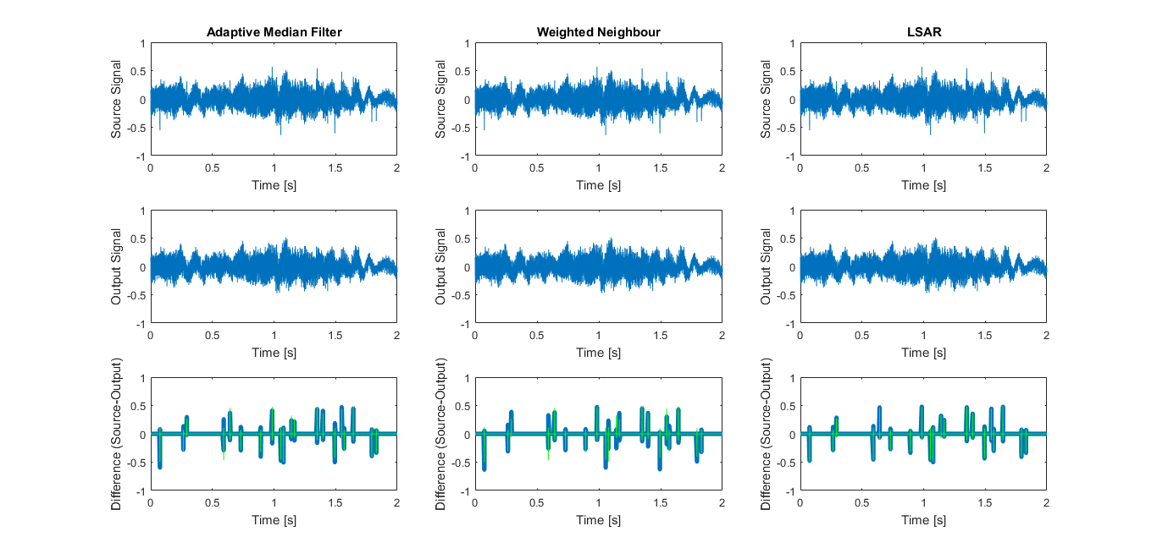
CLICK REMOVAL – Mussorgski

Slide 12
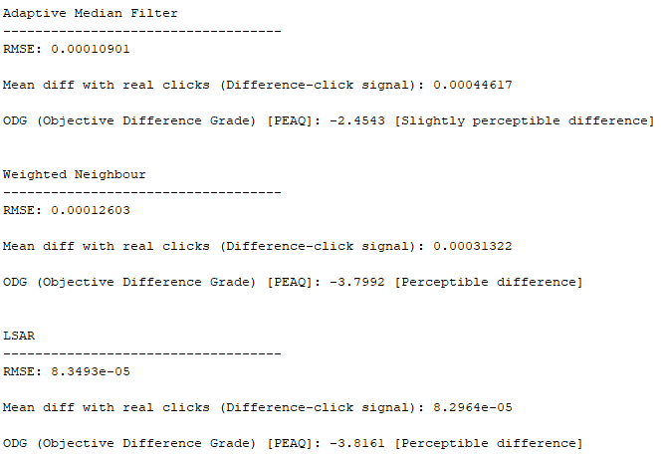
CLICK REMOVAL – Mussorgski
Values on a single iteration

Slide 13
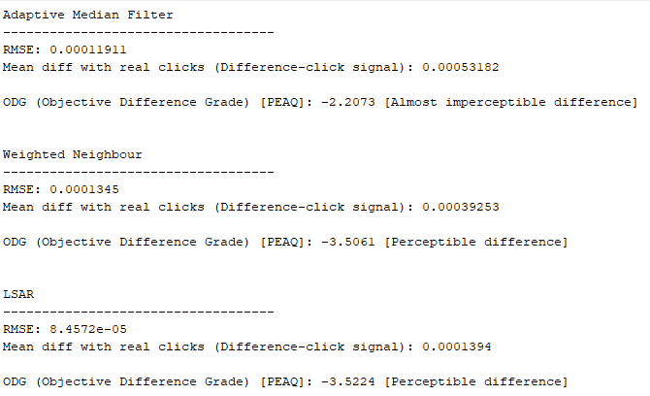
CLICK REMOVAL – Mussorgski
Mean values on 20 iterations

Slide 14
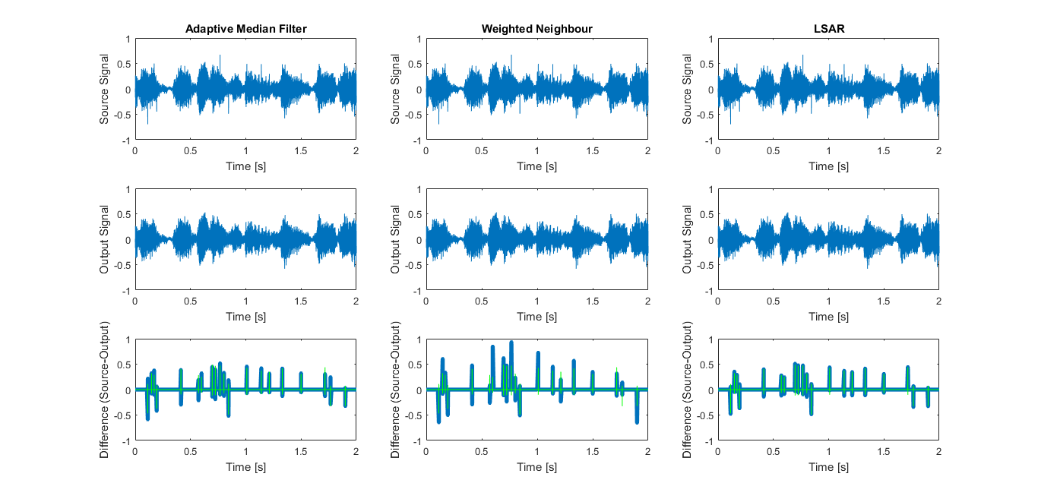
CLICK REMOVAL – Hot Fives

Slide 15
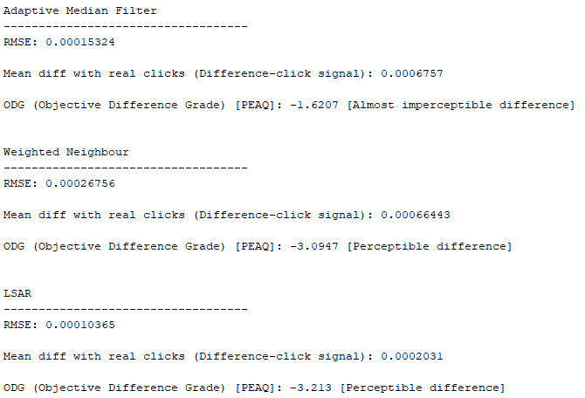
CLICK REMOVAL – Hot Fives
Values on a single iteration

Slide 16
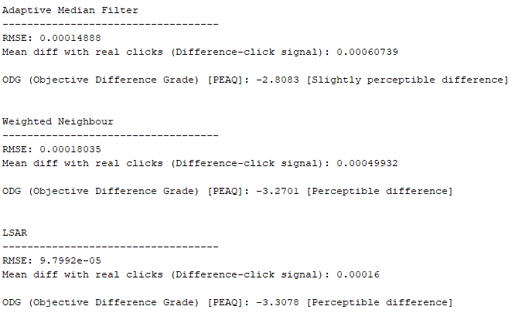
CLICK REMOVAL – Hot Fives
Mean values on 20 iterations

Slide 17
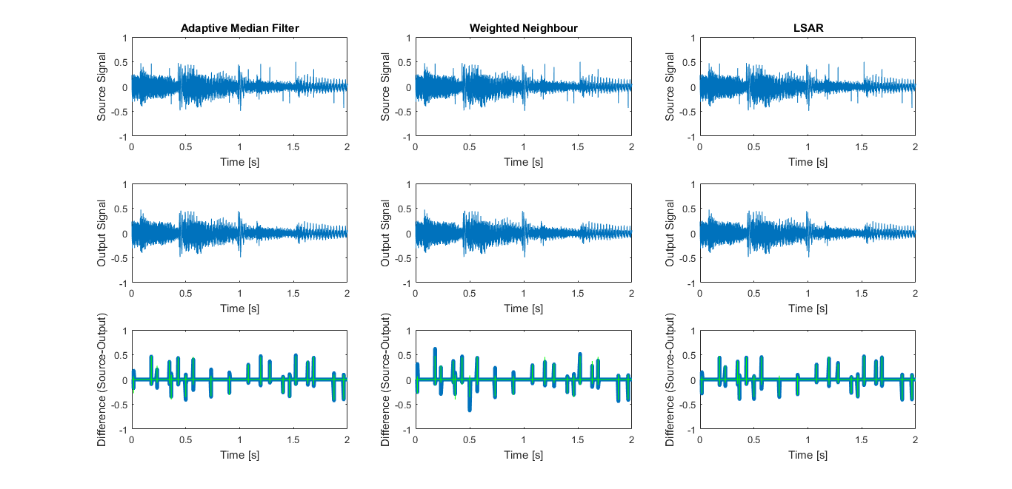
CLICK Removal – Morandi

Slide 18
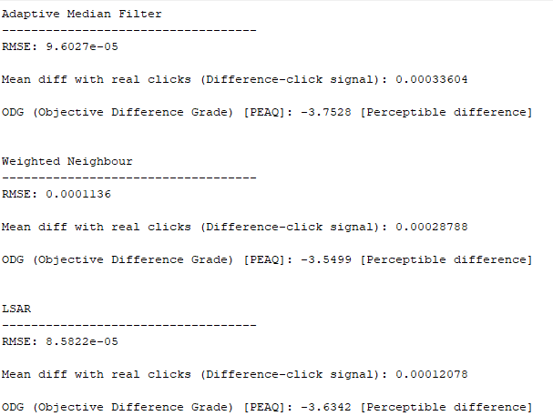
CLICK REMOVAL – Morandi
Values on a single iteration

Slide 19
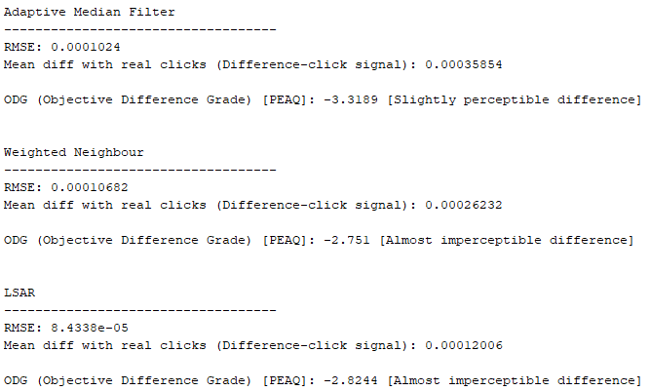
CLICK REMOVAL – Morandi
Mean values on 20 iterations

