Slide 1
Unibo DDR robots

Slide 2
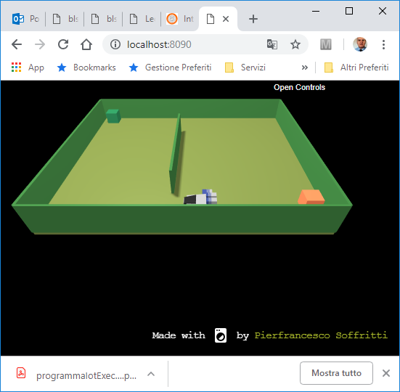

Slide 3
it.unibo.mbot2018
Linguaggi per la interazione con il robot virtuale
- moveForward - `{ "type": "moveForward", "arg": 300 }`
- moveBackward - `{ "type": "moveBackward", "arg": 300 }`
- turnRight - `{ "type": "turnRight", "arg": 300 }`
- turnLeft - `{ "type": "turnLeft", "arg": 300 }`
- alarm - `{ "type": "alarm" }`
commands
webpage-ready - `{ "type": "webpage-ready, "arg": {} }`
sonar-activated - `{
"type:" "sonar-activated",
"arg": { "sonarName": "sonarName", "distance": 1, "axis": "x" }
}`
collision - `{
"type": "collision",
"arg": { "objectName": "obstacle-1" }
}`
info
it.unibo.mbot.virtual.clientTcp.java

Slide 4
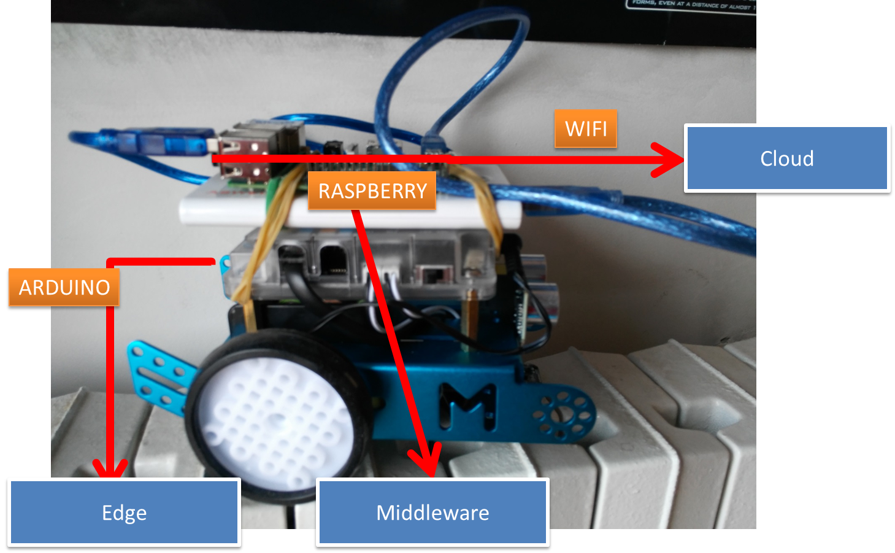
it.unibo.mbot2018

Slide 5
it.unibo.mbot2018
Linguaggi per la interazione con il robot fisico
commands
CMD = w | s | h | a | d
info
A double
it.unibo.mbot/src/mbotConnArduino.java
it.unibo.mbot.serial. …
it.unibo.mbot.MainUsage

Slide 6

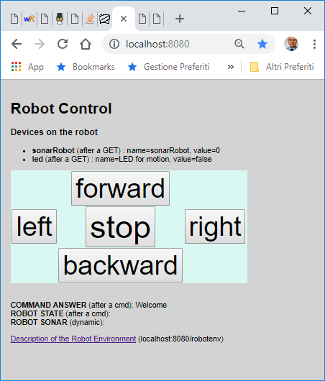
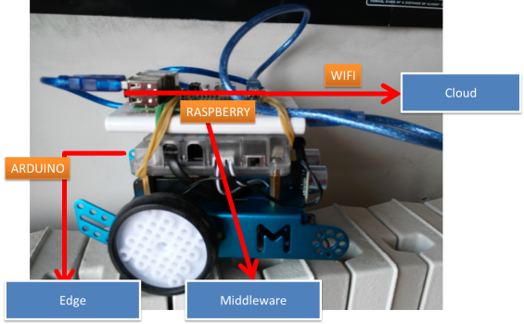
it.unibo.mbot2018
Un server per la interazione remota
clientRobotVirtual.js
not realRobot
Robot
Model
serverRobotCmd.js
realRobot
serial.js
ARDUINO
A solution based on a simple http server
with a model, views and controllers
and a limited usage of Express

Slide 7
it.unibo.mbot2018/nodeCode/robot
Note di costruzione del serverRobotCmd.js
Definizione del modello del robot (e del suo ambiente)
url, robot, robotEnv, meta ajaxAccess.html
{"url":"http://localhost:8080/model/",
"robot": {
"name": "UniboDdrRobot",
"description": "A simple robot model",
"properties":{
"link": "/robotstate",
"resources":{ "state": "stopped“ }
},
"devices":{ "link": "/robotdevices",
"resources":{ … }
},
"actions":{ … }
},
"robotenv": {
"link": "/robotenv",
"name": "RobotEnv",
"description": "The robot environment.",
"devices":{
"link": "/robotenv/devices",
“ resources":{ … }
}
…
nodeCode\robot\models\robot.json

Slide 8
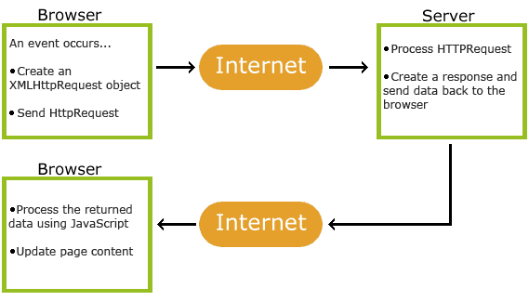
jquery
it.unibo.mbot2018/nodeCode/jQueryAjax
jQuery is a JavaScript Library.
jQuery greatly simplifies JavaScript programming.
ajax
Update a web page without reloading the page
Request data from a server - after the page has loaded
Receive data from a server - after the page has loaded
Send data to a server - in the background
testJQueryAjax.html

Slide 9
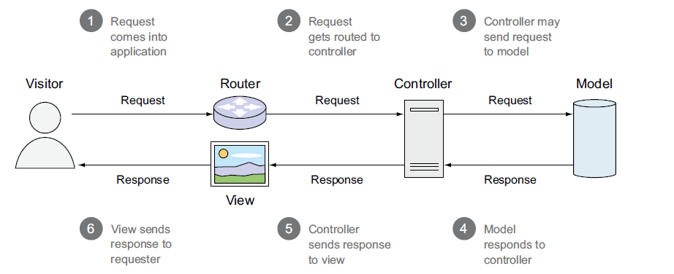
MVC
In MVC web applications, the user will typically request a resource from the server, which will cause the controller to request application data from the model and then pass the data to the view, which will finally format the data for the end user.
The view is often implemented using one of various templating languages. When an application uses templating, the view will relay selected values, returned by the model, to a template engine, and specify what template file should define how to display the provided values.

Slide 10
Express (basic)
https://expressjs.com/en/api.html
app.js (Middleware)
var express = require("express");
var http = require("http");
var app = express();
app.use ( <ARGS> ) ;
app.get ( <ARGS> ) ;
app.put ( < ARGS> ) ;
http.createServer(app).listen(3000);
starts a new Express application and returns a request handler function.
Run this on ALL requests.
routing
Run this on GET, PUT … requests.
( <ARGS> ) =
(‘/’, function( request, response ){..} )
or
( … , function( request, response, next ){…} )
response.send( … )
response.end( … )
views
response.render( … )
https://expressjs.com/en/api.html#res

Slide 11
it.unibo.mbot2018/nodeCode/robot
Note di costruzione del serverRobotCmd.js
Definizione del modello del robot (e del suo ambiente)
robot, robotEnv, links/meta ajaxAccess.html
Predisposizione del server
http, express, iosocket
Impostazione dei rendering engines
access.ejs, robotenv.ejs
Impostazione dei controllers
robotControl
Impostazione del middleware
express.static, app.use, app.get, app.post, ..
Creazione di un supporto per la notifica di eventi
channel
Creazione di supporti per la interazione con i robot fisici e/o virtuali
clientRobotVirtual, serial

Slide 12
iosocket
Middleware
Model
GET
robotControl
POST
robotState
channel
sonarEvent
clientRobotVirtual
serial
sonarEvent

Slide 13
Funzionalità
Consente di inviare comandi a un robot
Visualizza la risposta a un comando e lo stato del robot dopo la sua esecuzione
Permette l’ispezione del modello del robot e dell’ambiente in cui il robot opera
Visualizza lo stato del sonar montato sul robot
….

Slide 14
Robot DDR RASPBERRY-BASED

Slide 15
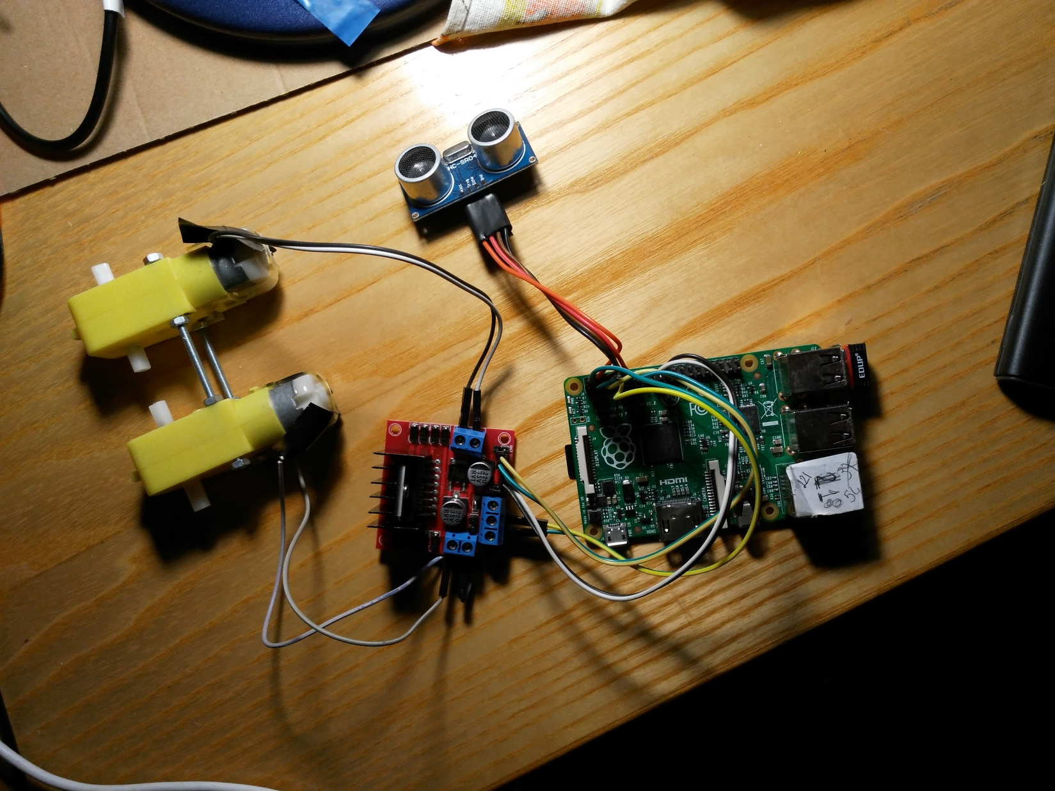
Skeleton

Slide 16
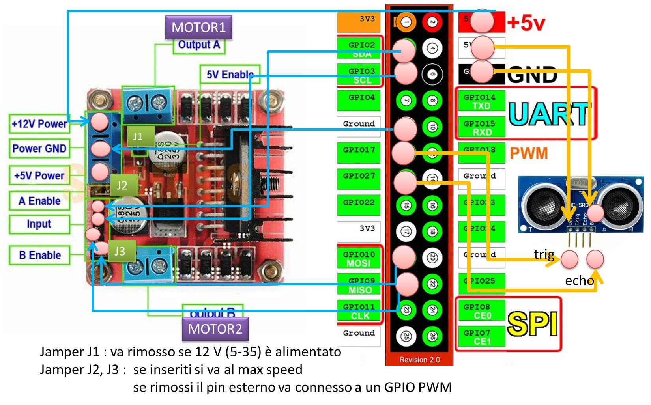
Connections

Slide 17
Resources
C:\Didattica\git\lab2014Bo\it.unibo.lab.baseRobot (robotSAM)
labbaseRobotSam.jar
C:/Didattica/git/lab2014Bo/it.unibo.qactors/report/qactors/qactors2017e.pdf (pg. 77)
it.unibo.robotRaspOnly.BasicRobotUsageNaive
Executes the commands w|a!s|d|h sent from the input console
On robotSkeleton: gpio version: 2.46
On robotNano1: gpio version: 2.29

Slide 18
Towards WOT robot

Slide 19
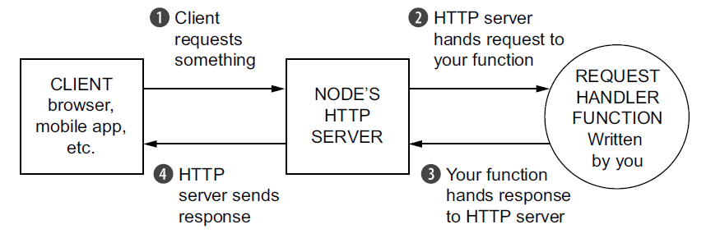
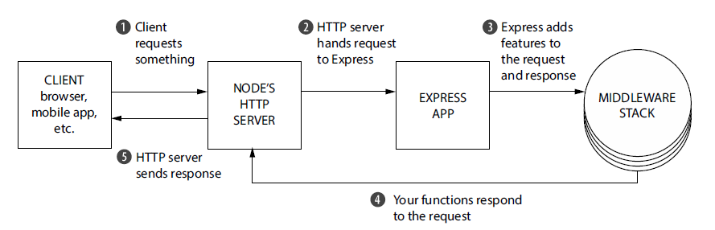
From Node to Express

Slide 20
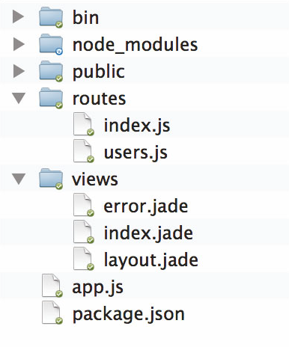
Express (project generated)
express
npm install
npm start
expressGen/app.js
app.js (Middleware)
var express = require("express");
var http = require("http");
var app = express();
app.use ( <ARGS> ) ;
app.get ( <ARGS> ) ;
app.put ( < ARGS> ) ;
http.createServer(app).listen(3000);
starts a new Express application and returns a request handler function.
Run this on ALL requests.
routing
Run this on GET, PUT … requests.
( <ARGS> ) =
(‘/’, function( request, response ){..} )
or
( … , function( request, response, next ){…}
response.send( … )
response.end( … )
views
response.render( … )
https://expressjs.com/en/api.html#res

Slide 21
In a default Express setup, controllers are very much part of the routes, but we want to
separate them out.
Controllers should manage the application logic, and routing should map URL requests to controllers.

Slide 22

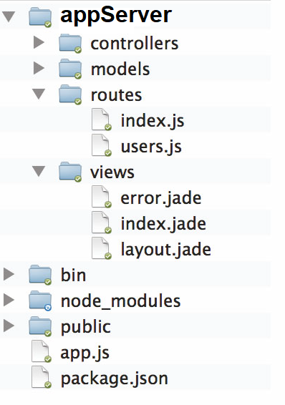
it.unibo.mbot2018/nodecode/robotwot
routing should just map URL requests to controllers embedding the application logic
index.ejs
app.js
var express = require("express");
var http = require("http");
var routes=require('./appServer/routes/index');
// view engine setup
app.set('views', path.join(__dirname, 'appServer', 'views'));
app.set("view engine", "ejs");
var app = express();
app.use( ‘/’, routes ) ;
app.get( ... ) ;
app.put( ... ) ;
http.createServer(app).listen(3000);
robotwot/app.js
https://expressjs.com/en/api.html#res

Slide 23
http://model.webofthings.io
A Web Thing (or simply Thing) is a digital representation of a physical object accessible via a RESTful Web API.
The API of the Web Thing can be hosted on the Thing itself or on an intermediate host in the network such as a Gateway or a Cloud service (for Things that aren't accessible through the Internet).
A Web Thing MUST always accept a valid JSON document [RFC7159] as input payload for requests and always return a JSON representation when requested.
While the Web Things Requirements are described with the HTTP and WebSockets protocols using JSON because they are well supported on the Web of browsers,
the Web Thing Model can also be applied to describe the models and interactions of Things supported via other RESTful protocols such as CoAP [RFC7252] or even pub/sub protocols such as [MQTT].

Slide 24
http://model.webofthings.io
Implementers are encouraged to create a logical tree structure for resources and to use relative URLs to keep JSON payloads short, for instance:
URL | Description
{wt} | The root resource URL
{wt}/model/ | The model of a Web Thing
{wt}/properties/ | The list of properties
{wt}/properties/{id} | A specific property
{wt}/actions/ | The list of actions
{wt}/actions/{id} | A specific action
{wt}/actions/{id}/{actionId} | A specific execution of an action
{wt}/.../

Slide 25
Metadata
{WT} /
must return a set of headers including the links
Link →
</model/>; rel="model",
</properties/>; rel="properties",
</actions/>; rel="actions",
</things/>; rel="things",
</help/>; rel="help",
</>; rel="ui",
<http://model.webofthings.io/>; rel="type“
Done by createRootRoute
Link →
</model/>; rel="model",
</properties/>; rel="properties",
</actions/>; rel="actions",
</things/>; rel="things",
</help/>; rel="help",
</>; rel="ui",
<http://model.webofthings.io/>; rel="type"

Slide 26
Extend the model (properties, actions) with data (alive when the server is alive)
createDefaultData(model.links.properties.resources);
createDefaultData(model.links.actions.resources);
Create the routes
Update the state of the Led in the model by a plugin PL that implements the physical
Update the state of the actionin the model by a POST
Observe the action update and execute PL => update the state of the Led

Slide 27
There is no POST on a Led state
POST on an action (ledState)
create a new instance of the action (state pending)
The observer of the change of the model at action level is a plugin
The plugin
executes the action
adds a new data entry in the (led) model
changes the action state to completed
PREPARATION
generate route per POST on action
GET {WT}/actions returns the list of actions
GET on an action returns the history
GET on led returns the history

Slide 28
it.unibo.mbot2018/nodecode/robotwot
express
npm install
npm start
Response.render( )
views
app.js (Middleware)
var express = require("express");
var http = require("http");
var app = express();
app.use( <ARGS> ) ;
app.get(<ARGS> ) ;
app.put(<ARGS> ) ;
http.createServer(app).listen(3000);
starts a new Express application and returns a request handler function.
Run this on ALL requests.
routing
Run this on GET, PUT … requests.
(<ARGS> )
(‘/’, function( request, response )

Slide 29
it.unibo.mbot2018/nodecode/robotwot
express
routing should just map URL requests to controllers embedding the application logic
.
xxx.ejs
app.js
var express = require("express");
var http = require("http");
var routes=require('./appServer/routes/index');
// view engine setup
app.set('views', path.join(__dirname, 'appServer', 'views'));
app.set("view engine", "ejs");
var app = express();
app.use( ‘/’, routes ) ;
app.get( ... ) ;
app.put( ... ) ;
http.createServer(app).listen(3000);

Slide 30
it.unibo.mbot2018/nodecode/robotwot
http://devices.webofthings.io
curl
postman
metadata
properties
express
actions
http://gateway.webofthings.io
WT
model

