Slide 1
BLS2018
From oop to distributed systems

Slide 2
Workflow
Design
Maintenance
Technology
Oop
Actors
Event driven
Java (C++ …)
JavaScript
Node
PC (OS)
Arduino
Raspberry
Deployment
Testing
Coding

Slide 3
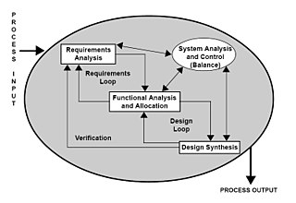

Slide 4
Workflow
Requirement analysis
Problem analysis
Logical architecture of the system
Identification of the software components
Bottom-up
Top-down
Selection and reuse of existing (tested) components
Technology language
Problem-specific supports
Definition of (domain) specific components
Domain-specific language
Domain-specific supports
What is a software component?
How components interact?
Which components embed the business logic?
In any case:

Slide 5
Analysis -> Project -> Implementation
POSSIBILI ‘COMPONENTI’
Funzioni - vedi Js …
Oggetti (POJO)
Componenti soft – vedi OSGI
Attori - vedi akka
Agenti - vedi …
Qactor – vedi custom unibo
…
POSSIBILI ‘Behavior’
Control-based vedi Java, C …
Event-driven vedi Js
Message-driven– vedi akka
POSSIBILI ‘cose da fare’
Dichiarazioni
Istruzionii imperative
Espressioni
Azioni (osservabili, timed,reactive …)
BASIC DOMAIN
‘COMPONENTS’
GOAL: DEFINIRE E COSTRUIRE
Entità riusabili e specializzabili
(con ederitarietà / delegazione)
Button
RequiredLed
Led
Use (or Inherits)?
LedMock
LedImplGui
LedImplGpio
LedImplArduino
All these entities must implement the same interface: ILedImpl

Slide 6
The impact of software
IoT is changing such fundamentals of software application that the traditional programming language constructs and principles are becoming impediments.
Language is the vehicle of thoughts. IOT applications are parallel, asynchronous and distributed, not sequential, synchronous or centralized.

Slide 7
demoBls.pdf (1-3)
it.unibo.bls18
Req0: accendere un Led premendo un Pulsante
IButtonObservable
IObserver
ILed
POJO
POJO
POJO
ButtonMock
BlsApplicationLogic
LedMock
call
call
KEY POINTS
OO Design
Analysis / Project
MainBlsMockBase

Slide 8
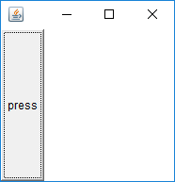
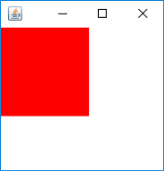
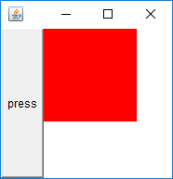
it.unibo.bls18
MainBlsOOModel
IObserver
IObservable
IObserver
ILedObservable
ButtonObserverModel
BlsApplicationLogic
LedObservableModel
call
call
call
call
HIGH
LOW
ButtonAsGui
LedAsGui
IObserver
PHYSICAL
DEVICE
IObservable
MainBlsModelWithGui
KEY POINTS
OO Design Patterns
MVC
Frameworks

Slide 9
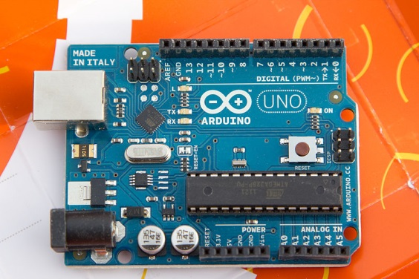
it.unibo.bls18
IObserver
IObservable
IObserver
ILedObservable
ButtonObserverModel
BlsApplicationLogic
LedObservableModel
call
call
call
call
HIGH
LedOnArduino
LOW
ButtonAsGui
PHYSICAL
DEVICE
IObserver
IObservable
ButtonOnArduino
SERIAL LINE
KEY POINTS
Physical device on Arduino
Proxy / Plugins
MainBlsModelWithArduino
PHYSICAL
DEVICE

Slide 10
it.unibo.bls18
IObserver
IObservable
IObserver
ILedObservable
ButtonObserverModel
BlsApplicationLogic
LedObservableModel
call
call
call
call
HIGH
LOW
ButtonAsGui
LedProxy
IObservable
IActorMessage
IObserver
NETWORK
IObservable
LedThingReceiver
call
KEY POINTS
Proxy / Plugins
P2P Two-Way Protocols
Messages
STANDARDS
LedAsGui
IObserver
MainBlsModelWithLedProxy

Slide 11
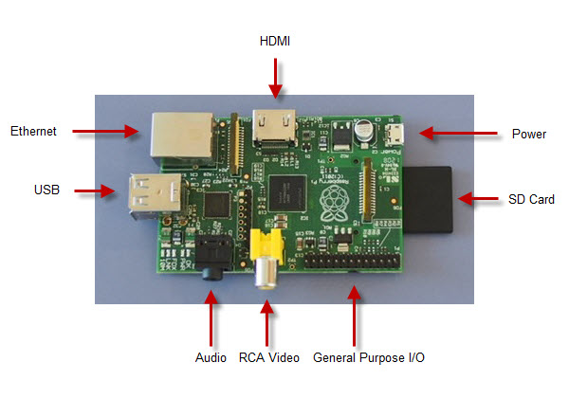
it.unibo.bls18
IObserver
IObservable
IObserver
ILedObservable
ButtonObserverModel
BlsApplicationLogic
LedObservableModel
call
call
call
call
HIGH
LOW
ButtonAsGui
LedProxyForRaspberry
IObservable
IObserver
ButtonOnRaspberry
NETWORK
LedOnRaspberry
todo
KEY POINTS
Physical device on Raspberry
Proxy / Plugins
GPIO / bash
/boot/mywifi.conf
PHYSICAL
DEVICE
MainBlsModelWithRaspberry

Slide 12
Req1: accendere un insieme di Led premendo un Pulsante

Slide 13
MOM
Publish–subscribe pattern
(remote)
Msg
Broker
topics
Observer
publish
subscribe
sensor
API
write
read
Application program
Worker
The MQ Telemetry Transport (MQTT) is an ISO standard (ISO/IEC PRF 20922) supported by the OASIS organization.
Eclipse Mosquitto™ is an open source (EPL/EDL licensed) message broker that implements the MQTT protocol versions 3.1 and 3.1.1.

Slide 14
Mosquitto on Docker
Images (docker pull … )
docker images
Container (a runnable instance of an image)
docker run -p 8484 -a stdin -a stdout -i -t --name natdocker node:nat /bin/bash
docker ps
docker start /stop --container
docker run -ti -p 1883:1883 -p 9001:9001 eclipse-mosquitto
Run for MQTT + websocket: docker run -d -p 1883:1883 -p 9001:9001 --name=mosquitto sourceperl/mosquitto
docker ps -a
docker start d8a5f1fefc5b
docker ps
docker exec -it d8a5f1fefc5b /bin/bash wizardly_ride

Slide 15
Activate a MQTT server on localhost:1883 (Docker images)
docker run -ti -p 1883:1883 -p 9001:9001 eclipse-mosquitto
it.unibo.bls18
IObserver
IObservable
IObserver
ILedObservable
ButtonObserverModel
BlsApplicationLogic
LedObservableModel
call
call
call
call
HIGH
LOW
ButtonAsGui
publish
LedPublisher
IObservable
IObserver
IActorMessage
NETWORK
IObservable
tcp://m2m.eclipse.org:1883
subscribe
MQTT Server
LedSubscriber
unibo/ledState
call
LedAsGui
KEY POINTS
Models as Resources
Rest
MainManyLeds
PHYSICAL
DEVICE
LedSubscriberOnRasp
IObserver
MainTreeLeds

Slide 16
KEY POINTS at the end of phase1
SISTEMI (DISTRIBUITI ETEREOGENEI
ARCHITETTURE – DESIGN PATTERN
STANDARD DI INTERAZIONE/COMUNICAZIONE:
Messaggi (dispatch, invitation, request, …)
Eventi (messaggi ‘senza destinatario’???)
Protocolli P2P (TCP, UDP, CoAP, HTTP, …) o publish/subscribe
Payload (vocabolari)
M2M, Man2M, M2Man (ManToMan)
SCHEMI DI COMPORTAMENTO
Message-Event BASED (FSM)
Message-Event DRIVEN

Slide 17
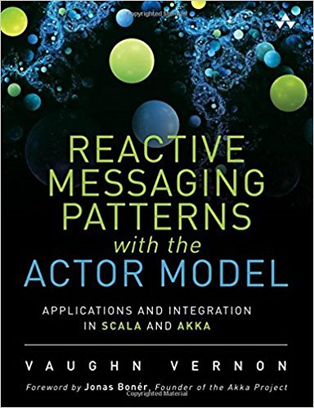
A new paradigm
actor
actor
Message
Message:
Dispatch
Request
Invitation
2016
Register as publisher
Register as subscriber
actor
publish
broker
actor
actor
actor
Event
Event

Slide 18
Behaviour
actor
The actor can handle messages/events:
1) as a FSM
2) as a reactor
Message
Event
Events can be emitted by asynchronous operations
write on a file
send a request
…

Slide 19
Strategic Information Systems
SIS
Software produces business competitive advantage (strategic results).
The Actor model allows us to design software models that are:
responsive, resilient, elastic,message-driven
more understandable
able to employ both sequential and functional programming techniques in a highly dynamic environemt
able to abstractely increase the distributiviy of computation as it evolves, by dynamically creating new actors
integrable with existing systems
Beyond performance and scalability, we need to reflect the mental model of business.
The Actor model allows us to intersect with the DDD-based approach.

Slide 20
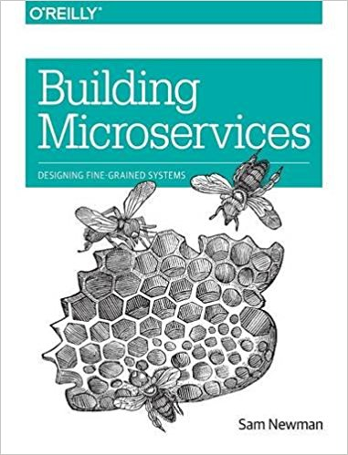
Microservices
Microservices is a variant of the service-oriented architecture (SOA) architectural style that structures an application as a collection of loosely coupled services: services should be fine-grained and the protocols should be lightweight.
Microservices emerged from: domain-driven design, conitnuos delivery, on-demand virtualization, infrastructure automation, small autonomous teams, systems at scale.
Microservices improve modularity and makes the application easier to understand, develop and test. It also parallelizes development by enabling small autonomous teams to develop, deploy and scale their respective services independently.It also allows the architecture of an individual service to emerge through continuous refactoring. Microservices-based architectures enable continuous delivery and deployment.
Distributed systems have become more fine-grained in the past 10 years, shifting from code-heavy monolithic applications to smaller, self-contained microservices.
With lots of examples and practical advice, this book takes a holistic view of the topics that system architects and administrators must consider when building, managing, and evolving microservice architectures.
2015

Slide 21
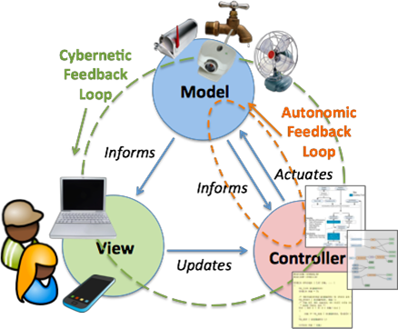
IL SISTEMA BLS (IOT minimal)
DOPO avere costruito il sistema:
Cosa è un LED? Cosa è un BUTTON?
Cosa fa il sistema?
Come fa un utente a sapere quello che fa?
IL PATTERN MVC

Slide 22
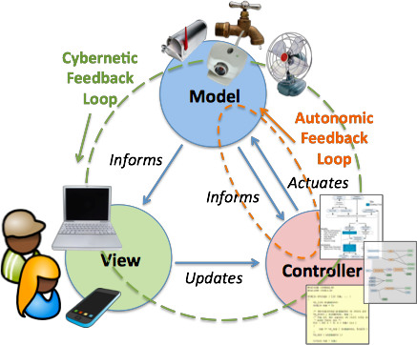
MVC
The Model-VIew-Controller macro pattern provides a framework for the structured division of responsibility between people and software in IoT applications. It also provides a framework for high level interoperability between data sources, control elements, and UI elements.
The Model is a representation or an abstraction of the physical things and their attributes, which informs a Controller.
The Controller is software which makes actuation decisions based on the information, and sends actuation commands to the thing using it’s modeled affordances.
The software goal is to maintain a desired state of the thing through it’s model.

Slide 23
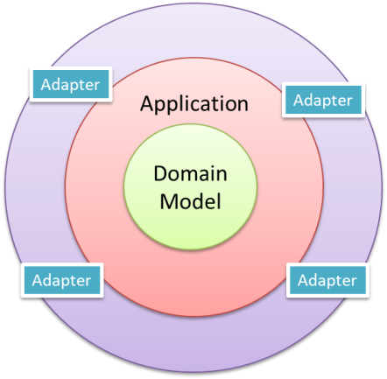
SISTEMI: una visione ‘olistica’
VISTE DI UN SISTEMA
Dal di fuori (cosa fa)
Dal di dentro (come è fatto)
ARCHITETTURA ESAGONALE
The connection between the inside and the outside part of the system is realized via abstractions called ports and their implementation counterparts called adapters.

Slide 24
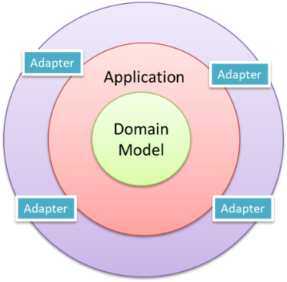
Hexagonal Architecture (Port-Adapter)
Alistair Cockburn
Allow an application to equally be driven by users, programs, automated test or batch scripts, and to be developed and tested in isolation from its eventual run-time devices and databases.
As events arrive from the outside world at a port, a technology-specific adapter converts it into a usable procedure call or message and passes it to the application. The application is blissfully ignorant of the nature of the input device.
When the application has something to send out, it sends it out through a port to an adapter, which creates the appropriate signals needed by the receiving technology (human or automated).
The application has a semantically sound interaction with the adapters on all sides of it, without actually knowing the nature of the things on the other side of the adapters.

Slide 25

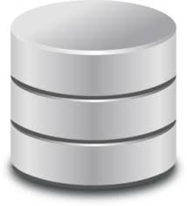
Domain events
persistence
Input
handling
Application
service
Domain
model
Output
adapter
Security
GUI
Security
Transactions
Task coordination
Entities
Business Logic
Domain events
Repositories
Documents
Cache
Inbound gateways
Outbound gateways
Core
HTTP
ZeroMQ
MongoDB
CloudWatch
Kinesis

Slide 26
Inbound gateways
Outbound gateways
Core
HTTP
ZeroMQ
MongoDB
CloudWatch
Kinesis
https://dzone.com/articles/hexagonal-architecture-it-works
Core components never violate the "only leave the process via a gateway" rule.
All out-of-process access (including logging) must flow through a gateway.
Simplifying testing is the primary benefit with the ability to swap out both
inbound and outbound integration points a close second.
Implement inter-service gateways using ZeroMQ which is a messaging system
that can operate both in-memory and distributed.
In theory, you could move a previously in-process service into its own microservice
with only minor changes to the ZeroMQ configuration.

Slide 27
MVC (WoT) loops
This cycle of Observation => Information => Actuation
creates a feedback control loop where the observed
property is controlled in a system known as a closed loop.
Cybernetic feedback loops, which involve a person in the loop participating in making decisions. For example, the person in the cybernetic loop is updating settings of an autonomic loop controller.
Autonomic feedback loops involve only software making decisions. An example of this is a motion sensor turning on a light.

Slide 28
Req2: accedere a un Led via web/REST
REST = REpresentational State Transfer: is an architectural style
Definiamo il modello come CoAp-resource osservabile
Inseriamo la CoAp-resource entro un CoAp-server (port 5683)
La CoAp-resource usa come observer il LedObservableModel già definito
Accediamo alla CoAp-resource attraverso un CoAp-client osservatore (CoapLedObserverClient) che invia GET e PUT
Modifichiamo il LedObservableModel attraverso un sotto-sistema. Le modifiche verranno osservate dalla CoAp-resource che aggiorna tutti i client osservatori
Osserviamo le modifiche della CoAp-resource lato client

Slide 29
Coap Californium
A CoAP server hosts a tree of Resources which are exposed to clients by means of one or more Endpoints which are bound to a network interface.
CoapResource is a basic implementation of a resource.
CoapResource uses four distinct methods to handle requests: handleGET(), handlePOST(), handlePUT() and handleDELETE().
Each resource is allowed to define its own executor.
CoapResource supports CoAP’s observe mechanism. Enable a CoapResource to be observable by a CoAP client by marking it as observable with setObservable(boolean).
The class ResourceObserver has nothing to do with CoAP's observe mechanism but is an implementation of the general observe-pattern.

Slide 30
it.unibo.bls18
CoapClient
Resource
CoapServer
CoapResource
handleGet
handlePut
…
Get
Put
Post
…
5683
LedCoapResource
CoAP observable
NETWORK
ILedObservable
The model is accessible from the network
A model change is propagated to physical
LedObservableModel
call
HIGH
IObserver
LOW
Plugin
PHYSICAL
DEVICE
event
KEY POINTS
Models as Resources
RestFul interaction
MainCoapBasicBls
CoapLedObserverClient

Slide 31
Inherits or use? → The resource USES the model
public class LedCoapResource extends CoapResource implements IObserver{
privateILedObservable ledModel ;
public LedCoapResource(String name, ILedObservable model ) {
super(name);
ledModel = model;
}
@Override //CoapResource
public void handleGET(CoapExchange exchange) {
exchange.respond( ResponseCode.CONTENT, getValue(), MediaTypeRegistry.TEXT_PLAIN) ;
}
@Override //CoapResource
public void handlePUT(CoapExchange exchange) {
try {
String value = exchange.getRequestText();//new String(payload, "UTF-8");
if( value.equals("switch")) switchValue(); else setValue(value);
exchange.respond(CHANGED, value);
} catch (Exception e) {
exchange.respond(BAD_REQUEST, "Invalid String");
}
}
protected void setValue(String v) {
if( v.equals("true")) ledModel.turnOn();
else ledModel.turnOff();
modelModified(); // notify all observers
}

Slide 32
La disponibilità del modello come CoAp-resource ci permette di definire una ‘LedThing’ accessibile via rete (MainCoapBasicLed, MainLedCoapOnRaspberry) e
di definire la business logic cone CoAp-client del modello (BlsApplicationLogicCoap)
di definire un server HTTP (serverHttpToCoap.js) che rende visibile via Web lo stato corrente della LedThing

Slide 33
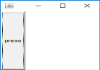
it.unibo.bls18
MainCoapControlToLedRest
IObserver
IObservable
IObserver
ILedObservable
ButtonObserverModel
BlsApplicationLogic
LedObservableModel
call
call
HIGH
ButtonAsGui
IObservable
Get
Put
Post
…
IObserver
LOW
LedOnRaspberry
NETWORK
Resource
CoapResource
The ‘thing’ is accessible via CoaP
A change on the model is propagate on physical
5683
CoapServer
LedCoapResource
LedObservableModel
KEY POINTS
Led Thing
Rest
IObserver
MainCoapBasicLed
Plugin
PHYSICAL
DEVICE
MainLedCoapOnRaspberry

Slide 34
Req3: accedere a un Led mediante una pagina WEB e visualizzare
lo stato del Led nella pagina

Slide 35
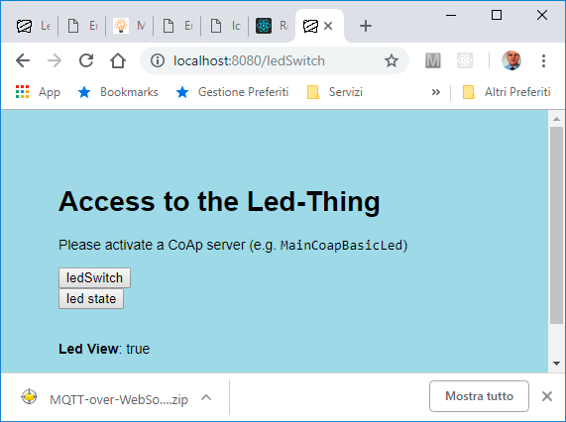
2
it.unibo.bls18
MainCoapControlToLedRest
IObserver
IObservable
IObserver
ButtonObserverModel
BlsApplicationLogicCoap
call
ButtonAsGui
IObservable
8080
Get
Put
Post
…
3
serverHttpToCoap.js
subscribe
5683
CoapServer
unibo/bls18
LedCoapResource
MQTT Server
MainCoapBasicLed
publish
1
LedObservableModel
KEY POINTS
Front end server
JavaScript
WebSockets
IObserver
LedAsGui

Slide 36
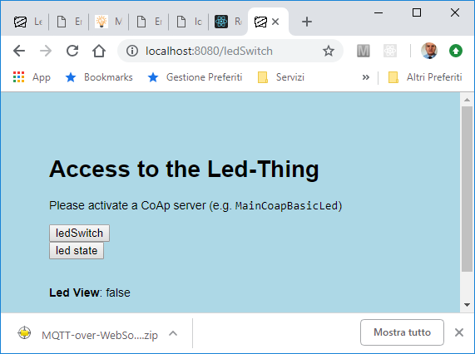
MainCoapBasicLed: rende disponibile il Led come risorsa Coap (LedThing) inserendo in un server Coap la risorsa LedCoapResource
MainCoapControlToLedRest: crea un (sotto)sistema che modifica la LedThing usando un ButtonGui
serverHttpToCoap.js: fornisce un front-end web alla LedThing che
Offre all’utente pulsanti per modificare/ispezionare la LedThing
Offre una vista aggiornata del valore corrente della LedThing usando una WebSocket
LedCoapResource
Risponde alle richieste GET/PUT per url=/Led
modifica lo stato del Led
come observer di ledmodel
in risposta a una PUT
agisce come observable
rispetto al led concreto
rispetto ai clienti Coap
Pubblica via MQTT le modifiche di stato sulla topic unibo/bls18. Queste sono ricevute dal server che aggiorna le pagine HTML via WebSocket

Slide 37
The resource as ‘THE MODEL’

Slide 38
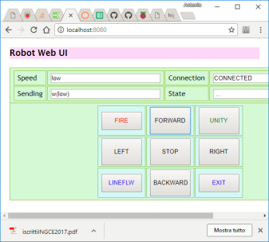
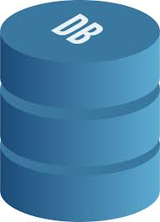
External
Appl
update
Adaper UI
External
Appl
Controller
Adaper INPUT
Resource
(domain)
Model
Adaper
CoAP
Actuator 1
update
OPC-UA
Sensor 1
Adaper
Adaper
Actuator N
Sensor N
Adaper
Adaper DB

Slide 39
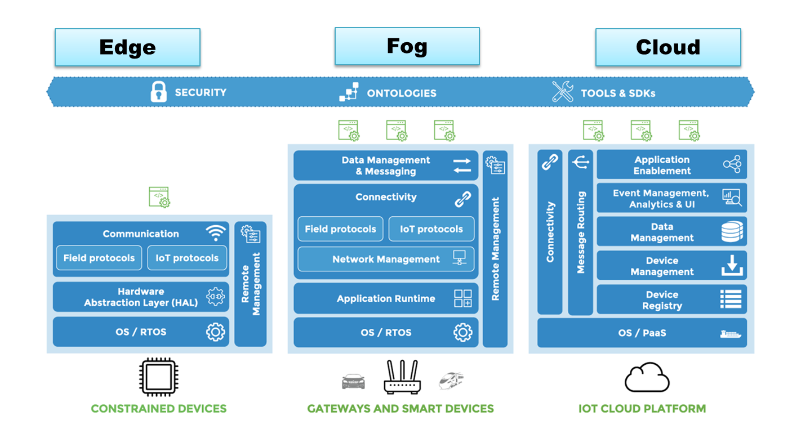
The business logic
Machine1
Resource
(domain)
Model
High Level Server
MachineN

Slide 40
Inherits or use? → The resource IS the model
public class LedResource extends CoapGofObservableResource {
public static final String resourcePath = "led";
private String value = "false";
public LedResource() {
super(resourcePath);
}
@Override //CoapResource
public void handleGET(CoapExchange exchange) {
exchange.respond( value );
}
@Override //CoapResource
public void handlePUT(CoapExchange exchange) {
try {
value = exchange.getRequestText();
setValue(value);
exchange.respond(CHANGED, value);
} catch (Exception e) {
exchange.respond(BAD_REQUEST, "Invalid String");
}
}
}
@Override // CoapGofObservableResource
public void setValue(String v) {
value = v ;
update(value);//notify the GOF observer
}

Slide 41
Observable (CoAP) resource
Resource
ResourceLObserver
CoapResource
IResourceIot
IResourceLocalGofObserver
CoapGofObservableResource
ResourceLocalGofObserver
SomeResource
SomeResourceGofObserver
PHYSICAL
DEVICE
update
usercmd
MQTT Server

Slide 42
LedResource
Risponde alle richieste GET/PUT per url=/Led
modifica lo stato del Led in risposta a una PUT
agisce come observable
rispetto al led concreto
rispetto ai clienti Coap
Pubblica via MQTT le modifiche di stato sulla topic unibo/bls18.
it.unibo.bls18
Led Thing
CoapResource
IResourceIot
IResourceLocalGofObserver
CoapGofObservableResource
ResourceLocalGofObserver
5683
LedResource
LedAsGuiPluginObserver
PHYSICAL
DEVICE
update
GET
LedResource
PUT
unibo/bls18
MQTT Server
LedThing
CoAp client
publish

Slide 43
ButtonResource
Risponde alle richieste GET/PUT per url=/Led
agisce come observable
rispetto ai clienti Coap
rispetto a osservatori GOF.
it.unibo.bls18
Button Thing
CoapResource
IResourceIot
IResourceLocalObserver
CoapGofObservableResource
ResourceLocalObserver
8020
ButtonResource
ButtonResourceGofObserver
update
PHYSICAL
DEVICE
ButtonAsGuiRestful
ButtonResource
CoAp client
GET
ButtonThing
PUT

Slide 44
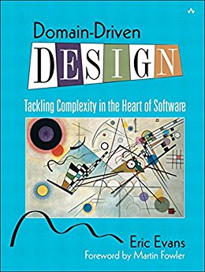
DDD
Software
developer
Designer
Domain
expert
Developers are insulated from the domain experts. If a developer does not understand a concept, it is likely the implementation will not accurately reflect the domain.
Developers without solid design principles will produce a code that is hard to understand or change – the oppostive of agility. (pg. xxiij)
2004
Domain model: a rigorously organized and selective abstraction of the knowledge in a domain’s expert head (pg. 3).
One model should underlie implementation, design and team communications (pg. 41)
The model is the backbone of a language used by all team members (pg.4, 26).
iterate a single model to reflect a shared understanding across domain experts, designers and developers
establisha common language, i.e. a UBIQUITOUS LANGUAGE (pg. 24)
Code as a design document does have its limits (pg. 38). A document should explain the concepts of the model and must be involved in project activities (pg.39)
Effective domain modelers are knowledge crunchers. Continuous learning takes place between domain experts, designers and developers (pg. 15)
(OO) MODEL-DRIVEN DESIGN pg. 47

Slide 45
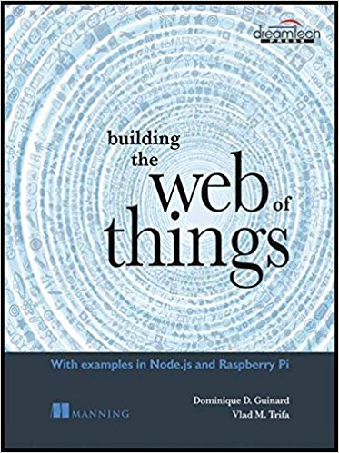
Web Thing Model
Model : metadata
Type : metadata
Product : metadata
1
led
2
properties
pir
wt
temperature
humidity
ledState action 1234
actions
ledState
ledState action 1235
http://gateway.webofthings.io/properties/pir
http://model.webofthings.io W3C

Slide 46
MVC-based servers providing an API
A model is the representation of a specific category of data, or entity, within the
application. A Model should not know about the rest of the application.
The View should contain logic for rendering structured data. The View should not have knowledge of the rest of the application. A view engine (EJS, PUG) can be defined as a module that does the actual rendering of views.
The Controller uses the Models and Views to accept and handle inputs and commands from the user.
MVC server handles requests by delegating the work to proper controllers. It may be a good idea to extract the business logic out to a service class and treat the controller as a method of accepting and returning (http) requests. The answer wiil be a status code and some (JSON) data.
Controller that access a resources with RESTFul API (to perform common CRUD functions ( create, read, update, delete) do not depend any more on data representation.

Slide 47
Terminology
WT: Web Thing
Model: metadata that defines various aspects of a WT, such as name, description, or configurations.
Properties: represent the internal state of a WT. A property is a collection of data values that relate to some aspect of the WT. Properties can be modified through actions.
Actions: functions offered by a WT (e.g. 'open','close','enable','scan',...).
ExternalThing: a (Application Layer) gateway to other devices that don't have an internet connection.

Slide 48
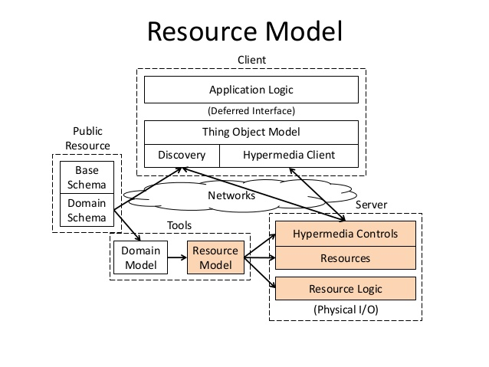

Slide 49
WOT design
Resource design. Identify the functionality or services of a Thing, and organize the hierarchy of these services.
Integration strategy. Choose a pattern to integrate Things to the internet and the web. The main patterns are:
Direct integration pattern (REST on device). A device can directly connect to the internet, e.g. via Wi-Fi or Ethernet.
Gateway integration pattern. Resource-constrained devices can use non-web protocols (e.g. ZigBee, Bluetooth) to talk to a more powerful device (the gateway), which then exposes a REST API for those non-web devices.
Cloud integration pattern. An extension of the gateway pattern where the gateway is a remote server that devices and applications access via the Internet.
Representation design. Decide which representations will be served for each resource.
Interface design. Decide which commands are possible for each service, along with which error codes.
Resource linking design. Decide how the different resources are linked to each other.

Slide 50
WoT
Integration patterns: REST on device, Gateway (CoAP), Cloud (MQTT)
Resource model design : (ontology) tree, knowledge base, ..
Representation design : json, prolog, HTML, MessagePack, …
Interface design : GET, PUT, etc
Resourse binding design : HAETOAS (web linking,..), findability, …
HATEOAS (Hypermedia as the Engine of Application State): state changes within an application happen by following links, which meets the self-contained-messages constraint. Links enable clients to discover related resources, either by browsing in the case of a human user following links on pages, or by crawling in the case of a machine.

Slide 51
GOALS
Define a server in Node
Provide a RESTful API for resources (data and things)
Define a sensor plugin to update properties in the resource model
Define an actuator plugin to observe the model and update properties when changing the state after an action has been executed.

Slide 52
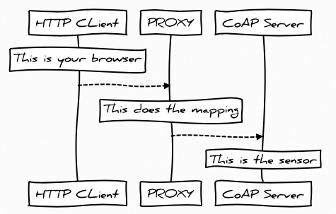
it.unibo.bls18
8080
serverHttpToCoap
2
CoAp client
ButtonResource
BlsHexagApplLogicObserver
update
subscribe
CoAp client
5683
CoAp server
LedResource
LedAsGuiPluginObserver
PHYSICAL
DEVICE
GET
publish
PUT
unibo/bls18
MQTT Server
BlsHexagSystem
1
3
PHYSICAL
DEVICE
CoAp client
ButtonAsGuiRestful
CoapLedObserverClient

Slide 53
Mongo (on Docker)
Req4: creare un Log delle varizioni di stato
docker ps -a
docker start natmongo
docker ps
docker exec -it natmongo /bin/bash
root@2dfcc1e4a145:/# mongo
show dbs
use mongoNaive
show collections => bls18logs, users
db.users.find()
db.users.find().pretty()
db.users.find( {"username" : "aa"} )

Slide 54
Mongoose (datamodel)
//models/dataModel.js
var mongoose = require( 'mongoose' ); //npm install --save mongoose
var dataSchema = new mongoose.Schema({
log: { type: String, required: true }
});
//Create a data model using the schema;
var Bls18DataLog =
mongoose.model('bls18Log', dataSchema); //collection bls18Logs;
module.exports = Bls18DataLog;
utilsMongoose.js
curl -X POST -d "{ \"log\": \“lxxx\" }" http://localhost:8080/api/log

Slide 55
Control
//controls/ctrlAddLogRest.js
var Bls18DataLog = require('../models/logModel');
module.exports.addLog = function(indata, response, cb){
var data = cvtDataToJson(indata);
var newData = new Bls18DataLog( {
log: data.log
} );
console.log("ctrlAddLogRest SAVING " + JSON.stringify( newData) );
newData.save( function(err) {
var s = "";
if( err ) s="ERROR in adding log";
else s="Data saved successfully";
cb( err, response, s ); //standard;
});
}

Slide 56
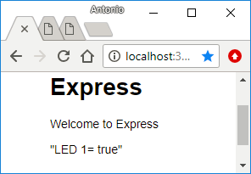
Controller
Resource
(domain)
Model
Adaper
Led 1
CoAP
Sensor1
Temperature
OPC-UA
Adaper
Adaper
Fan 1
Adaper DB

Slide 57
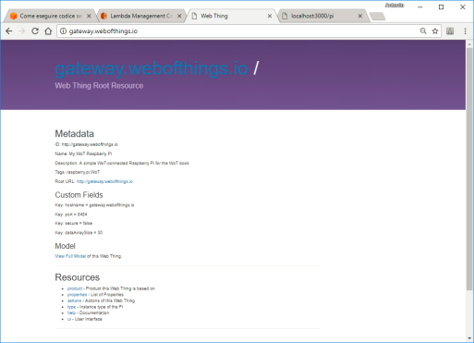
3a
2
1
Sensor
Impl1
Frontend
server
Resource Model
Actuator
Impl1
5
curl http://localhost:3000/pi/actuators/leds/L1
Application Logic
(Controller)
3b
msg(ctrlEvent,event,js,none,ctrlEvent(leds, led1, VAL N)
it.unibo.frontend/nodeCode/frontend/clientRest.js
4a
Led on Rasp
it.unibo.frontend/src/it/unibo/frontend/RestClientHttp.java
4b
Led Mock Gui
3c

Slide 58
At the centre of our design there is the resource model and the application logic written with reference to that model.
A frontend (REST) server is introduced to provide actions both for reading and for updating the resource model.
Model access can be performed by humans via web pages (3a) or via tools like curl (3b) or by machines by using REST-HTTP clients written in JavaScript (3c) Java (3c) or in some other language.
Physical resources can be (dynamically) added by means of mock objects (4b) or by concrete, smart objects (4a) handled by micro-controllers (Arduino) or low-cost computers (RaspberryPi).
In some case, when the server and the model are working near the edge, physical resources can be (dynamically) added by means of plugins loaded and executed at the server site (5).

Slide 59
Activate a MQTT server on localhost:1883 (docker run -ti -p 1883:1883 -p 9001:9001 eclipse-mosquitto)
Run node frontendServer.js in it.unibo.frontend/nodeCode/frontend
Activate it.unibo.bls17.ledMockGui.qa/src-gen/it/unibo/ctxLedMockGui/MainCtxLedMockGui.java
Execute it.unibo.frontend/src/it/unibo/frontend/restClientHttp.java

Slide 60
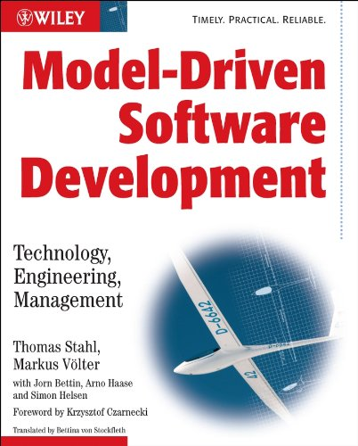
MDSD
Tecnhology-based
Model-based
Technology
Design
Design
Maintenance
Maintenance
Technology
Deployment
Coding
Testing
Deployment
Coding
Testing
Model-Driven Software Development (MDSD) puts analysis and design models on par with code.
Models do not constitute documentation, but are considered equal to code, as their implementation is automated.
The goal of the book is to convince you, the reader, that MDSD is a practicable method today, and that it is superior to conventional development methods in many cases.
2006

Slide 61
MDSD
instanceof
Metamodel
Code: Libraries /
Infrastructure
Software
Factory
uses
Model of the
software system
generates
Code: Schematic part
uses
Code: Application specific

Slide 62

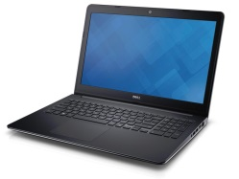
QActors
Structure
Class diagrams
(QA)
SYSTEM MODEL
Behavior
State Diagrams
Interaction diagrams
Interaction
Actors : active entities that:
behave in a context as a finite state machine
interact by means of messages
can handle events
can perform built-in or user-defined (implemented in objects) actions that:
realize algorithms (terminate)
can react to events
Main
Concepts
Dispense AN (pdf):
Introduction to QActors and Qrobots (2017)
Projects:
it.unibo.xtext.qactor …
it.unibo.qactors

Slide 63
QActors
2p301.jar
qa18Akka.jar
…
instanceof
qa metamodel
it.unibo.xtext.qactor
uses
SoftwareFactory
(Eclipse Pluigins)
Schematic part code in dirs:
src-gen
srcMore
doker
sites
Model of the
software system
generates
System helloSystem
Context ctxHello ip [ host="localhost" port=8010 ]
QActor qahello context ctxHello {
Plan init normal
actions[
println("Hello world!!"
]
}
uses
Application specific code: in dir
src

Slide 64
QActor
Dispatch
Event
Plan
…
Towards ubiquitous languages
IOutView
IOutEnvView
IConnInteraction
…
2p301.jar
qa18Akka.jar
…
instanceof
qa metamodel
it.unibo.xtext.qactor
SoftwareFactory
(Eclipse Pluigins)
Model
gen
Schematic
part
Application
specific code

Slide 65
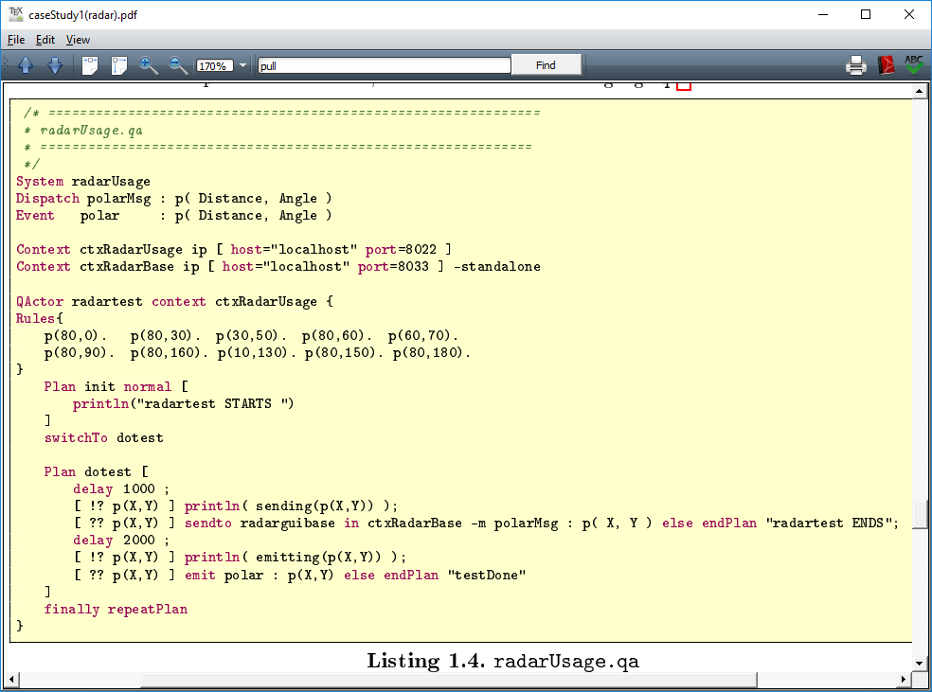
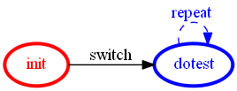
Declaration of
Messages and Events
Declaration of
Computational nodes
Local knowledge
of the actor
States of the actor
(as a Moore FSM)

Slide 66
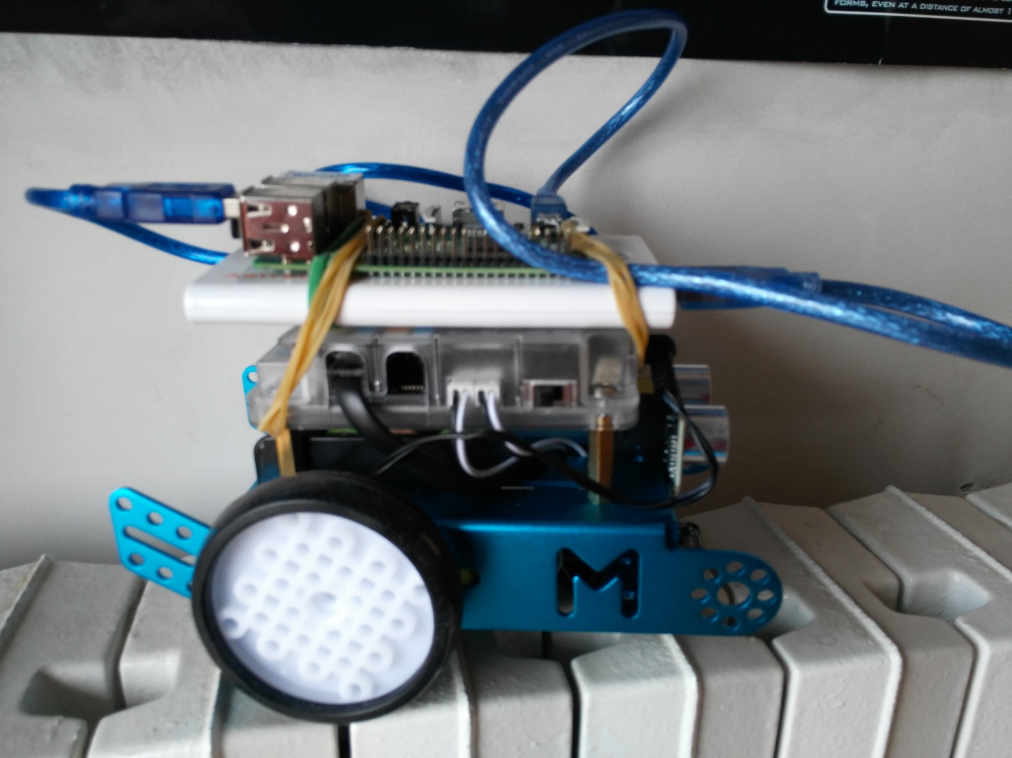
WIFI
RASPBERRY
ARDUINO

Slide 68
WoT
(HTTP)
client
1) GET
server
2) Response
(HTML page)
RESOURCE MODEL
actuators
led1
update
Sensor
plugin
led
led2
env
pir
sensors
temperature
humidity
Localhost:8080/env/sensors/pir
(HTTP)
client
1) PUT
server
2) Response
(HTML page)
RESOURCE
MODEL
Sensor
plugin
update

Slide 69
WoT
websocket
(HTTP)
client
1) GET (subscribe) …
server
2) Response
(HTML page)
RESOURCE
MODEL
update
Sensor
plugin
react

Slide 70
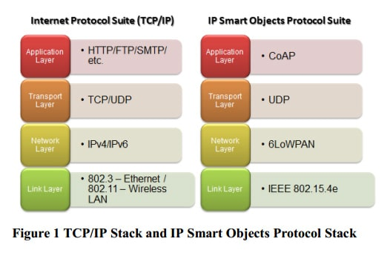
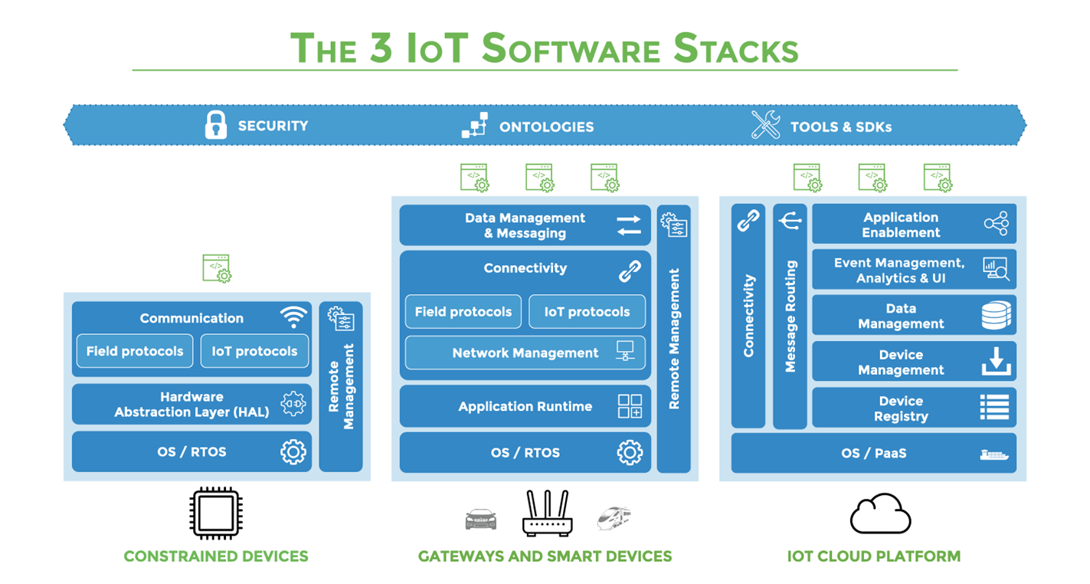

Slide 71
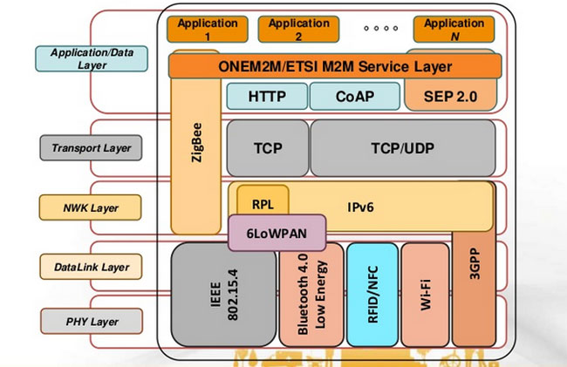

Slide 72
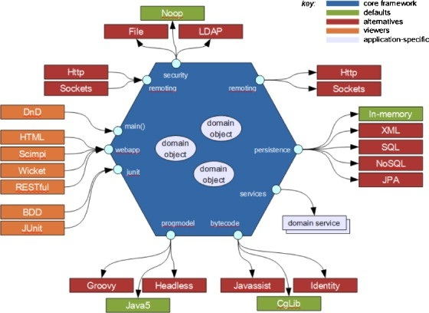

Slide 73
OPC-UA: an information technology
device1
device2
deviceN
Plant floor communications
Modbus TCP, Etherent/IP, Profinet IO, DeviceNet
Raw data
Information Model
XML files, Objects
Access Space
Nodes, State of the process, environemnt ,…
Nano
Micro
Embedded
Standard
OPC-UA Server
Profiles
Authenticate
Publish-subscribe
not very efficient
Services
Discovery (Local, Multicast), Global),
Secure Channel, Subscritpion, Query, Node, Method, …
Request (SOAP, HTTP, UA_TCP,…)
(to the address space,
To the system)
Method invocation
Secure (CA)
Authorized
OPC-UA Client
(controller)
Systemized way to create Information Models
Mechanisms to load, transport and reference models

Slide 74
W3C WoT Approach
learn how to interact with Thing
Semantic
Metadata
describe Thing
Platform A
Platform B
easy integration across platforms
Application
Application
Platform API
Platform API
Re-usable Technological Building Blocks
Data Model
Data Model
Protocol
Protocol
complement
“WoT Interface”

Slide 75
W3C WoT Building Blocks
WoT Thing Description (TD) with simple interaction model
WoT Servient
JavaScript
Runtime Environment
Lua
Properties
App Script 2
WoT Scripting API for browser-like runtime environment
Actions
Events
App Script 1
Scripting API
Thing Description
Interaction Model
Local Hardware
Binding Templates
WoT Binding Templates to connect to different platforms and ecosystems
Things can be in client and/or server role: “Servient”
Server
Client
HTTP
OCF
BACnet
Expose
Consume
CoAP
OneM2M
…

Slide 76
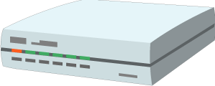

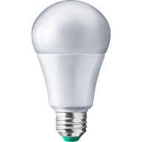
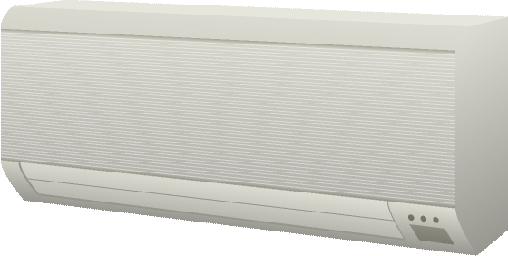
W3C WoT Architecture Patterns
Cloud
Edge Hubs
Servient
Digital Twiin
Orchestr. Client
Servient
Digital Twiin
Virtual Thing
Scripting API
Orchestr. Client
Interaction Model
Proxy Thing
Binding Templates
Scripting API
Interaction Model
Binding Templates
Web Browser
Direct Thing-to-Thing
Interaction
App Script
Scripting API
Thing
Thing
Existing Device
Interaction Model
App Script
Classic Firmware
Binding Templates
Scripting API
+
Web Integration
Interaction Model
Interaction Model
⇒
Thing
Protocol
Protocol
Complement Existing Devices

Slide 77
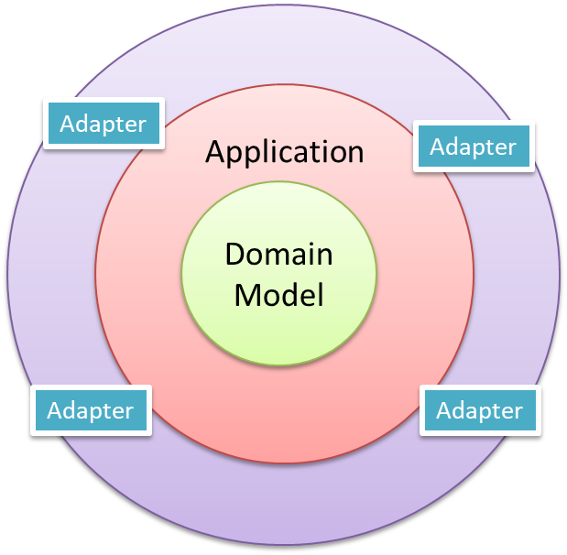
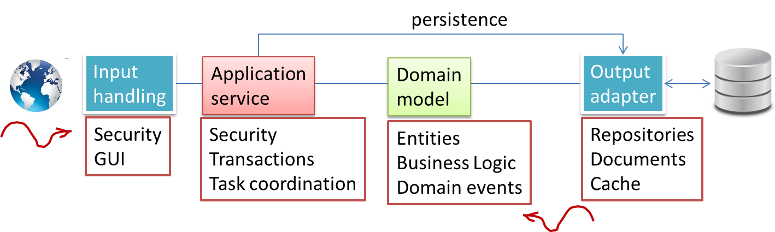

Slide 78
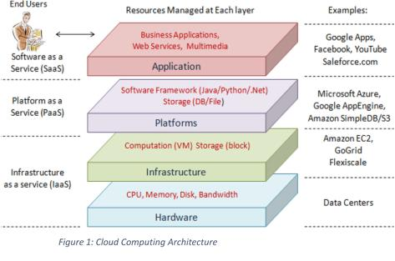
https://amagsmb.wordpress.com/2014/06/23/cloud-computing-part-3-architecture/

Slide 79
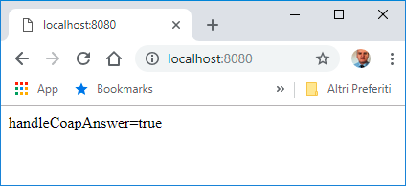
3
it.unibo.bls18
MainCoapControlToLedRest
IObserver
IObservable
IObserver
ButtonObserverModel
BlsApplicationLogicCoap
call
ButtonAsGui
IObservable
8080
Get
Put
Post
…
serverHttpToCoap.js
2
5683
CoapServer
Resource
CoapResource
MainCoapBasicLed
1
LedObservableModel
KEY POINTS
Front end server
IObserver
LedAsGui

Slide 81
http to CoAP
it.unibo.coap.examples
C:\Didattica2018Work\iss2018Lab\it.unibo.coap\src\it\unibo\coap\examples\ExampleCrossProxy.java
C:\Didattica2018Work\iss2018Lab\it.unibo.bls18\nodeCode\proxy.js
https://www.npmjs.com/package/ponte
C:\Didattica\Californium\californium\demo-apps\cf-benchmark\src\main\java\org\eclipse\californium\benchmark\BenchmarkServer.java
C:\Didattica2018Work\iss2018Lab\it.unibo.coap\src\it\unibo\coap\examples\CoapClientForLocal.java

Slide 82
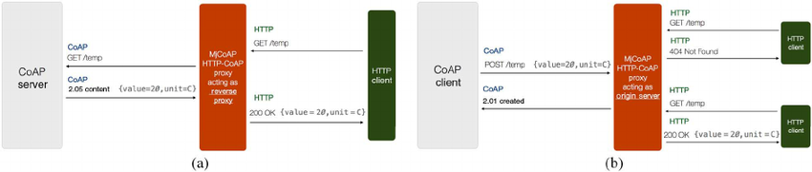

Slide 83
(Remote)
ResourceObserver
Get
5683
ResourceModel
PHYSICAL
DEVICE
Get
Put
Post
…
event
We make reference to the resource model(s) through a RESTful interface
which is a particular instance of message-passing interaction
publish
MQTT Server
FrontEnd
BlsApplicationLogic
subscribe
subscribe
Application FrontEnd
(ResourceObserver)

Slide 85
CoapResource
IResourceIot
IResourceLocalObserver
CoapGofObservableResource
ResourceLocalObserver
SomeResource
SomeResourceGofObserver
PHYSICAL
DEVICE
PHYSICAL
DEVICE
setValue
update
usercmd
MQTT Server

Slide 86
CoapResource
IResourceIot
IResourceLocalObserver
CoapGofObservableResource
ResourceLocalObserver
ButtonResource
ButtonResourceGofObserver
PHYSICAL
DEVICE
setValue
update
usercmd
CoAp client
GET
MQTT Server
PUT

Slide 87
CoapResource
IResourceIot
IResourceLocalObserver
CoapGofObservableResource
ResourceLocalObserver
LedResource
LedResourceGofObserver
PHYSICAL
DEVICE
update
CoAp client
GET
MQTT Server
PUT

Slide 89
org.eclipse.californium.core.server.resources.
Resource
CoapResource
IResourceIot
CoapGofObservableResource
LedCoapResource
ILed
LedMock
LedResource
ResourceLocalObserver
IResourceLocalObserver
LedThing
LedResourceGofObserver

Slide 90
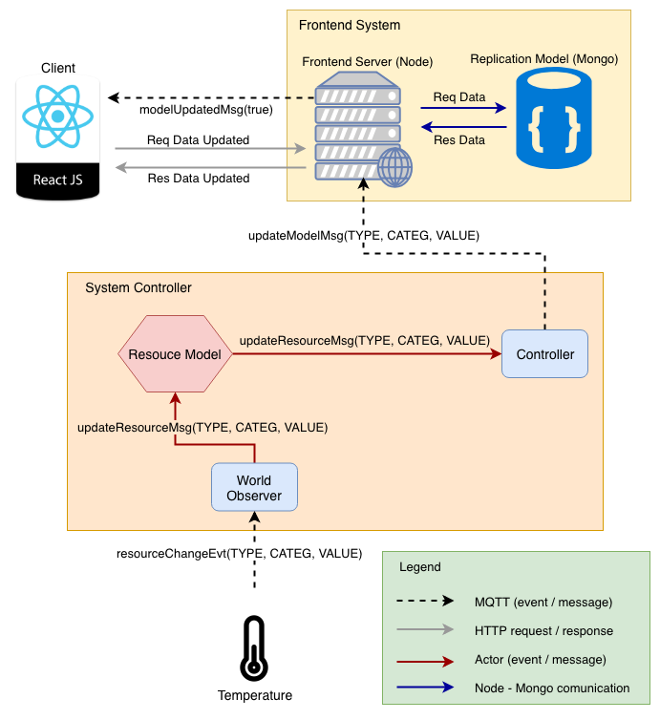

Slide 92
The resource IS the model
it.unibo.bls18
MainCoapControlToLedRest
IObserver
IObservable
IObserver
ButtonObserverModel
BlsApplicationLogic
call
HIGH
ButtonAsGui
IObservable
Get
Put
Post
…
LOW
NETWORK
Resource
CoapResource
The ‘thing’ is accessible via CoaP
A change on the model is propagate on physical
5683
CoapServer
LedResource
IObserver
Adapter
(Plugin)
PHYSICAL
DEVICE
KEY POINTS
Things
Rest

