Slide 1
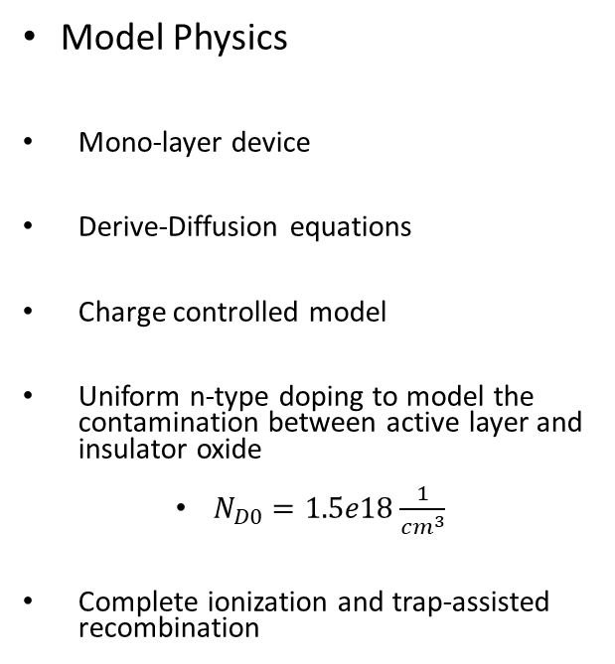
2D MoS₂ FET Simulations
Geometry parameters:
Channel length: 50-300 nm
Insulator thickness: 5-30 nm
Drain and Source contacts length: 10 nm
Thickness: 1.5 nm
Gaps between gate and contacts: 10 nm
Model Physics
Mono-layer device
Derive-Diffusion equations
Charge controlled model
Uniform n-type doping to model the contamination between active layer and insulator oxide
$N_{D0}=1.5e18\frac{1}{cm^{3}}$
Complete ionization and trap-assisted recombination
MoS₂ properties [monolayer]:
Relative Permittivity: 4.2
Band gap: 2.76 eV
Electron affinity: 4.7 eV
Electron mobility: 10 cm² V⁻¹ s⁻¹
Hole mobility: 10 cm² V⁻¹ s⁻¹
Electron effective mass: 0.5 × m_{e}
Hole effective mass: 0.5 × m_{e}
Defect n-type doping: 1.5 × 10¹⁸ cm⁻³

Slide 2
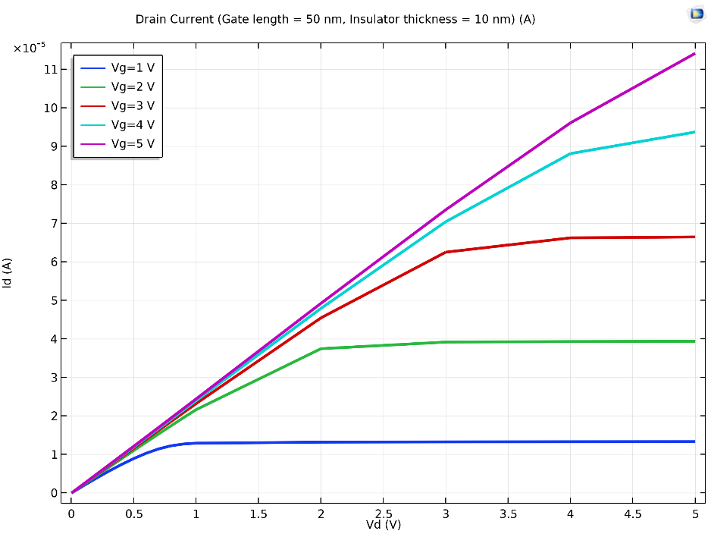
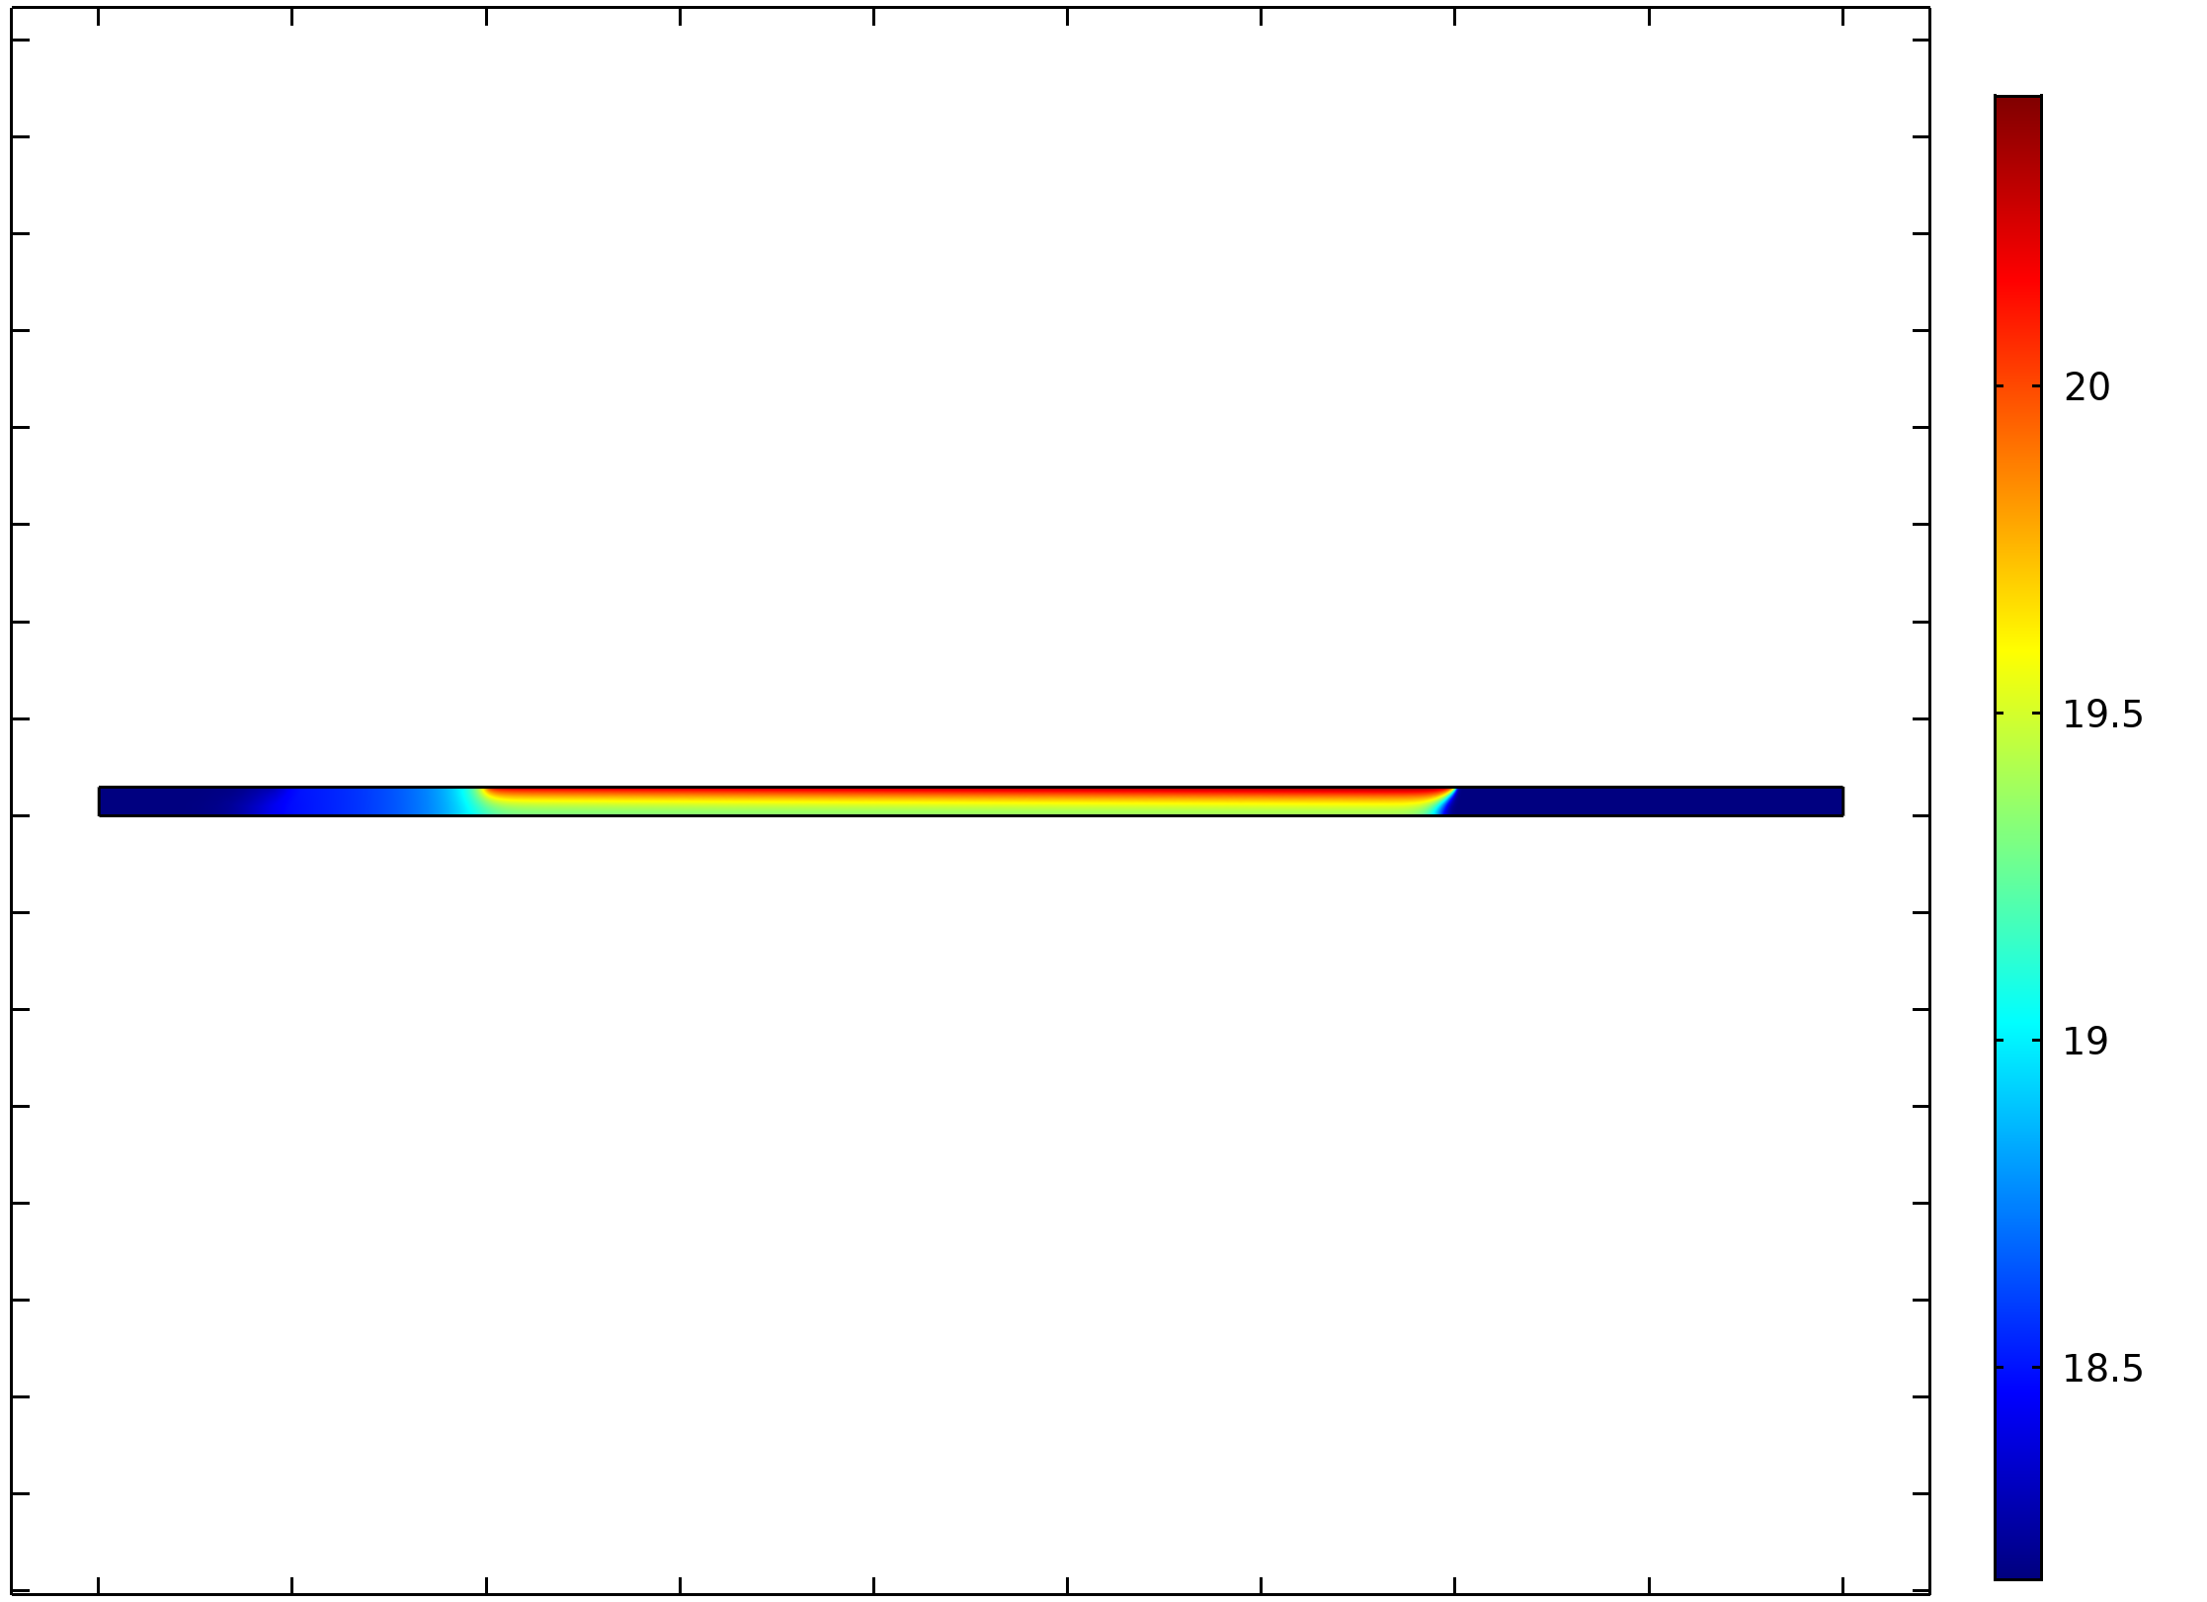
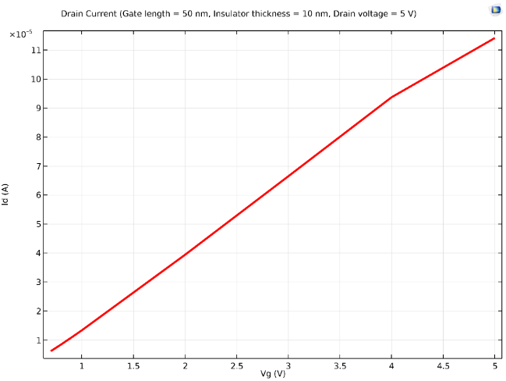
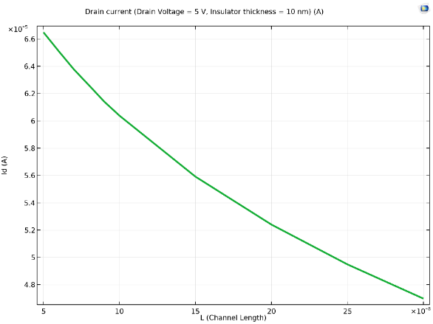
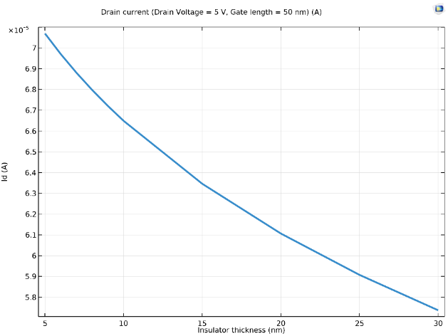
Simulation Results
Insulator thickness = 10 nm Gate length = 50 nm
x 10⁻⁵ [A]
x 10⁻⁹ m
x 10⁻⁵ [A]
11 10 9 8 7 6 5 4 3 2 1 0
35 30 25 20 15 10 5 0 -5 -10 -15 -20 -25 -30 -35 -40
Max: 8.71×10¹⁹ cm⁻³
11 10 9 8 7 6 5 4 3 2 1
Insulator thickness = 10 nm Gate length = 50 nm Drain Voltage = 5 V
Vd = 5 V, Vg = 5 V
0 1 2 3 4 5 6 7 8
x 10⁻⁸ [m]
1 1.5 2 2.5 3 3.5 4 4.5 5
Electron concentration (log10n)
ID vs VG
0 0.5 1 1.5 2 2.5 3 3.5 4 4.5 5
ID vs VD (VG)
x 10⁻⁵ [A]
Insulator thickness = 10 nm
Drain current = 5 V, Gate length = 50 nm
6.6 6.4 6.2 6.0 5.8 5.6 5.4 5.2 5.0 4.8
x 10⁻⁵ [A]
7.0 6.9 6.8 6.7 6.6 6.5 6.4 6.3 6.2 6.1 6.0 5.9 5.8
5 10 15 20 25
x 10⁻⁸ [m]
5 10 15 20 25 30
x 10⁻⁹ [m]
ID vs Channel Length
ID vs Insulator thickness [nm]
Notes:
Dependence on electrical and geometrical parameters

