Slide 1
How Suicide Contagion Spreads
Physical Distance vs. Community Proximity
Does elevated risk in nearby communities fade with physical distance (km) — or with how "close" a community is in a density-adjusted sense?
Risk fades over physical distance
Risk fades over number of neighboring communities
Chronic "hot regions" (e.g. Mountain West, Appalachia) -> not event-driven clusters, high baseline
“a suicide event raise risk in nearby communities for a period of time.”
To study at smaller scale, we need to define what is nearby

Slide 2
Relative Risk
national vs regional vs state vs baseline?
Relative Risk (RR) = observed / expected
Decay curve
Plot RR against Distance if closer high, then fades to 1 (decay curve) demonstrate contagion
Physical distance vs Rank distance
Km vs “number of ZIP away” natural adjustment for population size
Test
- Split by density (urban / suburb / small town / rural …)
- Plot decay curves by group (km vs rank)

Slide 3
Poisson GLM fit
Curve align in rank, not in km: Contagion scales with community density Same thing everywhere, just stretched out geographically in rural areas
Curves align in km-space, not rank-space:
Contagion scales with physical distance. Rural and Urban must be a different phenomenon
They are all different No pattern?

Slide 4
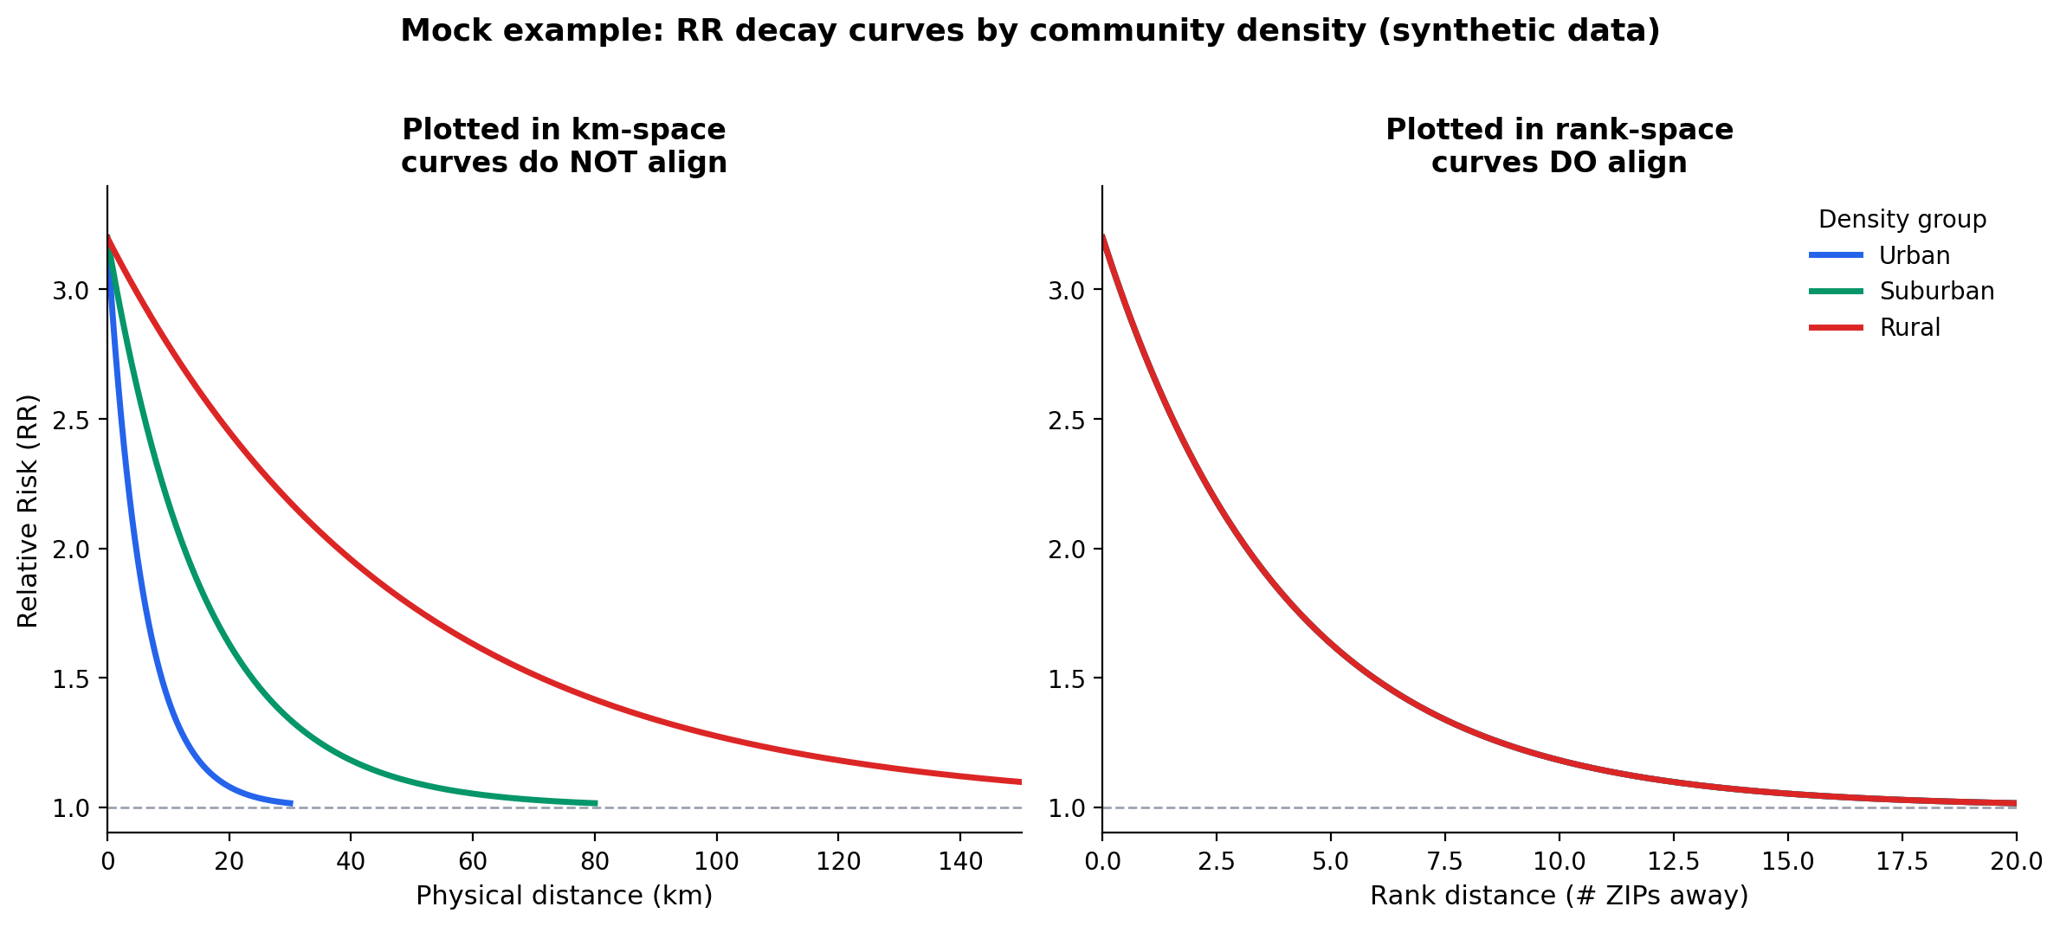
Example: RR decay curves, km vs. rank (mock data)
Same decay function in rank-space, scaled by density-dependent km spacing.

Slide 5
SaTScan censoring estimate
With x=SaTScan km threshold what fraction of the curve's mass falls beyond whatever fixed radius used earlier in SaTScan (150km-250km)
SaTScan threshold
Censored in SaTScan by threshold

