Slide 1
Prediction Markets as DeGroot Dynamics
with Time-Varying Communication Topology
Matteo Perona
Guest Lecture · Random Signal Processing

Slide 2
Why Prediction Markets?
The Core Question
How do decentralized agents, each with partial and noisy information, aggregate knowledge into a single price that converges to truth?
Key Insight
A prediction market is an implicit DeGroot consensus process. Traders never talk directly, the market price encodes past beliefs, creating peer influence through the price channel.
Signal Processing Angle
Noisy signals → belief updates → price dynamics.
The market acts as a nonlinear filter fusing correlated, biased random signals into an estimate of a hidden binary state θ.
Model Setup
θ ∈ {0, 1} — binary ground truth
K = 4 information sources with bias μⱼ
N = 6 traders with heterogeneous attention
Each source emits:
sⱼ(t) = θ + μⱼ + εⱼ(t)
εⱼ ~ N(0, σ²)
Three-layer architecture:
Sources (B) → Traders (V) ⇄ Market (M)
Topology grows over time as traders
enter and trade, adding edges to D(t).

Slide 3
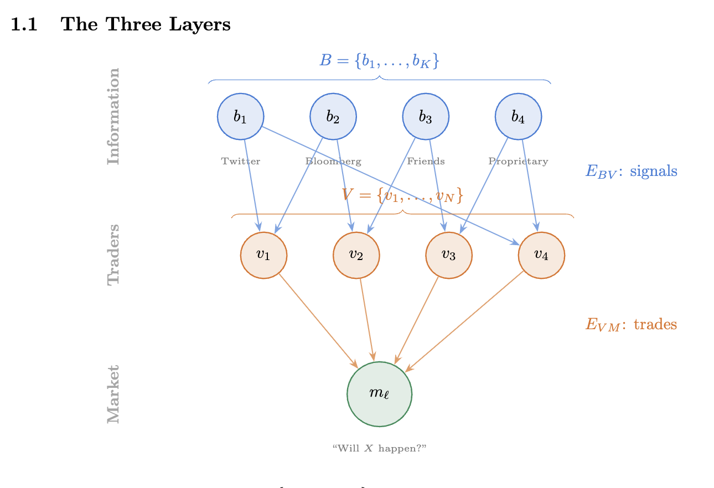
Model Formulation

Slide 4
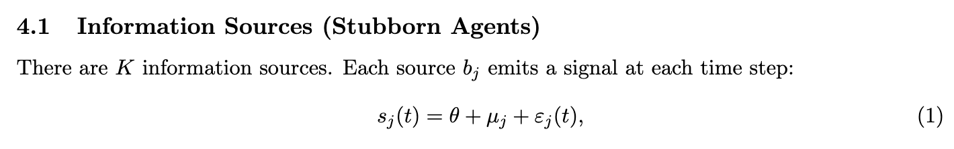
Model Formulation: Information Sources

Slide 5




Model Formulation: Information Sources

Slide 6
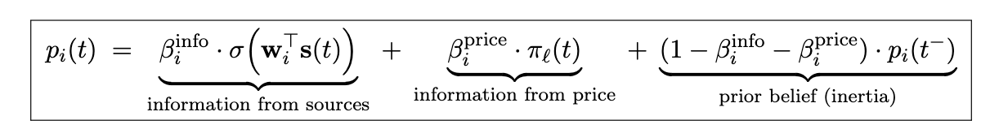
Model Formulation: Trader Belief

Slide 7
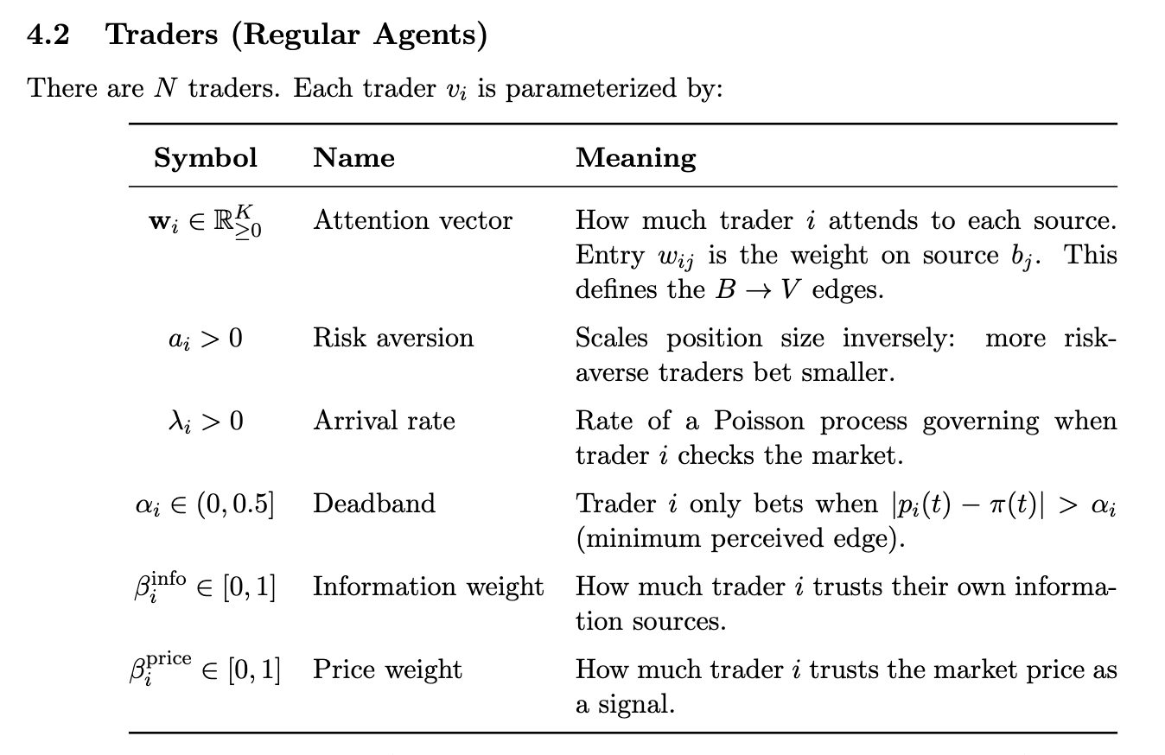
Model Formulation: Trader Belief

Slide 8
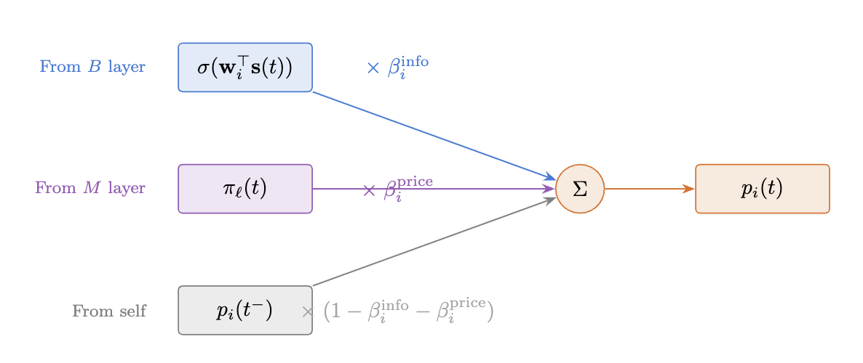
Model Formulation: Trader Belief

Slide 9
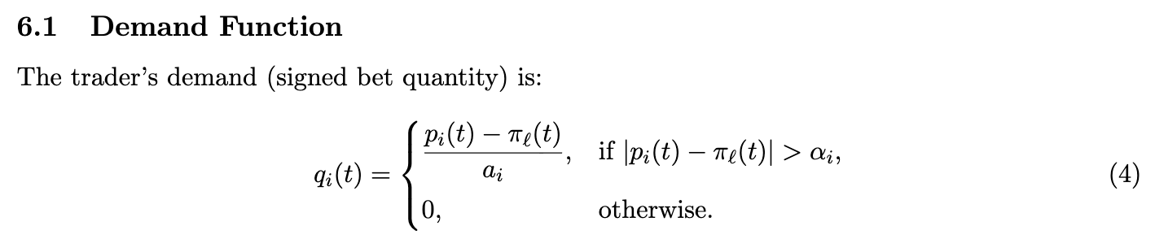
Model Formulation: From Belief to Trade

Slide 10
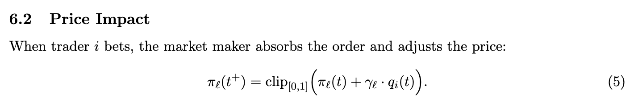
Model Formulation: From Belief to Trade

Slide 11
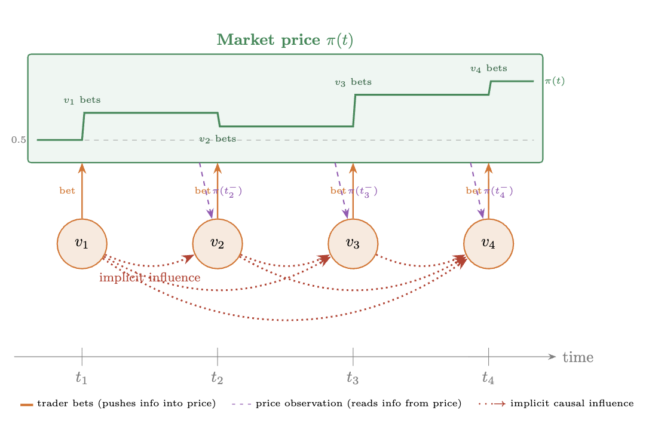
Model Formulation: From Belief to Trade

Slide 12
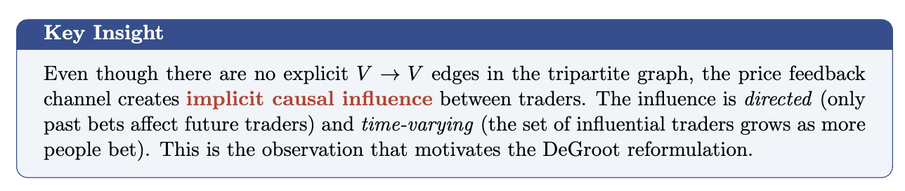
Model Formulation: From Belief to Trade

Slide 13
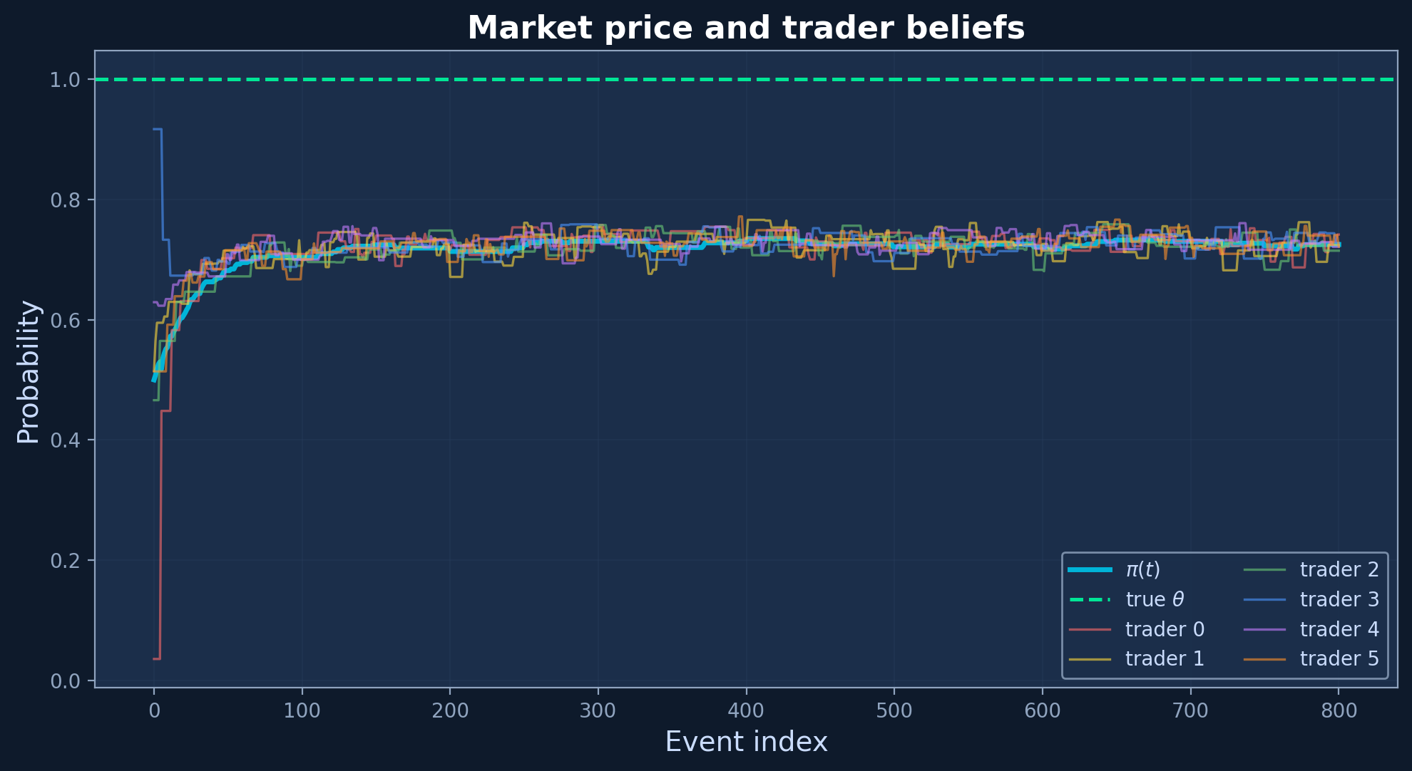
Simulation: Price Convergence
Observations
800 discrete time steps
θ = 1 (green dashed line)
Three phases:
1. Seeding — sparse trades, volatile price
2. Discovery — active trading, oscillation around truth
3. Consensus — beliefs and price stabilize near θ
π(t) (cyan) tracks the belief centroid and converges to θ.

Slide 14
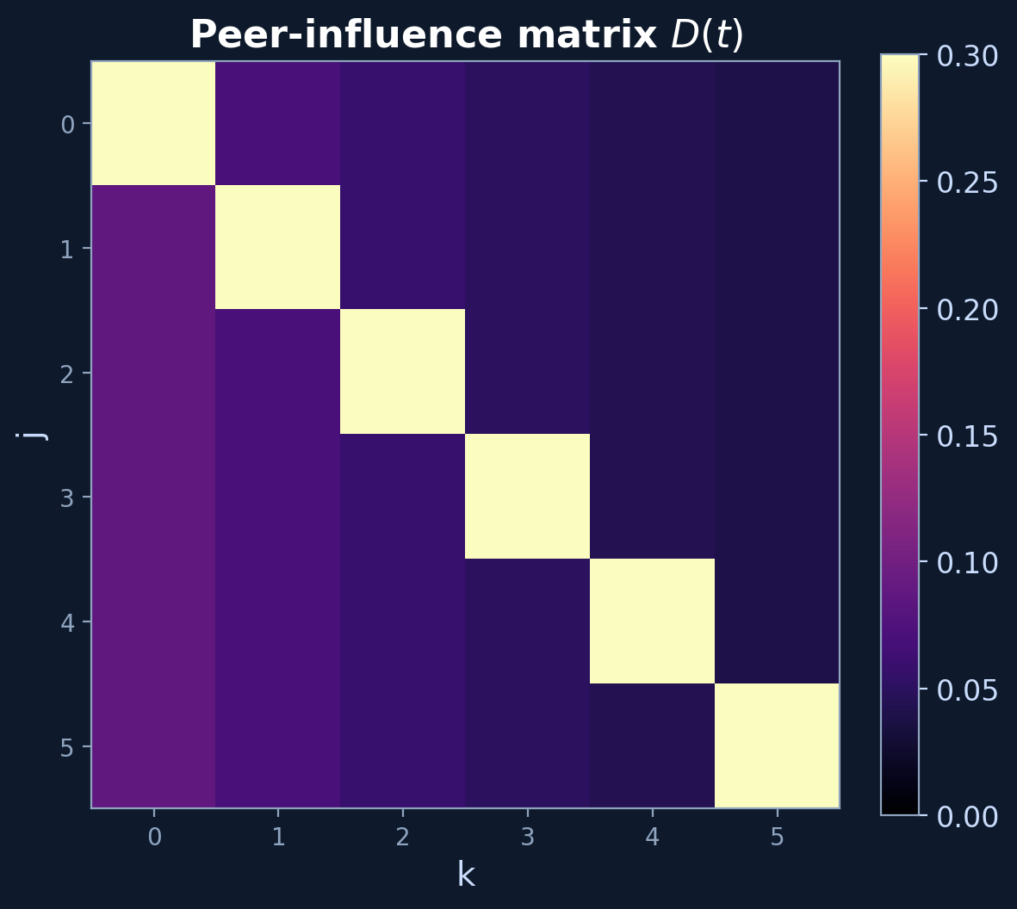
DeGroot Dynamics & Peer Influence
The DeGroot Connection
In log-odds coordinates, the belief update becomes exactly linear — a DeGroot model:
D(t) is the peer-influence matrix — it grows as traders enter the market.
Time-Varying Topology
D(t) starts nearly diagonal (self-weights only). As traders trade, off-diagonal entries grow — reflecting implicit influence through the price channel.
Convergence speed → spectral radius ρ(D)

Slide 15
Key Takeaways
Market as Filter
The prediction market acts as a nonlinear recursive filter — aggregating noisy, biased signals into a consensus estimate of the hidden state θ.
Connects information theory to market microstructure.
Implicit Communication
Traders never communicate directly. Yet the market price creates causal peer-to-peer influence — captured by the growing matrix D(t).
Price is the communication channel in this network.
Spectral Convergence
Convergence rate depends on spectral radius ρ(D). Information diversity (rank of Φ) determines whether consensus lands near θ or a biased value.
Classic DeGroot theory applies in log-odds coordinates.
Thank you · Questions?

