Slide 1
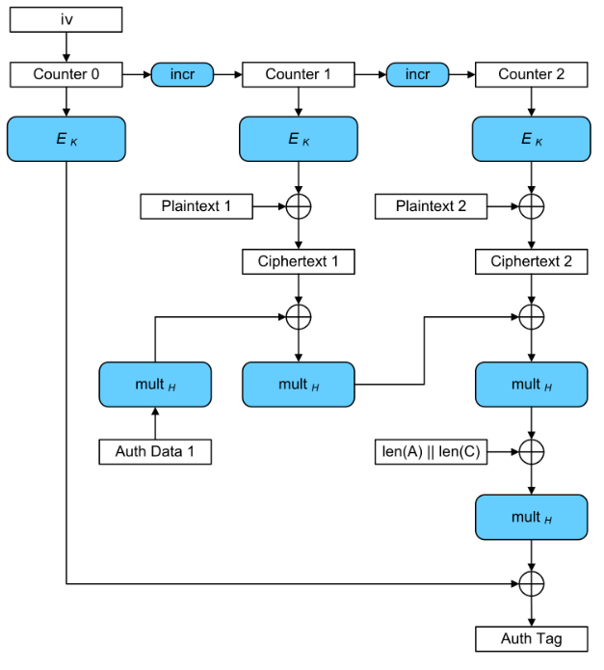
Galois Counter Mode
GCM is a block cipher mode of operation that is based on Galois field in order to provide authenticated encryption, ensuring both data integrity and data confidentiality.
Block : numbered sequentially, each of them with size equal to 128 bits.
Main operation : Each block’s number is combined with the initialization vector (IV) and encrypted. The result is XORed with a plaintext block in order to produce the corresponding ciphertext block.
Interpretation : the ciphertext blocks are treated as coefficients of a polynomial which will be evaluated at a key-dependent point H on a finite field.
Authentication tag : subsequently, the result is encrypted in order to produce an authentication tag that can be used to verify the integrity of the data.
Thus, the encrypted text will contains the IV, ciphertext and authentication tag.

Slide 2
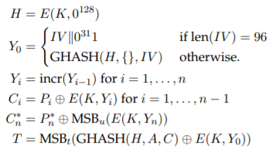

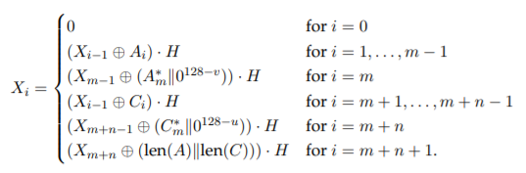
Encryption
Lets consider the plaintext blocks P1, P2, …., Pn and a given key K. Then we can define the authenticated encryption in the following way :
where H is the hash key obtained encrypting a string of 128 zero bits using the block cipher E, Y_i represent successive counter values generated by incr() function, which treats the rightmost 32 bits of its argument as a nonnegative integer with the least significant bit on the right, and increments this result modulo 2^32, GHASH is a function defined as
where A is authenticated data, C is the ciphertext, m is the number of 128-bit blocks in A, n is the number of 128-bit blocks in C, and the variables X_i for i = 0, …, m + n +1 are defined as follows :

Slide 3
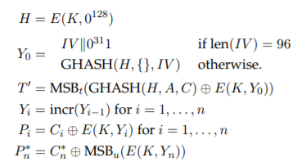
Decryption
The decryption process is very similar to the encryption one, but proceed in reverse order :
The tag T’ is compared with the tag T associated with the ciphertext C. If the two tags match then the ciphertext is returned; otherwise, it will return a special symbol called FAIL.

Slide 4
Security and vulnerabilities
GCM’s security depends on choosing a unique initialization vector for every encryption performed with the same key. Also the bit length of the authentication tag is a security requirement, indeed it can assume only a limited number of values.
Ferguson and Saarinen described how an adversary can attack in optimal way GCM authentication.
Ferguson’s idea : if n denotes the total number of ciphertext blocks then there is a probability of n*2^-t to rebuild the corresponding ciphertext, where t denote the authentication tag length. If t < 128 bits then the probability will increase, leading to know some informations about H. If H can be fully compromised than the guarantee of authentication is completely lost.
Saarinen’s idea : his work describes a particular way of forging a GCM message, from a valid GCM message, that works with a probability of n*2^-128 for messages that are n*128 bits long.
Another type of attack is by guessing different tags for a given input, and thus increasing the probability that sooner or later a tag will be accepted. For this reason, GCM should be monitored, eventually inserting some mechanism to limit the number of unsuccessful verification attempts for each key.

Slide 5
Performance
Parallelizability : encryption process can be parallelized since each ciphertext block is indipendent from the others, so as the decryption process. Authentication tag process is not parallelizable because each polynomial depends from the previous one and current ciphertext block.
Error propagation : There isn’t error propagation because each plaintext block is treated as a separate message.
Pre-processing : The keystream generation can be precomputed, and several methods for speed up the authentication process are available.

