Slide 1
RSATree
Distribution-Aware Data Representation of Large-Scale Tabular Datasets for Flexible Visual Query

Slide 2
Introduction (1/2)
Exploratory data analysis (EDA) involves huge size of datasets
Data items space needs to be reduced (by filtering and aggregation techniques) before encoding
limited number of screen pixels
high dimensional dataset

Slide 3
Introduction (2/2)
Two main challenges when answering aggregate queries:
low response time
mitigated with data cubes -> no flexibility !
arbitrary queries
flexible approach
user-defined binning strategies
Q1: can we guarantee both? Yes! Use approximate query answering

Slide 4
RSATree (1/3)
RSATree enables arbitrary queries and flexible binning strategies by leveraging three schemes:
a R-tree-based space partitioning scheme
catch the data distribution
a locality-sensitive hashing (LSH) technique
locality-preserving random access to data items
a summed area table (SAT) scheme
support interactive query of aggregated values with a linear computational complexity.

Slide 5
RSATree (2/3)
Goal
support fast approximate query answering
Requirements
constant time, independent from the specified range!
flexible binning strategy rather than equi-width binning only
error rate at an overall low rate

Slide 6
RSATree (3/3)
Distribution awareness
Reduce storage consumption
exploiting adaptive granularity in preprocessing
improve accuracy

Slide 7
Design methodology
Challenges
flexible binning strategy 3. low accuracy error
data cubes are static
arbitrary ranges 4. low response time and storage consumption
considerable preprocessing
high storage consumption
Q2: can we reduce the storage consumption ? Optimize the preprocessing phase

Slide 8
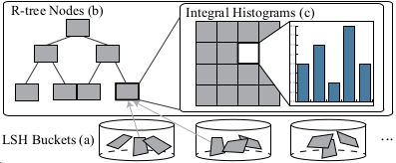
RSATree: data structure
RSATree is basically a nested three-level representation that flattens the input dataset :
it’s the index of partitioned spaces by LSH
the next level is the IH
features descriptor

Slide 9
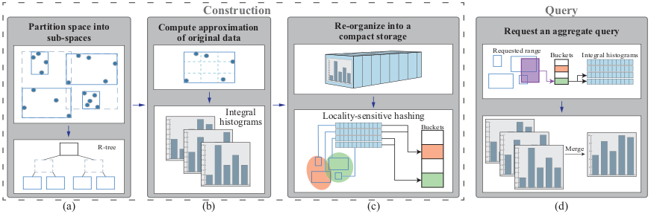
RSATree: construction
Progressive construction : once constructed the R-tree based on the sampled input data points, just update the structure in presence of a new point.

Slide 10
Conclusions (1/2)
Limitations
Performs bad on high-dimensional data
at most 5 dimensions
R-tree is not perfect for all data and situations
Several complex data distributions cannot be captured because R-tree divides the space into orthogonal subspaces.

Slide 11
Conclusions (2/2)
Beyond this study
Change the Space Partitioning Algorithm (to feed the R Tree)
deep learning models
Support Categorical Dimensions (partially supported)
Change Sampling Algorithm for Progressive Construction
Adopt a Mixed Storage model
Improve through parallelism
implement on a GPU

Slide 12
Thank you

