Slide 1
Lecture P2-L12:
Project Work
DAT530 Discrete Simulation and Performance Analysis
Deadline for submission of:
Project Proposal: Friday, September 25 (hours 23:59)
Final project: Friday, November 06 (hours 23:59)
Reggie Davidrajuh
University of Stavanger

Slide 2
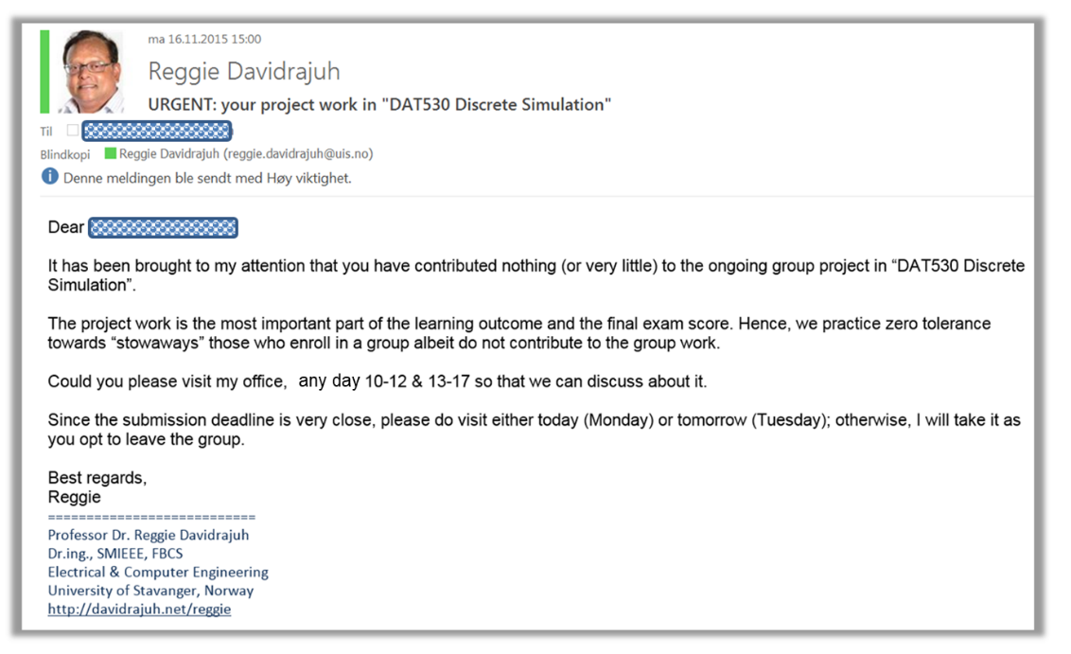
Project Groups
Group size: maximum 2 students.
  Group size will be considered when marking: a group with 2 students should produce 2 times as much work as a single person.
  Group working: Negotiate and agree with your partner, about your efforts, before you start your work (“Stowaways” can become a headache; hence avoid it in the early stages).
  Addition of new group members after the project proposal, must go through the lecturere.

Slide 3
How to perform the Project work?
Some Guidelines:
Always remember the “KISS” principle.
Start writing project report from day-one. Dump everything (any idea you may have) into the report; later you can edit or delete the contents later.
Use “Unified Approach” - this is very important: start with a very crude model and then add functionality (details) step-by-step.
Use all the PN analysis techniques (Part-3): coverability, PN class type, liveness,…
Use decent statistical analysis; don’t stop with mean and standard deviation.

Slide 4
How to perform the Project work?
Some Guidelines:
Final report: Follow the IMRAD standard in the final reporting (Introduction with problem definition; Methodology; Design; Implementation; Results & Analysis; Discussion). See a separate document about IMRAD format.
Final report: Use figures to explain; tables to summarize.
Final report: Number of pages doesn’t matter. Only the amount of useful information in the report matters.
Program code: generally, each “M-file” is about one-page long.
Program code: at least 40% of the code is “sensible” comments.

Slide 5
Want to score “A”?
Interesting problem and/or useful problem
Design (partition/composition of modules, design of modules, module interactions, etc.)
Clean Programming: code is easy to understand; well documented code; clean flow (no zig-zag or spaghetti)
  GPenSIM: Use of advanced facilities in GPenSIM: colors, resources, COMMON & specific processor files.
A well documented report that explains all the points stated above
In detail: categories of project marking:
  Model Quality (Design): 20 pts
  Realistic (interesting/useful problem): 10 pts
  Quality (depth) of Analysis: 20 pts
  Coding (programming): 20 pts
  Reporting (quality of the report): 20 pts
  Group Size: 10 pts

Slide 6
Always acknowledge the source
Always acknowledge the source, if you have copied from others work; clearly state the copied material within quotation marks.
Always acknowledge the source, if you have adapted from others work. It is all right to adapt from other, but make sure that the reader can evaluate how much original work you have put up on top of the adapted work.
Ask your supervisor, if you need more explanation.
Failure to do so will result in fail mark.
In serious cases, direct copying, the students will be ejected from the study.

Slide 7
How much work is needed? Contacting industry, supervisor
How much time shall I put on the project work:
  See the previous works (e.g., 2023-P07-Dirdal-Multiprocessor-Scheduling, 2023-P19-Schedel-AGV, and 2023-P05-Chandler-Factorio). If you can do better than this, “A” is guaranteed for your project work.
  You can also show you intermediate work to your supervisor and verify whether you are on the right track.
Contacting industries: Make sure to do preliminary work before going to Industries for real-life data; or contacting expert on the topic.
Contacting the supervisor: This is an independent project, with minimal support from the supervisor.
  Help each other.
  Use Debug facilities in MATLAB (as the supervisor will do the same).
Discussing with your supervisor:
  Pre email appointment necessary.
  If I am in my office, it is okay to talk to me.

Slide 8
Submission of project proposal:
Friday, September 25, hrs. 23:59
The proposal (MS Word or PDF file):
An abstract of the planned project work ca. two pages.
Start with a title that represents the system you are going to model, and the names of the group members (max 2 students).
Clearly explain what the project is, and why it is interesting/useful.
Should contain figures to explain composition of the systems and the interaction (e.g., synchronization) between the modules, etc.
Please submit the proposal (Word or PDF file) as an assignment on Canvas. Please do not email me.
Submission of final report: Friday, November 06, hrs. 23:59

Slide 9
Plagiarism Warning
In your Project Work:

Slide 10
Plagiarism
The project work is subject to the general UiS guidelines about academic misconduct. UIS considers as cheating or attempted cheating:
  Presenting others’ work as one’s own (e.g.: delivering the activity made by another student, for example, rewritten through ChatGPT)
  Submitting practical work not produced by the student (e.g.: code, data, and figures obtained by others)
  Submitting work not written by the student (e.g.: copying and pasting code and text generated by ChatGPT)
  … and much more, see https://www.uis.no/en/student-pages/cheating

Slide 11
DO NOT use
ChatGPT, DeepSeek, etc., for your project work!!!!!

