Slide 1
IoT TRAP debug tool
TRAP debug tool for Transiently-Powered sensing systems
Student
Matteo Spadetto
[214352]

Slide 2
Battery-less sensors network
With battery-less wireless sensors the communication is guaranteed only if, in the transmission instant, both the sending
node and the receiving one have enough energy to share data
between each other

Slide 3
TRAP approach
Thanks to the energy status information, TRAP verifies that both sender and receiver have enough energy before the transmission starts in order to ensure a successful communication without loss of data.

Slide 4
Why the TRAP debug tool
Several sensors are connected in the same network so, if there is not a proper tool, it is not so easy to test the TRAP protocol itself.
The key words are: monitoring, remote and scalable

Slide 5
Basic test
Design an entire application, acquiring from an Arduino UNO, parsing and storing messages with Node-RED and showing the data saved in the InfluxDB database thanks to the Grafana visualiser

Slide 6
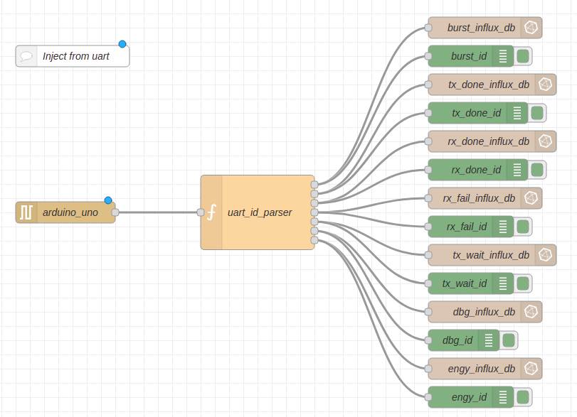


Slide 7
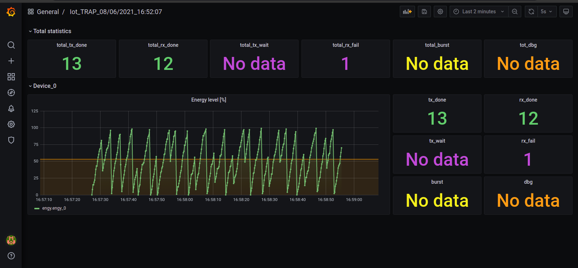

Slide 8
Scalability level
Several sensors should be tested simultaneously, for this reason, an upgrade to increase scalability is necessary.
In TRAP debug tool, the “constructor.py” and “manage_influx_db.sh” scripts were implemented to be able to automatically add new devices to Node-RED, InfluxDB and Grafana with one command

Slide 9
Constructor.py
Python3 script responsible to add new devices to Node-RED and Grafana json files.
/usr/bin/python3 constructor.py ‘/dev/ttyACM3 /dev/ttyACM4’

Slide 10
manage_influx_db.sh
Linux bash script that manages the entire application:
./manage_influx_db.sh -r '/dev/ttyACM3 /dev/ttyACM4'
./manage_influx_db.sh -w /path/to/folder/

Slide 11
Remotely?
The TRAP debug tool can run on every Linux based OS, also remotely, just importing all the necessary files and dependencies. Then, when the environment is set, just ssh commands are needed and the Grafana output is reachable on port 3000 of the IP address of the remote device.

Slide 12
Thank you for your attention
TRAP debug tool for Transiently-Powered sensing systems
Student
Matteo Spadetto
[214352]

