Slide 1

Changes in the new release of CARNIVAL
Improvements for Developers and Users
Based on the work of the group of Prof. Julio Saez-Rodriguez at
Heidelberg University - Instutitute of Computational Biomedicine in Heidelberg
Module: Bioinfromatik II – Supervisor: Dr. Attila Gabor – Tutor: Dr. Olga Ivanova – Speaker: Matteo Spatuzzi
Notes:
This presentation is about some core changes to carnival that will come with the release of the next version. It includes changes relevant for developers that make the code easier to underdtand and modify and improvements that make it easier to implement and more flexible for users.

Slide 2
Index
CARNIVAL Introduction
Constraints writing
Unit testing
New arguments
Inputs
CarnivalOptions
Adding Solvers
Api functions:
runVanillaCarnival
runInverseCarnival
generateLpFile
runFromLpCarnival
Upcoming Developments
Notes:
Here‘ s a brief overview of the topic covered by this presentation. This does not reflect all of the changes brought to carnival, only the ones that I have been working with

Slide 3
Introduction to CARNIVAL
Software to infer upstream causuality in perturbed molecular networks:
Identifies perturbed nodes that explain downstream measurements
Based on integer linear programming (ILP):
method to solve optimization problems
Relies on constraints that reflect the structure of the molecular network model
Applications:
Identification of drugs‘ mode of action
Identification of alterated molecular pathways

Slide 4
Introduction to CARNIVAL
Inputs:
Perturbations: A list of perturbed nodes upstream
Prior Knowledge Network: Information known about the molecular network of interest
Measurements: Downstream measurements, e.g. Transcription factors
Weights: An optional input that indicates how active various pathways are
Solvers:
ILP problems can be solved by different solvers
Standard: lpSolve, included in an R package, no further software required
Cplex and Cbc are also supported but are external to R

Slide 5
CARNIVAL Overview
(1)
Input
Check data
Solve Carnival
Result
Check PKN
Check weights
Write Lp File
Process
Solution
Check perturbations
Check measurements
Run ILP Solver
Figure 1: Overview of the stdCarnival Pipeline

Slide 6
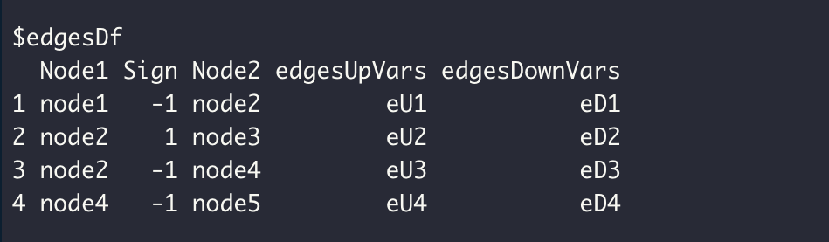
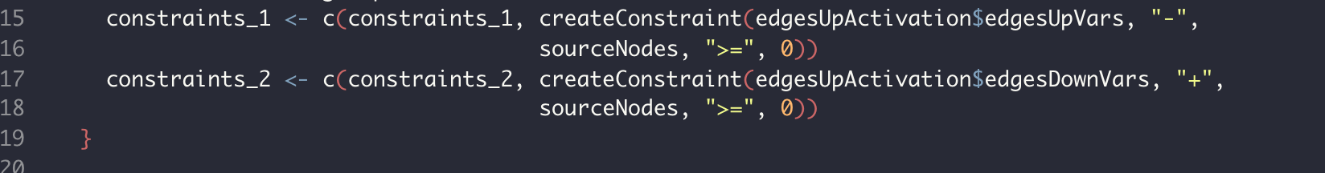
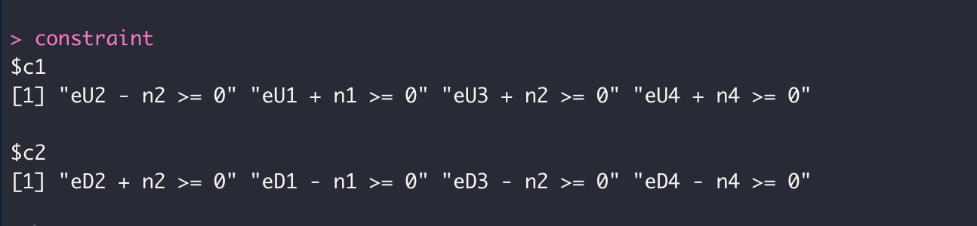
Constraints writing
(2)
New constraints writing functions:
createConstraint()
createConstraintFreeForm()
Allow for modular constraint system to be implemented in next version
Allow user to write own constraints
(3)
(4)
Figures 1-3: Toy network (2), creating constraints from the network (3), finished constraints (4).

Slide 7
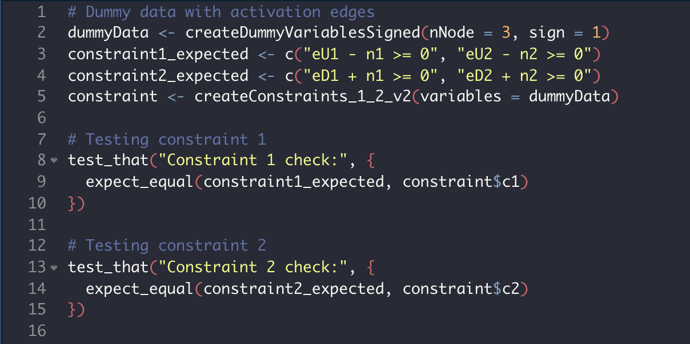
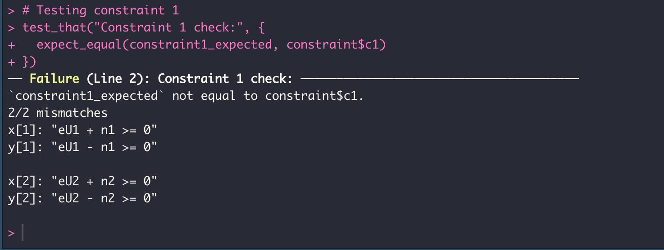
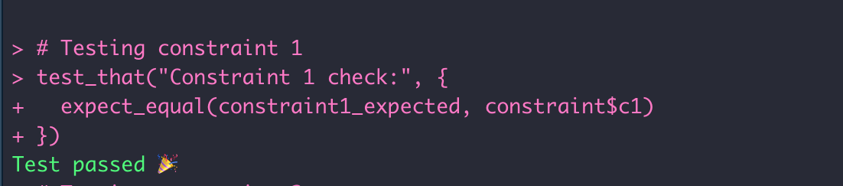
Unit Testing
(5)
Unit tests written for constraints-writing functions
Different Dummy Datasets created:
Only Activatory Edges, only Inhibitory Edges, mixed
Results:
Issues with only one type of edge due to function structure
Errors have been fixed
(6)
(7)
Figures 5-7: Unit test for createconstraints_1_2_v2 (5), failed test (6), successful test (7).

Slide 8
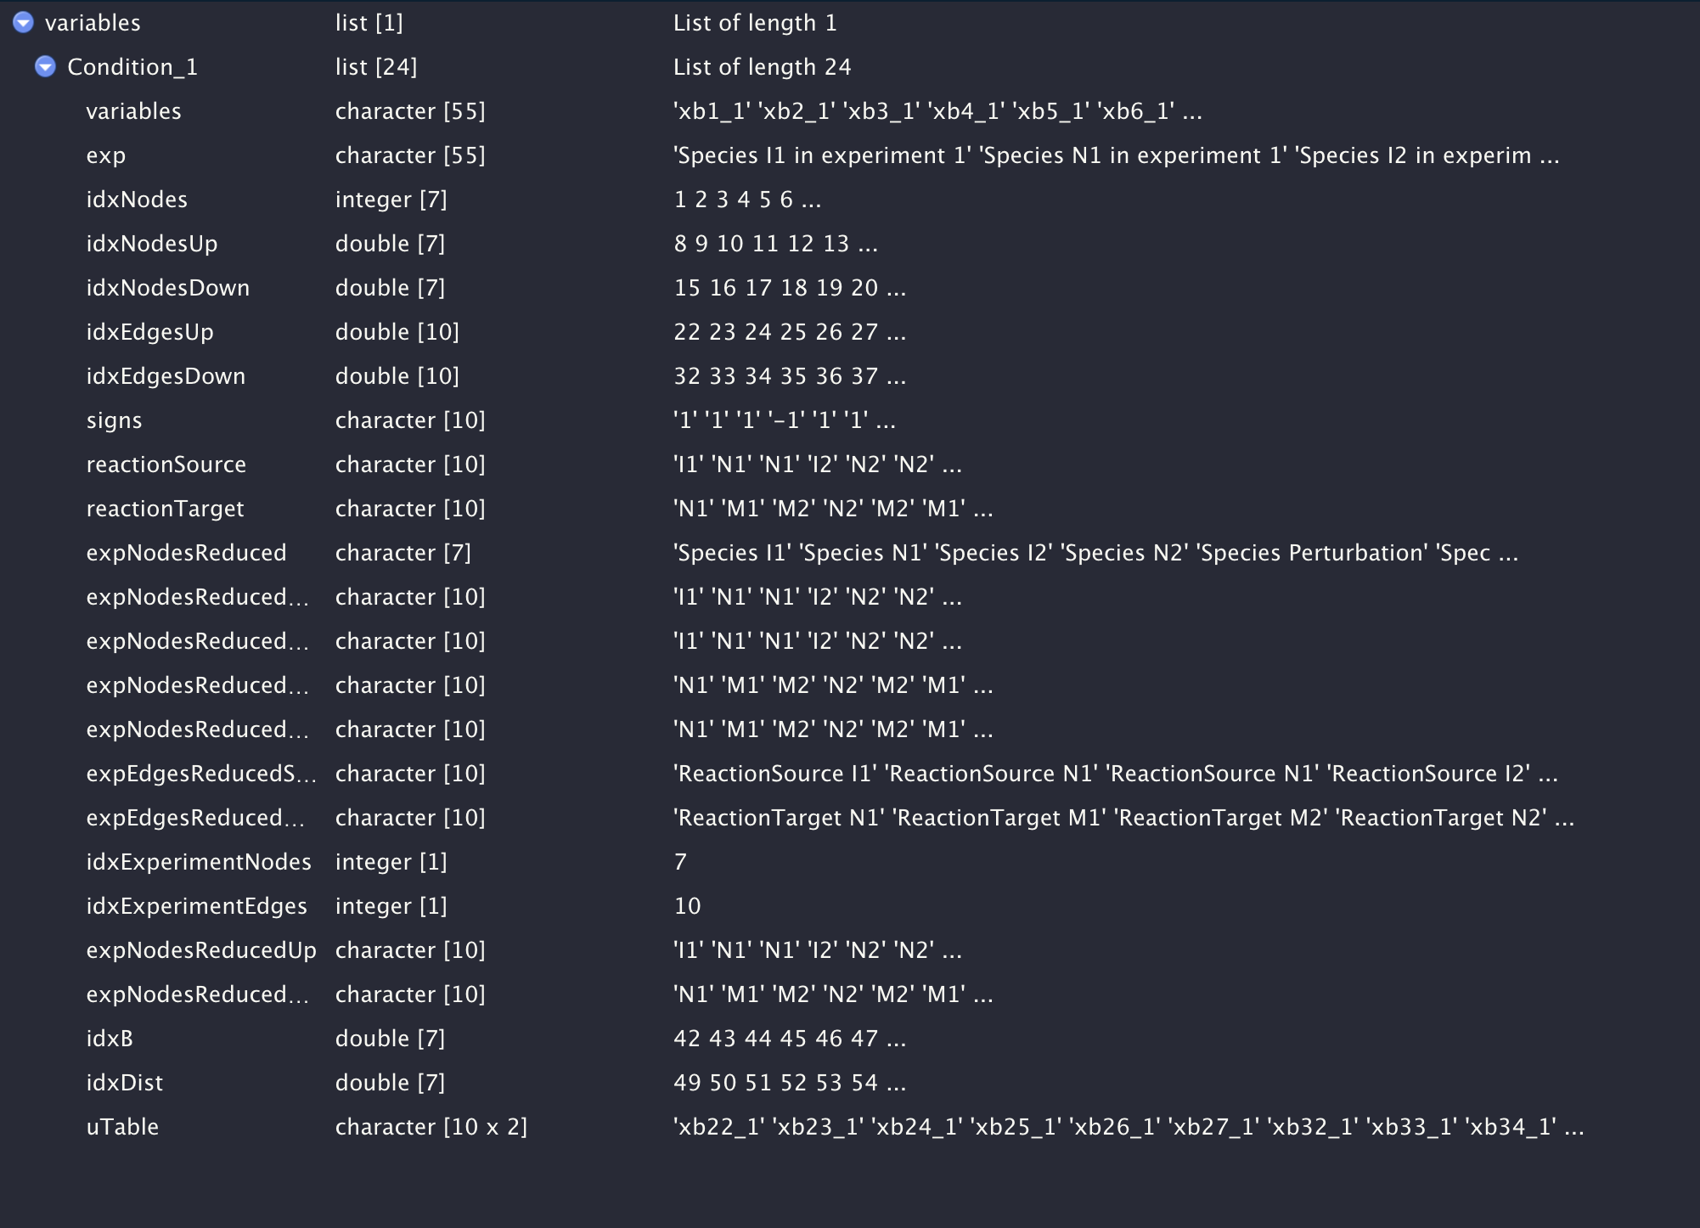
New Internal Data Representation
(8)
Previous method:
Difficult to get an overview
Difficult to find relationships between variables
A lot of redundant information
Figure 8: Internal Data representation in the original code.

Slide 9
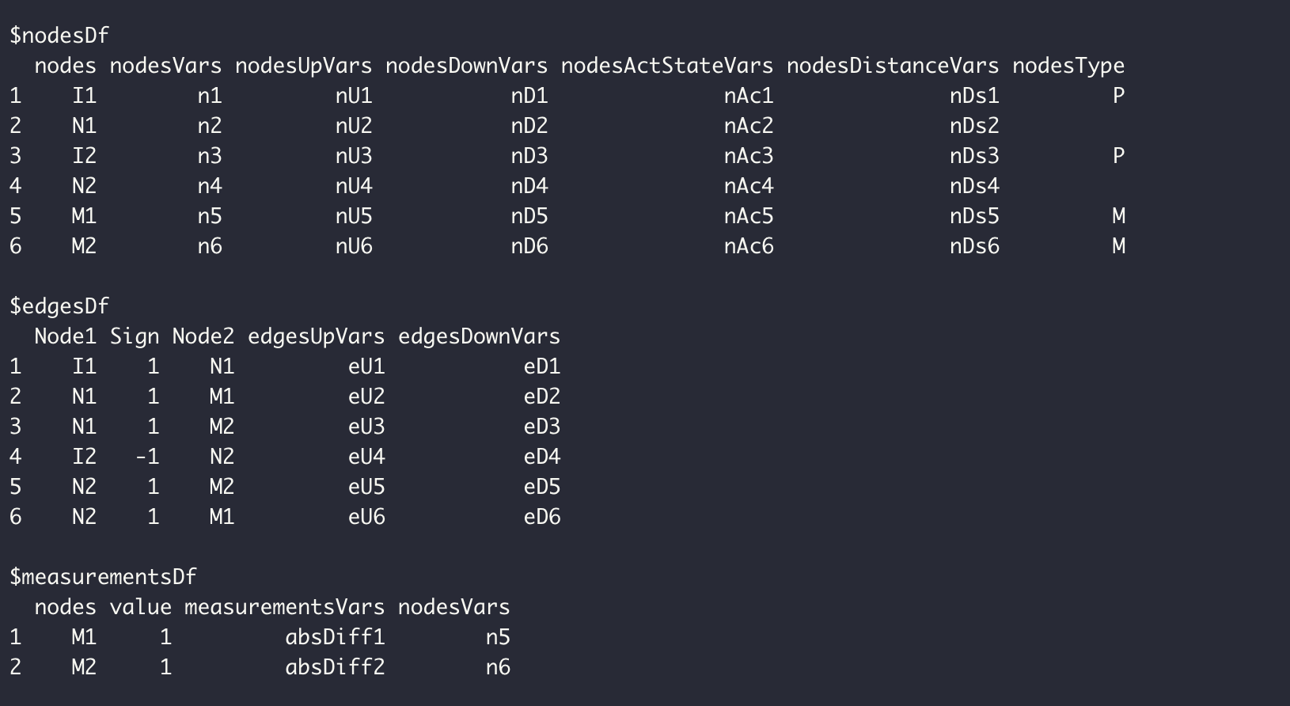
New Internal Data Representation
(9)
New Data representation:
Easy to get an overview
Clear relationship between variables
Almost no redundancies
Figure 9: Improved Internal Data representation in the new code.

Slide 10
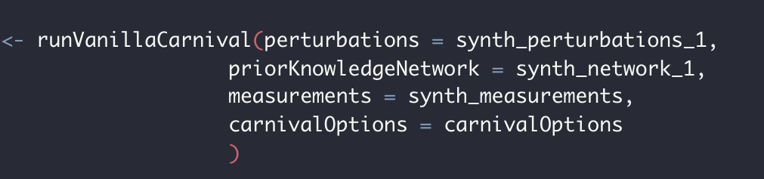
New Arguments: Input Arguments
New set of arguments for more intuitive and practical usage
Input arguments renamed for clarification:
measObj -> measurements
netObj -> priorKnowledgeNetwork
inputObj -> perturbations
weightObj -> weights
(10)
Figure 10: Running stdCarnival with the new set or arguments.

Slide 11
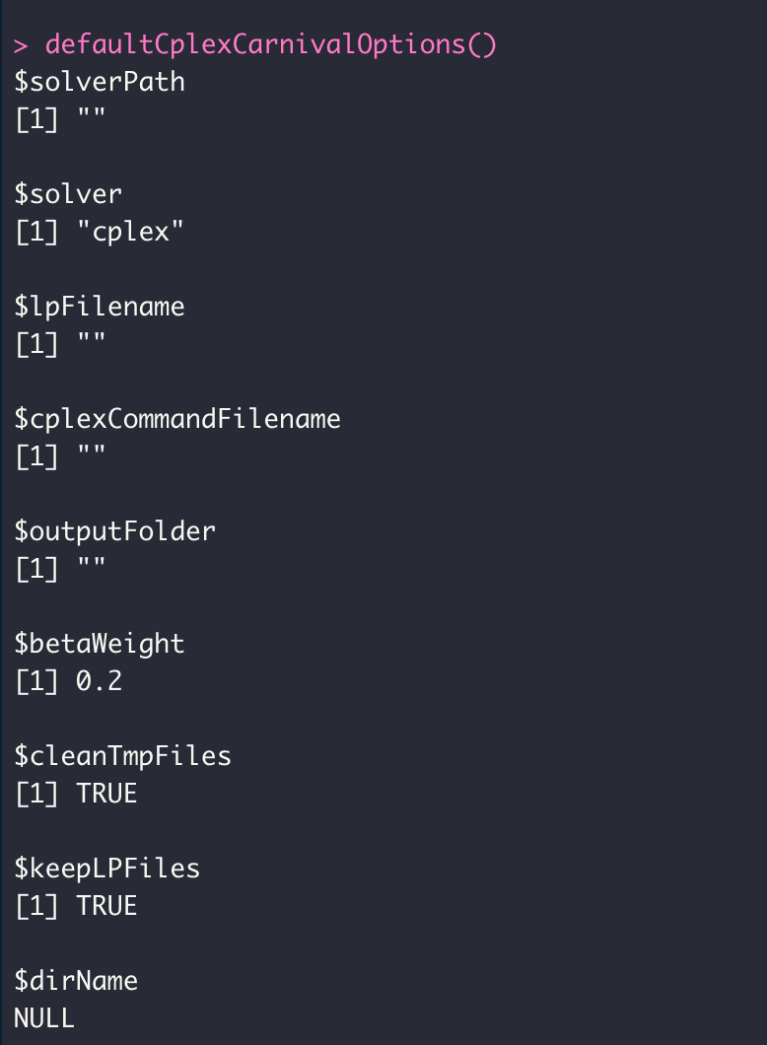
New Arguments: carnivalOptions
(11)
API functions have fewer arguments than runCARNIVAL() from the previous branch
Most old arguments are subsumed under the argument carnivalOptions
takes a list of settings, can be generated with the following functions:
defaultCplexCarnivalOptions()
defaultCbcCarnivalOptions()
defaultLpSolveCarnivalOptions()
Figure 11: The first 8 elements of defaultCplexCarnivalOptions().

Slide 12
Adding solvers
The various solvers and the function to run them are stored in a modular way
Supported so far:
cplex
cbc
lpSolve
checkSolverInputs()
supportedSolvers()
prepareforCarnivalRun()
processSolution()
sendTaskToSolver()
getSupportedSolversFunctions()
Figure 12: Functions to modify to add a solver.

Slide 13
Api functions
Function | Usage | Notes
runVanillaCarnival() | Runs the stdCARNIVAL pipeline | Equivalent to runCarnival() in original CARNIVAL
runInverseCarnival() | Runs the invCARNIVAL pipeline | All parents node as potential perturbations, biologically inaccurate
generateLpFile() | Only generates internal Data representation and lp file
runFromLpCarnival() | Takes position of internal Data representation and lp file as input, runs stCARNIVAL pipeline otherwise
Table 1: Api functions and their usage.

Slide 14
runInverseCarnival Overview
(13)
Api
Check data
Solve Carnival
Result
Write Lp File
Process
Solution
Check PKN
Check weights
Run ILP Solver
Add Perturbation Nodes
Check measurements
Figure 13: Overview of the invCarnival Pipeline.

Slide 15
generateLpFile Overview
(14)
Parsed Data
Api
Check data
Write Lp File
Lp File
Check PKN
Check weights
Check perturbations
Check measurements
Figure 14: Overview of the generateLpFile function.

Slide 16
runFromLpCarnival Overview
Parsed Data
(15)
Solve Carnival from Lp
Result
Lp File
Run ILP Solver
Process
Solution
Figure 15: Overview of the runFromLpCarnival function.

Slide 17
Upcoming Changes
runCarnivalWithManualConstraints:
Allows to run Carnival with a separatedly generated Lp file
Ideally works in tandem with support functions to easily create LP File correctly
Matrix-based system to uniformly create constraints
Integration testing

Slide 18
Thank you for your attention!
Questions?
Feedback?

Slide 19
Adding solvers
Function | Usage | List | Usage
checksolverinputs | Controls that the chosen solver is supported, must be extended/rewritten | supportedSolvers | Generates a list of supported solvers, need to be extended with solver‘s name
prepareForCarnivalRun | Prepares data to be sent to solvers, some solvers may require specific changes (e.g. lpSolve) | getSupportedSolversFunctions | Generates a lists of functions to run the solver, needs to be extended with functions
sendTaskToSolvers | Sends task to chosen solver, calls output of getSupportedSolversFunctions of chosen solvers

