Slide 1



VSM ENGINEERING · FEASIBILITY STUDY
RoboSprayer Electric
Deterministic feasibility study on a validated 347-sample electric field profile.
GVW 3,500 kg
Electric powertrain
12 kph field
Battery 50 kW
Motor 63 rpm
DISTANCE
DRIVE CYCLE TIME
FINAL BATTERY SOC
1.00 km
5.77 min
72.45 %
ENERGY CONSUMPTION
RANGE @ 85%
MAX BATT POWER
3,778.1 Wh/km
11.25 km
47.92 kW
Samples: 347 | Tool version: v1.3.0
1 / 12

Slide 2



System & Simulation Overview
Electric profile resolution and deterministic simulation scope
GVW 3,500 kg
Electric powertrain
12 kph field
Battery 50 kW
Motor 63 rpm
Drive Cycle Structure
Computation Context
▸ Selected reporting profile: Electric.
▸ Powertrain type: fully electric.
▸ Imported samples: 347 · source channels: 601.
▸ Resolved required raw channels: 289 / 289.
▸ Calculated MATH channels: 25.
▸ Calculated statistics: 35 · KPIs: 12.
▸ Rendered profile plots: 15.
▸ Inactive / all-zero resolved channels: 33.
DRIVE CYCLE TIME
DISTANCE
MAX SPEED
FINAL BATTERY SOC
5.77 min
1.00 km
14.93 kph
72.45 %
VSM ENGINEERING · POST-PROCESSING TOOL v1.3.0
2 / 12

Slide 3
Executive Results
● Battery ● Consumption ● Drive Cycle
Deterministic KPIs from the validated profile pipeline
DRIVE CYCLE TIME
DISTANCE
MAX SPEED
INITIAL BATTERY SOC
5.77 min
1.00 km
14.93 kph
80.00 %
FINAL BATTERY SOC
BATTERY CAPACITY USED
ENERGY CONSUMPTION
RANGE @ 85%
72.45 %
3.77 kWh
3,778.1 Wh/km
11.25 km
Calculations are sourced from the profile statistics and KPI results.
VSM ENGINEERING · POST-PROCESSING TOOL v1.3.0
3 / 12

Slide 4

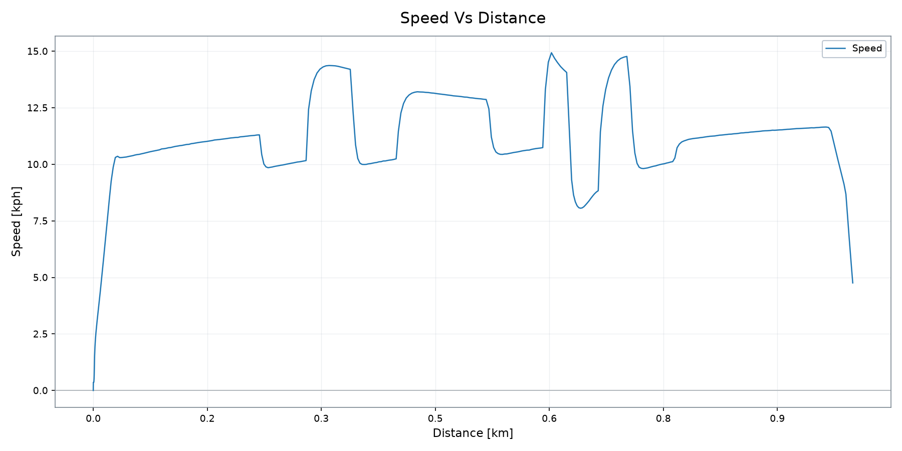
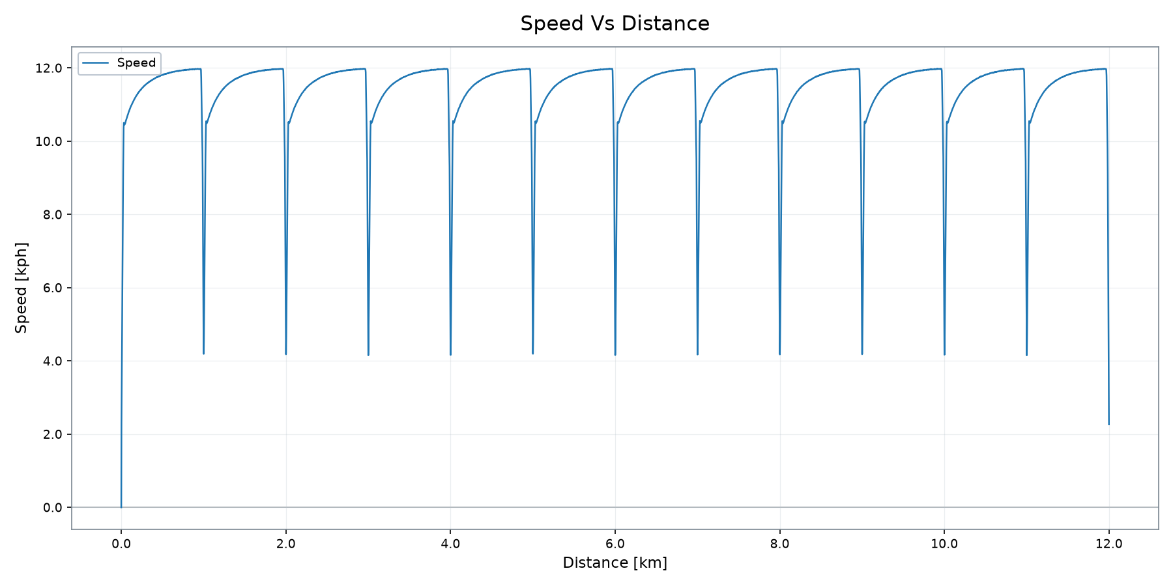
Vehicle Operation
Speed trace from the validated profile plot output
DISTANCE
DRIVE CYCLE TIME
MAX SPEED
FINAL BATTERY SOC
1.00 km
5.77 min
14.93 kph
72.45 %
VSM ENGINEERING · POST-PROCESSING TOOL v1.3.0
4 / 12

Slide 5

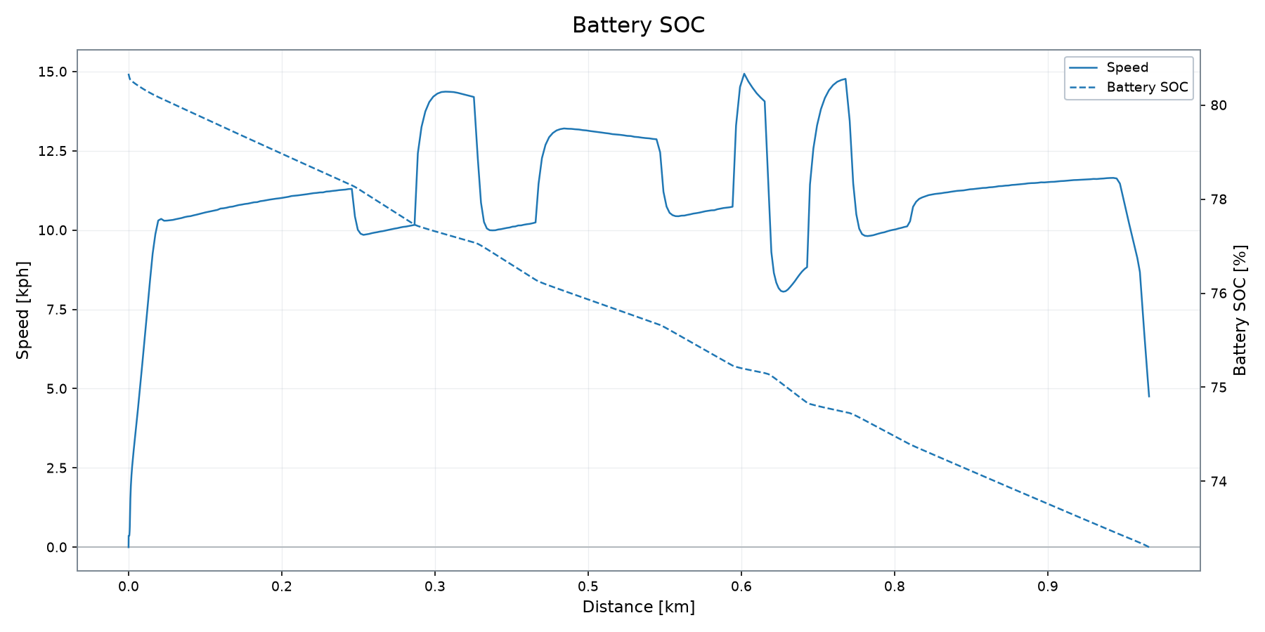
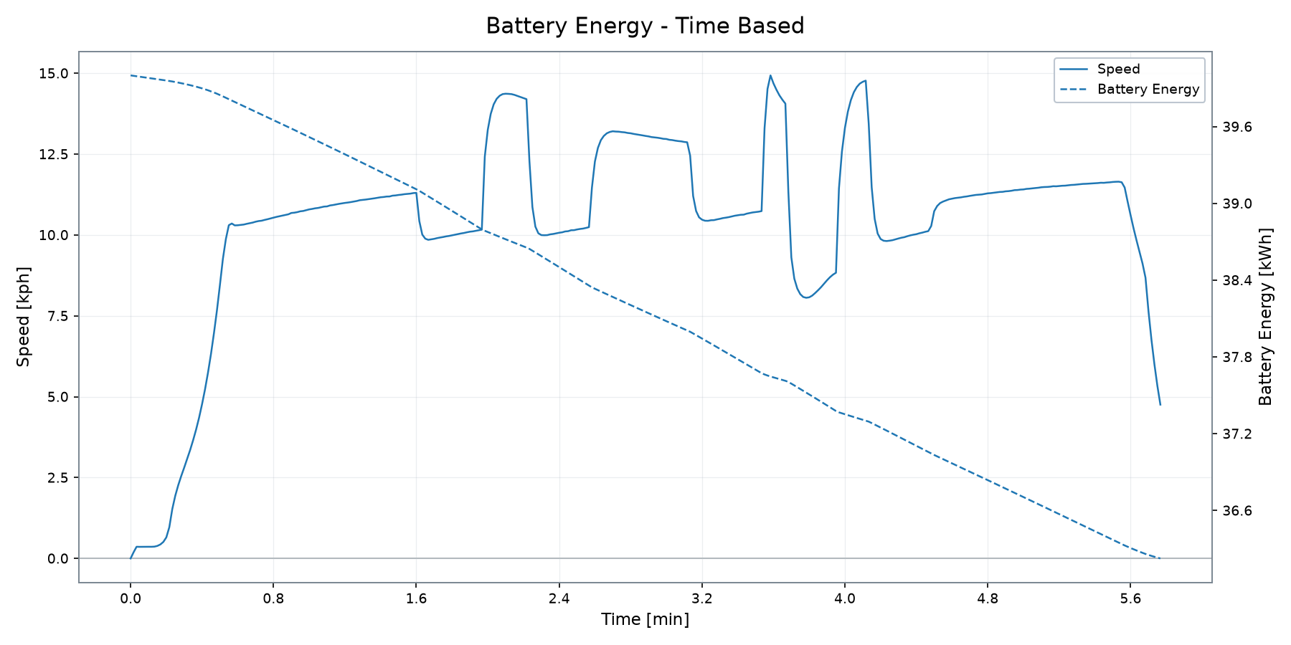
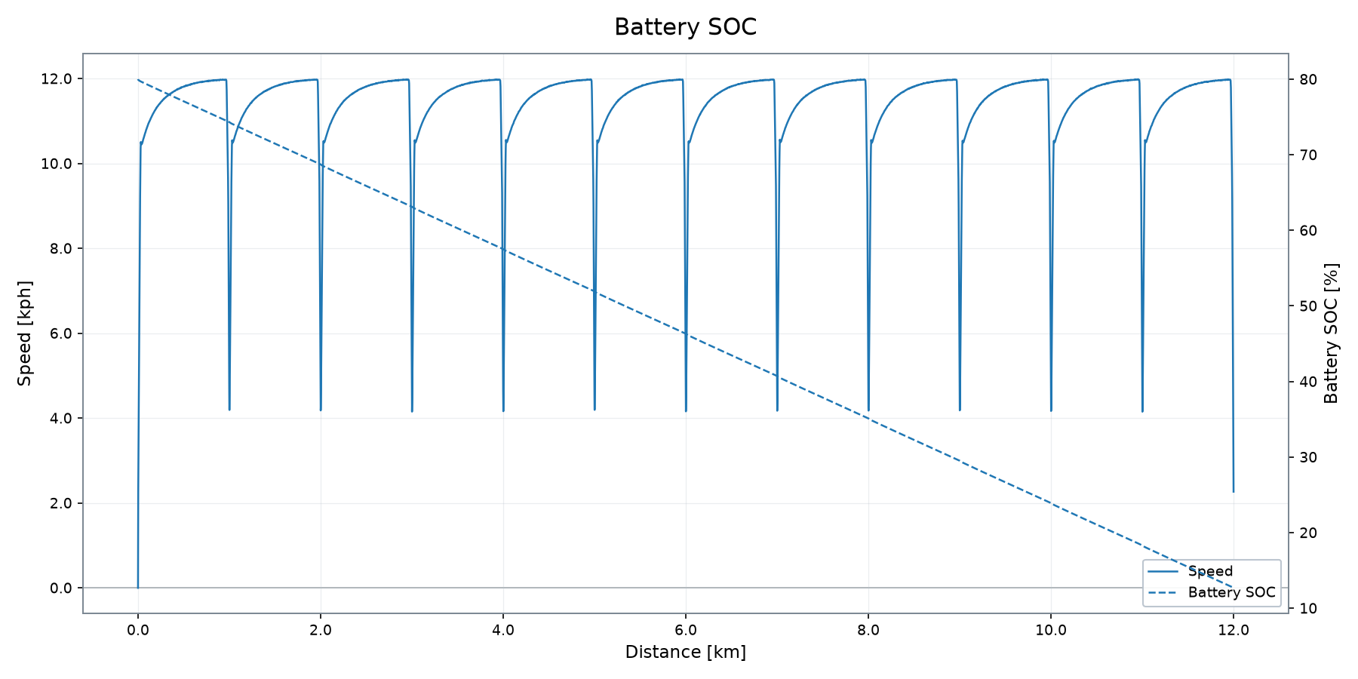
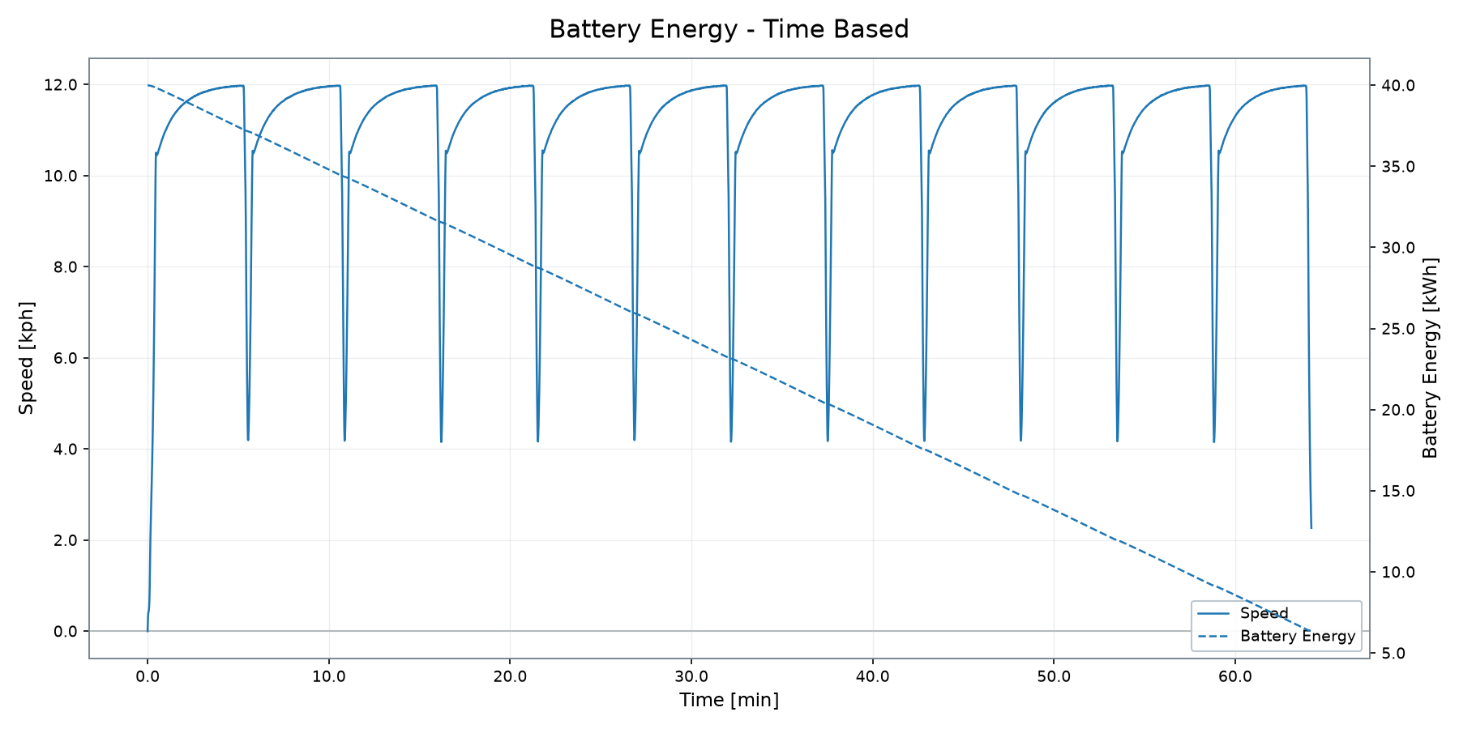
Battery & Electrical Energy System
State of charge, stored energy and battery demand
INITIAL BATTERY SOC
FINAL BATTERY SOC
MAX BATT POWER
BATT POWER RMS
HEATFLOW RMS
BATTERY CAPACITY USED
80.00 %
72.45 %
47.92 kW
36.78 kW
3.64 kW
3.77 kWh
VSM ENGINEERING · POST-PROCESSING TOOL v1.3.0
5 / 12

Slide 6

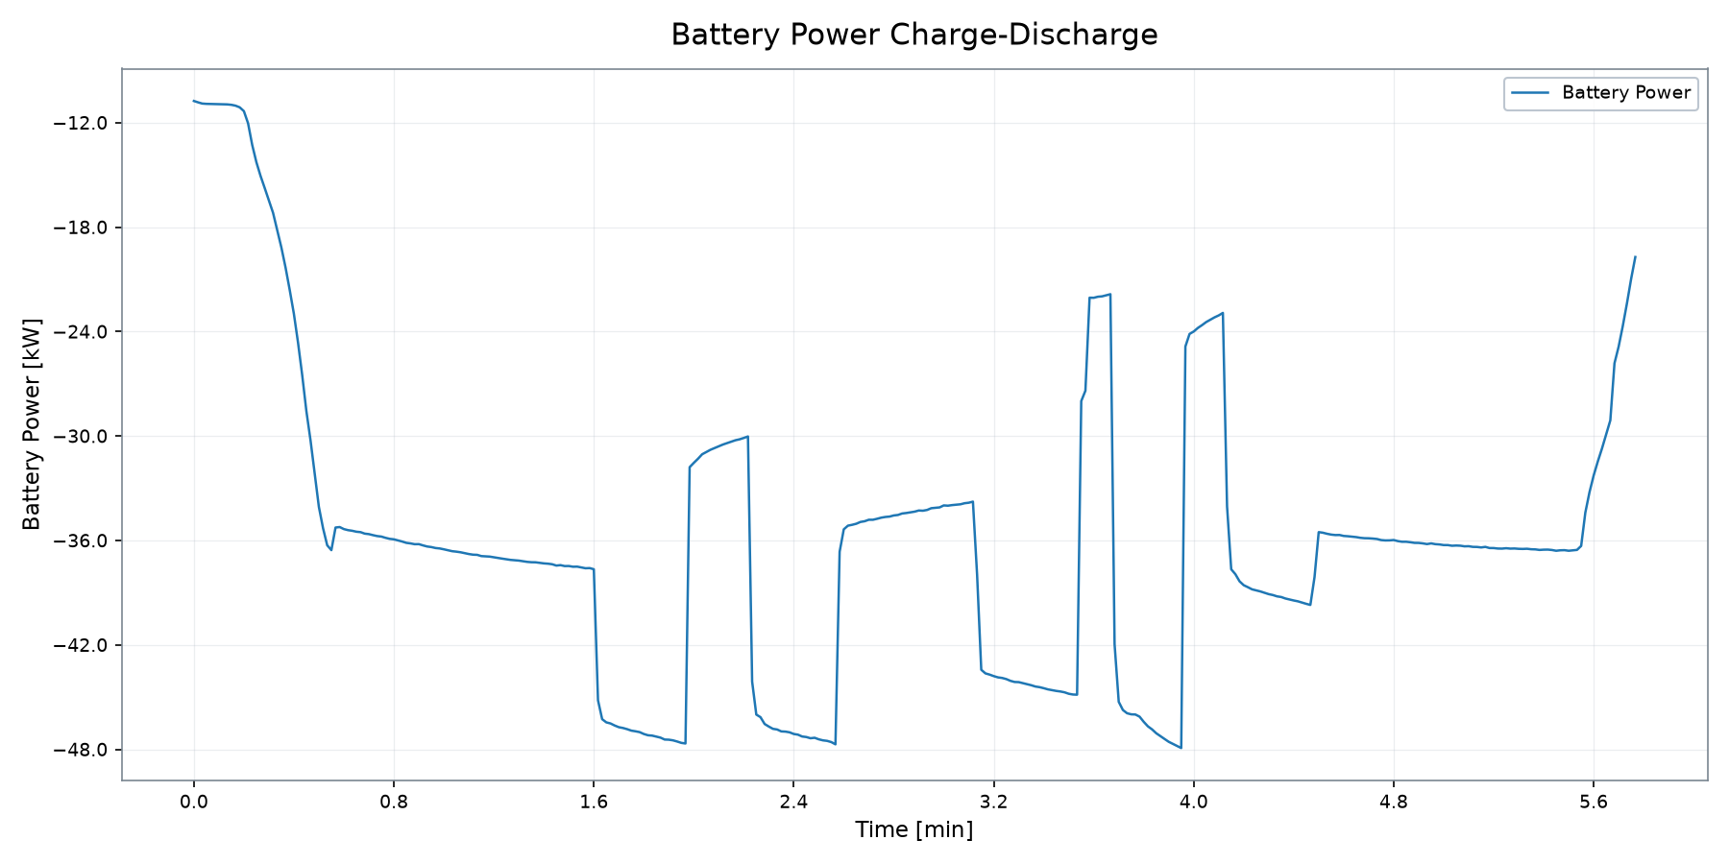
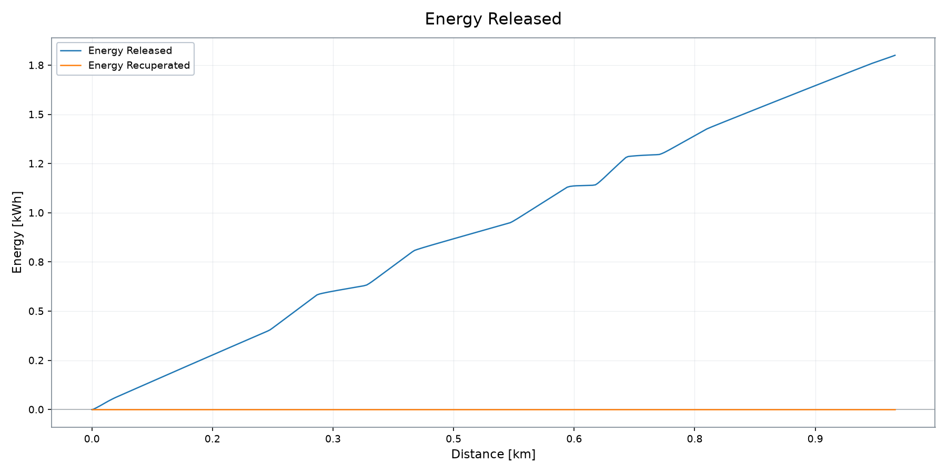
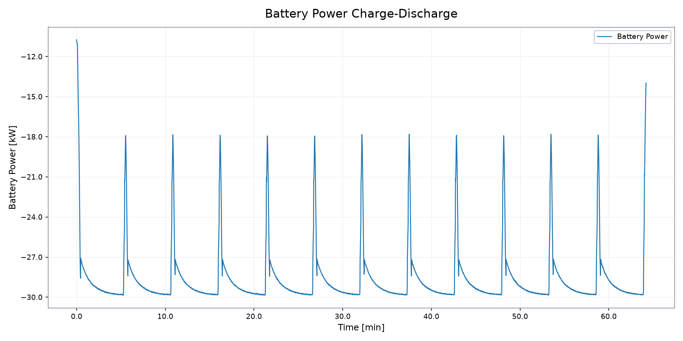
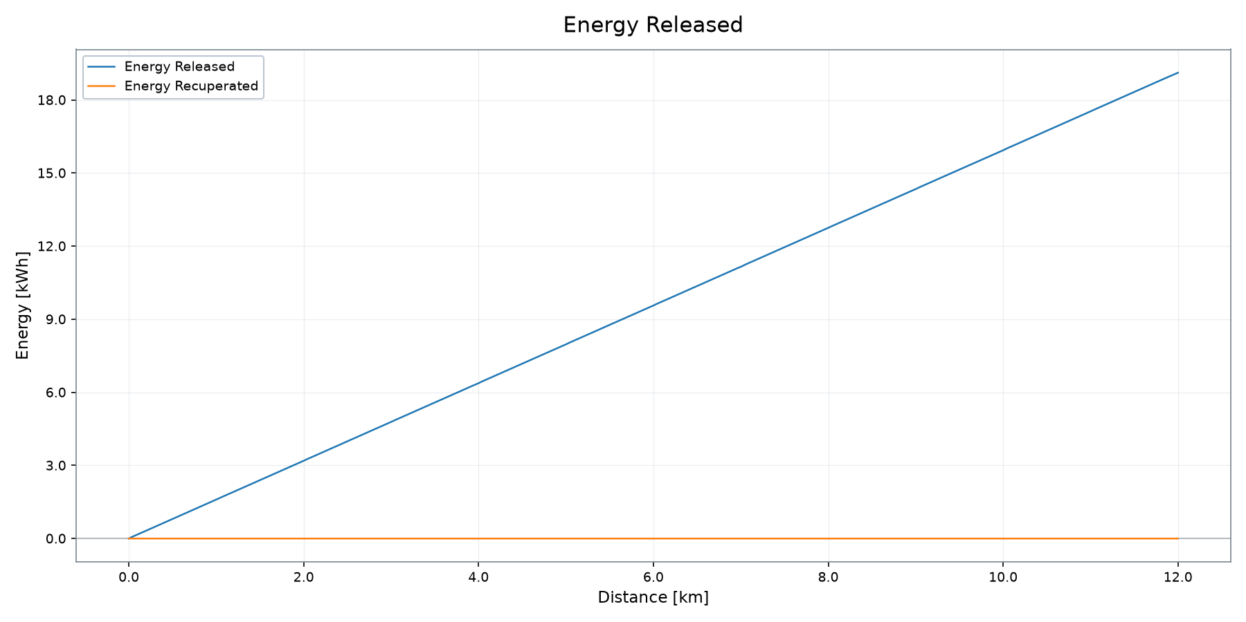
Battery Power & Energy Recovery
Charge / discharge behaviour and released / recuperated energy
BATT POWER RMS
ENERGY RELEASED
ENERGY RECOVERED
AUX ENERGY
MAX BATT POWER
36.78 kW
1.80 kWh
0.00 kWh
1.04 kWh
47.92 kW
VSM ENGINEERING · POST-PROCESSING TOOL v1.3.0
6 / 12

Slide 7

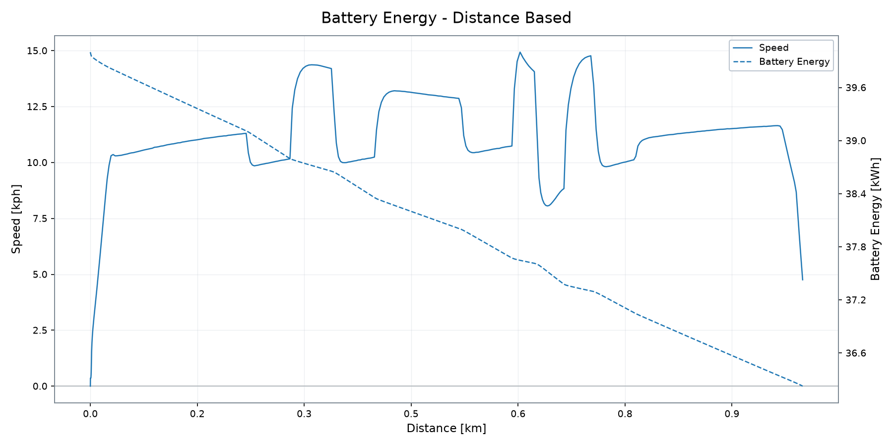
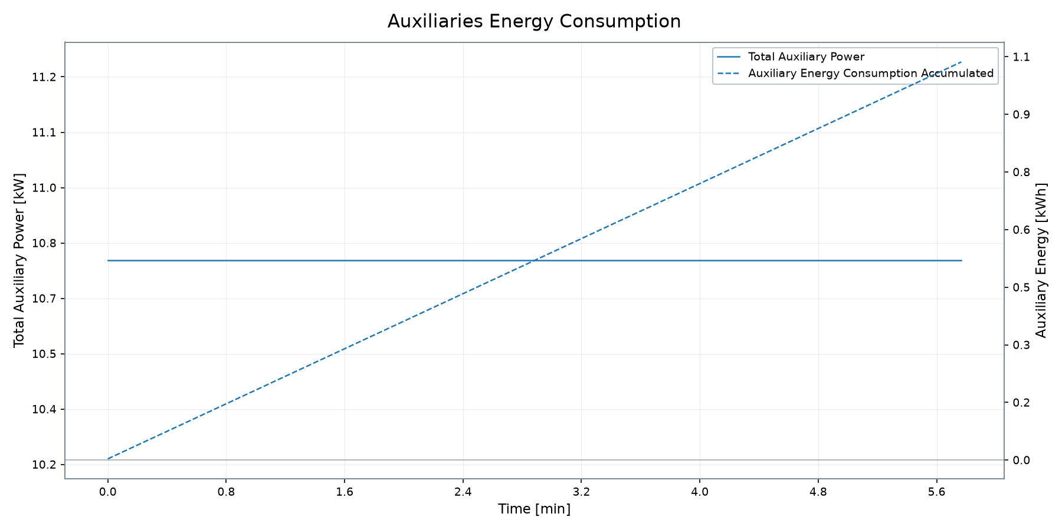
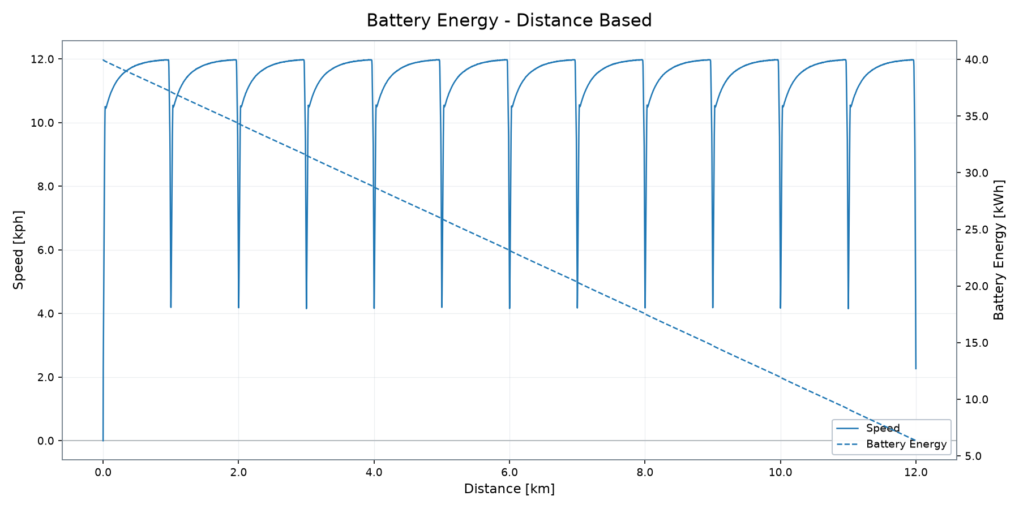
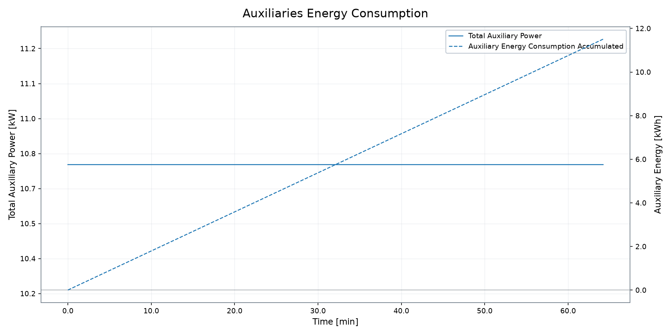
Energy Consumption & Estimated Range
Battery energy consumption and range indicators
BATTERY CAPACITY USED
ENERGY CONSUMPTION
RANGE @ 85%
FINAL BATTERY SOC
MAX BATT POWER
AUX ENERGY
3.77 kWh
3,778.1 Wh/km
11.25 km
72.45 %
47.92 kW
1.04 kWh
Range and consumption are deterministic profile KPI outputs.
VSM ENGINEERING · POST-PROCESSING TOOL v1.3.0
7 / 12

Slide 8

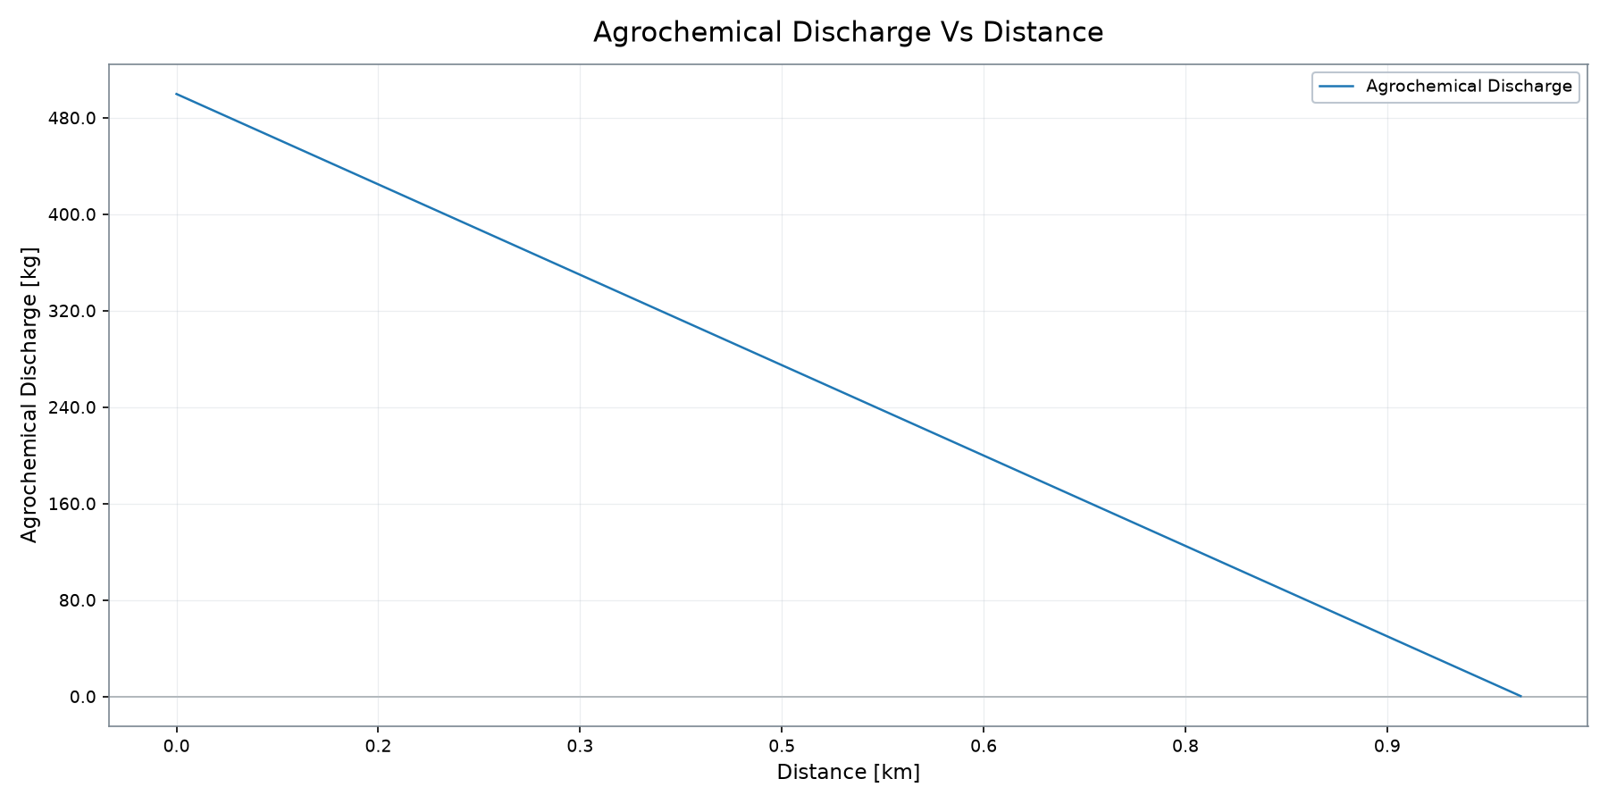
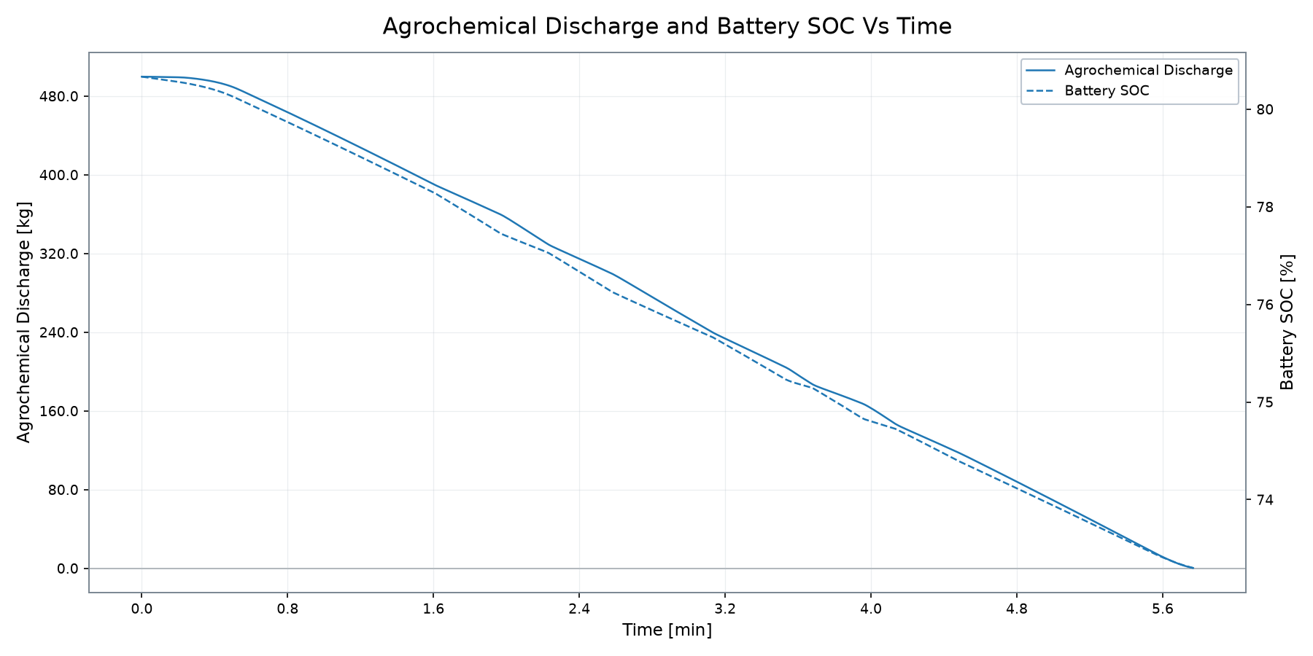
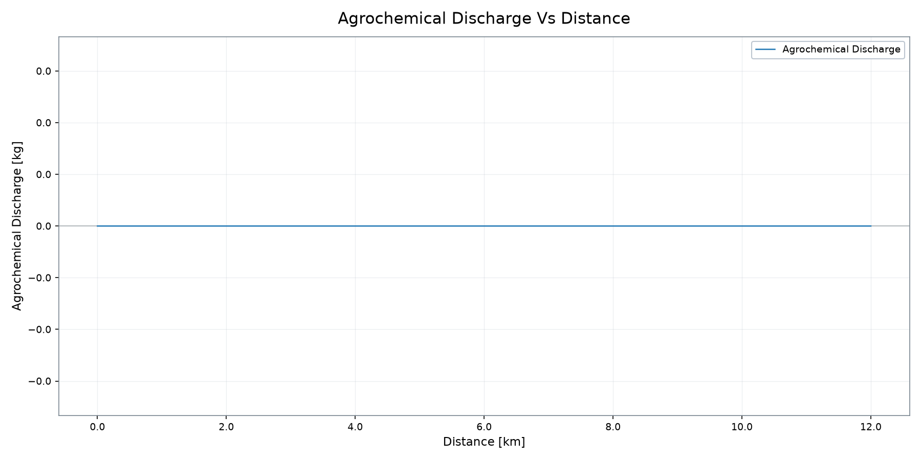
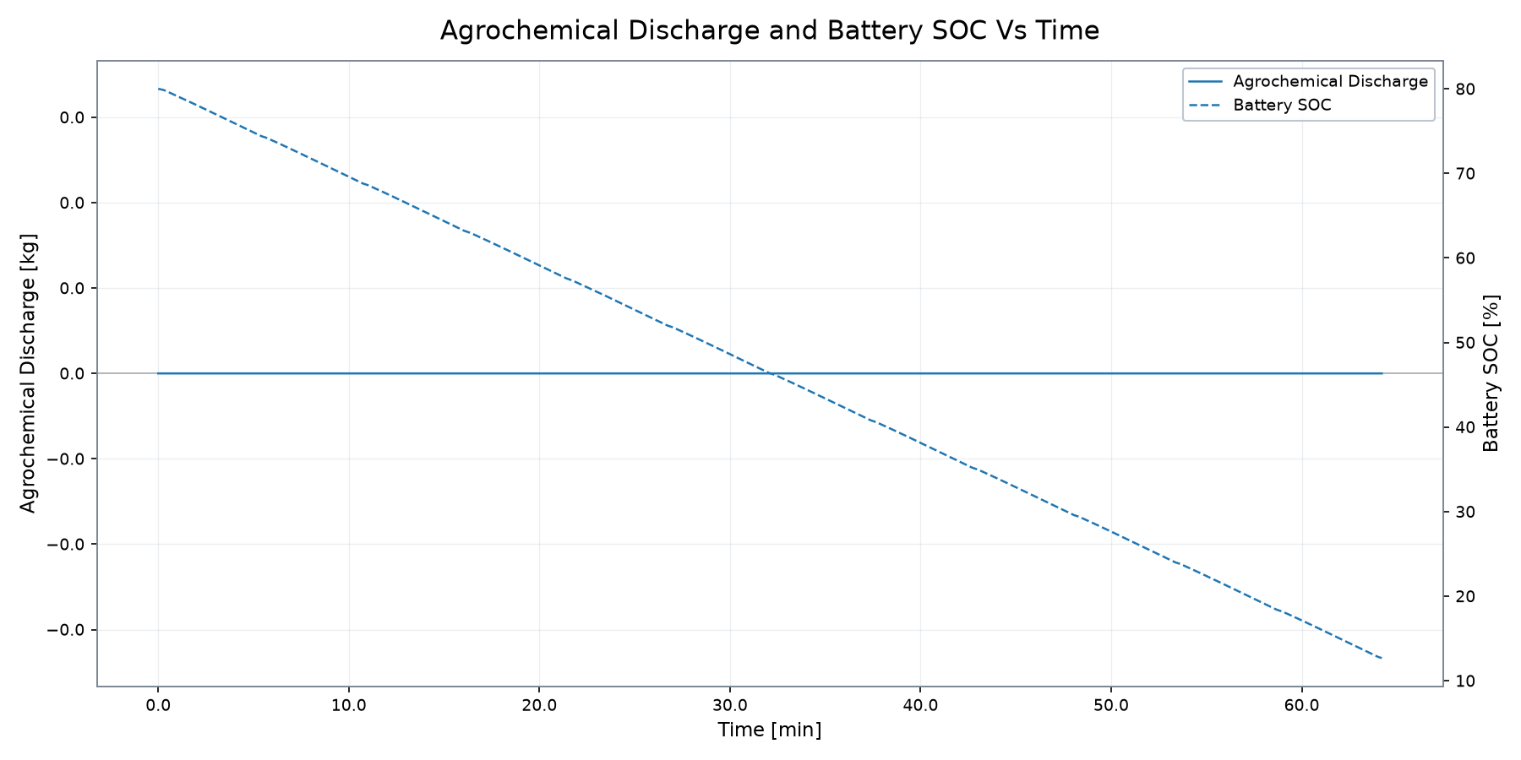
Agrochemical & Battery Behaviour
Profile-supported system interaction from the active source data
AGRO DISCHARGE
FINAL BATTERY SOC
BATTERY CAPACITY USED
DRIVE CYCLE TIME
499.83 kg
72.45 %
3.77 kWh
5.77 min
VSM ENGINEERING · POST-PROCESSING TOOL v1.3.0
8 / 12

Slide 9

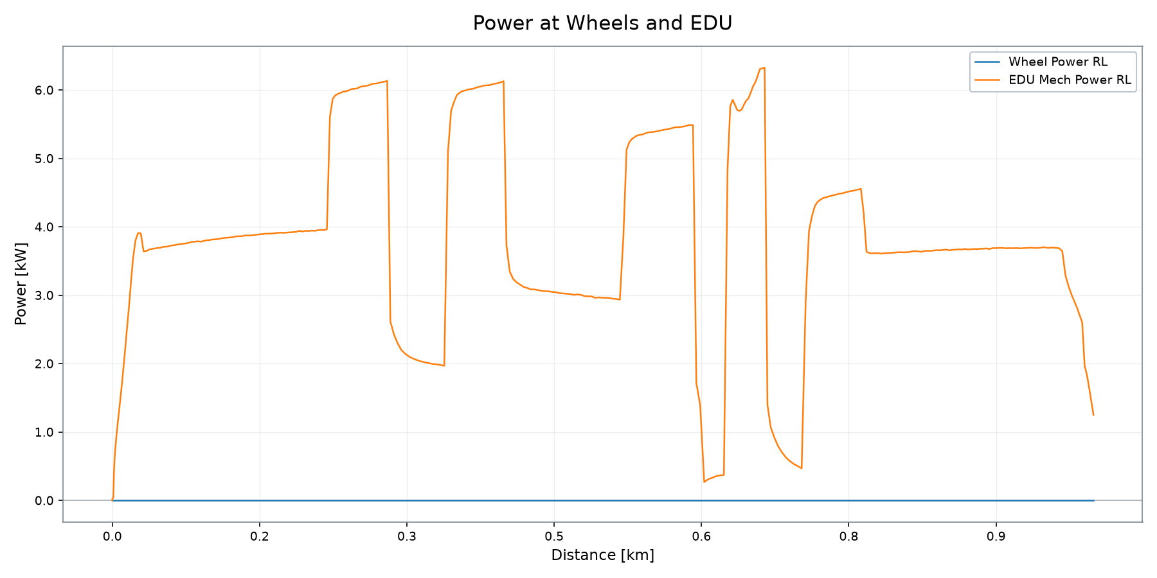
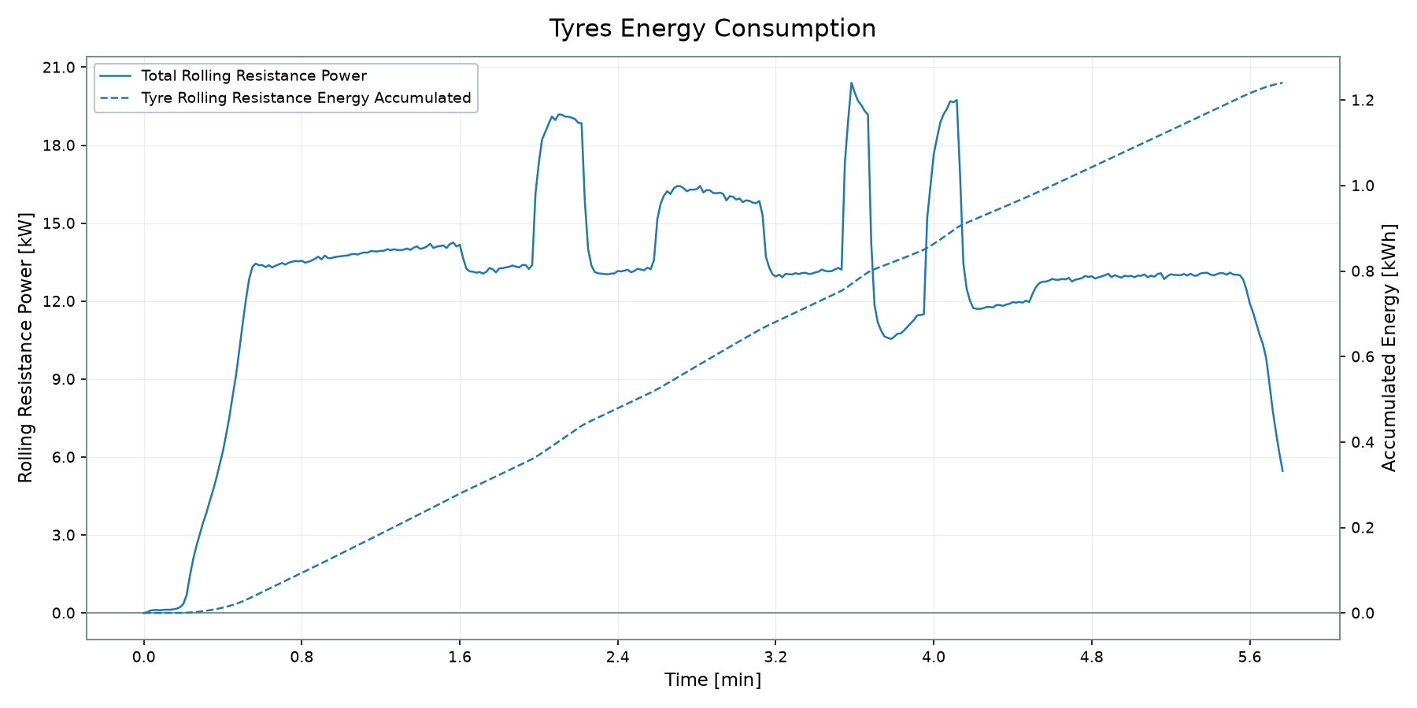
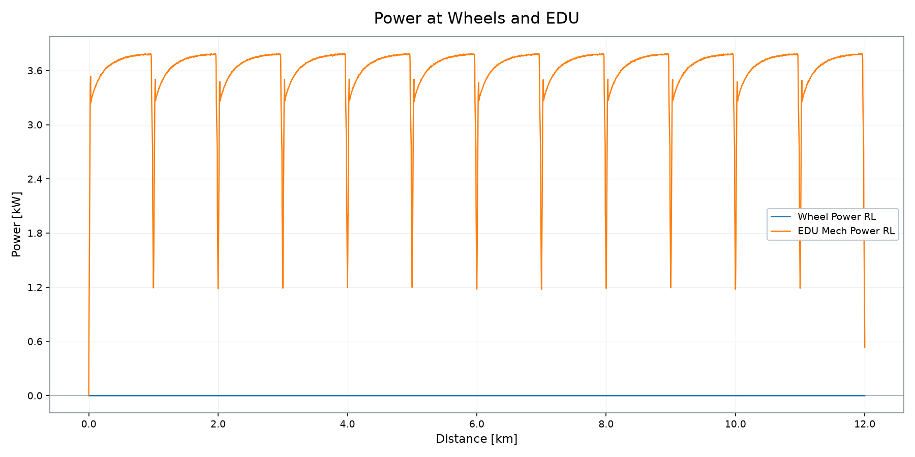
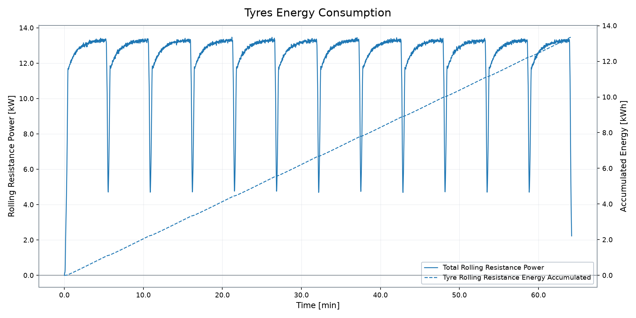
Traction, EDU & Auxiliary Energy Demand
Wheel, EDU, tyre and auxiliary demand from profile plots
EDU MAX POWER
WHEEL MAX POWER
EDU MAX SPEED
EDU MAX TORQUE
TYRE RR ENERGY
AUX ENERGY
6.33 kW
0.00 kW
70 rpm
1,420.9 Nm
1.24 kWh
1.04 kWh
VSM ENGINEERING · POST-PROCESSING TOOL v1.3.0
9 / 12

Slide 10

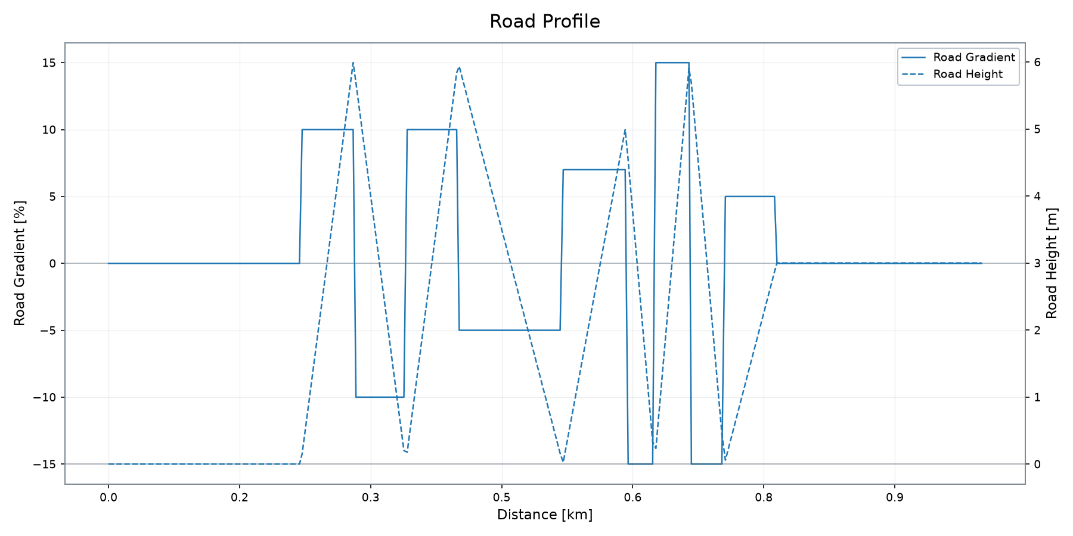
Road Profile
Road height and road gradient over the drive cycle
MAX GRADIENT
MIN GRADIENT
MAX HEIGHT
MIN HEIGHT
HEIGHT RANGE
DISTANCE
15.00 %
-15.00 %
5.99 m
0.00 m
5.99 m
1.00 km
VSM ENGINEERING · POST-PROCESSING TOOL v1.3.0
10 / 12

Slide 11

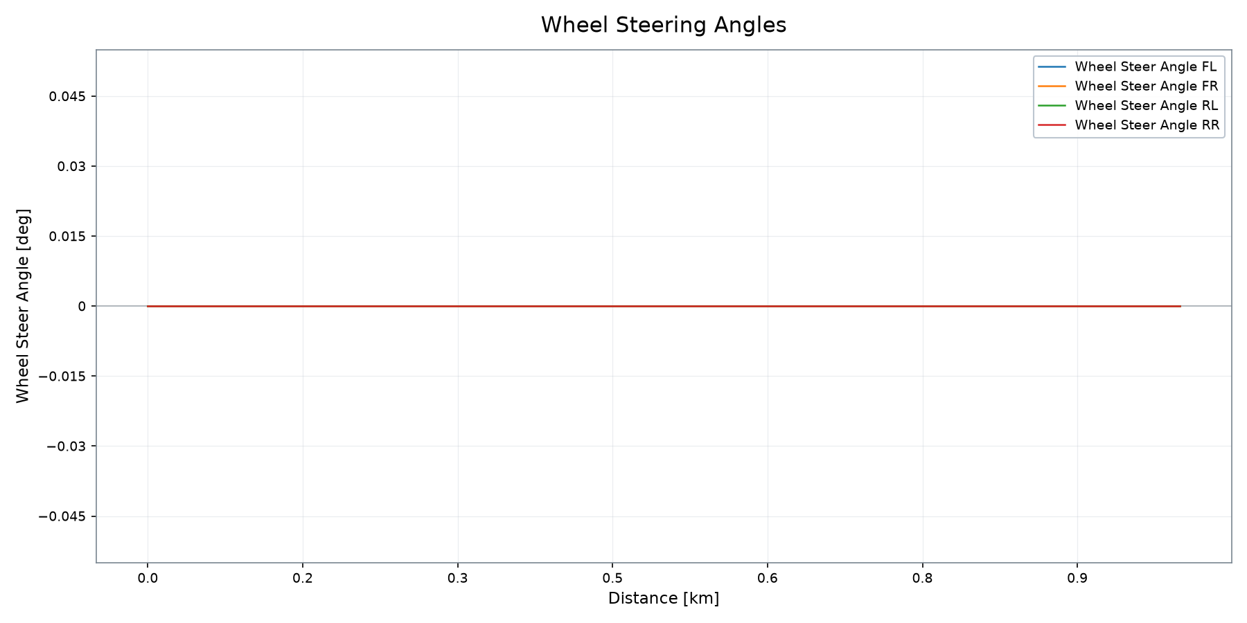
Wheel Steering Angles
Front and rear wheel steering behaviour over the drive cycle
MAX STEER FL
MAX STEER FR
MAX STEER RL
MAX STEER RR
MAX ABS STEER
DISTANCE
0.00 °
0.00 °
0.00 °
0.00 °
0.00 °
1.00 km
All steering-angle channels remain at 0.00° for this drive cycle.
VSM ENGINEERING · POST-PROCESSING TOOL v1.3.0
11 / 12

Slide 12

Simulation Summary
Deterministic profile result snapshot
1.00 km covered · SOC 72.45 % · consumption 3,778.1 Wh/km
DETERMINISTIC SUMMARY
▸ Deterministic run covered 1.00 km in 5.77 min.
▸ Final battery SOC is 72.45 % from an 80.00 % initial state.
▸ Battery capacity used is 3.77 kWh; estimated range for 85% battery is 11.25 km.
▸ Results are deterministic simulation outputs; acceptance conclusions require explicit engineering criteria.
DISTANCE
DRIVE CYCLE TIME
FINAL BATTERY SOC
BATTERY CAPACITY USED
ENERGY CONSUMPTION
RANGE @ 85%
1.00 km
5.77 min
72.45 %
3.77 kWh
3,778.1 Wh/km
11.25 km
VSM ENGINEERING · POST-PROCESSING TOOL v1.3.0
12 / 12

