Slide 1





VSM ENGINEERING · FEASIBILITY STUDY
Caiman SP Hybrid
VSM Engineering - Feasibility Study
Machine Caiman SP
Powertrain Hybrid
Source Profile source dataset
Samples 1,770
Tool v1.3.0
DISTANCE
MISSION TIME
FINAL BATTERY SOC
FUEL CONSUMPTION
12.00 km
29.48 min
46.20 %
3.63 kg
VSM Engineering Post-Processing Tool · v1.3.0
1 / 10

Slide 2




System and Simulation Overview
Hybrid profile resolution and deterministic simulation scope
Samples 1,770
Distance 12.00 km
Mission time 29.48 min
Hybrid profile
Mission Structure
Hybrid System Context
Source dataset: Profile source dataset
Imported samples: 1,770
Mission duration: 29.48 min
Mission distance: 12.00 km
Maximum speed: 33.78 kph
Battery SOC: 57.40 % to 46.20 %
Fuel consumption: 3.63 kg
Maximum generator power: 80.00 kW
Range-extender activity is reported directly from resolved simulation channels.
Inactive channels remain visible as zero deterministic outputs.
MISSION TIME
DISTANCE
MAX SPEED
MAX GEN POWER
29.48 min
12.00 km
33.78 kph
80.00 kW
VSM Engineering Post-Processing Tool · v1.3.0
2 / 10

Slide 3

Executive Results
Deterministic KPIs from the validated profile pipeline
MISSION TIME
DISTANCE
MAX SPEED
29.48 min
12.00 km
33.78 kph
INITIAL BATTERY SOC
FINAL BATTERY SOC
BATTERY CAPACITY USED
57.40 %
46.20 %
11.20 kWh
Calculations are sourced from the profile statistics and KPI results.
VSM Engineering Post-Processing Tool · v1.3.0
3 / 10

Slide 4
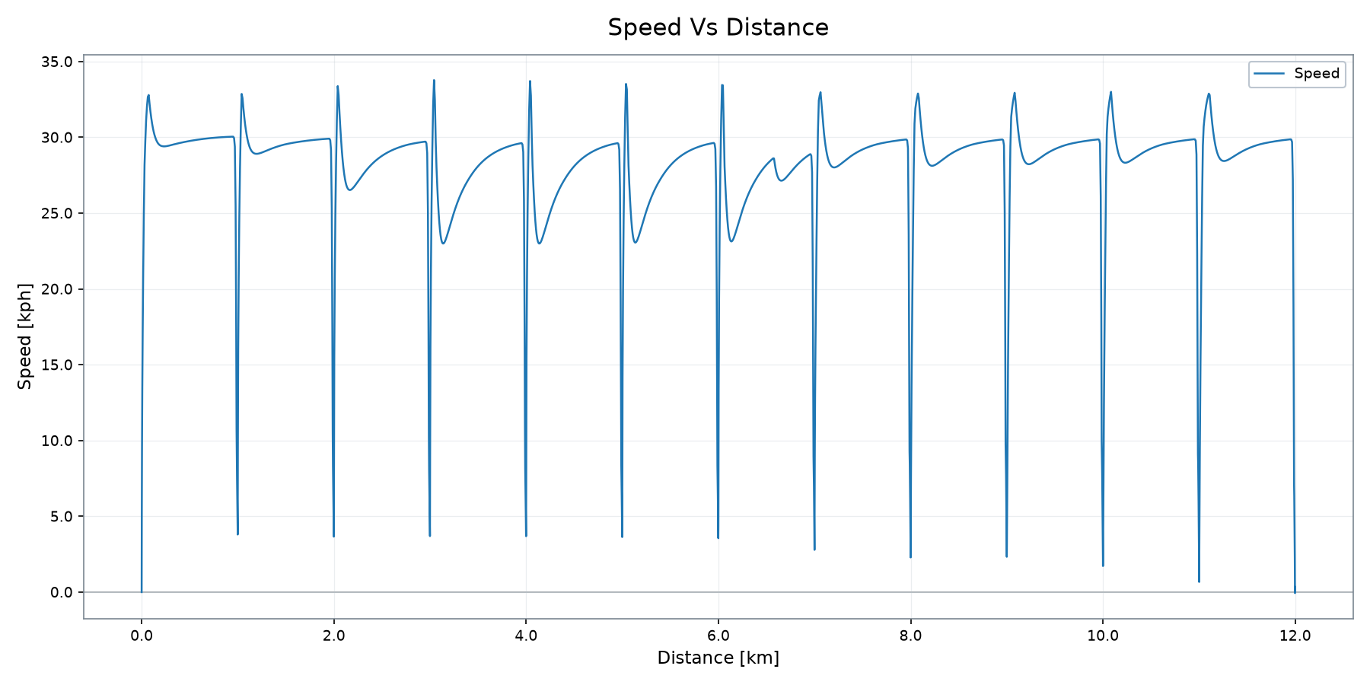
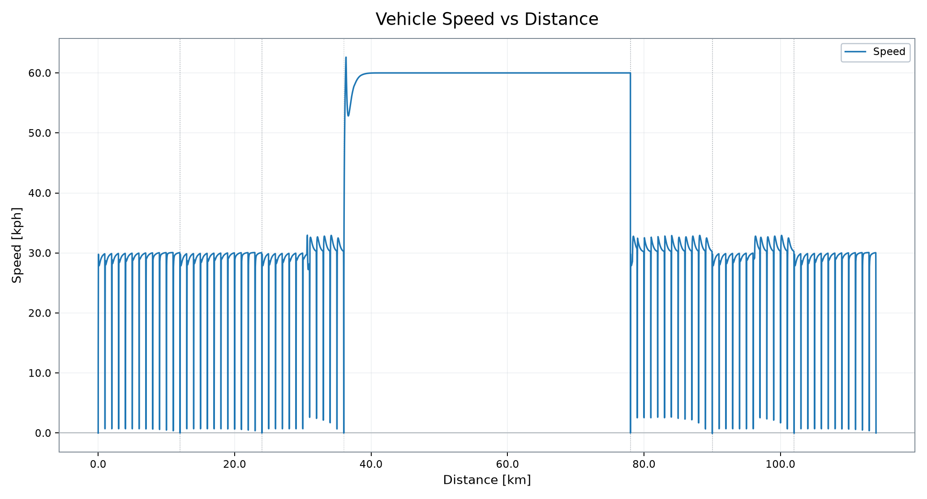
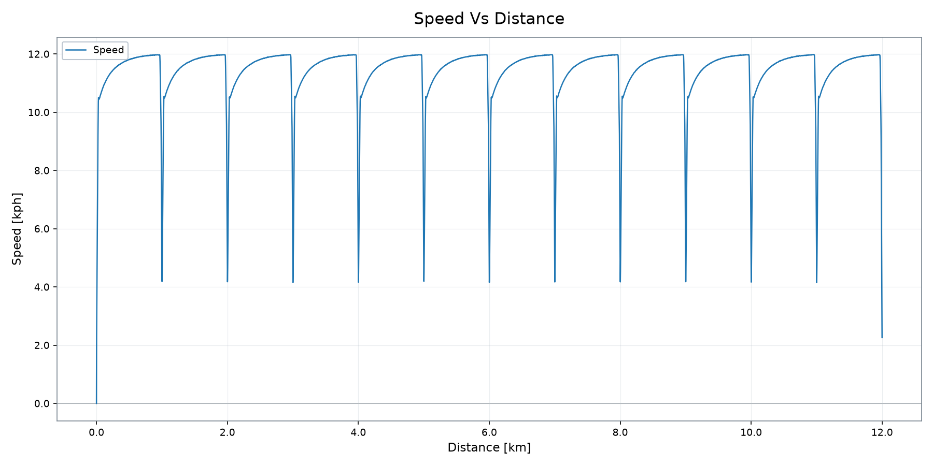
Vehicle Operation
Speed trace from the validated profile plot output
DISTANCE
MISSION TIME
MAX SPEED
FINAL BATTERY SOC
12.00 km
29.48 min
33.78 kph
46.20 %
VSM Engineering Post-Processing Tool · v1.3.0
4 / 10

Slide 5

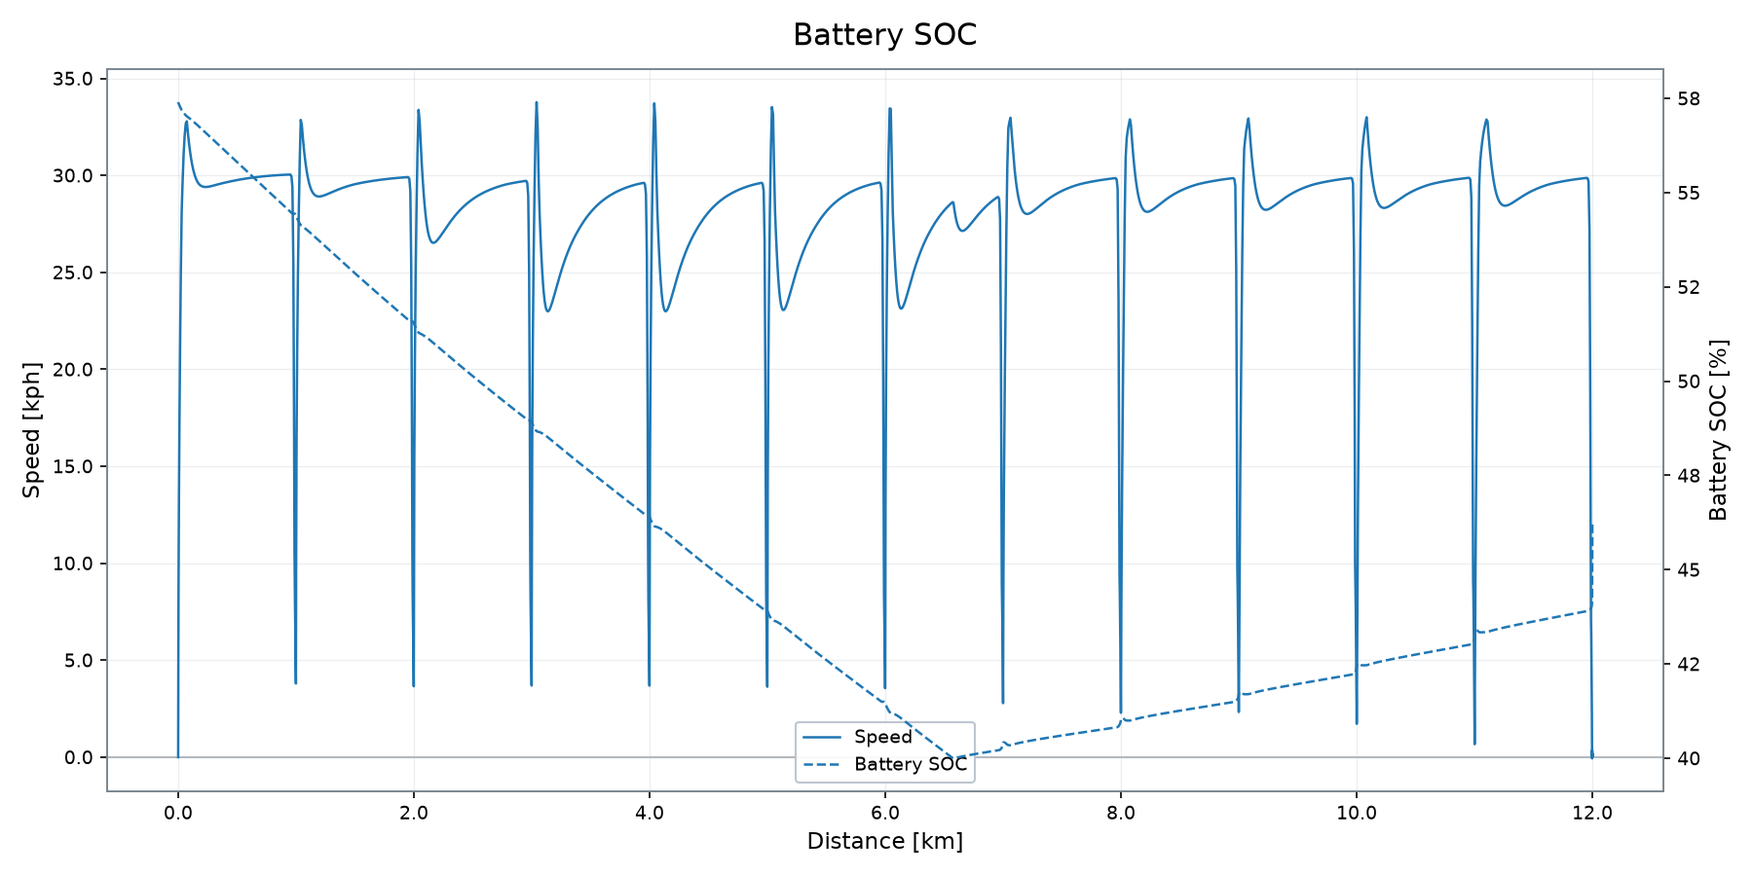
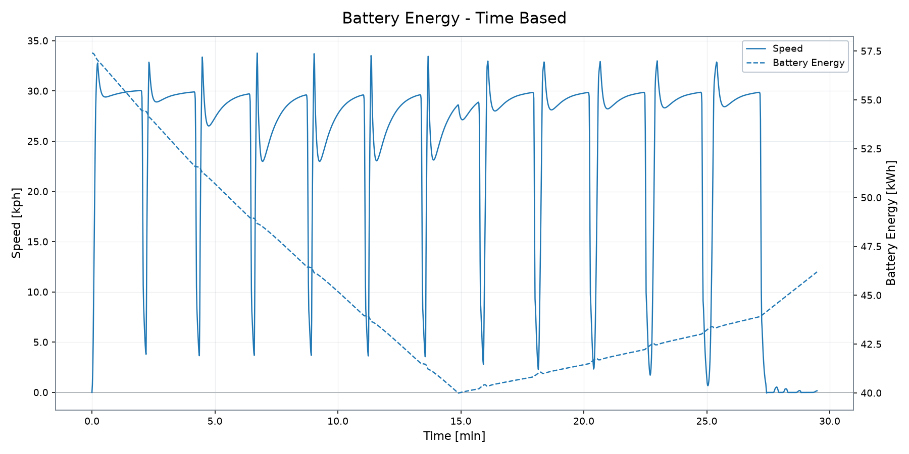
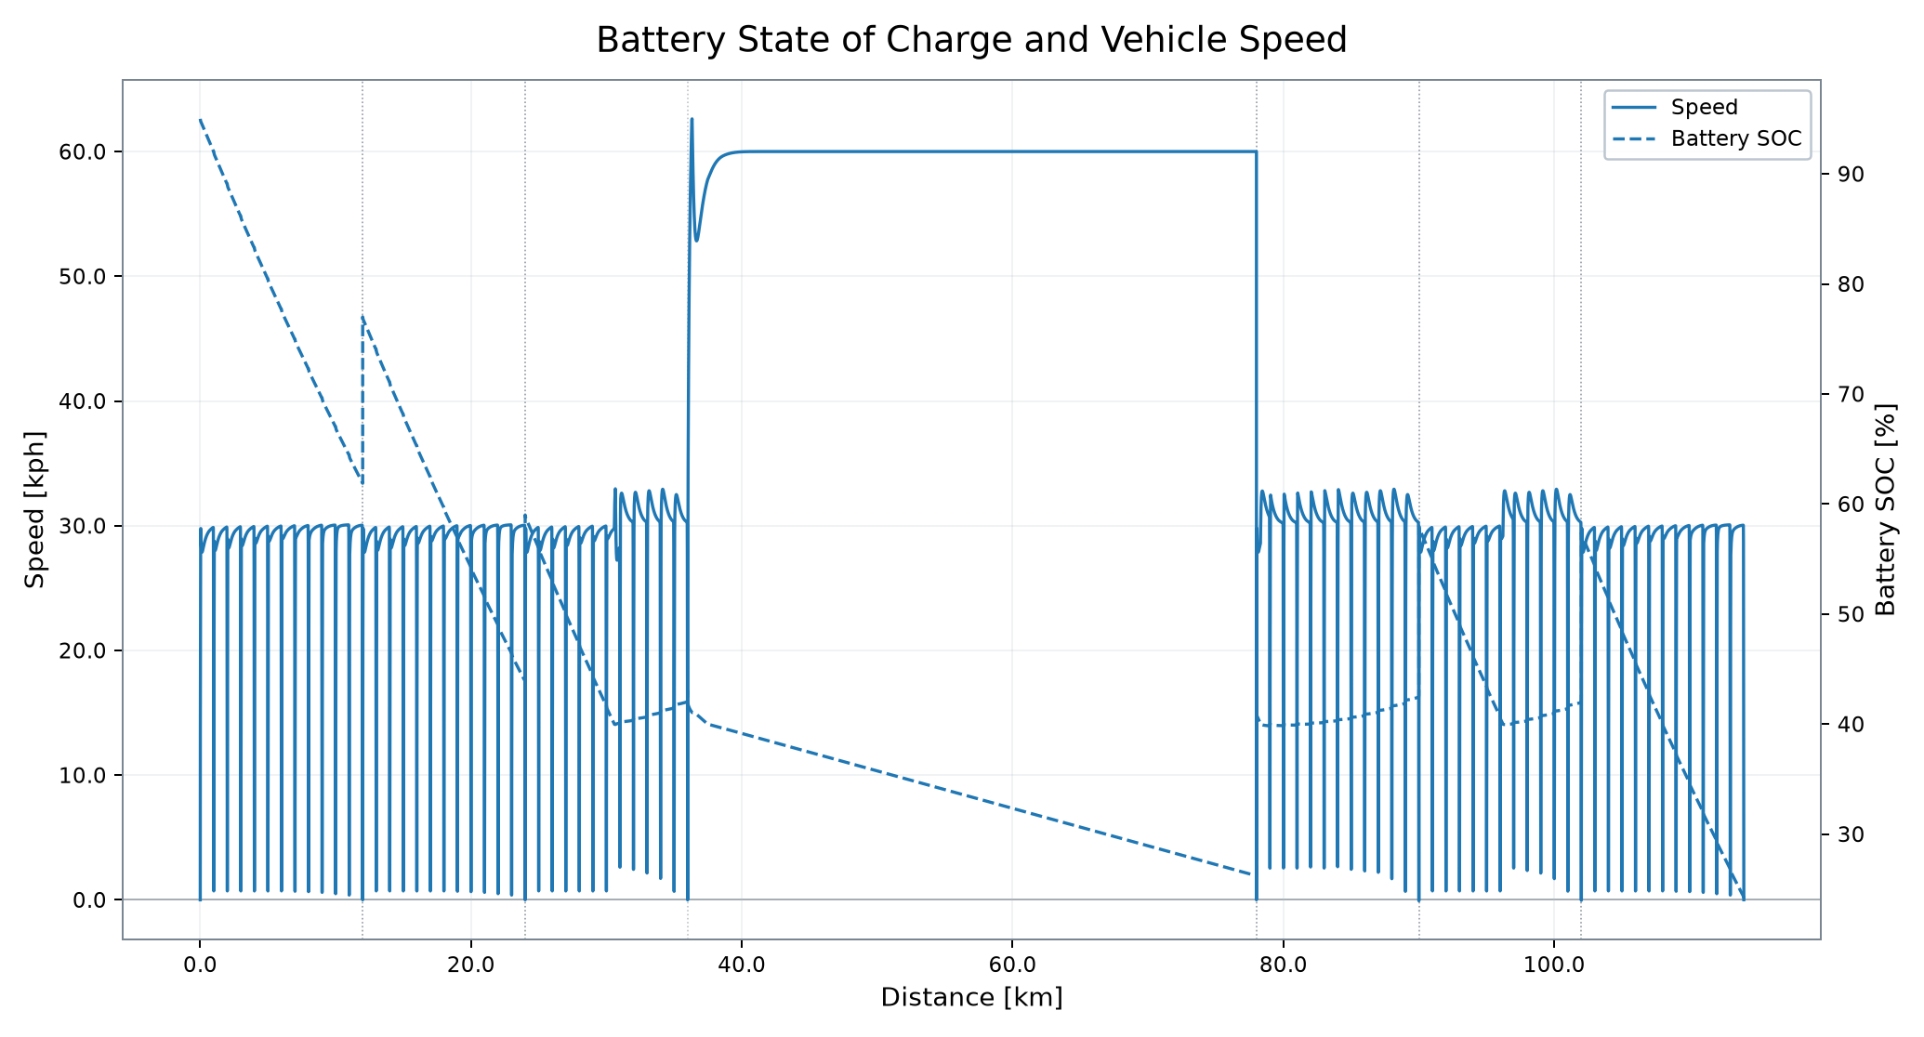
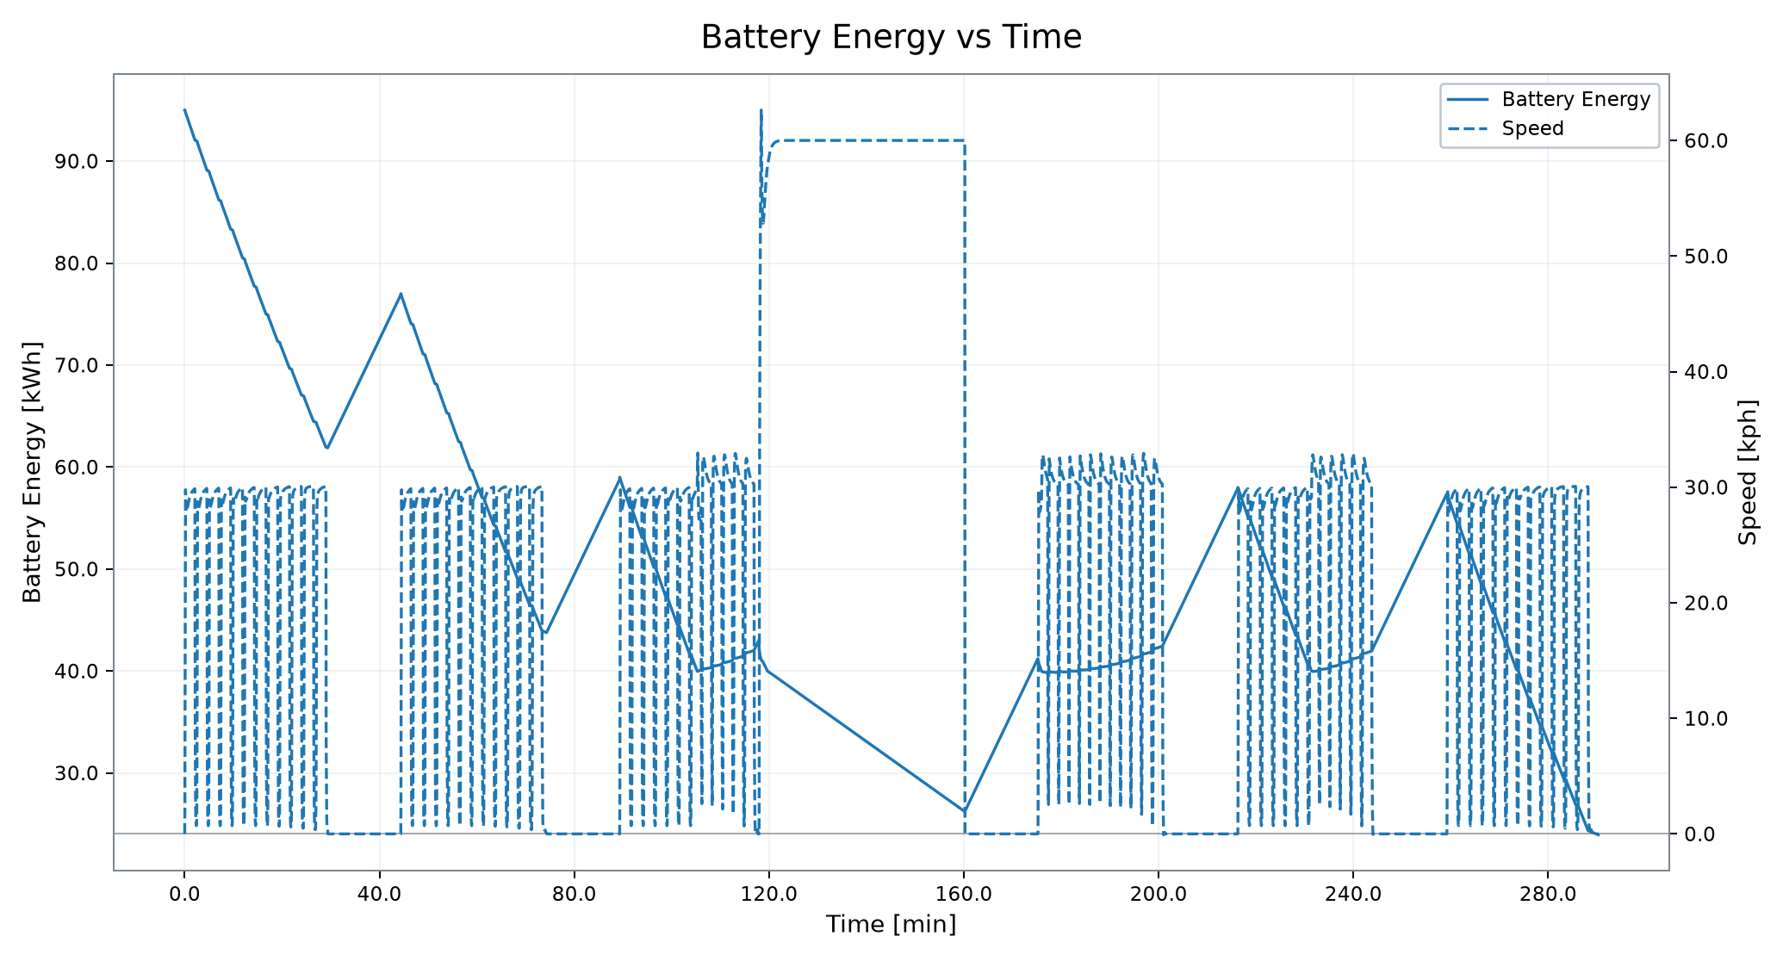
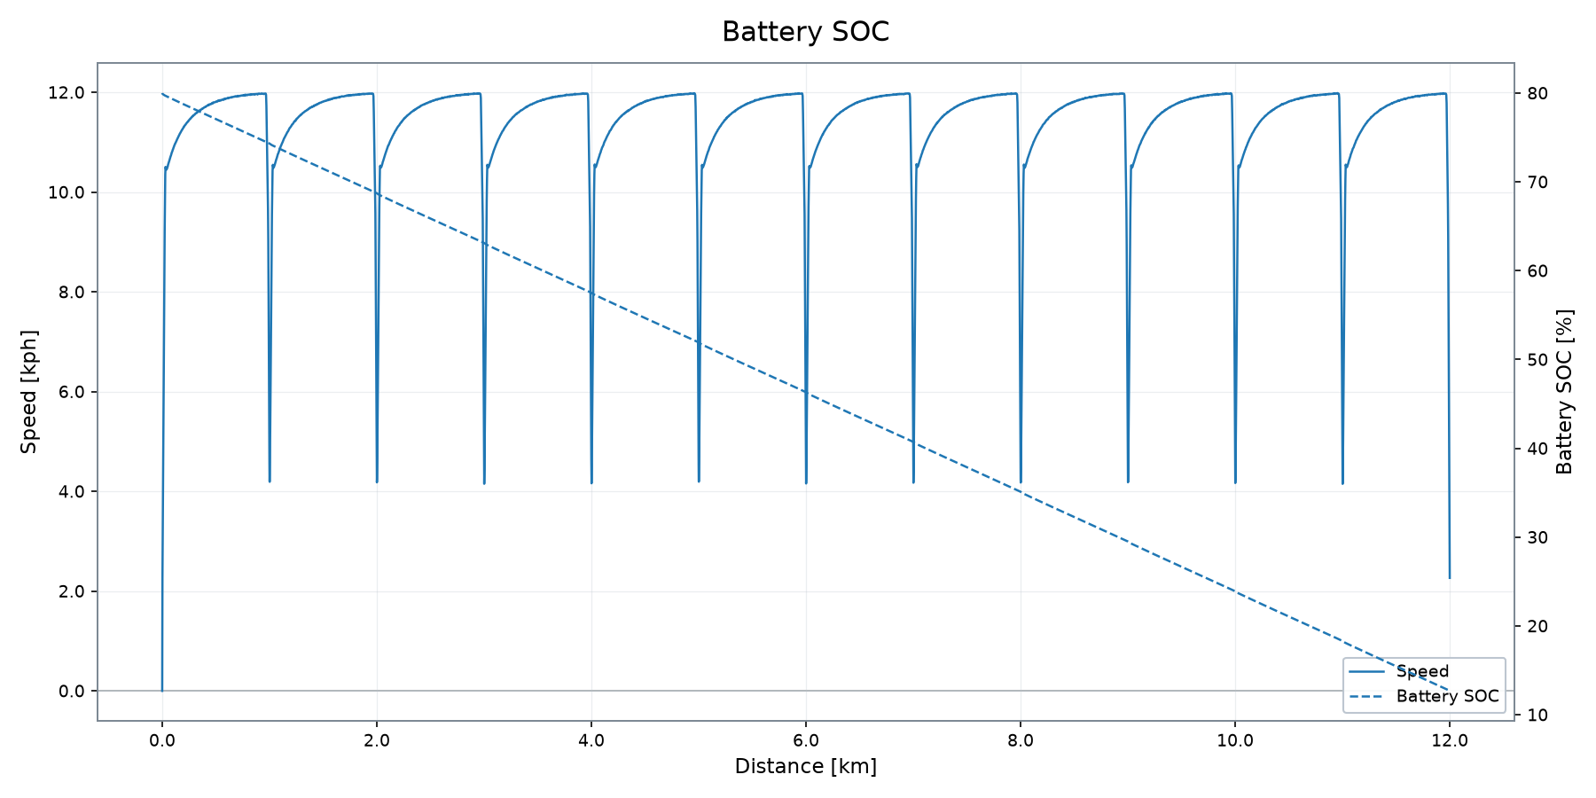
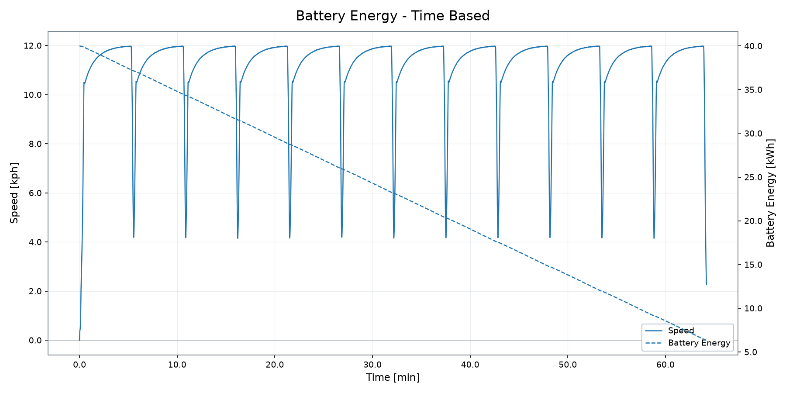
Battery and Electrical Energy System
State of charge, stored energy and battery demand
INITIAL BATTERY SOC
FINAL BATTERY SOC
MAX BATT POWER
BATT POWER RMS
HEATFLOW RMS
57.40 %
46.20 %
149.96 kW
55.19 kW
5.36 kW
VSM Engineering Post-Processing Tool · v1.3.0
5 / 10

Slide 6

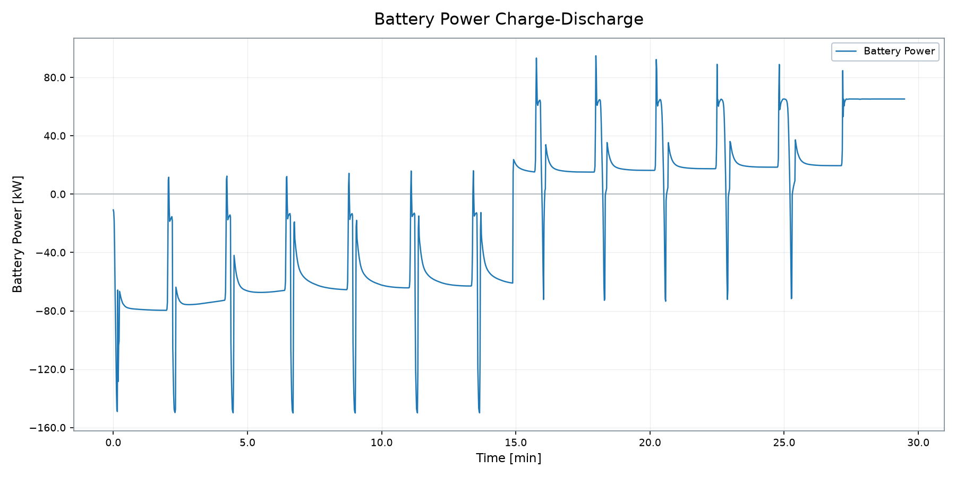
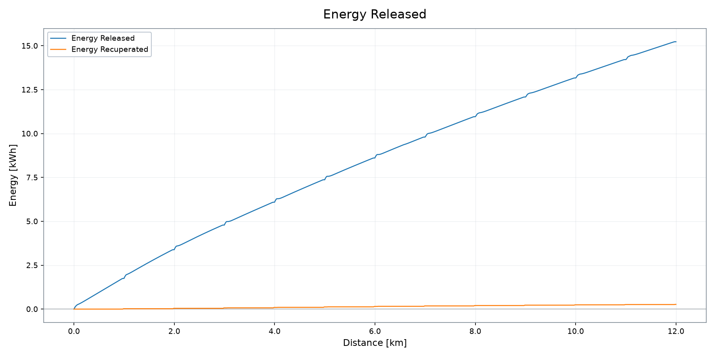
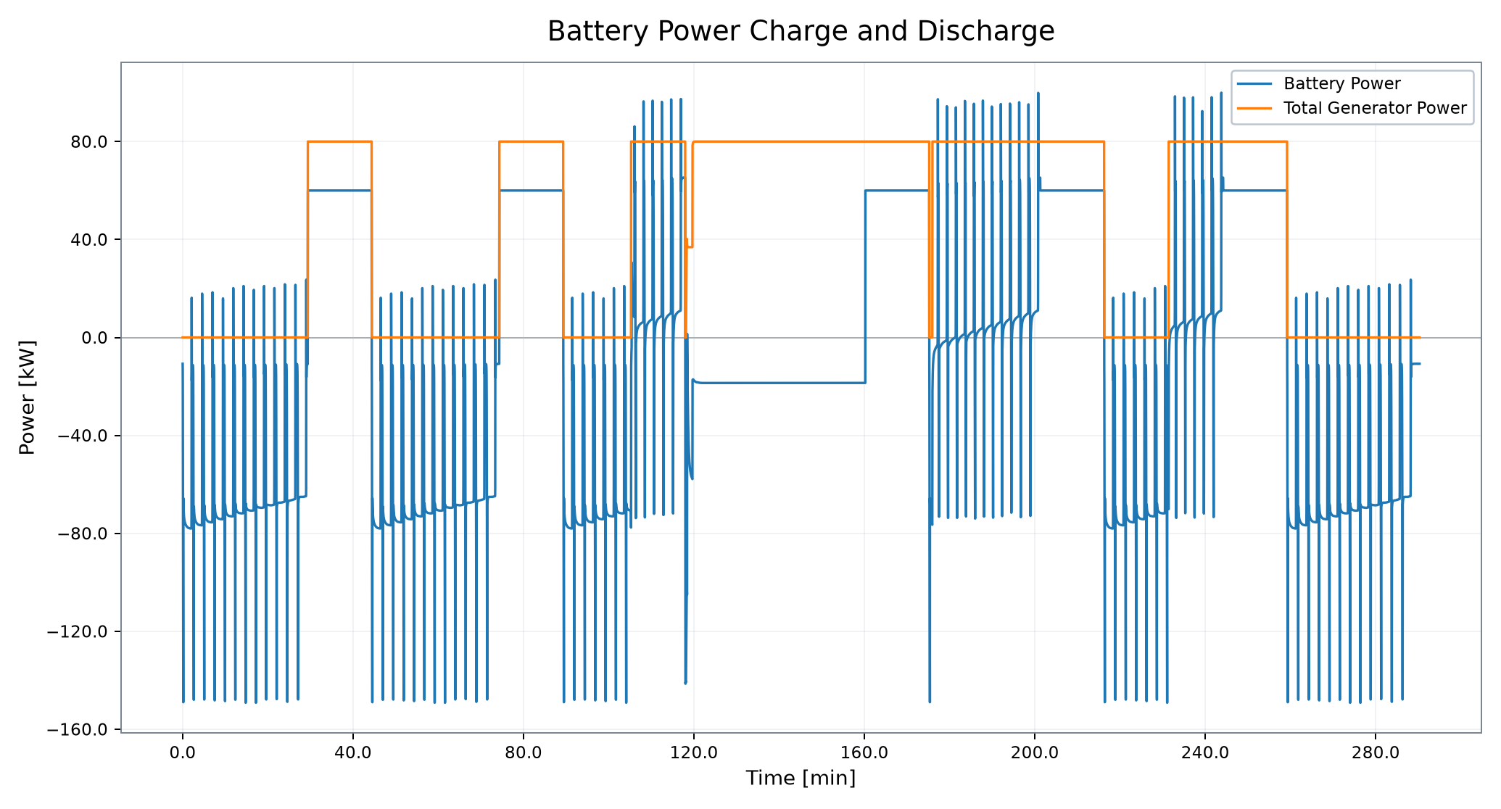
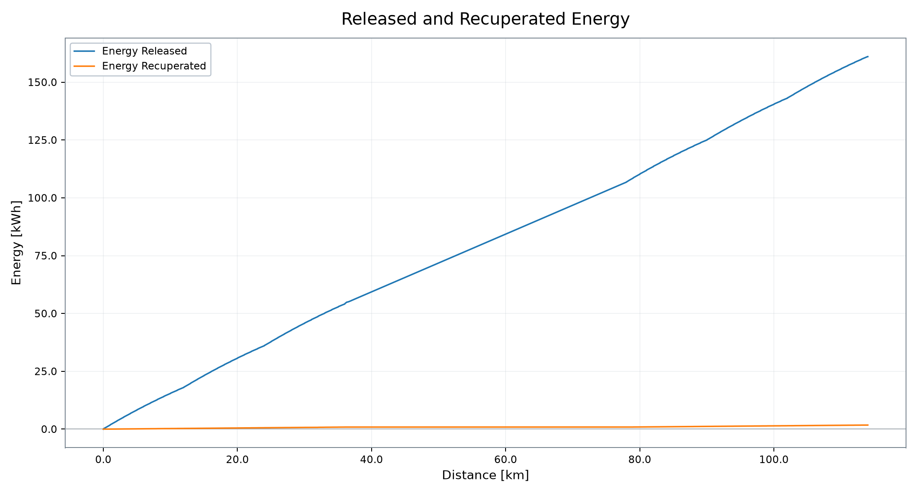
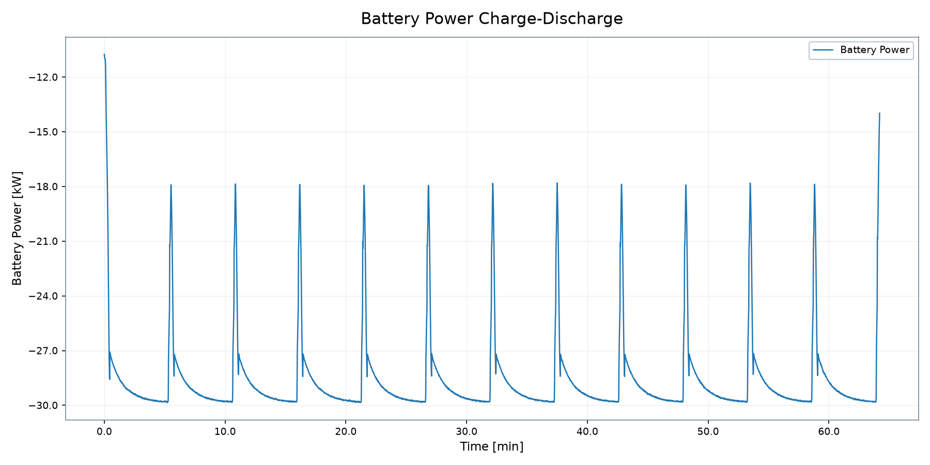
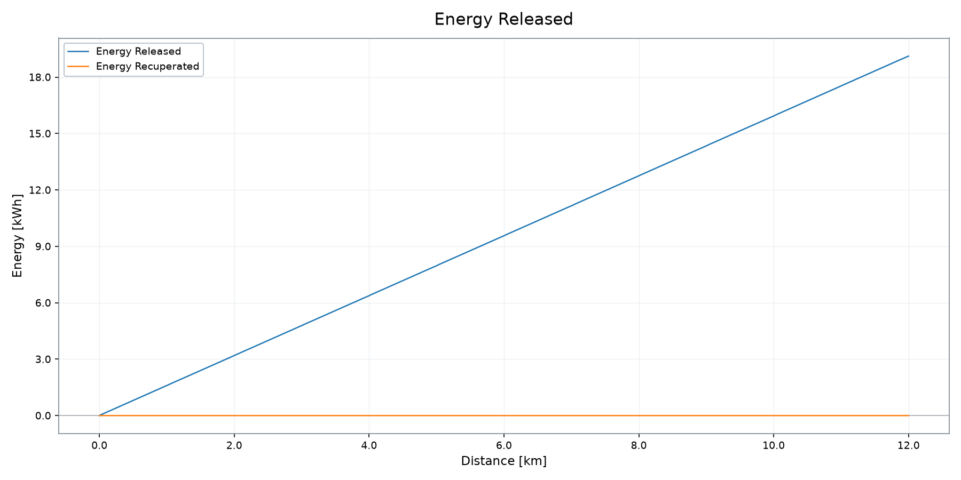
Battery Power and Energy Recovery
Charge/discharge behavior and released/recuperated energy
BATT POWER RMS
ENERGY RELEASED
ENERGY RECOVERED
AUX ENERGY
55.19 kW
15.23 kWh
0.27 kWh
5.29 kWh
VSM Engineering Post-Processing Tool · v1.3.0
6 / 10

Slide 7

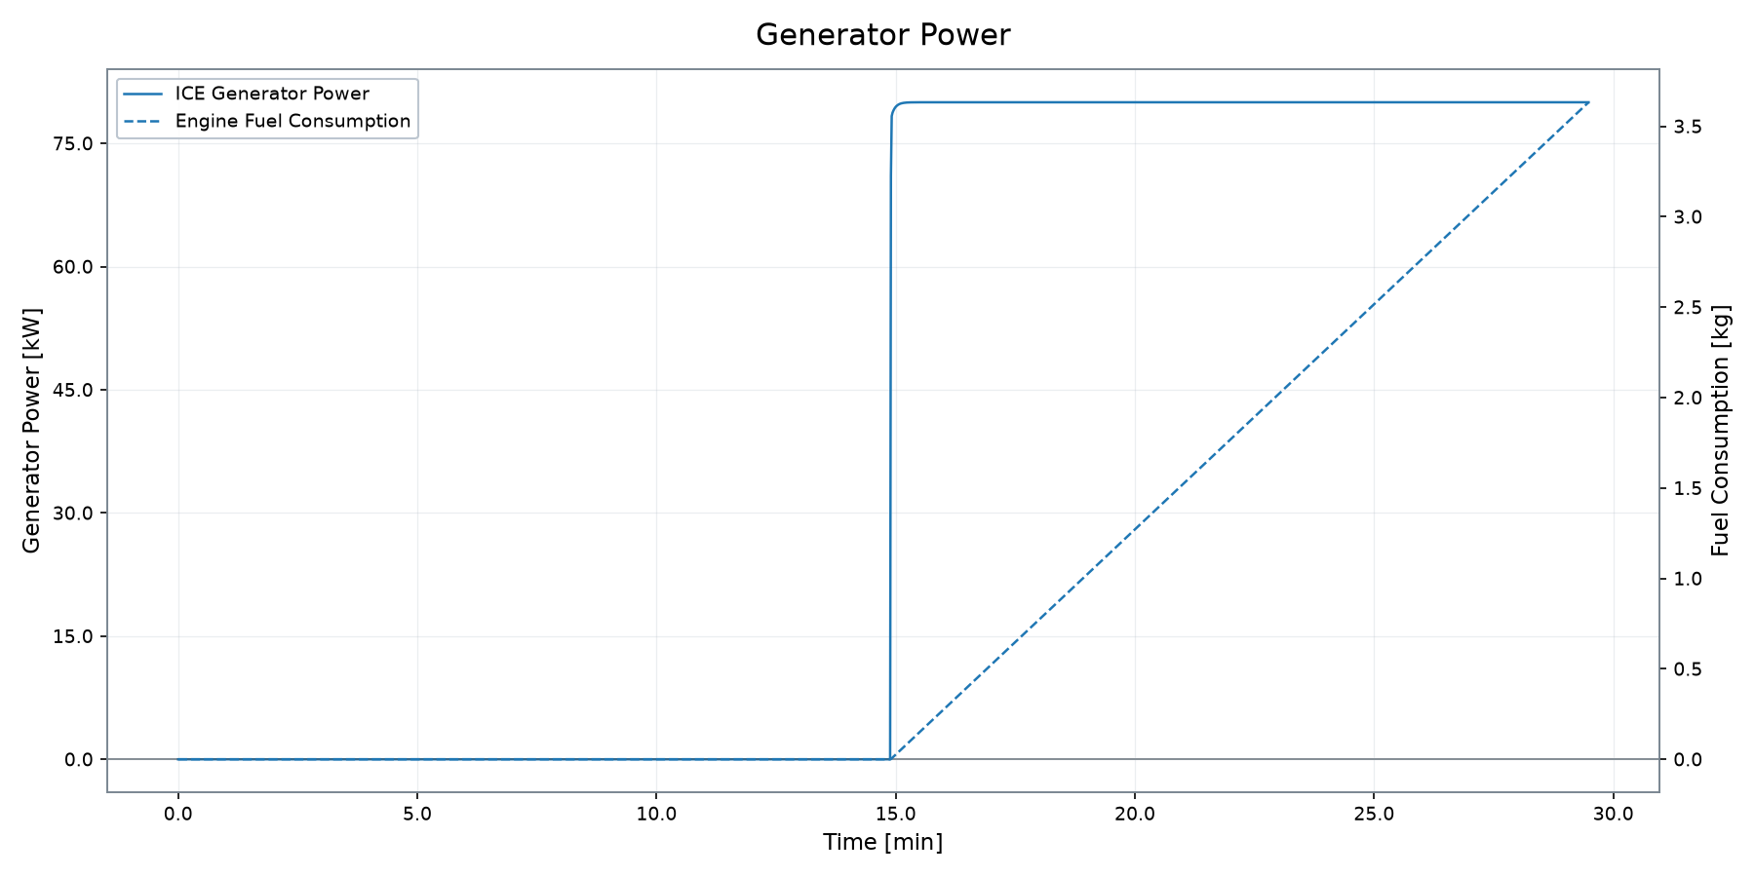
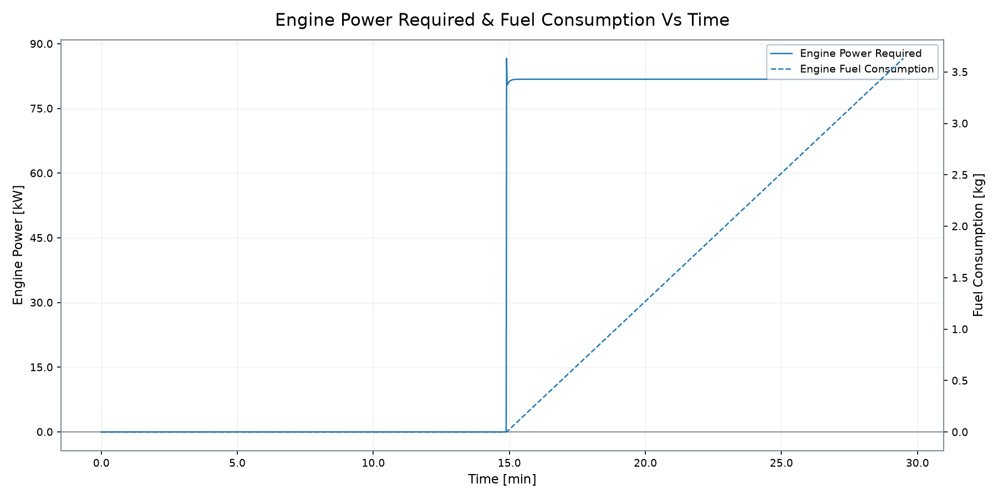
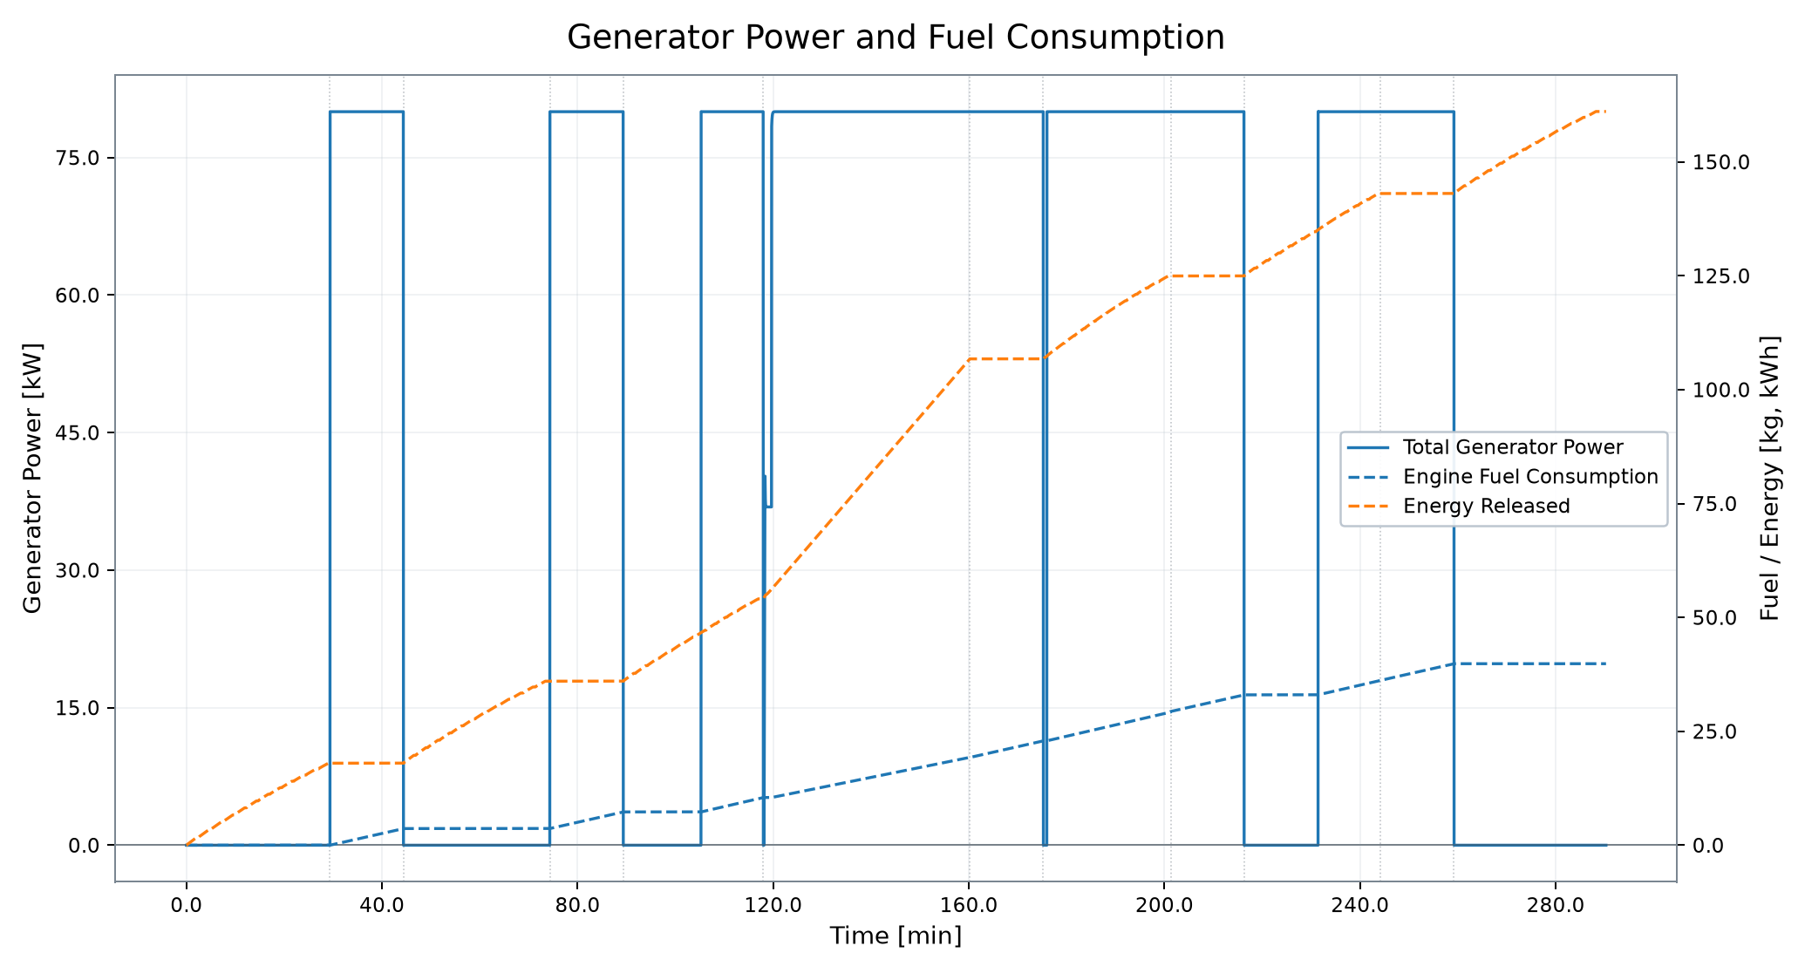
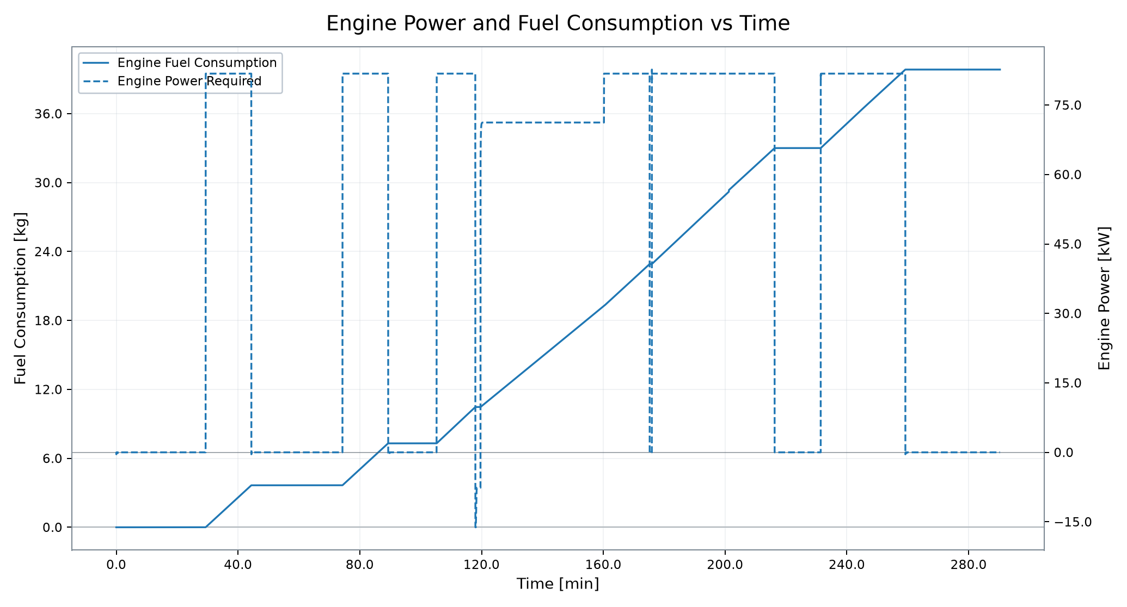
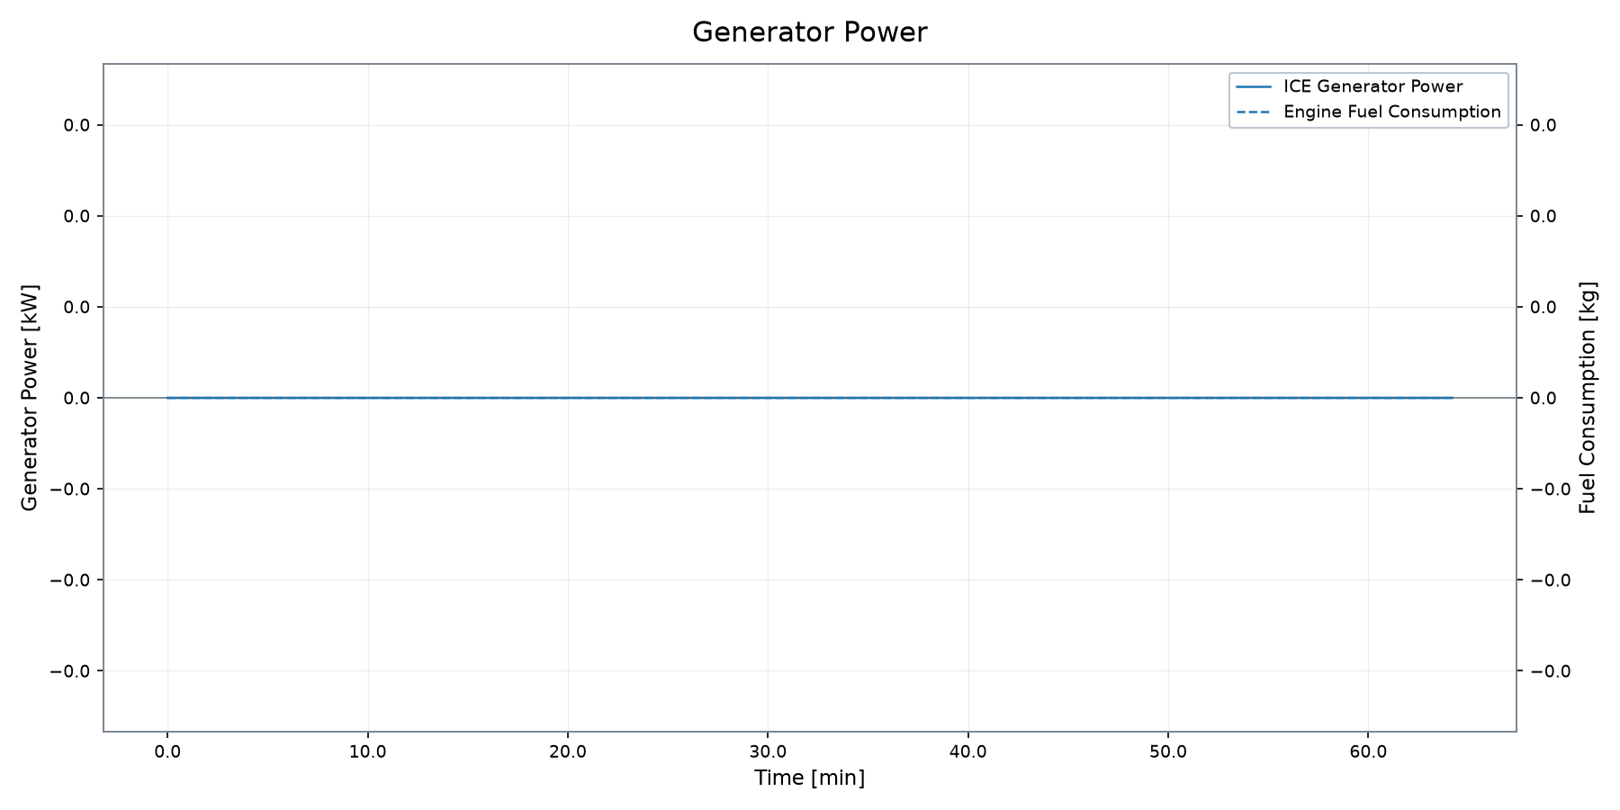
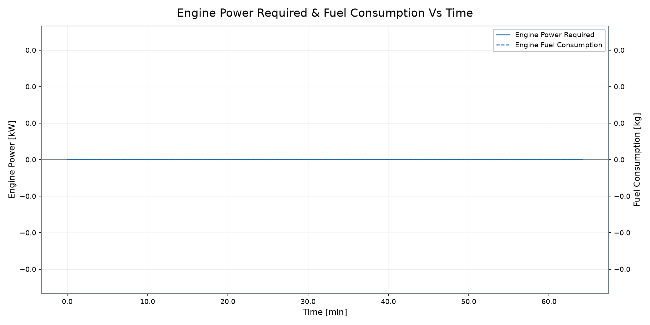
Range Extender and Generator
Engine demand, fuel consumption and generator behavior
MAX GEN POWER
MAX ENG POWER
MAX ENG SPEED
MAX ENG TORQUE
FUEL CONSUMPTION
ENGINE ENERGY
80.00 kW
86.63 kW
1,700 rpm
578.06 Nm
3.63 kg
19.90 kWh
The range extender becomes active at approximately 15 min, with generator power reaching 80 kW.
VSM Engineering Post-Processing Tool · v1.3.0
7 / 10

Slide 8
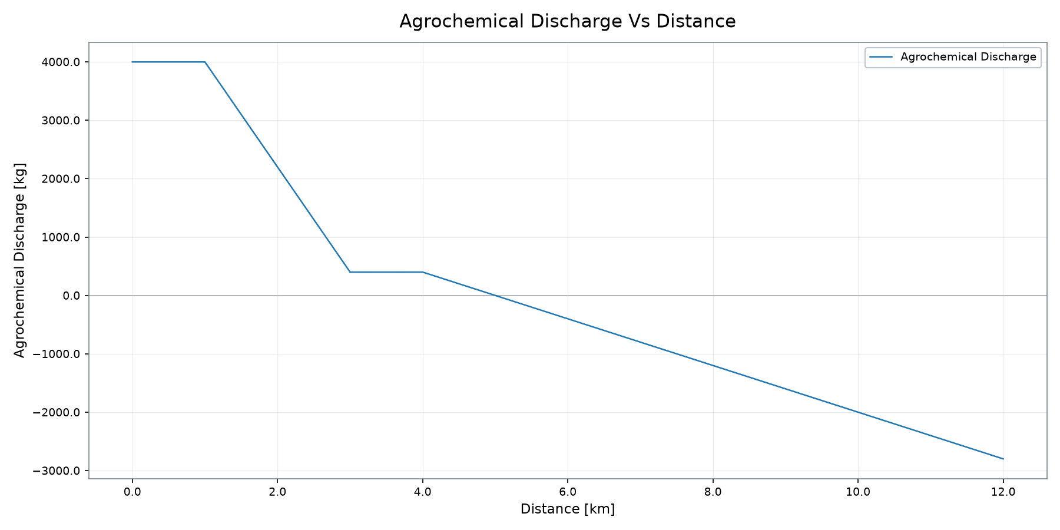
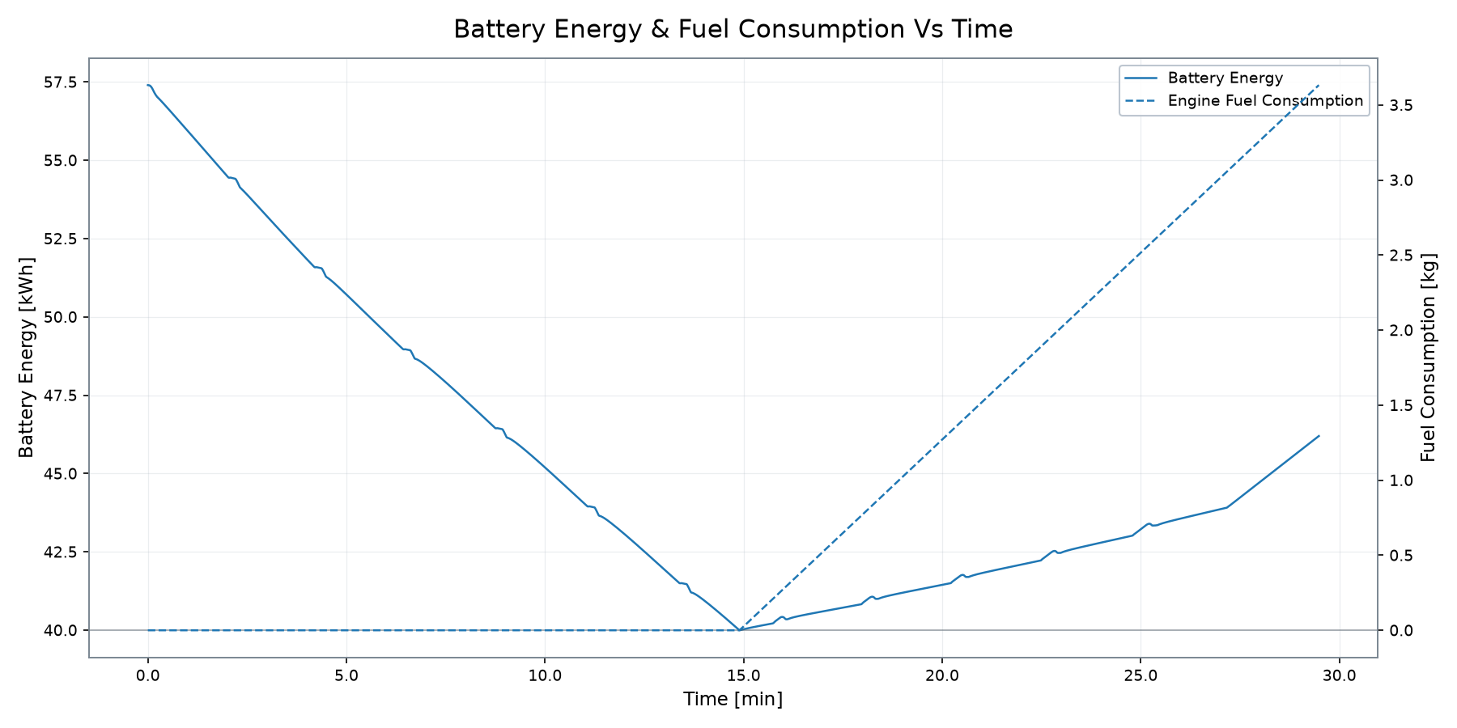
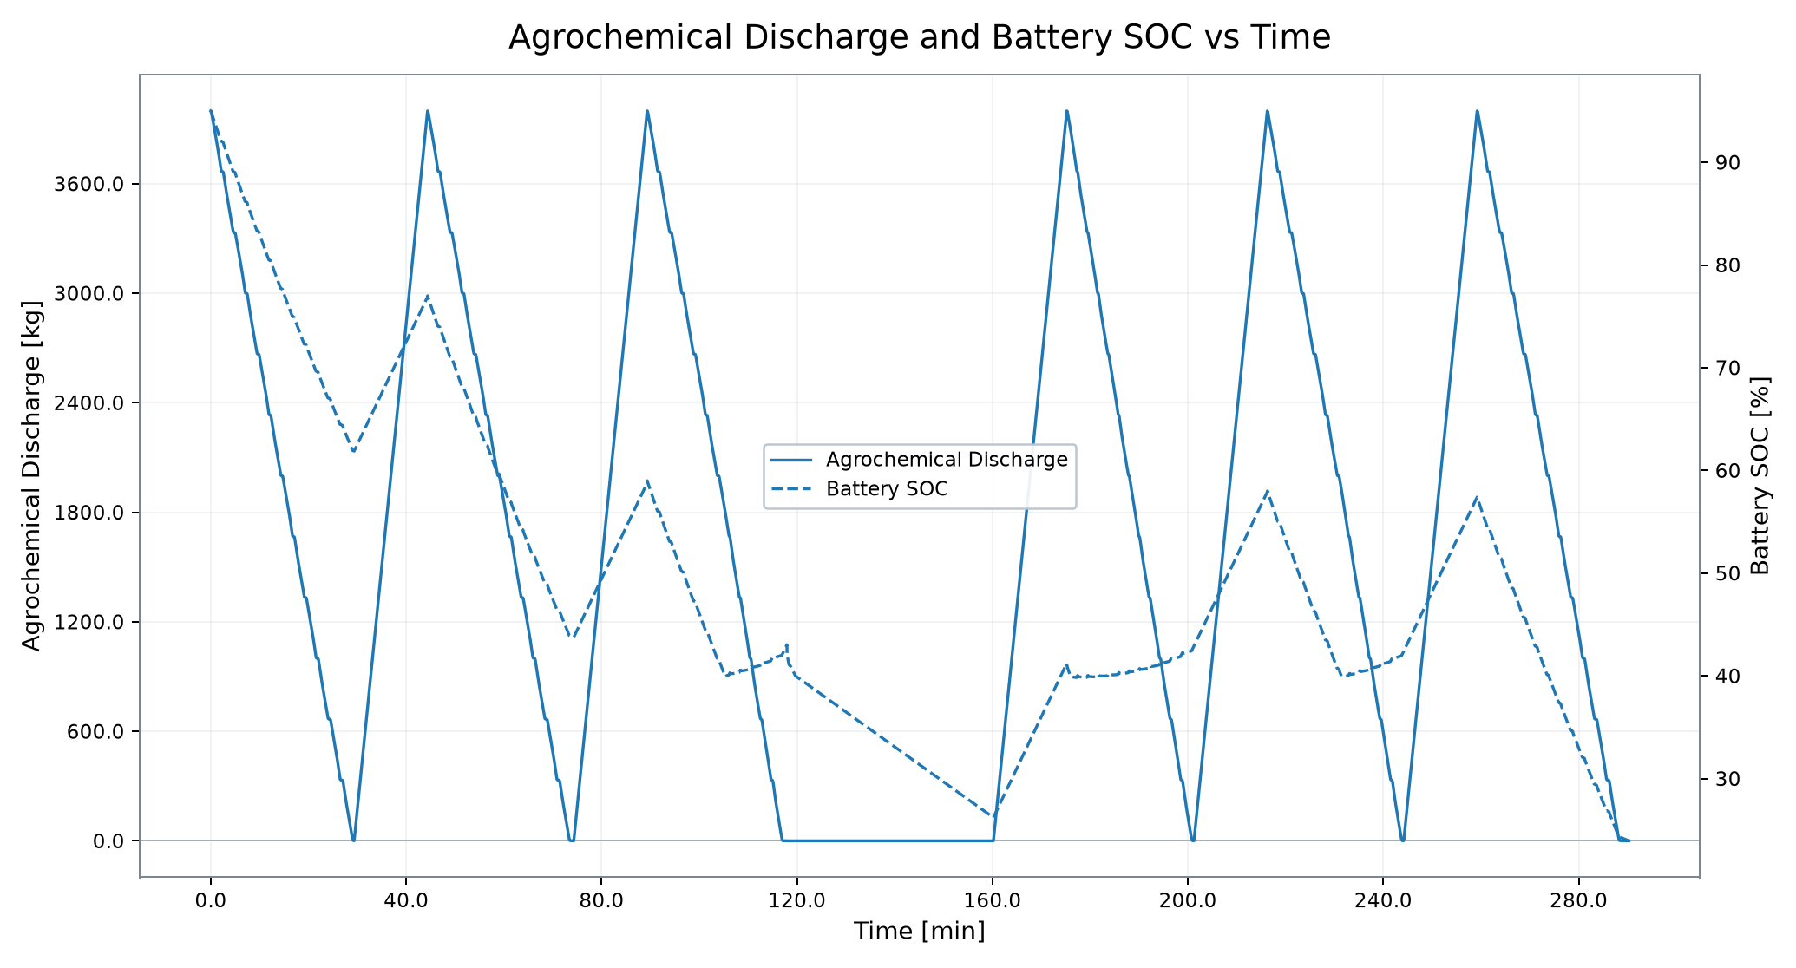
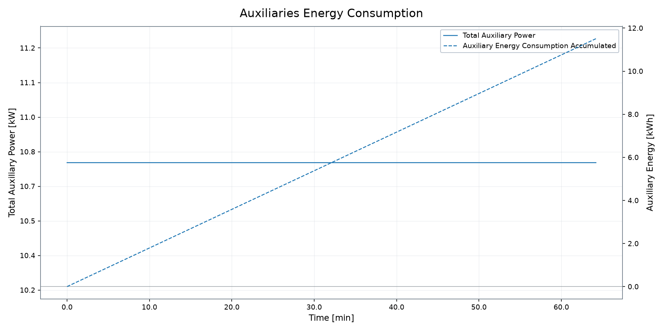
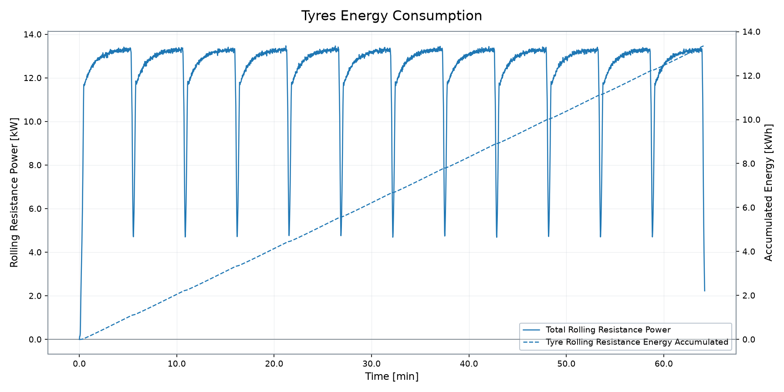
Agrochemical and Battery Behaviour
Profile-supported system interaction from the active source data
AGRO DISCHARGE
FINAL BATTERY SOC
FUEL CONSUMPTION
MISSION TIME
3,998.7 kg
46.20 %
3.63 kg
29.48 min
Agrochemical discharge is shown only when active in the deterministic hybrid profile data.
VSM Engineering Post-Processing Tool · v1.3.0
8 / 10

Slide 9

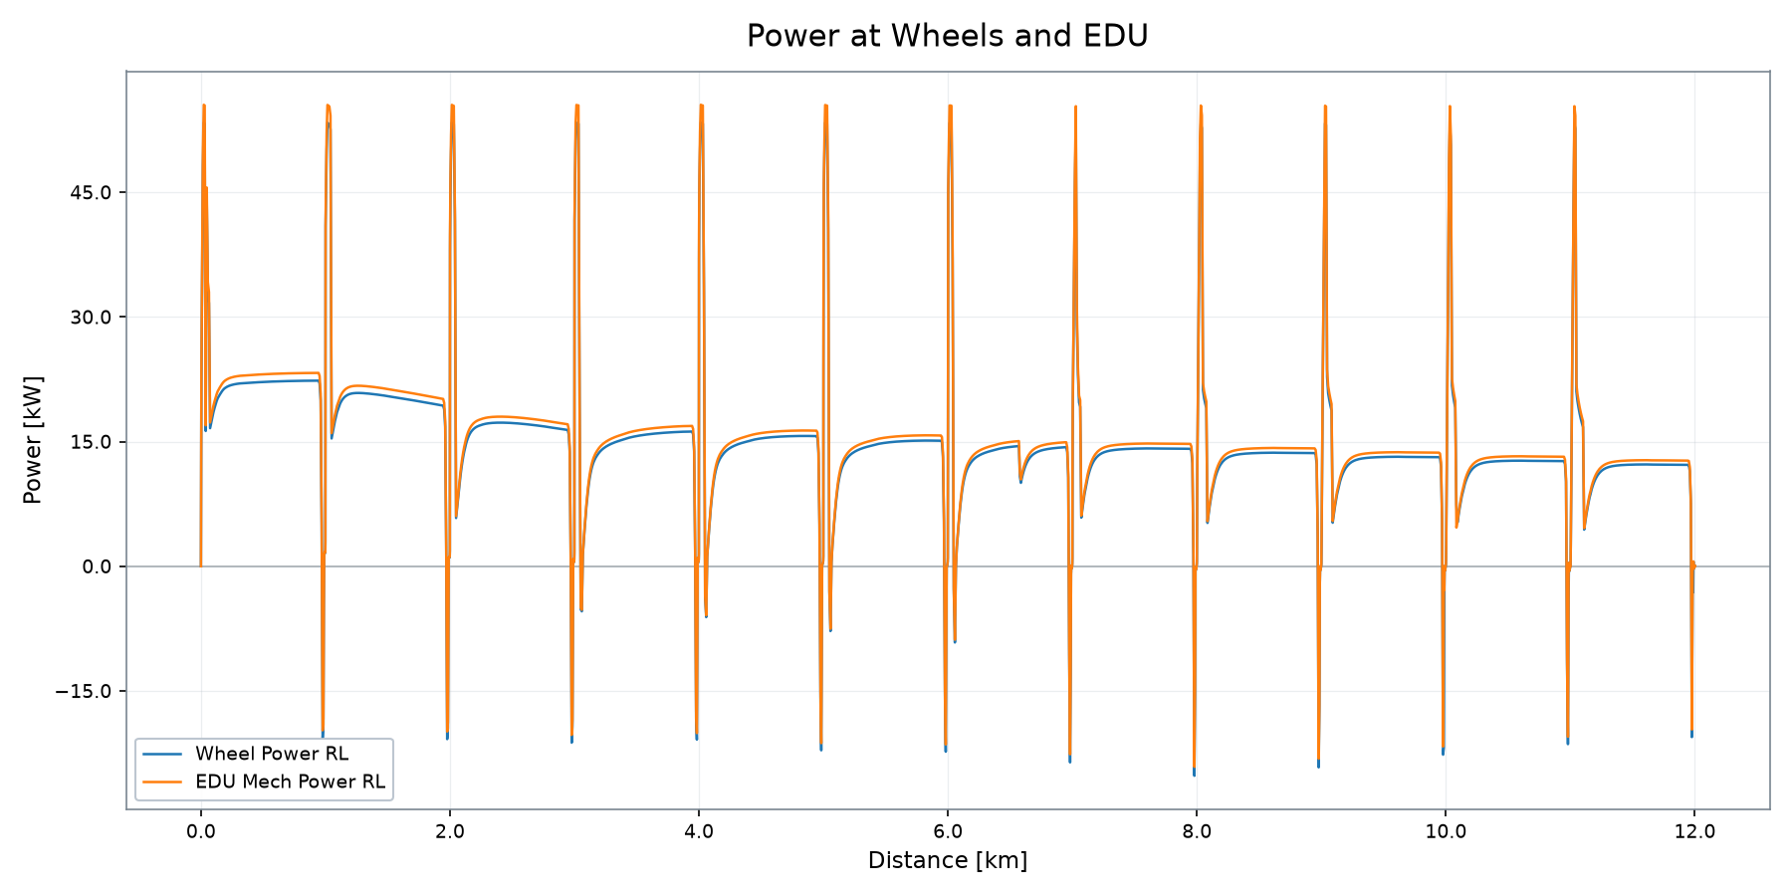
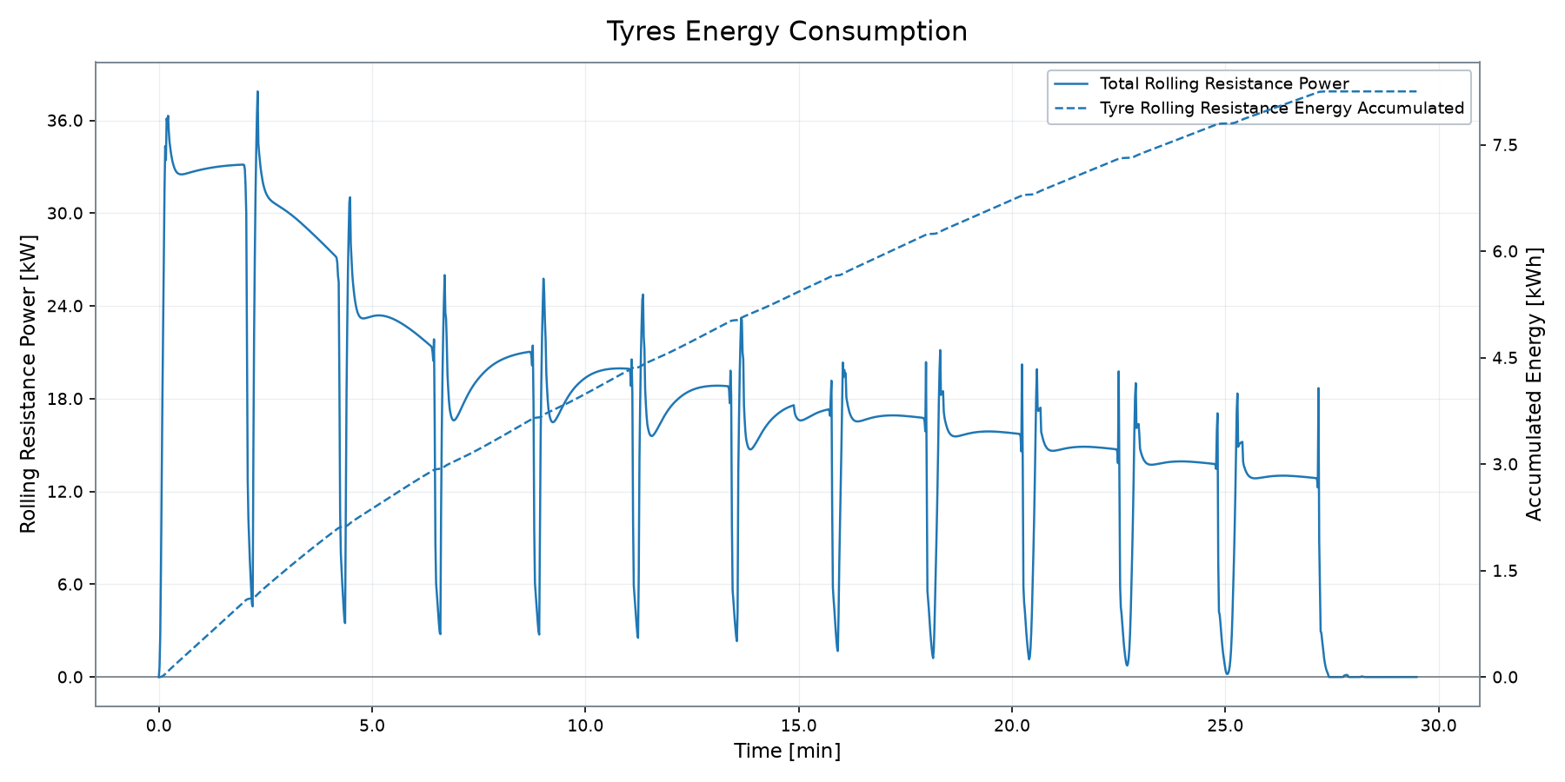
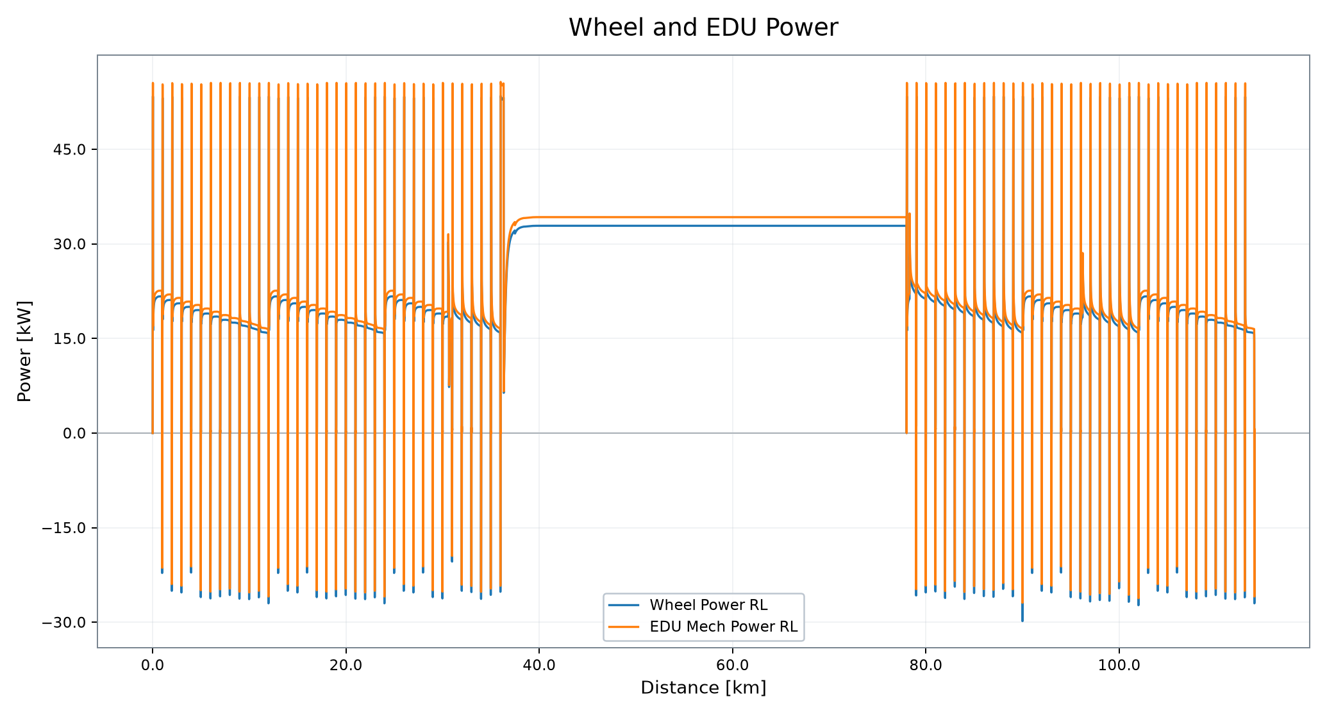
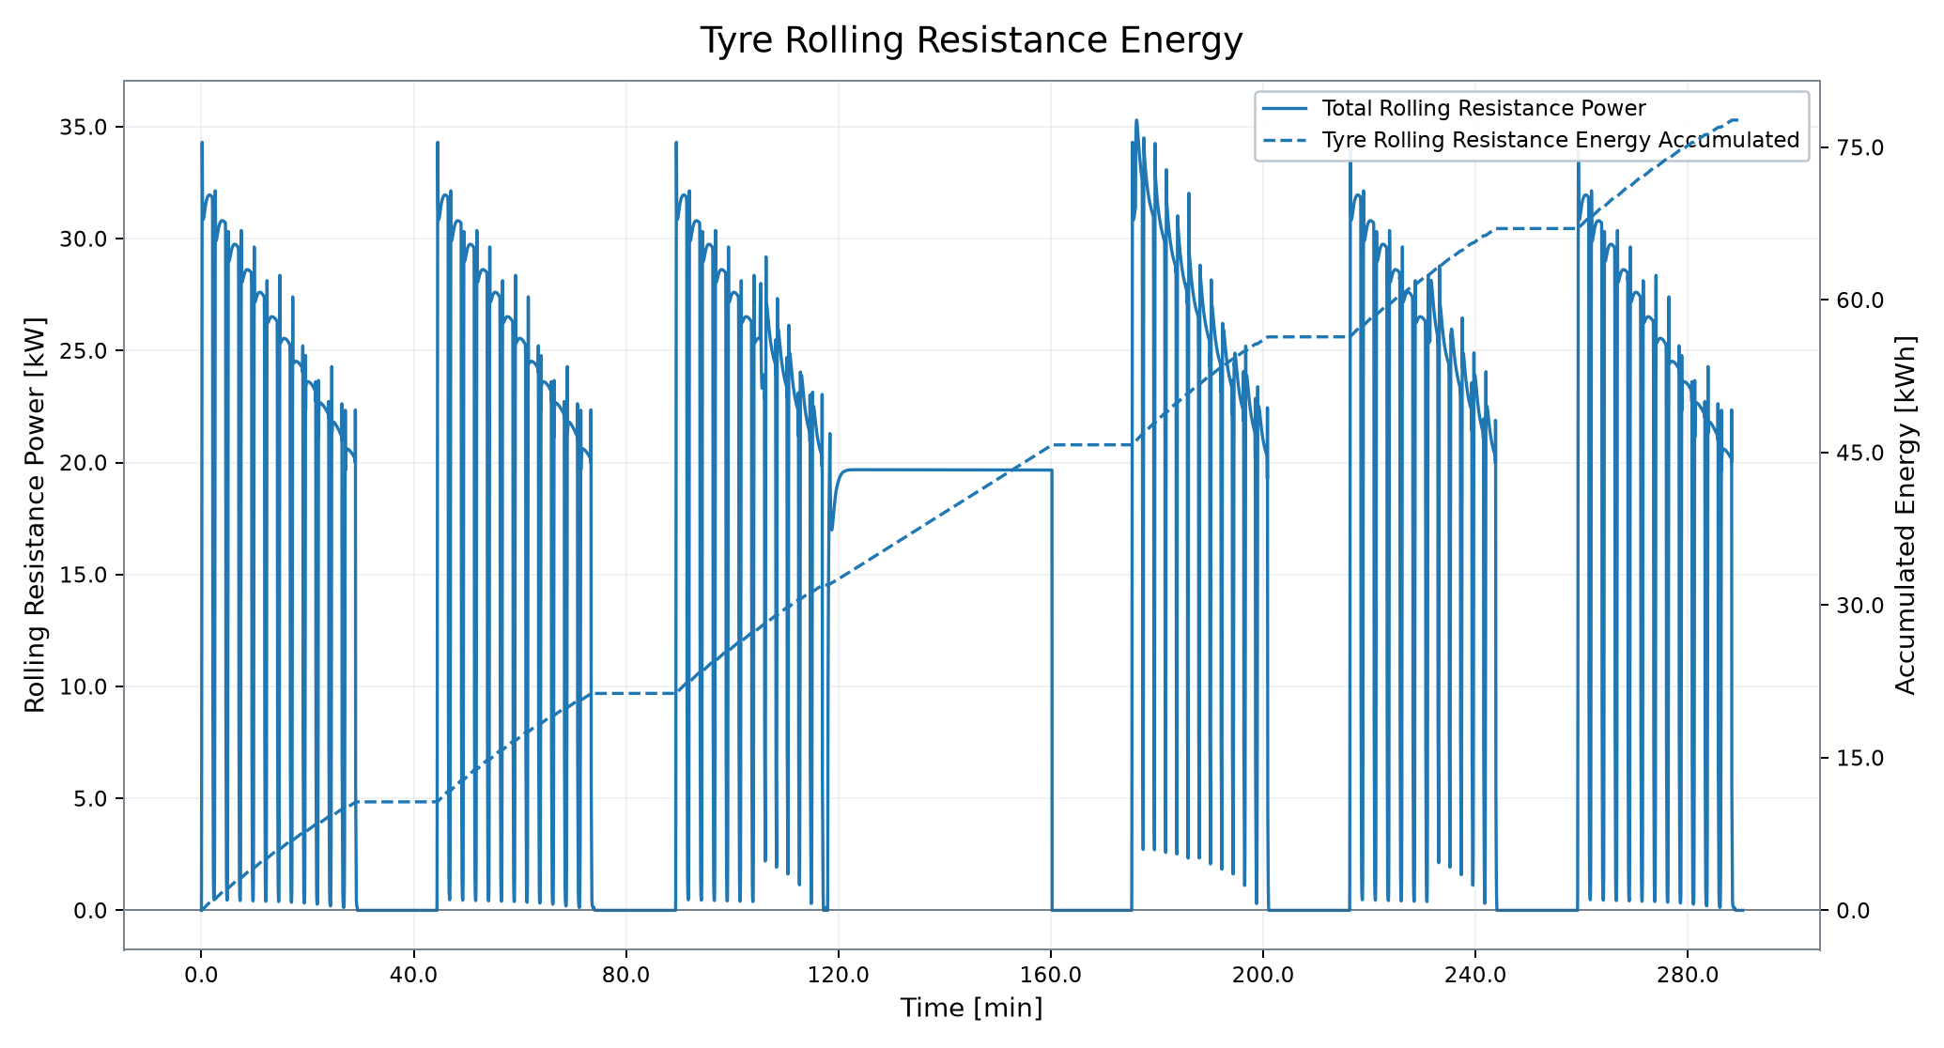
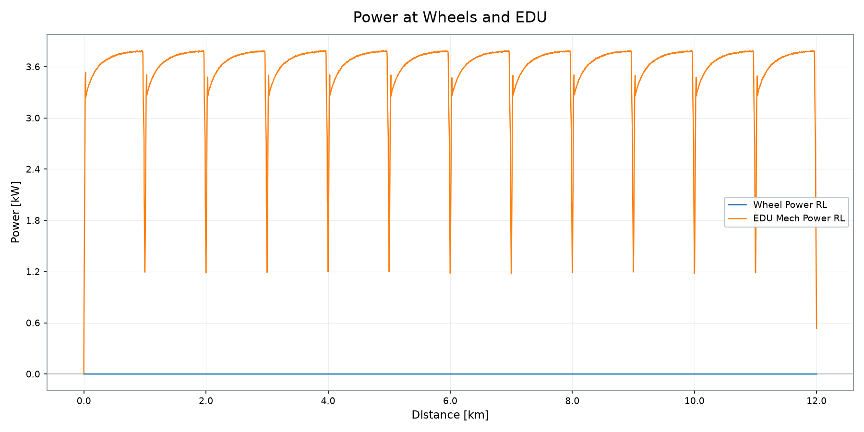
Traction, EDU and Auxiliary Energy Demand
Wheel, EDU, tyre and auxiliary demand from profile plots
EDU MECH POWER
WHEEL POWER
EDU SPEED RL
EDU TORQUE RL
TYRE RR ENERGY
AUX ENERGY
111.07 kW
106.80 kW
22,750 rpm
892.45 Nm
8.25 kWh
5.29 kWh
VSM Engineering Post-Processing Tool · v1.3.0
9 / 10

Slide 10
Simulation Summary
Deterministic profile result snapshot
DISTANCE
MISSION TIME
FINAL BATTERY SOC
12.00 km
29.48 min
46.20 %
FUEL CONSUMPTION
MAX GEN POWER
ENGINE ENERGY
3.63 kg
80.00 kW
19.90 kWh
Deterministic run covered 12.00 km in 29.48 min.
Final battery SOC is 46.20 %.
Fuel consumption is 3.63 kg; maximum generator power is 80.00 kW.
Results are deterministic simulation outputs; acceptance conclusions require explicit engineering criteria.
VSM Engineering Post-Processing Tool · v1.3.0
10 / 10

