Slide 1


VSM ENGINEERING · FEASIBILITY STUDY
RoboSprayer Electric
Deterministic feasibility study on a validated 3,853-sample electric field profile.
GVW 3,500 kg
Electric powertrain
12 kph field
Battery 50 kW
Motor 63 rpm
DISTANCE
TIME
BATTERY FINAL SOC
12.00 km
64.20 min
12.69 %
BATTERY ENERGY CONSUMPTION
RANGE FOR 85% BATTERY
MAX BATTERY POWER
2,804.6 Wh/km
12.76 km
29.85 kW
Samples: 3,853 | Tool version: v1.2.10
1 / 10

Slide 2



System & Simulation Overview
Electric profile resolution and deterministic simulation scope
GVW 3,500 kg
Electric powertrain
12 kph field
Battery 50 kW
Motor 63 rpm
Mission Structure
Computation Context
▸ Selected reporting profile: RoboSprayer Electric.
▸ Powertrain type: fully electric.
▸ Imported samples: 3,853 · source channels: 607.
▸ Resolved required raw channels: 288 / 288.
▸ Calculated MATH channels: 29.
▸ Calculated statistics: 27 · KPIs: 9.
▸ Rendered profile plots: 12.
▸ Inactive / all-zero resolved channels: 35.
TIME
DISTANCE
MAX SPEED
BATTERY FINAL SOC
64.20 min
12.00 km
11.99 kph
12.69 %
VSM ENGINEERING · POST-PROCESSING TOOL v1.2.10
2 / 10

Slide 3
Executive Results
● Battery ● Consumption ● Mission
Deterministic KPIs from the validated profile pipeline
TIME
DISTANCE
MAX SPEED
BATTERY INITIAL SOC
64.20 min
12.00 km
11.99 kph
80.00 %
BATTERY FINAL SOC
BATTERY CAPACITY USED
ENERGY CONSUMPTION
RANGE FOR 85% BATTERY
12.69 %
33.65 kWh
2,804.6 Wh/km
12.76 km
Calculations are sourced from the profile statistics and KPI results.
VSM ENGINEERING · POST-PROCESSING TOOL v1.2.10
3 / 10

Slide 4

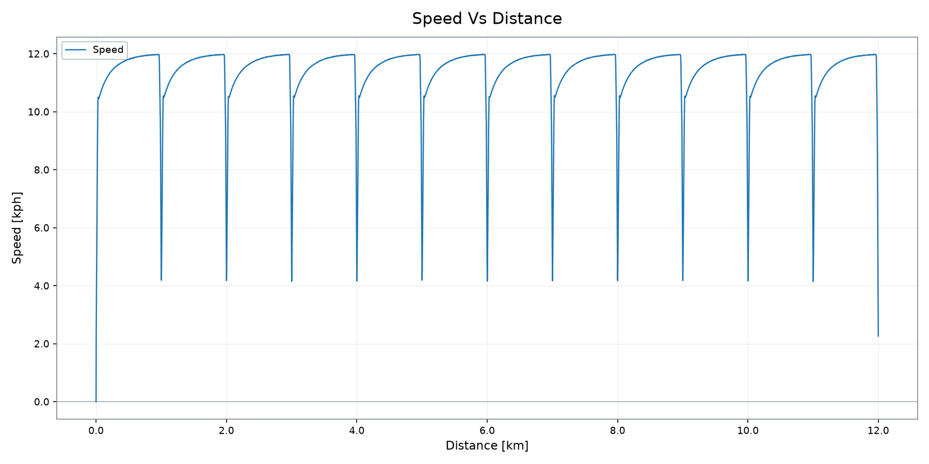
Vehicle Operation
Speed trace from the validated profile plot output
DISTANCE
TIME
MAX SPEED
BATTERY FINAL SOC
12.00 km
64.20 min
11.99 kph
12.69 %
VSM ENGINEERING · POST-PROCESSING TOOL v1.2.10
4 / 10

Slide 5

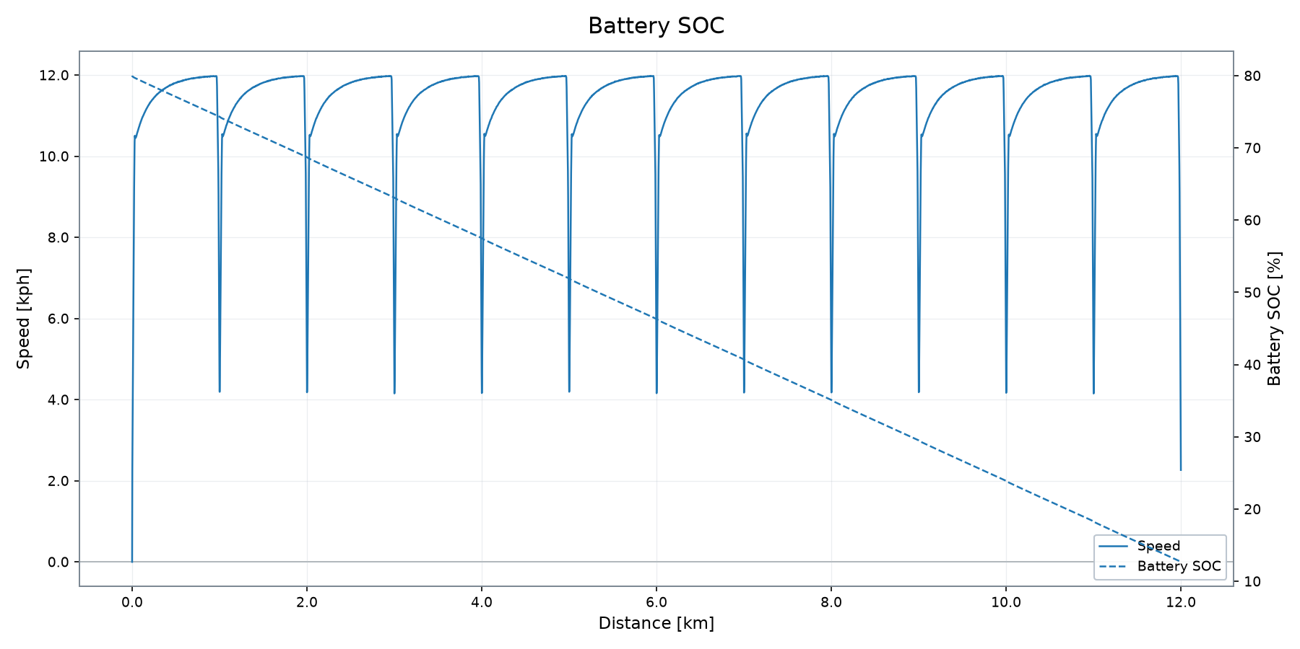
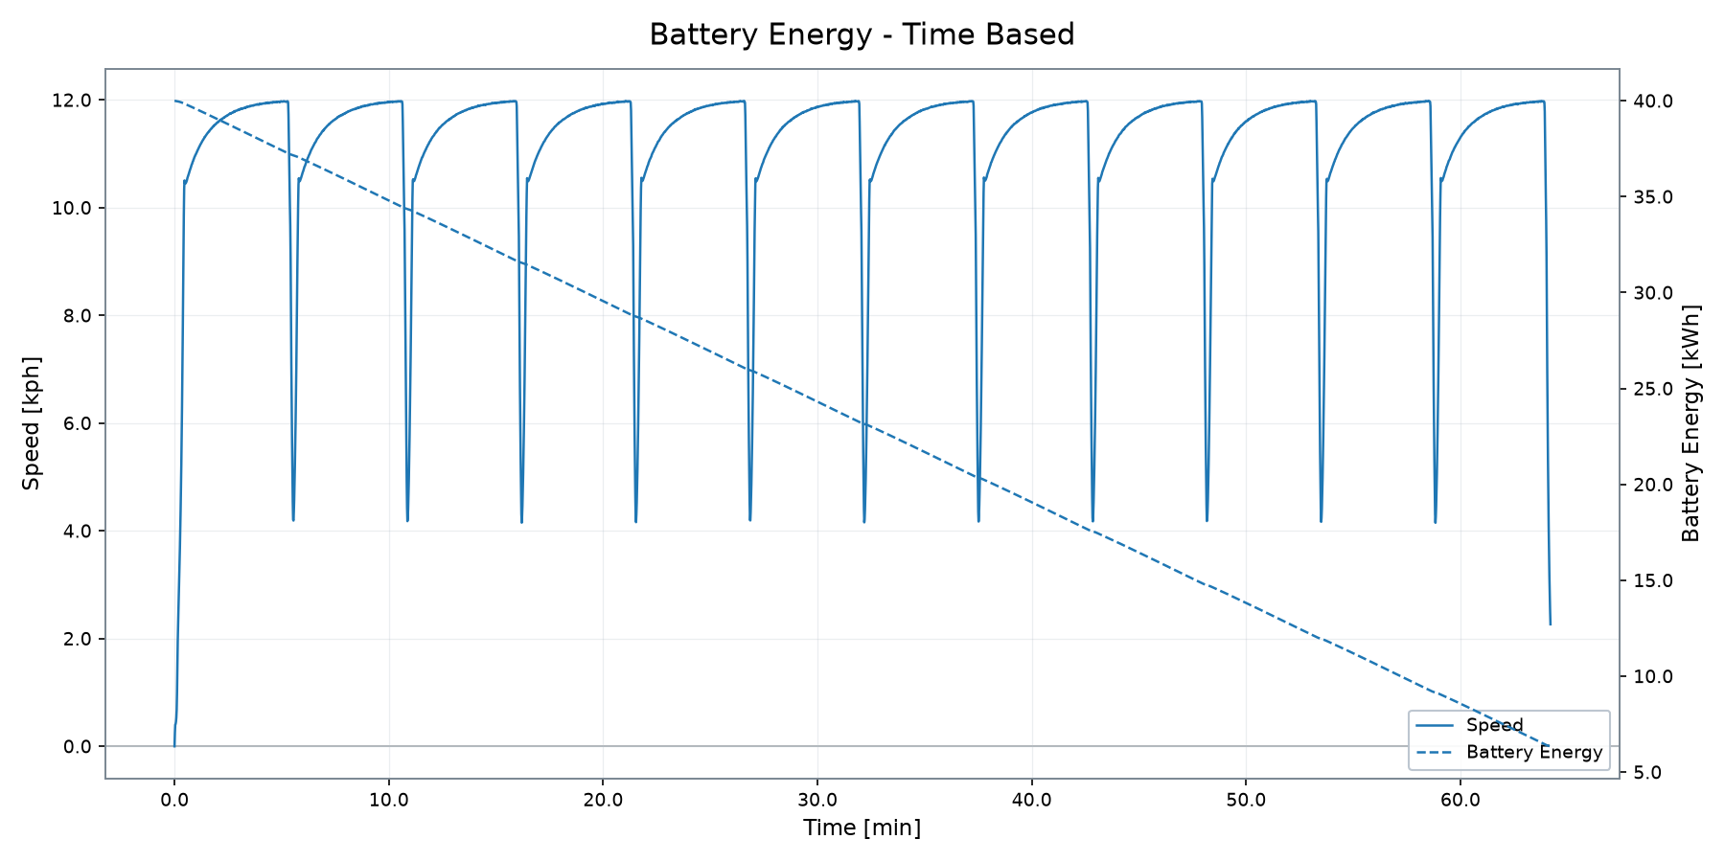
Battery & Electrical Energy System
State of charge, stored energy and battery demand
INITIAL SOC
FINAL SOC
MAX BATTERY POWER
BATTERY POWER RMS
HEATFLOW RMS
CAPACITY USED
80.00 %
12.69 %
29.85 kW
28.72 kW
2.84 kW
33.65 kWh
VSM ENGINEERING · POST-PROCESSING TOOL v1.2.10
5 / 10

Slide 6

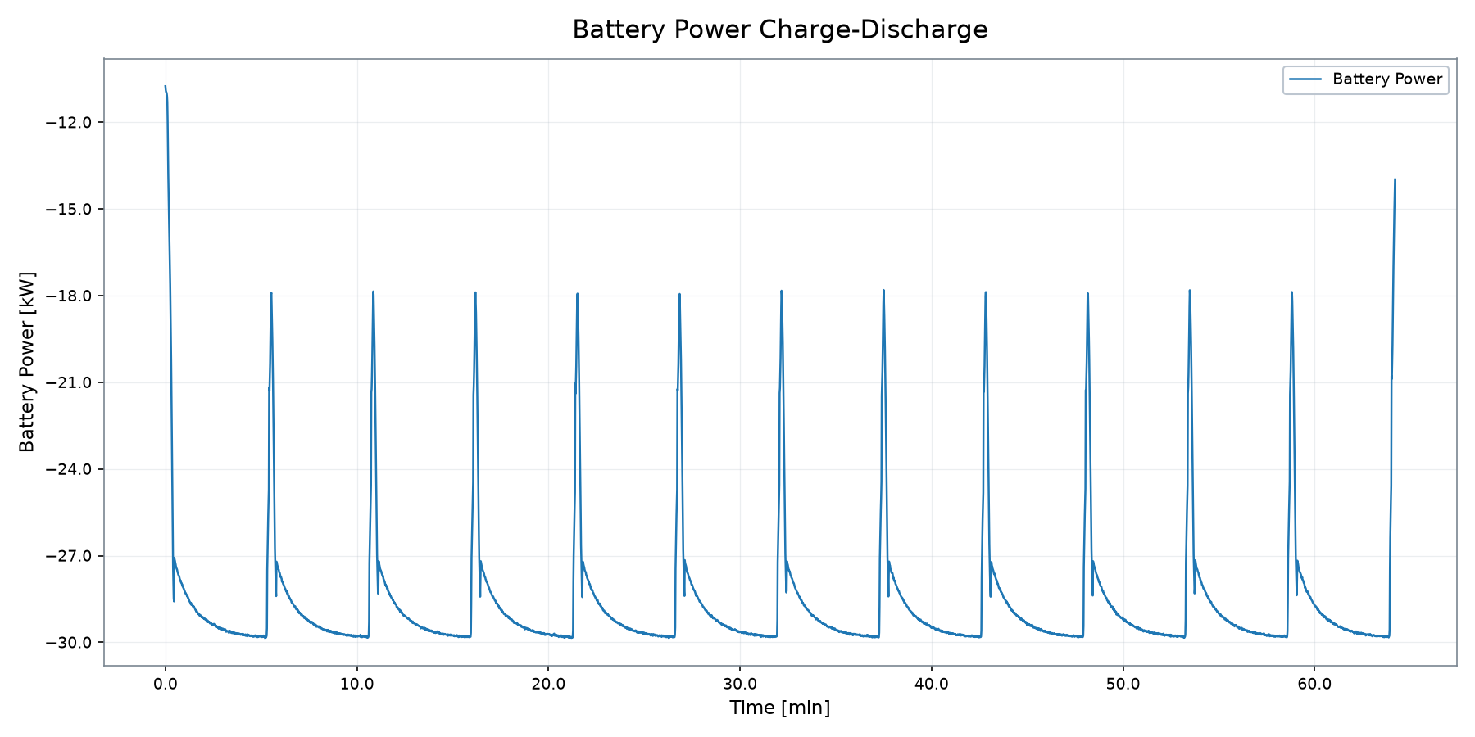
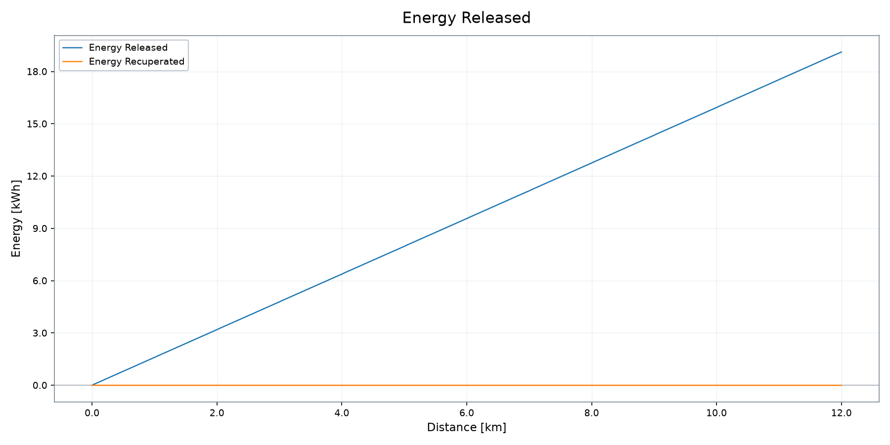
Battery Power & Energy Recovery
Charge / discharge behaviour and released / recuperated energy
BATTERY POWER RMS
RELEASED ENERGY
RECUPERATED ENERGY
AUXILIARIES ENERGY
MAX BATTERY POWER
28.72 kW
19.12 kWh
0.00 kWh
11.51 kWh
29.85 kW
VSM ENGINEERING · POST-PROCESSING TOOL v1.2.10
6 / 10

Slide 7

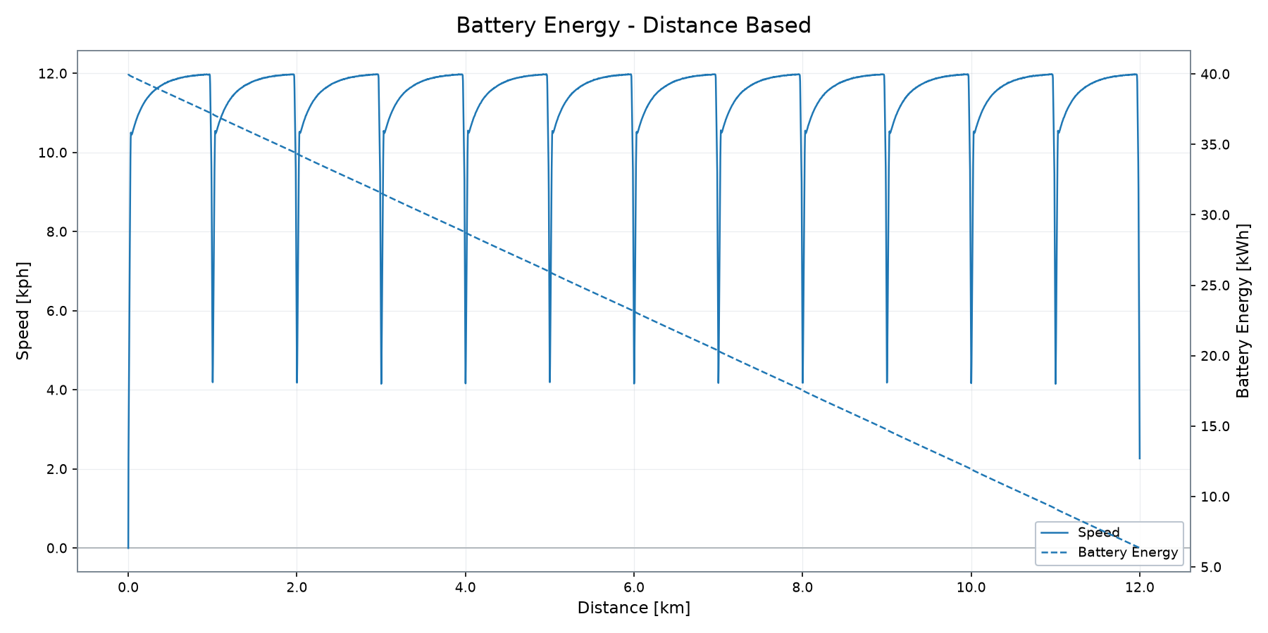
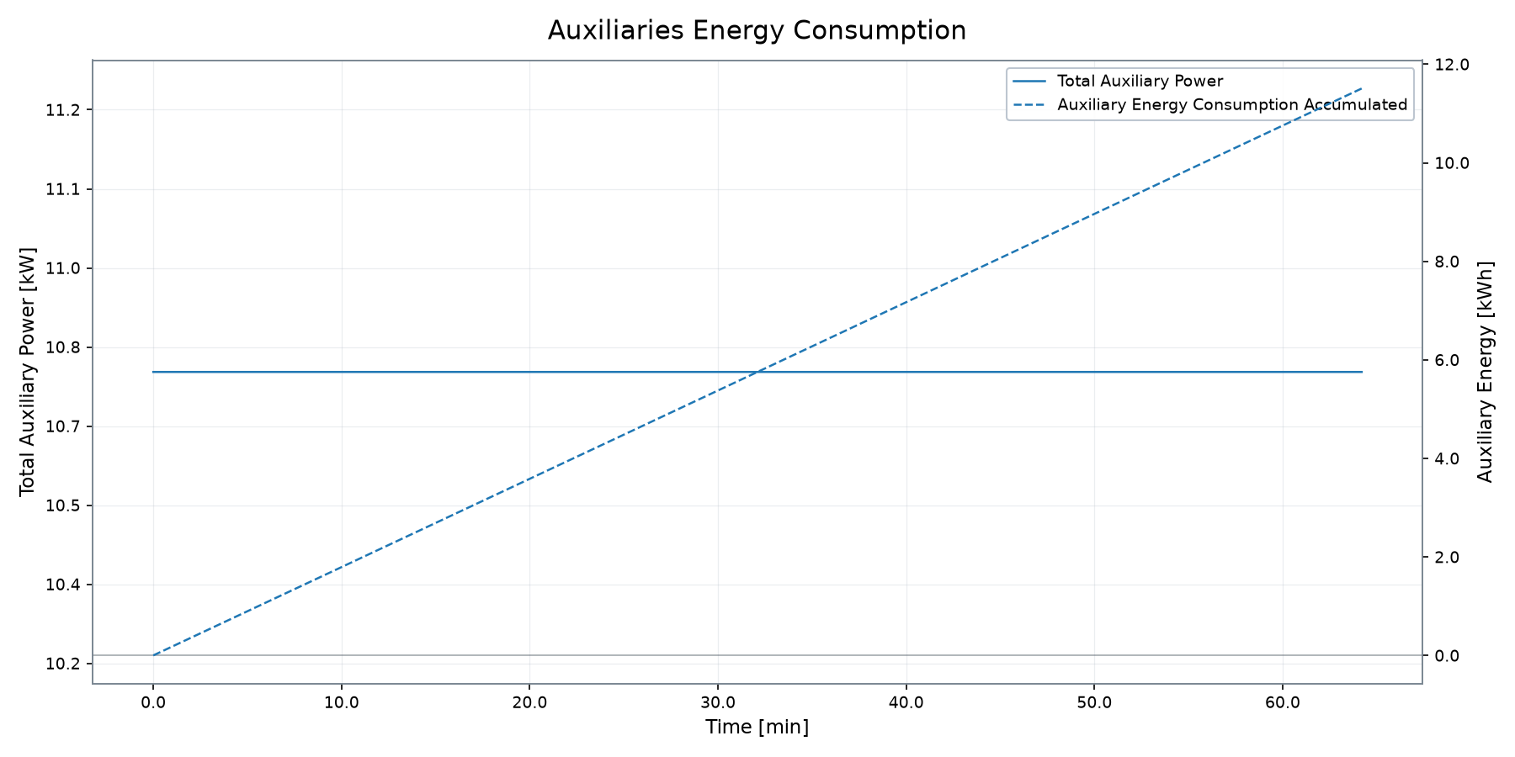
Energy Consumption & Estimated Range
Battery energy consumption and range indicators
CAPACITY USED
ENERGY CONSUMPTION
RANGE 85% BATT
BATTERY FINAL SOC
MAX BATTERY POWER
AUXILIARIES ENERGY
33.65 kWh
2,804.6 Wh/km
12.76 km
12.69 %
29.85 kW
11.51 kWh
Range and consumption are deterministic profile KPI outputs.
VSM ENGINEERING · POST-PROCESSING TOOL v1.2.10
7 / 10

Slide 8

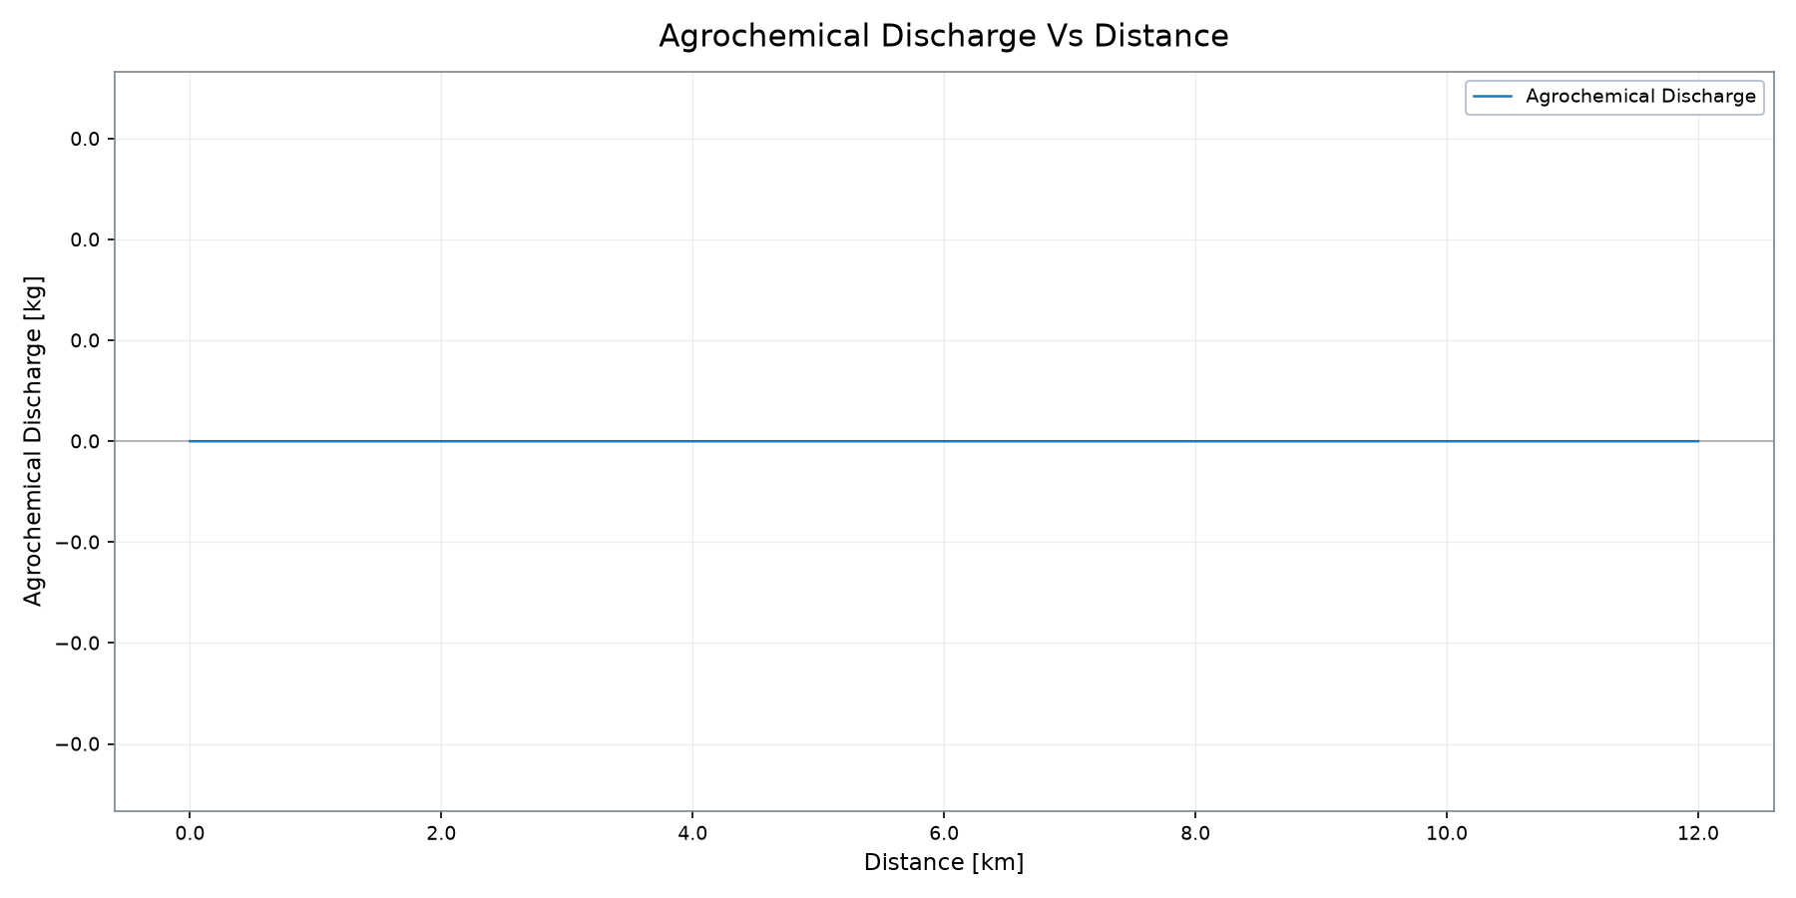
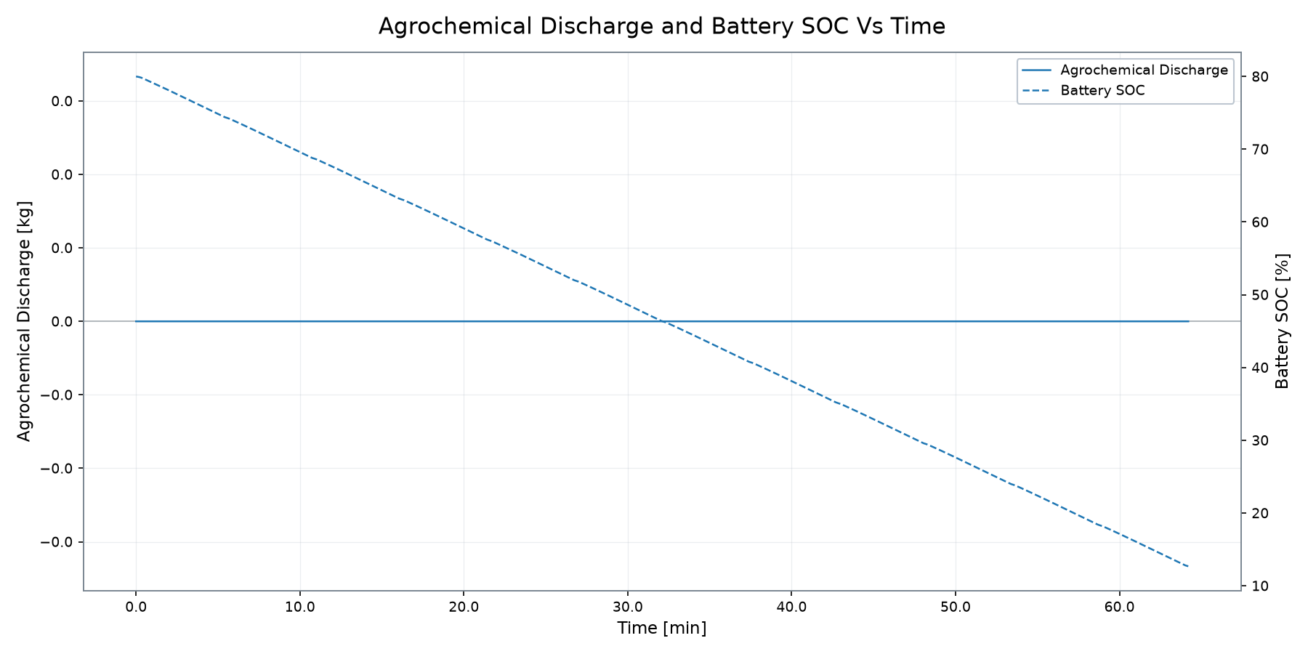
Agrochemical & Battery Behaviour
Profile-supported system interaction without reconstructed charging assumptions
MAX AGROCHEM. DISCHARGE
BATTERY FINAL SOC
CAPACITY USED
TIME
-0.00 kg
12.69 %
33.65 kWh
64.20 min
VSM ENGINEERING · POST-PROCESSING TOOL v1.2.10
8 / 10

Slide 9

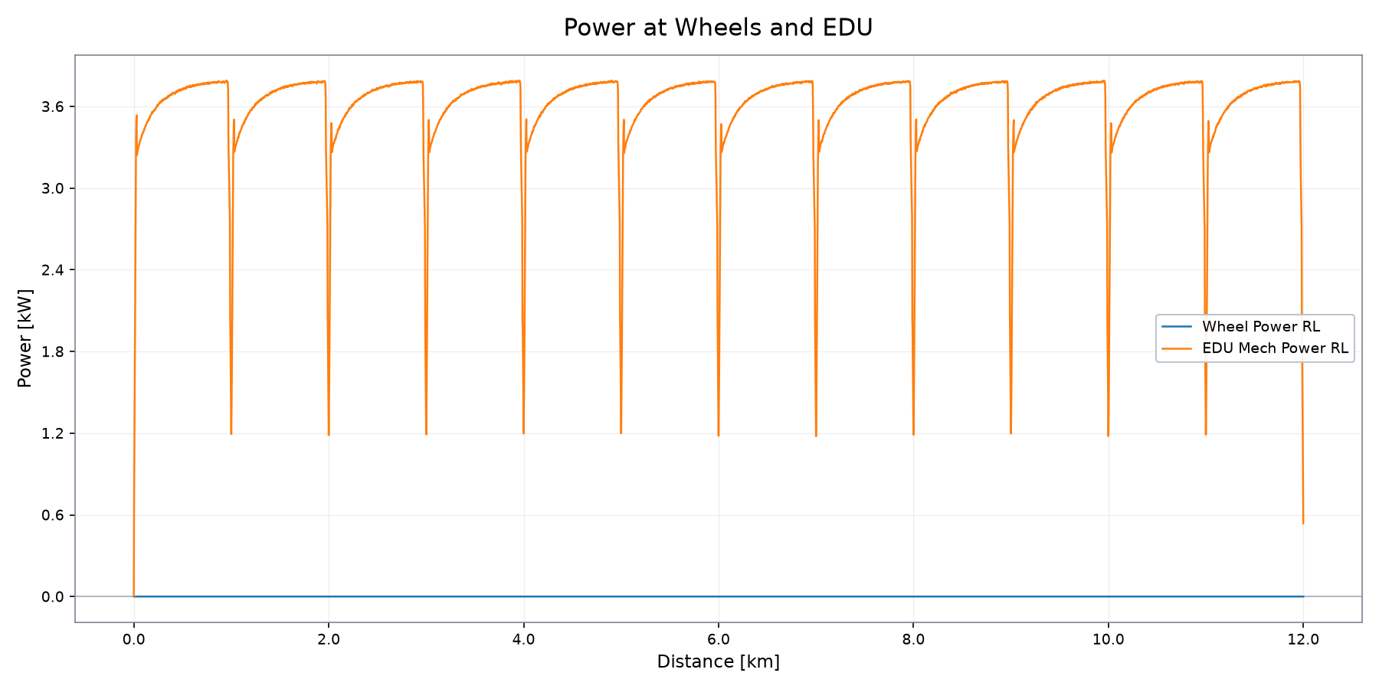
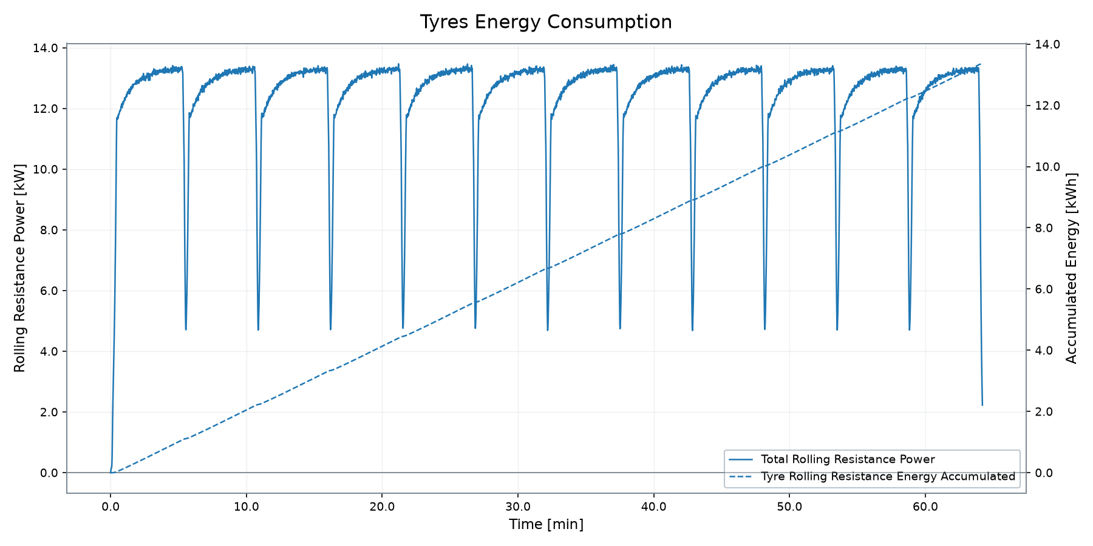
Traction, EDU & Auxiliary Energy Demand
Wheel, EDU, tyre and auxiliary demand from profile plots
MAX EDU MECH POWER
MAX WHEEL POWER
EDU MAX SPEED
EDU MAX TORQUE
TYRE RR ENERGY
AUXILIARIES ENERGY
15.17 kW
0.00 kW
58 rpm
737.87 Nm
13.36 kWh
11.51 kWh
VSM ENGINEERING · POST-PROCESSING TOOL v1.2.10
9 / 10

Slide 10

Simulation Summary
Deterministic profile result snapshot
12.00 km covered · SOC 12.69 % · consumption 2,804.6 Wh/km
DETERMINISTIC SUMMARY
▸ Deterministic run covered 12.00 km in 64.20 min.
▸ Final battery SOC is 12.69 % from an 80.00 % initial state.
▸ Battery capacity used is 33.65 kWh; estimated range for 85% battery is 12.76 km.
▸ Results are deterministic simulation outputs; acceptance conclusions require explicit engineering criteria.
DISTANCE
TIME
FINAL SOC
CAPACITY USED
CONSUMPTION
RANGE 85%
12.00 km
64.20 min
12.69 %
33.65 kWh
2,804.6 Wh/km
12.76 km
VSM ENGINEERING · POST-PROCESSING TOOL v1.2.10
10 / 10

