Slide 1




VSM ENGINEERING · FEASIBILITY STUDY
RoboSprayer Hybrid
VSM Engineering - Feasibility Study
Powertrain Hybrid
Source RoboSprayer raw VSM CSV
Samples 3,853
Profile RoboSprayer Hybrid
Tool v1.2.10
DISTANCE
MISSION TIME
FINAL BATTERY SOC
FUEL CONSUMPTION
12.00 km
64.20 min
12.69 %
0.00 kg
VSM Engineering Post-Processing Tool · v1.2.10
1 / 10

Slide 2




System and Simulation Overview
Hybrid profile resolution and deterministic simulation scope
Samples 3,853
Distance 12.00 km
Mission time 64.20 min
Hybrid profile
Mission Structure
Hybrid System Context
Source dataset: RoboSprayer raw VSM CSV Imported samples: 3,853 Mission duration: 64.20 min Mission distance: 12.00 km Maximum speed: 11.99 kph
Battery SOC: 80.00 % to 12.69 % Fuel consumption: 0.00 kg Maximum generator power: 0.00 kW Range-extender activity is reported directly from resolved simulation channels. Inactive channels remain visible as zero deterministic outputs.
MISSION TIME
DISTANCE
MAX SPEED
MAX GEN POWER
64.20 min
12.00 km
11.99 kph
0.00 kW
VSM Engineering Post-Processing Tool · v1.2.10
2 / 10

Slide 3

Executive Results
Deterministic KPIs from the validated profile pipeline
MISSION TIME
DISTANCE
MAX SPEED
64.20 min
12.00 km
11.99 kph
INITIAL BATTERY SOC
FINAL BATTERY SOC
BATTERY CAPACITY USED
80.00 %
12.69 %
33.65 kWh
Calculations are sourced from the profile statistics and KPI results.
VSM Engineering Post-Processing Tool · v1.2.10
3 / 10

Slide 4
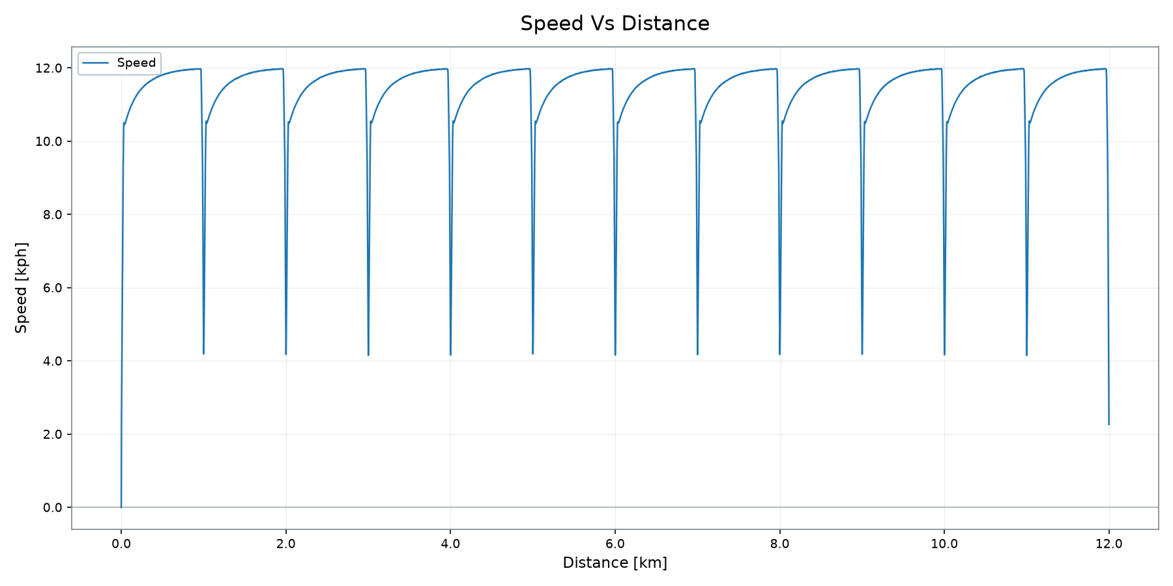
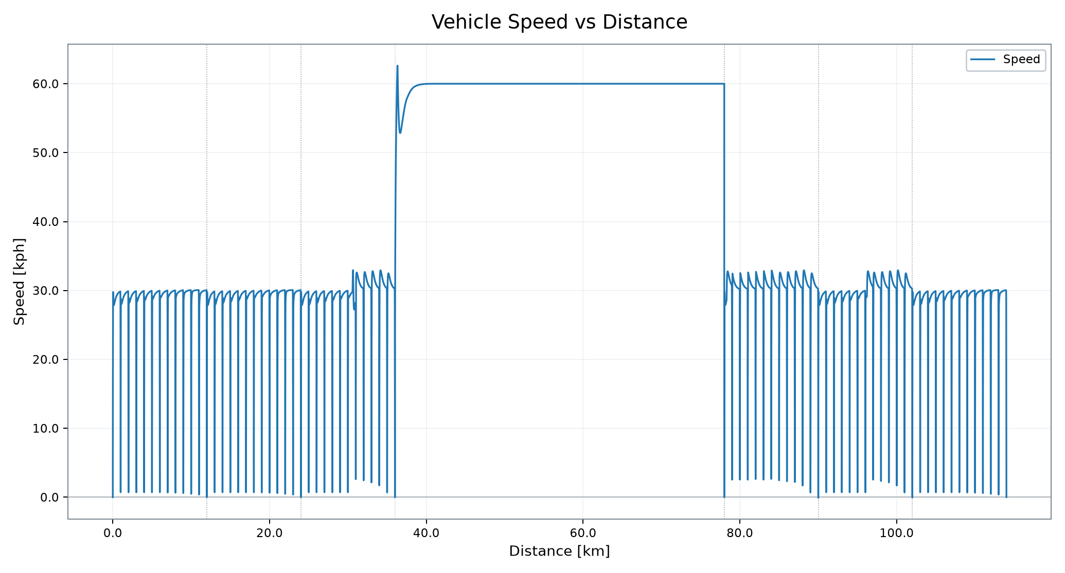
Vehicle Operation
Speed trace from the validated profile plot output
DISTANCE
MISSION TIME
MAX SPEED
FINAL BATTERY SOC
12.00 km
64.20 min
11.99 kph
12.69 %
VSM Engineering Post-Processing Tool · v1.2.10
4 / 10

Slide 5

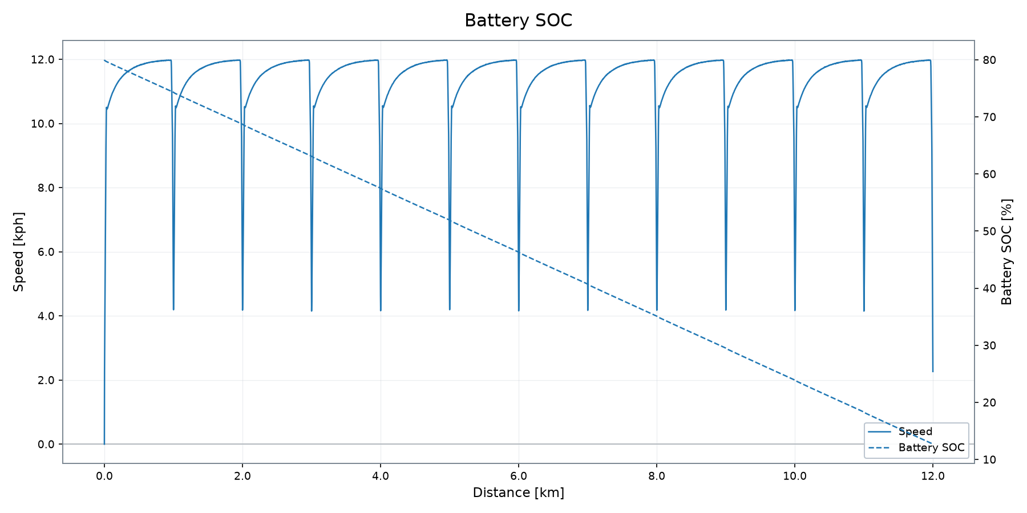
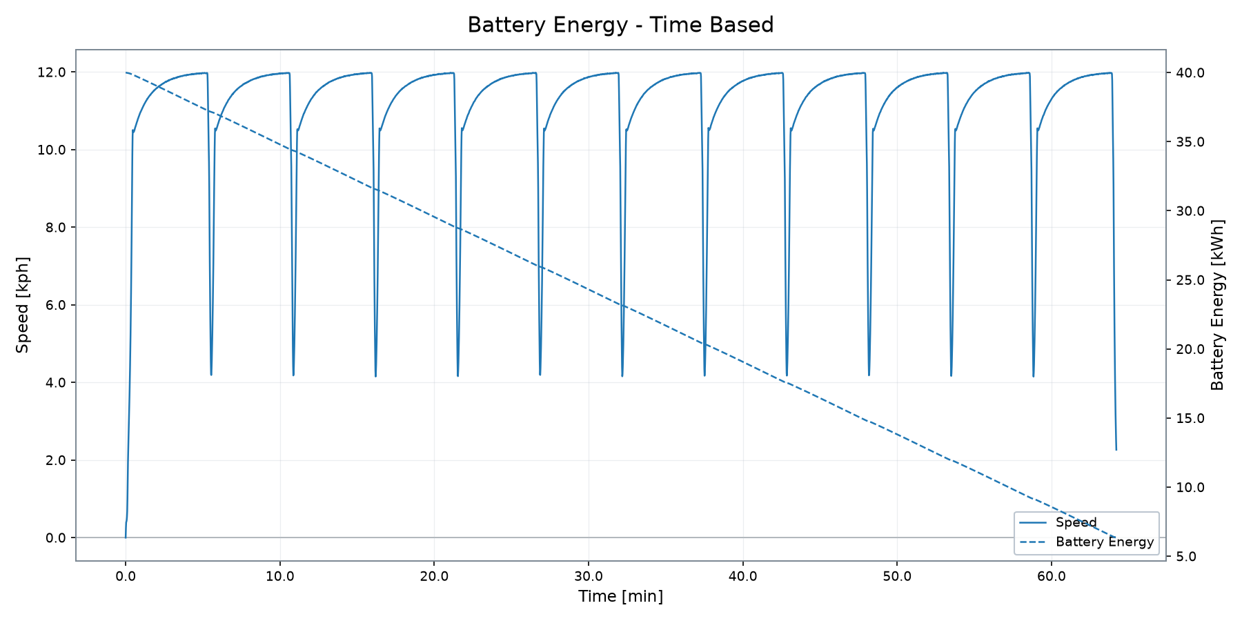
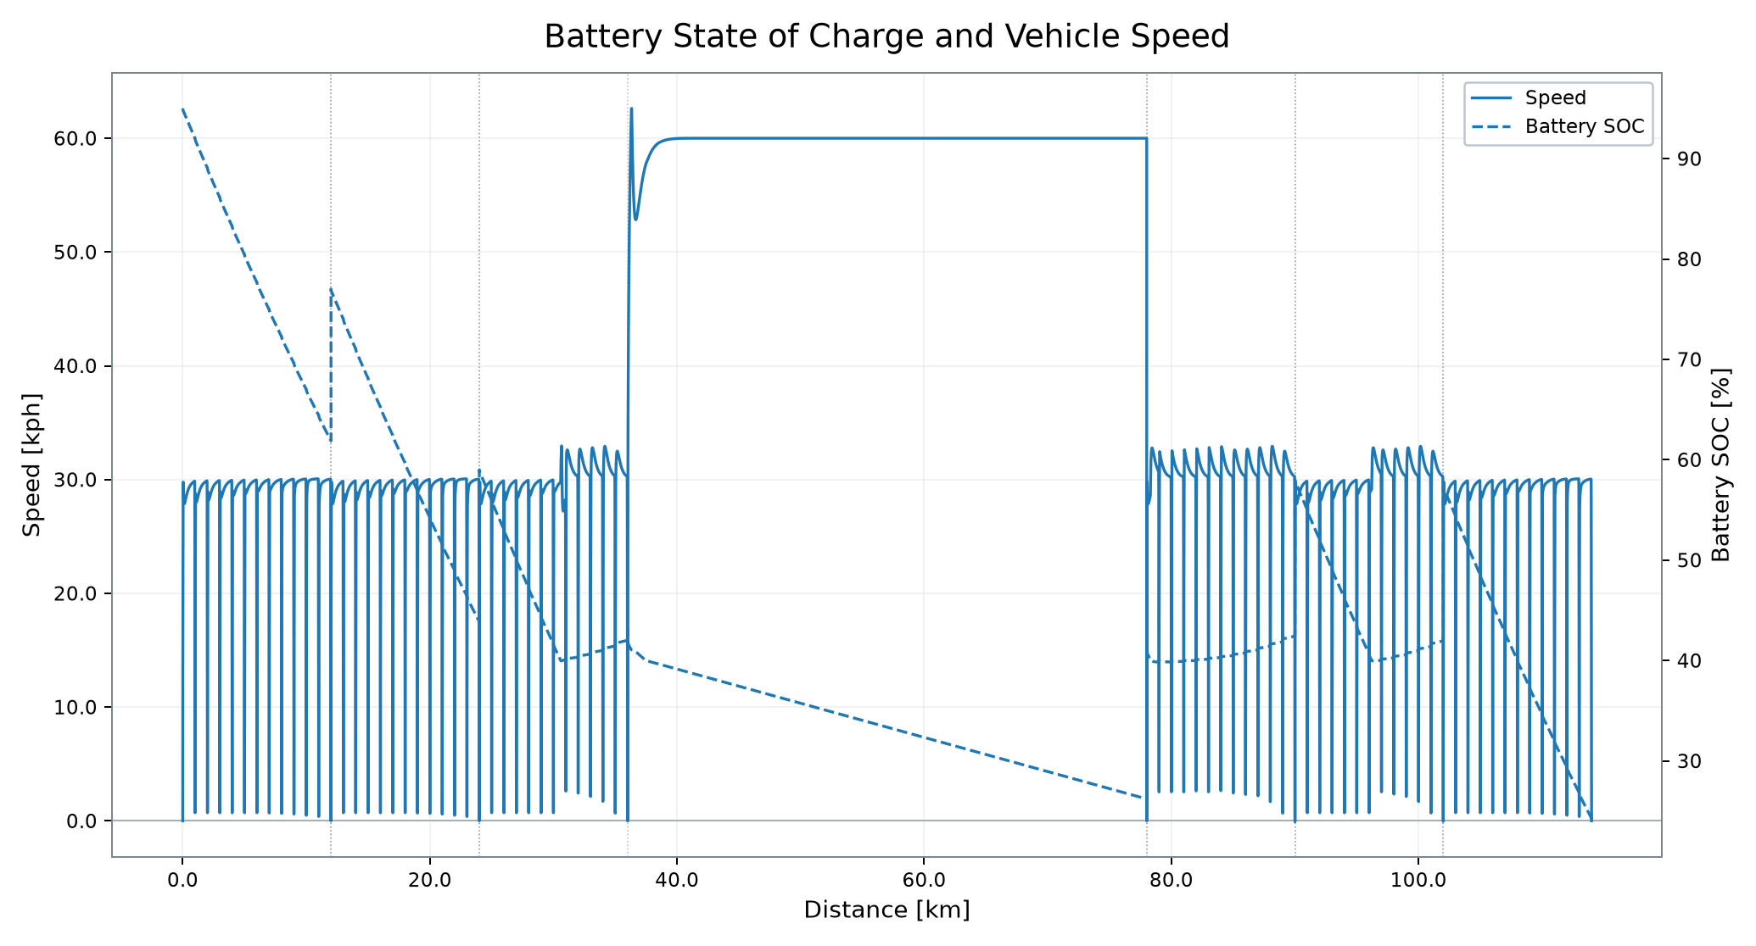
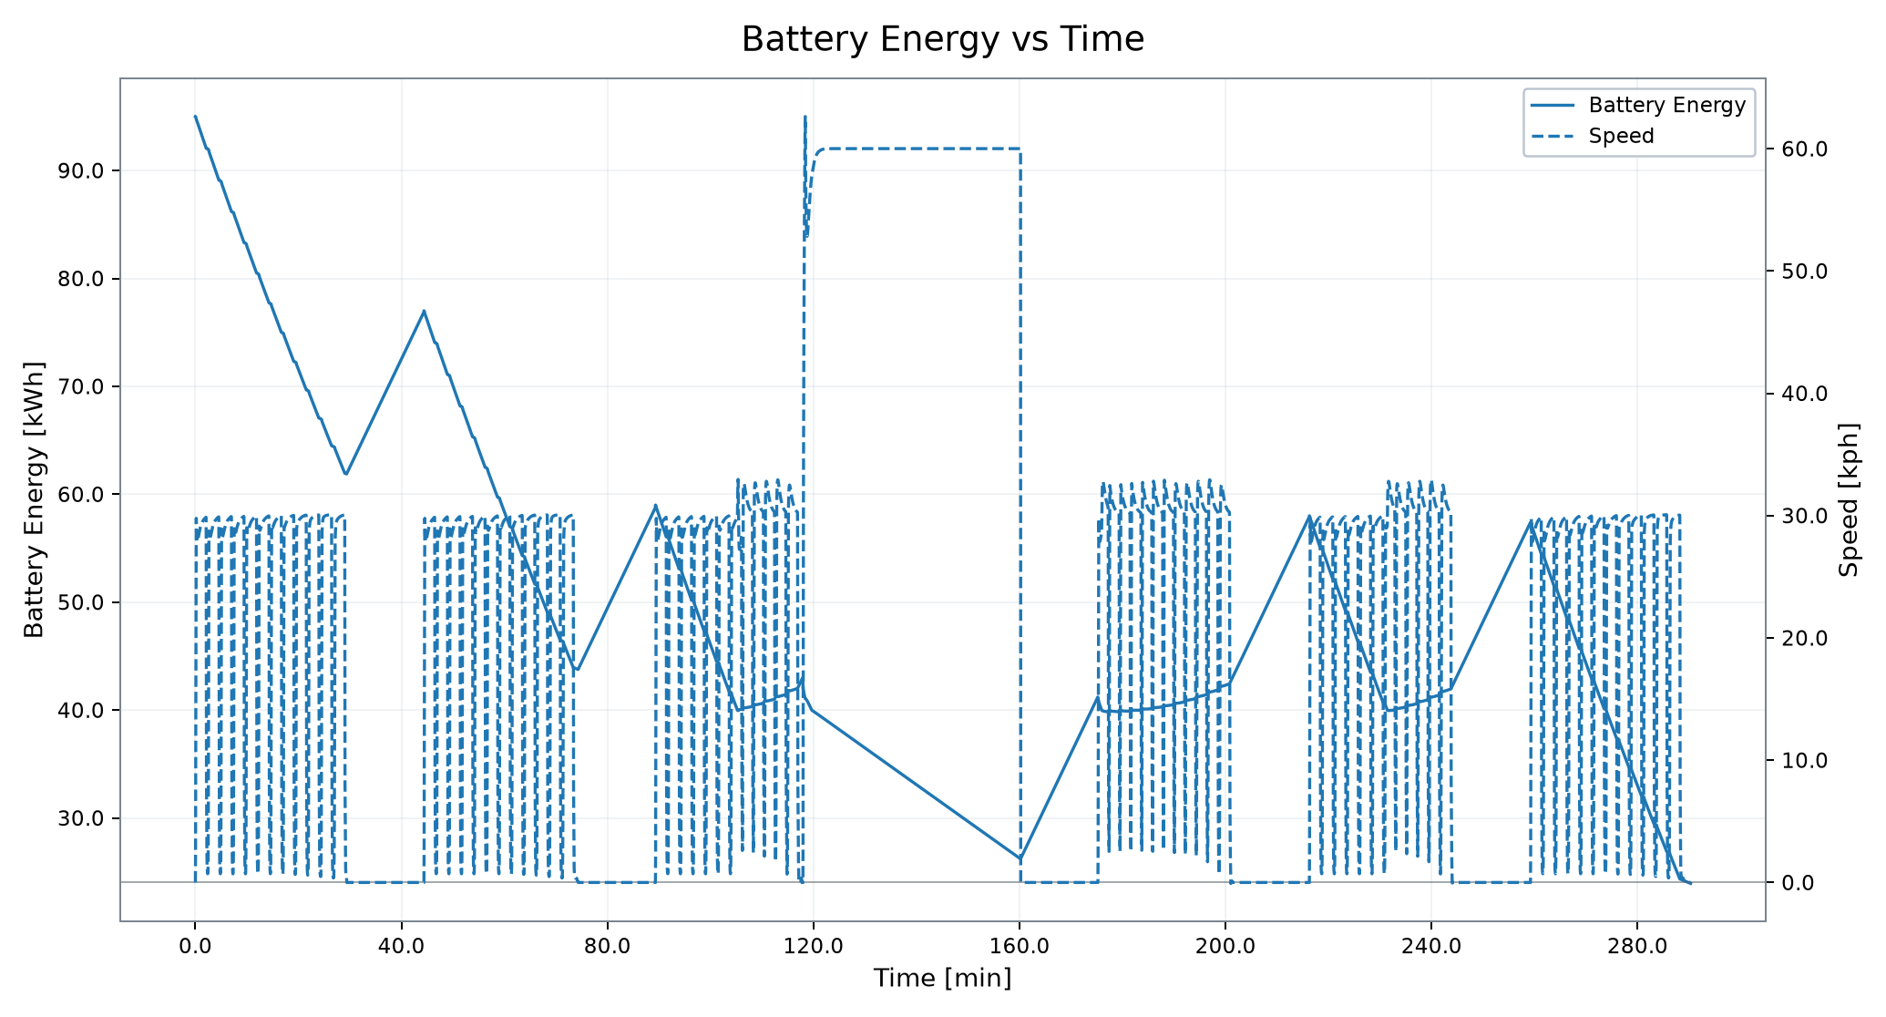
Battery and Electrical Energy System
State of charge, stored energy and battery demand
INITIAL BATTERY SOC
FINAL BATTERY SOC
MAX BATT POWER
BATT POWER RMS
HEATFLOW RMS
80.00 %
12.69 %
29.85 kW
28.72 kW
2.84 kW
VSM Engineering Post-Processing Tool · v1.2.10
5 / 10

Slide 6

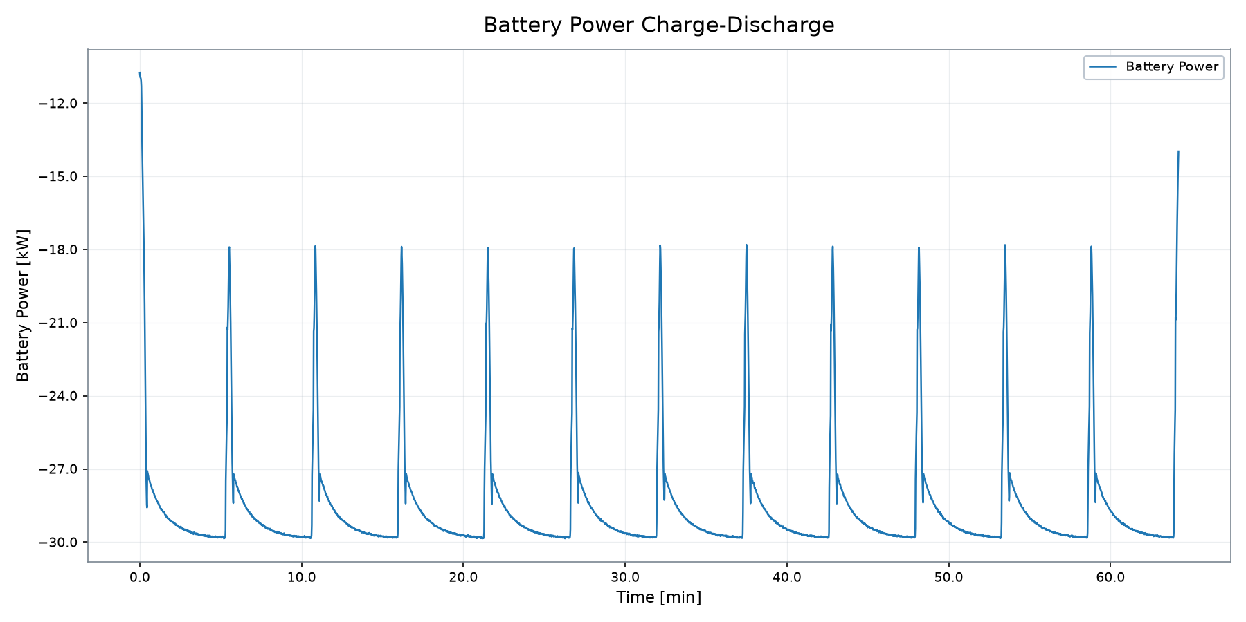
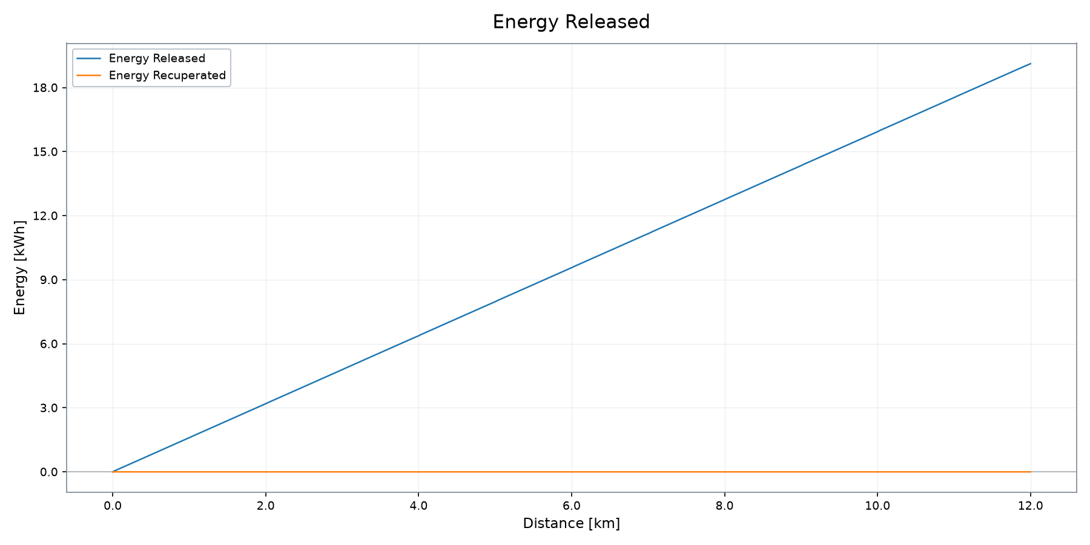
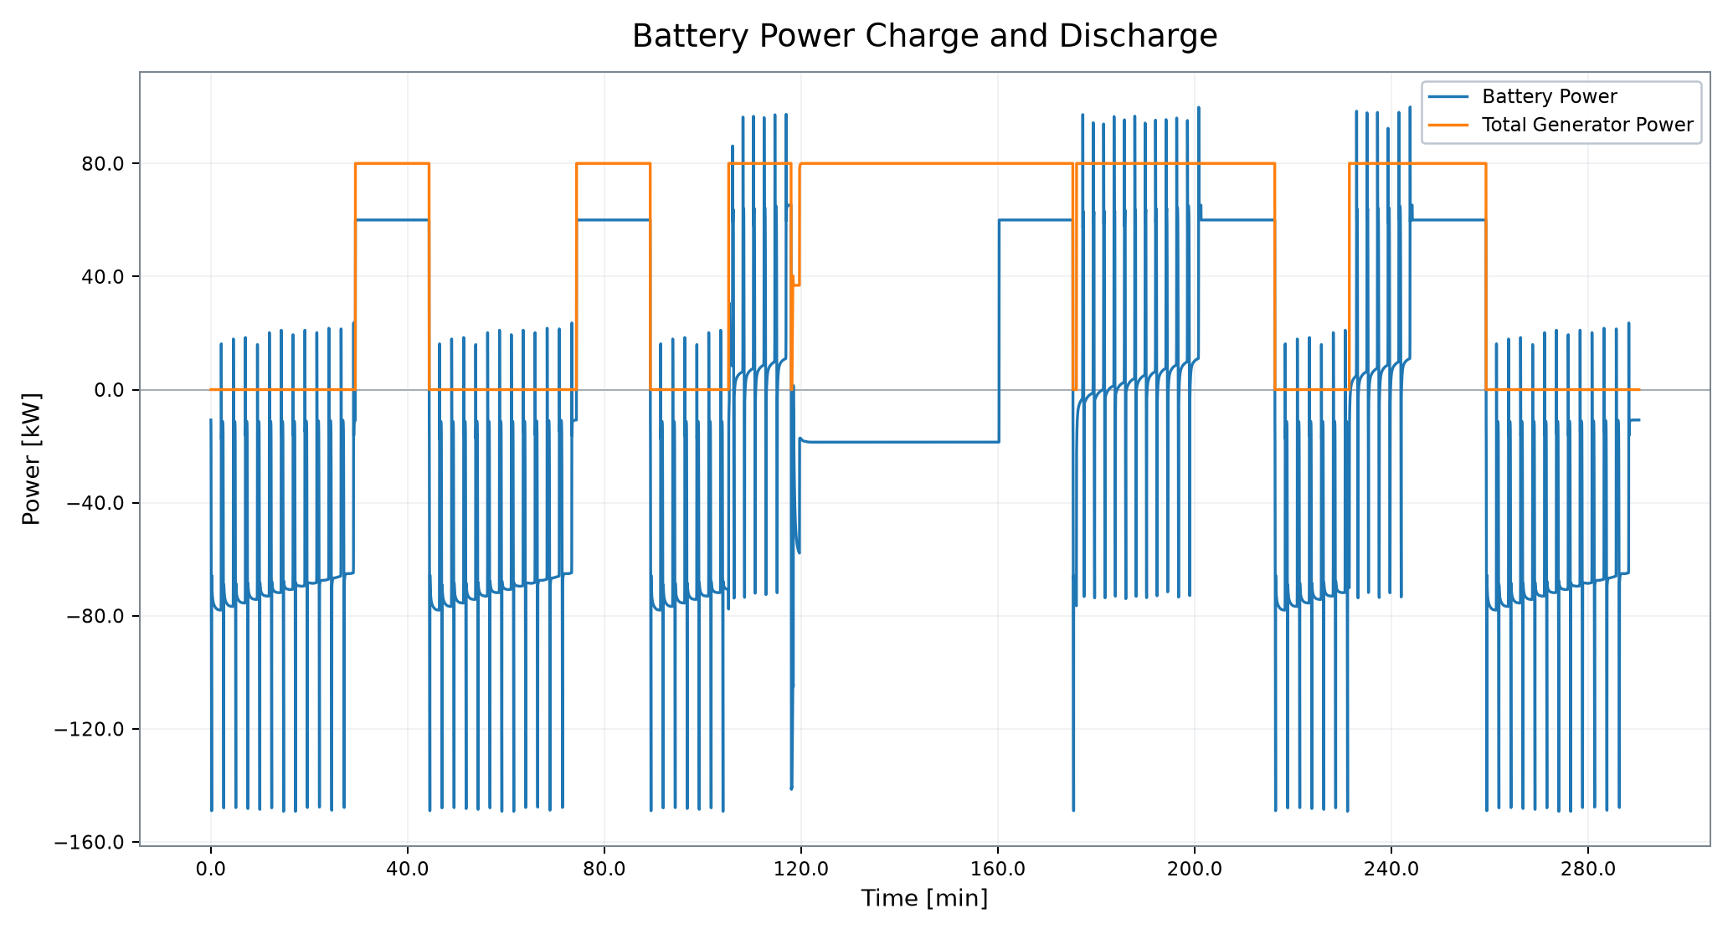
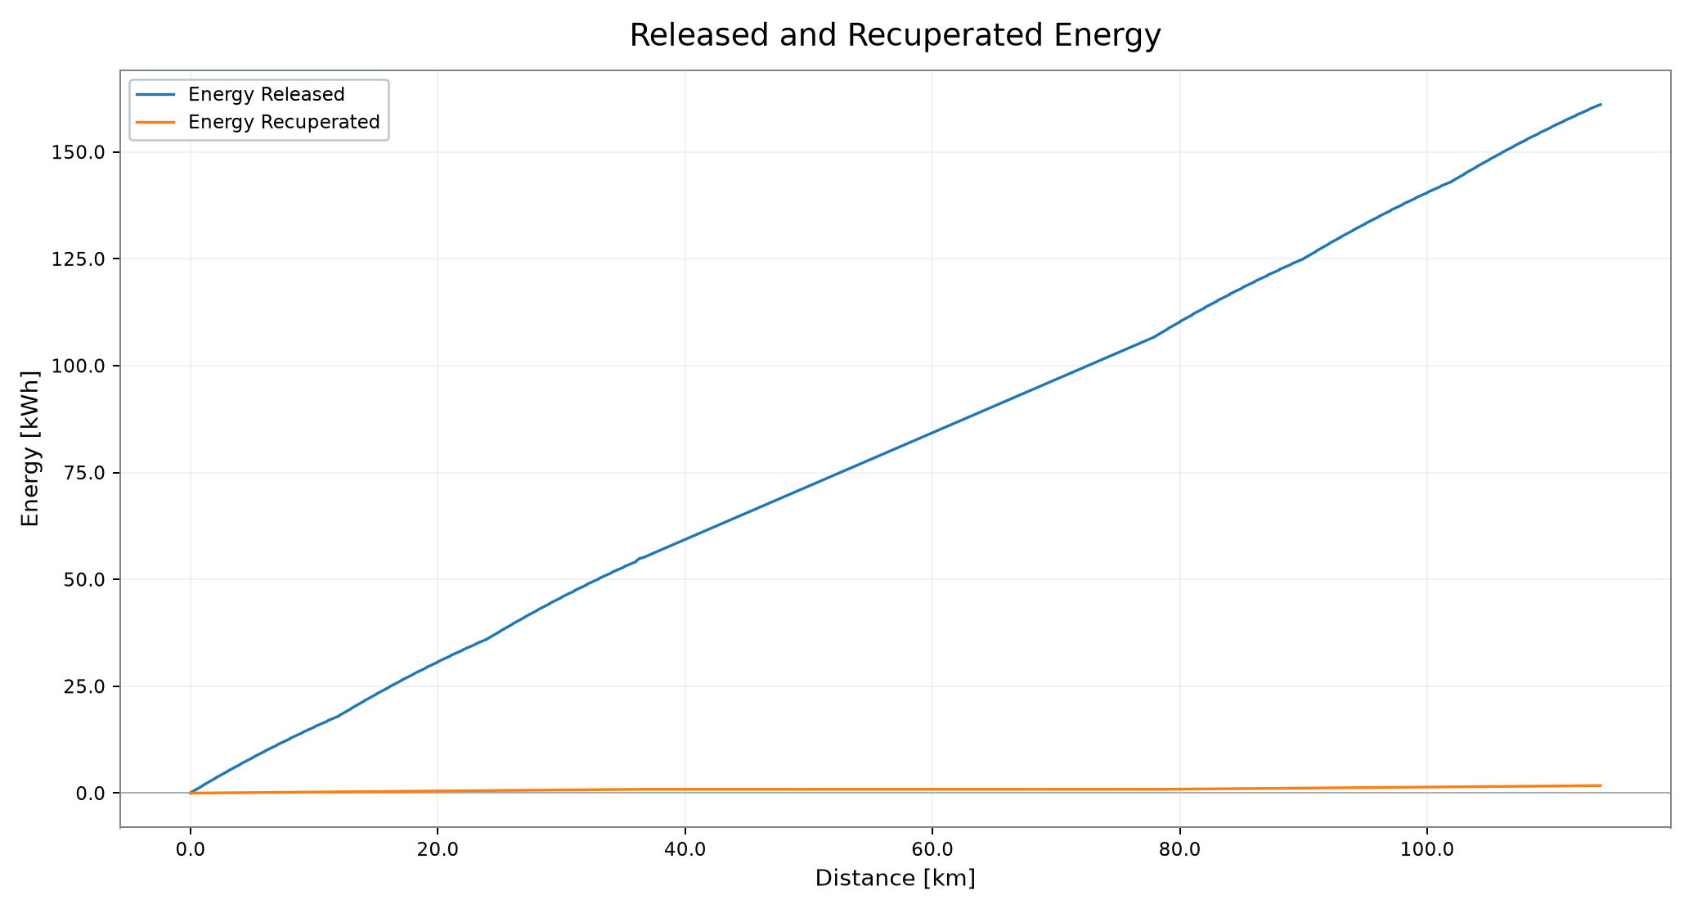
Battery Power and Energy Recovery
Charge/discharge behavior and released/recuperated energy
BATT POWER RMS
ENERGY RELEASED
ENERGY RECOVERED
AUX ENERGY
28.72 kW
19.12 kWh
0.00 kWh
11.51 kWh
VSM Engineering Post-Processing Tool · v1.2.10
6 / 10

Slide 7

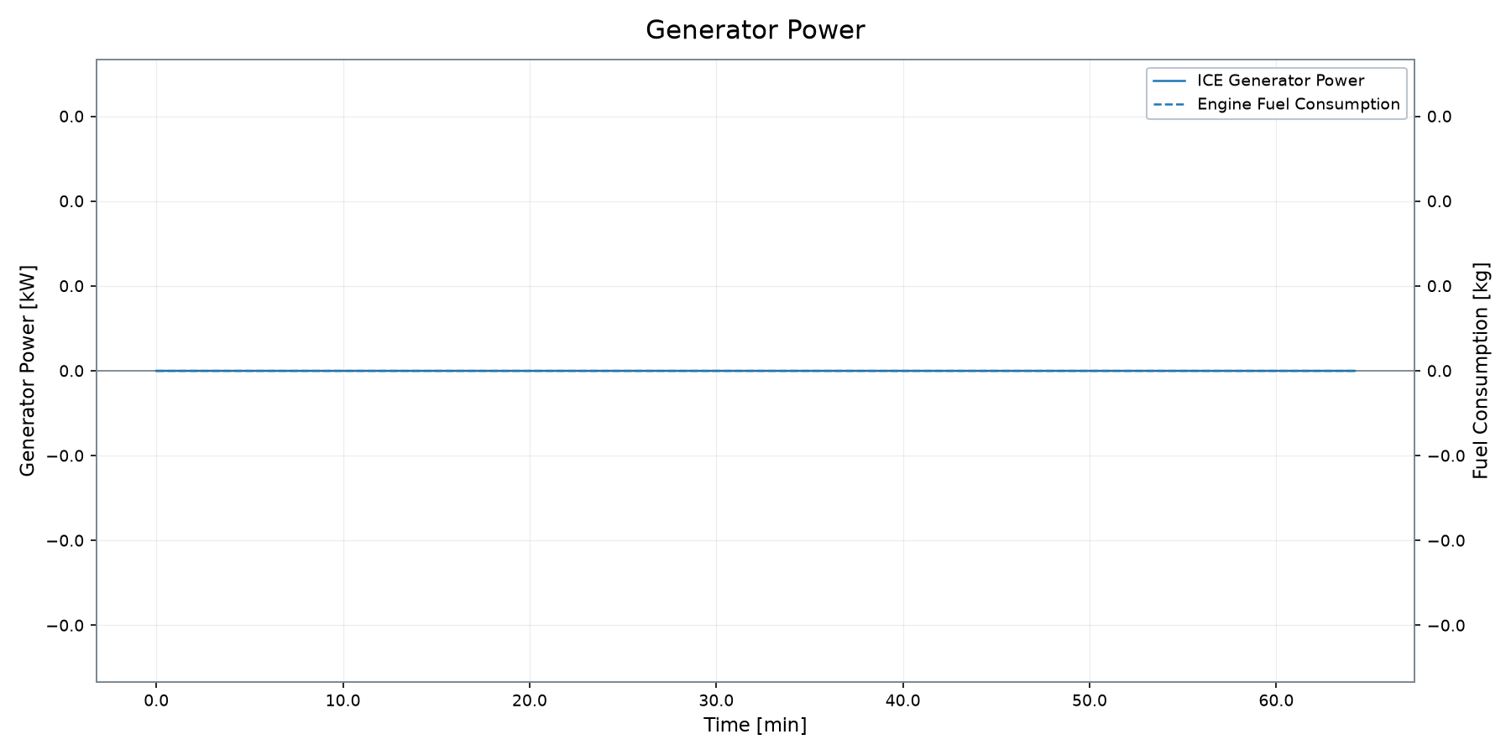
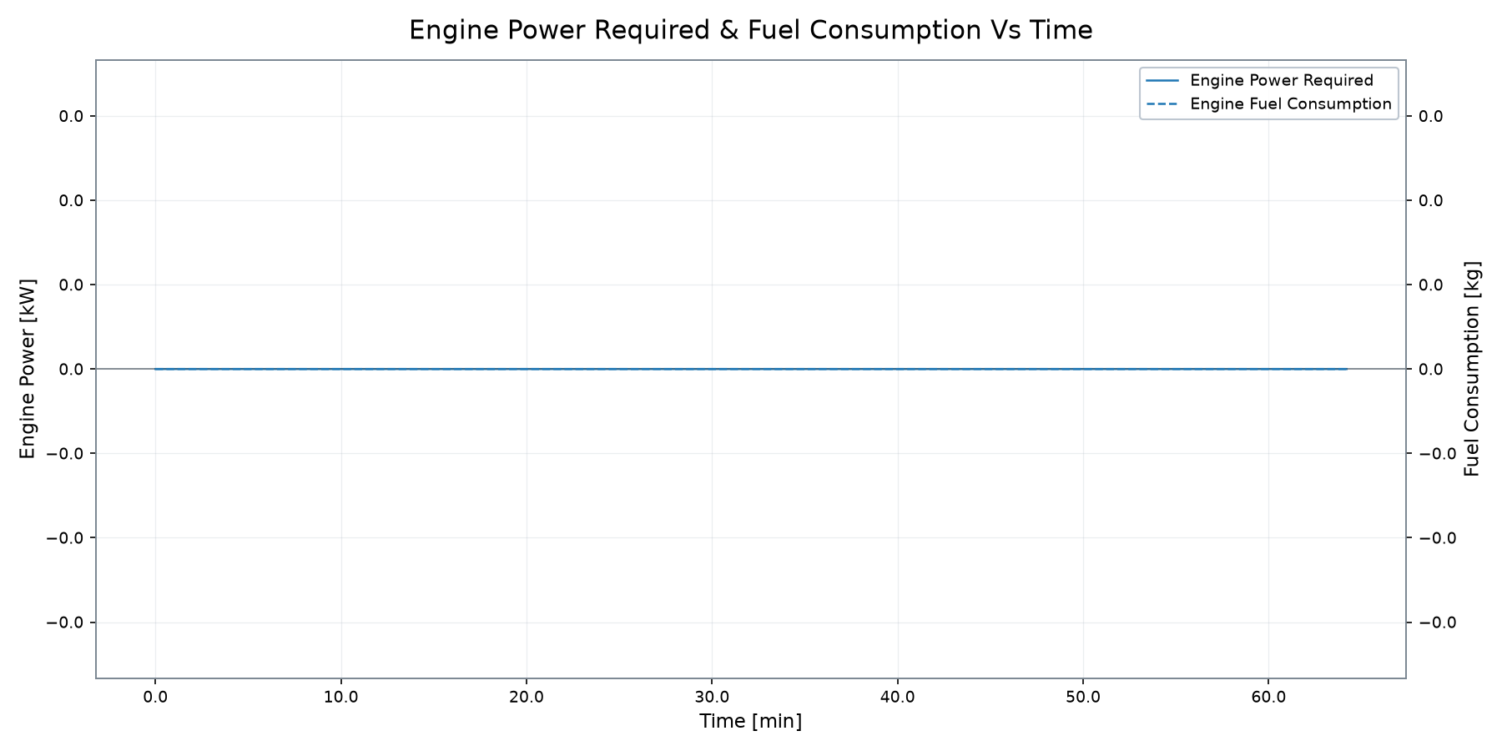
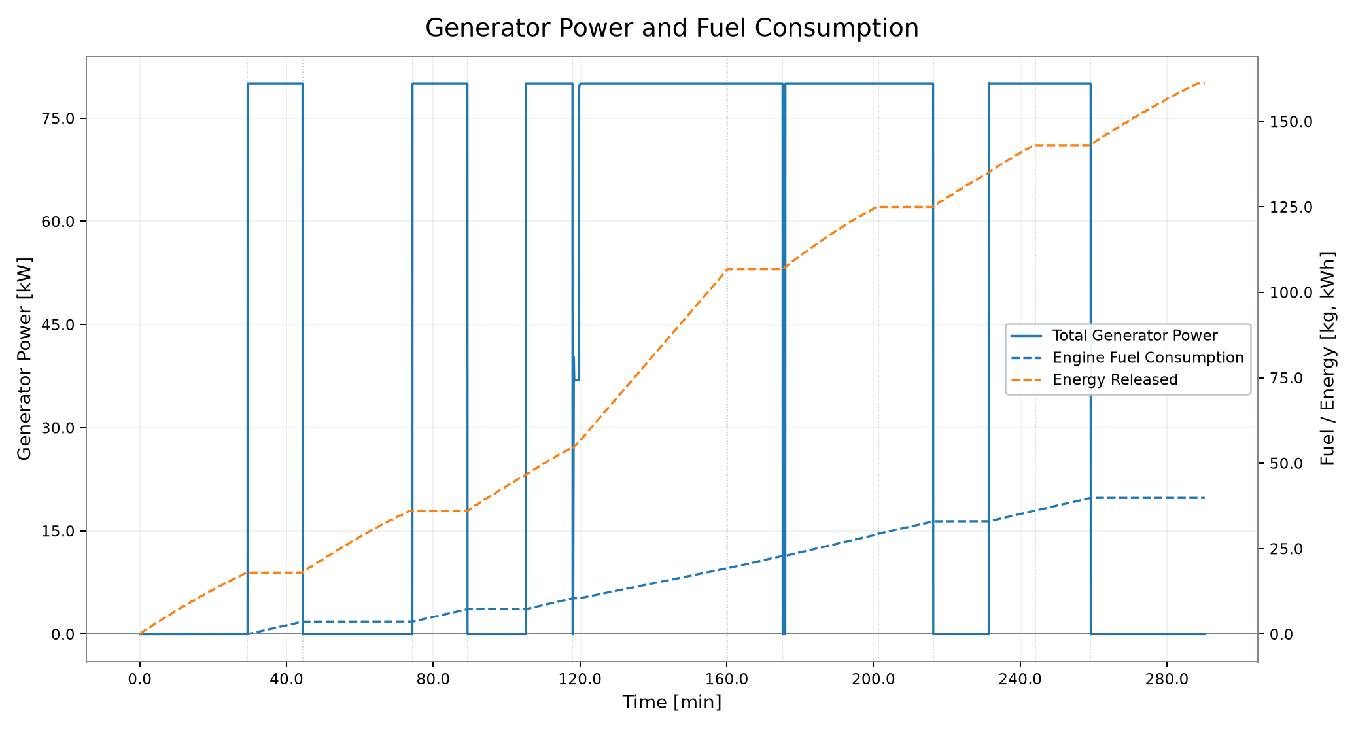
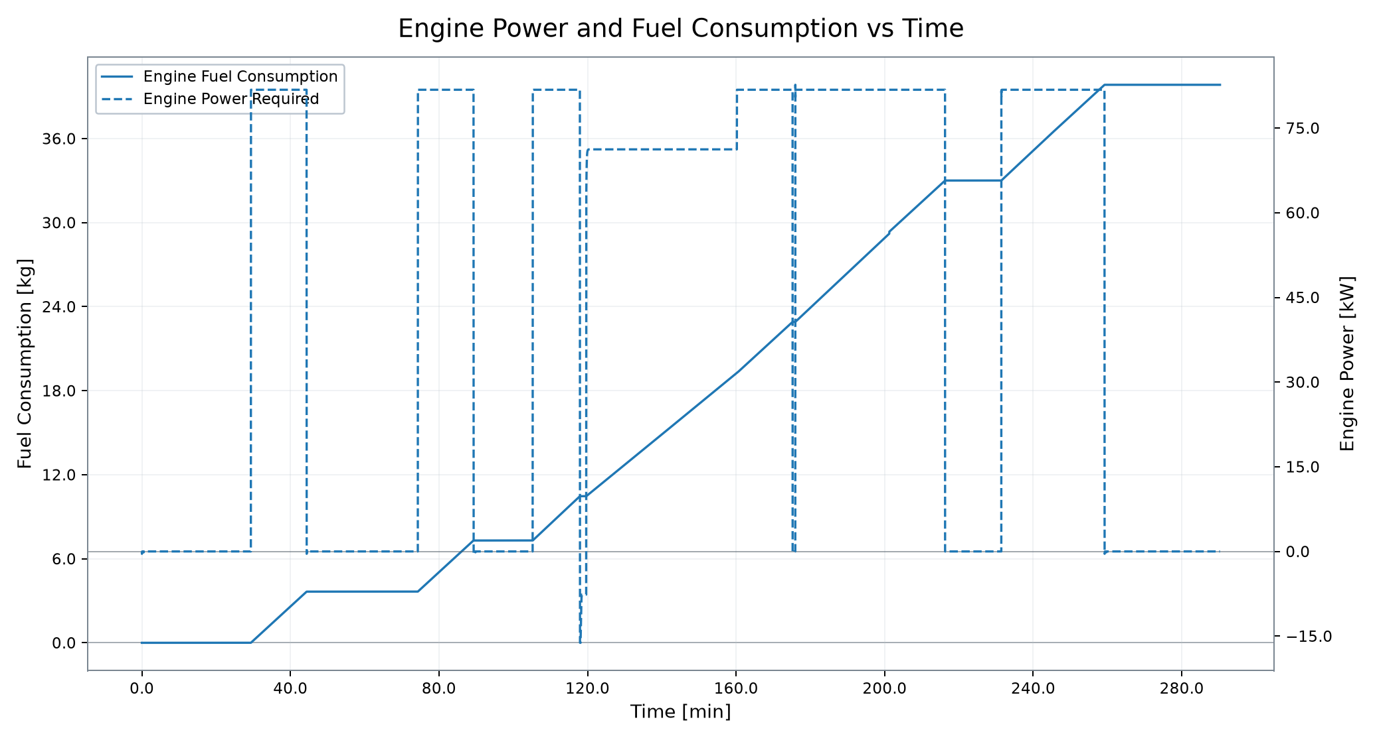
Range Extender and Generator
Resolved range-extender channels are inactive in this simulation
MAX GEN POWER
MAX ENG POWER
MAX ENG SPEED
MAX ENG TORQUE
FUEL CONSUMPTION
ENGINE ENERGY
0.00 kW
0.00 kW
0 rpm
0.00 Nm
0.00 kg
0.00 kWh
RANGE EXTENDER INACTIVE IN THIS SIMULATION ICE/generator channels resolved; no operating activity detected in this simulation.
VSM Engineering Post-Processing Tool · v1.2.10
7 / 10

Slide 8
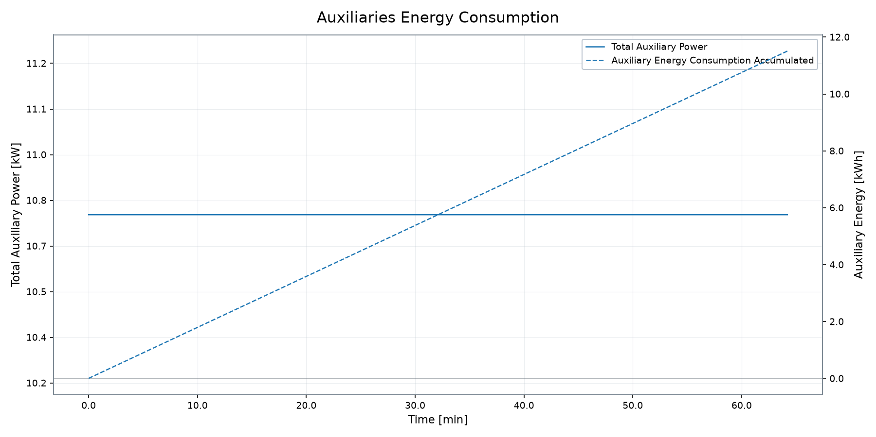
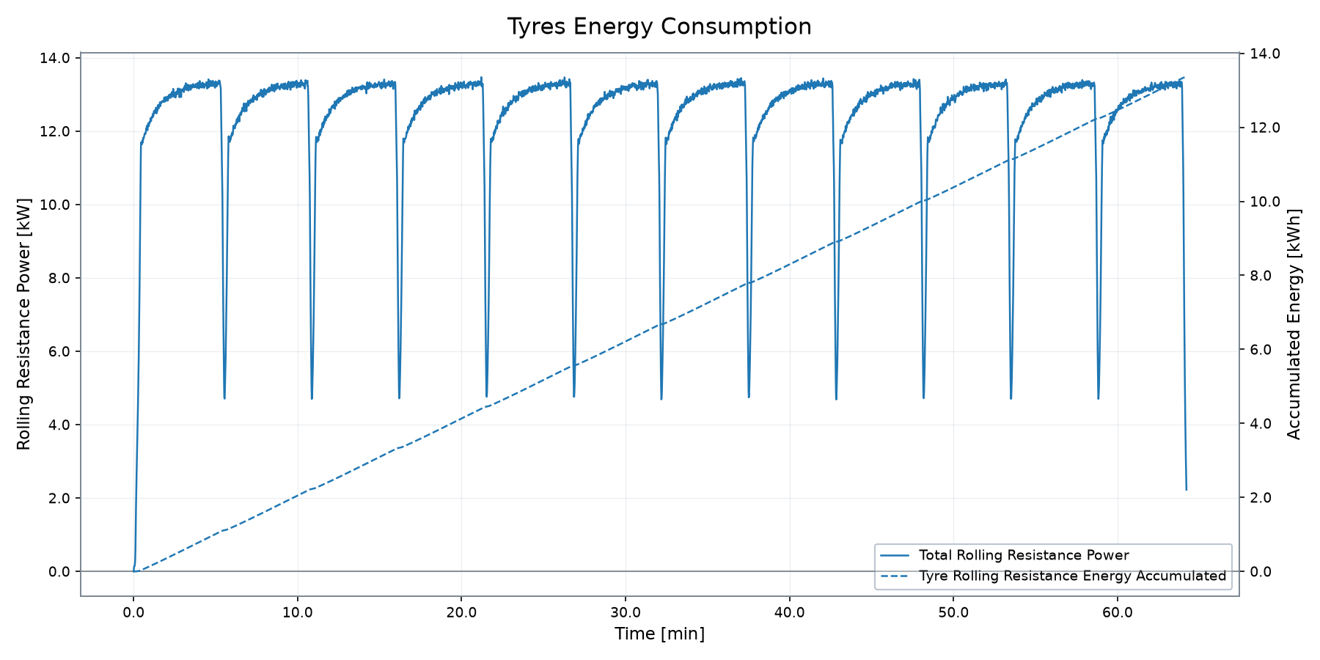
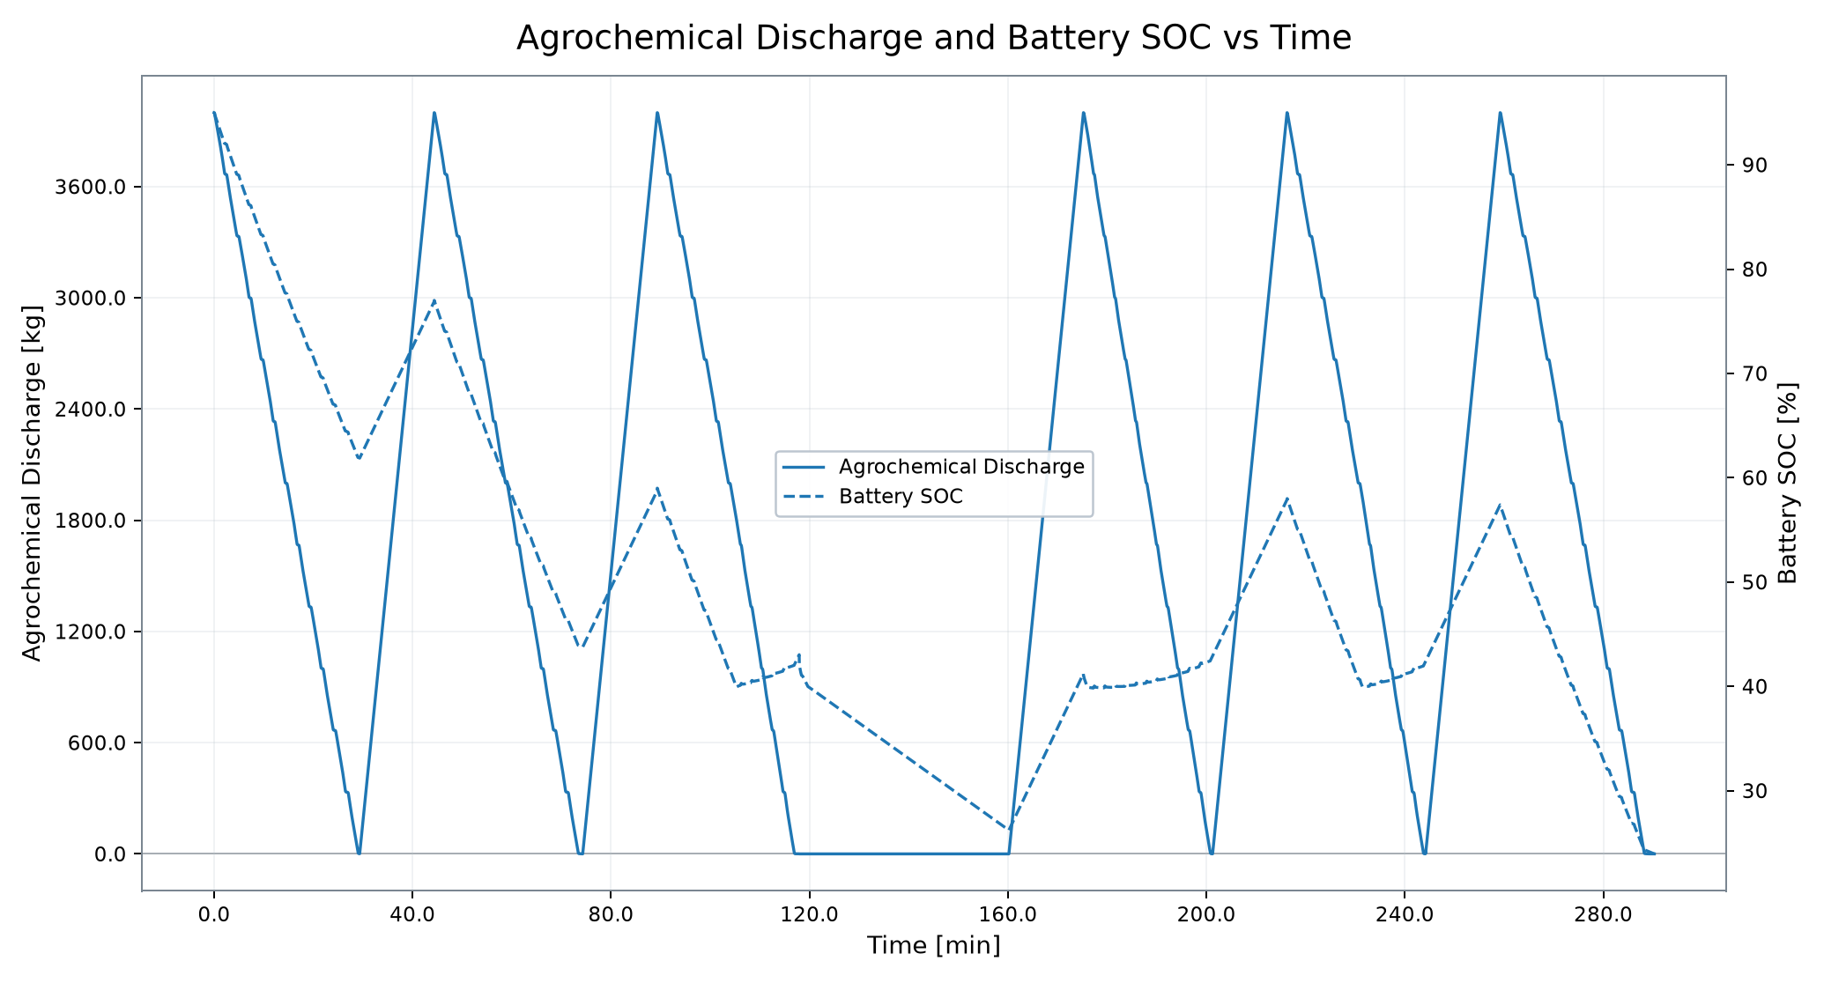
Auxiliary and Tyre Energy Demand
Fallback profile view selected because agrochemical discharge is inactive
MAX AUX POWER
AUX ENERGY
TYRE RR ENERGY
FINAL BATTERY SOC
MISSION TIME
10.75 kW
11.51 kWh
13.36 kWh
12.69 %
64.20 min
Agrochemical discharge is inactive/all-zero; this slide substitutes configured auxiliary and tyre energy demand.
VSM Engineering Post-Processing Tool · v1.2.10
8 / 10

Slide 9

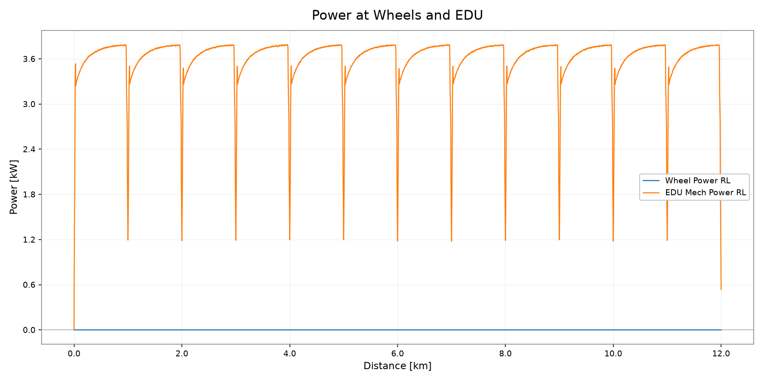
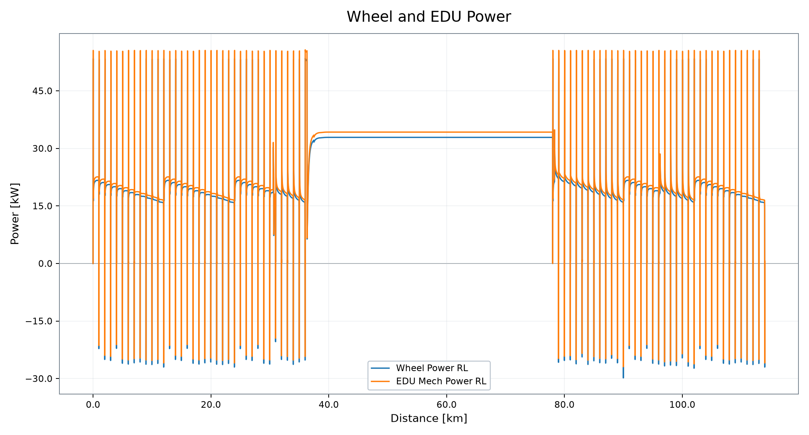
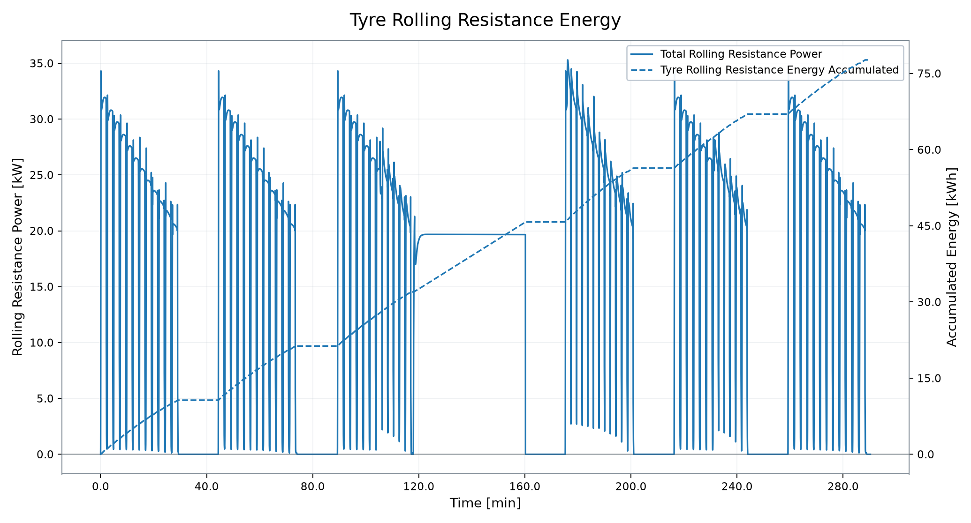
Traction, EDU and Auxiliary Energy Demand
Wheel, EDU, tyre and auxiliary demand from profile plots
EDU MECH POWER
WHEEL POWER
EDU SPEED RL
EDU TORQUE RL
TYRE RR ENERGY
AUX ENERGY
15.17 kW
0.00 kW
58 rpm
737.87 Nm
13.36 kWh
11.51 kWh
VSM Engineering Post-Processing Tool · v1.2.10
9 / 10

Slide 10
Simulation Summary
Deterministic profile result snapshot
DISTANCE
MISSION TIME
FINAL BATTERY SOC
12.00 km
64.20 min
12.69 %
FUEL CONSUMPTION
MAX GEN POWER
ENGINE ENERGY
0.00 kg
0.00 kW
0.00 kWh
Deterministic run covered 12.00 km in 64.20 min. Final battery SOC is 12.69 %. Fuel consumption is 0.00 kg; maximum generator power is 0.00 kW. Resolved ICE/generator channels are inactive/all-zero for this run. Results are deterministic simulation outputs; acceptance conclusions require explicit engineering criteria.
VSM Engineering Post-Processing Tool · v1.2.10
10 / 10

