Slide 1


BPMN Implementation of the Users Life Cycle process
Arcangeli Matteo
Giovanni Michetti
Francesco Feliziani
Nasa Rizoanun
A.Y. 2021/2022

Slide 2
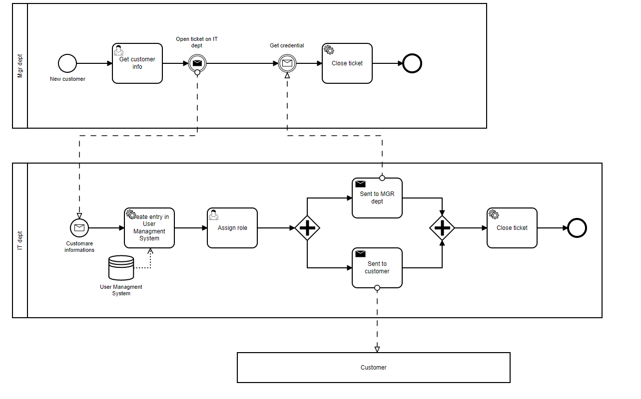
Customer

Slide 3
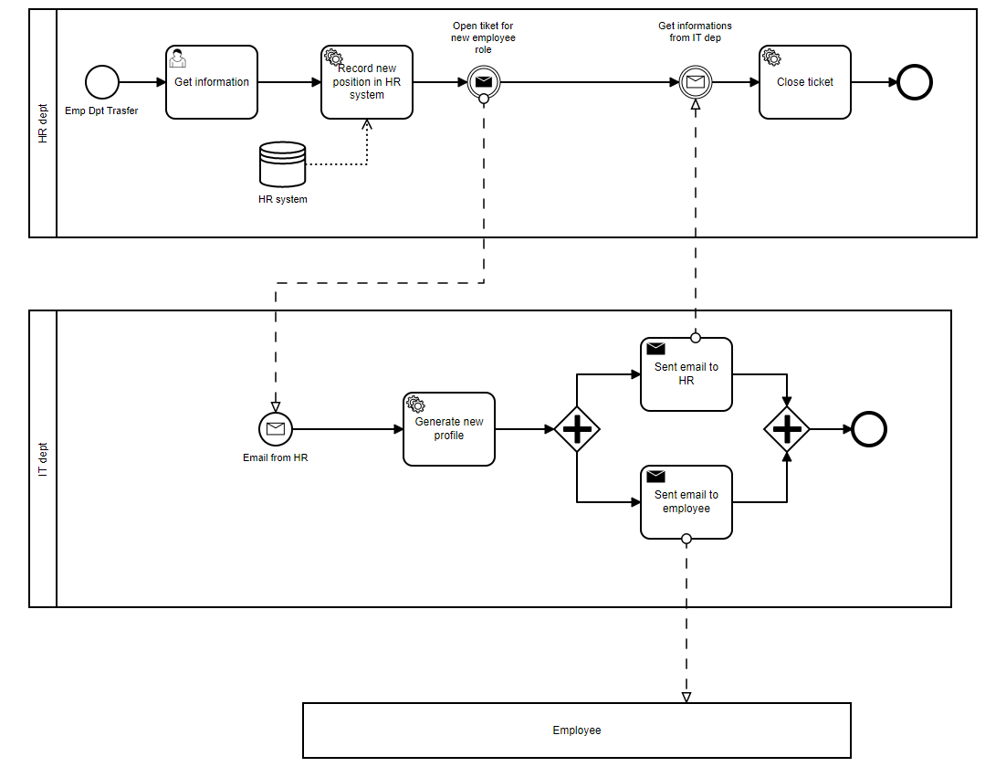
Employee transfert

Slide 4
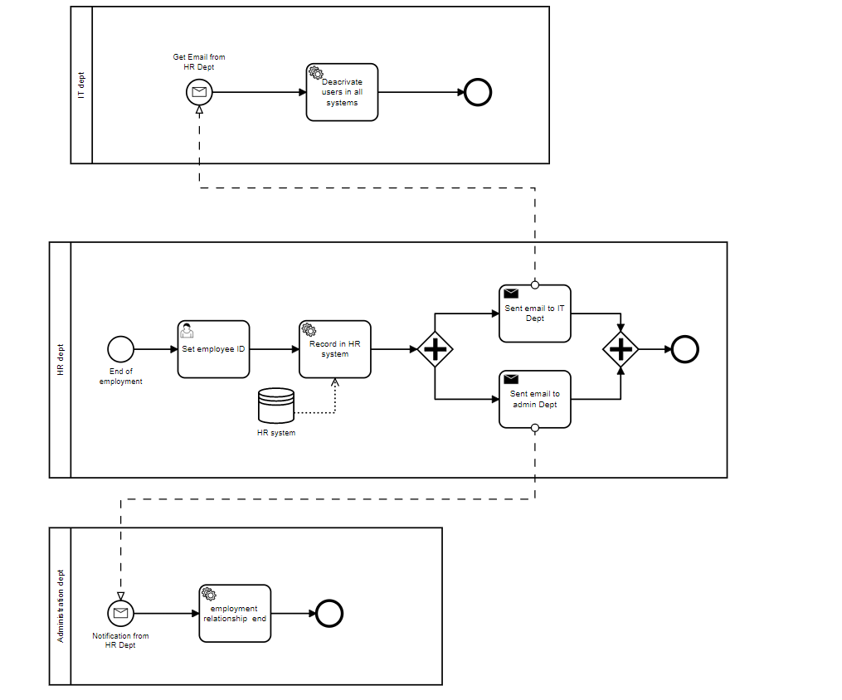
End employment

Slide 5
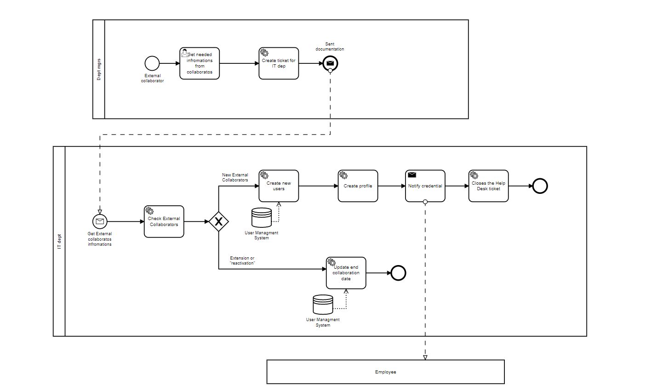
External collaborator

Slide 6
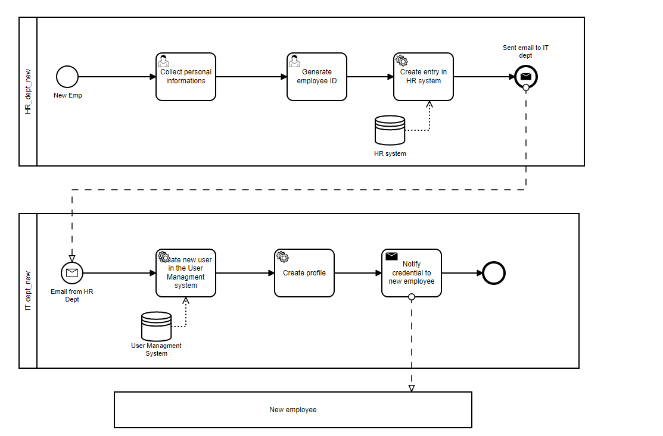
New employee

Slide 7
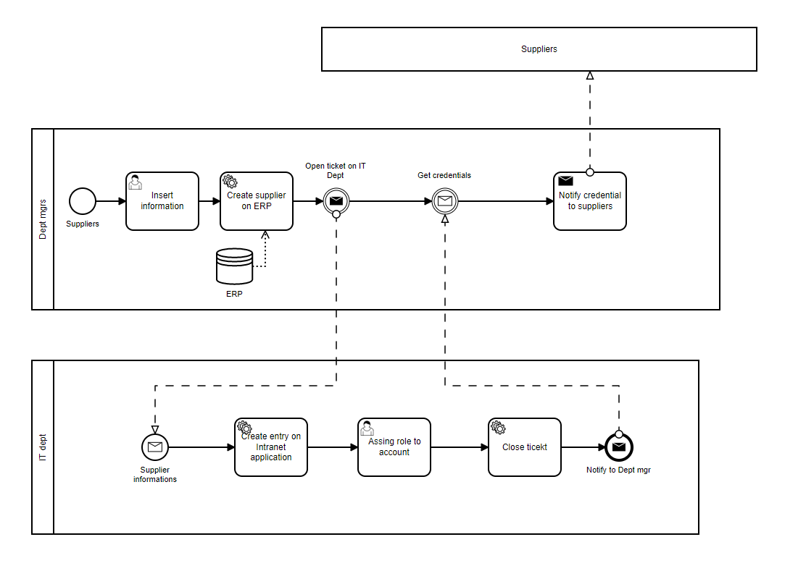
Suppliers

Slide 8

Conclusions and future developments
Thank to this project we made practice of Camunda into a real case provided by Loccioni group
We made practice of BPMN modelling and implementations using Java.

Slide 9
THANKS FOR YOUR ATTENTION!

