Slide 1
CAPTCHA detection with machine learning and computer vision
MC906/MO416 – Final Project

Slide 2
Team
Christian Maekawa
RA - 231867
Giovane de Morais
RA - 192683
Maísa Silva
RA -
Matteus Vargas
RA- 262885
Stéfani Fernandes
RA - 147939

Slide 3
Schedule
Introduction
Concepts
Methodology
Tests
Results
Conclusion

Slide 4
1.
Introduction
Problem and how to solve?

Slide 5
CAPTCHA
Completely Automated Public Turing test to tell Computers and Humans Apart

Slide 6


Introduction
CAPTCHA: distinguish a human from robots;
Visual, sounds, “I’m not a robot”: complexity
SECURITY!!!!
This solution: Decipher CAPTCHAS
Machine Learning
Weak? Complex? Breakable?

Slide 7
2.
concepts
Theoretical basis

Slide 8
Concepts
Machine Learning
Supervised Learning
Computer Vision
Convolutional Neural Networks (CNN)
Activation Function
ReLU
Softmax
Sigmoid
Optimization
Adam
Dropout
Overfitting
Confusion Matrix
Tools
Tensorflow
Keras
OpenCV
Scikit-learn

Slide 9
3.
Methodology
What was done and how?

Slide 10
Methodology
Datasets creation
Pre-processing
Neural Network
Training

Slide 11
Methodology
Dataset creation
Gerador_de_captcha.py
Random
99910 images
Permutation
100029 images
Test
19976 images
Pre-processing
OpenCV
Resize
From 60x160 to 30x80
Grayscale
Send to neural network

Slide 12
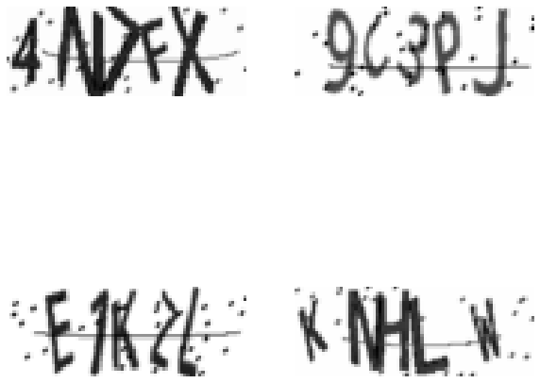
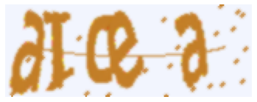

Slide 13
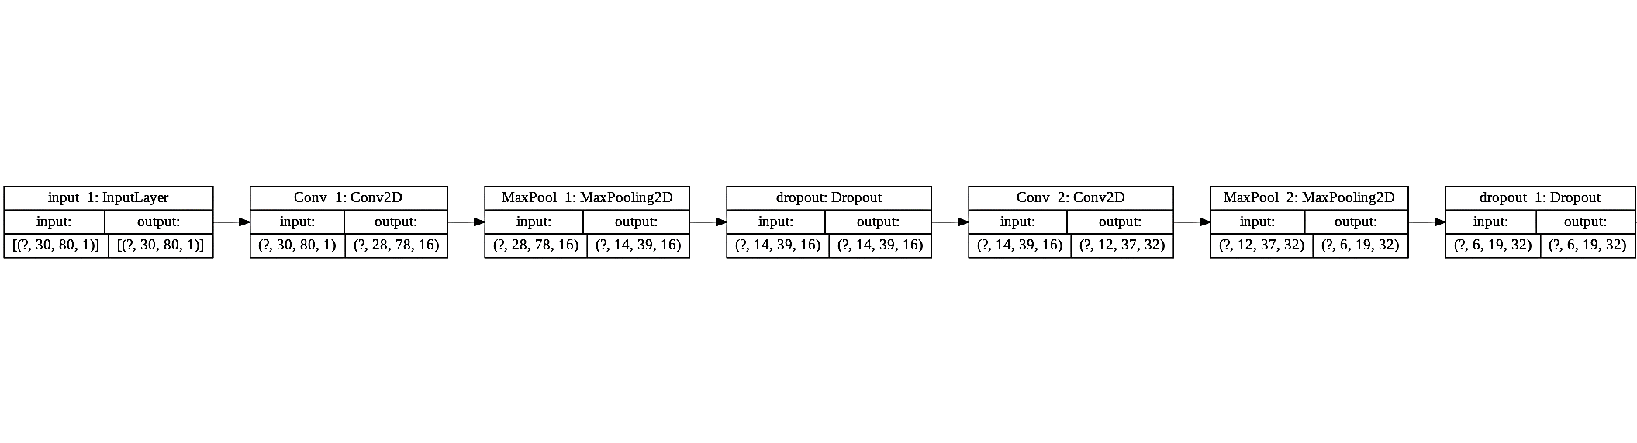
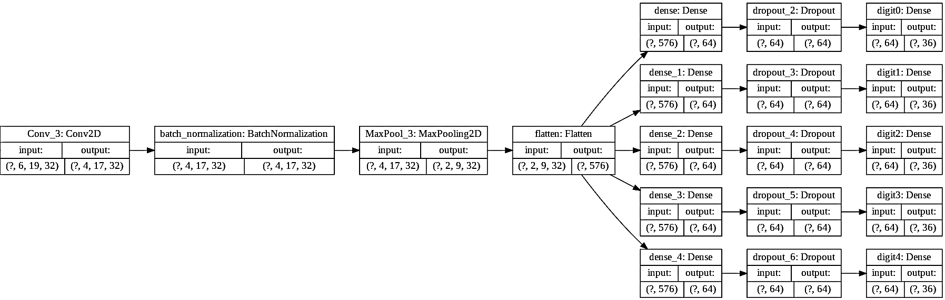

Slide 14
Methodology
Neural Network CNN Layers
Input: Instantiation, image shape
Three Convolutional layers: ReLU + kernel initalization + no padding
First layer: 16 filters
Second and third: 32 filters
Three pooling layers: reduce data representation (Maxpooling)
Dropout layers: 0.1, 0.2 and 0.5
Batch normalization: normalize activation
Flatten: flat the next input
Dense: fully connected layer with five outputs. Sigmoid function
Compilation: Adam; Accuracy metric

Slide 15
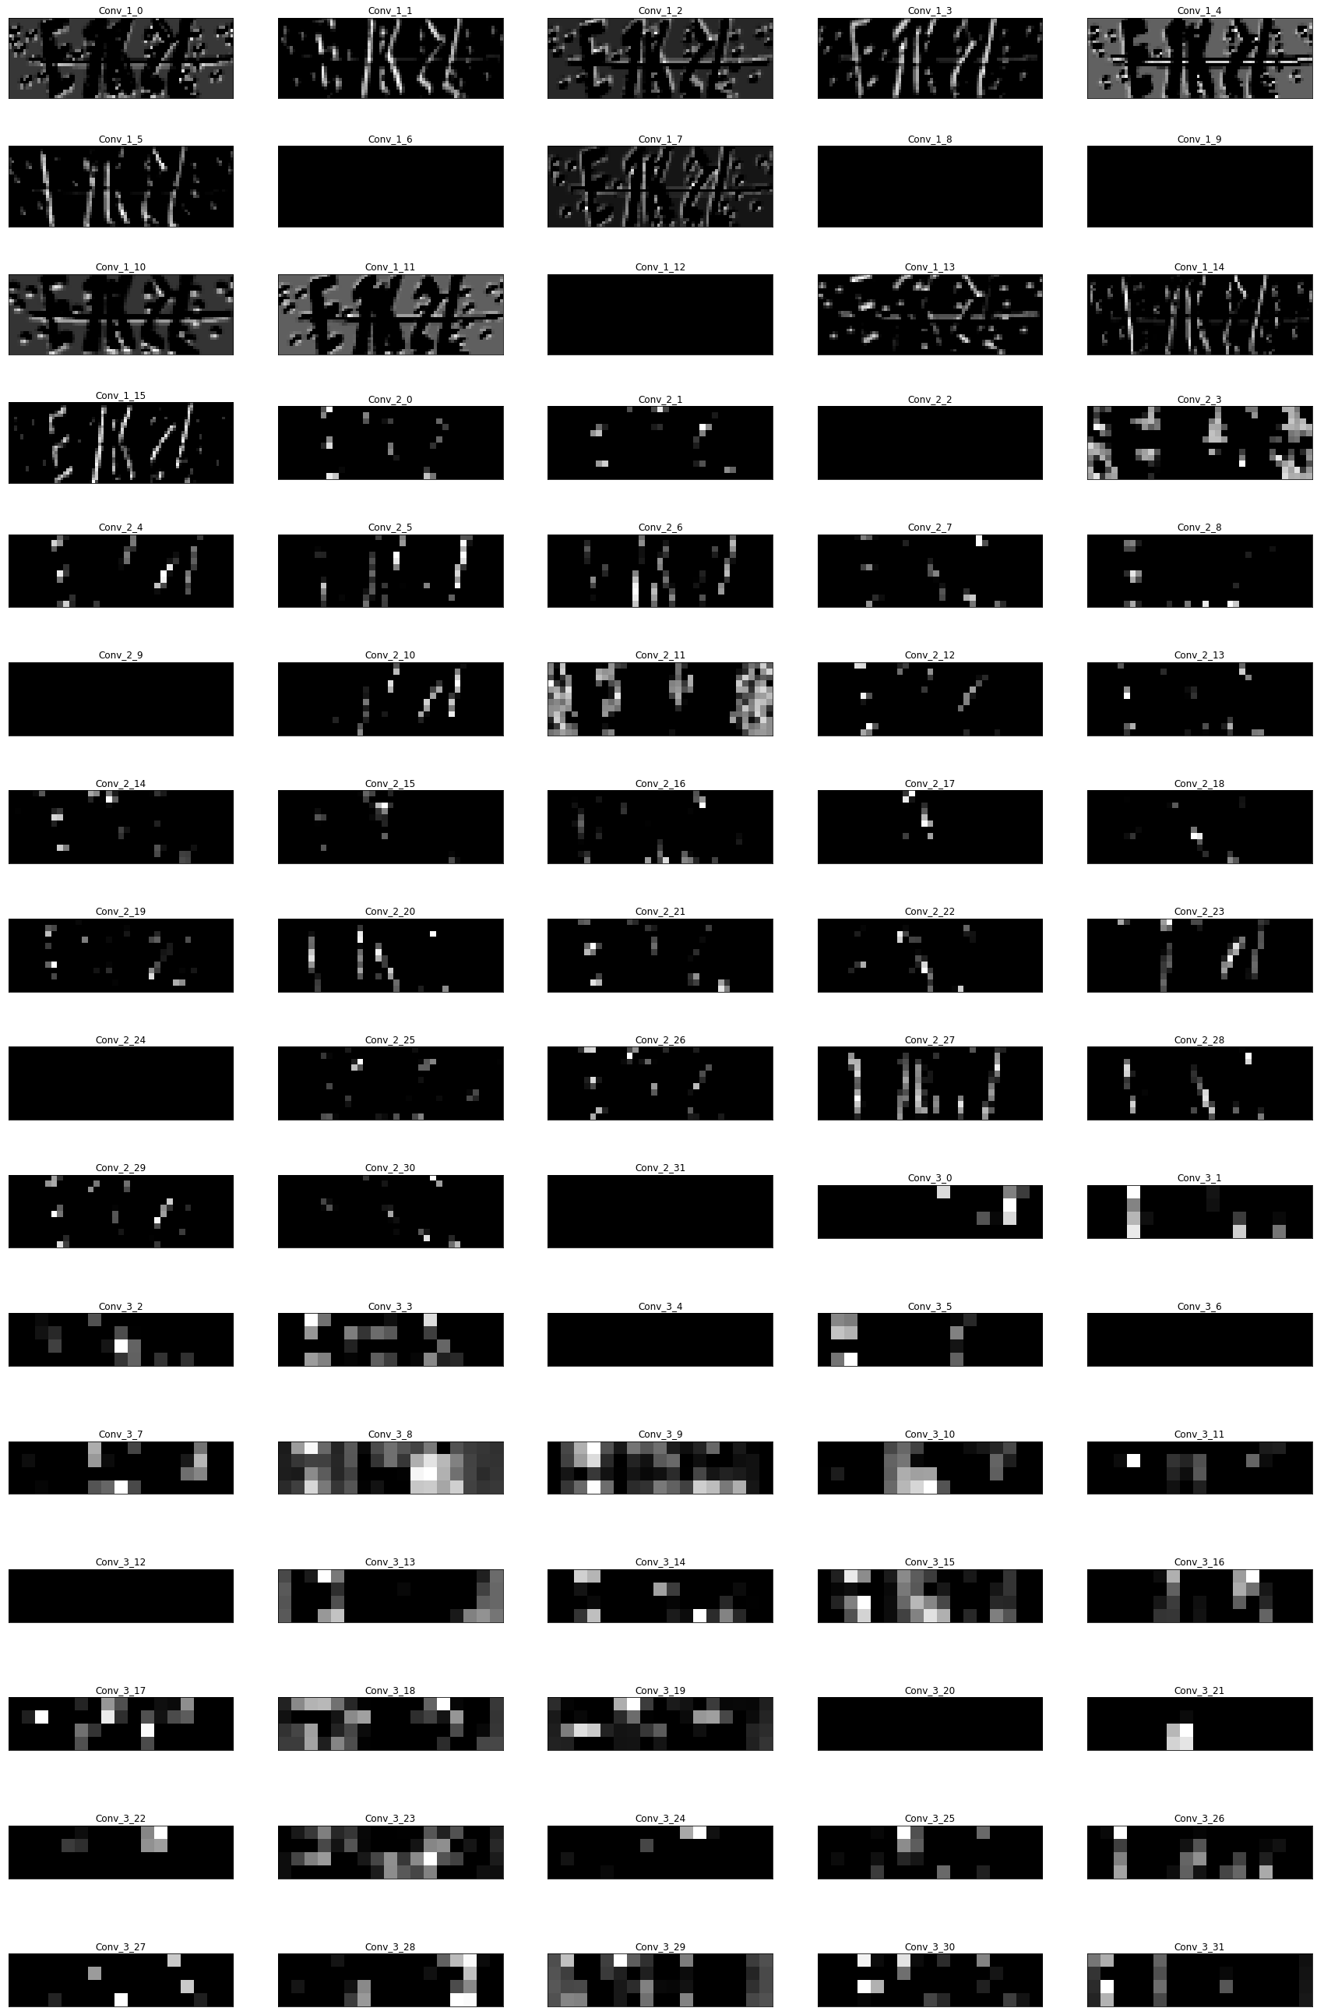

Slide 16
Methodology
Training: Baseline
Epochs: 500
Batch Size: 1000
Validation Split: 0.2
Callbacks:
Early stopping: 200 patience

Slide 17
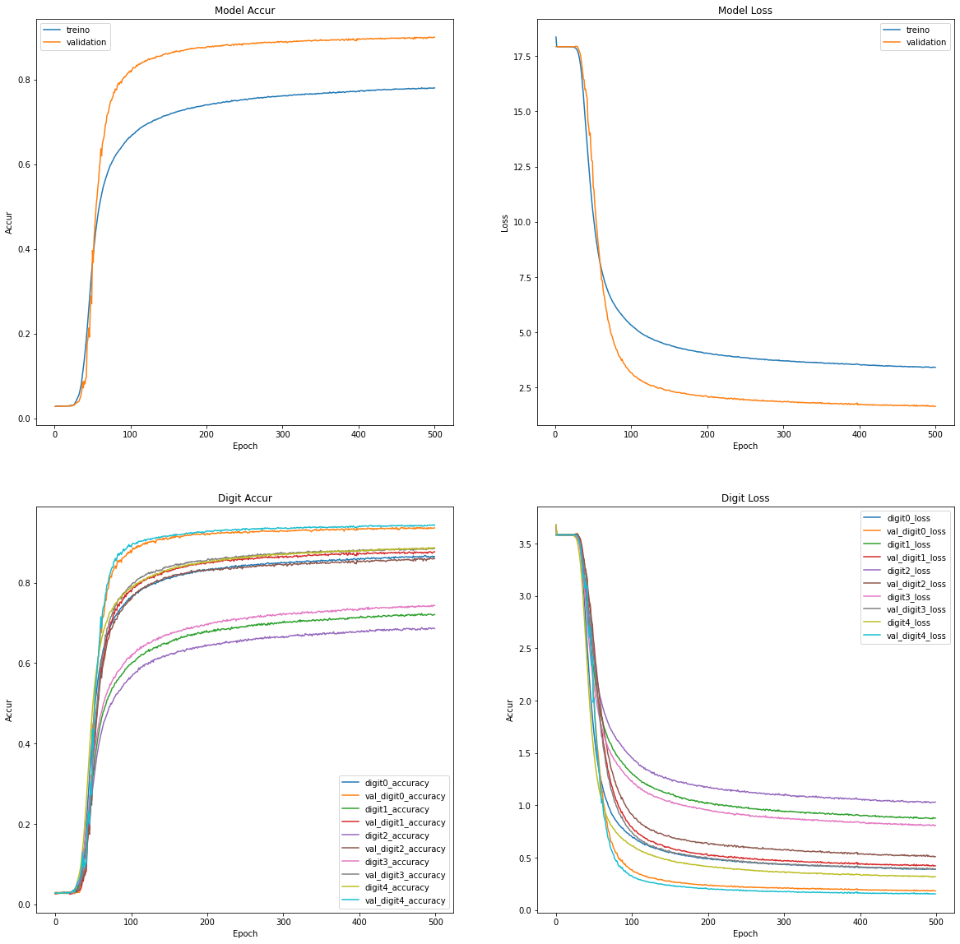

Slide 18
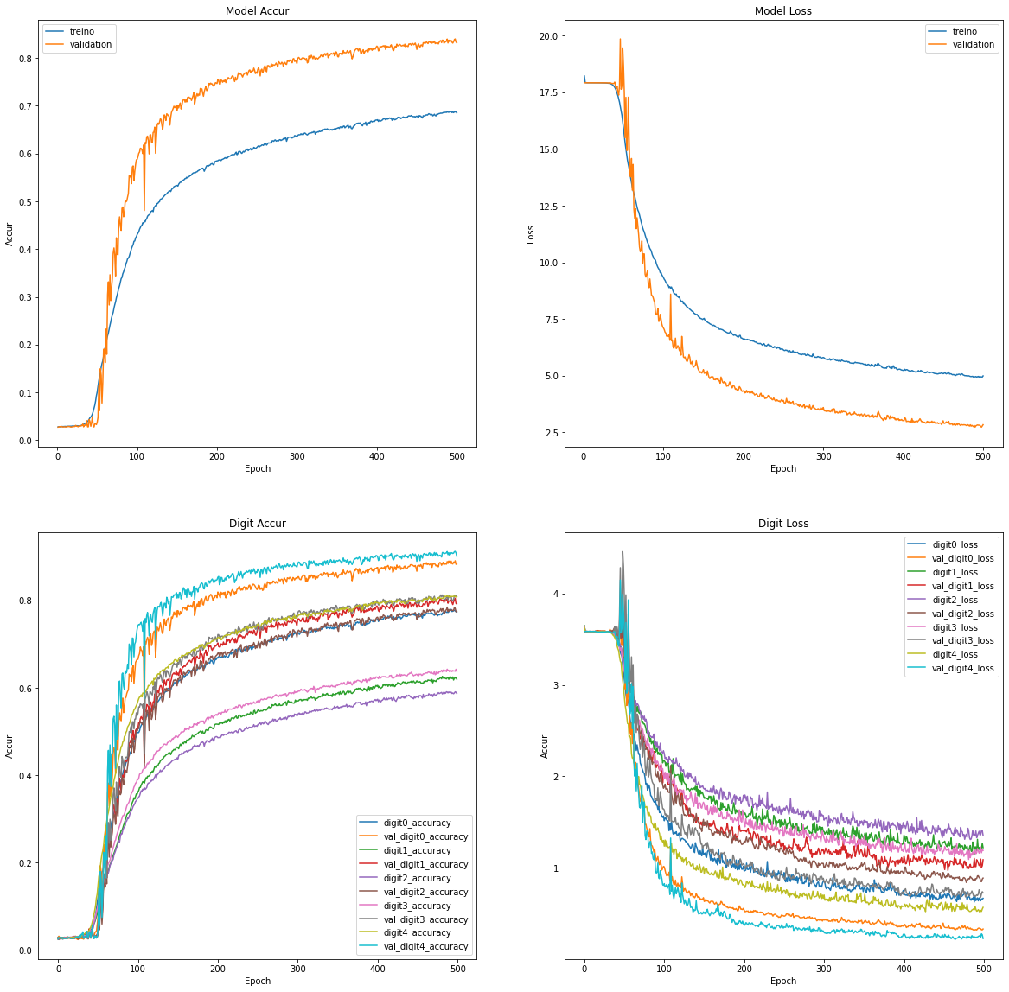

Slide 19
4.
Tests
Let’s evaluate the solution and its possibilities

Slide 20
Tests
Google Colaboratory
Questions:
Are there better scenarios?
If varying hyperparameters influences the final result?
Do datasets influence?
What is the role of dropout?
Determine the best combination and its scenario
Here, we focus on the Dense layer forward

Slide 21
Baseline Test
Digit | Random | Permutation
1 | 0.94 | 0.88
2 | 0.88 | 0.80
3 | 0.86 | 0.77
4 | 0.88 | 0.81
5 | 0.94 | 0.90
Total | 0.90 | 0.83

Slide 22
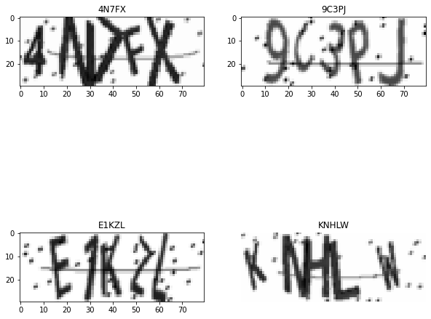
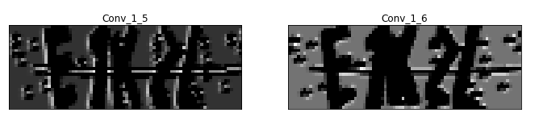


Slide 23
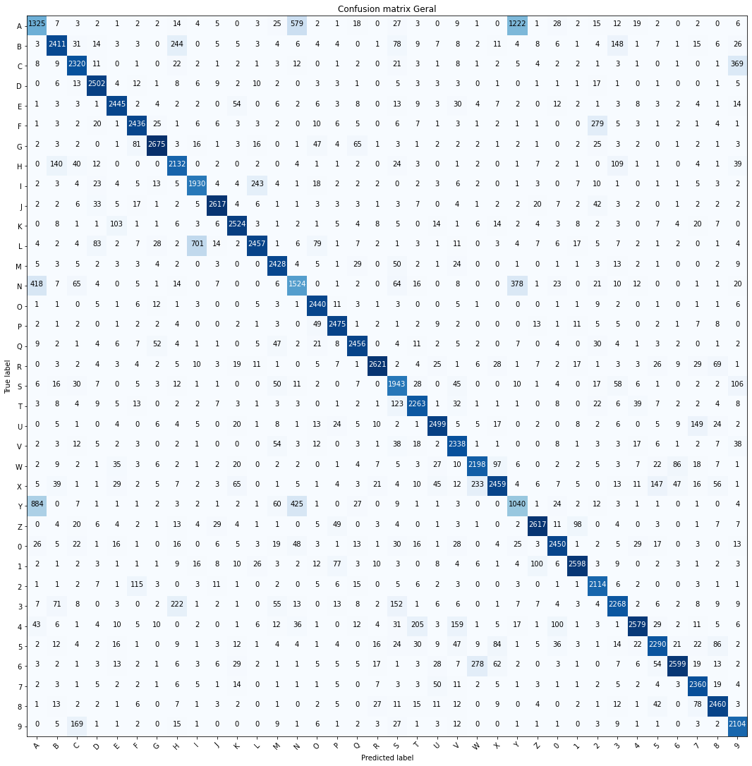

Slide 24
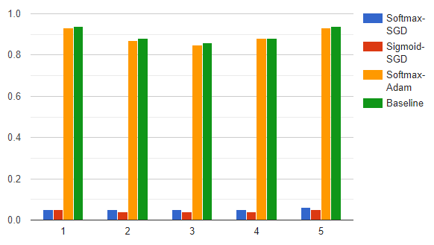
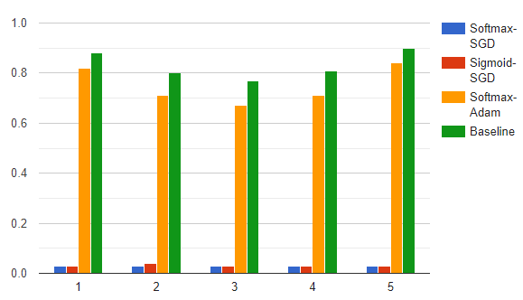
Activation + Optimizer

Slide 25
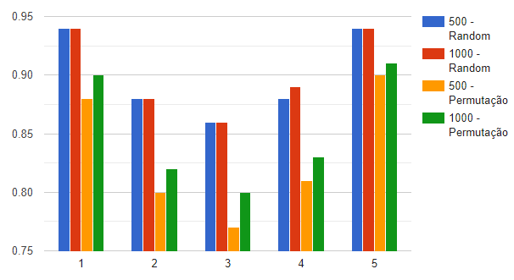
Traning parameters

Slide 26
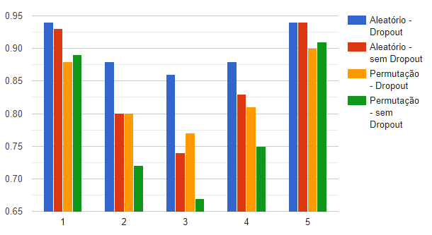
dropout

Slide 27
4.
Results
Let’s evaluate the solution and its possibilities

Slide 28
Results
The baseline proved to be very good for the random dataset and good for the permutation
Adam works!
Permutation needs more epochs: from 83% to 85%
Extremes are easy, the medium needs dropout
Permutation is more challenging: specific configuration
Best configuration:
1000 Epochs + Sigmoid + Adam +Dropout

Slide 29
Results
Reference | Accuracy
Wei et al. | 98.43%
Noury et al. | 98.3%
Goodfellow | 97.4%
Yu et al. | 92.37%
Proposal | 90% (random)/85%(permutation)

Slide 30
References
L. Wei, X. Li, T. Cao, Q. Zhang, L. Zhou, and W. Wang, “Research on optimization of captcha recognition algorithm based on svm,” in Proceedings of the 2019 11th International Conference on Machine Learning and Computing, 2019, pp. 236–240.
Noury and M. Rezaei, “Deep-captcha: a deep learning based captcha solver for vulnerability assessment,” arXiv preprint arXiv:2006.08296,2020.
J. Goodfellow, Y. Bulatov, J. Ibarz, S. Arnoud, and V. Shet, “Multi-digit number recognition from street view imagery using deep convolutional neural networks,”arXiv preprint arXiv:1312.6082, 2013.
N. Yu and K. Darling, “A low-cost approach to crack python captchas using ai-based chosen-plaintext attack,” Applied Sciences, vol. 9, no. 10,p. 2010, 2019

Slide 31
Thanks!
Any questions?

