Slide 1




Compound heat–drought events as datable
early-warning signals for arbovirus outbreaks
Causal evidence from Northeast Brazil
Mattheus Rodrigues da Silva¹ · Tatiane Almeida de Menezes¹ · Rafaela Camila da Silva Ferreira¹ · Celina Maria Turchi Martelli² · Noêmia Teixeira de Siqueira-Filha³
¹ Universidade Federal de Pernambuco, Brazil · ² Instituto Aggeu Magalhães, Fiocruz, Brazil · ³ University of York, UK
SCS23 LB — Late Breakers · Monday 7 September 2026 · Auditorium II
Notes:
Good afternoon. I am Mattheus, from the Federal University of Pernambuco in Brazil. I will show you what happens to notifications of dengue, chikungunya and Zika when extreme heat and drought hit the same place in the same month — and why that coincidence can be used as an early-warning signal. (≈30 s)

Slide 2
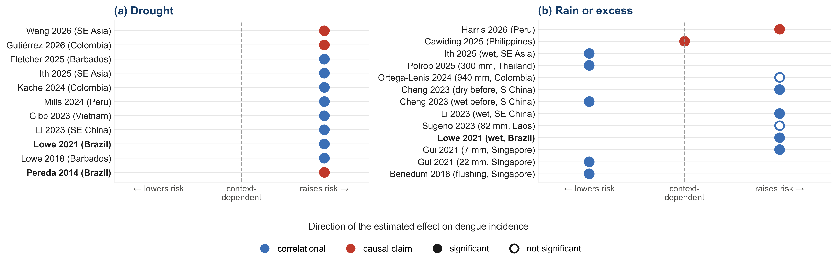
Why this matters for One Health
2
• Climate change is making the co-occurrence of extreme heat and drought more frequent.
• Whether this compound exposure worsens the burden of dengue, chikungunya and Zika is unclear: drought is confounded with heat, deprivation and seasonality.
Our question
Does the coincidence of extreme heat and drought causally increase the notified incidence of urban arboviruses? “Causal” in the design sense: exogenous, datable shocks — not the biological mechanism.
What the literature finds: consensus on the dry side, disagreement on the wet side — almost all correlational; the causal claims rely on synthetic control, causal discovery or causal machine learning — none identifies drought from exogenous, datable variation.
9th World One Health Congress · Lisbon 2026 · SCS23 LB · Abstract 2669
Notes:
Climate change is making compound extremes — heat and drought together — more frequent. Whether that worsens the arbovirus burden is unclear, because drought comes bundled with heat, poverty and seasonality. Here is what the literature finds. On the dry side, panel a, eleven studies all point the same way: drought raises risk. On the wet side, panel b, the picture is mixed: rain raises risk in some settings and flushes breeding sites in others. And almost all of this is correlational. Three studies do claim a causal effect, by synthetic control, causal discovery and causal machine learning. None of them identifies drought from exogenous, datable variation. That is the gap we fill. Our question is causal in the design sense — exogenous, datable shocks, not the biological mechanism: does the coincidence of extreme heat and drought raise the notified incidence of dengue, chikungunya and Zika? (≈60 s)

Slide 3
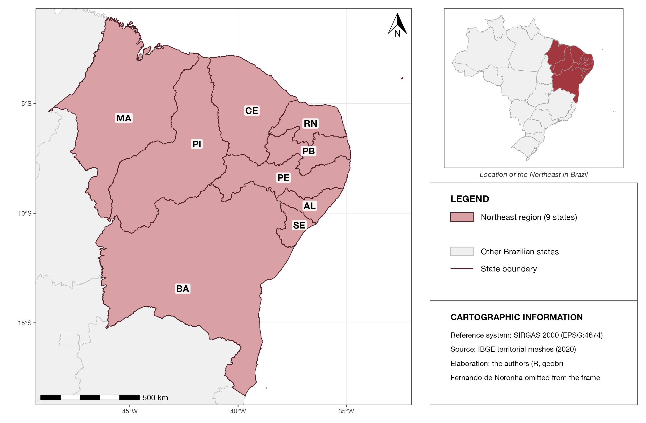
Setting: Northeast Brazil, a semi-arid, high-burden region
3
• All 1,786 municipalities of the nine Northeast states
• Monthly panel, January 2015 – February 2020 (about 110,000 municipality-months)
• Outcome: notified urban arboviruses (dengue, chikungunya, Zika) per 100,000 — national surveillance system
• Climate from a daily gridded dataset, aggregated to each municipality
• The interior (semi-arid) is the most populous dry region on Earth: recurrent drought, intermittent water supply
9th World One Health Congress · Lisbon 2026 · SCS23 LB · Abstract 2669
Notes:
The setting is Northeast Brazil: 1,786 municipalities, monthly, 2015 to early 2020 — about 110 thousand municipality-months. The outcome is the notified incidence of dengue, chikungunya and Zika, from the national surveillance system, taken together because the three share the same vector, Aedes aegypti. The interior is semi-arid: the most populous dry region on the planet, where drought is recurrent and water supply intermittent. (≈40 s)

Slide 4
What counts as a compound heat–drought shock
4
EXTREME HEAT
METEOROLOGICAL DROUGHT
At least 3 days in the month with maximum temperature above the municipality's own 90th percentile
+
One-month SPEI below −1: the month's water balance (rain minus evaporation) more than one standard deviation below the local norm
• Both in the same month → the municipality enters the shock state; the exposure is lagged one month (incubation and reporting delay).
• The shock switches on and off: it is datable, recurrent and plausibly exogenous — weather, not a decision anyone announces.
• Thresholds are external climatological conventions, fixed before estimation.
9th World One Health Congress · Lisbon 2026 · SCS23 LB · Abstract 2669
Notes:
The shock is defined by two climatological conventions: at least three days above the local 90th percentile of maximum temperature — heat relative to each place's own climate — and one-month SPEI below minus one, meteorological drought. When both happen in the same month, the municipality is in the shock state; we lag it by one month. The key property: it switches on and off, it is datable, and nobody can anticipate it. (≈50 s)

Slide 5
How we isolate the effect (in plain terms)
5
• Each municipality is compared with itself: its incidence after the shock versus just before it (municipality fixed effects).
• That change is then set against the change, over the same months, in similar municipalities not (yet) shocked — same state, same climate zone — so seasonal and regional waves cancel out.
• We follow this double difference from the month before the shock up to 12 months after.
• Modern difference-in-differences, robust to staggered and recurrent shocks (de Chaisemartin & D'Haultfœuille).
• Six pre-shock placebo months test whether the two groups were already diverging before the shock.
Why we call it causal
By causal I mean the design, not the biology: exogenous, datable shocks; each municipality as its own control; flat pre-trends; negative-control exposures (heat alone, drought alone); a permutation test.
It is the closest you get to a trial when the exposure is the weather.
9th World One Health Congress · Lisbon 2026 · SCS23 LB · Abstract 2669
Notes:
Think of it as a natural experiment run by the weather: no one chooses when heat and drought coincide, so the shocked months are as good as random once we account for place and season. Identification in plain terms: each municipality is first compared with itself — incidence after the shock versus just before it. That change is then set against the change over the same months in similar municipalities, same state and climate zone, that have not yet been shocked, so seasonal and regional waves cancel out. We follow this double difference for a year. It is a modern difference-in-differences estimator built for shocks that are staggered and recurrent. Six placebo months before the shock check that the groups were not already diverging. And this is why I say causal — the design, not the biology: exogenous, datable shocks, each municipality as its own control, flat pre-trends, negative-control exposures and a permutation test. It is the closest you get to a trial when the exposure is the weather. (≈55 s) [Q&A, if asked why not estimate drought controlling for heat: heat and drought are physically coupled — the SPEI already embeds temperature through evapotranspiration — so controlling for heat is a bad control: it blocks part of the very channel we want to measure, and near-collinearity makes the drought coefficient unstable, which is why Wang et al. had to drop temperature. Taking the compound as one exogenous shock avoids separating two collinear dimensions.]

Slide 6
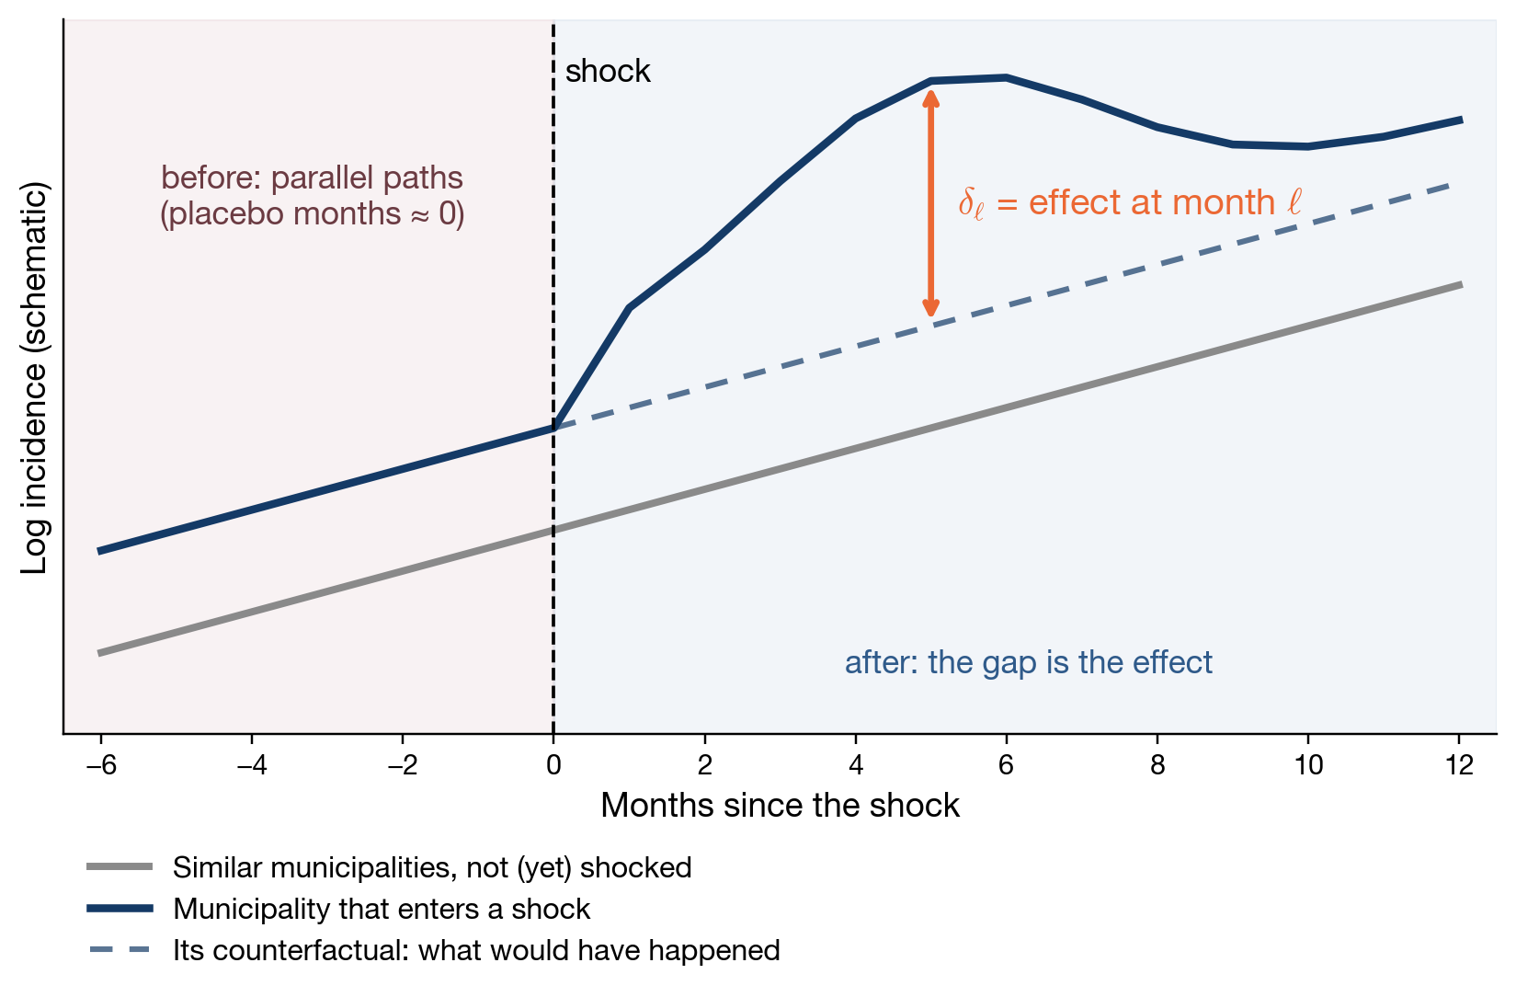
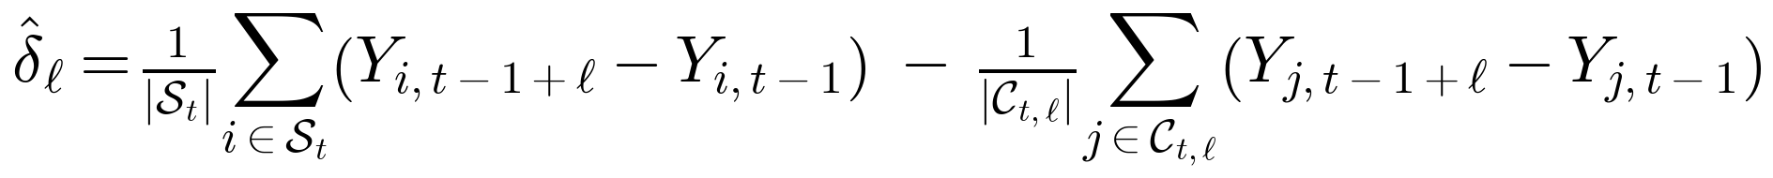
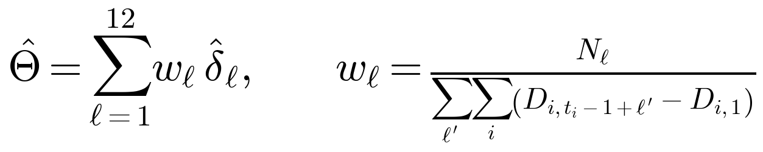
The estimator: one picture, three equations
6
Shock and treatment state (lagged one month)
Dynamic effect at horizon ℓ: a difference in differences
Total effect over 12 months (dCDH 2024 weights)
Identifying assumption: parallel trends in the no-shock state
Y = ln(1 + notified incidence per 100,000). S = switchers entering the shock at t; C = not-yet-shocked municipalities with the same initial state, within the same state × Köppen cell. Trends by state × Köppen; SE clustered by municipality; six pre-shock placebos.
9th World One Health Congress · Lisbon 2026 · SCS23 LB · Abstract 2669
Notes:
For the technically minded, the estimator in one picture and three equations. The picture: the shocked municipality and its comparison group move together before the shock — that is what the placebo months check — and after the shock the gap between the observed path and the counterfactual is the dynamic effect delta-ell. The equations: the shock is heat and drought in the same month, lagged one month; delta-ell is the change in the shocked group minus the change in not-yet-shocked comparables; theta sums the twelve horizons with the de Chaisemartin–D'Haultfoeuille weights; and the identifying assumption is parallel trends in the no-shock state. (≈40 s)

Slide 7
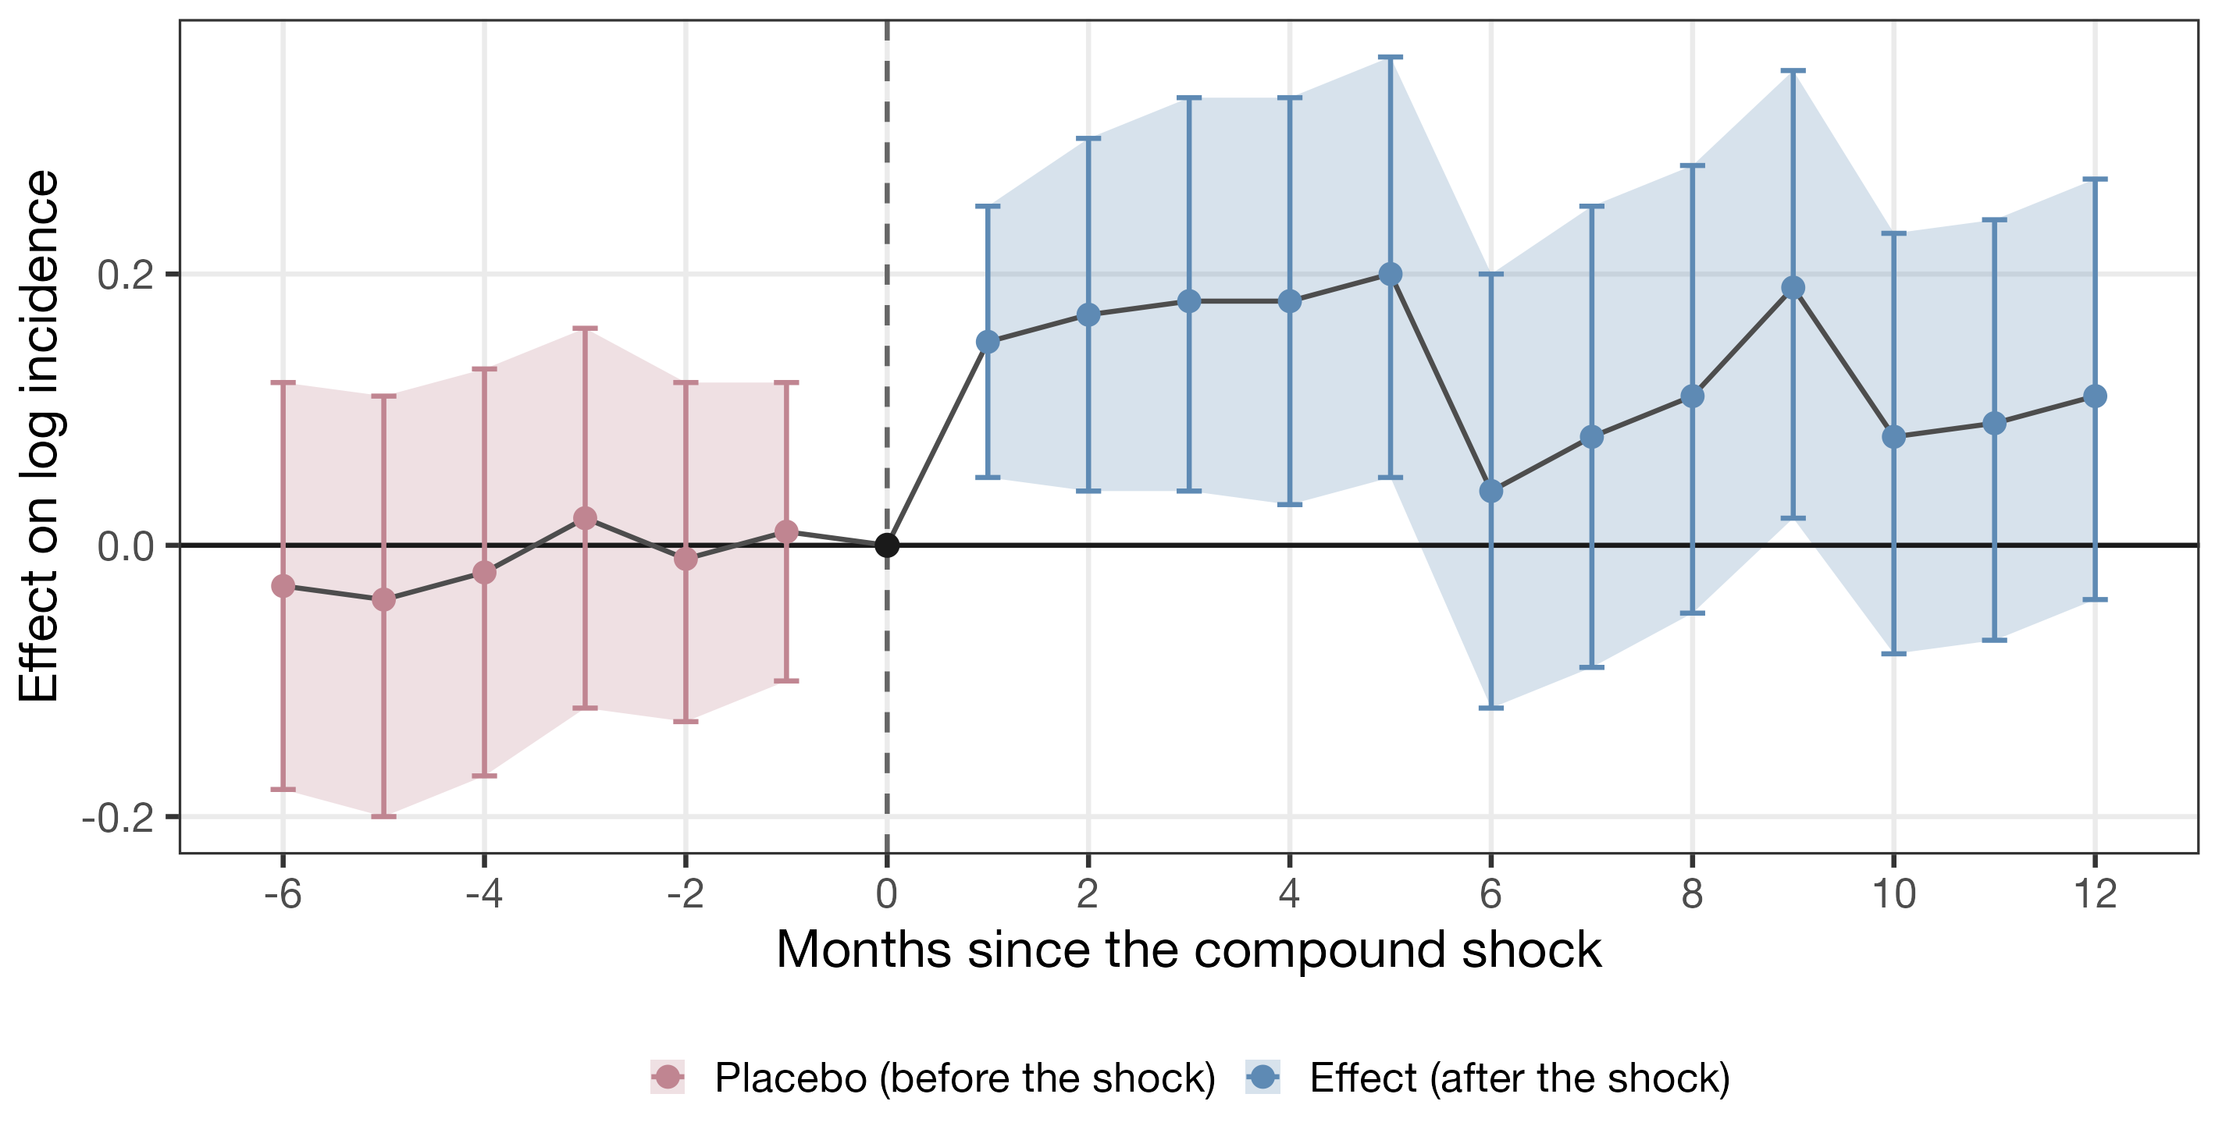
Compound shocks raise notified incidence — with a lag
7
Total effect over 12 months
+1.32
95% CI 0.16 – 2.49 (log points)
• No pre-trend: the six placebo months are jointly indistinguishable from zero
• Lagged: builds over months, peaks around the 5th month
• Transitory: dissipates within a year
9th World One Health Congress · Lisbon 2026 · SCS23 LB · Abstract 2669
Notes:
Here is the main result. Before the shock, in red, nothing: the placebo months are flat and jointly zero. After the shock, in blue, incidence rises, peaks around the fifth month and fades within a year. Summed over twelve months the total effect is 1.32 log points, confidence interval 0.16 to 2.49. Wide, because the compound shock is rare — but clearly positive. (≈50 s)

Slide 8
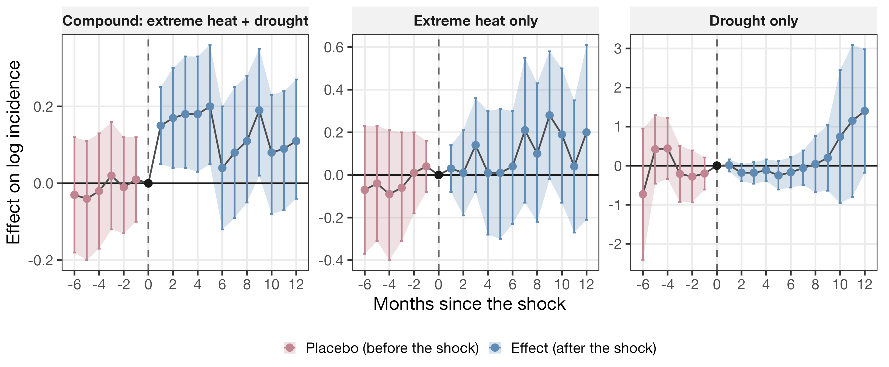
Only the compound moves incidence
8
Extreme heat alone and drought alone produce no discernible effect — despite being far more frequent and better powered than the compound.
9th World One Health Congress · Lisbon 2026 · SCS23 LB · Abstract 2669
Notes:
Is it the heat, the drought, or the coincidence? Same design, three definitions. Heat alone: imprecise, centred on zero. Drought alone: nothing discernible. Only the compound moves incidence — even though each isolated extreme is far more frequent, so has more statistical power. The coincidence is the object. (≈40 s)

Slide 9
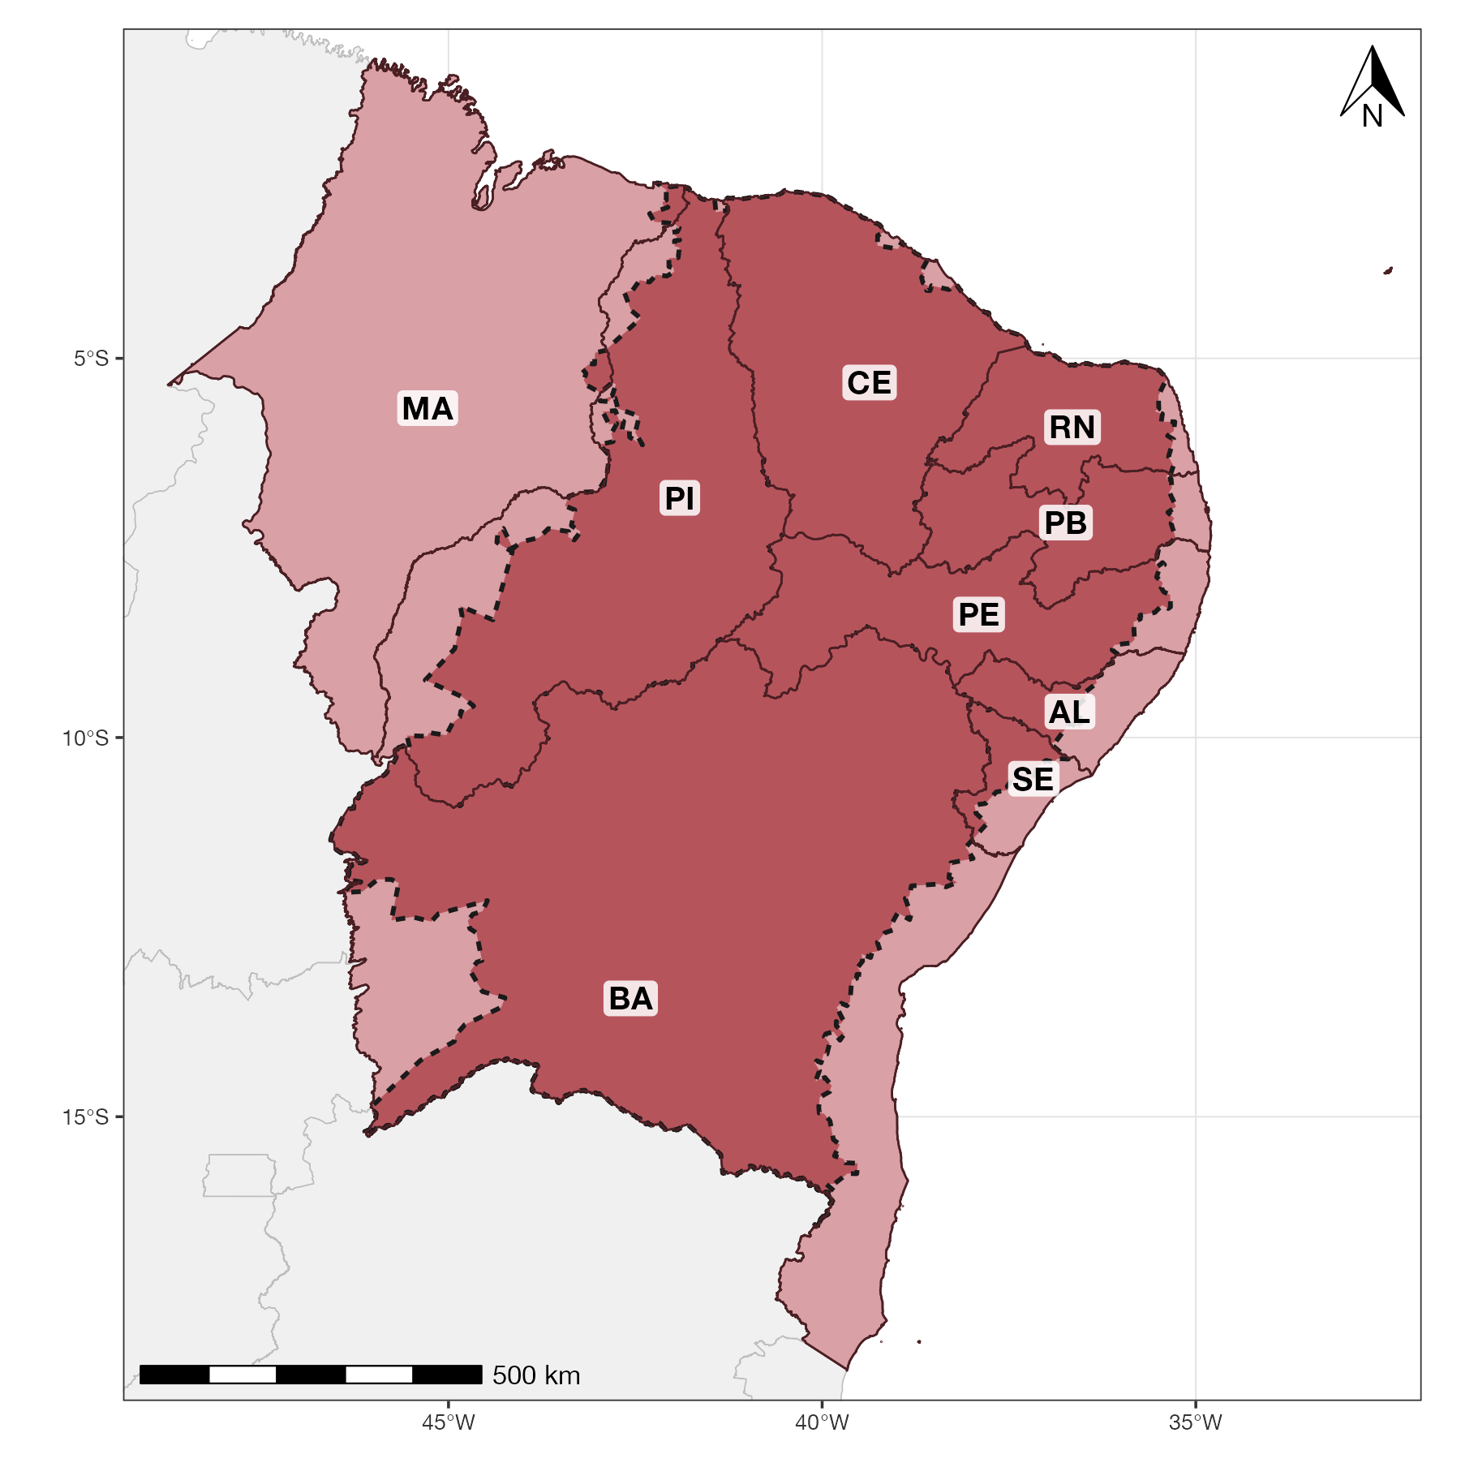
Where and how
9
WHERE
HOW
• The effect concentrates in the semi-arid interior — where drought is recurrent and water storage at home is routine
• Extensive margin: previously quiescent municipalities begin to register cases — existing outbreaks are not amplified
• Consistent with a water-scarcity channel — plausibly household water storage creating breeding sites — which the design does not test directly
• The sign depends on the water regime: in monsoon Southeast Asia the same compound lowers dengue risk (Wang et al. 2026); under recurrent scarcity it raises it.
9th World One Health Congress · Lisbon 2026 · SCS23 LB · Abstract 2669
Notes:
Where and how. The effect concentrates in the semi-arid interior. And it works on the extensive margin: municipalities that were quiet start registering cases; places already in outbreak are not amplified. That pattern is consistent with a water-scarcity channel — people storing water at home when it is dry and hot — although the design does not test that mechanism directly. One more point: the sign of the compound depends on the water regime. Wang and colleagues, in monsoon Southeast Asia, find the same compound lowering dengue risk. Under recurrent scarcity, as here, it raises it. So the finding is located, not universal. (≈50 s) [Q&A, if asked about Wang 2026: three differences. Context — monsoon climate, dengue risk peaking around 460 mm of rain a month, versus a semi-arid panel with about 74 mm a month. Object — they model heat, drought and their overlap as separate terms, so their compound coefficient is the net interaction; our Theta measures the compound event as a whole. Identification — ours is a rare, datable extreme relative to each place's own climatology, not baseline aridity.]

Slide 10
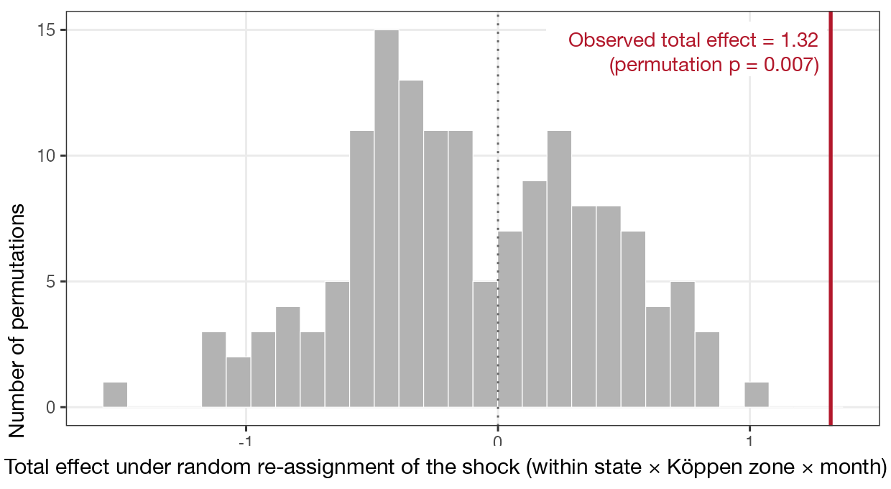
Is it real? Random re-assignment gives nothing like it
10
• Spatial permutation placebo: shocks re-assigned at random within state × climate zone × month, 150 times — observed effect in the tail, p = 0.007
• Robust to finer regional trends
• Robust to alternative drought indices
• Pre-shock placebos jointly zero
9th World One Health Congress · Lisbon 2026 · SCS23 LB · Abstract 2669
Notes:
Robustness in one picture: we re-assign the shocks at random within state, climate zone and month, 150 times. The grey distribution is what you get by chance; the red line is our estimate — in the far tail, p equal 0.007. The result also survives finer regional trends and alternative drought indices. (≈30 s)

Slide 11
What this means for One Health practice
11
A months-long warning window
Water as prevention
Attribution, beyond arboviruses
The effect is lagged and datable: jointly monitoring heat and drought opens a window of several months for pre-emptive, geographically targeted vector control. The trigger is binary and readable in real time from open climate data — no health series or forecasting model needed. And because the effect is on the extensive margin, past outbreak maps are not enough to target it.
Reliable water supply may serve as a complementary preventive margin — the dry arm of the water–arbovirus relationship now has quasi-experimental evidence.
The design attributes the impact of an extreme event in a causal-counterfactual key: factual versus counterfactual incidence after a datable shock. Compound climate extremes can serve as datable, intermittent treatments in One Health causal designs — beyond arboviruses.
9th World One Health Congress · Lisbon 2026 · SCS23 LB · Abstract 2669
Notes:
Three take-aways for practice. First, because the response is lagged and the shock is datable, monitoring heat and drought together opens a window of several months for targeted vector control — you know where and roughly when. The trigger is binary and readable in real time from open climate data; it needs no health series and no forecasting model. And because the effect is on the extensive margin, the map of past outbreaks is not enough: a quiet municipality can become a focus under the shock. Second, reliable water supply becomes a preventive measure in its own right. Third, methodologically, this is an attribution exercise: the impact of an extreme event, factual versus counterfactual, after a datable shock. Compound extremes can be used the same way for other outcomes in One Health. (≈60 s)

Slide 12
Thank you — and disclosures
12
In one sentence
Use of artificial intelligence
When extreme heat and drought coincide, notified arbovirus incidence rises months later — a signal that can be dated, mapped and acted upon.
Generative AI (Claude, Anthropic) was used as a coding and editing assistant: drafting figure and slide layout code and language editing. Study design, data assembly, estimation, results and their interpretation are the authors' own and were verified by them.
Contact
Mattheus Rodrigues da Silva — PIMES/UFPE, Recife, Brazil
mattheus.rodrigues@ufpe.br · +55 (83) 99615-4778
Data: SINAN (Ministry of Health); gridded daily climate (Xavier et al.); IBGE.
9th World One Health Congress · Lisbon 2026 · SCS23 LB · Abstract 2669
Notes:
Thank you. In one sentence: when extreme heat and drought coincide, notifications of dengue, chikungunya and Zika rise months later — a signal that can be dated, mapped and acted upon. I am happy to take questions. (≈15 s)

