Slide 1



Multivariate DEB models
Gonçalo Marques
goncalo.marques@tecnico.ulisboa .pt
MARETEC, LARSyS, University of Lisbon
School: 26 May - 3 Jun 2025
University of Crete, Heraklion, Greece

Slide 2

Possibilities

Slide 3

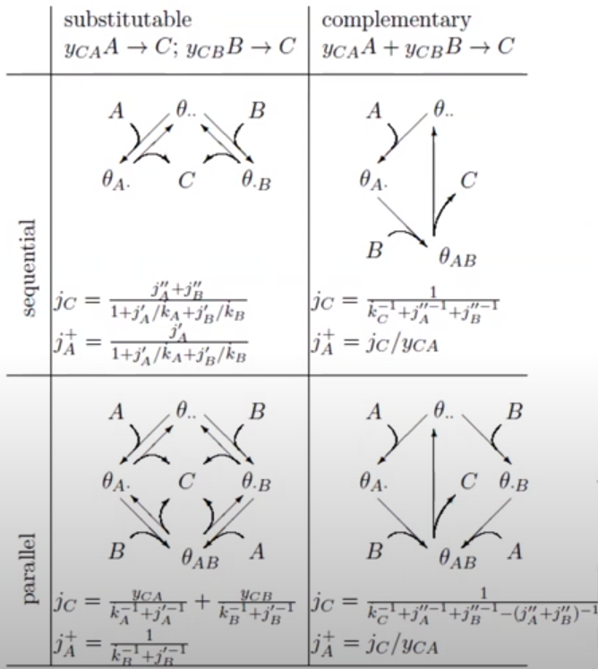

Slide 4
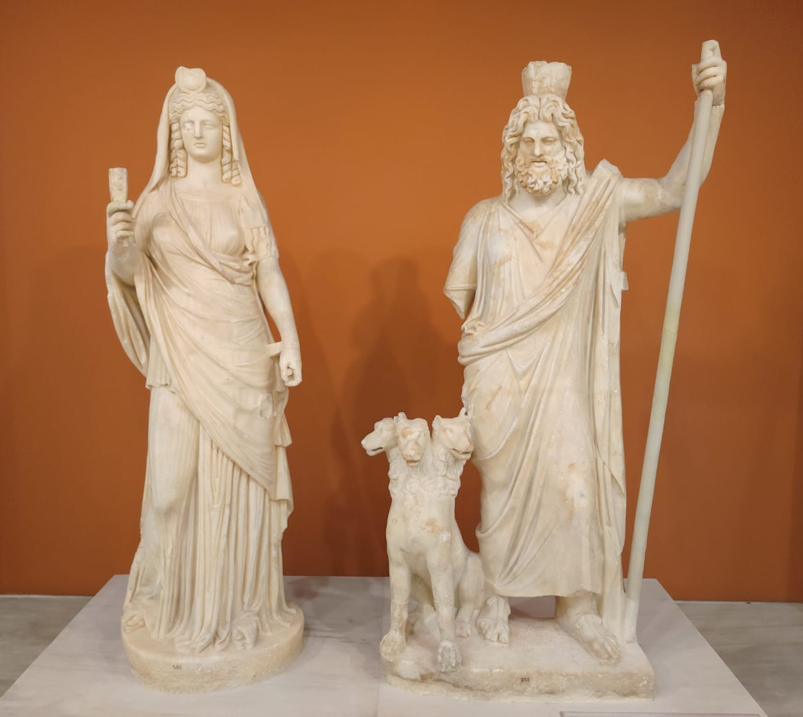


Slide 5

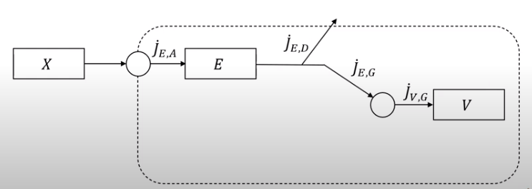

Slide 6
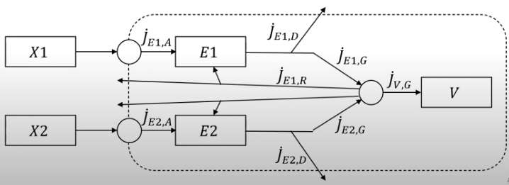

Slide 7

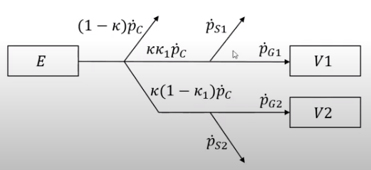

Slide 8

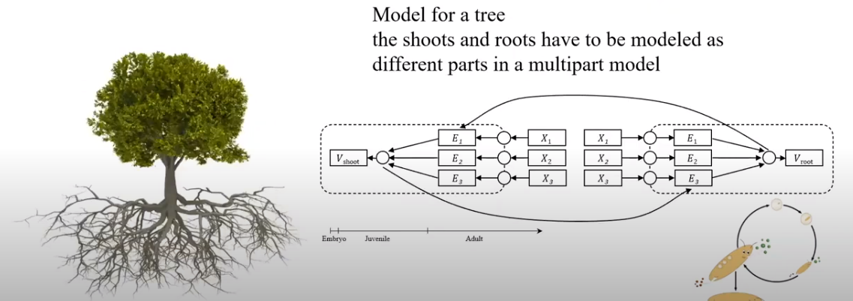

Slide 9
