Slide 1



Welcome & Tele-course summary
Gonçalo Marques
goncalo.marques@tecnico.ulisboa.pt
MARETEC, LARSyS, University of Lisbon
Starrlight Augustine
Romain Lavaud
School: 26 May - 3 Jun 2025
University of Crete, Heraklion, Greece

Slide 2
Outline
Orientation, Structure of the practical course, Objectives
Summary of the tele-course

Slide 3
Orientation
Structure of the practical course
Objectives

Slide 4
Useful resources
Amp Database
DEB Manuals (Book, comments of the book)
Code repositories (GitHub)
Frequent updates (Packages, documentation, pages)
Short videos
Teaching team and DEB experts

Slide 5
Ask questions!
“There are no stupid questions, only stupid answers”
We welcome all questions. With a well formulated question one is 99% on the way to a solution
We all come with a broad spectrum of experience. Cross-disciplinary communication can sometimes be challenging.

Slide 6
Learning Objectives
Formulate a research question
Learn the core DEB concepts and associated alternative concepts
Acquire the skills necessary to estimate DEB parameters using real-world data
Critically evaluate and discuss the biological realism of DEB parameters
Apply DEB (parameter estimation) techniques to support and enhance one's own research projects
Demonstrate the capacity to apply DEB theory to address contemporary issues in conservation, environmental impacts, and resource management

Slide 7
Content of the practical school
"AmP workshop" - estimate parameters for your species (14 h)
"DEB in practice" - guided exercises on applications (11 h)
Lectures (19 h + 1 h)
"Group discussions" - present your discussion topic (6 h)
"Plenary discussions" (2 h)
"Pet presentations" (3 h)

Slide 8

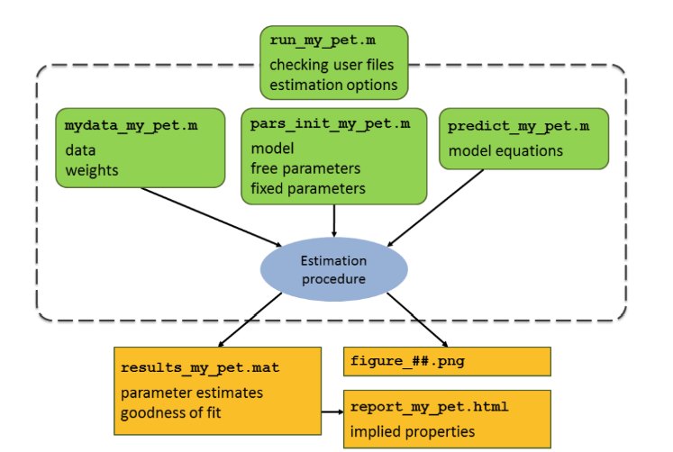
AmP workshop (14 h)

Slide 9

Lectures (19h + 1h)
Multivariate DEB models
https://www.youtube.com/watch?v=w0aAoVj_diU

Slide 10

Group discussion (6 h)
Discuss personal research questions
Group input and feedback
Unstructured discussion on general topic
Topic 1: From formulae to theories – May 26, 27, 28
Topic 2: Good modelling practices – May 30, 31, Jun 02

Slide 11
Plenary discussion (2 h)
Report to everyone the points discussed on general topics
Moderation of debate around the topics
Shuffle groups between topics
May 28 & May 31

Slide 12

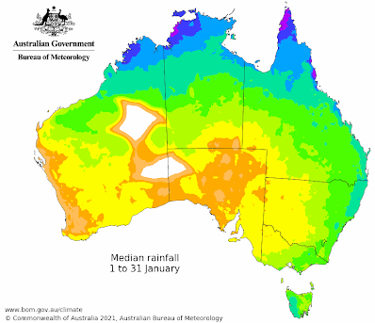






DEB in practice - guided exercises on applications (11 h)
Data
DEB parameters
Life-history
Biophysical modelling
Ecotoxicology

Slide 13
Tele-course Summary

Slide 14
DEB book outline
Chap 1 Chap 2 Chap 3 Chap 4
Individuals
Homeostasis
Temperature
Std DEB model
Body size & composition
Compounds
Macrochemical reactions
Synthesising Units
(Isotopes)…
Uni-variate DEB models
Changing shapes
Products…

Slide 15
Cornerstones of DEB theory
What are the key concepts (Cornerstones) behind DEB theory?
C
H
R
K

Slide 16
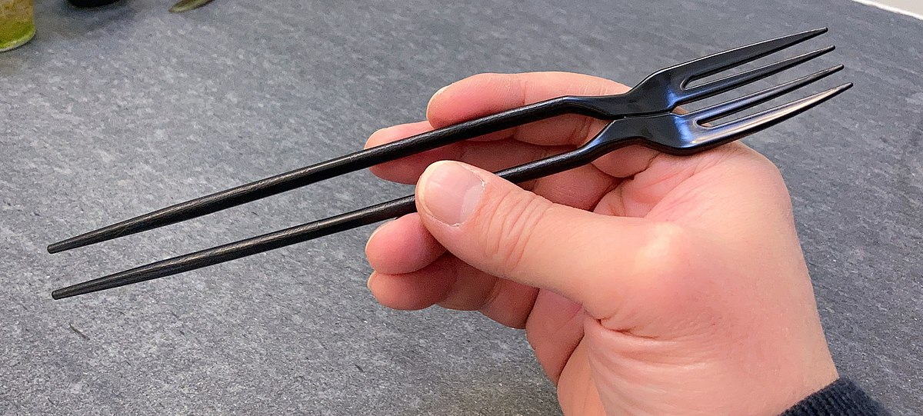

Cornerstones of DEB theory
What are the key concepts (Cornerstones) behind DEB theory?
C
Ho
R
K

Slide 17
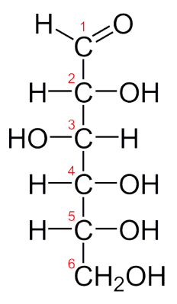
Conservation
C
H
R
K
Exploiting conservation of mass and energy
Energy conservation is straightforward
Mass conservation is not because elements are trapped in molecules and body composition is not homogenous
C-moles concept
C₆H₁₂O₆ 6 C-moles of CH₂O

Slide 18
Homeostasis
C
H
R
K
Strong or Pool
Constant composition of pools (reserves, structures)
Generalized compounds
Stoichiometric constraints on synthesis

Slide 19
Homeostasis
C
H
R
K

Slide 20
Homeostasis
C
H
R
K
Strong or Pool
Constant composition of pools (reserves, structures)
Generalized compounds
Stoichiometric constraints on synthesis
Weak or Constant Food
Constant composition of biomass during growth at constant food
Essential to reserve dynamics

Slide 21
Homeostasis
C
H
R
K
Strong or Pool
Constant composition of pools (reserves, structures)
Generalized compounds
Stoichiometric constraints on synthesis
Weak or Constant Food
Constant composition of biomass during growth at constant food
Essential to reserve dynamics
Structural
Constant relative proportions during growth
Isomorphy

Slide 22
Standard DEB model

Slide 23
Cornerstones of DEB theory
What are the key concepts (Cornerstones) behind DEB theory?
Conservation
Homeostasis
Reserve
Kappa

Slide 24

Other concepts
Notation
Basic transformations
Demand / Supply
Intensive / Extensive
Life cycles

Slide 25
Life-cycles: creating maps
Why are DEB defined life-stages different from terminology used by specialists?
How to model a complex life-cycle?
When does feeding starts?
When is puberty reached?
Is there a metamorphosis?
Complex life-cycles as variations of the standard DEB model “std”

Slide 26
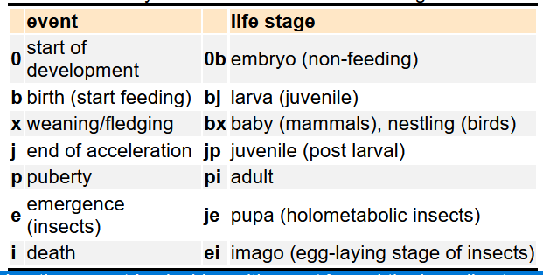
Life-cycles: creating maps

Slide 27

Thank you
Questions ?

