Slide 1

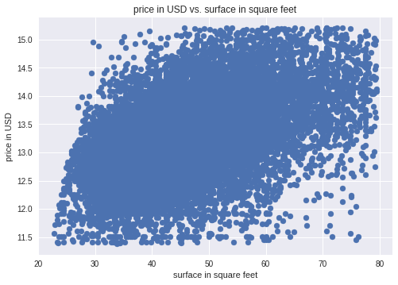
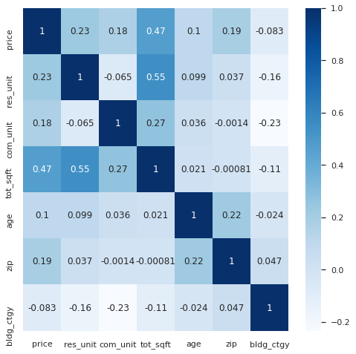
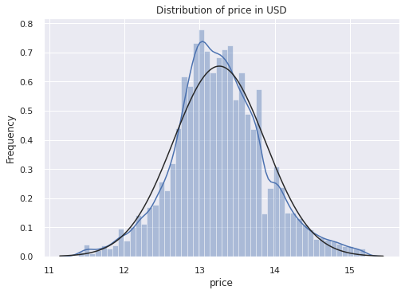
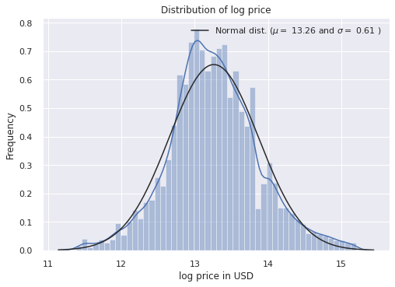
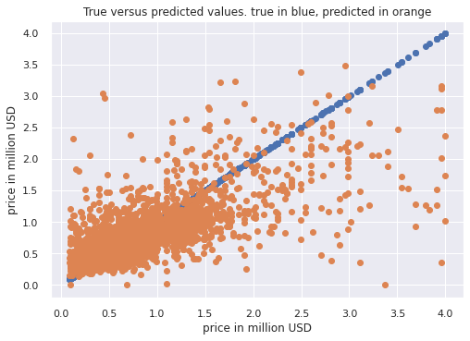




Building a robust regression model on New York City property prices
Algorithms can robustly outperform common approaches on NYC property sale price predictions.
PRESENTER
Matthaeus Hilpold
Background
Can AI outperform junior appraisers in predicting selling prices of NYC properties? If so, time and money can be saved by developing a reliable automated solution. Many have tried, few have succeeded. Here, I discuss my approach.
Methods
Sales data for NYC
Pre-processing & data exploration
Remove incomplete entries and entries with erroneous or irrelevant data. Transform variables. Pick best variables.
Model | R² | MAE (mln. USD)
Linear baseline regressor | 0.23 | 288.05
Linear Kernel Ridge regressor | 0.56 | 189.99
RBF Kernel Ridge regressor | 0.66 | 193.12
Random Forests regressor | 0.53 | 195.24
Combined average boosted regressor | ?? | ??
Outlier removal. Drop extreme data points for square footage and prices. We want the classifier to be robust wrt avg. NYC properties.
Split off test set.
Split off training and validation set.
Train a baseline linear regression model.
Used to benchmark other algorithms.
Train and cross-validate other models.
Evaluate them against the linear regression model.
Combine the models and average their predictions to boost results?
One is strong – but three are stronger? Runtime on my PC exceeds the deadline- unfortunately.
Challenges, Conclusion and Limitations
NYC sale data is very noisy: many properties are sold at 0$, data pertaining to the date and area of the property is often infeasible or missing. Appropriate data cleaning and the right model nonetheless achieve a better and more robust average prediction than the commonly used linear regressors. Human junior appraisers are –however- still better at mitigating these outliers. They are doubly as accurate, with an average 70000$ error, according to REIT (sources on the website – scan the QR code).
PrePrint

