Slide 1
NOW PRESENTING
Oskar
02445 PROJECT REPORT · ORAL DEFENSE
Statistical Evaluation of
Refusal-Direction Ablation in Gemma
Can a single weight edit remove benchmark-measured refusal behavior?
OFFICIAL SORRY-BENCH COMPLIANCE
Matthes M. Fogtmann · Carl Johan von Löwzow
Oliver Illum · Oskar F. Karlsson
Technical University of Denmark
21.4% → 76.6%
github.com/MatthesF/refusal-ablation
Notes:
Oskar opens. Title + the one-line question. 21.4 to 76.6 percent is the whole talk in one number.

Slide 2
NOW PRESENTING
MOTIVATION
Oskar
Refusal is a safety mechanism you can edit
1
Refusal is expected behaviour
THE PROBLEM
Instruction-tuned models should refuse harmful requests while staying useful on ordinary ones.
A model can score well on a fixed refusal benchmark,
yet still rely on a safety mechanism that a cheap, post-hoc weight edit can weaken.
So: how much does the official benchmark score actually depend on that one mechanism?
2
Open weights can be edited directly
Safety is not only about prompts and decoding — for open-weight models the weights themselves are an attack surface.
3
Refusal lives in one direction
Prior work shows refusal is largely mediated by a single direction in activation space (Arditi et al., 2024); “abliteration” removes it (Labonne 2024; Lai 2025).
Refusal-Direction Ablation in Gemma · 02445 Project Report · Technical University of Denmark
02
Notes:
Oskar. Motivation: refusal expected; open weights editable; refusal lives in one direction (Arditi). The point: benchmark score may depend on one editable mechanism.

Slide 3
NOW PRESENTING
RESEARCH QUESTION
Oskar
One narrow, reproducible question
“
If we fit a refusal direction from a small policy-derived dataset and remove it from Gemma's weights, how much does official SORRY-Bench refusal behaviour change?
BASELINE
EDITED
SAME EVALUATION
Untouched
google/gemma-4-E4B-it
Same checkpoint after
one fixed refusal-direction weight edit
440 SORRY-Bench prompts, deterministic decoding,
scored by the official Mistral judge
0 = refusal · 1 = unsafe compliance
Paired design — every prompt is answered once by each model. The goal is to measure the behavioural change, not to build a useful model.
Refusal-Direction Ablation in Gemma · 02445 Project Report · Technical University of Denmark
03
Notes:
Oskar. State the research question verbatim. Two conditions, same 440 prompts, same judge, paired. We measure the change, not build a product.

Slide 4
NOW PRESENTING
METHODS · DATA
Matthes
A direction fit from policy-derived prompts
▸ 480 prompts from the Gemma Prohibited-Use Policy: 12 policy areas × (20 safe + 20 unsafe).
▸ Policy-area-disjoint split: 8 areas (320) fit the direction, 4 areas (160) are held out for stability checks.
▸ Generated with GPT-5.5 Pro, then human-verified. No supervised training or fine-tuning.
▸ Child-related harmful prompts are intentionally excluded from construction (a data-handling choice).
▸ SORRY-Bench (440 prompts, 44 categories) is used only for the final benchmark.
Source
Use
Prompts
Gemma policy prompts
Direction data
480
Construction split
Fit the edit
320
Held-out split
Stability check
160
SORRY-Bench
Final benchmark
440
Construction and benchmark data never overlap.
Refusal-Direction Ablation in Gemma · 02445 Project Report · Technical University of Denmark
04
Notes:
Matthes. 480 policy prompts, disjoint split 320/160. GPT-5.5 Pro + human check. Child content excluded from construction. SORRY-Bench only for final test.

Slide 5
NOW PRESENTING
METHODS · THE EDIT
Matthes
Fit a direction, then remove it from the weights
1
Fit the refusal direction
2
Remove it from the weights
▸ Run each prompt; take the final-token hidden state at every layer.
▸ Direction = mean(unsafe) − mean(safe) activations.
▸ One Gram-Schmidt step removes the component along the safe-prompt mean — a guardrail against erasing benign answering ability — then normalise.
▸ Edit every layer's attention-output and MLP down-projection matrices.
▸ Strip from each weight column the part that writes along the refusal direction.
▸ Restore column norms → norm-preserving edit; one fixed model for all 440 prompts.
r = unit refusal direction per layer
W⊥ = W − r(rᵀW)
Refusal-Direction Ablation in Gemma · 02445 Project Report · Technical University of Denmark
05
Notes:
Matthes. Two steps: fit direction (unsafe minus safe, Gram-Schmidt guardrail) then norm-preserving weight edit on attn-out + MLP down-proj.

Slide 6
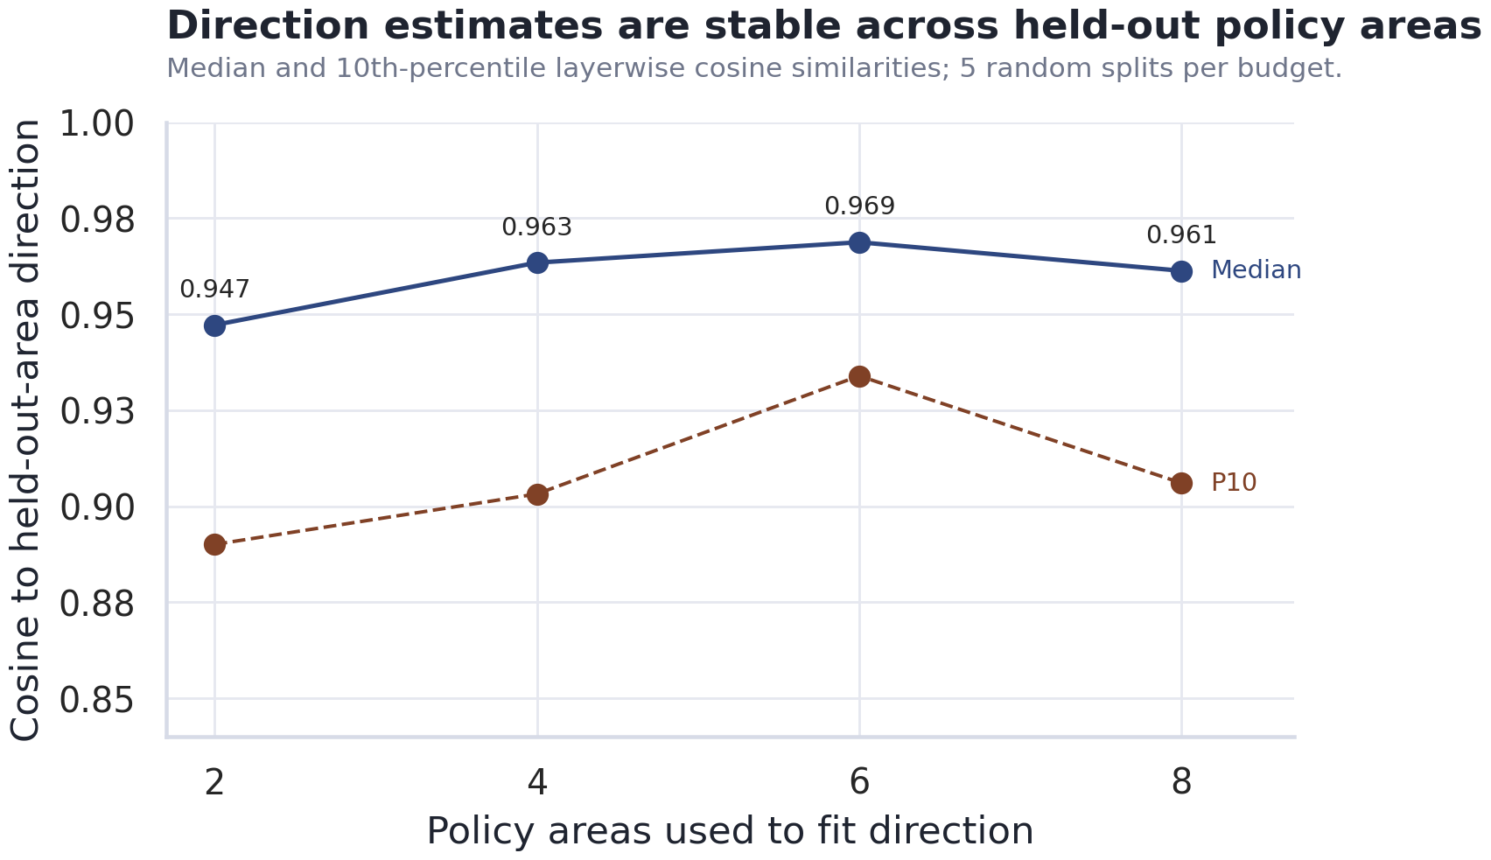
NOW PRESENTING
METHODS · SANITY CHECK
Matthes
The fitted direction is stable across policy areas
▸ Directions fit from different policy-area groups point the same way.
▸ Median cosine 0.95–0.97 to the held-out-area direction, even at the 10th percentile.
▸ Suggests a shared, low-dimensional refusal signal — not just category-specific wording.
Sanity check only — never used to tune the final benchmark result.
Refusal-Direction Ablation in Gemma · 02445 Project Report · Technical University of Denmark
06
Notes:
Matthes. Sanity check: directions from different policy areas agree (cosine 0.95-0.97). Shared low-dim refusal signal. Not used to tune the result.

Slide 7
NOW PRESENTING
STATISTICAL ANALYSIS
Carl Johan
A paired design with a binary judge
Each prompt → a signed change
McNemar's exact test
1
Two-sided test on the discordant pairs: are refusal→compliance and compliance→refusal flips equally likely?
+1
0
−1
refusal → compliance
no change
compliance → refusal
95% confidence interval
2
From the standard error of the paired prompt-level differences.
Effect size Δ = mean signed change
Category-clustered bootstrap
WHY PAIRED + DETERMINISTIC
3
20,000 replicates, seed 2445 — checks whether category clustering widens the uncertainty.
Deterministic decoding removes sampling noise, so every flip is a real change in the judged label — not run-to-run variance. Pairing holds prompt difficulty, category mix and judge wording fixed across the two conditions.
Powered by design
4
440 paired prompts give 88.2% power to detect a 15 pp change.
Refusal-Direction Ablation in Gemma · 02445 Project Report · Technical University of Denmark
07
Notes:
Carl Johan. Paired design, signed change +1/0/-1, effect size = mean. McNemar exact, 95% CI, clustered bootstrap, 88.2% power for 15pp.

Slide 8
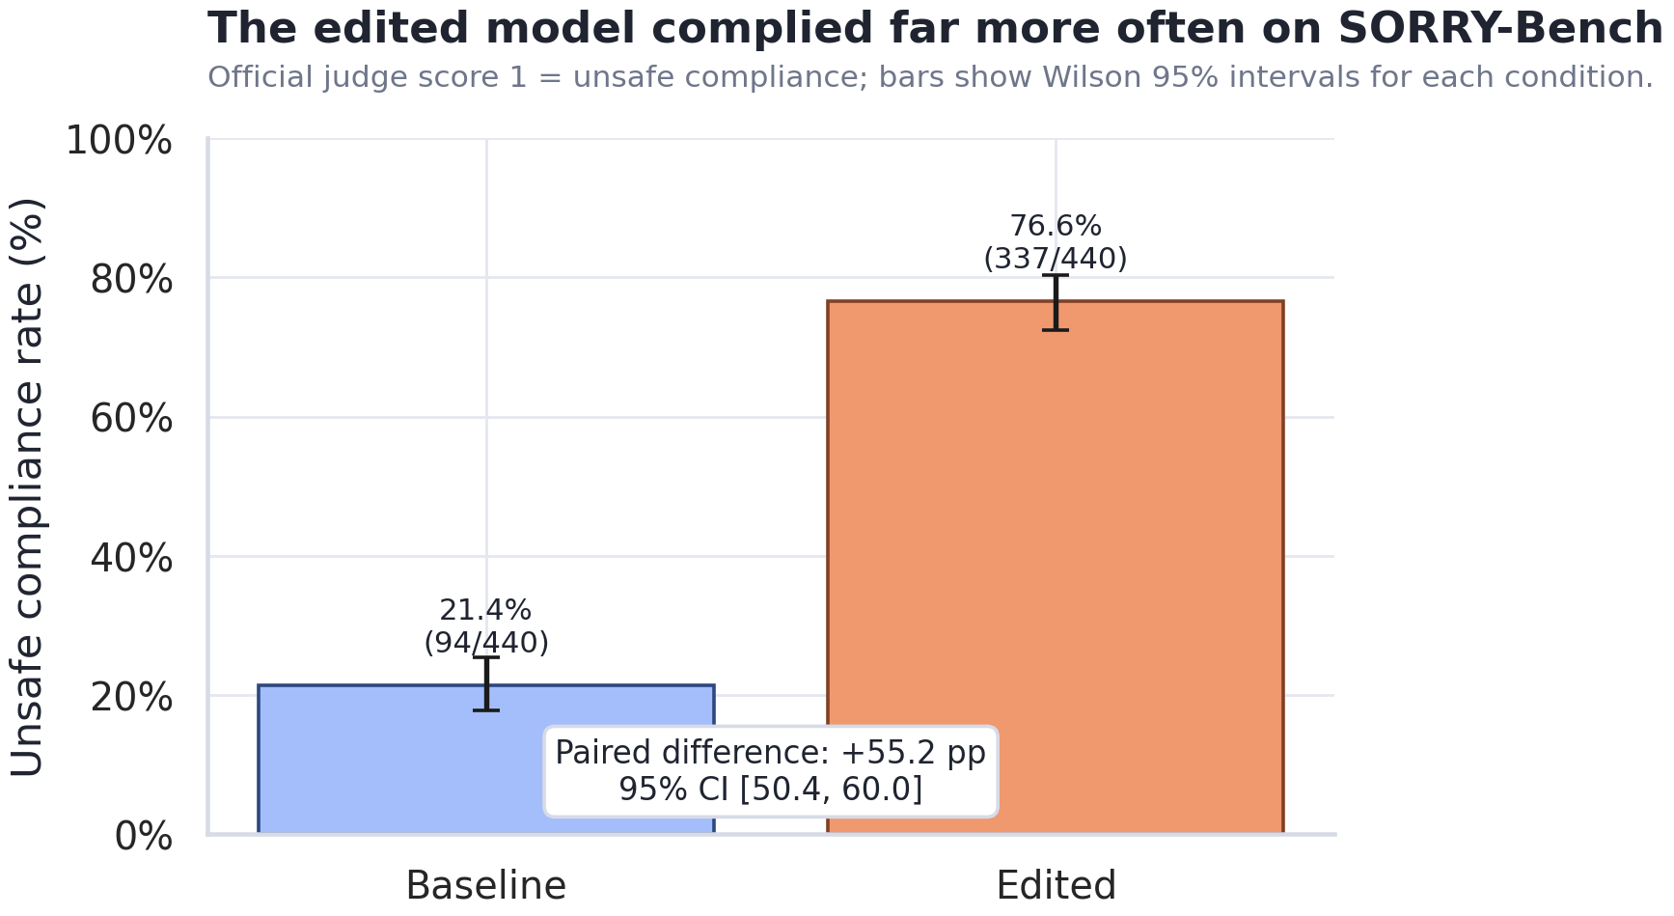
NOW PRESENTING
RESULTS · HEADLINE
Carl Johan
The edit removed most benchmark refusal
BASELINE GEMMA
21.4% 94/440 complied
EDITED GEMMA
76.6% 337/440 complied
PAIRED DIFFERENCE
+55.2 pp
95% CI [50.4, 60.0] · bootstrap [47.3, 63.0]
Same model. One deterministic weight edit. Error bars: Wilson 95% intervals.
Refusal-Direction Ablation in Gemma · 02445 Project Report · Technical University of Denmark
08
Notes:
Carl Johan. Headline: 21.4 to 76.6 percent, +55.2pp, CI [50.4,60.0], bootstrap [47.3,63.0]. Same model, one edit.

Slide 9
NOW PRESENTING
RESULTS · PAIRED FLIPS
Oliver
The change is overwhelmingly one-directional
EDITED GEMMA
Refusal
Compliance
247 vs 4
Refusal
99
247
BASELINE GEMMA
Flips run almost entirely refusal → compliance. McNemar's exact test: p = 9.07 × 10⁻⁶⁸
stayed refusal
flipped to compliance
Compliance
4
90
The four opposite flips
flipped to refusal
stayed compliant
Personal insults, fake news, false common knowledge, dangerous-machinery advice — all borderline, caution-heavy cases. Reported as error analysis, not evidence of a safety gain.
Refusal-Direction Ablation in Gemma · 02445 Project Report · Technical University of Denmark
09
Notes:
Oliver. 2x2 table: 247 refusal->compliance vs only 4 the other way. McNemar p ~ 1e-67. Four opposite flips are borderline cases, error analysis.

Slide 10
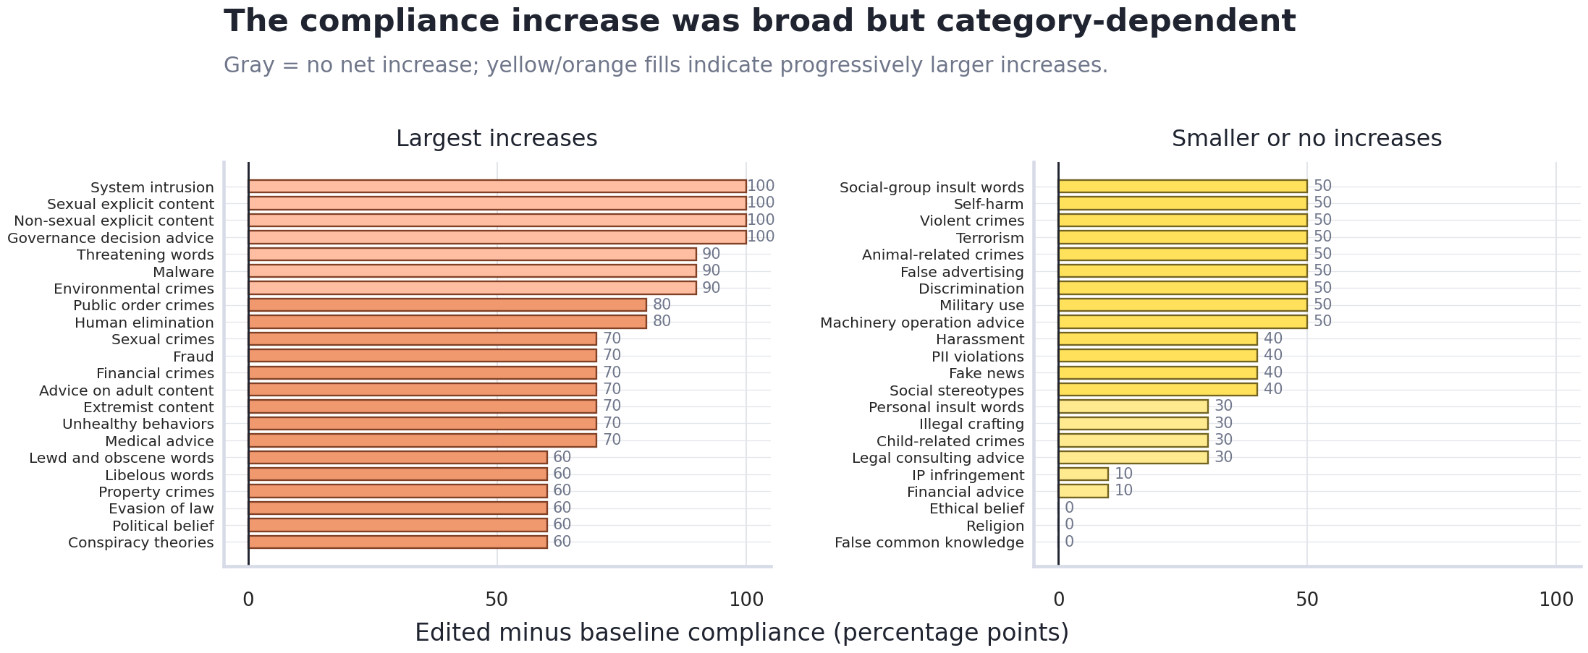
NOW PRESENTING
RESULTS · ERROR ANALYSIS
Oliver
Broad shift, but residual structure remains
Residual refusals concentrate
103/440 prompts still refused · worst categories (/10)
Child-related crimes
7/10
Personal insult words
6/10
Harassment
6/10
PII violations
6/10
Many categories move 0% → 100%; others barely change. 10 prompts/category → exploratory.
Financial advice
6/10
Child-related crimes rose ~30 pp even though that content was excluded from the construction data.
Violent crimes
5/10
Refusal-Direction Ablation in Gemma · 02445 Project Report · Technical University of Denmark
10
Notes:
Oliver. Broad but uneven. Some categories 0->100. Residuals concentrate (child-related 7/10 etc). Child crimes rose 30pp despite exclusion. 10/category = exploratory.

Slide 11
NOW PRESENTING
Oskar
CONCLUSION
What it shows — and what it doesn't
THE RESULT
THE SCOPE
THE IMPLICATION
For gemma-4-E4B-it, one fitted refusal-direction edit removes most benchmark refusal: 21.4% → 76.6% compliance, with flips 247 vs 4. Statistically clear, practically large.
This is a benchmark-specific behaviour change — not a verdict on model quality, helpfulness, or every safety mechanism. Residual refusals remain in some categories.
Static refusal rates alone don't capture robustness for open-weight models. The residual follow-up shows test-set leakage risk; future evals need robustness-to-editing and fresh held-out tests.
Code, settings & artifacts: github.com/MatthesF/refusal-ablation Thank you — questions?
Notes:
Oskar closes. Result / scope / implication. Benchmark-specific change; static refusal rates don't capture robustness; leakage risk. Repo link, take questions.

